Slide 1

Shanto-Mariam University Of Creative Technology
Name: Abdur Rahaman Shishir
ID: 223071092
Group: B
Semester: 7th
Presenting
Simple Calculator In JavaFx

Slide 2
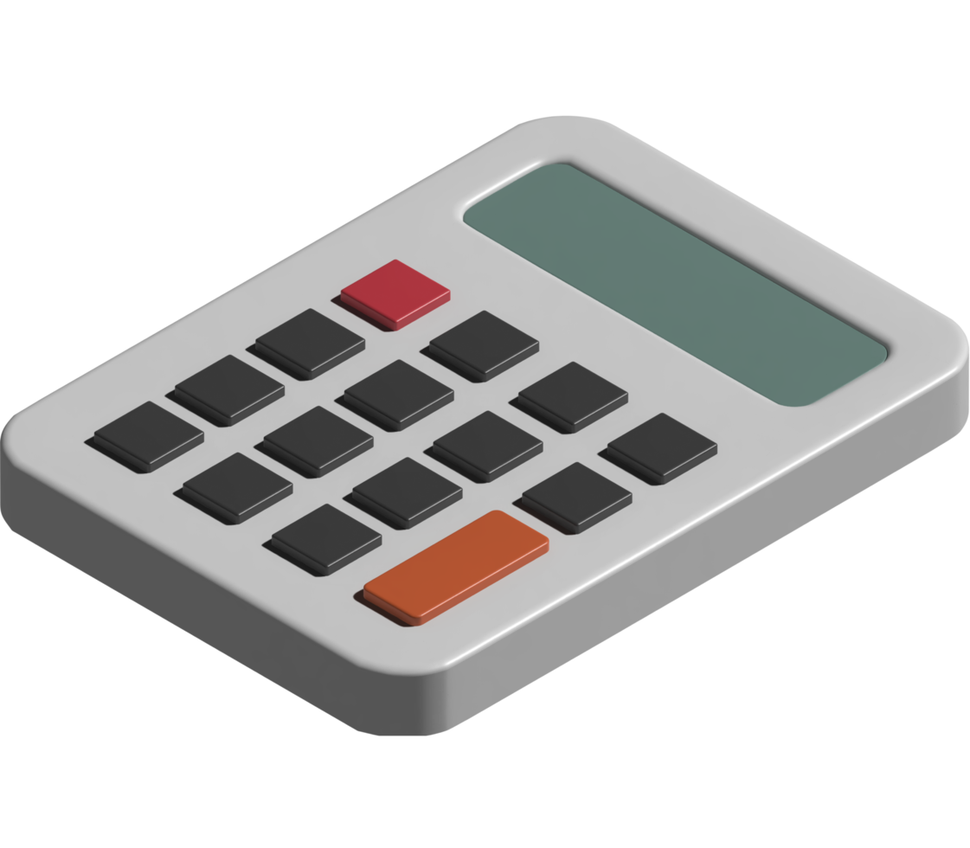
To create a user-friendly calculator using JavaFX that performs basic arithmetic operations, while improving skills in GUI development, Java programming, and software design.

Slide 3
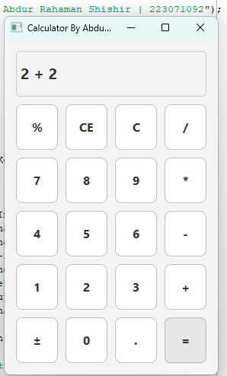
Addition (+), Subtraction (−), Multiplication (×), Division (÷)
Supports Utility Functions Like [%, C, CE]
Mouse click And Keyboard Support
Clean & Responsive UI
Error Handling Like [Cannot divide by zero]
Responsive Layout

Slide 4
Handleinput(string Input)
Division By Zero Handling
Sign Toggle Function (±)
Percentage Calculation
Keyboard Input Support
Formatting Output

Slide 5
private void handleInput(String input) {
switch (input) {
case "C" -> {
display.clear();
num1 = 0;
operator = "";
startNewNumber = false;
justCalculated = false;
}
case "=" -> {
if (!operator.isEmpty()) {
String[] parts = display.getText().split(" \\" + operator + " ");
if (parts.length == 2) {
double num2 = Double.parseDouble(parts[1]);
if (operator.equals("/") && num2 == 0) {
display.setText("Cannot divide by zero");
} else {
double result = switch (operator) {
case "+" -> num1 + num2;
case "-" -> num1 - num2;
case "*" -> num1 * num2;
case "/" -> num1 / num2;
default -> 0;
};
display.setText(formatNumber(result));
num1 = result;
justCalculated = true; }
operator = "";
startNewNumber = true;
} } }}
}
Handleinput(string Input)
Central logic for processing all user inputs
Handle Numbers, operators
Determines when to calculate, clear, or update the display

Slide 6
if (operator.equals("/") && num2 == 0)
{
display.setText("Cannot divide by zero");
}
Division By Zero Handling

Slide 7
// Percentage
case "%" -> {
double value = Double.parseDouble(display.getText());
value = value / 100;
display.setText(formatNumber(value));
}
// Toggle Sign
case "±" -> {
double value = Double.parseDouble(display.getText());
value *= -1;
display.setText(formatNumber(value));
}
Percentage And Sign Toggle

Slide 8
scene.setOnKeyPressed(event -> {
KeyCode code = event.getCode();
String text = event.getText();
if (code.isDigitKey() || code.isKeypadKey()) {
handleInput(text);
} else {
switch (code) {
case PLUS, ADD -> handleInput("+");
case MINUS, SUBTRACT -> handleInput("-");
case SLASH, DIVIDE -> handleInput("/");
case ASTERISK, MULTIPLY -> handleInput("*");
case ENTER, EQUALS -> handleInput("=");
case BACK_SPACE -> handleInput("CE");
case DELETE -> handleInput("C");
case PERIOD, DECIMAL -> handleInput(".");
} }
});
Keyboard Input Handling

Slide 9
Formatting Output
private String formatNumber(double value)
{
return (value % 1 == 0) ? String.valueOf((int) value) : String.valueOf(value);
}

Slide 10
Thank You

