Slide 1
Thesis Topic: Forecasting Volatility of Crypto-Currencies on the base of an NLP analysis of Twitter’s API feed
Faculty of Social Sciences
International Laboratory for Applied Network Research (ANR-Lab)
Moscow 2022
Artemij Kiel & Roman Pavlyutin

Slide 2

Description & statement of the problem
International Laboratory for Applied Network Research (ANR-Lab)
Forecasting Volatility of Crypto-Currencies on the base of an NLP analysis of Twitter’s API feed
Moscow
2022
The result of our master thesis and this term paper will contribute to a project within Sberbank
Sberbank’s Data Science team has already built pipelines and a big part of the infrastructure of an application
Our job is to use the data streams for forecasting volatility, while using the already built structure and create a forecasting model

Slide 3
GOAL
International Laboratory for Applied Network Research (ANR-Lab)
Forecasting Volatility of Crypto-Currencies on the base of an NLP analysis of Twitter’s API feed
Moscow
2022
To create a forecasting model, which can be implemented into the already built IT-architecture
STEPS
Sentiment analysis of tweets in real time
Construction of market sentiment time series
Construction of crypto time series
Econometric forecasting with two time series

Slide 4
CURRENT TASKS & CHECKLIST
International Laboratory for Applied Network Research (ANR-Lab)
Forecasting Volatility of Crypto-Currencies on the base of an NLP analysis of Twitter’s API feed
Moscow
2022
Applying an algorithm for sentiment computation with the VADER dictionary
Applying an algorithm for sentiment computation with Chen‘s (2018) „Market Sentiment Dictionary“
Validation of & Comparison between the two sentiments
Sentiment Analysis
Creating a database which updates the following variables in Sberbank‘s infrastructure in real time:
VADER-Sentiment
Chen‘s sentiment
Market volatility
Volatility of single currencies
Database Creation
Exploratory Analysis
& Implementation
Building different time series models and comparison of their performance
Implementing the model into Sberbank‘s application

Slide 5
HYPOTHESES
International Laboratory for Applied Network Research (ANR-Lab)
Forecasting Volatility of Crypto-Currencies on the base of an NLP analysis of Twitter’s API feed
Moscow
2022
H1:
Volatility in the crypto market has an effect on Twitter’s sentiment towards crypto-currencies
H2:
Twitter’s sentiment towards crypto-currencies has an effect on volatility of the crypto market
H3:
Volatility of crypto-currencies is predictable
H4:
Twitter’s sentiment is predictable

Slide 6
International Laboratory for Applied Network Research (ANR-Lab)
Forecasting Volatility of Crypto-Currencies on the base of an NLP analysis of Twitter’s API feed
Moscow
2022
THEORETICAL BACKGROUND I
Chen, Huang and Chen (2018)
Have created a sentiment dictionary for financial markets;
It does not only contain words, but also emojis;
In addition to that, it is able to categorize whether an item indicates a bullish or a bearish market sentiment, which is valuable for our study.
VADER (Valence Aware Dictionary and sEntiment Reasoner)
Is a lexicon and rule-based sentiment analysis tool that is specifically attuned to sentiments expressed in social media;
VADER does not only tell about the polarity score but also tells us about how positive or negative a sentiment is.

Slide 7
International Laboratory for Applied Network Research (ANR-Lab)
Forecasting Volatility of Crypto-Currencies on the base of an NLP analysis of Twitter’s API feed
Moscow
2022
THEORETICAL BACKGROUND II
Kreiß, Neuhaus (2006)
GARCH is an acronym for Generalized AutoRegressive Conditional Heteroscedasticity;
It is a stochastic model for time series and an established method in Econometrics for stock analytics or volatility modelling;
The variance in GARCH-series is conditionally depended by its past value and the past of the whole time series.
Hansen, Lunde (2005)
There are different established models and methods to calculate volatility in time series;
Hansen and Lunde compared the predictive strengths of a variety of models and their adaptations and made the conclusion, that “there is no evidence that the GARCH(1,1) model is outperformed by other models”.

Slide 8
International Laboratory for Applied Network Research (ANR-Lab)
Forecasting Volatility of Crypto-Currencies on the base of an NLP analysis of Twitter’s API feed
Moscow
2022
METHODOLOGY
Twitter posts for the NLP Analysis and sentiment computing
Crypto time series for computation of volatility
What data to collect
(and what data to ignore)
Who to collect it from
(“sampling design”)
Sampling method of Twitter posts is already done by the infrastructure of Sberbank, which uses Twitter’s API and SQL pipelines
The Crypto time series can be scraped on any trading platform
To handle the large amounts of data we use DASK and other Python packages like matplotlib, PANDAS and seaborn
How to analyse it
(this is called “data analysis methods”)
Exploratory data analysis is based on econometric forecasting techniques

Slide 9
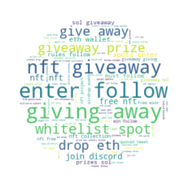
PRELIMINARY RESULTS I
International Laboratory for Applied Network Research (ANR-Lab)
Forecasting Volatility of Crypto-Currencies on the base of an NLP analysis of Twitter’s API feed
Moscow
2022
Our first analysed Twitter sample contained circa 6 mln posts.
The word cloud for the lemmatized posts provides an insight into the word frequency distribution.

Slide 10
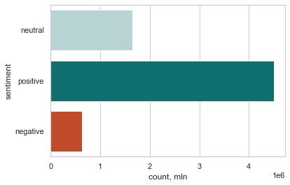
PRELIMINARY RESULTS II
International Laboratory for Applied Network Research (ANR-Lab)
Forecasting Volatility of Crypto-Currencies on the base of an NLP analysis of Twitter’s API feed
Moscow
2022
Here we see the amount of positive, negative and neutral posts.
We see that the overall sentiment is mostly positive. Negative sentiment is very rare, which indicates herding effects and bubbles, which must be analyzed in further studies.

Slide 11
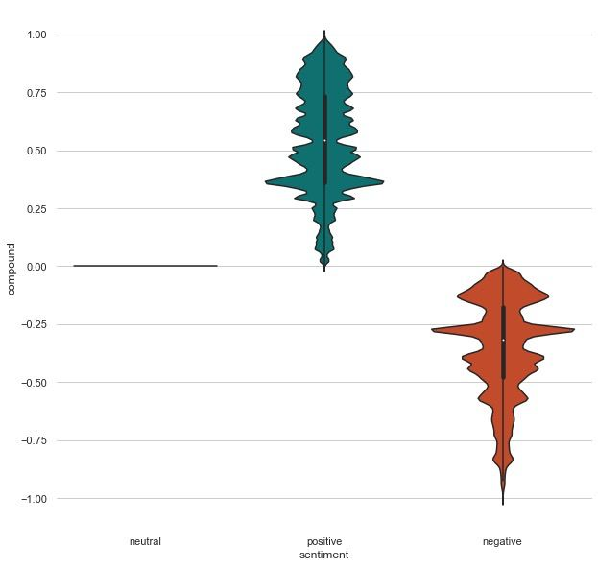
PRELIMINARY RESULTS III
International Laboratory for Applied Network Research (ANR-Lab)
Forecasting Volatility of Crypto-Currencies on the base of an NLP analysis of Twitter’s API feed
Moscow
2022
The violin plot shows an expected significant difference between the positive and negative sentiments.
We also see that there are not as many extremely negative posts. The positive sentiment is distributed more equally than the negative one, which peaks at a compound near -0.25.

Slide 12
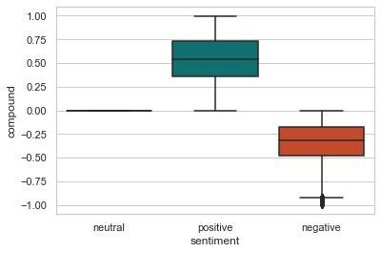
PRELIMINARY RESULTS IV
International Laboratory for Applied Network Research (ANR-Lab)
Forecasting Volatility of Crypto-Currencies on the base of an NLP analysis of Twitter’s API feed
Moscow
2022
The boxplot show a similar results to the violin plot. The positive sentiment is distributed more equally, while most of the negative sentiment have compounds near -0.25.
Neutral posts are very rare because of the VADER algorithm. Only posts with a compound of zero are neutral. Therefore, the boxplot for neutral posts is not very meaningful.

Slide 13

LITERATURE
International Laboratory for Applied Network Research (ANR-Lab)
Forecasting Volatility of Crypto-Currencies on the base of an NLP analysis of Twitter’s API feed
Moscow
2022
Chen, Cathy Yi-Hsuan; Hafner Christian: Sentiment-Induced Bubbles in the Cryptocurrency Market; 2019; Journal of Risk and Financial Management
Hansen, Peter; Lunde, Asger: A FORECAST COMPARISON OF VOLATILITY MODELS: DOES ANYTHING BEAT A GARCH(1,1)?; 2005; Journal of Applied Econometrics 20: 873–889
Kreiß, Jens-Peter; Neuhaus, Georg: Einführung in die Zeitreihenanalyse; 2006; Springer-Verlag Berlin/Heidelberg
VADER (Valence Aware Dictionary and sEntiment Reasoner); https://www.geeksforgeeks.org/python-sentiment-analysis-using-vader/; clicked on 20.06.2022

