Slide 1
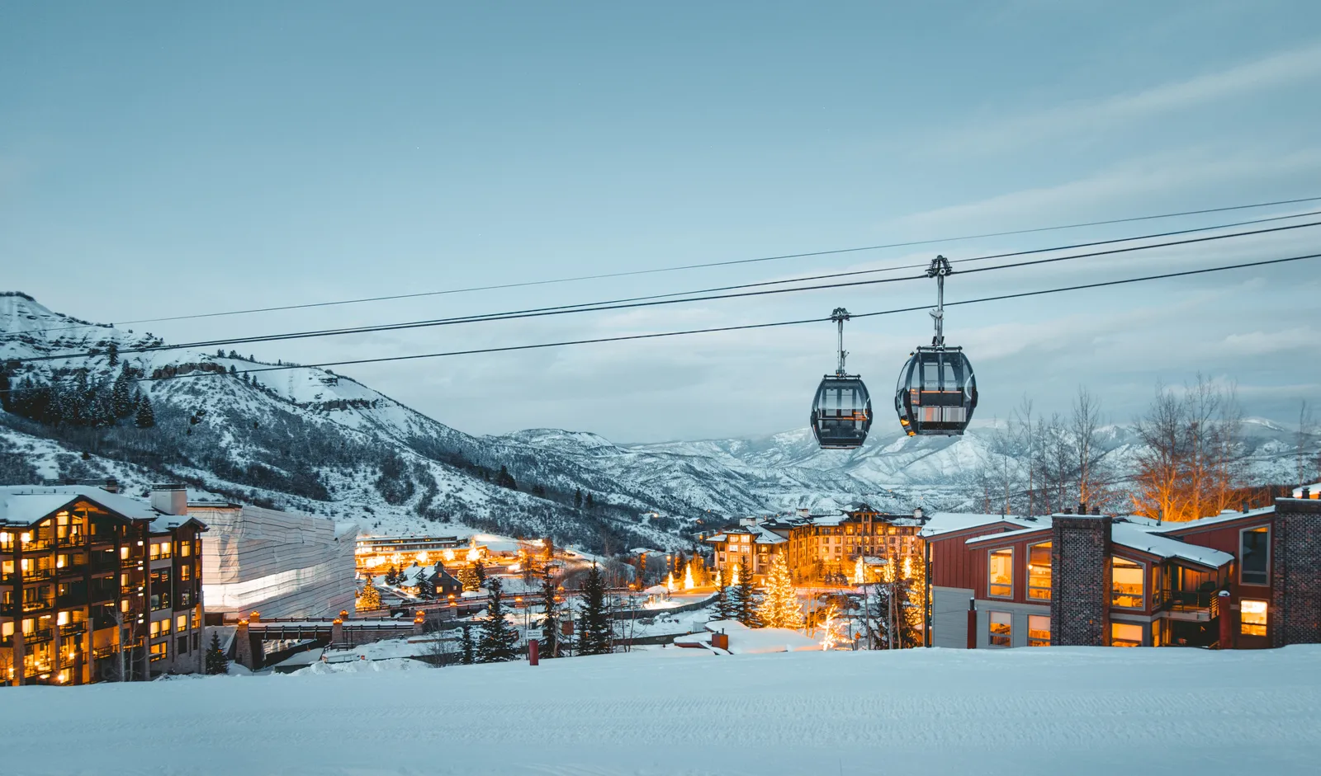
Big Mountain Resort ticket price strategies

Slide 2
Problem Statement
Improve the pricing strategy in a way that accommodates the operational costs of the new chair lift.
The resort is also seeking ways to cut operational costs that support or justify the ticket price.

Slide 3
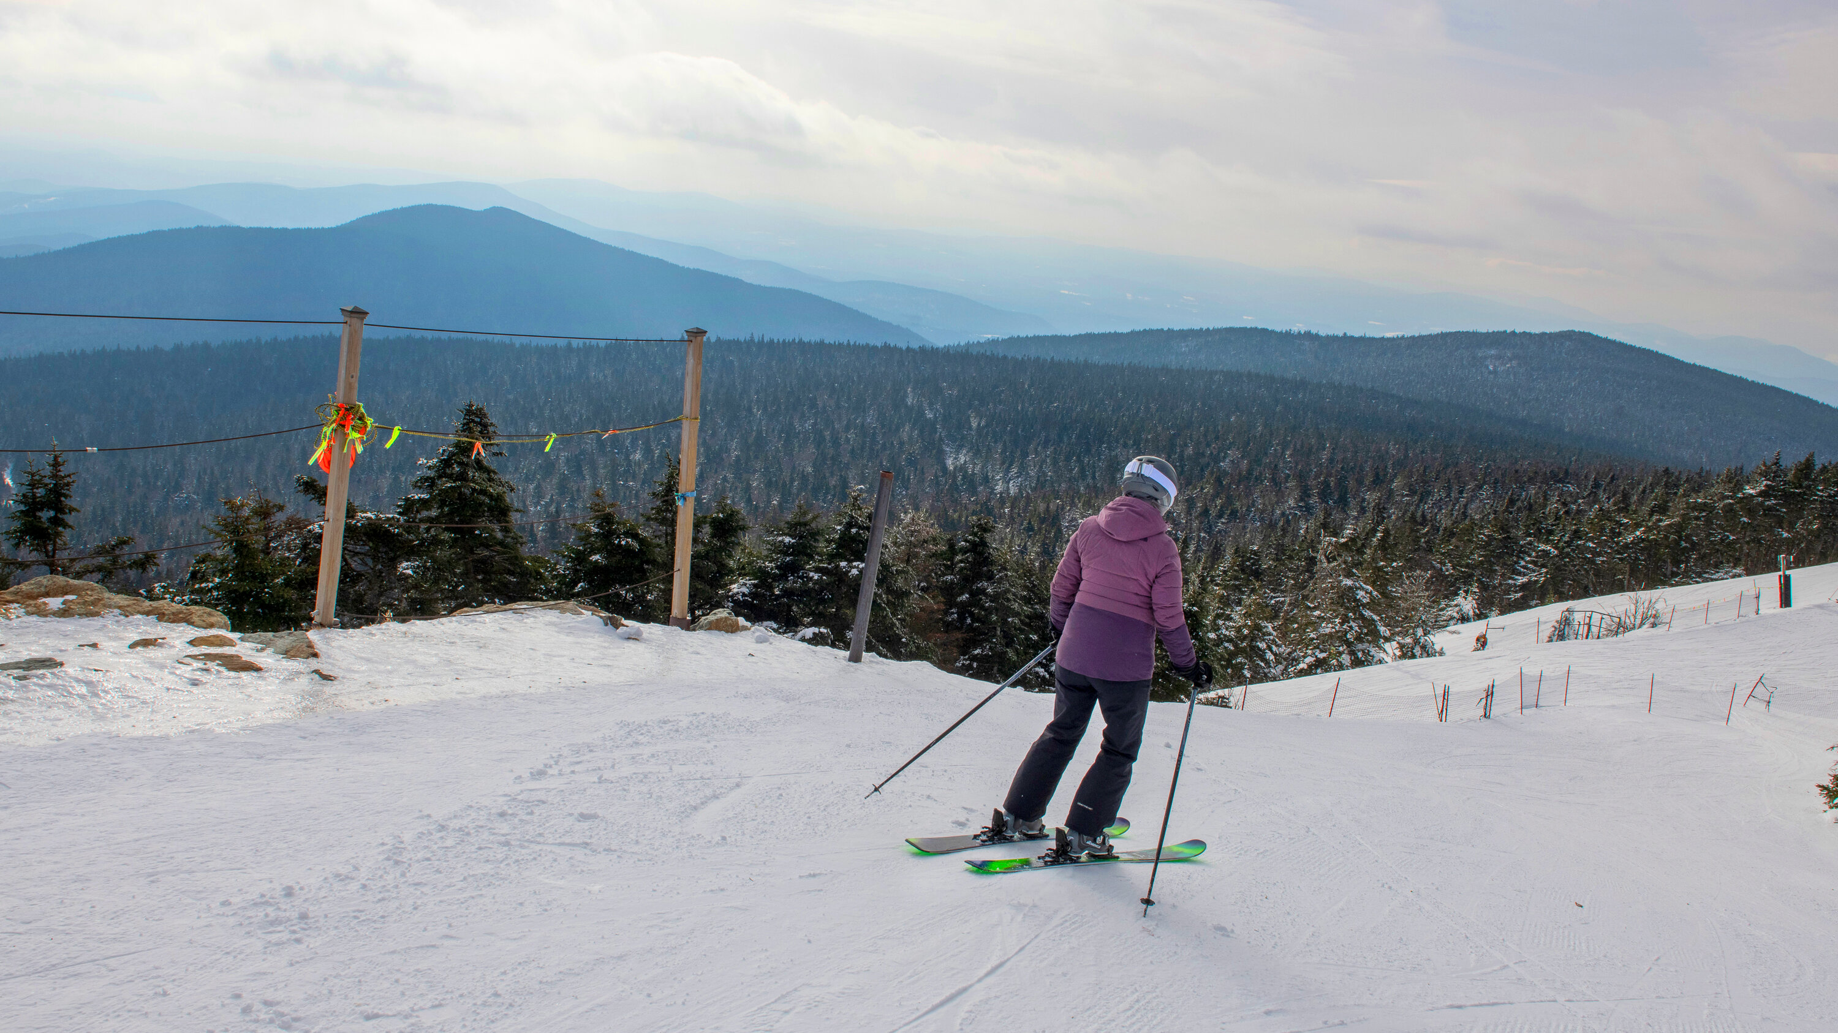
Goal
We want to train a model to predict Big Mountain's ticket price based on data from all the other resorts

Slide 4
Evaluating 4 potential scenarios
Eventually, we want to use our model to help us decide which proposed scenario supports Big Mountain’s goal of cutting costs or increasing revenue.

Slide 5
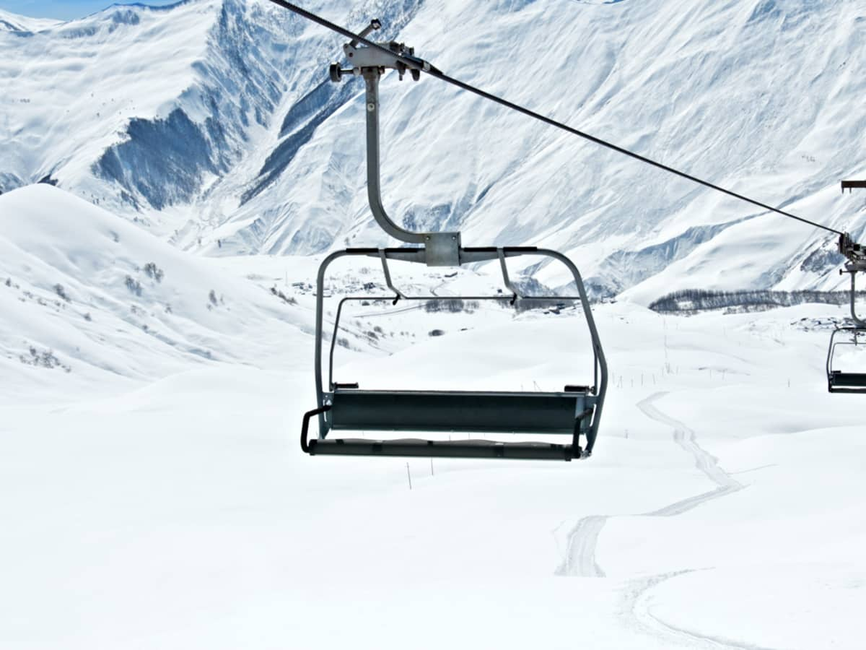
Recommendations and Key Findings
Key findings indicate that fast quads, snow amounts, and vertical drops significantly affect pricing.

Slide 6
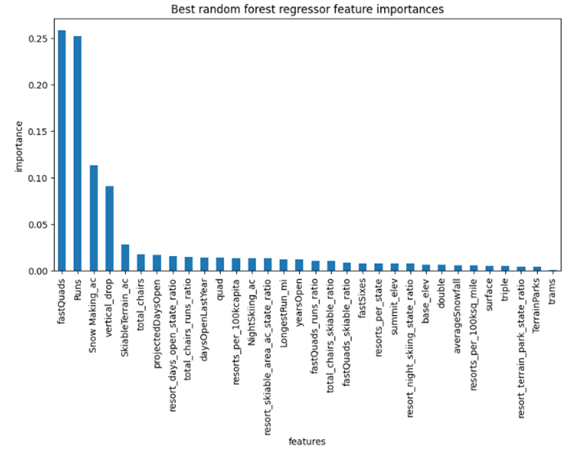
Recommendations and Key Findings
The presence of fast quad chairlifts notably influences the pricing at resorts with extensive terrain.
The volume of snow at a resort is highly regarded by guests and consequently drives up both operational expenses and ticket prices.
Furthermore, there is a direct relationship between the extent of the vertical drop and the number of descents a resort offers, and the elevation of ticket prices.

Slide 7
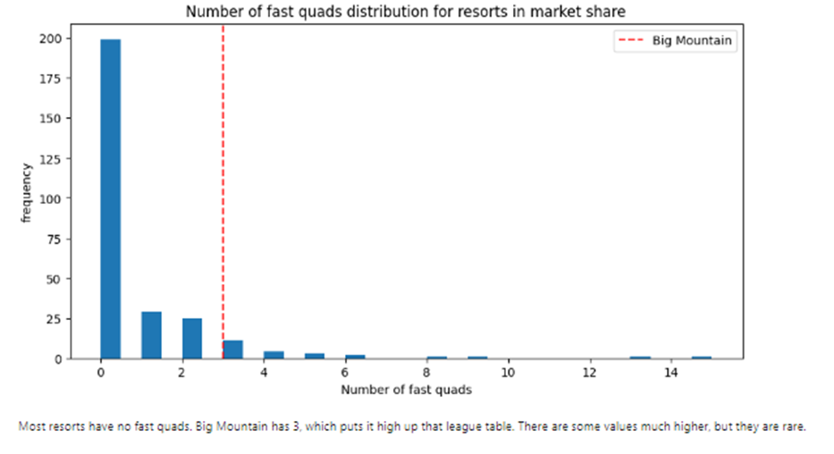
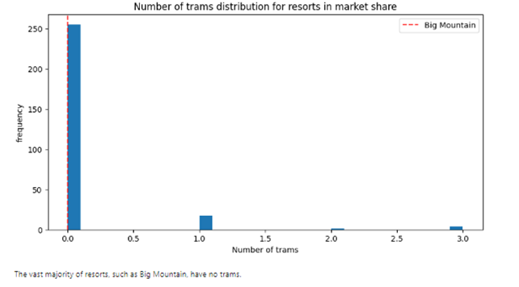
Modeling Results and Analysis
Most resorts have no fast quads. Big Mountain has 3. There are some values much higher, but they are rare.
The vast majority of resorts, such as Big Mountain, have no trams.

Slide 8
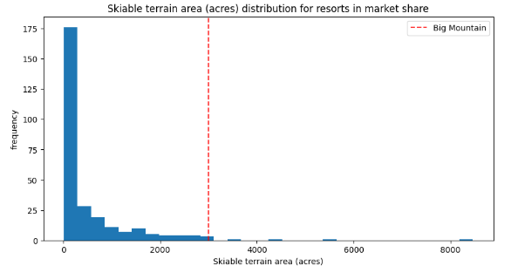
Modeling Results and Analysis
Big Mountain is amongst the resorts with the largest amount of skiable terrain.

Slide 9
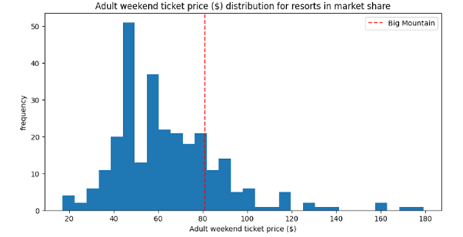
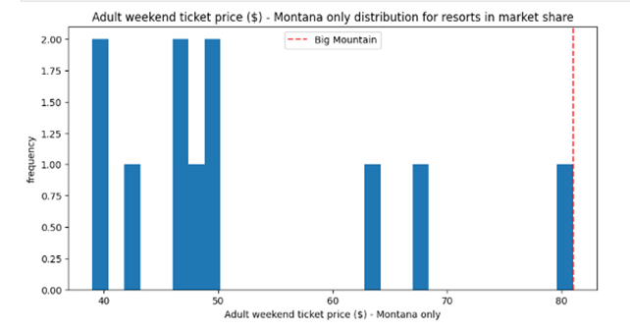
Modeling Results and Analysis
Big Mountain’s prices are relatively high locally, but average amongst all resorts in the data

Slide 10
We evaluated 4 scenarios

Slide 11
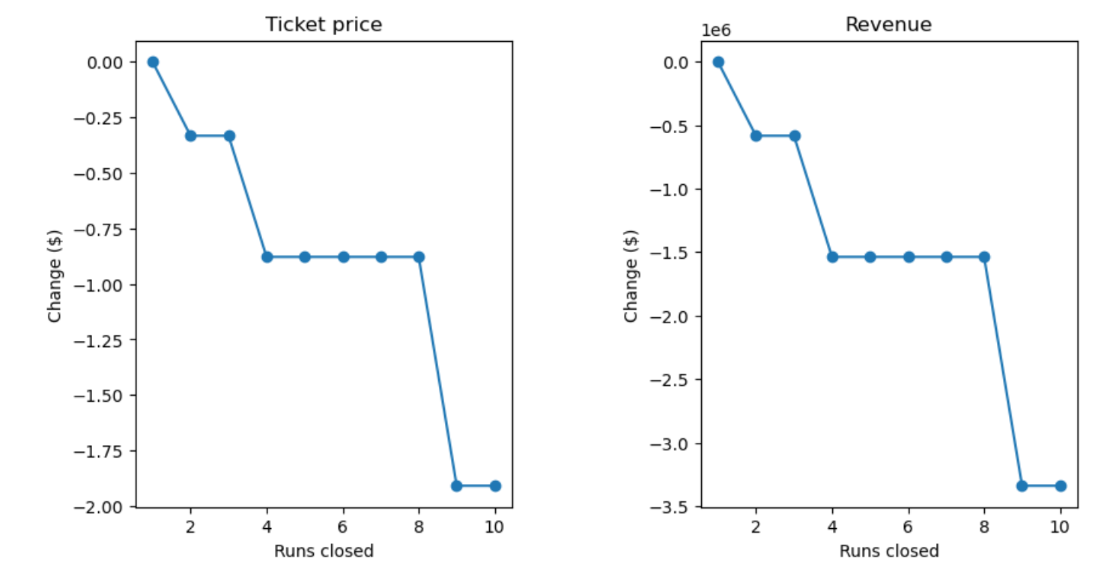
Scenario 1
Permanently closing down up to 10 of the least used runs.
This doesn't impact any other resort statistics. As shown below, the model says closing one run makes no difference. Closing 2 and 3 successively reduces support for ticket price and so revenue. If Big Mountain closes down 3 runs, it seems they may as well close down 4 or 5 as there's no further loss in ticket price. Increasing the closures down to 6 or more leads to a large drop

Slide 12

Scenario 2
Big Mountain is adding a run, increasing the vertical drop by 150 feet, and installing an additional chair lift.
This scenario increases support for ticket price by $2.36.
Over the season, this could be expected to amount to $4136364
Scenario 3
In this scenario, you are repeating the previous one but adding 2 acres of snow making
This scenario increases support for ticket price by $2.36, The change is so small.
Scenario 4
No difference whatsoever. Although the longest run feature was used in the linear model, the random forest model (the one we chose because of its better performance) only has the longest runway down in the feature importance list.
This scenario calls for increasing the longest run by .2 miles and guaranteeing its snow coverage by adding 4 acres of snow making capability.

Slide 13
Summary & Conclusion
The adult weekend ticket price is $81. Adding a run and increasing vertical drop is expected to increase profits even more, increasing ticket price by $2 and amounting to $3474638.

