Slide 1
Lumen Aurora
NEW · v2.0
Product launch plan · Autumn 2026
Notes:
Welcome everyone. Today: why Aurora, who it is for, and how we launch it in three phases.
Keep this under one minute.

Slide 2
Agenda
Why the market is ready
What Aurora does differently
Three-phase launch roadmap
  Beta in October, public release in November
Pricing and packaging
Next steps & owners
Notes:
Walk through the agenda quickly. Emphasise that pricing is still open for feedback.

Slide 3

Why now?
Remote teams present 3× more often than in 2020
Decks are shared, not just shown: they must work offline
Privacy rules push teams away from cloud-only tools
Our users already ask for it
Notes:
The picture is a placeholder for the campaign key visual.

Slide 4
The opportunity in numbers
68 %
want offline-first editing
3.4 M
decks exported to PDF per month
+93 %
growth in presenters year on year
Notes:
Source: internal survey of 1,240 customers, June 2026.
Pause on the 68 % figure.

Slide 5
Launch roadmap
Beta
Oct
Launch
Nov
Scale
Q1
• 200 teams onboarded
• Feedback loop every week
• Public release, press kit
• Template gallery
• Partners & education
• Enterprise deployment
Today
Notes:
Each phase has an owner and an exit criterion. Beta exit = 200 active teams.

Slide 6
Pricing & packaging
MOST POPULAR
 | Free | Team | Enterprise
Editors | Unlimited | Per seat | Per seat
PowerPoint import/export | ✓ | ✓ | ✓
Shared templates | — | ✓ | ✓
Price / editor / month | €0 | €6 | Talk to us
Notes:
Free stays free forever. Team pricing is per editor, presenters are free.

Slide 7
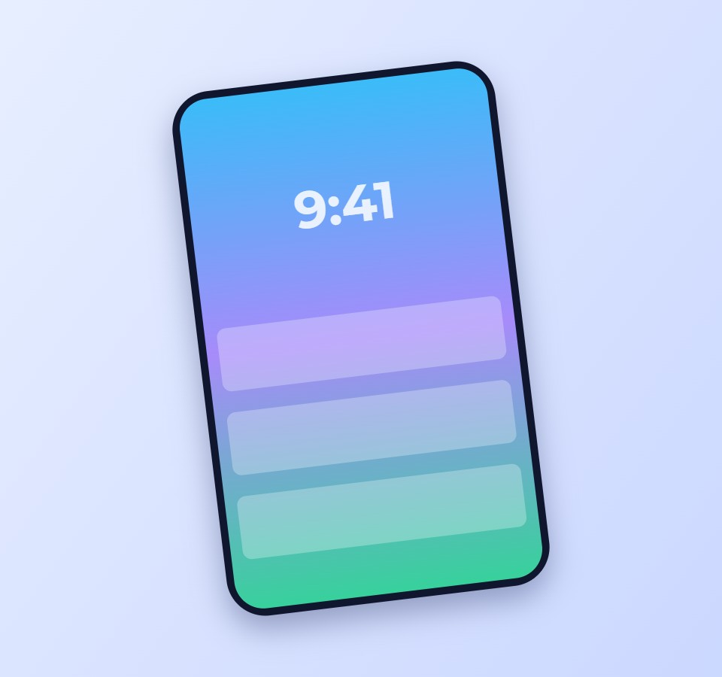
Designed for the stage
Presenter view with notes, timer and the next build. A second window for the projector — or one screen, split.
Works offline. Opens and saves PowerPoint files.
Notes:
Demo the presenter view live here (Alt+F5).

Slide 8
Thank you
Questions? aurora@lumen.example
Notes:
Open the floor for questions. Share the deck as PDF afterwards (File → Export → PDF).

