Slide 1
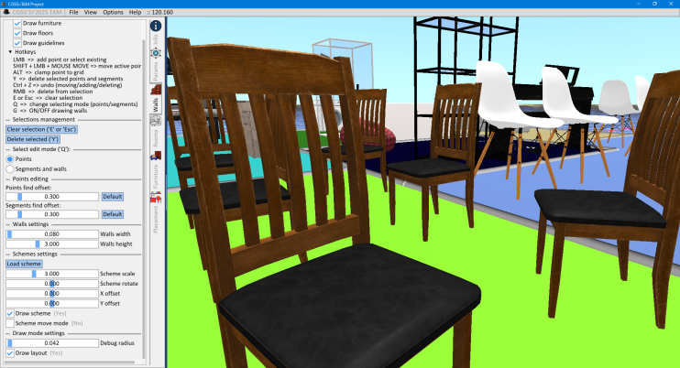
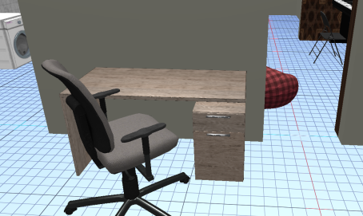
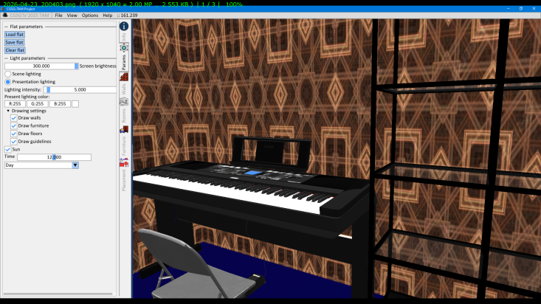
Hybrid System for Room Layout Creation and Automatic Furniture Placement Based on Geometric Constraints, Heuristic Optimization, and Machine Learning.
Notes:
#1

Slide 2
Project structure
Animation
User interface
Vulkan API
Resources
Input system
Room editor
Utilities
Graphical output
Unit system
Furniture arrangement

Slide 3
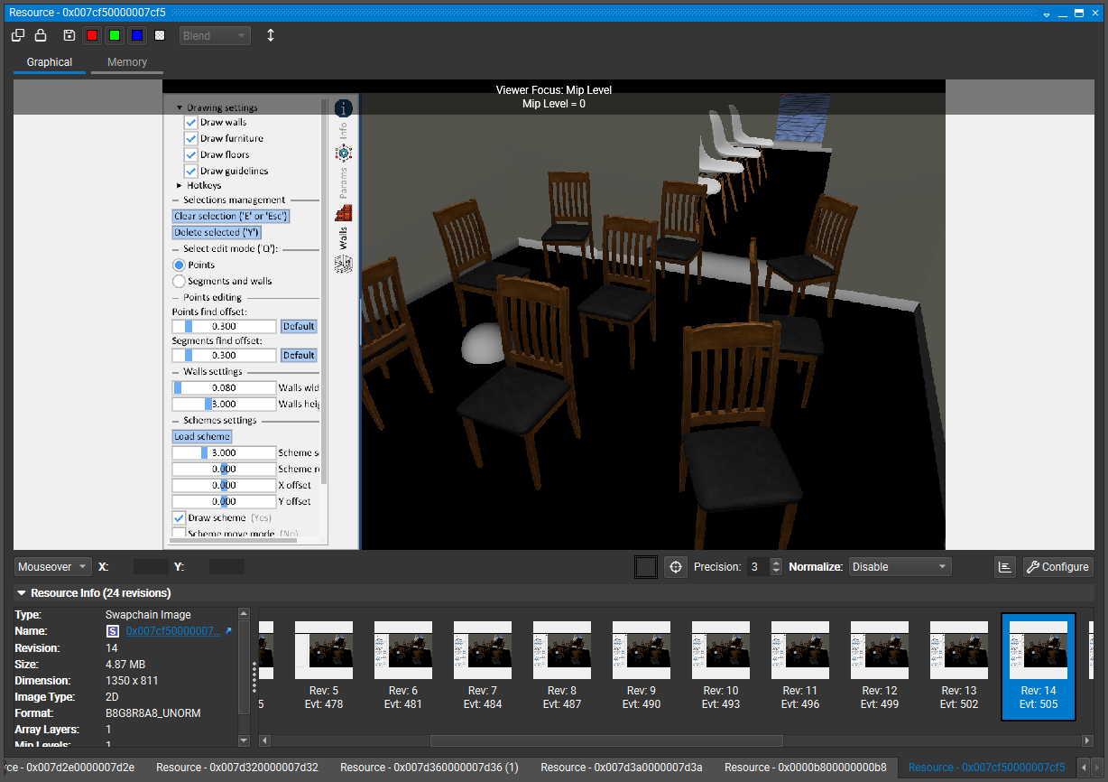
Vulkan API
General scheme of working with the Vulkan API
Example of Swapchain output image
Application
Initialization
Instance
Resource initialization
Physical device
Logical device
Graphics Queue
Surface
Transfer Queue
Swapchain
Command buffers
Compute Queue

Slide 4
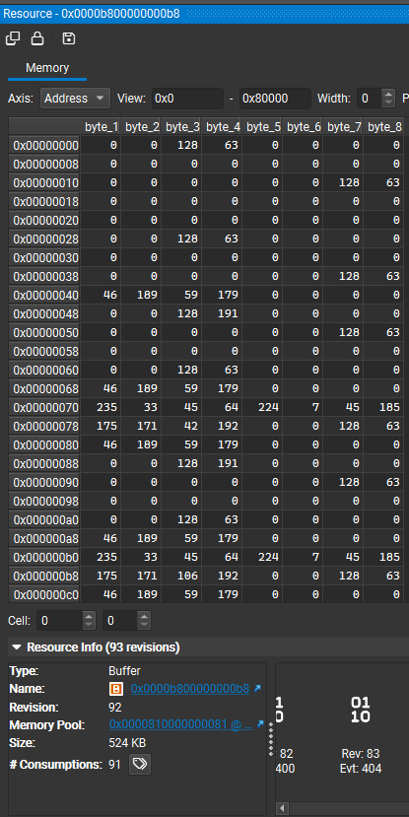
Vulkan resources
An example of a real Vulkan buffer
Sampler
Buffers
Image
Descriptor set
Descriptor set
Shader
Frame buffer
Pipeline
Render pass

Slide 5
Resources
Applied resources
Resources
Models
Lights
Buffers
Material patterns
Fonts
Markers
Shaders
Materials
Textures
Primitives

Slide 6
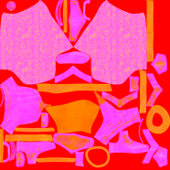
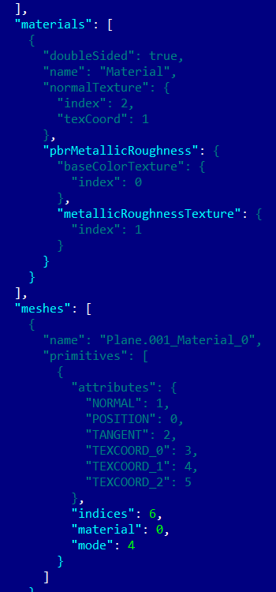
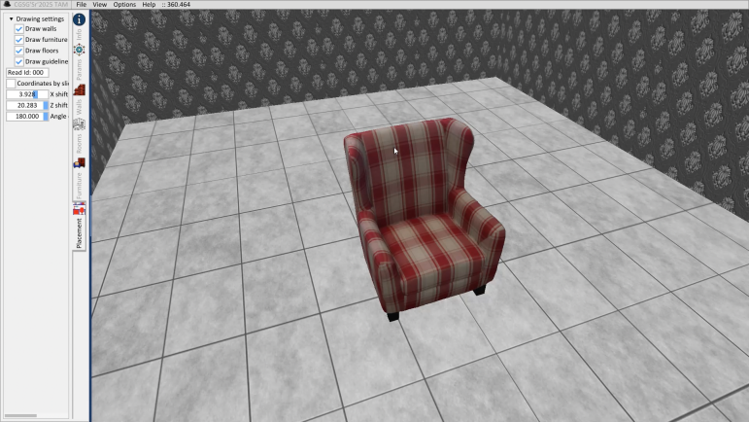
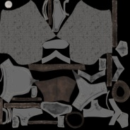
Resources. Models
Basic format – GLTF (GLB).
Roughness
Metallic
Base color
material
material
mesh
mesh
mesh
Joints
node
node
Skeletal animation
node
node
Scene

Slide 7
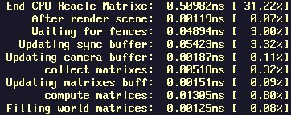
CPU and GPU Matrix Recalculation Test
Recalculation of matrices of 1000 primitives
CPU
End GPU Recalc Matrixes: 0.02099ms [1.29%]
GPU

Slide 8
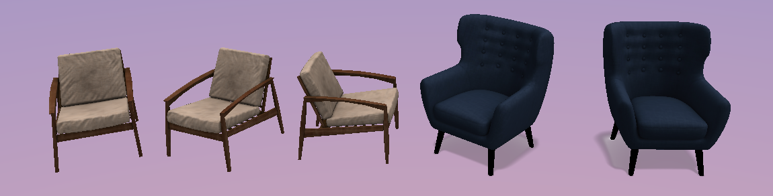
Matrix recalculation
Drawing request
Matrix buffer
Units
Primitive
world matrixа
shader
Recalculated matrix buffer
№1 model instances
№2 model instances

Slide 9
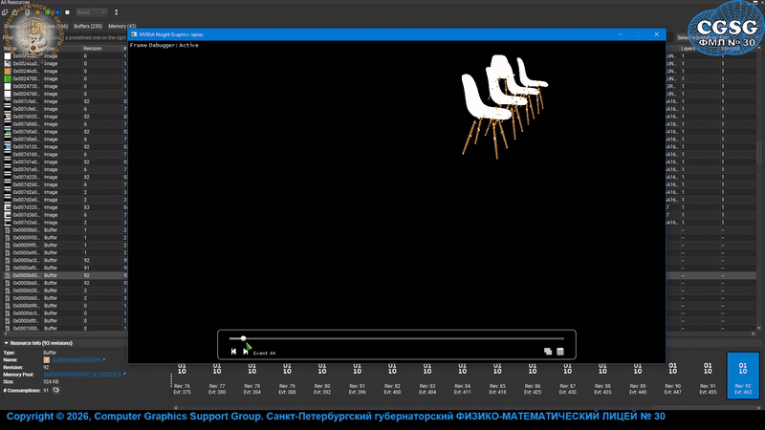
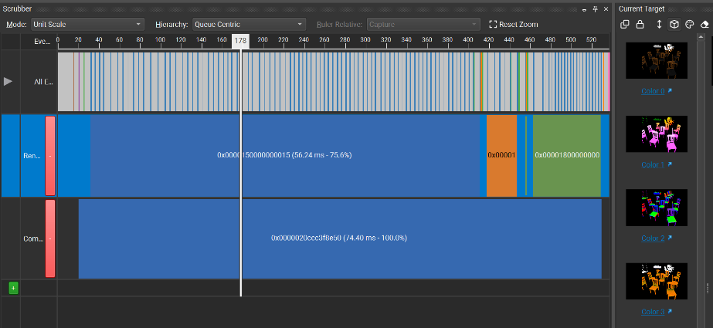
Render pipeline
Render pipeline cycle

Slide 10
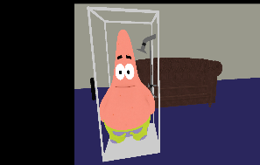
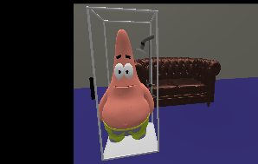
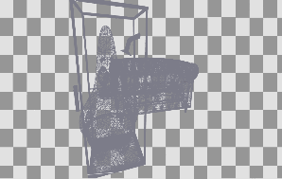
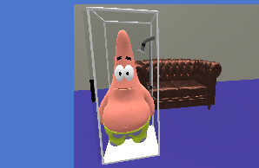
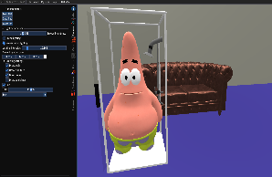
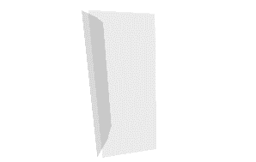
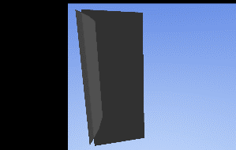
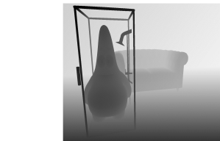
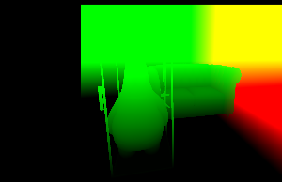
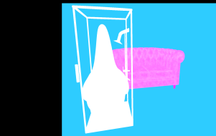
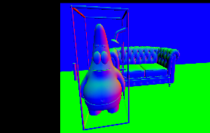
Render pipeline
Opaque draw
Opaque light
Input geometry
Merge pass
Post Processing
Transparent draw
Transparent light
Targets

Slide 11
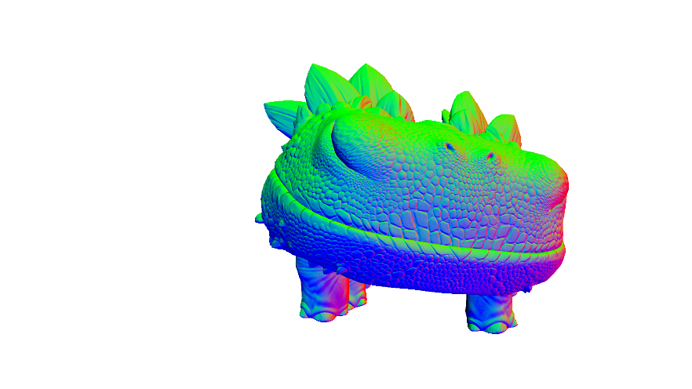
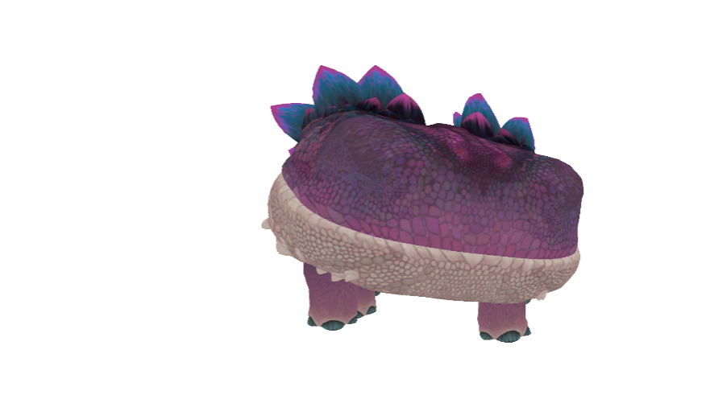
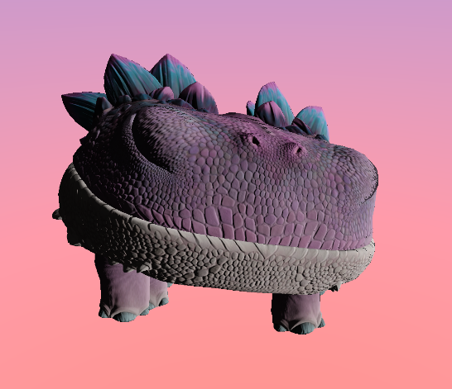

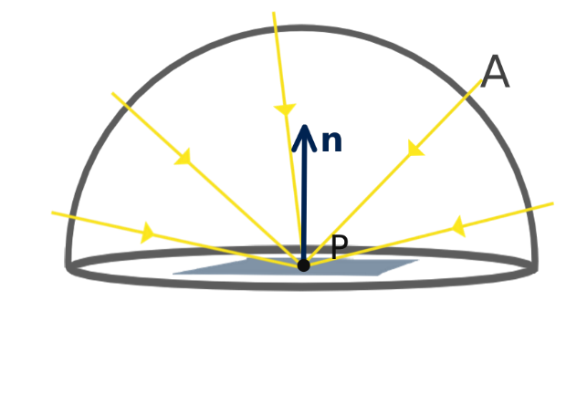


Resources. Lighting
Metallic & Roughness
Normal mapping
Albedo
Final color

Slide 12

Animation
Units
Animation system
Resources
Render
Input systems
Timer

Slide 13
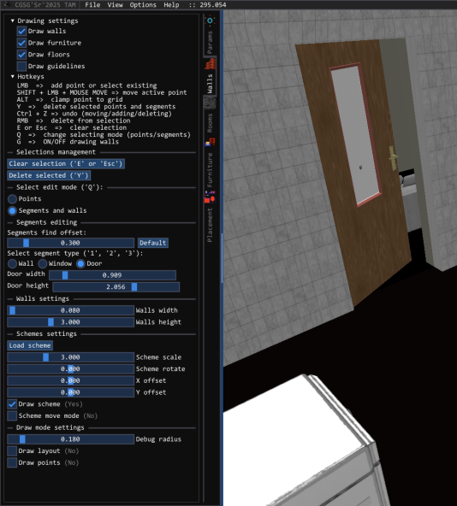
Editor
Active tab
Its filling
Active editor unit
Current layout
Determining the active editor tab
Editor

Slide 14
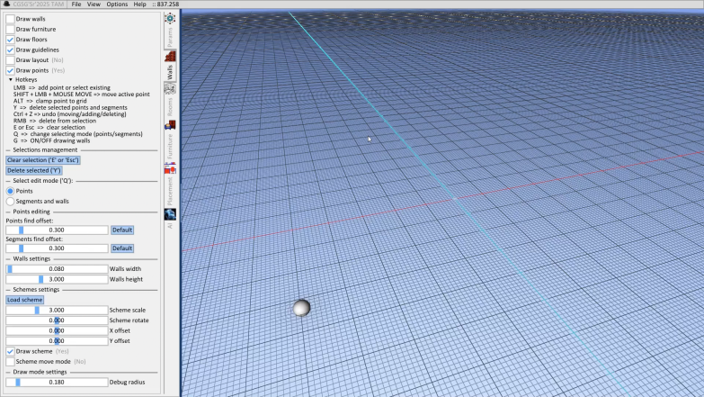
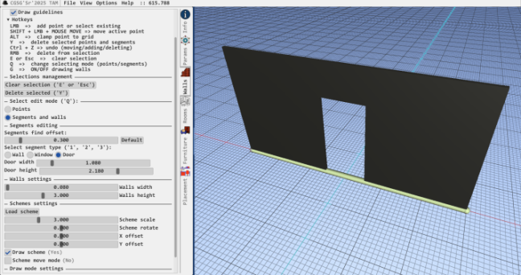
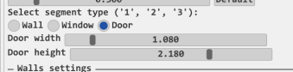
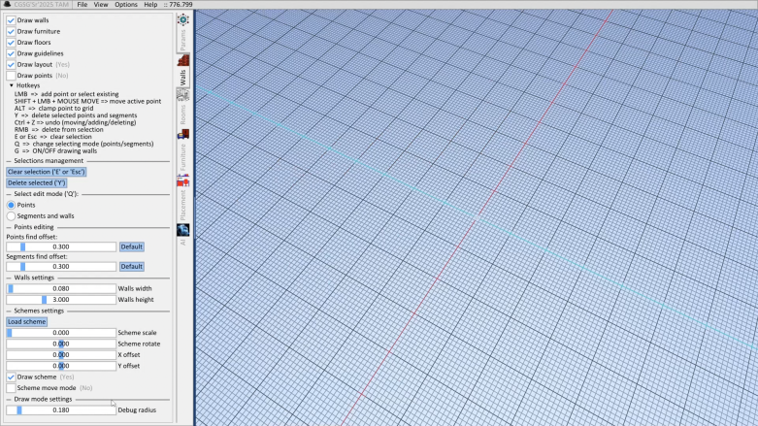
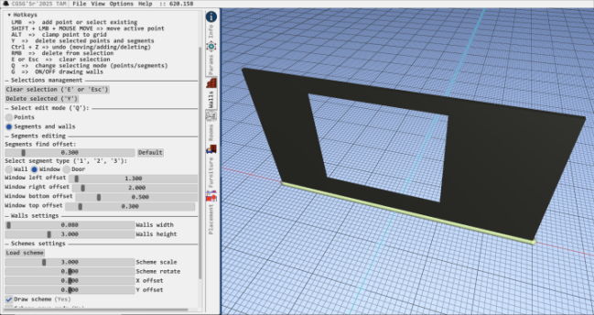
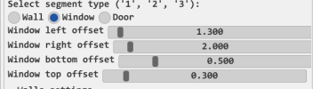
Editor. Premises
Setting up wall parameters (window, door, and their parameters)
Creation of premises
adaptive interface
Downloading floor plans

Slide 15
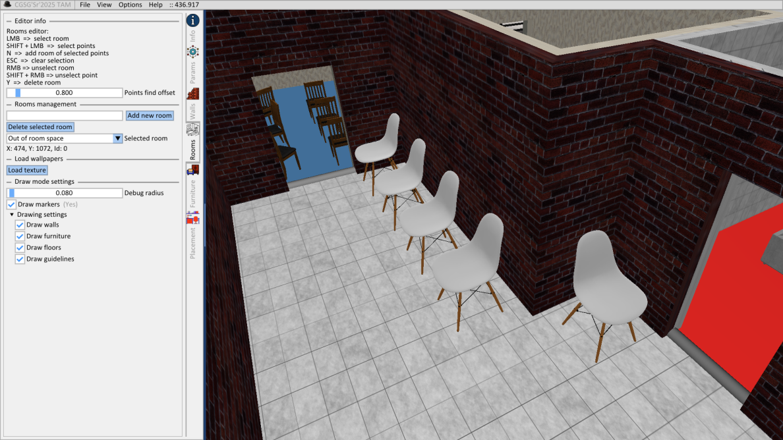
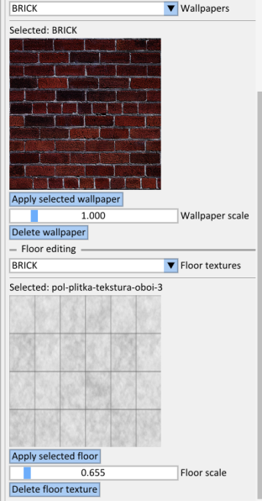
Editor. Rooms
Editing the wall and floor textures of a specific room
Adding a room
Loading texture
Output parameters

Slide 16
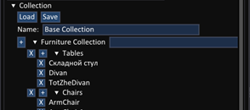
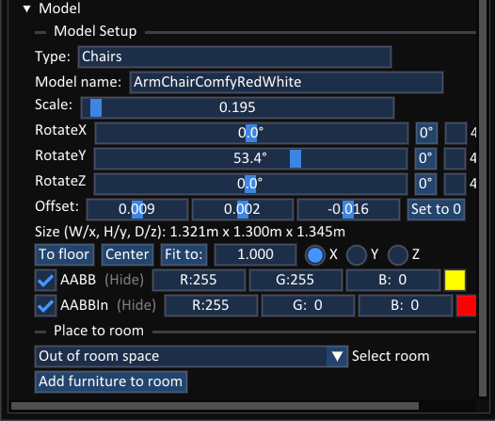
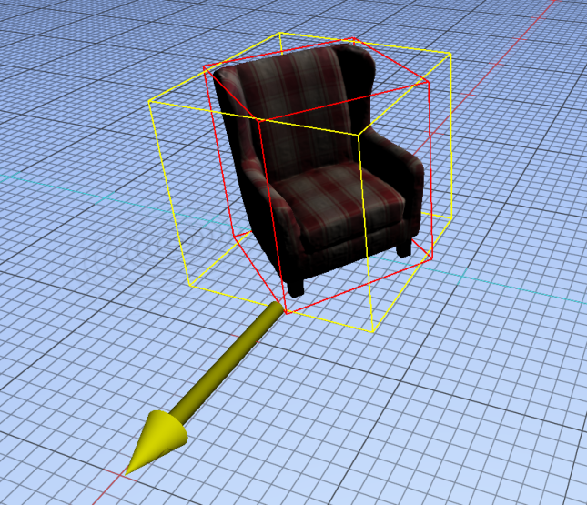
Editor. Furniture
Type Name
Model Name
Furniture type
Rotation around axes
Model
Axis-aligned bound-box
Oriented bound-box
Add furniture to the room

Slide 17
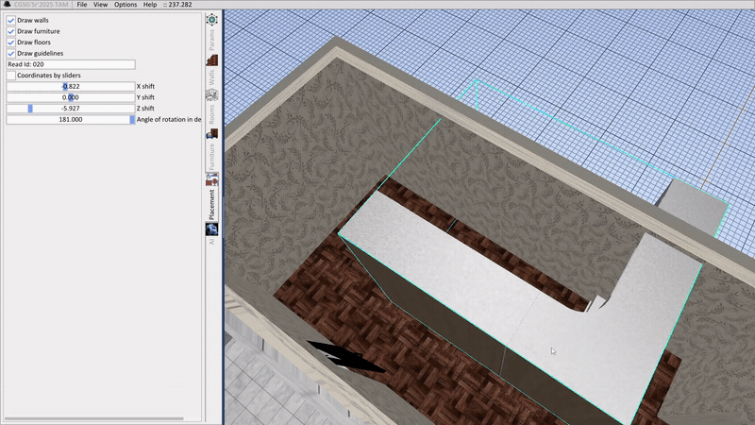
Editor. Furniture arrangement
Movement along axes, rotation
Control with mouse or sliders in the interface

Slide 18
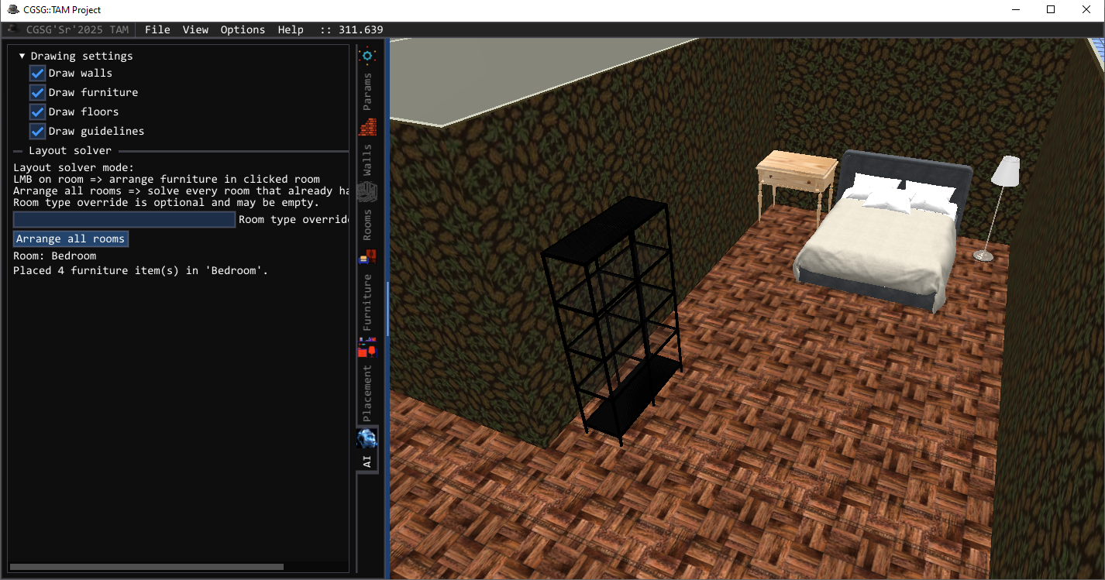
Editor. Furniture arranger
Override room type
Rearranging furniture in all rooms
Left-click to rearrange the selected room

Slide 19
Editor. Furniture arranger
Sorting furniture by priority
Entrance room
Processing room data
Selection of candidates
AI Ranking
Search results by candidates
Polygons
Geometry from above
Post Validation
Rotations
Segments
Data Processing. Prioritization
Furniture
Output room

Slide 20
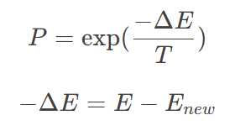
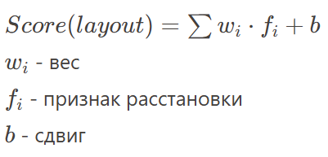
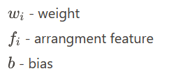



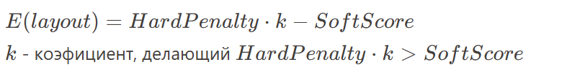

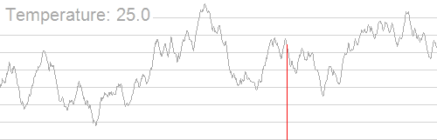
Editor. Furniture arranger
Linear model
Simulated annealing algorithm
The transition to a neighbor is carried out if ΔE<0 or with a probability of PP
Energy function
An example of optimization in action
The main task: Find a layout with minimal energy

Slide 21
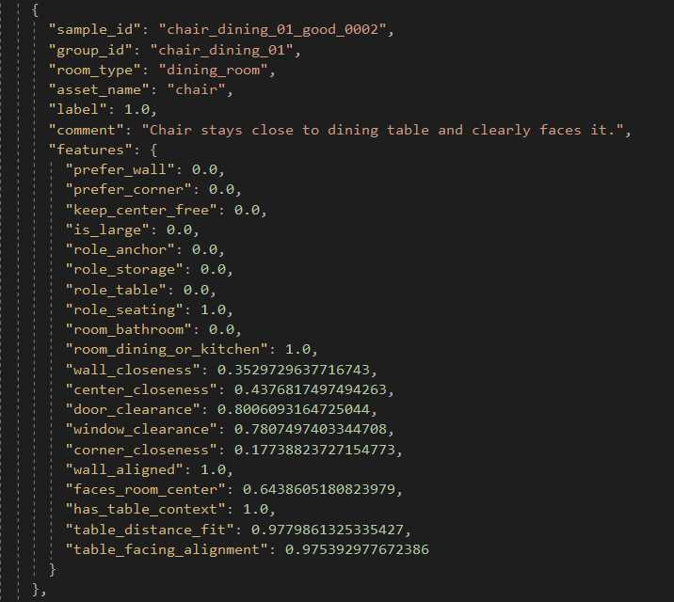
Editor. Furniture arranger
Model training
Sample from the dataset
Reading the dataset
Cycle
Separating data into training and validation
Score calculation
Error calculation
Normalization of features
Updating scales
Initialization of initial w, b
Saving to JSON

Slide 22
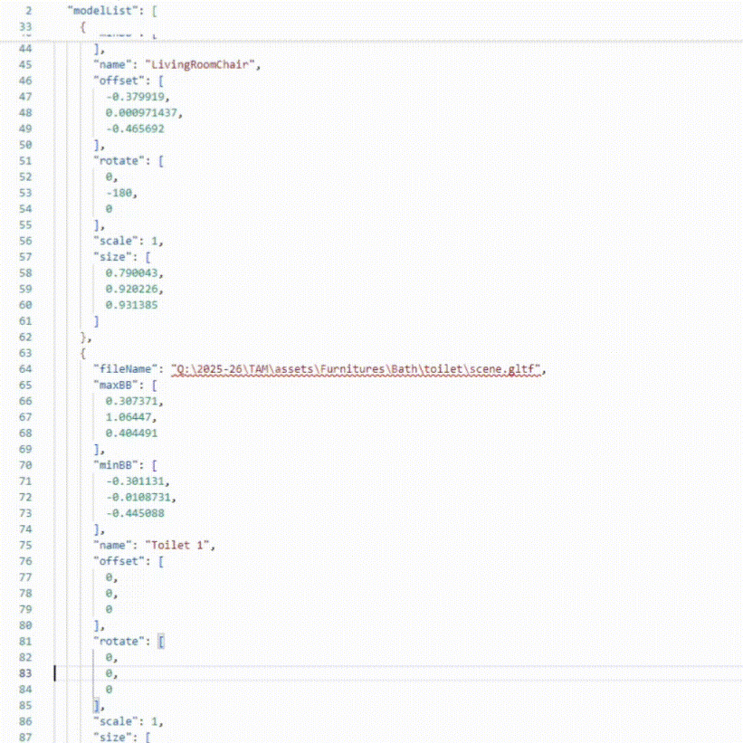
Storage room structure
Apartment
rooms
points
Furniture ID
Array of positions
segments
Furniture ID
Array of positions
Furniture ID
Array of positions
walls
Furniture collection

Slide 23
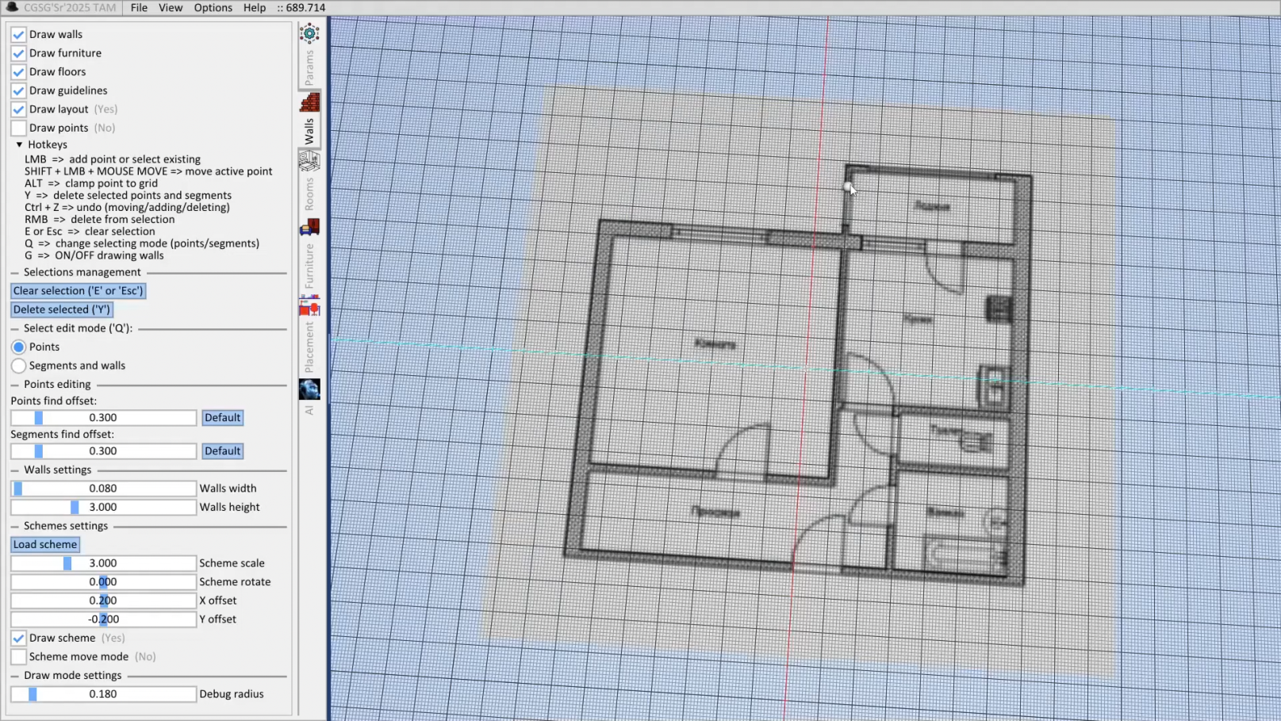
An example of the application work

Slide 24
Conclusion
The goals and objectives defined at the beginning of the project were successfully achieved.
The result of the project is a fully functional room layout editor with a user-friendly interface and a wide range of features.
The application allows users to create room layouts from scratch or import existing floor plans for further editing.
Users can manually arrange furniture or use the automated placement functionality provided by the system.
The modular architecture of the project enables further extension and scalability of both low-level components and high-level editor functionality.

Slide 25
Code development
Kochugueva Maria
Buffers, materials, furniture arrangement editor
Arsentev Artemy
Low-level Vulkan API, textures, render pipeline, furniture arranger
Necharv Vladimir
Resource storage, buffers, lighting, shadows
Kupchenkov Ivan
Shaders, working with JSON files, room editor
Novojilova Maryana
Low-level Vulkan API, primitives, models, wall construction and texturing
Tretyakov Andrew
Low-level Vulkan API, animation system, room editor

Slide 26
Code development
Authors: 6
Languages: С++ / Python / GLSL (for Vulkan API)
(vertex, tessellation, geometry, pixel, and compute shaders)
Development time: fall-summer 2025-2026
Code size: 1.9 MiB
(90 x *.cpp - 1192 KiB, 73 x *.glsl - 131 KiB, 82 x *.h - 589 KiB, 1 x *.py - 30 KiB)
Lines of code: 53415
(*.cpp - 30307, *.glsl - 4350, *.h - 18005, *.py - 753)

