Slide 1

Slide Template for the Arts-lab
Subtitles can be helpful
Austin Downey
Assistant Professor, Department of Mechanical Engineering
Assistant Professor, Department of Civil and Environmental Engineering
Note: This slide format is not in the slide master, rather it is a modified version of the basic slides with a white box in the bottom left to cover the UofSC logo.
Notes:
<number>

Slide 2
A title in Arial size 30 font (Liberation Sans in Libre Office)
A few things to consider
Bullet points work well in Arial size 20 font.
I deleted all the slide master templates; I just find these confusing as its hard to track down problems.
If you need a new slide, just copy the slide and delete the old content.
If you copy slides in, note that it may also bring in the template on the slide master. Best of luck!
Nothing beats black text on a white background.
The intended bullet points carry more information.
Bullet points should have at least two points.
Notes:
<number>

Slide 3
Progress Bars with Macros
Note: You can use red slides for section breaks, does not work well with the snake macro

Slide 4
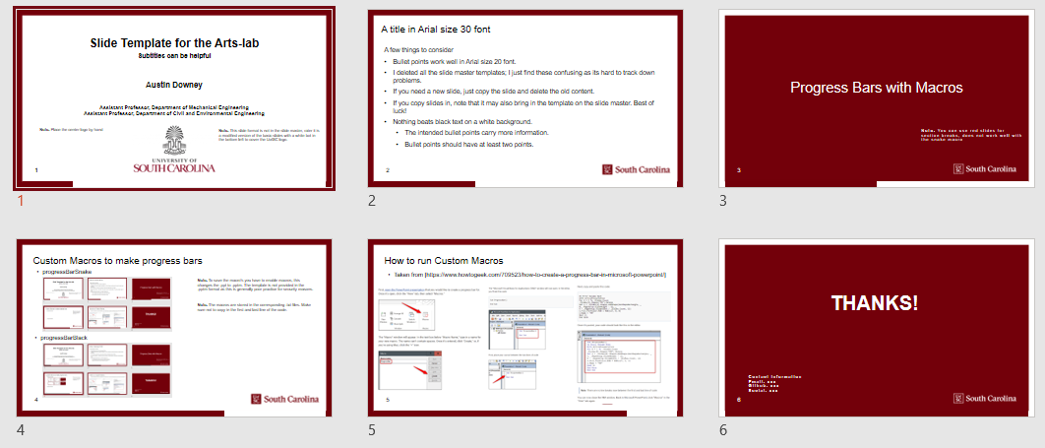
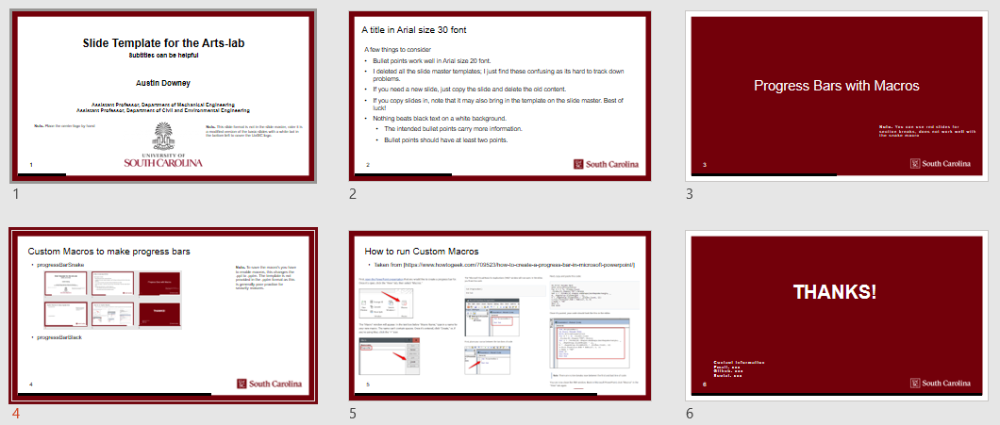
Custom Macros to make progress bars
progressBarSnake
Note: To save the macro’s you have to enable macros, this changes the .ppt to .pptm. The template is not provided in the .pptm format as this is generally poor practice for security reasons.
Note: The macros are stored in the corresponding .txt files. Make sure not to copy in the first and last line of the code.
Note: To delete, just click on the bar on the bottom of each slide and select delete.
progressBarBlack

Slide 5
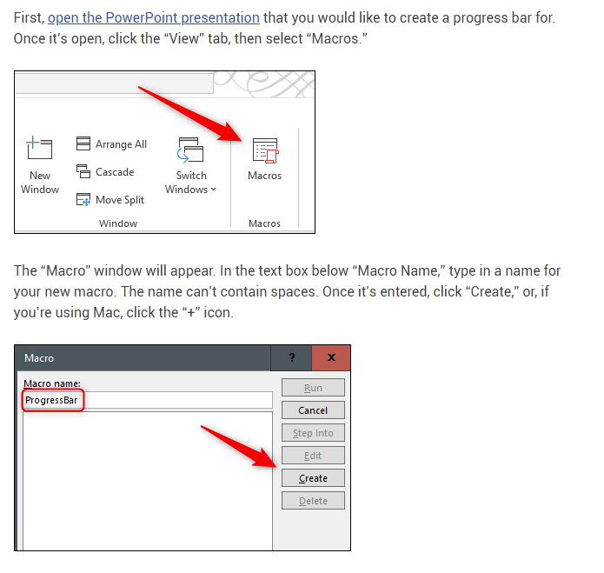
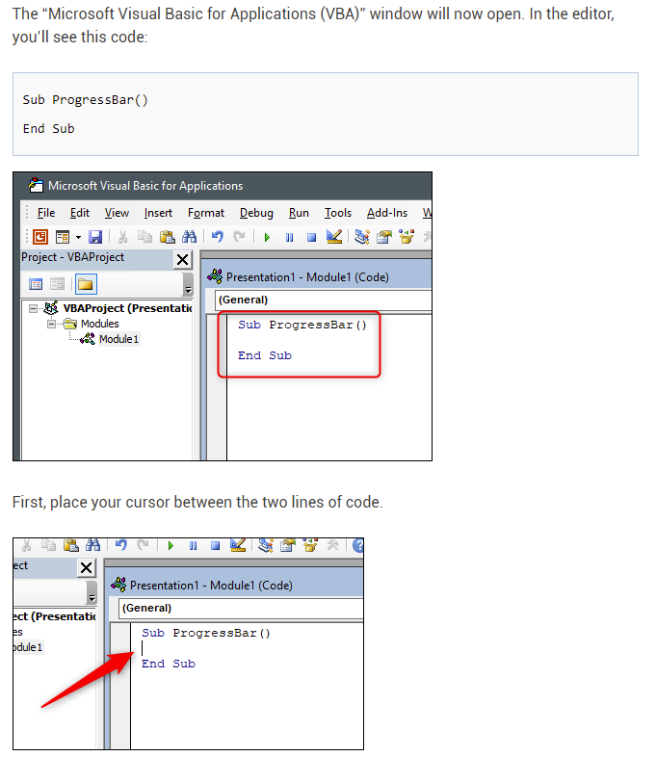
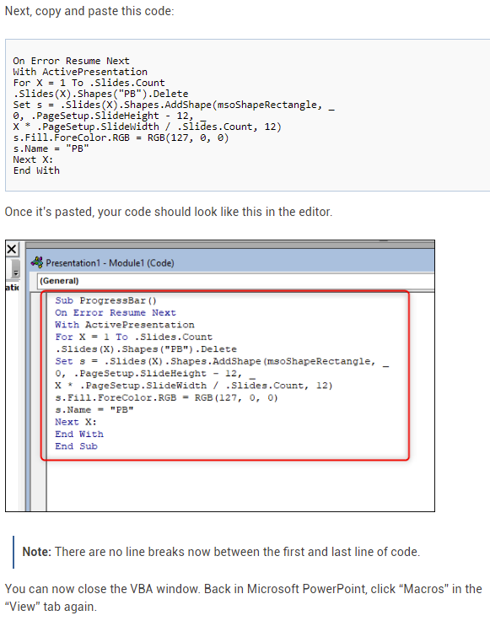
How to run Custom Macros
Taken from [https://www.howtogeek.com/709523/how-to-create-a-progress-bar-in-microsoft-powerpoint/]

Slide 6
Thanks!
Contact Information
Email: xxx
Github: xxx
Social: xxx

