Slide 1
Cholesky – Jacobi eigenvalue algorithm
A method for solving the generalized eigenvalue problem on FPGAs
Austin Downey
Assistant Professor, Department of Mechanical Engineering
Assistant Professor, Department of Civil and Environmental Engineering

Slide 2
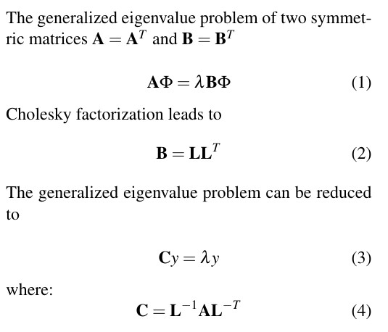
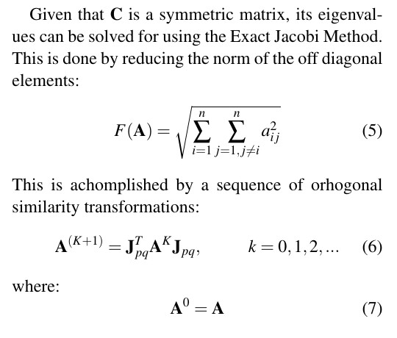
Technical Update: Computing Eigenvalues on a FPGA
Needed to develop a generalized eigenvalue solver that could run on an FPGA
Could not find anything in the literature for generalized eigenvalues solved on a FPGA The core concept is to keep all matrices as symmetric (as possible)
Investigated several methodologies, the proposed solution is a two-step generalized eigenvalue solver.
Cholesky decomposition to create a symmetric reduction of the M and K matrix
Jacobi eigenvalue algorithm to solve the reduced problem.

Slide 3
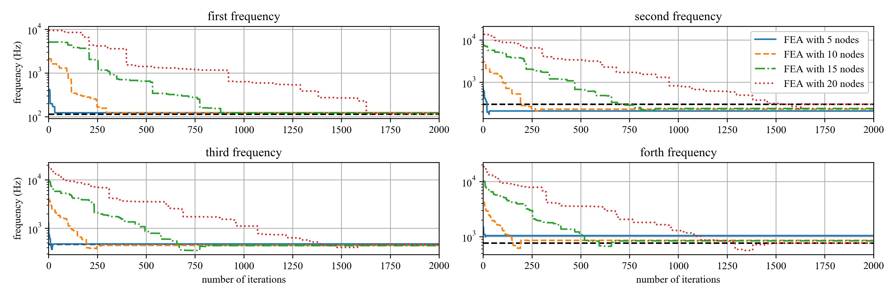
Technical Update: Cholesky-Jacobi Simulations
Simulated the proposed Cholesky-Jacobi general eigenvalue solver
The code is not fast on a CPU (order of seconds).
Code is concise and should be straightforward to implement in LabVIEW.

Slide 4
Next Steps: Hardware Implementation and Updating Probability Density Functions Cholesky-Jacobi
Implement proposed Cholesky-Jacobi algorithm on a FPGA
Need to consider hardware space and data sharing between FPGA and CPU Potential of just using FPGA for the rotations of the Jacobi eigenvalue solver
Implementing a reduced order model technique may be a key step in accelerating calculations
Investigate updating the PDFs based on prior knowledge and upcoming events.
Look into existing mathematical tools for quantifying uncertainty (DRAM: Efficient adaptive MCMC)
Use precalculated uncertainty to limit search space (variances of PDF)
Update PDFs based on prior error in the predictions.

Slide 5
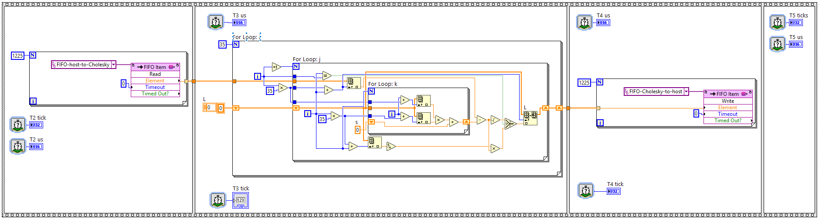
Technical Update: FPGA Update
Implemented Cholesky algorithms on FPGA
In the single precision floating point form, the CPU is 2x faster than the FPGA.
Fixed point numbers allow for single cycle timed loops (increases speed, decreases hardware requirements).
Implementing a usable fixed point method will take some optimization, currently have a 64-bit version working.

Slide 6
Thanks!

