Slide 1

Cholesky-Jacobi Eigenvalue Decomposition

Slide 2
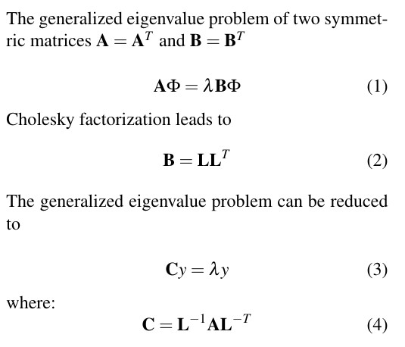
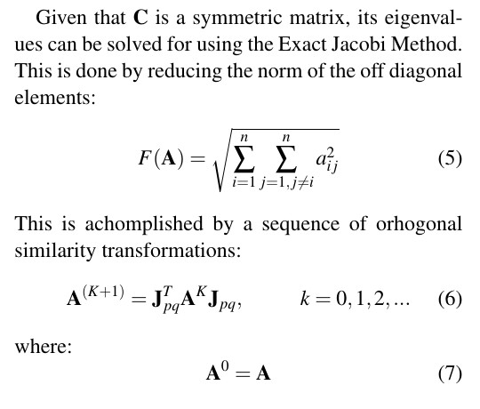
Technical Update: Computing Eigenvalues on a FPGA
Needed to develop a generalized eigenvalue solver that could run on an FPGA
Could not find anything in the literature for generalized eigenvalues solved on a FPGA The core concept is to keep all matrices as symmetric (as possible)
Investigated several methodologies, the proposed solution is a two step generalized eigenvalue solver.
−
−
−
λ
1: Cholesky decomposition to create a symmetric reduction of the M and K matrix 2: Jacobi eigenvalue algorithm to solve the reduced problem.
λ

Slide 3
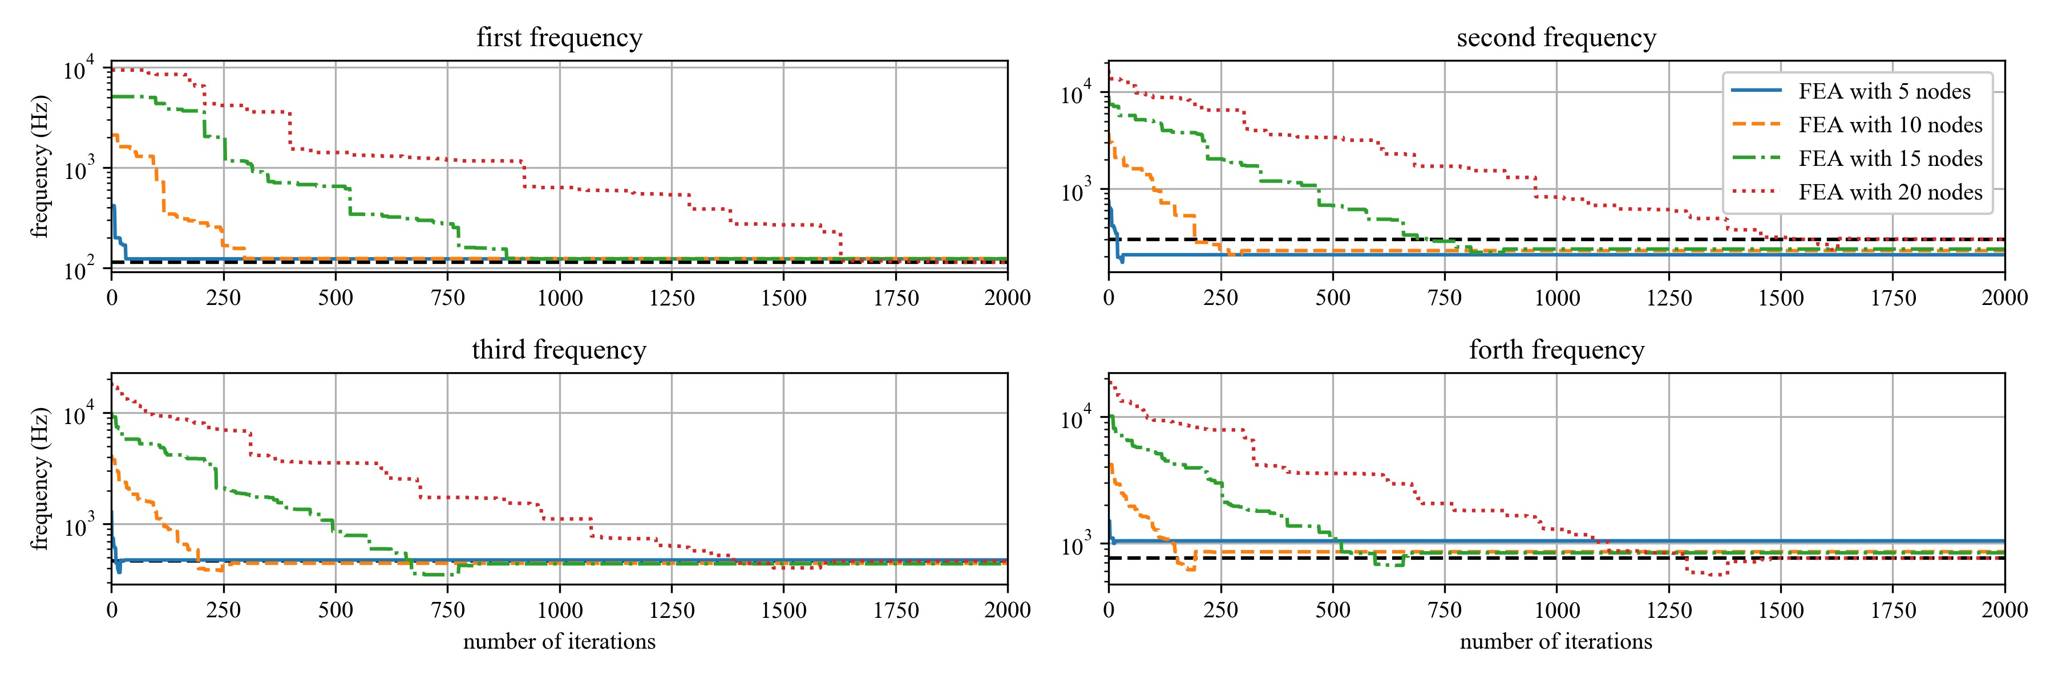
Technical Update: Cholesky-Jacobi Simulations
TOC
Simulated the proposed Cholesky-Jacobi general eigenvalue solver
The code is not fast on a CPU (order of seconds).
Code is concise and should be straightforward to implement in LabVIEW.

Slide 4
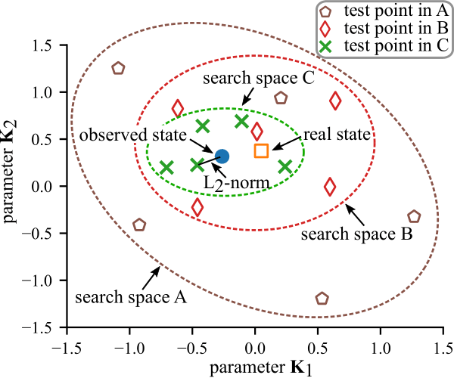
Next Steps: Hardware Implementation and Updating Probability Density Functions Cholesky-Jacobi
Implement proposed Cholesky-Jacobi algorithm on a FPGA
•
•
•
Need to consider hardware space and data sharing between FPGA and CPU Potential of just using FPGA for the rotations of the Jacobi eigenvalue solver
Implementing a reduced order model technique may be a key step in accelerating calculations
Investigate updating the PDFs based on prior knowledge and upcoming events.
−
Look into existing mathematical tools for quantifying uncertainty (DRAM: Efficient adaptive MCMC)
Use precalculated uncertainty to limit search space (variances of PDF)
Update PDFs based on prior error in the predections.
−
−

Slide 5
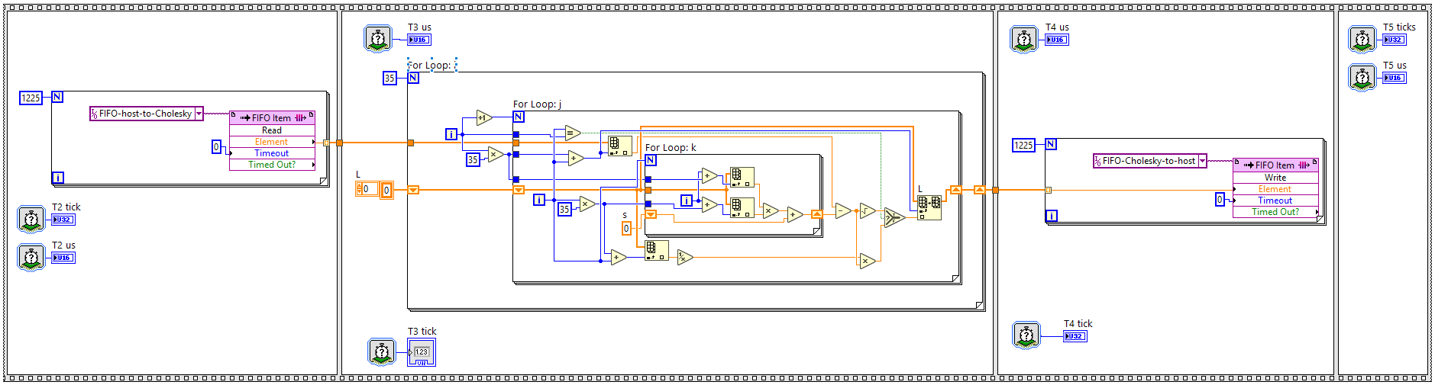
Technical Update: FPGA Update
Implemented Cholesky algorithms on FPGA.
λ
In the single precision floating point form, the CPU is 2x faster than the FPGA.
Fixed point numbers allow for single cycle timed loops (increases speed, decreases hardware requirements). Implementing a usable fixed point method will take some optimization, currently have a 64-bit version working.
λ
λ

Slide 6
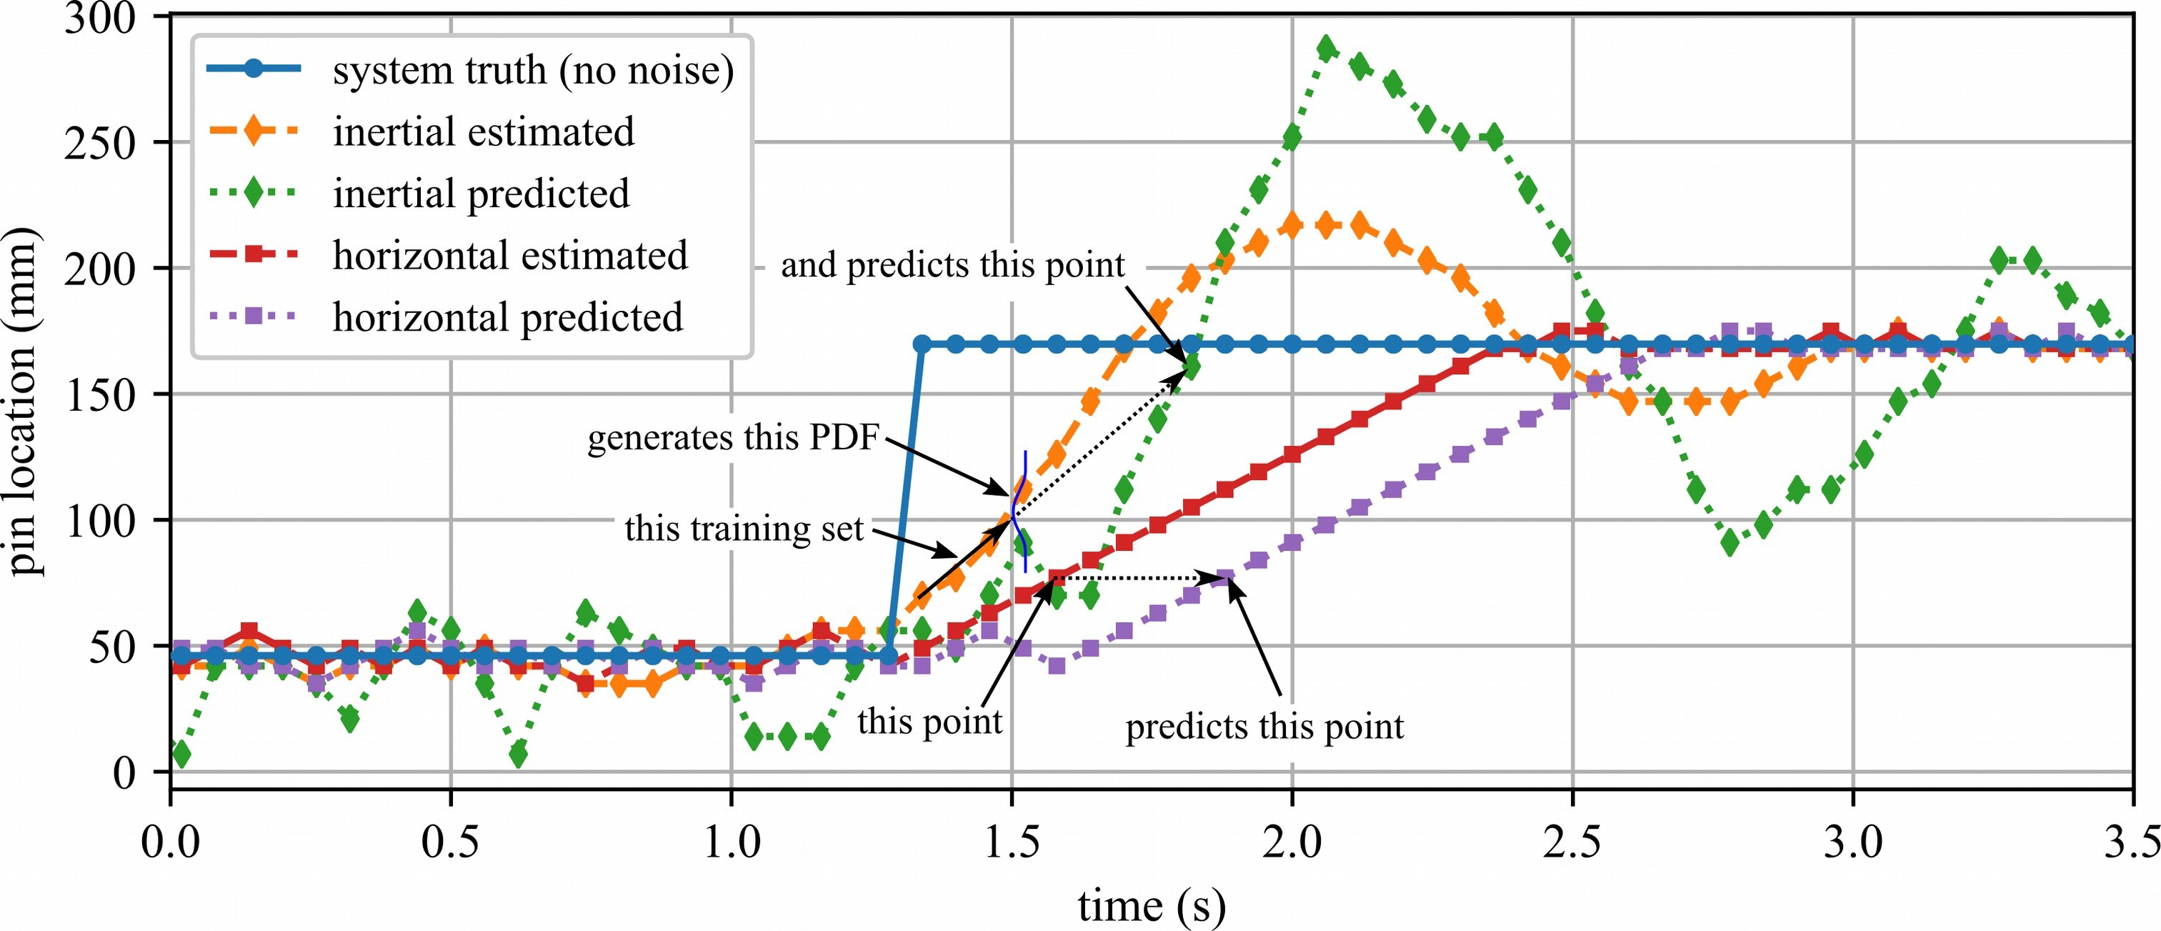
Technical Update: Algorithm Update
•
•
Both algorithms can be used for prediction
The inertial algorithm responds faster to a change in the system state but also over shoots the state.

Slide 7
Thank You for Your Time
Name: Austin Downey
Title: Associate Professor
Email: austindowney@sc.edu
Lab GitHub: github.com/arts-laboratory

