Slide 1
TEAm cell-u-later
End of Term Presentation
Kevin Crean, Hudson Dye, Wyatt Hill, Davis Hobbs

Slide 2
Agenda
Team Overview
Subsystem Progress
Wireless Communication
User Interface
Onboard Processing
Power Distribution and Management

Slide 3
Project Overview
Project Mission: Create a data collection waystation that collects data from deployed sensor packages, computes structural health metrics, and sends the metrics through a commercial cellular network.
Project Description:
Wireless communication between the waystation and the sensors.
Onboard computing at waystation to calculate structural health metrics.
Results passed on to a host PC via commercial cellular network

Slide 4
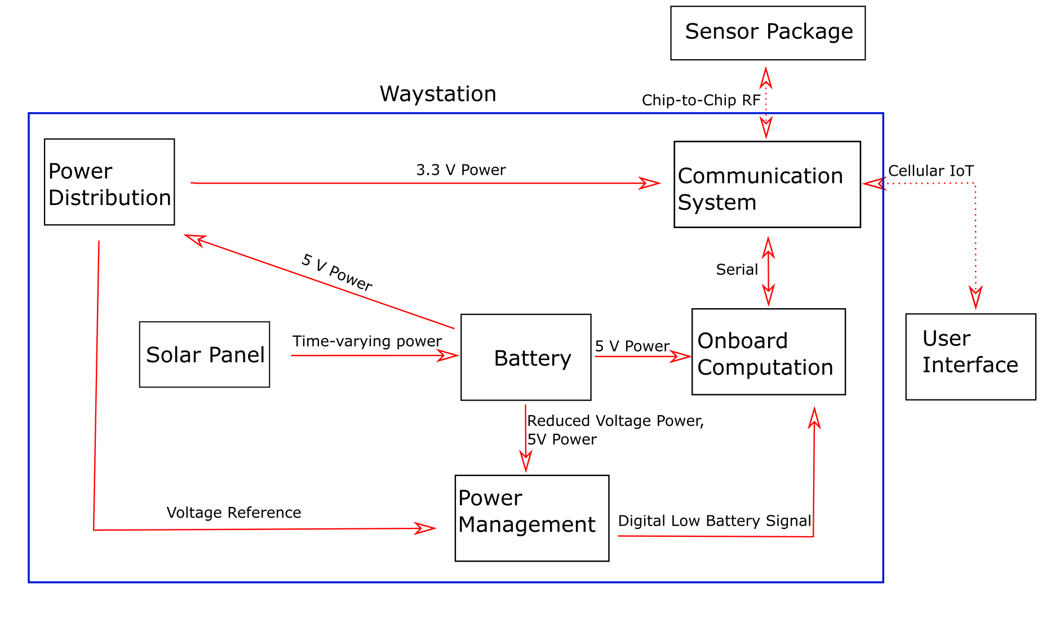
System Block Diagram

Slide 5
Design Philosophy
Physical Limitations: Size and Weight
Monetary Limitations: Pricing
Ease of Implementation
ADD DIAGRAM

Slide 6
Team organization
Project Sponsor: Austin Downey
Team Lead: Kevin Crean
Onboard Processing Subsystem: Kevin Crean
Wireless Communication: Hudson Dye
Power Distribution and Management: Davis Hobbs
User Interface: Wyatt Hill

Slide 7
Project status: Schedule
Acquired all necessary parts to prototype entire system
Completed subsystem demonstrations
Meeting consistently at least once a week

Slide 8
Project status: Financials
Component | Price
Botletics SIM700A-LTE-Shield (2) | $65
Micro SIM card + IoT subscription | $5
LP311P Differential Comparator (2) | $3
OKR-T-3-W12-C Buck Converter (2) | $16
SUNER BC-10 Solar Panel | $56
Talent Cell 5V/12000mAh Lithium-ion Battery | $40
SAE– Barrel Jack adapter | $10
 | $195

Slide 9
High Level Problems
Transferring pre-packaged data to generic data files
Power Management for regulated battery voltage
Understanding new concepts
RF Communication/Protocol

Slide 10
Wireless Communication subsystems
Hudson Dye

Slide 11
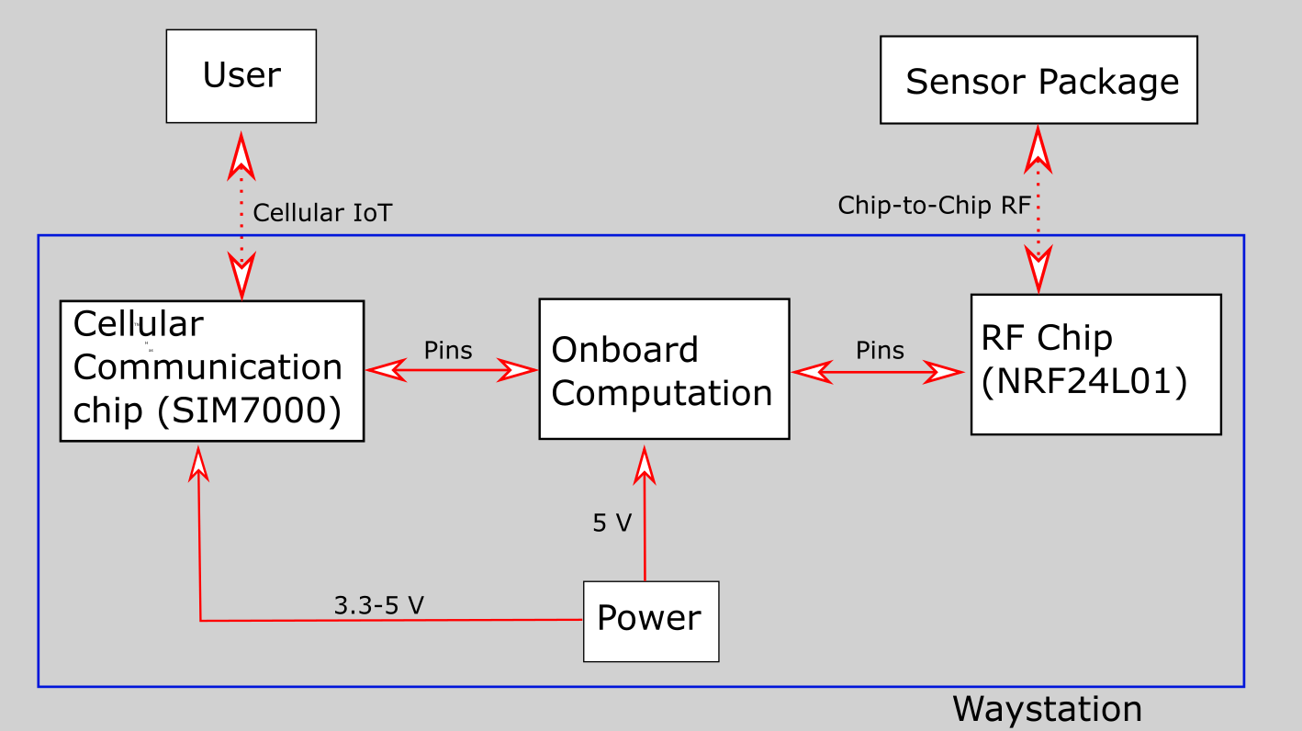
Block Diagram – communication focused
Notes:
Please change background color of this picture to white

Slide 12
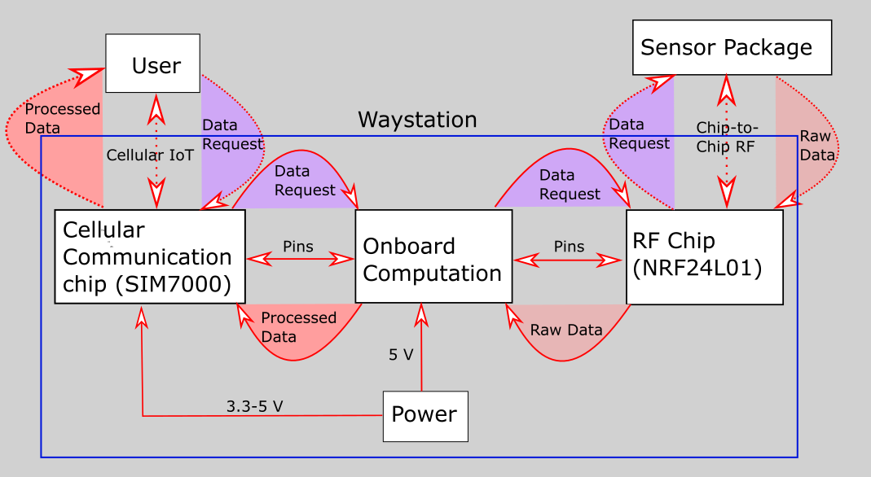
Block Diagram – Information flow
Notes:
Please change background color of this picture to white

Slide 13


Wireless subsystems
Cellular Communication
Chip-to-Chip RF
Cellular chip + microSIM
IoT connection to user
NRF chip
Previously implemented RF connection

Slide 14
Cellular Communication functions
Read chip & source information
battery voltage, ID, etc.
Read wireless environment information
registration status, RSSI, network time, etc.
Send/Receive SMS
post chip information to dweet.io
Goal: Send files to user via IoT

Slide 15
Cellular Characterization
This slide may include evidence of functioning cellular IoT capabilities

Slide 16
Learning Process
Custom PCB necessary to use any microcontroller except Arduino
Use Arduino Uno for prototyping
Spent ~25 hours testing faulty chip
Provided with free replacement extensive troubleshooting with CEO
Will need to play catch up during Christmas for RF portion
This delayed RF communication implementation

Slide 17
user interface (UI) Subsystem
Wyatt Hill

Slide 18
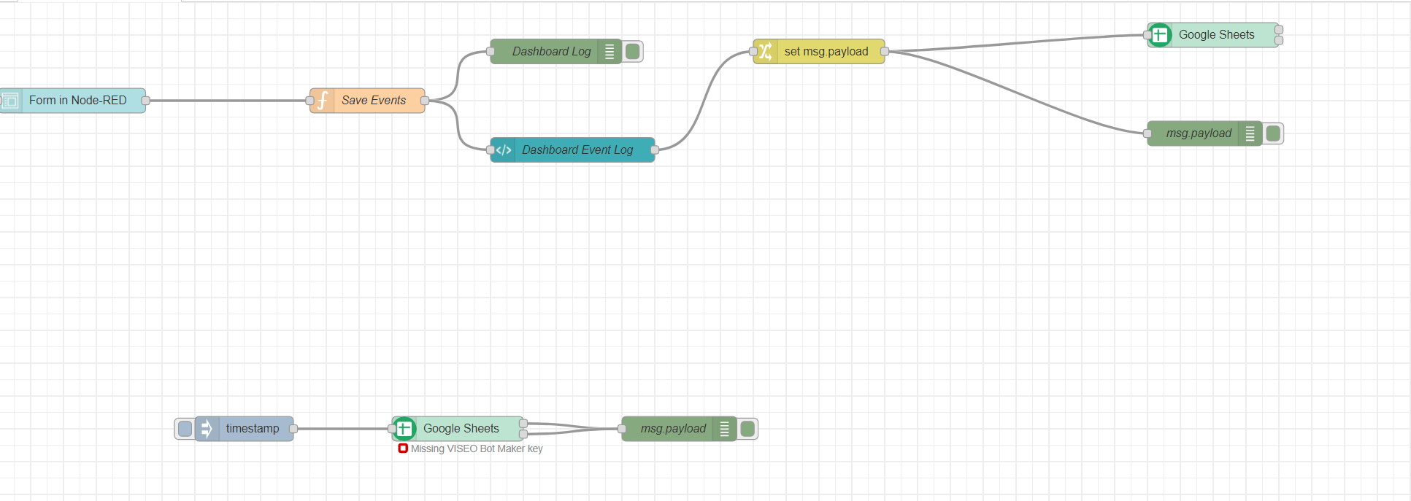
UI Subsystem overview

Slide 19
UI Subsystem Functions
Read Function
Ability to read and display data from data storage
Ability to select specific points and periods of data and read and display it from data storage.
Write Function
Ability to write to data storage for use of the read function
Ability to write processed data real time when requisition is given

Slide 20
Ui Read function Experiment
The Data sheet is loaded with mock data
First Name
Last Name
Country
The read function is called from UI as in normal operation
The debug window of the UI will be populated with mock data if the read function is successful

Slide 21
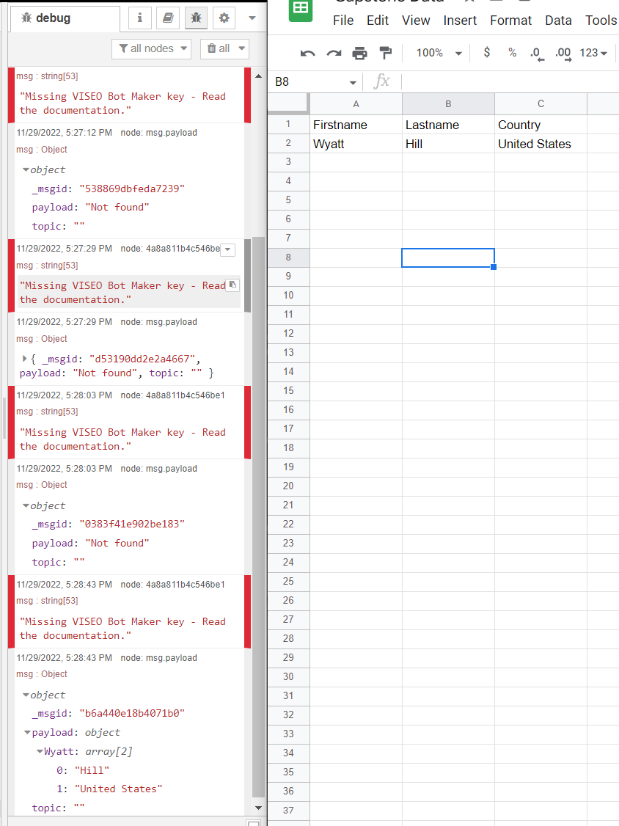
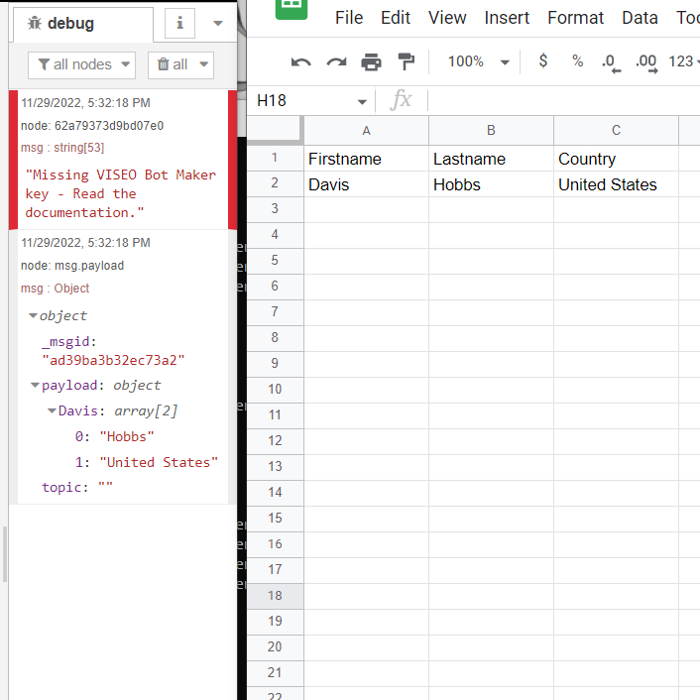
UI Experimental results
2 trials with different names and countries were successful

Slide 22
UI Subsystem Next steps
Work with Communication subsystem to achieve completion of write function.
Implement user input window for read function of UI subsystem
Integrate functions to successfully interface with local storage

Slide 23
Onboard processing subsystem
Kevin Crean

Slide 24
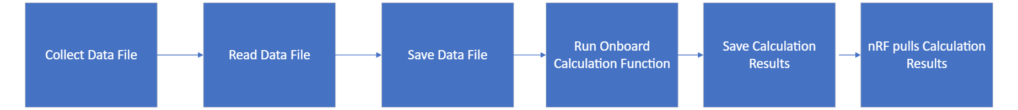
Onboard processing subsystem objective
Microcontroller receives and saves raw data to SD card.
Code will perform the structural health metrics that are requested.
Once metrics are calculated, processed data will be sent wirelessly to the user interface.

Slide 25
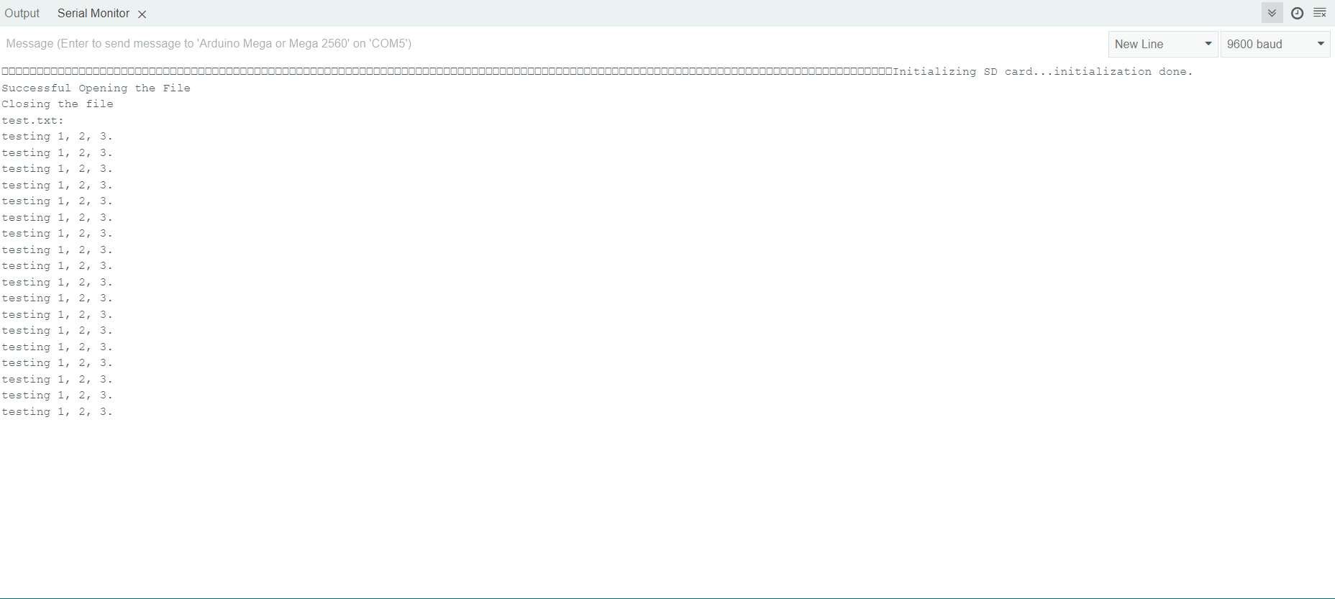
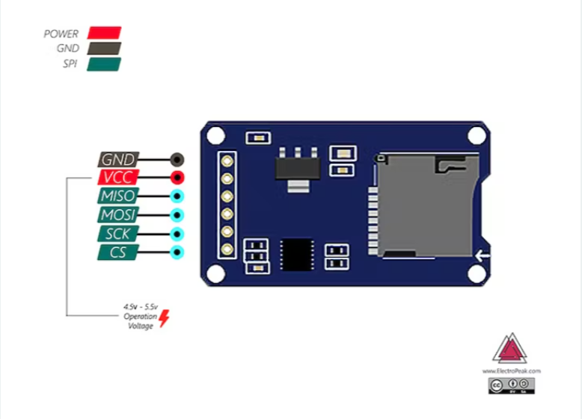
Onboard processing Experiment: Read and Write SD Card
Read and Write to test file contained on SD Card
Print out Results on Serial Monitor
Serial Peripheral Interface (SPI) Protocol.

Slide 26
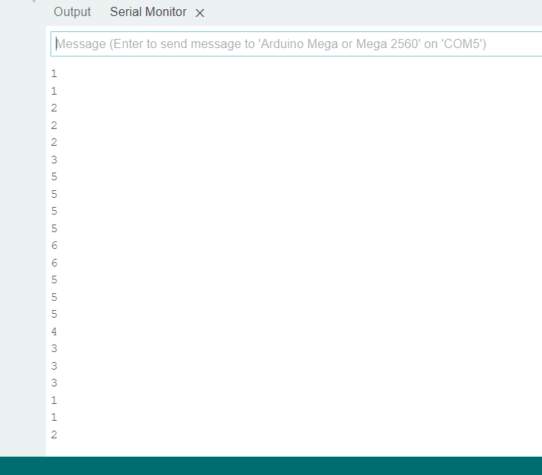
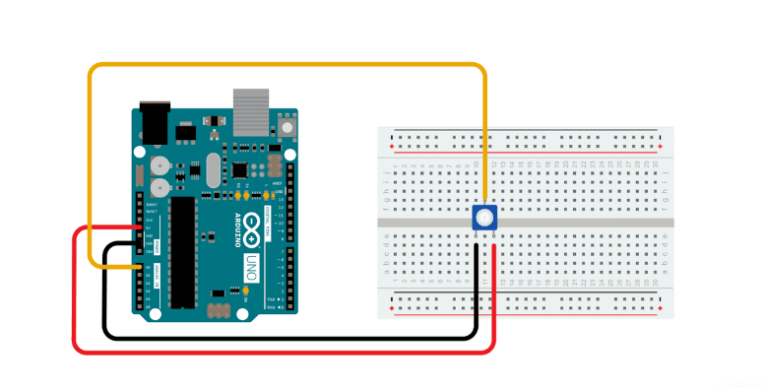
Onboard processing Experiment: Mean function
Stores Data in an Array
Finds the Average Value
Running Average Function

Slide 27
Onboard processing problems and concerns
Learning Arduino Programming Language
Some parts taking longer than expected
Fast Fourier Transform Function
Low Resolution that Arduino Mega 2560 R3 will be able to compute
Switching to a Raspberry Pi
Potentially Delay Gantt Chart Schedule

Slide 28
Onboard processing next steps
Combine and Adjust Mean Function Calculation Code with Read/Write SD Card Code
Write Fast-Fourier Transform Function
Microcontroller communication with nRF module
Using a Raspberry Pi instead of the Arduino Mega 2560 R3

Slide 29
Power Distribution and Management (PDM) Subsystem
Davis Hobbs

Slide 30
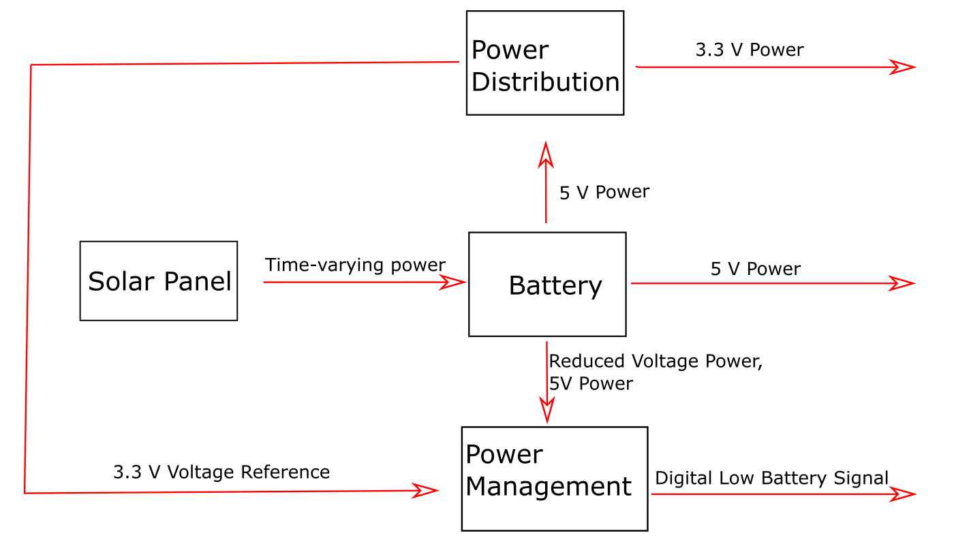
PDM Subsystem Overview

Slide 31
PDM Subsystem Objectives
Power Supply
Establish a ~5 V power source to supply the microcontroller
High capacity with solar recharge capabilities
Power Distribution
Establish a ~3.3V power source to supply the comms hardware
Capable of enduring rapid changes in load
Power Management
Signal the microcontroller when the battery is at low capacity

Slide 32
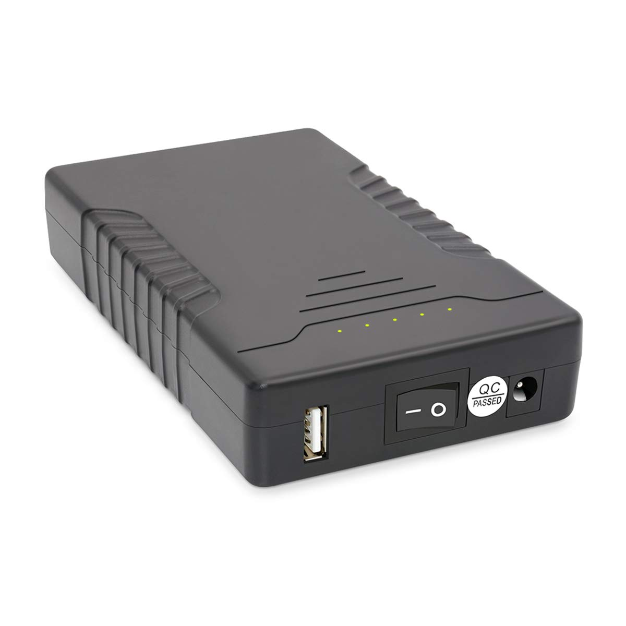
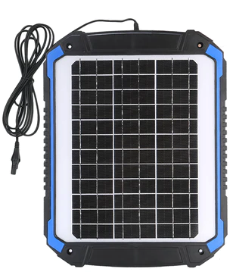
Subsystem Hardware: Power Supply
A 5V Talent Cell Battery was selected
Internal 5V regulator to reduce voltage ripple
Internal battery management system allows for solar panel integration
Sufficient capacity for 4 days of operation using data sheet values
The battery is supported by a 12 W Suner Solar Panel
Interfaces with battery via an SAE connector
Designed for Li Battery charging

Slide 33
Subsystem Hardware: Power distribution
OKR buck converter supplies power to comms hardware.
Reduces ~5V battery voltage to ~3.3V
Up to 93% efficient power conversion
Highly effective at responding to pulsed loads
Converter has been experimentally validated to supply loads mimicking the comms hardware

Slide 34
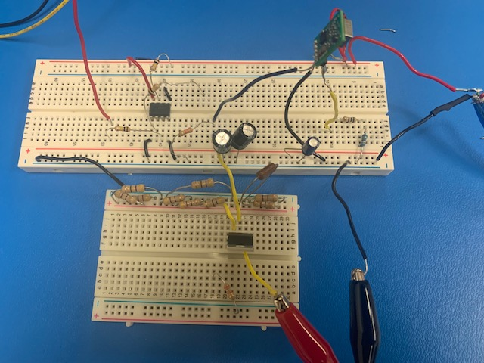
Distribution System Experiment
Buck Converter
Battery: 5 V
Base Load
The distribution system was given a load meant to mimic comms hardware power draw.
This load was turned on and off at 15 Hz.
The effect of dynamic loading on distribution output voltage was monitored.
Mosfet
High current load
Mosfet Gate Signal

Slide 35
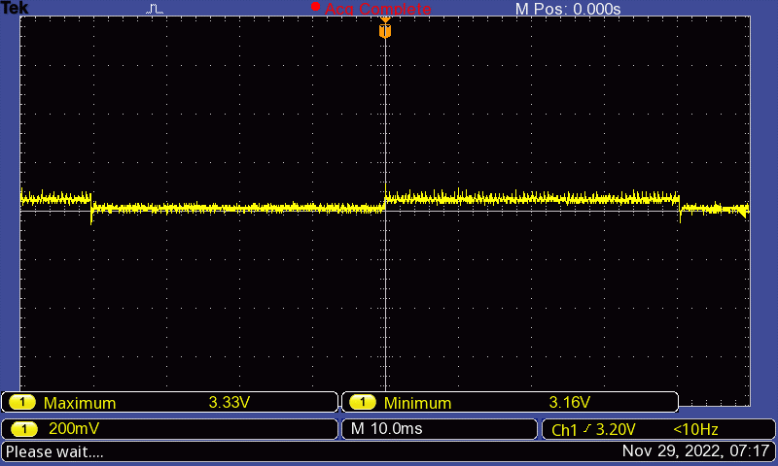
Experimental Results
The buck converter can successfully reduce battery supply voltage
The distribution subsystem provided a max load voltage range of 3.35 – 3.14 V
This range falls well within the 3.0 – 3.6 V range acceptable by the comms hardware.

Slide 36
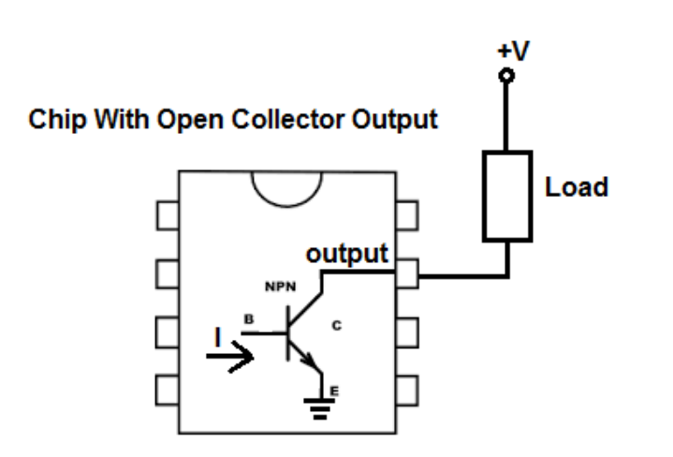
Subsystem Hardware: Power Management
The LP311P comparator was selected
Tracks battery voltage fade
Alerts microcontroller of low battery voltage
Microcontroller provides signal voltage to avoid overvoltage
This subsystem was experimentally validated

Slide 37
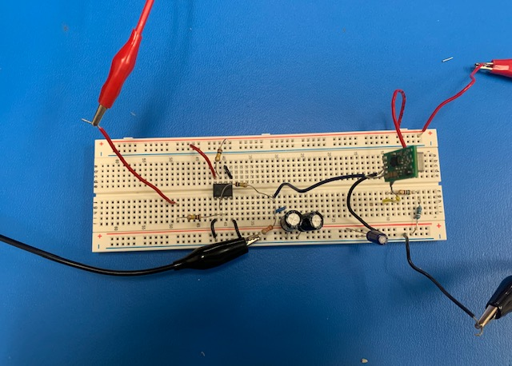
Power Management Experiment
Buck Converter
Test Signal
Load Resistor
Supply: 5 V
The power management hardware was supplied with a 3.3 V reference signal
A power supply was used to mimic battery voltage fade
The output signal of the comparator was monitored
Comparator

Slide 38
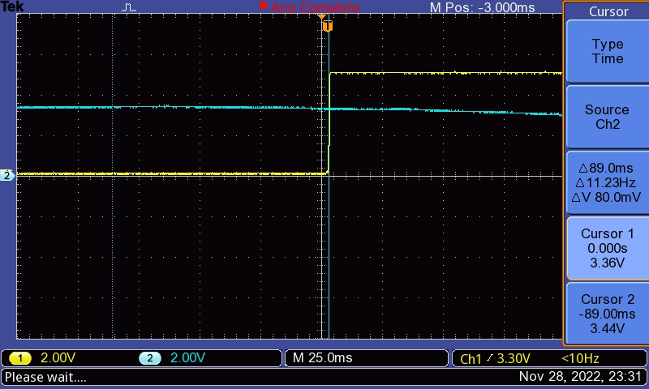
Power Management Experimental Results
Demonstrated to Professor Smoak
A digital signal does change from 0 V to 5.15 V when the input falls below the reference
This validates the signal is accurate under static load conditions

Slide 39
PDM Subsystem: next steps
The original design of the power management system did not anticipate regulated battery voltage
Necessitates a redesign of the power management system
The solar panel’s ability to charge the battery will be tested
Distribution hardware should be integrated with the comms hardware to test functionality

