Slide 1

Smart-Pack-for-Advanced-Research-and-Control (SPARC)

Slide 2
Why Develop a Modular, Sensor-Rich Battery System?
Supports Next-Generation Energy Storage
Enables research on distributed energy systems and high-performance battery management
Facilitates scalability for a wide range of power applications
Enhances Digital Twin Development
Real-time, high-fidelity data streams enable dynamic model validation and predictive analytics
Integrated sensors allow continuous updates to electrochemical, thermal, and mechanical models
Enables Flexible and Configurable Testing
Modular 42V (10S1P) design allows for series/parallel stacking to replicate different battery pack architectures
Supports multiple cell sizes and chemistries (e.g., 18650, 21700, NMC, LFP) for diverse application studiesImproves
Advanced Battery Control and Monitoring
High-resolution BMS with CompactDAQ integration enables real-time state estimation and anomaly detection
Adaptive energy management through advanced control strategies

Slide 3
Why Not Just Buy a Battery Pack?
It’s Not That Simple
Off-the-shelf battery packs are designed for consumer or industrial use, not for research and experimentation
Most commercial packs come with proprietary BMS systems that restrict access to raw data, limiting the ability to monitor and analyze cell-level behavior
Limited Experimental Flexibility
Research often requires testing individual cells and full packs under identical conditions, which isn’t possible with third-party pack builders
By sourcing cells from a single batch, researchers can compare degradation, thermal response, and electrochemical performance at both cell and pack levels
Pack design constraints in commercial solutions prevent studies on alternative cooling strategies, advanced sensing, and new control architectures
Need for Custom Sensing and Instrumentation
Commercial battery packs do not support high-resolution instrumentation, such as differential voltage sensing, strain monitoring, and acoustic emissions
In research, advanced sensing capabilities are critical for developing and validating digital twins, studying failure mechanisms, and improving predictive modeling
Custom-built packs allow for direct integration with external control and data acquisition systems, ensuring researchers have full control over charging, discharging, and monitoring parameters

Slide 4
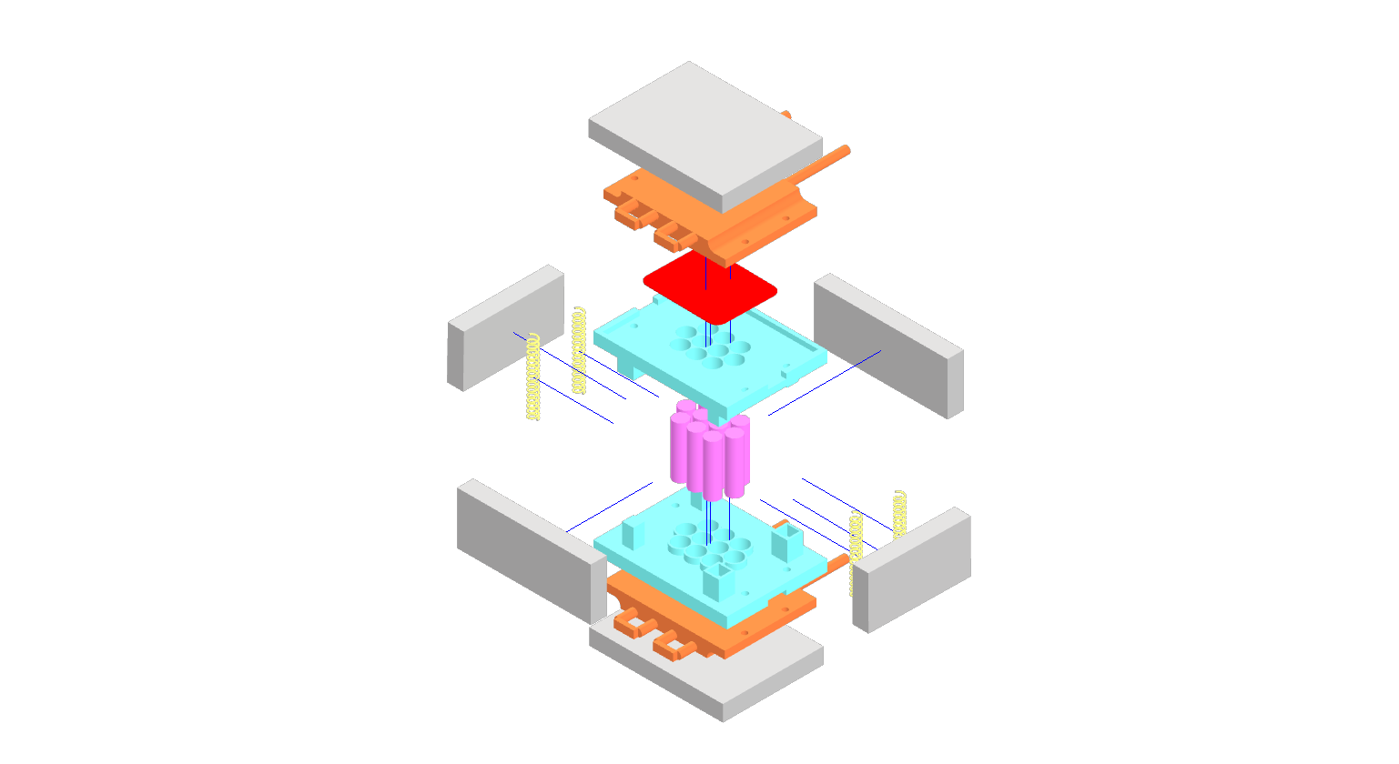
What Will the Battery Module look like?
Thermal pad
Cold plate
Assembly springs
Cells
Insulation
Cell holder

Slide 5
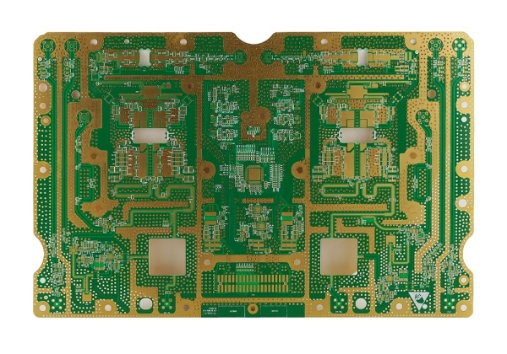
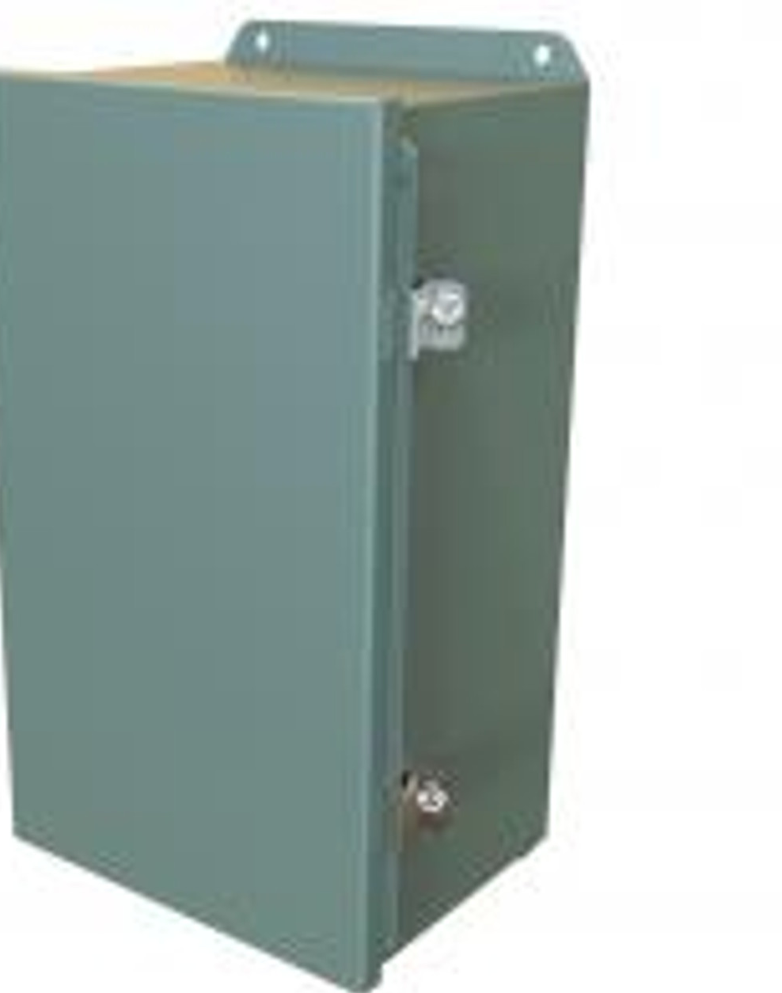
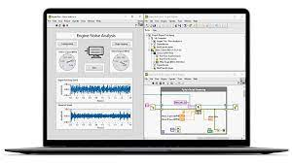

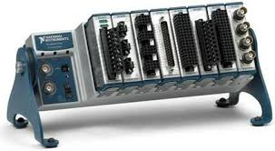
What Will the BMS Look Like?
BMS Control Board
Battery
Cost:
$20,000 fully-instrumented
$10,000 typical deployment
$4,000 minimal viable
cDAQ based DAQ

Slide 6
What Features will the Pack Have
Comprehensive Sensing Capabilities
Voltage Monitoring – Individual cell voltages and differential voltage across each cell for precise state-of-charge (SOC) estimation
Temperature Sensors – Each cell will have dedicated temperature monitoring, ensuring thermal stability and safety
Current Sensors – High-resolution current measurement for charge/discharge tracking and efficiency analysis
Strain Gauges – Integrated strain sensing on cells and pack components to monitor mechanical deformation and aging effects
Acoustic Emission Sensors – Captures high-frequency signals from crack formation, gas evolution, and early failure indicators
Advanced Battery Management Features
Cell-Level Monitoring – Every cell is individually monitored for voltage, temperature, and strain, allowing detailed analysis of cell-to-cell variations
Cell Balancing – Passive balancing to start, ensuring even charge distribution and extending pack lifetime
Customizable Data Sampling – Fully open data acquisition interface, allowing researchers to modify sampling rates and data logging parameters
Open-Access and Reconfigurable Design
Fully Open Front Panel – Allows for easy access to all monitoring points, enabling rapid sensor modifications, data acquisition customization, and external integrations
Flexible Control Integration – Can directly support adaptive BMS algorithms and digital twin updates

Slide 7
Thank You for Your Time
Name: Austin Downey
Title: Associate Professor
Email: austindowney@sc.edu
Lab GitHub: github.com/arts-laboratory

