Slide 1





Design of Vacuum- and Pressure-Compatible Optical and Thermal Camera Modules for Laser Powder Bed Fusion
Mumin Adhamiª, Mateo Garica-Sandovalª, Thienan Hoangª, Matt Whethamª, Yanzhou Fu^{a,c}, Can Sunª, Austin R.J. Downey^{a,b}, and Lang Yuanª
ªDepartment of Mechanical Engineering, University of South Carolina, Columbia, SC, USA
^{b}Department of Civil and Environmental Engineering, University of South Carolina, Columbia SC, USA
^{c}Engineering and Computer Science Department, Benedict College, Columbia SC, USA

Slide 2
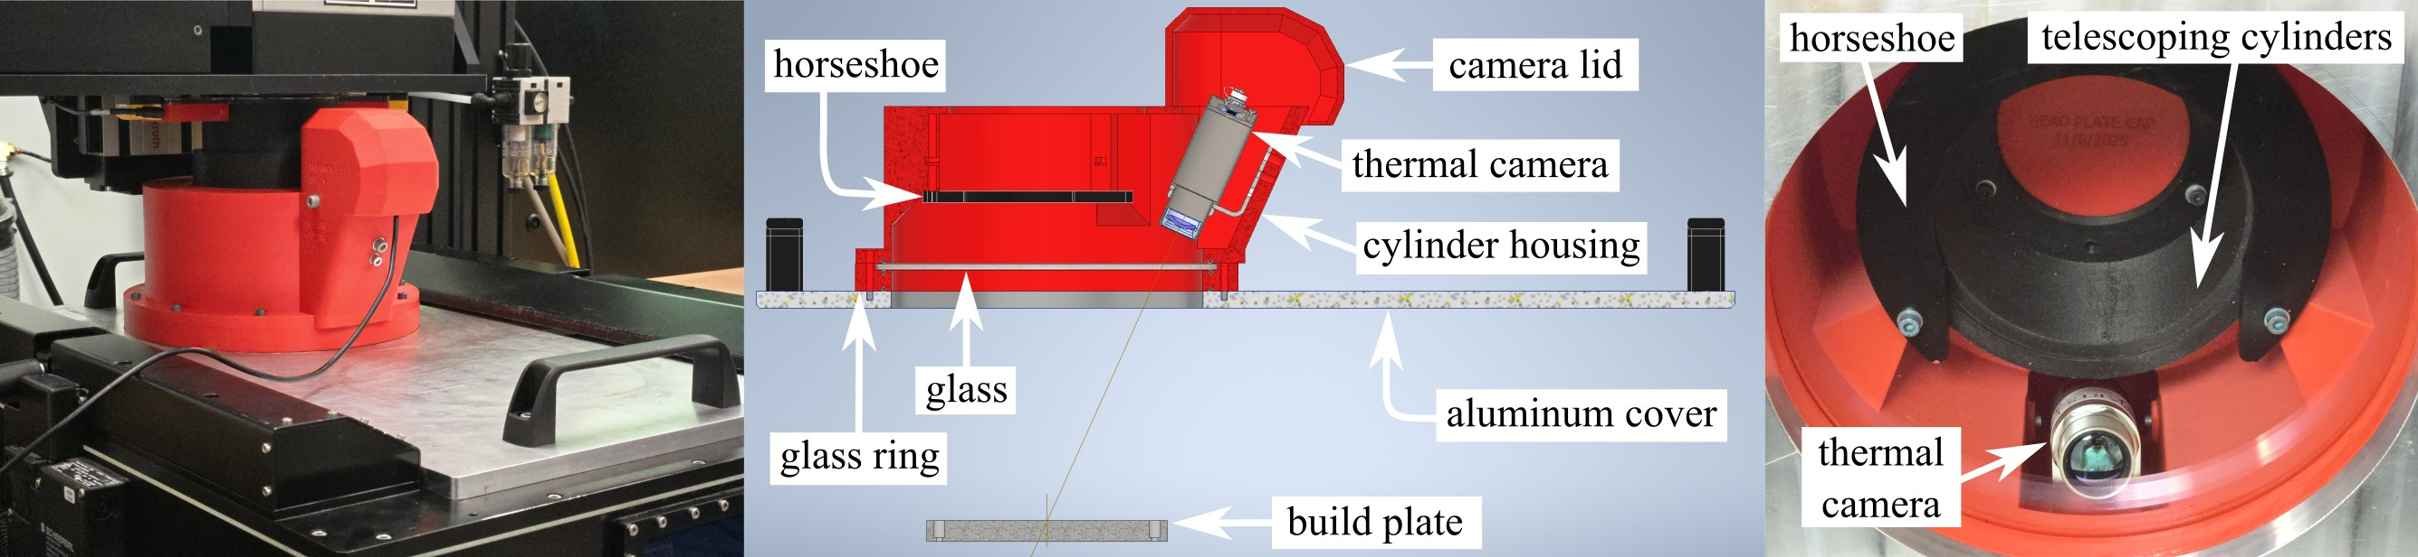
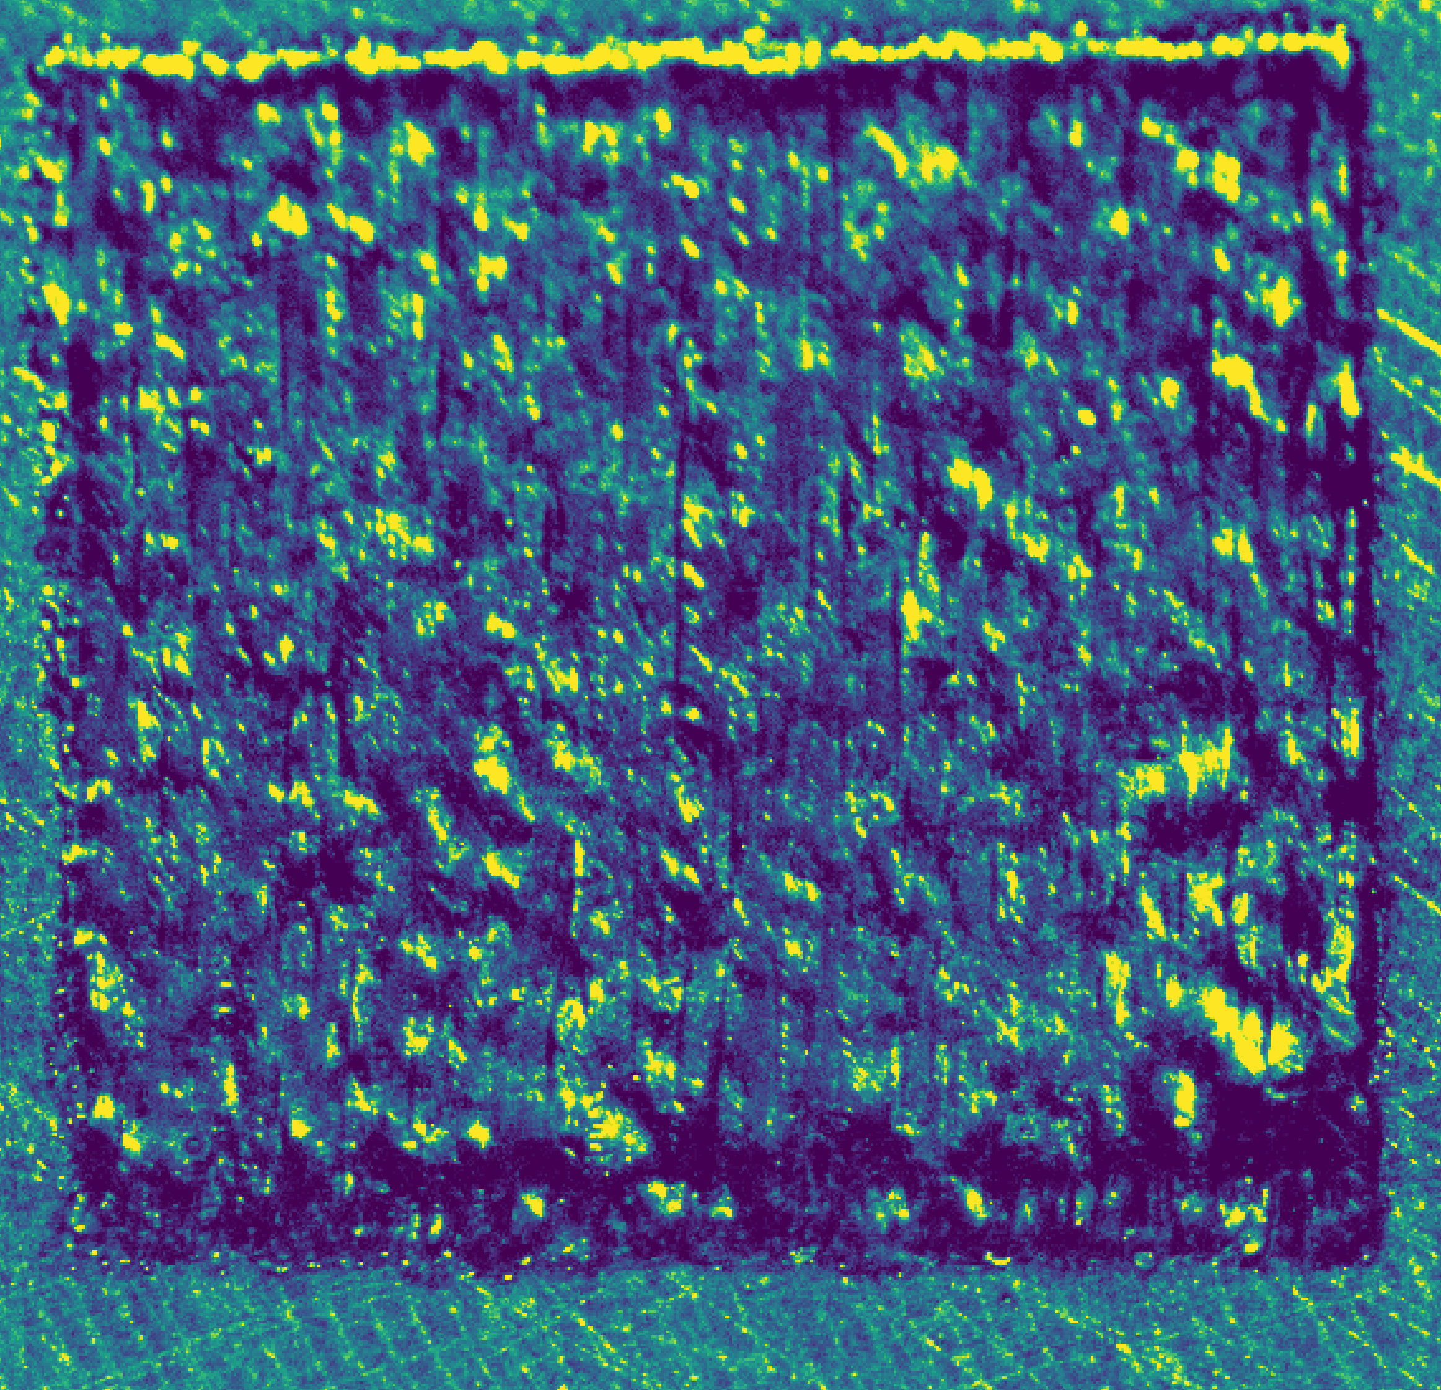
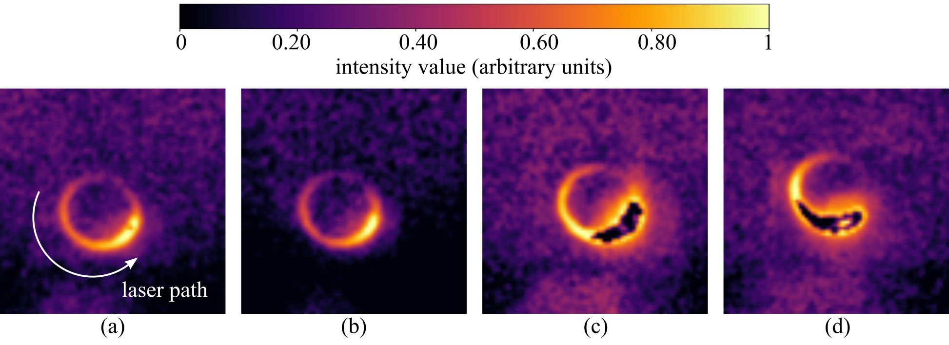
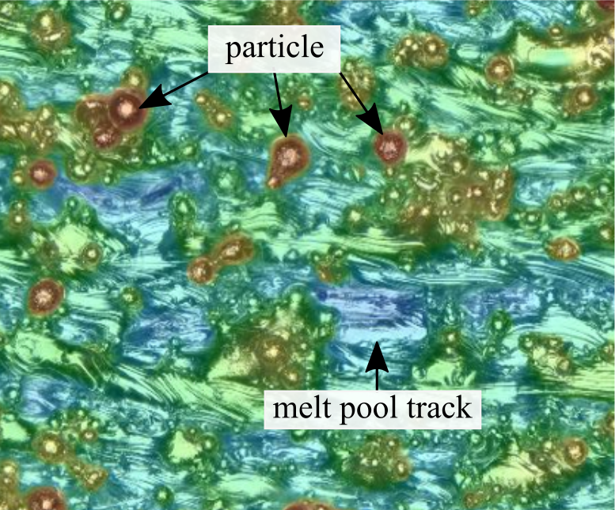
Laser Powder Bed Fusion (LPBF)
Surface Quality and Melt Pool Behavior
Prior Work on In-Situ Process Monitoring
Camera Module Design for Inter-layer LPBF Monitoring
2
Notes:
Laser Powder Bed Fusion (LPBF) is a cutting-edge metal additive manufacturing technology that enables the precise construction of complex geometries layer by layer. It is widely used in aerospace, medical, and automotive industries due to its unmatched design flexibility. However, LPBF faces several challenges: Process variations lead to defects that affect mechanical properties. Traditional defect detection methods, such as X-ray computed tomography, are slow and costly. It also has a limitation on specimen size. Real-time monitoring is limited without labeled data, making it difficult to detect quality issues during printing rather than after fabrication.

Slide 3
Surface Quality and Melt Pool Behavior

Slide 4
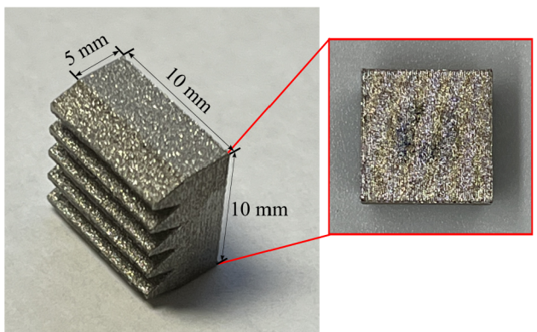
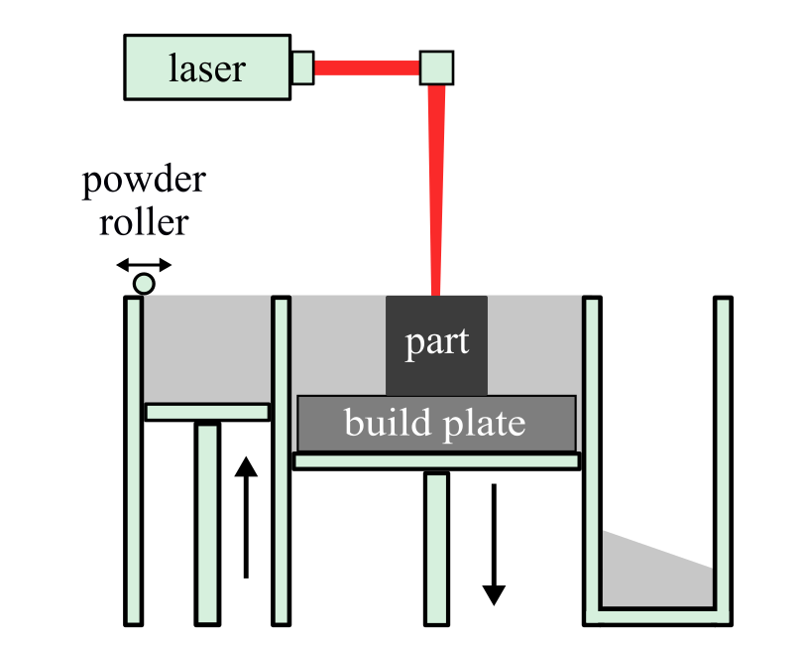
Laser Powder Bed Fusion (LPBF)
Metal additive manufacturing process using a scanning laser
Powder is melted layer-by-layer to build complex geometries
Enables high precision and material efficiency
Widely used in aerospace, biomedical, and automotive industries
4
1. https://www.bcn3d.com/introduction-fff-3d-printing-technology-additive-manufacturing-basics/
Notes:
Laser Powder Bed Fusion (LPBF) is a cutting-edge metal additive manufacturing technology that enables the precise construction of complex geometries layer by layer. It is widely used in aerospace, medical, and automotive industries due to its unmatched design flexibility. However, LPBF faces several challenges: Process variations lead to defects that affect mechanical properties. Traditional defect detection methods, such as X-ray computed tomography, are slow and costly. It also has a limitation on specimen size. Real-time monitoring is limited without labeled data, making it difficult to detect quality issues during printing rather than after fabrication.

Slide 5
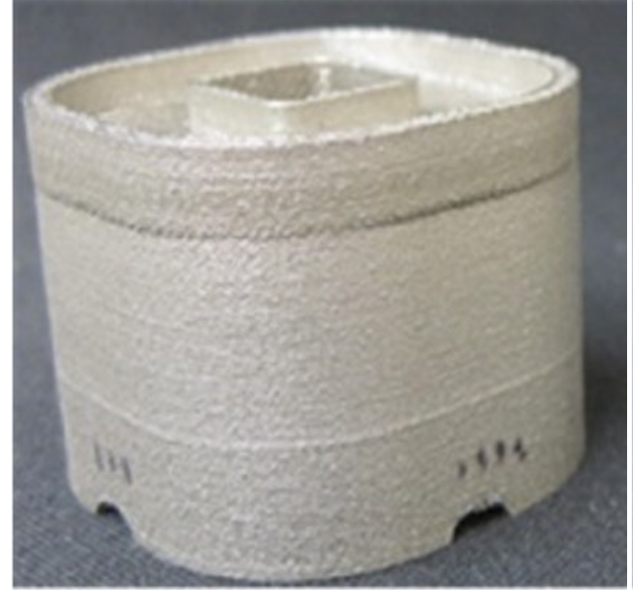
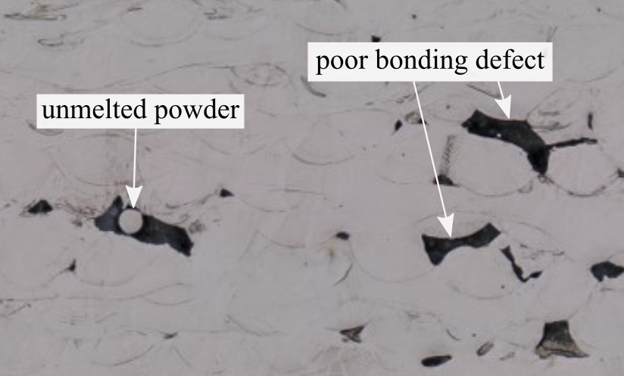
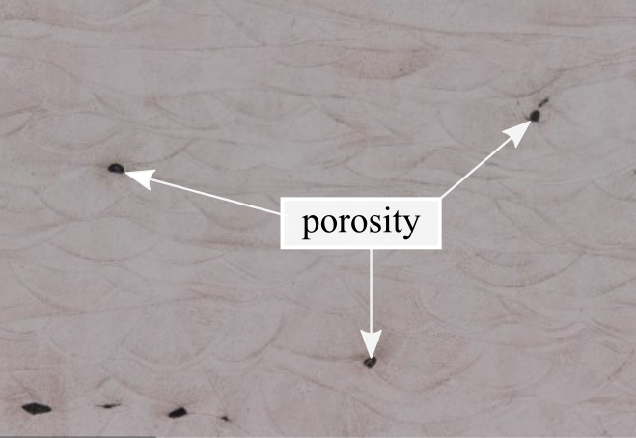
Defects in LPBF Manufacturing
Process instabilities can introduce internal and surface defects
Common defects include porosity, keyhole formation, and distortion
Surface roughness and lack of fusion affect mechanical properties
Detecting these defects during printing remains challenging
Surface roughness
Distortion
Keyhole
Porosity
5
Notes:
Key defects include keyhole, porosity, surface roughness, and distortion.
Keyhole formation, which happens when excessive laser energy causes deep vapor cavities, weakening the structure. Porosity, which occurs when the melt pool is too shallow and insufficiently fused. Surface roughness and distortion, which degrade mechanical properties and often require post-processing.

Slide 6
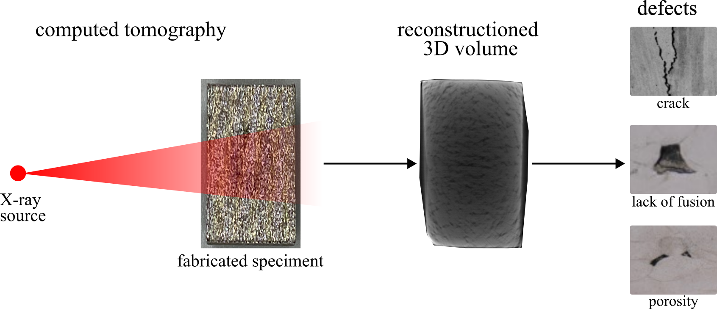
Challenges in LPBF Monitoring
Defects are typically identified after printing using XCT or microscopy
Post-process inspection is time-consuming and expensive
Limited ability to detect defects during fabrication
Real-time monitoring is needed for improved process control
fabricated specimen
reconstructed
3D volume
6
Notes:
One challenge is how to detect defects in the printing process. Existing approaches to LPBF defect detection rely on ex-situ methods, such as X-ray computed tomography and optical microscopy. These methods, while effective, are costly and time-consuming.

Slide 7
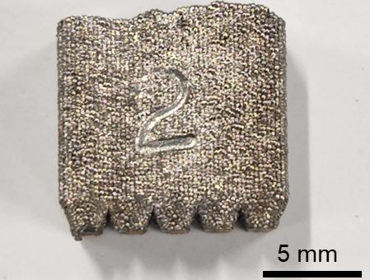
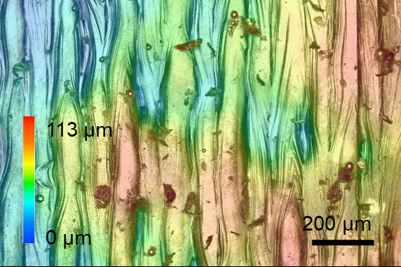
Surface Roughness
Surface roughness is a key indicator of part quality and performance
Strongly influenced by melt pool dynamics and spatter formation
Low energy input can cause discontinuities and incomplete melting
Excessive energy can create humps and unstable melt behavior
7
Notes:
Another challenge in LPBF is to get smooth surface roughness. melt pool stability and spatter control are key factors in achieving a smooth surface finish. Instabilities in the melt pool lead to excessive spatter, which in turn increases surface roughness and defects in the final part. Generally, Melt pool stability impacts the global surface roughness, since it dictates the overall uniformity of the layer deposition and the formation of defect. Spatter influences the local surface roughness – as individual spatter particles settle on specific areas, creating localized surface irregularities and defects.
Proper laser parameter tuning, powder bed cleanliness, and optimized gas flow can mitigate these issues, leading to better surface quality and mechanical performance of printed components.

Slide 8
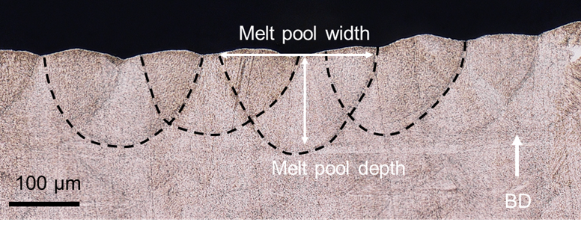
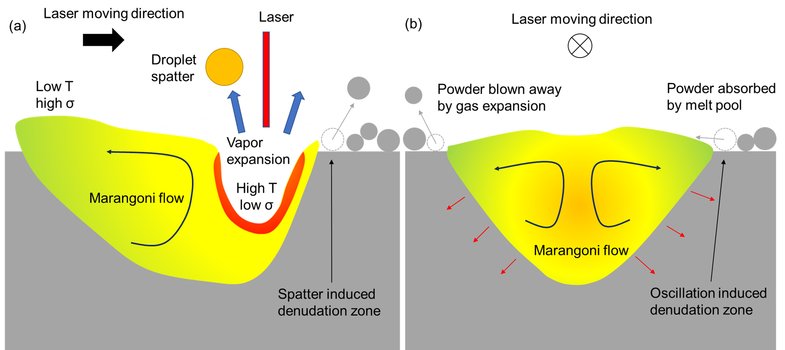
Melt Pool Stability and Spatter
Melt pool behavior directly affects layer quality
Stable melt pools produce smooth and continuous tracks
Instability leads to spatter ejection and irregular solidification
These effects increase surface roughness and defect probability
8
Notes:
Another challenge in LPBF is to get smooth surface roughness. melt pool stability and spatter control are key factors in achieving a smooth surface finish. Instabilities in the melt pool lead to excessive spatter, which in turn increases surface roughness and defects in the final part. Generally, Melt pool stability impacts the global surface roughness, since it dictates the overall uniformity of the layer deposition and the formation of defect. Spatter influences the local surface roughness – as individual spatter particles settle on specific areas, creating localized surface irregularities and defects.
Proper laser parameter tuning, powder bed cleanliness, and optimized gas flow can mitigate these issues, leading to better surface quality and mechanical performance of printed components.

Slide 9
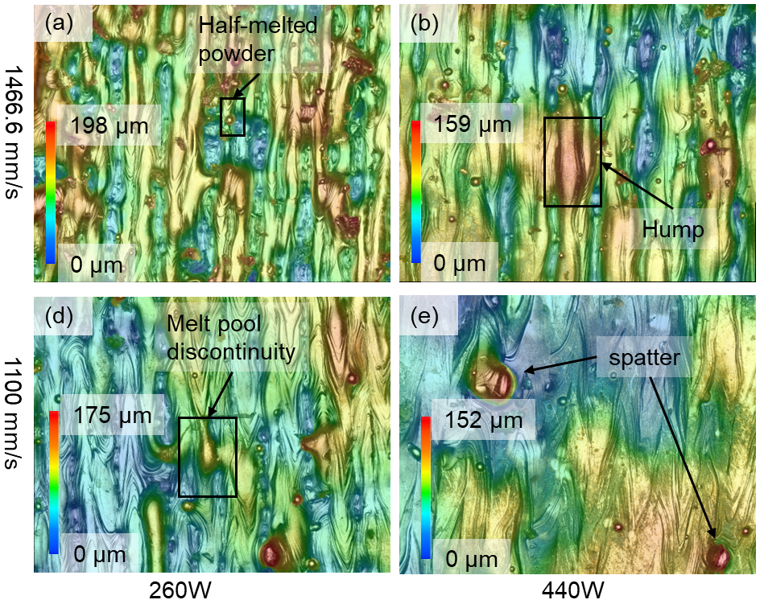
Impact of Laser Power on Surface Quality
Low laser power leads to melt pool discontinuities and track gaps
Moderate power improves melt pool continuity and surface finish
High power can produce spatter and hump formation
Optimizing laser power is critical for consistent surface quality
Eliminating melt pool discontinuities, valleys, and spatter improves the top surface quality.
9
Notes:
surface roughness is determined by different features under different printing conditions. As shown in the figure, Top surface roughness is dominated by melt pool discontinuity and valleys between melt tracks at 260 W condition. With power increasing, the disappear of melt pool discontinuity and valley leads to the smoother top surface. Top surface roughness is dominated by hump and spatter at 620 W condition. Eliminating melt pool discontinuities, valleys, and spatter improves the top surface quality.

Slide 10
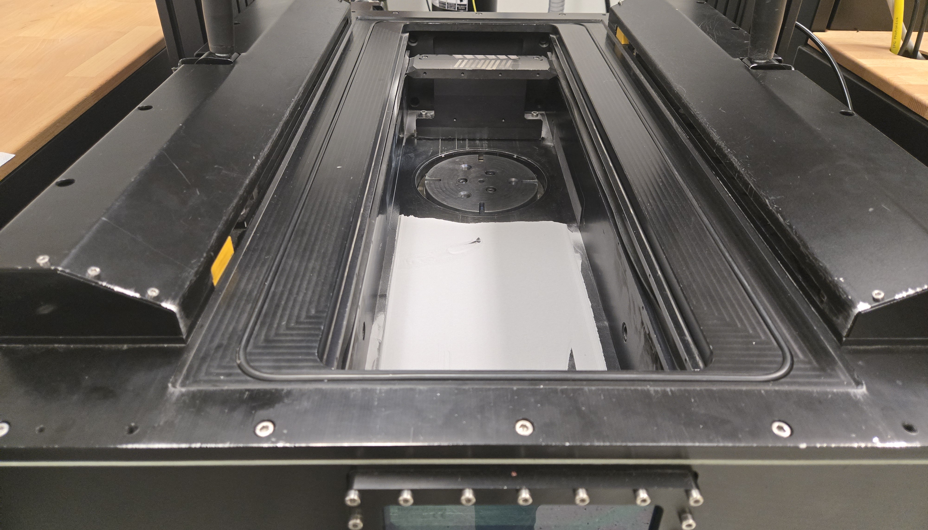
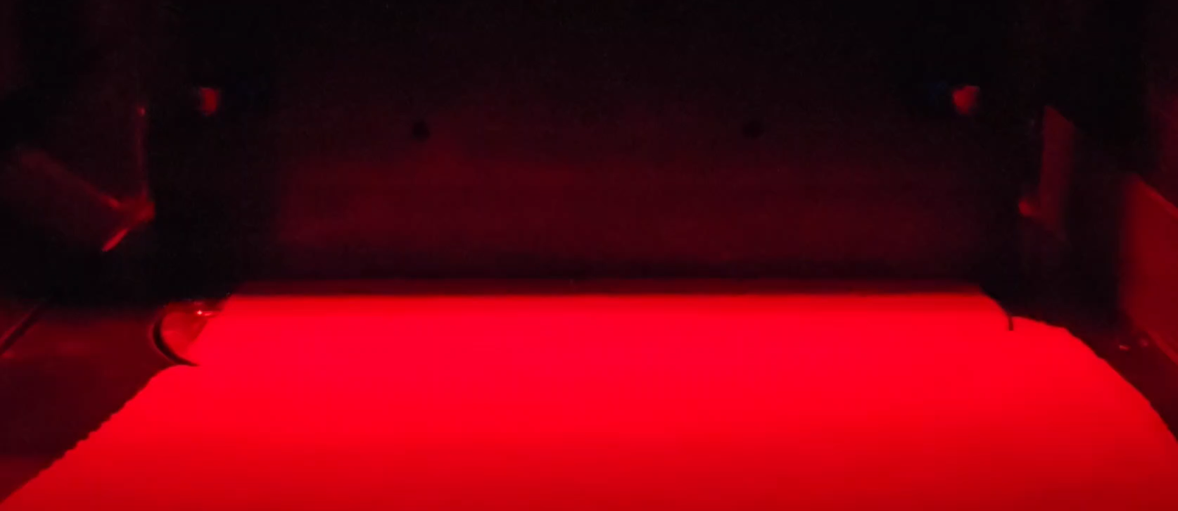
LPBF Printing Chamber Environment
Printing occurs in a controlled atmosphere chamber
Inert gases (e.g., argon) prevent oxidation of reactive materials
Vacuum conditions are relevant for space-based welding
Optical access must maintain sealing and laser safety

Slide 11
Prior Work on In-Situ Process Monitoring

Slide 12
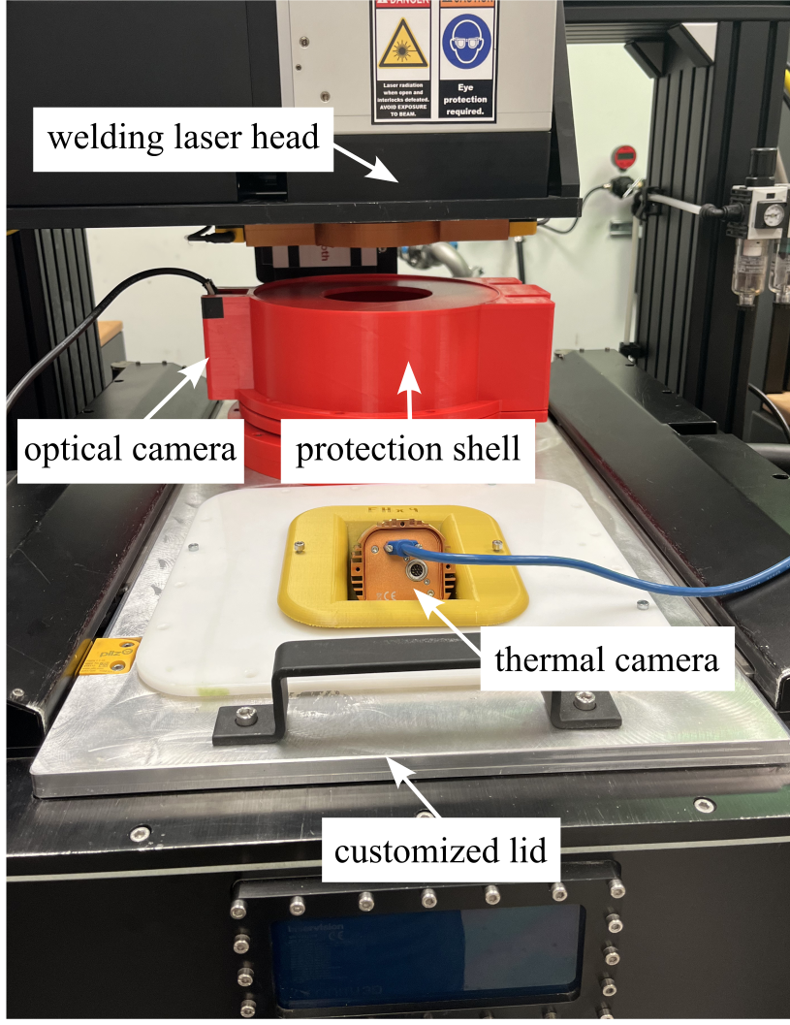
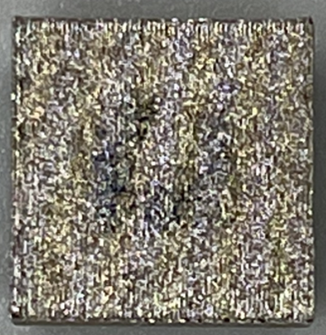
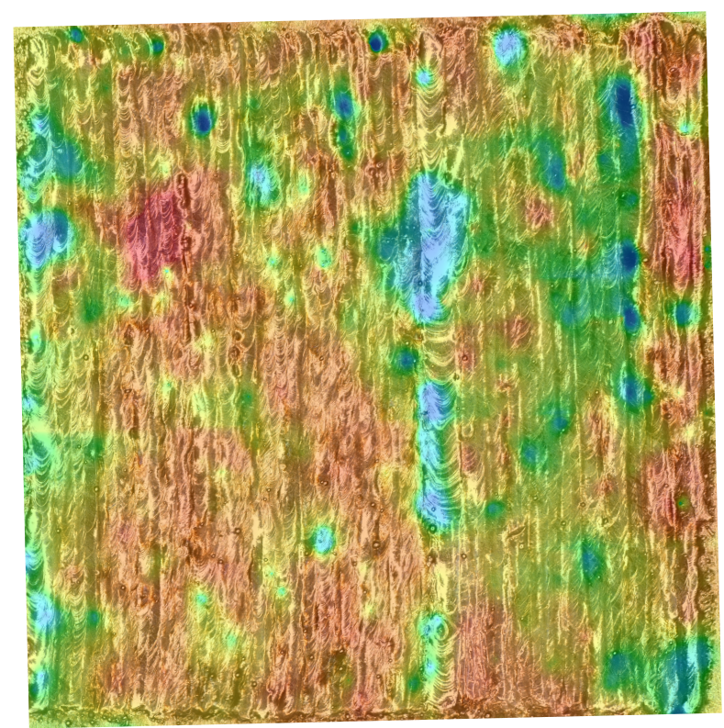
Experimental Setup for LPBF Process
LPBF system instrumented with optical and thermal imaging
Controlled build using 316L stainless steel samples
Part: 10 mm × 10 mm
Material: 316L stainless steel
Printing parameters:
  Laser power: 200 W
  Scan speed: 100 mm/s
  Laser spot size: 100 μm
  Hatch distance: 100 μm
12
Notes:
We conducted experiments using a 10 mm x 10 mm test part fabricated from 316L stainless steel powder on an LPBF printer. Printing parameters are listed here.
Two cameras (FLIR Blackfly optical camera and Workswell Infrared Camera) are used to capture printing images in real-time at 100 and 60 frames per second, respectively. Notes that only optical images are utilized in this study.

Slide 13

Imaging of LPBF Welding Process
Captured using a FLIR Blackfly USB optical camera (1440 × 1080 resolution, 100 fps).
Tracks melt pool, plume, and spatter dynamics in real-time.
MidOpt BP660 bandpass filter (640-680 nm) enhances imaging clarity.
13
Notes:
Here is the printing process.

Slide 14
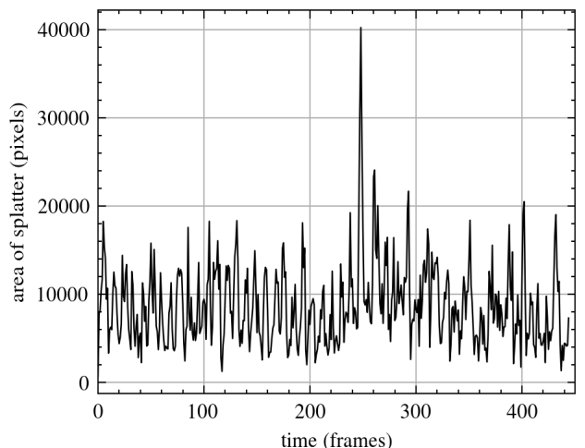
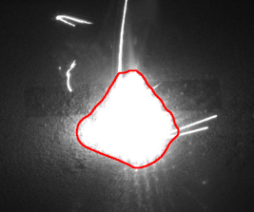
Real-Time Weld Feature Tracking
Image processing used to track the weld/plasma region
Tracks properties such as area, intensity, and motion
Captures overall weld behavior, not limited to spatter alone
Enables real-time monitoring with reduced data complexity
Yanzhou Fu, Braden Priddy, Austin Downey, and Lang Yuan. Real-time splatter tracking in laser powder bed fusion additive manufacturing. In Norbert G. Meyendorf, Ripi Singh, and Christopher Niezrecki, editors, NDE 4.0, Predictive Maintenance, Communication, and Energy Systems: The Digital Transformation of NDE. SPIE, apr 2023. doi:10.1117/12.2658544

Slide 15
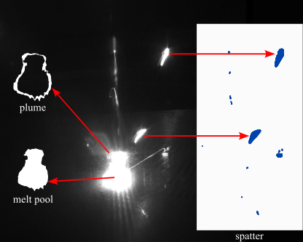
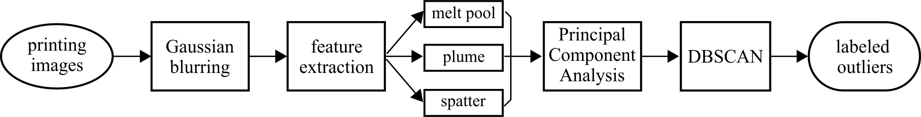
Feature-Based Process Monitoring
Multiple features extracted: melt pool, plume, and spatter
Image preprocessing improves feature segmentation
Dimensionality reduction (PCA) captures key process variations
Enables data-driven analysis of printing behavior
15
Notes:
The flowchart of outlier detection is showing here. After the images are captured, the Image preprocessing techniques such as: Contrast enhancement, Gaussian blurring, were applied to extract relevant process features.
Six key metrics were computed, which are melt pool intensity and area, plume intensity and area, and spatter intensity and area.
The Principal Component Analysis (PCA) is used to reduce data dimensionality while preserving key process variations then DBSCAN clustering is Used to classify printing conditions and detect outliers indicative of defect formation.
The figure above shows the extracted features from one of the frames.

Slide 16
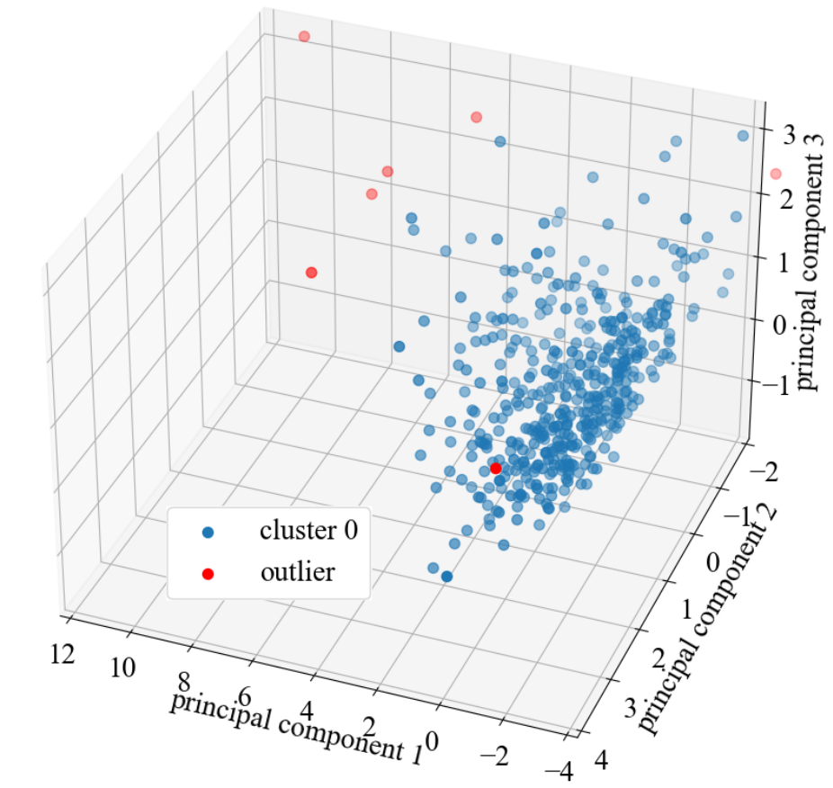
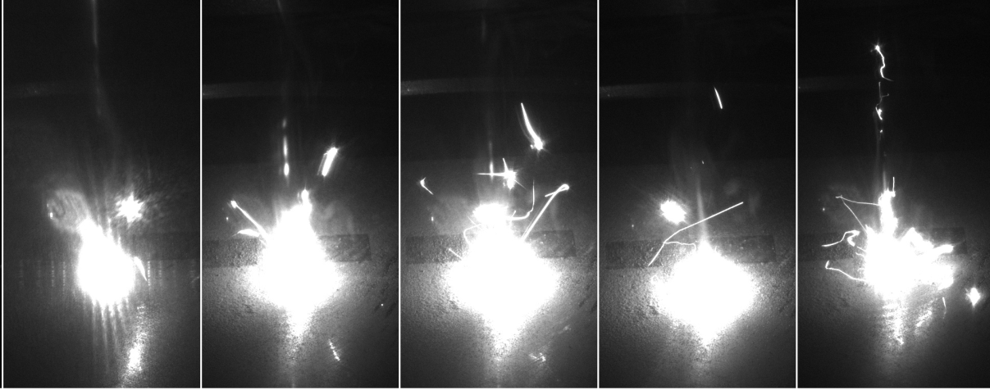
Unsupervised Defect Detection (DBSCAN)
DBSCAN clustering separates normal and abnormal process states
Outliers correspond to potential defect formation
No labeled data required for training
Demonstrates potential for real-time anomaly detection
Yanzhou Fu, Matthew Whetham, Austin R. J. Downey, Lang Yuan, and Gurcan Comert. A study of online melt pool, plume, and spatter tracking in laser powder bed fusion using DBSCAN. In Christopher Niezrecki and Saman Farhangdoust, editors, Digital Twins, AI, and NDE for Industry Applications and Energy Systems 2025, page 21. SPIE, May 2025. doi:10.1117/12.3051110
16
Notes:
DBSCAN was applied to 445 frames from the last printed layer. In the figure, each dot represents one frame, the blue dots are the normal frames, and red dots are the clustered outliers. The clustering results were visualized in 2D and 3D space, showing clear distinctions between normal and potential defective frames.

Slide 17
Camera Module Design for Inter-layer LPBF Monitoring

Slide 18
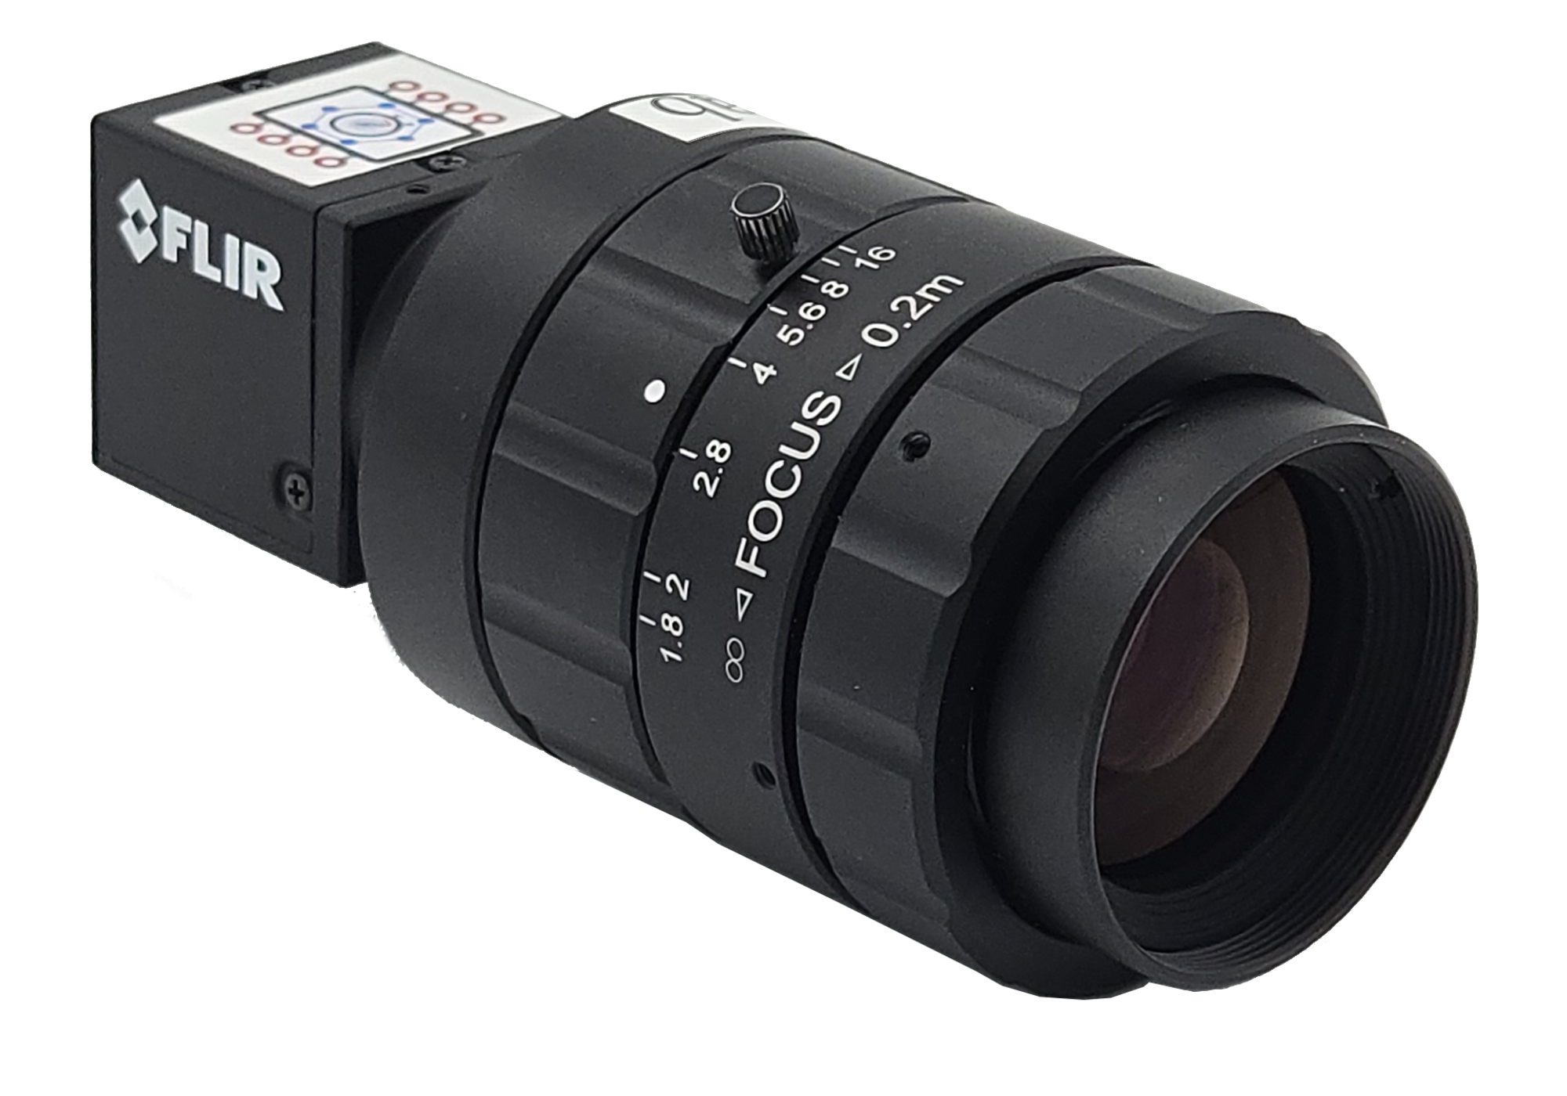
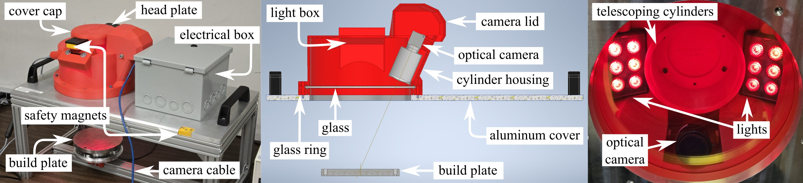
Optical Camera System
FLIR Blackfly camera, 20 MP resolution
USB 3.0 interface, 1" monochrome sensor
35 mm/F1.8 Edmund Optics lens
660 nm bandpass filter, red LED illumination at 625 nm
18
Notes:
surface roughness is determined by different features under different printing conditions. As shown in the figure, Top surface roughness is dominated by melt pool discontinuity and valleys between melt tracks at 260 W condition. With power increasing, the disappear of melt pool discontinuity and valley leads to the smoother top surface. Top surface roughness is dominated by hump and spatter at 620 W condition. Eliminating melt pool discontinuities, valleys, and spatter improves the top surface quality.

Slide 19
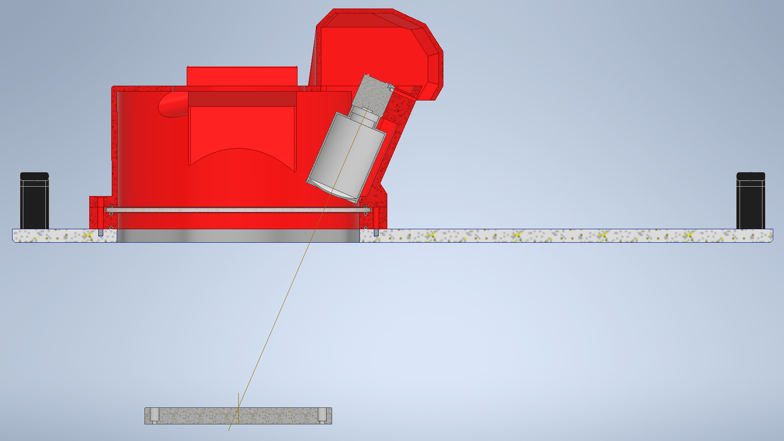
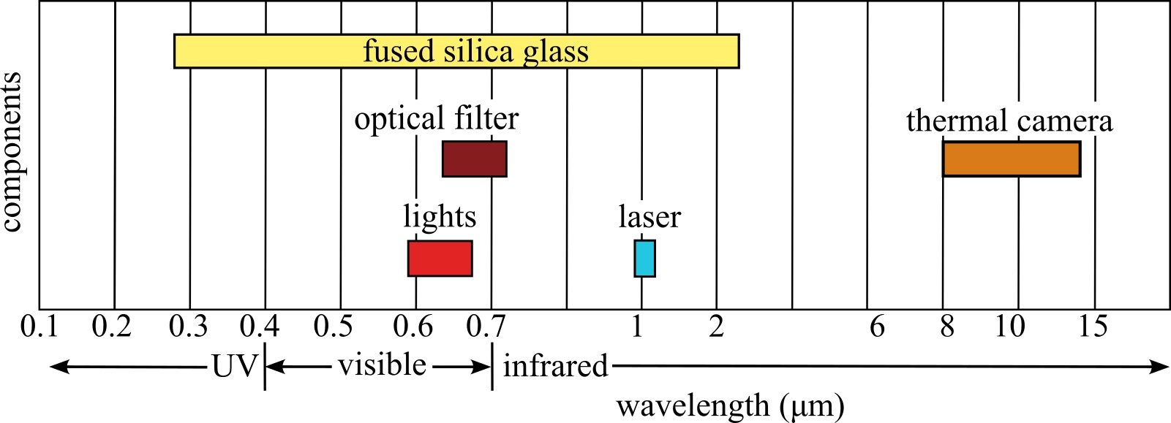
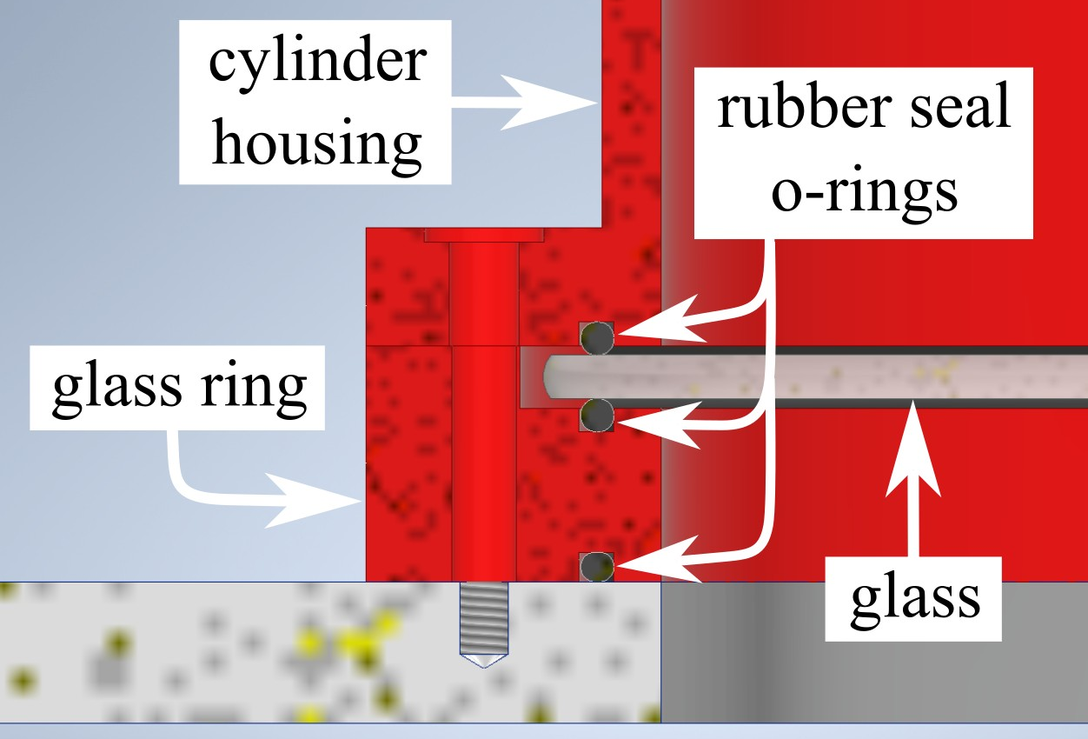
Sealed Chamber Design
Stable argon gas environment for printing
Chamber compatible with vacuum conditions if needed
Sealing achieved with greased rubber o-rings
19
Notes:
surface roughness is determined by different features under different printing conditions. As shown in the figure, Top surface roughness is dominated by melt pool discontinuity and valleys between melt tracks at 260 W condition. With power increasing, the disappear of melt pool discontinuity and valley leads to the smoother top surface. Top surface roughness is dominated by hump and spatter at 620 W condition. Eliminating melt pool discontinuities, valleys, and spatter improves the top surface quality.

Slide 20
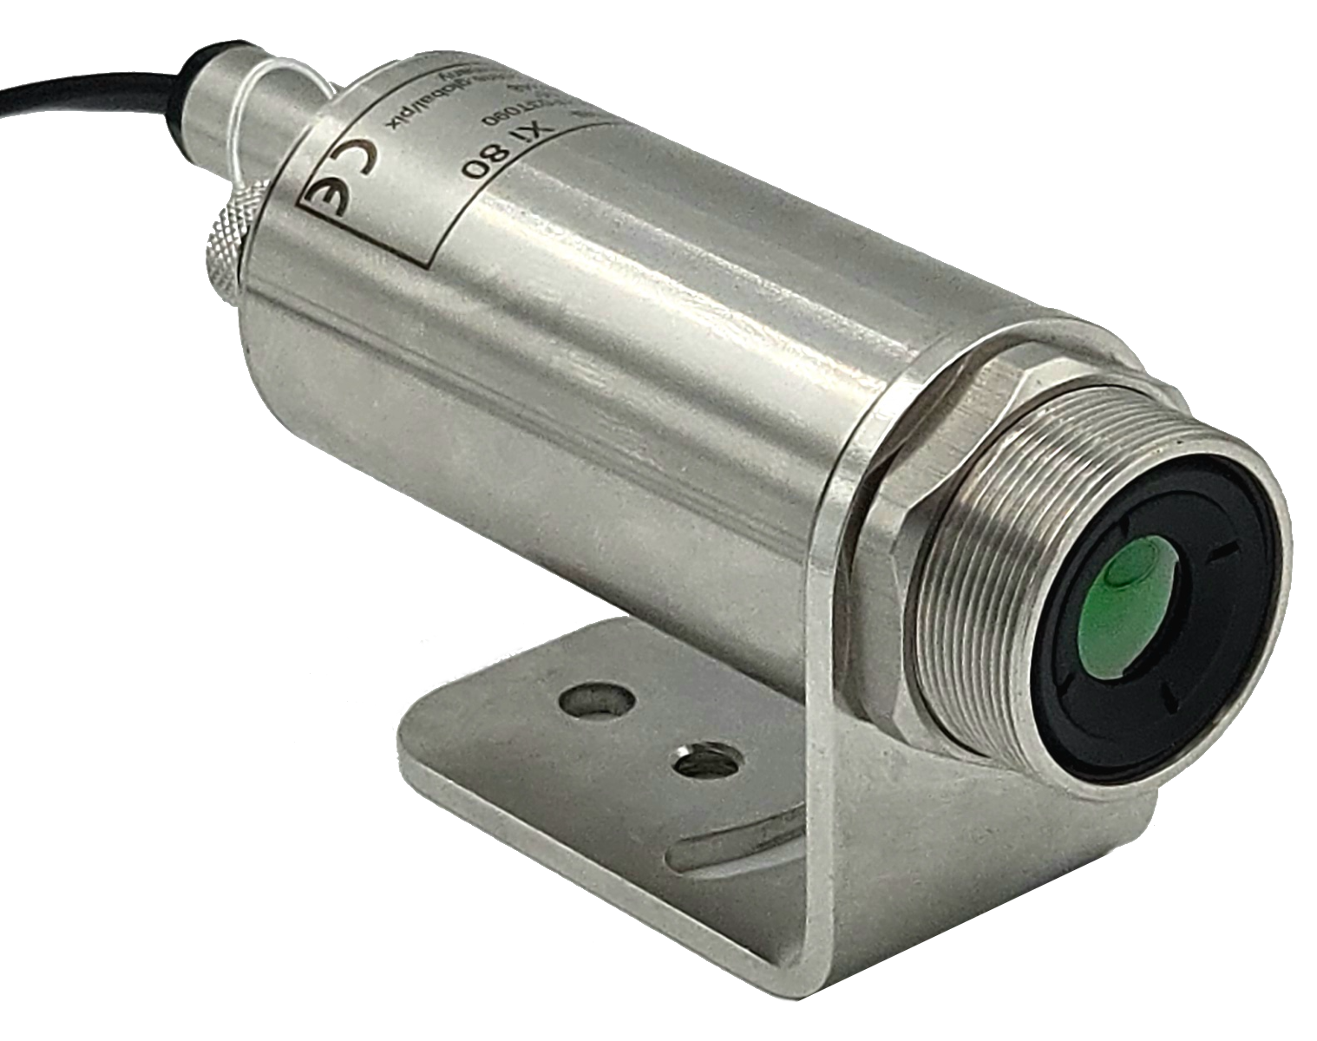
Thermal Camera System
Optris Xi 400, 382 × 288 pixels
80 fps video, 18° × 14° field of view
Digital focal depth control, USB communication via PIX Connect software
20
Notes:
surface roughness is determined by different features under different printing conditions. As shown in the figure, Top surface roughness is dominated by melt pool discontinuity and valleys between melt tracks at 260 W condition. With power increasing, the disappear of melt pool discontinuity and valley leads to the smoother top surface. Top surface roughness is dominated by hump and spatter at 620 W condition. Eliminating melt pool discontinuities, valleys, and spatter improves the top surface quality.

Slide 21
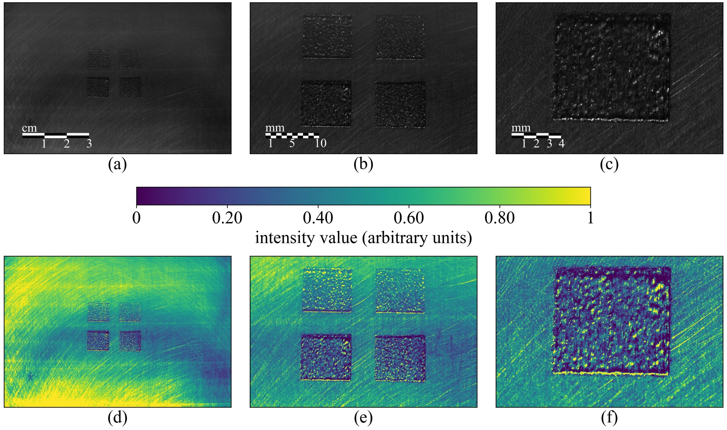
Inter-Layer Optical Imaging
Captures the build surface after each layer is deposited
Observes melt tracks, surface morphology, and spatter distribution
Monochrome imaging enhances contrast of surface features
Enables layer-by-layer assessment of build quality
10 mm
2 mm
21
Notes:
surface roughness is determined by different features under different printing conditions. As shown in the figure, Top surface roughness is dominated by melt pool discontinuity and valleys between melt tracks at 260 W condition. With power increasing, the disappear of melt pool discontinuity and valley leads to the smoother top surface. Top surface roughness is dominated by hump and spatter at 620 W condition. Eliminating melt pool discontinuities, valleys, and spatter improves the top surface quality.

Slide 22
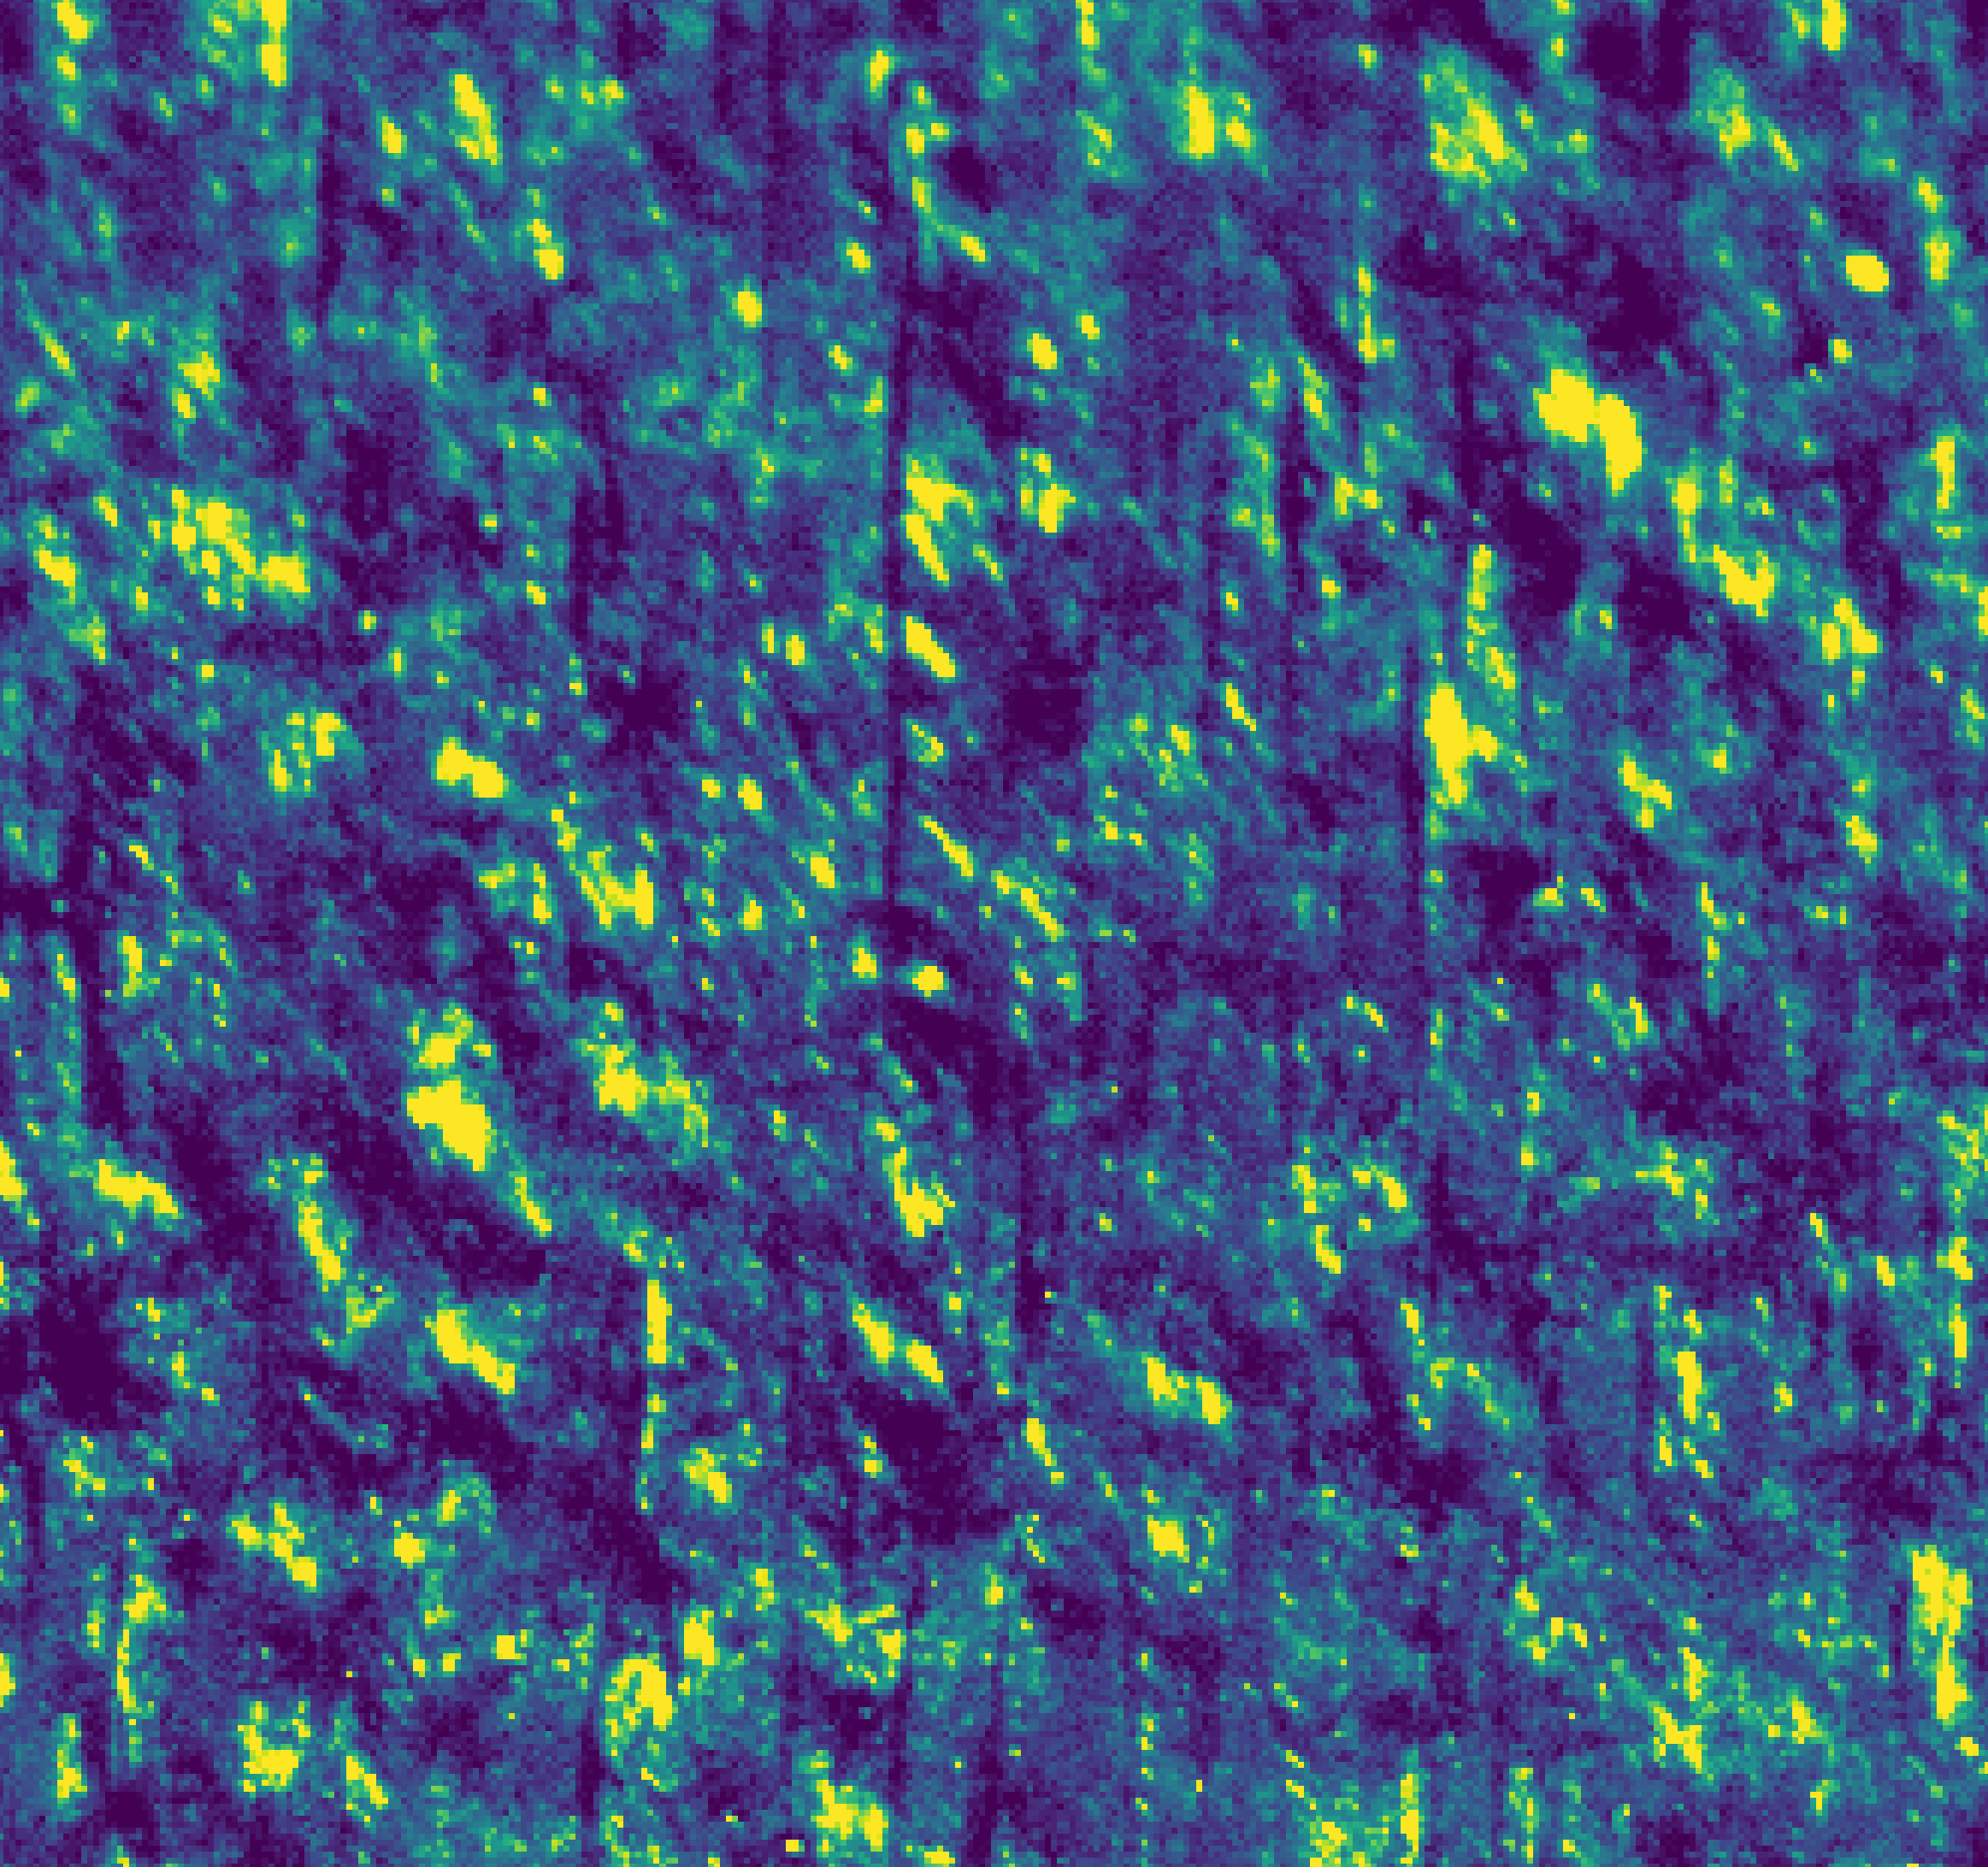
Optical Imaging Resolution
Sample width: 10 mm field of view
Spatial resolution: ~50 pixels per mm (20 μm per pixel)
Individual melt tracks ~15 pixels wide (~300 μm)
Resolution sufficient to capture fine surface and track features
1 mm
22
Notes:
surface roughness is determined by different features under different printing conditions. As shown in the figure, Top surface roughness is dominated by melt pool discontinuity and valleys between melt tracks at 260 W condition. With power increasing, the disappear of melt pool discontinuity and valley leads to the smoother top surface. Top surface roughness is dominated by hump and spatter at 620 W condition. Eliminating melt pool discontinuities, valleys, and spatter improves the top surface quality.

Slide 23
Thermal Imaging Insights
Thermal images show relative energy distribution in welds
Absolute temperature is qualitative due to window attenuation
Identifies melt pool stability and cooling behavior
Used to detect anomalies during the build
23
Notes:
surface roughness is determined by different features under different printing conditions. As shown in the figure, Top surface roughness is dominated by melt pool discontinuity and valleys between melt tracks at 260 W condition. With power increasing, the disappear of melt pool discontinuity and valley leads to the smoother top surface. Top surface roughness is dominated by hump and spatter at 620 W condition. Eliminating melt pool discontinuities, valleys, and spatter improves the top surface quality.

Slide 24


ACKNOWLEDGEMENT
This research was supported by the United States’ National Science Foundation (NSF), USA, Grants Nos. CCF-2503055, and CPS-2237696. This work is also partially supported by the National Institute of Standards & Technology, United States, under grant number 70NANB23H030, as well as the South Carolina Space Grant Consortium under grants 21-117-RID RGP-SC-009, 25-073-REAP-SC-001, and 25-073-BTC-SC-001. Additional support is provided by the United States’ National Science Foundation (NSF) through the NSF ASEE Fellowship

Slide 25

Discussion
In Situ Monitoring of Powder Bed Fusion Additive Manufacturing
https://github.com/ARTS-Laboratory/In-situ-monitoring-of-powder-bed-fusion-additive-manufacturing
Author Information
Name: Austin R.J. Downey
Email: austindowney@sc.edu
Lab GitHub: github.com/arts-laboratory

