Slide 1

Traceable Retrieval and Citation Engine (TRACE)
Toward a high-trust, locally deployed scientific agent
Thienan Hoang and Austin R.J. Downey and Kerry Sado

Slide 2
A High-Trust Scientific Agent
An agent that reads our papers, reports, and data, then answers with sources
High trust = traceable and repeatable
  Same question, same cited answer, today and decades from now
We build it ourselves so we know what every step does
  Parser, database, model, and tools are all inspectable
Cites its sources
Every claim links to the document, page, and verbatim text
Parses science faithfully
Tables, figures, equations, and references survive ingestion
Frozen and local
Same weights, same answer. No vendor can change the model on us
Notes:
Three pillars. One: every answer cites the exact source text. Two: the parser keeps scientific content intact, including tables and equations. Three: the model runs locally and is frozen, so nobody changes it on the back end. For a repository program, defensibility over decades matters more than raw benchmark performance.

Slide 3
Packaged to Run for Decades
One container holds everything
  Model weights, runtime, parsers, database, agent code
Pinned versions, fixed seed, zero temperature
  Same query, same answer
Archive it with the project record
  Reopen and rerun in 10 to 20 years
Live web tools stay outside the archive
Archived container e.g., Docker or Apptainer image
Agent code + tool definitions
Nemotron 3.5 Lightning weights (30B MoE)
Ollama runtime + Python environment
Marker + Docling parsers
ChromaDB: source documents + vectors
Live external tools search, news, weather. Not archived.
Notes:
Because everything runs locally, the whole stack can be frozen into one container image and archived with the project record. Someone can reopen it in 10 or 20 years and rerun the same question. Caveat to state honestly: tool calls that hit the live internet (web search, news, weather) cannot be archived, so they are fenced off from the archival core. Also, bit-identical output needs the same hardware class; GPU floating-point can differ slightly across hardware, so we pin seed and temperature and verify reruns.

Slide 4
Vector Databases in One Slide
“Docling parses 1.27 pages/s on an M3 Max”
[0.12, −0.83,
0.45, 0.31,
…, 0.07]
Documents are split into short text chunks
An embedding model turns each chunk into a vector
  A list of hundreds of numbers that encodes meaning
Similar meaning lands close together
A question is embedded the same way and matched to its nearest chunks
embed
Meaning space (2-D sketch)
parser benchmarks
lab handbook
question → 3 nearest chunks
digital twins
Notes:
Plain-language primer. Each chunk of text becomes a vector, a long list of numbers that encodes its meaning. Chunks about similar things end up near each other. When you ask a question, it is converted the same way and the database returns the nearest chunks. That nearest-neighbor lookup is what the agent's query_collection tool does.

Slide 5

Build Once, Then Freeze
Build runs once, compute-heavy
Build runs once
  Gather, parse, chunk, embed, write
Freeze the database, read-only from then on
Query runs on every question
  Reads the database, never writes
The embedding model is frozen with it
New documents mean a new versioned snapshot
1
Gather documents
2
Parse with Marker or Docling
3
Chunk the text and embed each chunk
4
Write documents and vectors to ChromaDB
Freeze as versioned snapshot v1.0
Query every question, read-only
Question
Nearest chunks
Cited answer
Reads the snapshot. Nothing writes back.
Notes:
Two phases. Build runs once: gather the documents, parse them with Marker or Docling, chunk and embed the text, and write documents plus vectors into ChromaDB. That is the compute-heavy step. Then we freeze it as a versioned snapshot. From then on, every question only reads the snapshot; nothing writes back. The embedding model has to be frozen with the database, because new questions must be embedded into the same vector space as the stored chunks. Adding documents produces a new snapshot, v1.1, and v1.0 stays rerunnable, so any past answer can be reproduced exactly.

Slide 6


RAG
Document Classifier
  To determine parser and profile to use for optimal system resource usage and time.
Marker and Docling
  Parsing engines
  Can parse multiple formats
    PDF, DOCX, CSV, PPTX, XLSX
  Both capable of OCR
    Docling: EasyOCR
    Marker: Surya
  Marker for scientific papers and Docling for general documents.
https://github.com/datalab-to/marker.git
https://github.com/docling-project/docling.git

Slide 7
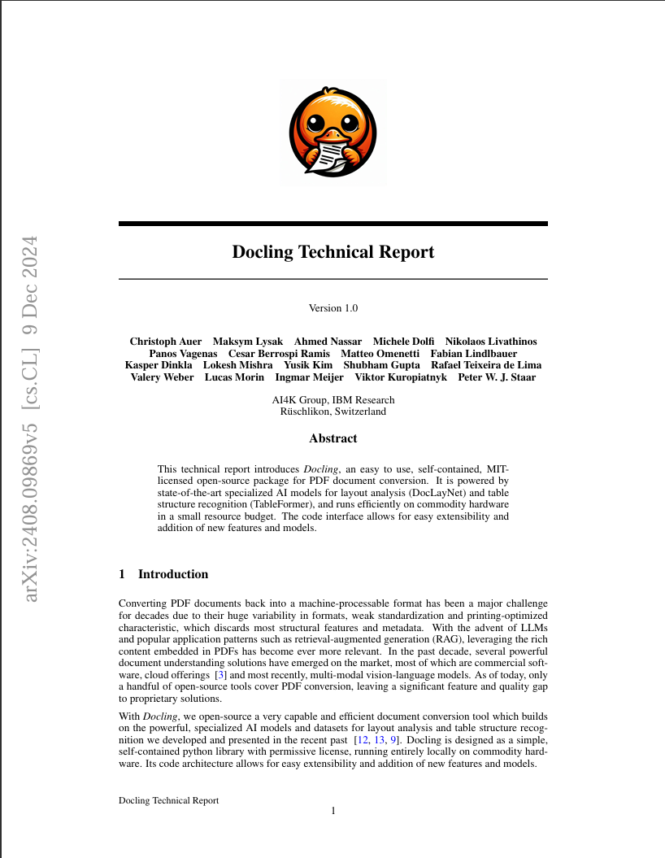
Parsing Docling
Current capabilities
  Pulls text, images, and tables.
  Identification of object type via optical character recognition.
    Table, images, captions, body text, Formulas etc.
Example document: Docling Technical Report
Auer, Christoph, et al. “Docling Technical Report.” arXiv, 2024, https://doi.org/10.48550/arXiv.2408.09869.

Slide 8
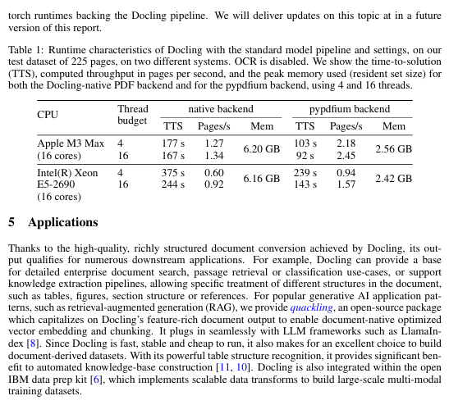
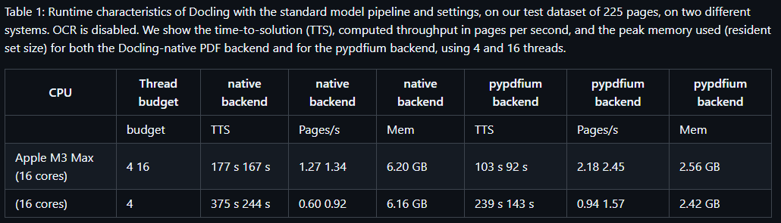
Docling Feature extraction (tables)
Parsing of tables
  Will preserve table header if table exceeds chunk size for maintaining semantic

Slide 9
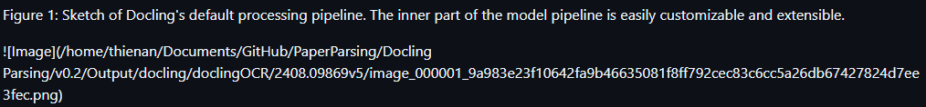
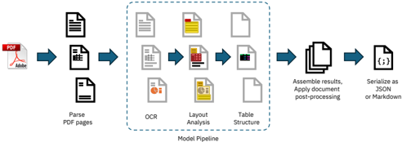
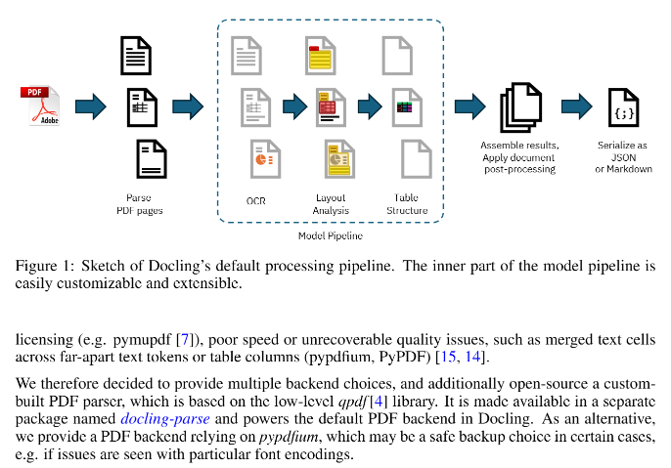
Docling Feature extraction (images)
Image Extraction
  Image object extracted via pipeline
  Provides a uniform resource identifier (URI) to link image to parsed output.

Slide 10
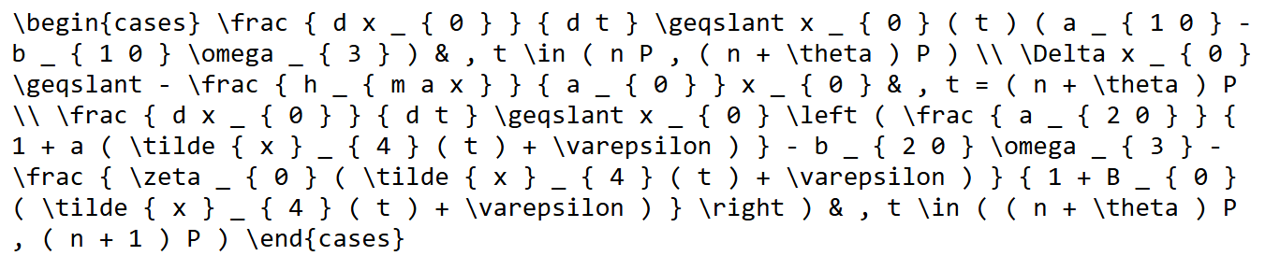
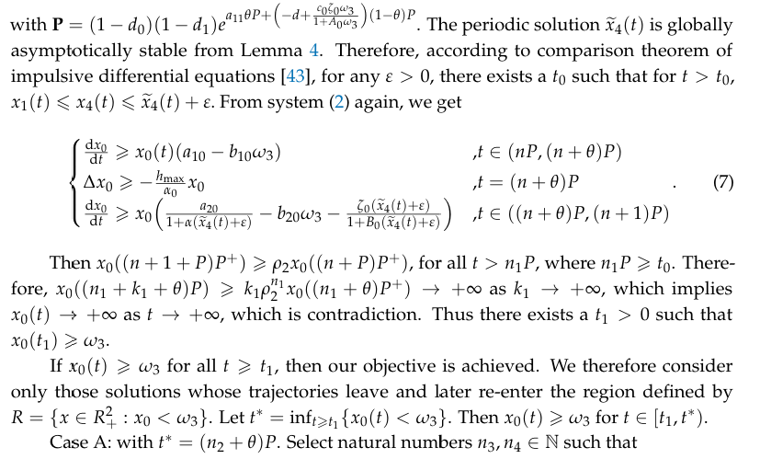
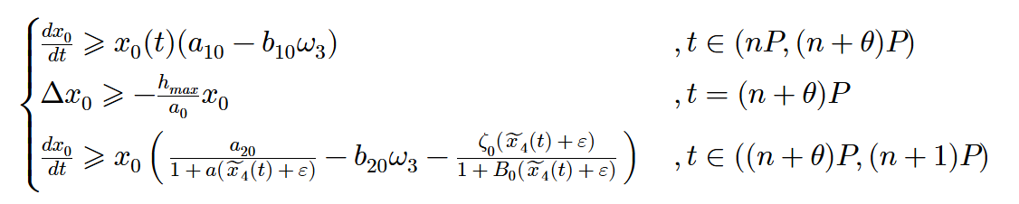
Docling Feature extraction (formulas)
Formula extraction
  Outputs in LaTeX format.
Gao, Bingying, et al. “Dynamics of a Fishery Management Model with Predation-Induced Fear Effect, Impulsive Nonlinear Harvesting Prey and Predator Seasonally Migrating Between Two Patches.” Axioms, vol. 15, no. 1, 2026, article 32, https://doi.org/10.3390/axioms15010032

Slide 11
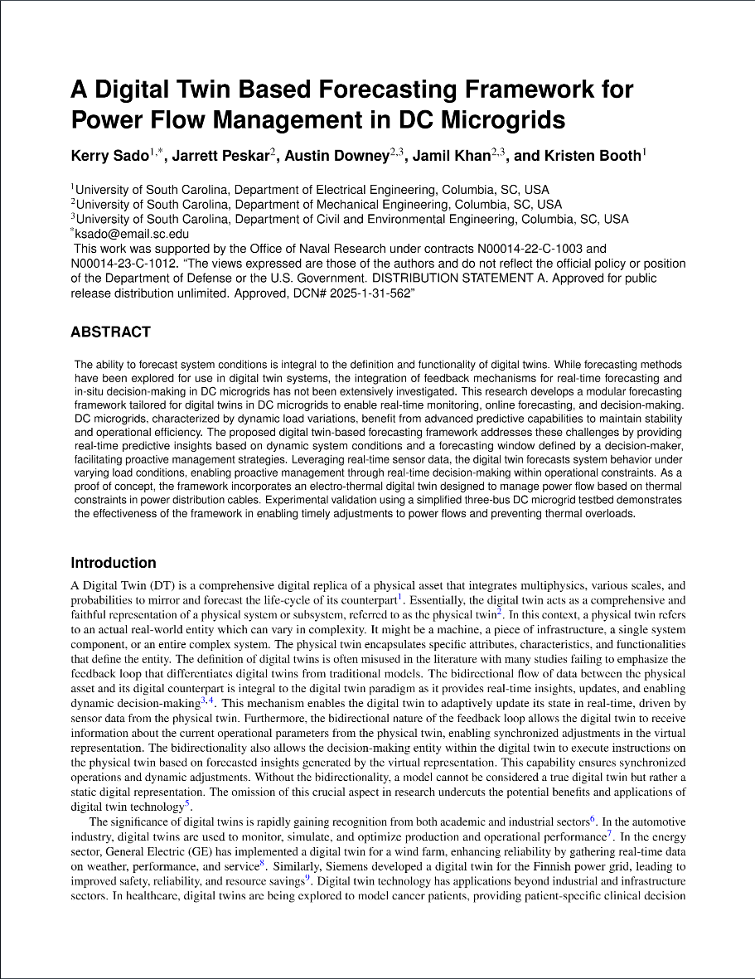
Parsing Marker
Largely same capabilities as Docling
  More expensive, but better accuracy.
Example document: A Digital Twin Based Forecasting Framework for Power Flow Management in DC Microgrids
Sado, Kerry, et al. “A Digital Twin Based Forecasting Framework for Power Flow Management in DC Microgrids.” Scientific Reports, vol. 15, 2025, article 6430, https://doi.org/10.1038/s41598-025-91074-0.

Slide 12
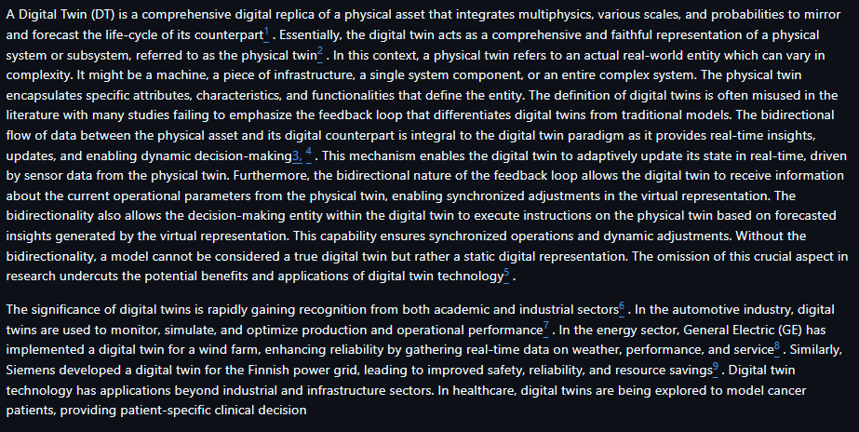
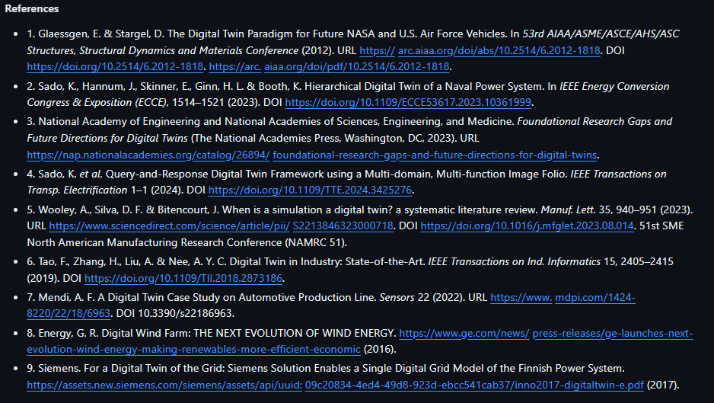
Marker Feature Extraction (in text citations)
Linking in-text citations to the references section
  Largely dependent on the document itself. (garbage in, garbage out)

Slide 13
What Our Database Stores
Vector machines read | Text chunk we read | Source we read
[0.12, −0.83, 0.45, …] | “A Digital Twin (DT) is a comprehensive digital replica of a physical asset…” | Sado et al. 2025, p. 1
[−0.31, 0.08, 0.92, …] | “Docling … runs efficiently on commodity hardware in a small resource budget.” | Auer et al. 2024, p. 1
[0.55, 0.17, −0.40, …] | “The periodic solution … is globally asymptotically stable from Lemma 4.” | Gao et al. 2026, near Eq. (7)
A normal database stores documents
Ours stores documents and vectors
The machines read the vectors
  Vectors find the relevant passage
We read the documents
  Original text, source, and page are stored verbatim
Each record keeps its vector, its original text, and where it came from. Nothing is dissolved into the model.
Notes:
Key message for a non-specialist audience. A normal database stores documents. Ours stores documents and vectors side by side. The machines read the vectors to find the right passage. We read the documents. The original sentences, the source, and the page travel with every vector, which is exactly what makes citation and auditing possible.

Slide 14
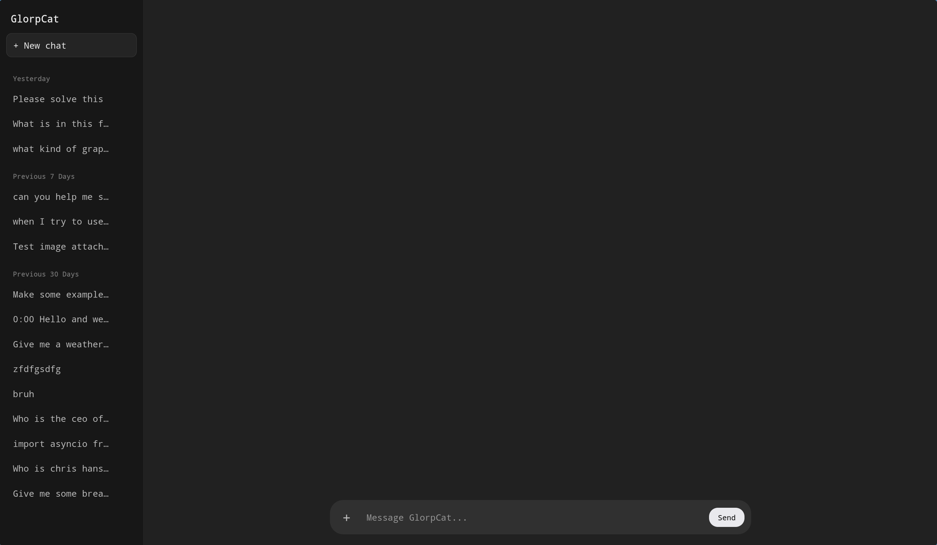
Agent
Current Model: Nemotron 3.5 Lightning
  30 billion parameter mixture of experts model (MoE)
  Model hosted through Ollama via Python
  Browser UI
  Tool Calling:
    get_collections
    query_collection
    get_time
    get_weather
    search_text
    search_images
    search_news
    search_videos
    search_books
    extract_content
    sequentialthinking

Slide 15
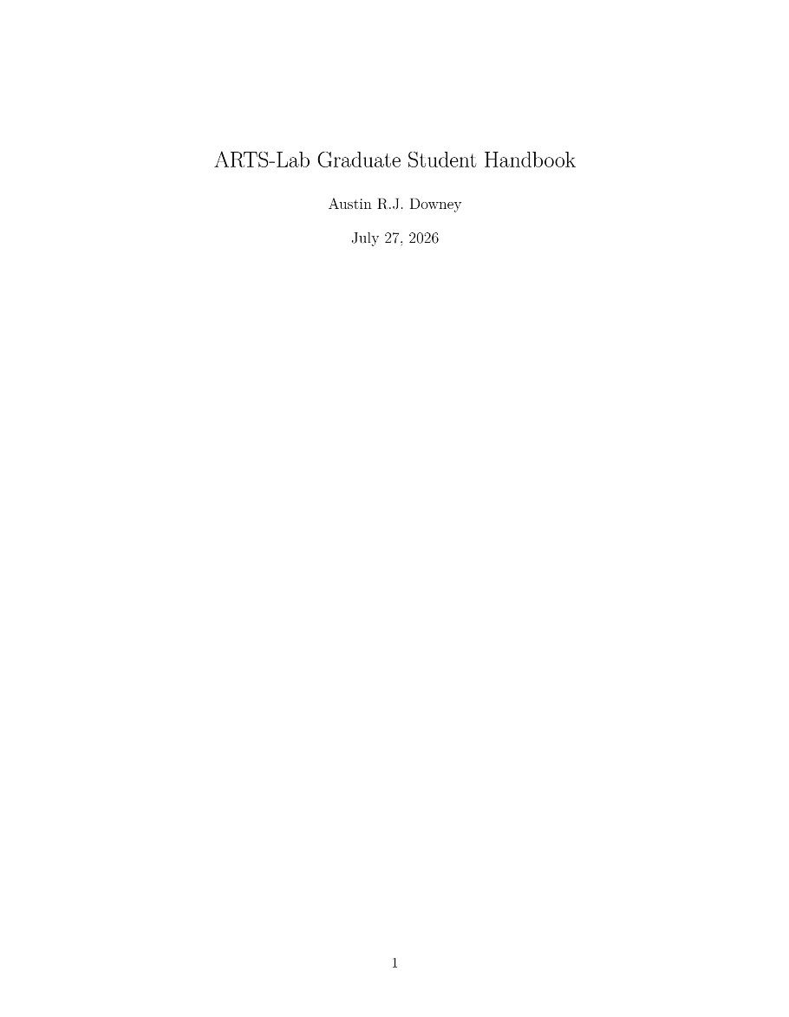
Retrieval
Retrieval of documents is based on tool use.
  Get_collections
    Checks what collections exist
  Query_collection
    Query collection
Example document: arts_lab_graduate_handbook
Downey, Austin R. J. ARTS-Lab Graduate Student Handbook. 27 July 2026.

Slide 16

Overall Results
Performance:
Total Prompt Tokens (tokens): | 144285 | Average Prompt Speed (tok/s): | 3111.16 | Average Query Time (s): | 0.18
Total Generated Tokens (tokens): | 16766 | Average Generation Speed (tok/s): | 49.97 | Average Response Time (s): | 26.62
Total Tokens: | 161051 | Average Generated Tokens (tokens): | 838 | Average Prompt Tokens (tokens): | 7,212
Questions:
1 | What do I need to graduate with a Ph.D.? | Pass | 11 | Compare M.S. vs. Ph.D. expectations | Pass
2 | What IDE does the lab recommend? | Pass | 12 | Summarize the software stack | Pass
3 | Can I work remotely? | Pass | 13 | Can I graduate if my funding runs out? | Pass
4 | Timeline for completing a Ph.D. | Fail | 14 | How should I spend my time at conferences? | Pass
5 | How should I structure my dissertation? | Fail | 15 | Why do I need a “making_figures” folder? | Pass
6 | What to do with figures in “making_figures”? | Pass | 16 | Font sizes in figures? | Pass
7 | Do I have to say hi to Dr. Downey at a conference? | Fail | 17 | Who do we work for? | Pass
8 | Expected version of M.S. thesis | Pass | 18 | What values does ARTS-Lab expect? | Pass
9 | Compare qualifier, proposal, final defense | Pass | 19 | What is LaTeX? | Pass
10 | How does cosine similarity work? | Pass | 20 | What is peer review? | Pass

Slide 17
Retrieval Versus Fine-Tuning
 | Fine-tuning | Retrieval (ours)
Knowledge lives in | Model weights | Readable documents
The model | Changed by training | Frozen, never changed
Cites its sources | No | Yes, every claim
Add a document | Retrain and revalidate | Add chunks, new snapshot
Remove a document | No clean way | Delete its chunks
Audit in 20 years | Inspect billions of numbers | Read the source text
Fine-tuning retrains the model on our documents
  Knowledge dissolves into the weights
Retrieval hands a frozen model an open book
  Documents stay readable, outside the model
Only retrieval can show what it used
Fine-tuning still helps with domain vocabulary and output style. The facts come from retrieval.
Notes:
Common question: why not just train the model on our documents? Fine-tuning bakes the knowledge into the weights. The model changes, nothing can be cited, adding a document means retraining and revalidating, and removing one cleanly is an open research problem. Retrieval keeps the model frozen and hands it the relevant passages at question time, like an open-book exam. The documents stay readable, every claim cites its chunk, and an auditor in 20 years reads text instead of weights. Fine-tuning can still be layered on for vocabulary or output format, but the facts should come from retrieval.

Slide 18

Scientific Merit and Publication
Contribution: a retrieval agent designed for high trust
Faithful scientific ingestion
  Papers to Marker, other documents to Docling
Provenance as the design target
  Every claim traces to a stored chunk
Frozen, offline, and edge-deployable
A trusted assistant for deployable digital twins
Notes:
The retrieval loop itself is established. The contribution is designing it for a constraint most systems ignore: answers that must stay traceable and repeatable for decades. Three design choices carry that: classifier-routed parsing so scientific content survives ingestion, provenance as the design target so every claim traces to a stored chunk, and a frozen, offline stack that can be deployed at the edge. IDETC fits because the framing is a deployable, high-trust assistant for digital twins. The paper is scored on four measurable properties: reproducibility across reruns, citation support, parsing fidelity against ground truth, and answer accuracy on expert-graded questions, with the handbook pilot at 17 of 20 as the baseline. Confirm the edge hardware and quantization before quoting specifics.

Slide 19
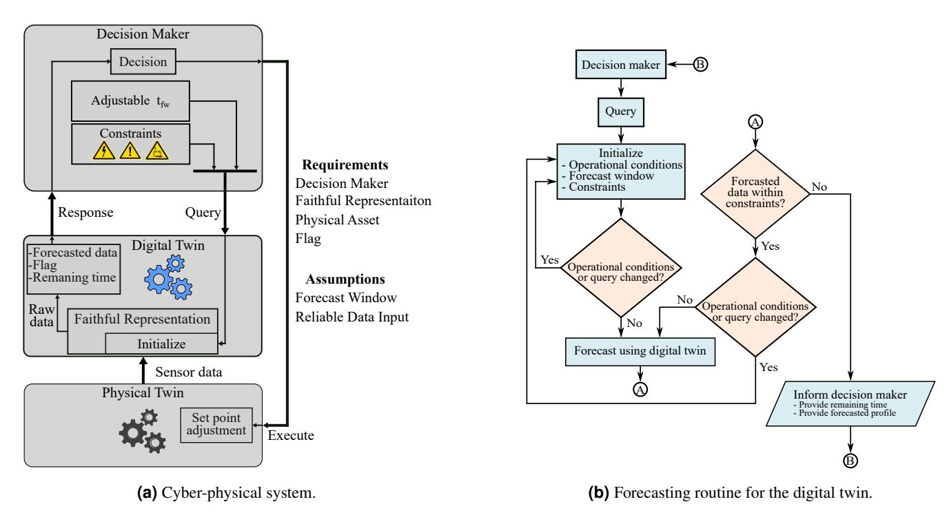
Other Applications
Due to tool use, agent can be used to control systems
  Such as digital twins
  Knowledge-based decision making
  Runs in an agent loop

Slide 20
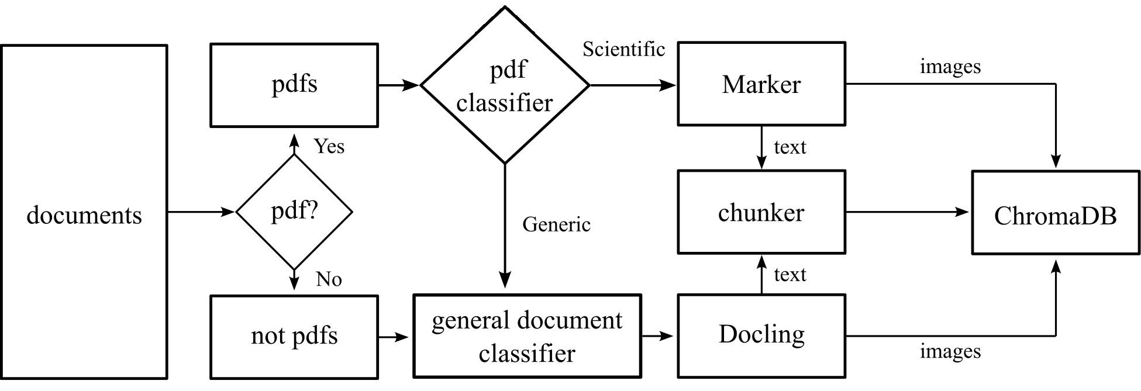
Pipeline
Notes:
Marker and

