Slide 1
RTML Meeting
Austin Downey

Slide 2
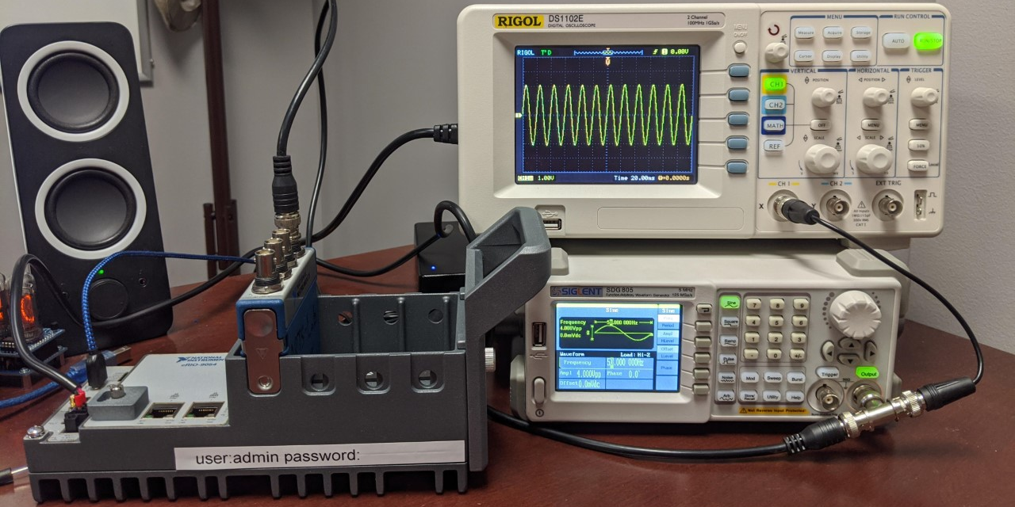
FFT running on FPGA
24-bit +/- 60v ADC with max rate of 50k S/s
1.33 GHz Dual-Core CPU, 4 GB Storage, Artix 7 100T FPGA

Slide 3
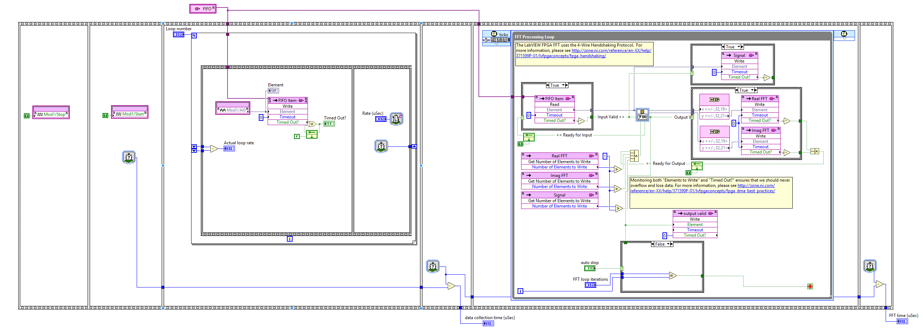
FFT running on FPGA
40 MHz clock
5-7 ticks / sample
Could use 1 tick / sample if needed
Limited to a FFT length of 8192 with current code, 65536 is max value otherwise.

Slide 4
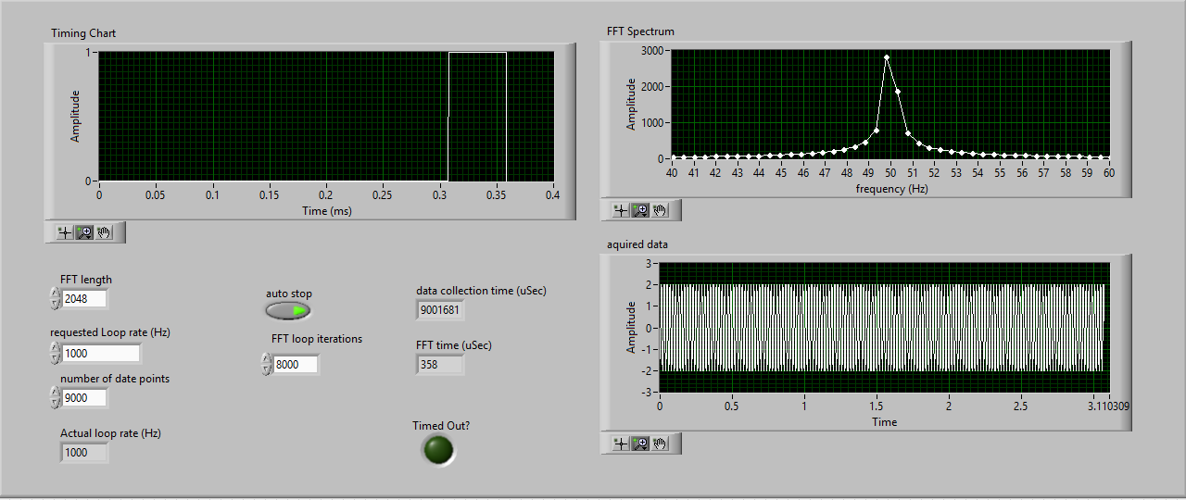
FFT length 2048
0.05 ms compute time for FFT

Slide 5
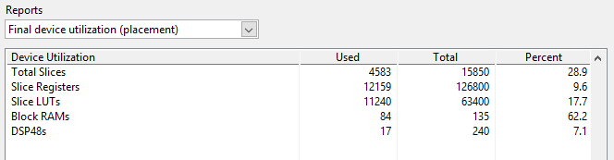
FFT length 2048
0.05 ms compute time

Slide 6
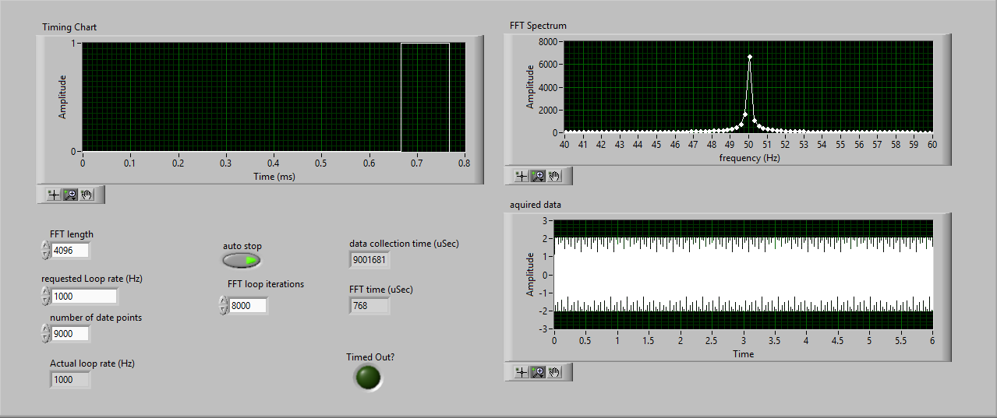
FFT length 4096
0.1 ms compute time for FFT

Slide 7
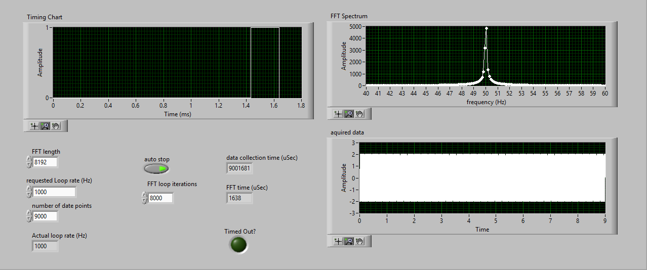
FFT length 8192
0.2 ms compute time for FFT

Slide 8
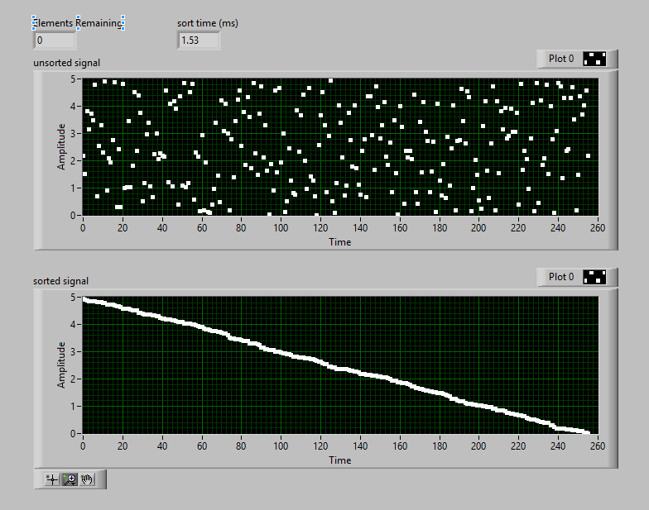
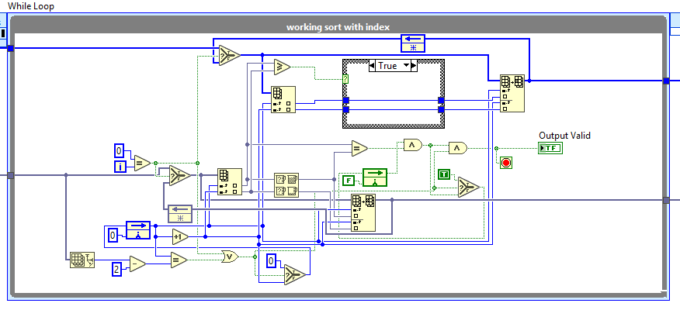
Bubble sort 254
1.53 ms compute time
Desktop sort 254
0.056 ms compute time
np.sort() uses quicksort

Slide 9
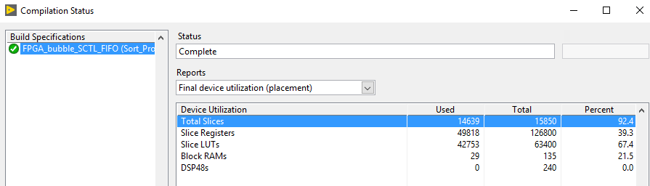
Bubble sort 254 points
40 MHz clock
Could not compile higher

Slide 10
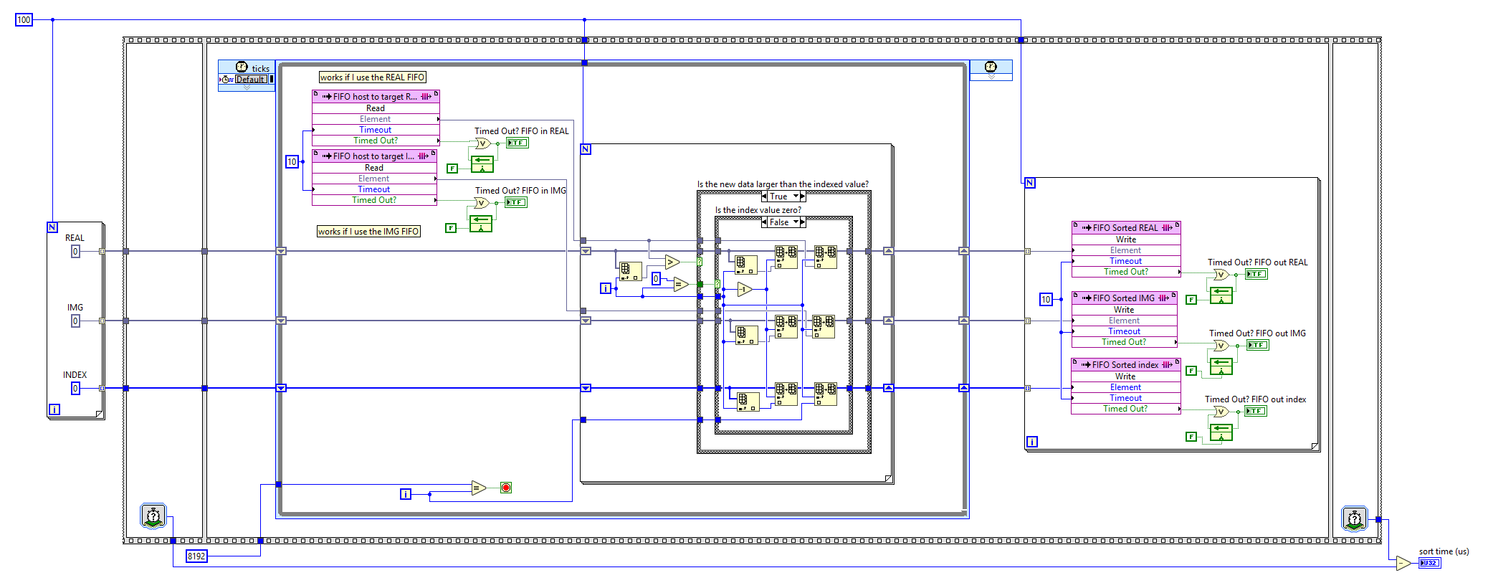
Catch the top n points
Stores the top n points
Includes real, Img, and fft index
200 us for 100 points

Slide 11
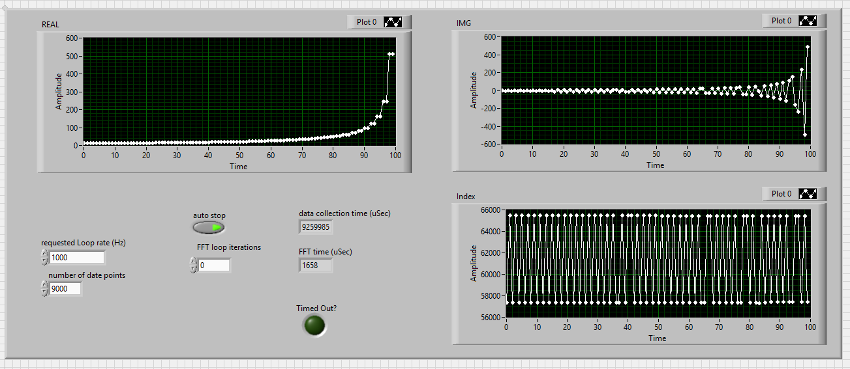
Catch the top n points
8192 FFT points, stores top 100 points
1.68 ms

Slide 12
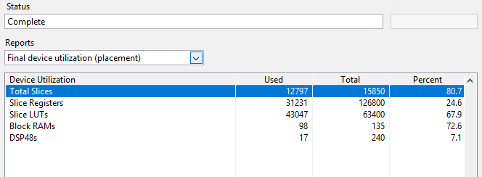
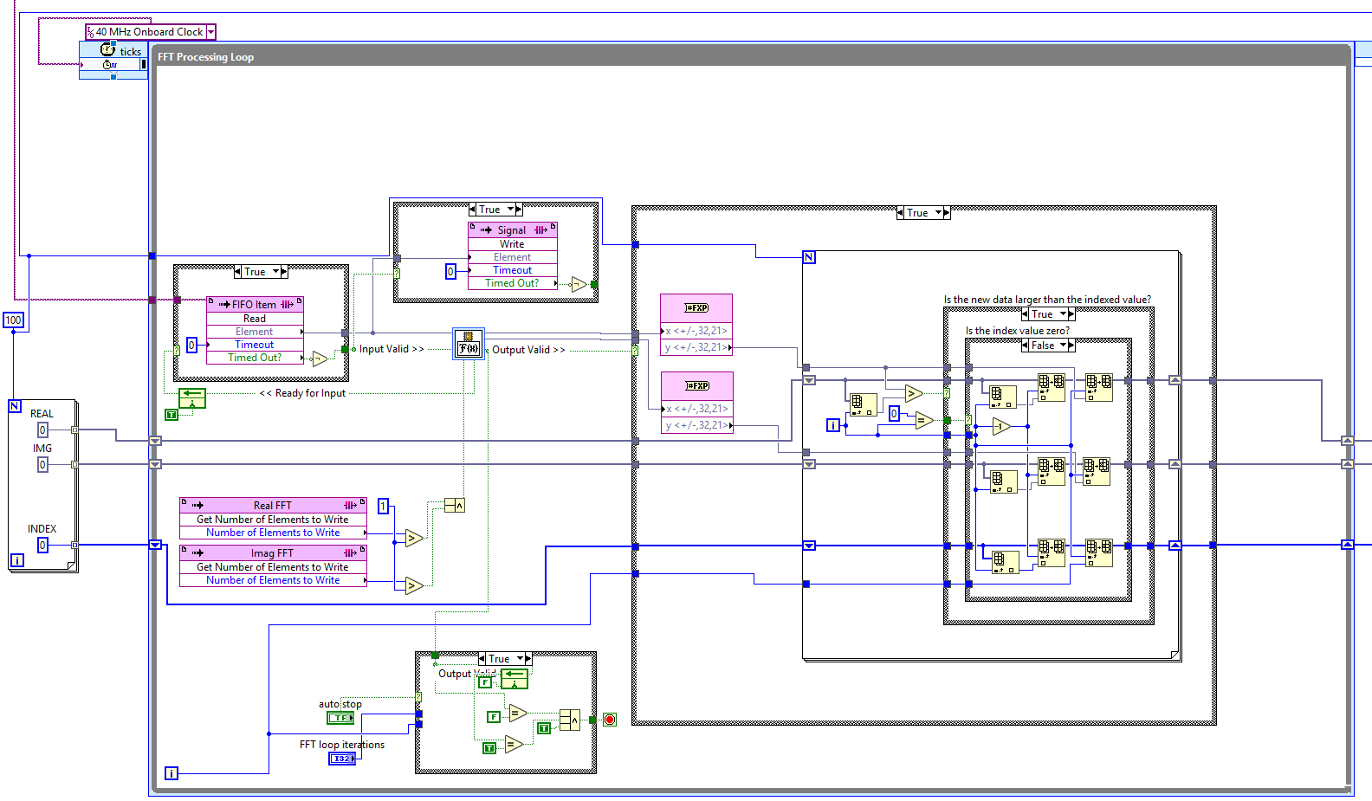
Catch the top n points
40 MHz clock

Slide 13
Bubble sort 254 points
40 MHz clock
Could not compile higher

Slide 14
Bubble sort 254 points
40 MHz clock
Could not compile higher

Slide 15
Thanks!

