Slide 1


Topological Data Analysis (TDA)
MOHSEN GOL ZARDIAN; Department of Mechanical Engineering

Slide 2
Required packages for TDA
Synthetic point cloud
TDA on synthetic point cloud
LiDAR point cloud
TDA on LiDAR point cloud
Outline
Python Packages installation for TDA:
Installing the necessary packages for TDA in python.
Slop generation:
Applying mesh to create surface with a cavity using Synthetic data.
TDA implementation:
Applying initial TDA on created point cloud.
Extracting the persistence homology diagram.
2

Slide 3
Required packages for TDA
Synthetic point cloud
TDA on synthetic point cloud
LiDAR point cloud
TDA on LiDAR point cloud
Installed important packages for running TDA:
Laspy (Laszip).
Giotto-tda
Gudhi
Tensorflow
Dionysus or Dionysus2 (Still there is some issues to install this package)
Scikit-tda
Scipy
Ripser
Persim
Scikit-learn
Plotly
Tadasets
3

Slide 4
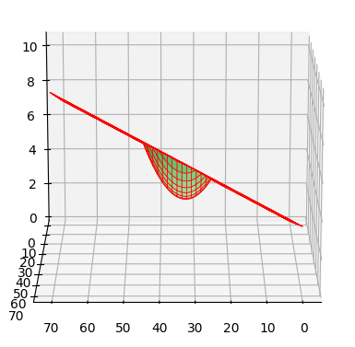
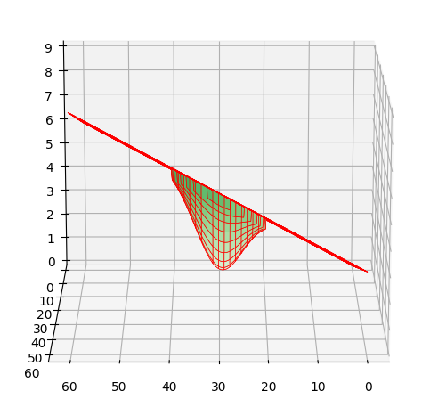
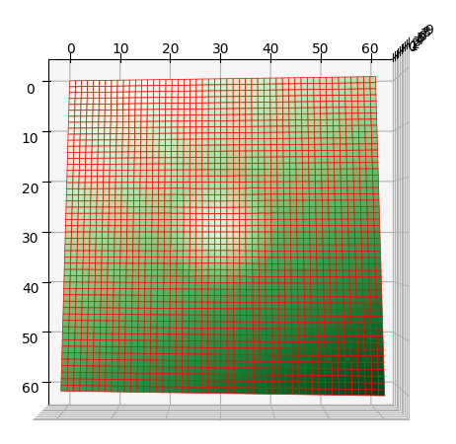
Required packages for TDA
Synthetic point cloud
(Mesh)
TDA on synthetic point cloud
LiDAR point cloud
TDA on LiDAR point cloud
Before generating point clouds, the surface should be generated.
Slope generated using ‘Trimesh” package in Python.
The cavity is designed used parabolic and gaussian equation at the middle of the slop.
Gaussian Cavity
Parabolic Cavity
4

Slide 5
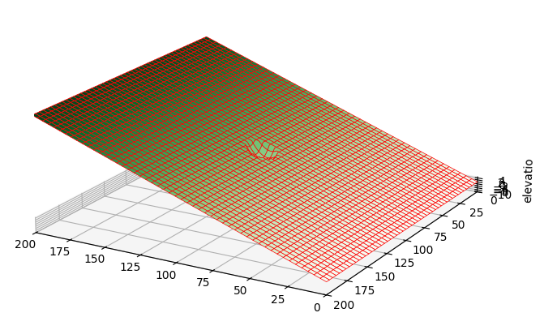
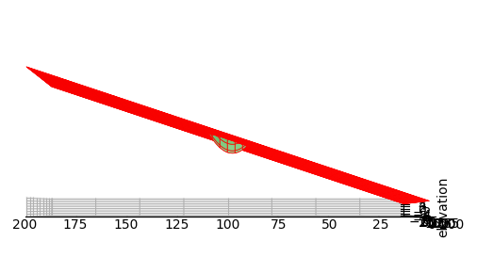

Required packages for TDA
Synthetic point cloud
(Mesh)
TDA on synthetic point cloud
LiDAR point cloud
TDA on LiDAR point cloud
Slope generated using ‘Trimesh” package in Python.
The cavity formulation is as follow: $z=h−d\left(1−{\left(\frac{x}{r}\right)}^{2}\right)$
where z is elevation of point at the cavity curve
h is the elevation of flat base of cavity
d is the maximum depth of cavity
x is the distance of cavity center (defined by an equation)
r is cavity radios
Cavity Diameter=10 units
5

Slide 6
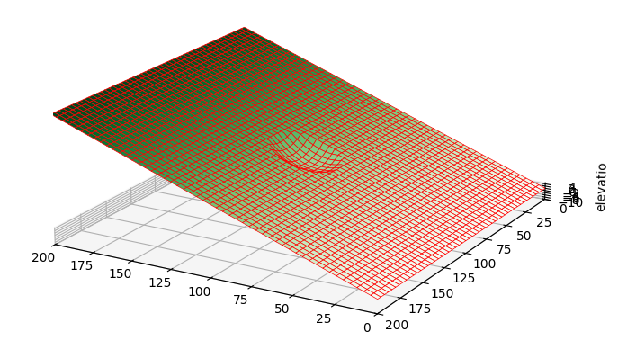
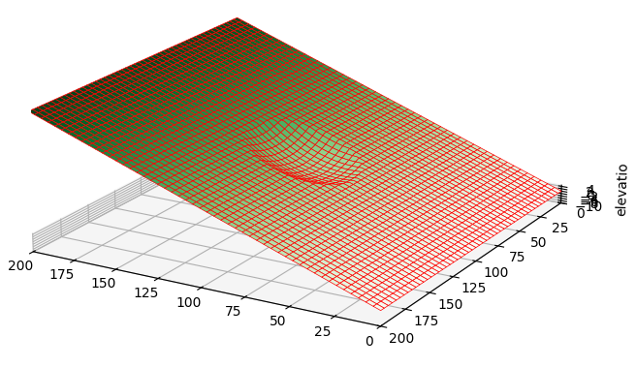
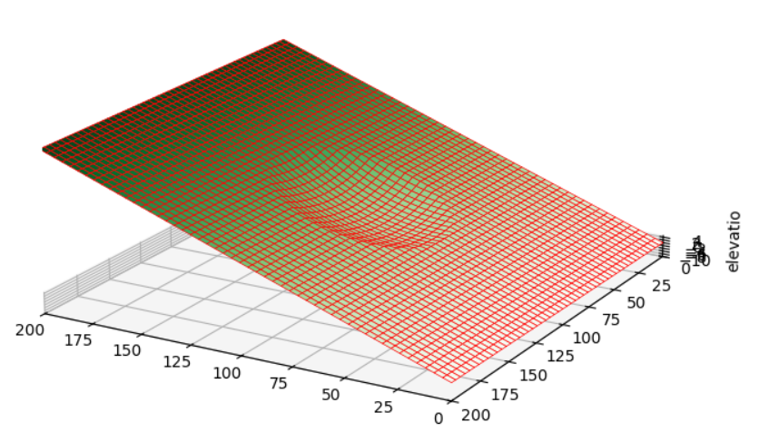
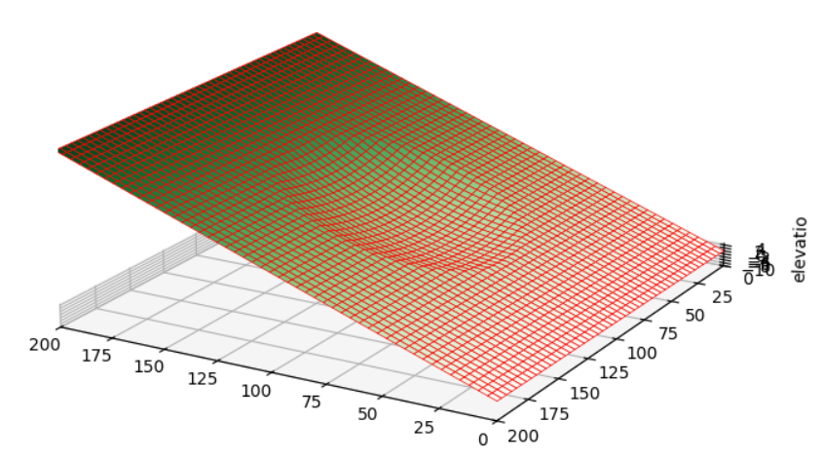
Required packages for TDA
Synthetic point cloud
(Mesh)
TDA on synthetic point cloud
LiDAR point cloud
TDA on LiDAR point cloud
Different diameter for cavity:
Cavity Diameter=20 units
Cavity Diameter=30 units
Cavity Diameter=40 units
Cavity Diameter=50 units
6

Slide 7
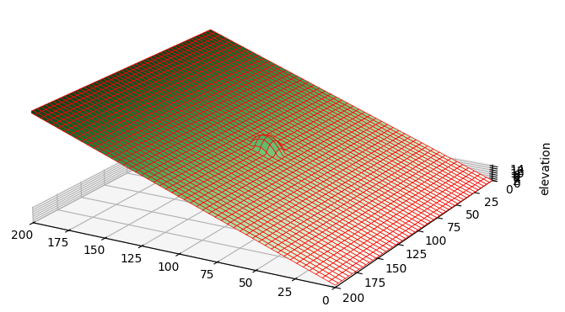
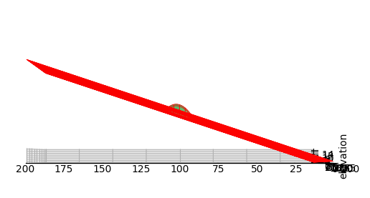

Required packages for TDA
Synthetic point cloud
(Mesh)
TDA on synthetic point cloud
LiDAR point cloud
TDA on LiDAR point cloud
Slope generated using ‘Trimesh” package in Python.
The hump formulation is as follow: $z=h+d\left(1−{\left(\frac{x}{r}\right)}^{2}\right)$
where z is elevation of point at the hump curve
h is the elevation of flat base of hump
d is the maximum height of hump
x is the distance of hump center (defined by an equation)
r is hump radios
Hump Diameter=10 units
7

Slide 8
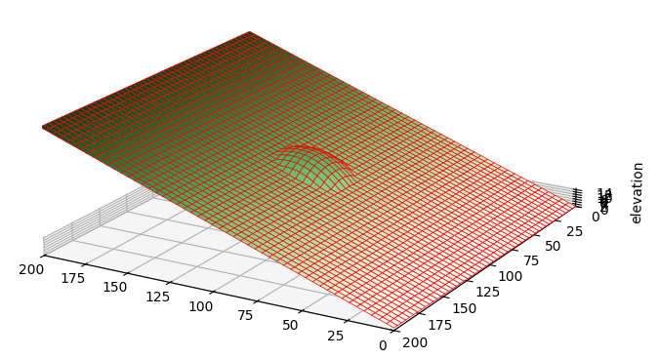

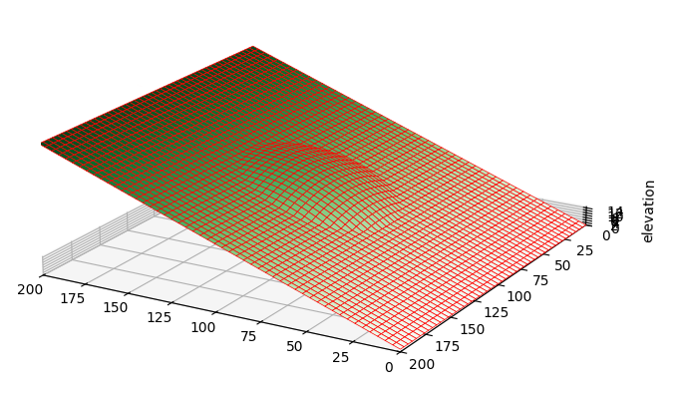
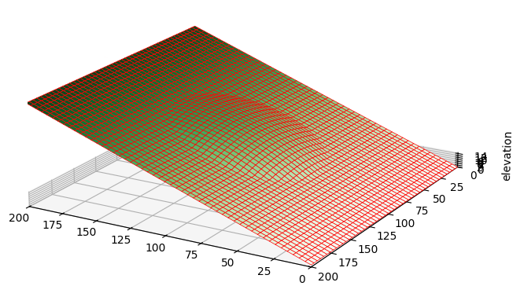
Required packages for TDA
Synthetic point cloud
(Mesh)
TDA on synthetic point cloud
LiDAR point cloud
TDA on LiDAR point cloud
Different diameter for hump:
Hump Diameter=20 units
Hump Diameter=30 units
Hump Diameter=40 units
Hump Diameter=50 units
8

Slide 9
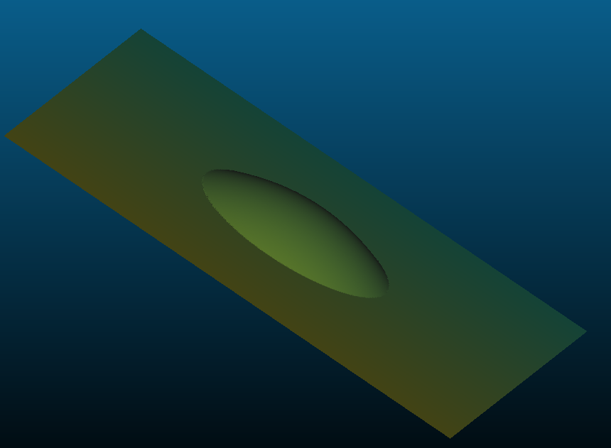
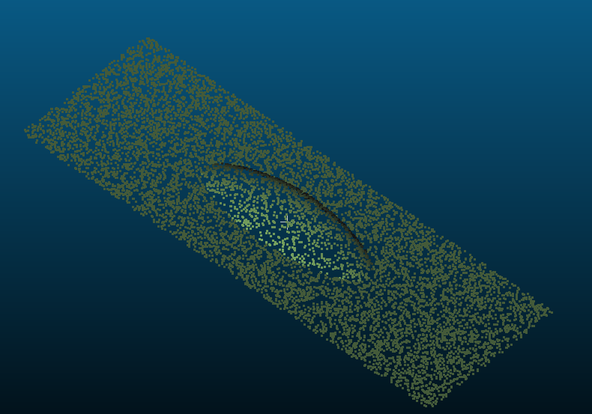
Required packages for TDA
Synthetic point cloud
(Mesh)
TDA on synthetic point cloud
LiDAR point cloud
TDA on LiDAR point cloud
The next step is to create point cloud from presented mesh surfaces using “ Cloud Compare” software to extract the desired number of points to proceed with TDA.
50 units Hump Meshed
50 units Hump Point Cloud
9

Slide 10
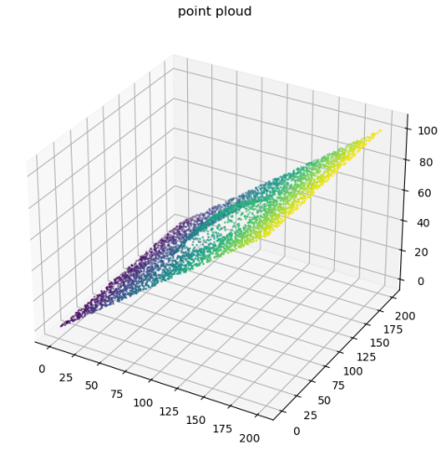
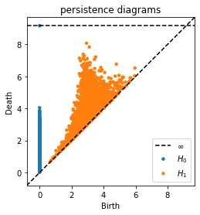
Required packages for TDA
Synthetic point cloud
(Mesh)
TDA on synthetic point cloud
LiDAR point cloud
TDA on LiDAR point cloud
The persistence diagram using Ripser/ Persim package (9000 points) and point cloud regeneration are illustrated bellow:
Point Cloud with Hump
Persistence diagram (PD)
10

Slide 11
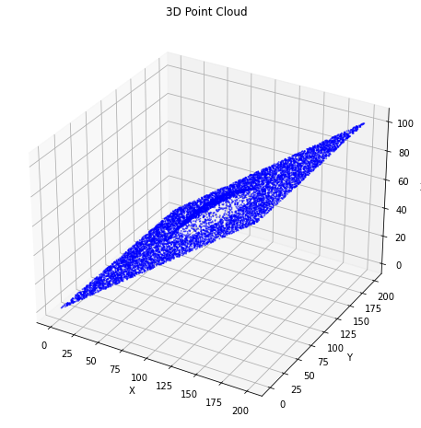
Required packages for TDA
Synthetic point cloud
(Mesh)
TDA on synthetic point cloud
LiDAR point cloud
TDA on LiDAR point cloud
The TDA feature extraction using Giotto-tda package :
The main TDA features belong to (Homology dimensions: H0 & H1) are as below :
Persistence entropy features
Number-of-points features
Amplitude features:
Bottleneck Distance
Wasserstein Distance
Persistence Landscape
Persistence Image
Betti Curve
Heat Kernel
The TDA implementation and feature extraction are based on the previous slope, which includes a hump at the center.
11

Slide 12
Required packages for TDA
Synthetic point cloud
(Mesh)
TDA on synthetic point cloud
LiDAR point cloud
TDA on LiDAR point cloud
The TDA feature extraction output:
[[12.98170879 10.55455118]]
[[1.95484507e+00 2.53934181e+00 7.60039550e+01 2.78459388e+01
2.23151972e+00 3.60304209e+00 8.03171369e+03 1.10065574e+03
9.47122820e+03 1.04878994e+03 1.07306080e+04 1.35579865e+03]]
Persistence entropy features: [[ H0 H1]]
[[8999 2438]]
No of points features: [[ H0 H1]]
Amplitude features: [[ H0 H1]]
: Bottleneck distance [[ H0 H1]]
: Wasserstein distance [[ H0 H1]]
: Persistence Landscape [[ H0 H1]]
: Persistence Image [[ H0 H1]]
: Betti Curve [[ H0 H1]]
: Heat Kernel [[ H0 H1]]
12

Slide 13
Required packages for TDA
Synthetic point cloud
(Mesh)
TDA on synthetic point cloud
LiDAR point cloud
TDA on LiDAR point cloud
The TDA feature extraction output for surface_with_smooth_circular_cavity_10.las-(5000 points):
[[12.18283007 9.75673111]]
RANSAC filtered point cloud shape:
Persistence entropy features: [[ H0 H1]]
[[5151 1407]]
No of points features: [[ H0 H1]]
Persistence entropy features: [[ H0 H1]]
[[2.94151235e+00 3.20920312e+00 7.61922612e+01 2.75099774e+01
4.11896619e+00 5.02170662e+00 4.17089600e+03 5.14644963e+02
6.27974214e+03 6.82004120e+02 5.63012809e+03 6.54624709e+02]]
No of points features: [[ H0 H1]]
Amplitude features: [[ H0 H1]]
: Bottleneck distance [[ H0 H1]]
: Wasserstein distance [[ H0 H1]]
: Persistence Landscape [[ H0 H1]]
: Persistence Image [[ H0 H1]]
: Betti Curve [[ H0 H1]]
: Heat Kernel [[ H0 H1]]
Amplitude features: [[ H0 H1]]
13

Slide 14
Required packages for TDA
Synthetic point cloud
(Mesh)
TDA on synthetic point cloud
LiDAR point cloud
TDA on LiDAR point cloud
The TDA feature extraction output for surface_with_smooth_circular_cavity_20.las-((4994, 3) points):
[[12.13759719 9.65422232]]
RANSAC filtered point cloud shape: (4838, 3)
Persistence entropy features: [[ H0 H1]]
residual_threshold=1.0
[[4993 1326]]
[[12.09111164 9.55073286]]
No of points features: [[ H0 H1]]
[[2.40893388e+00 3.45307302e+00 7.58580985e+01 2.85119974e+01
3.05259742e+00 5.54512194e+00 4.01853012e+03 4.62198669e+02
6.10584441e+03 6.65095304e+02 5.30440964e+03 5.91397470e+02]]
Persistence entropy features: [[ H0 H1]]
[[4837 1283]]
No of points features: [[ H0 H1]]
[[2.40893388e+00 1.62873718e+01 7.49124991e+01 3.19929003e+01
3.05259742e+00 5.37217838e+01 3.88244689e+03 4.77451815e+02
5.92103404e+03 6.40068619e+02 5.12498382e+03 5.52000009e+02]]
Amplitude features: [[ H0 H1]]
: Bottleneck distance [[ H0 H1]]
: Wasserstein distance [[ H0 H1]]
: Persistence Landscape [[ H0 H1]]
: Persistence Image [[ H0 H1]]
: Betti Curve [[ H0 H1]]
: Heat Kernel [[ H0 H1]]
Amplitude features: [[ H0 H1]]
14

