Slide 1


Topological Data Analysis (TDA)
MOHSEN GOL ZARDIAN; Department of Mechanical Engineering

Slide 2
Required packages for TDA
Synthetic point cloud
TDA on synthetic point cloud
LiDAR point cloud
TDA on LiDAR point cloud
Outline
Python Packages installation for TDA:
Installing the necessary packages for TDA in python.
Slop generation:
Applying mesh to create surface with a cavity using Synthetic data.
TDA implementation:
Applying initial TDA on created point cloud.
Extracting the persistence homology diagram.
2

Slide 3
Required packages for TDA
Synthetic point cloud
TDA on synthetic point cloud
LiDAR point cloud
TDA on LiDAR point cloud
Installed important packages for running TDA:
Laspy (Laszip).
Giotto-tda
Gudhi
Tensorflow
Dionysus or Dionysus2 (Still there is some issues to install this package)
Scikit-tda
Scipy
Ripser
Persim
Scikit-learn
Plotly
Tadasets
3

Slide 4
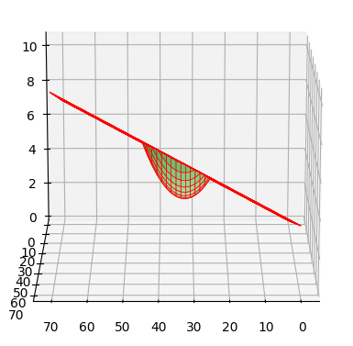
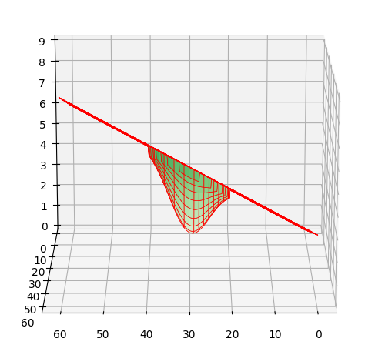
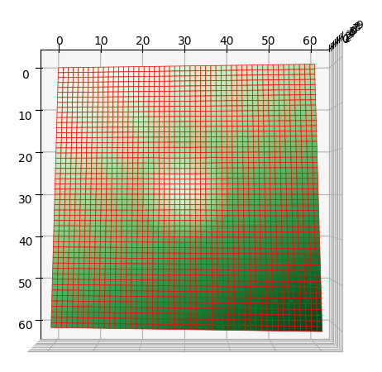
Required packages for TDA
Synthetic point cloud
(Mesh)
TDA on synthetic point cloud
LiDAR point cloud
TDA on LiDAR point cloud
Before generating point clouds, the surface should be generated.
Slope generated using ‘Trimesh” package in Python.
The cavity is designed used parabolic and gaussian equation at the middle of the slop.
Gaussian Cavity
Parabolic Cavity
4

Slide 5
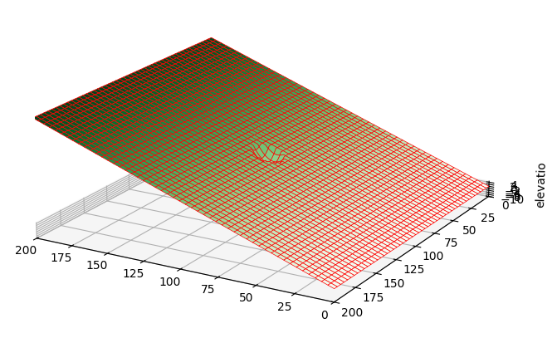
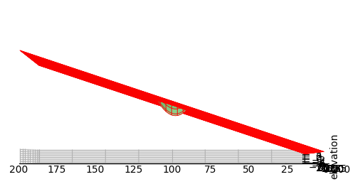

Required packages for TDA
Synthetic point cloud
(Mesh)
TDA on synthetic point cloud
LiDAR point cloud
TDA on LiDAR point cloud
Slope generated using ‘Trimesh” package in Python.
The cavity formulation is as follow: $z=h−d\left(1−{\left(\frac{x}{r}\right)}^{2}\right)$
where z is elevation of point at the cavity curve
h is the elevation of flat base of cavity
d is the maximum depth of cavity
x is the distance of cavity center (defined by an equation)
r is cavity radios
Cavity Diameter=10 units
5

Slide 6
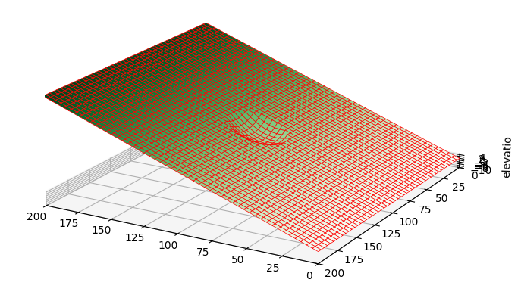
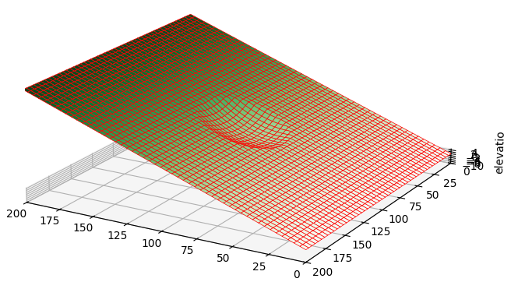
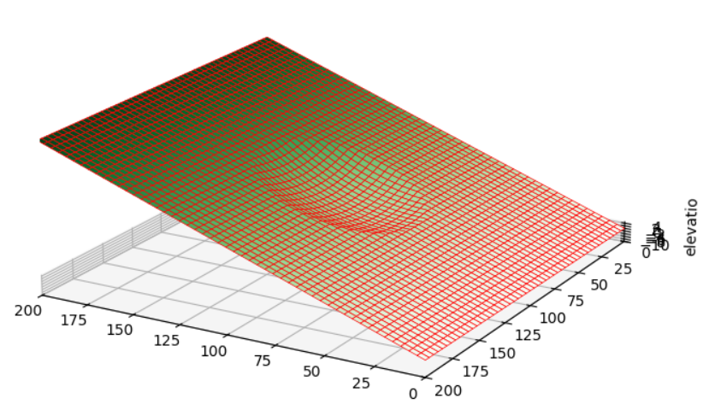
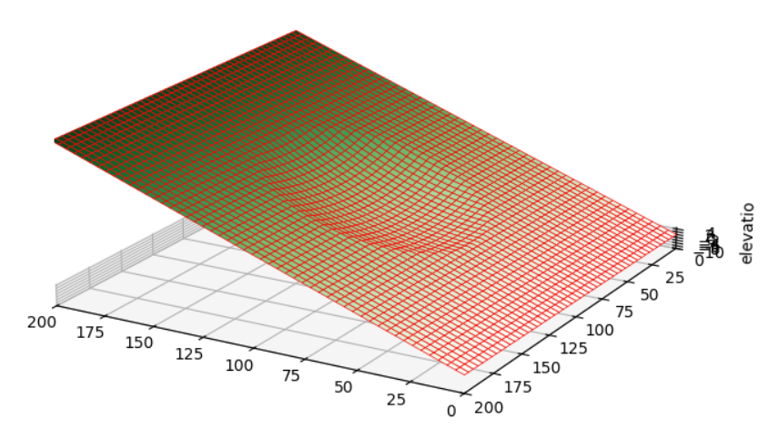
Required packages for TDA
Synthetic point cloud
(Mesh)
TDA on synthetic point cloud
LiDAR point cloud
TDA on LiDAR point cloud
Different diameter for cavity:
Cavity Diameter=20 units
Cavity Diameter=30 units
Cavity Diameter=40 units
Cavity Diameter=50 units
6

Slide 7
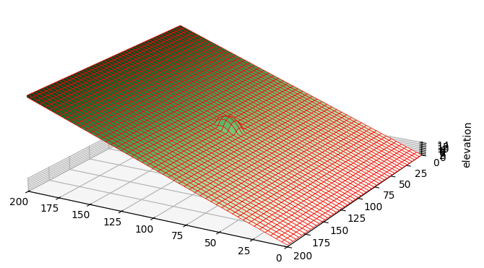
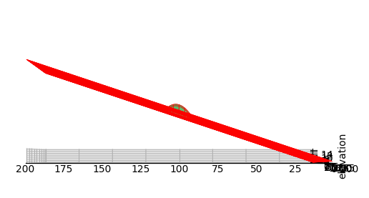

Required packages for TDA
Synthetic point cloud
(Mesh)
TDA on synthetic point cloud
LiDAR point cloud
TDA on LiDAR point cloud
Slope generated using ‘Trimesh” package in Python.
The hump formulation is as follow: $z=h+d\left(1−{\left(\frac{x}{r}\right)}^{2}\right)$
where z is elevation of point at the hump curve
h is the elevation of flat base of hump
d is the maximum height of hump
x is the distance of hump center (defined by an equation)
r is hump radios
Hump Diameter=10 units
7

Slide 8
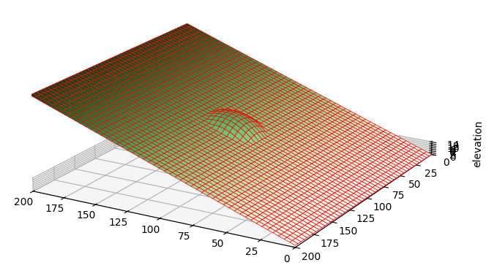

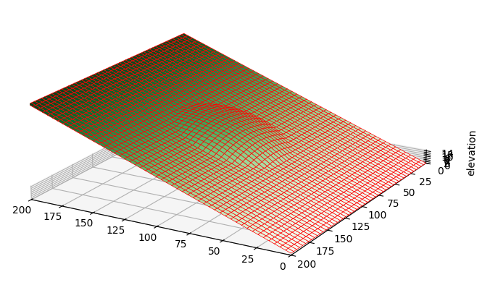
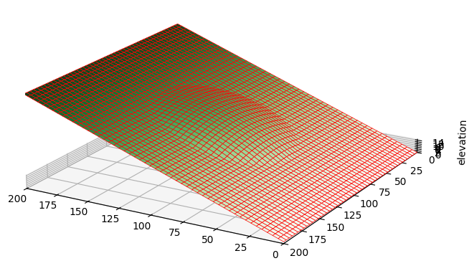
Required packages for TDA
Synthetic point cloud
(Mesh)
TDA on synthetic point cloud
LiDAR point cloud
TDA on LiDAR point cloud
Different diameter for hump:
Hump Diameter=20 units
Hump Diameter=30 units
Hump Diameter=40 units
Hump Diameter=50 units
8

Slide 9
Required packages for TDA
Synthetic point cloud
(Mesh)
TDA on synthetic point cloud
LiDAR point cloud
TDA on LiDAR point cloud
The next step is to create point cloud from presented mesh surfaces using “ Cloud Compare” software to extract the desired number of points to proceed with TDA.
9

