Slide 1
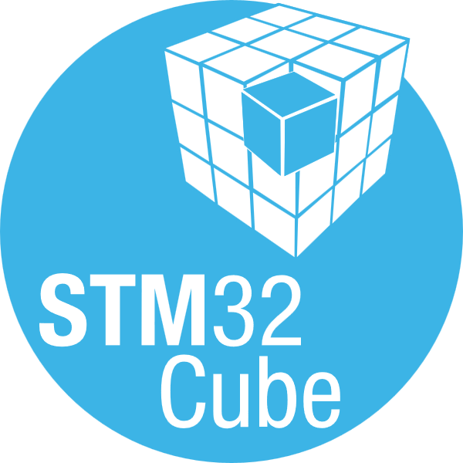
STM32Cube Ecosystem

Slide 2
STM32Cube Framework
Helping developers releasing their creativity
Develop faster
With STM32 code generation tools, IDE and production-ready examples
Differentiate more
With optimized drivers leveraging all STM32 smart features
1.5M+
Active developer
Save costs
With Free and permissive production licenses
76% CSAT
at professional engineers
Notes:
Establishing and maintaining leadership require continuous investment in attracting and delighting embedded software developers
Our STM32Cube is a comprehensive developer Framework providing necessary bricks to ease and accelerate embedded designs
STM32Cube combines:
HW development kits offering prototyping references design boards
Embedded SW Development Kit offering optimized drivers, middleware and implementation examples
Development tools simplifying MCU configuration, applications development and monitoring.
Extensive offer of development resources including technical documentations, application notes and education materials.
150+ STM32Cube expansions from ST and partners enlarge the framework offer and include:
STM32Cube Extensions focusing on specific functions such as AI, Motor Control, or Cloud connectivity
Function packs with application-level implementation references such as Face recognition or MEMS sensing
The framework is consistent across the STM32 portfolio and leverages ST worldwide support channels and communities.

Slide 3
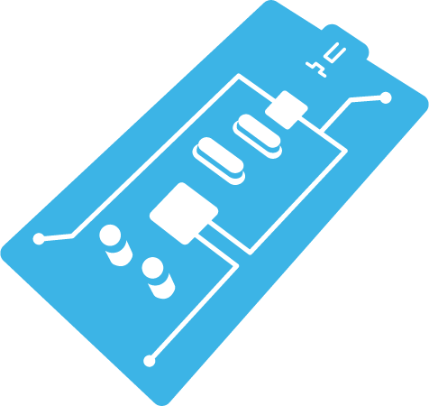
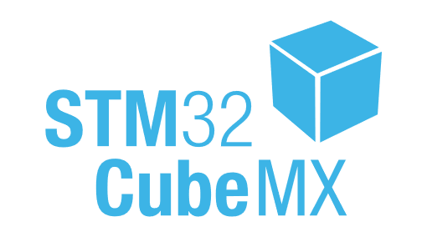
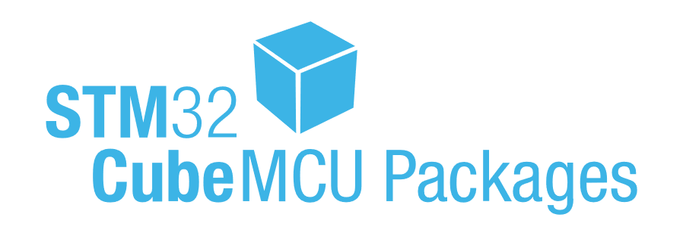
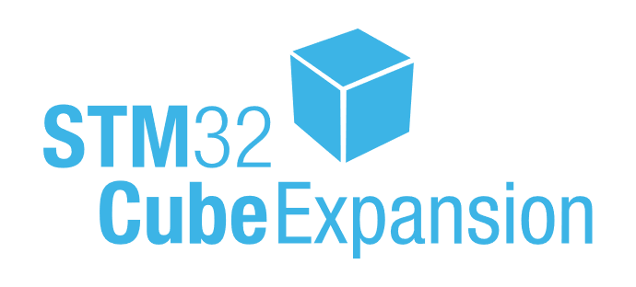
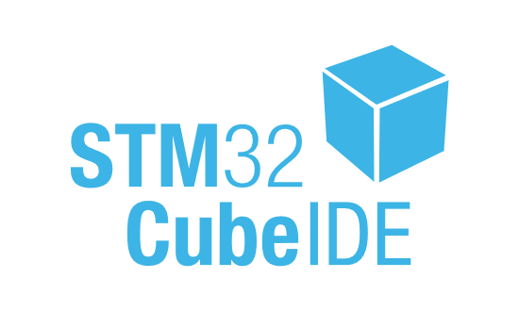
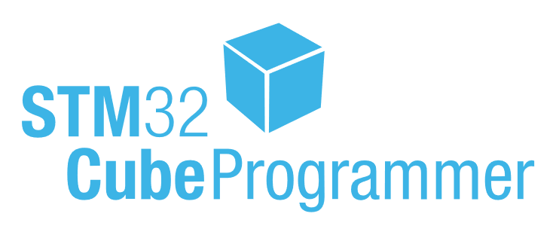
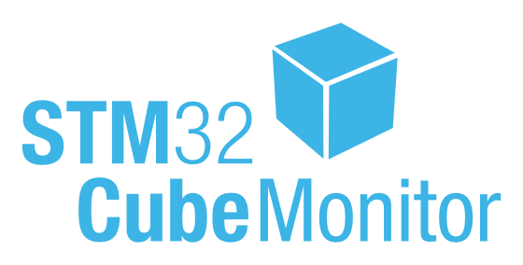
STM32Cube Ecosystem
Tools and software supporting you during all your design steps
Evaluation
Large and affordable selection of evaluation kits
Getting Started
Efficient and intuitive MCU configuration with automatic code generation
Development and Debug
Optimized drivers and middleware, full access to hardware features, production-ready examples
Extended selection of optimized middleware and part drivers
Eclipse & VSCode, C/C++ code editing, GCC &LLVM build, advanced debugging
Programming
Efficient and secure code and option bytes programming
Monitoring
Graphical and non-intrusive code monitoring

Slide 4

STM32Cube Ecosystem
STM32Cube Ecosystem is evolving to help you even more
We are upgrading our STM32Cube Ecosystem to:
Implement developers’ expected enhancements and fixes
Introduce more advanced features and deploy them at scale
Accelerate our reactivity and release cycles
Strengthen our foundation to support richer STM32 MCUs roadmap
“We cannot solve our problems with the same thinking we used when we create them”
Albert Einstein

Slide 5

STM32Cube Ecosystem
STM32Cube Ecosystem is evolving to help you even more
Our new architecture principals
Decoupled embedded software and tools
Modular and configurable embedded software components
Data-centric tools, STM32 MCUs agnostic
Inter-operable tools instead of tools integration
“We Cannot solve our problems with the same thinking we used when we create them”
Albert Einstein

Slide 6
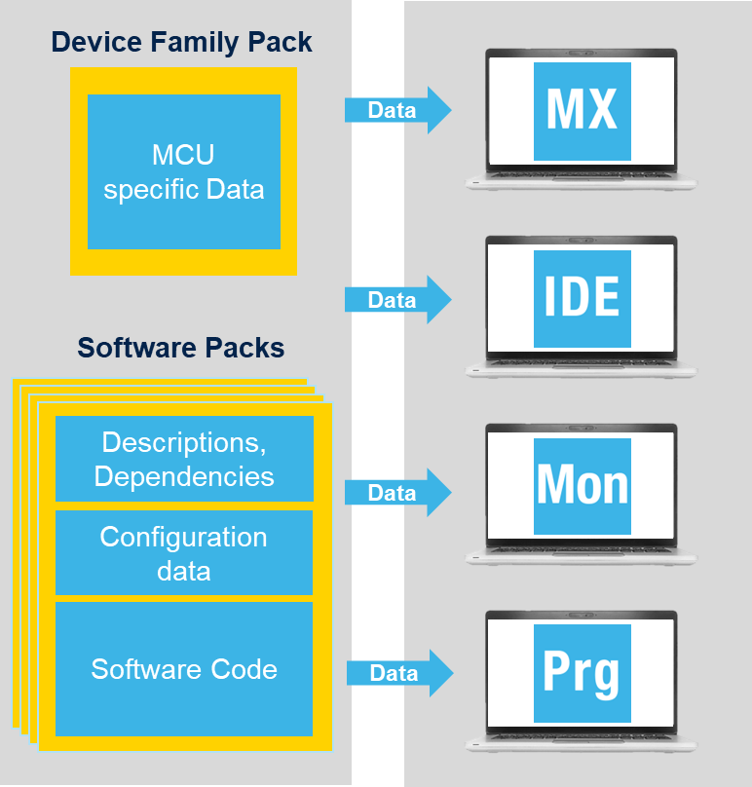
STM32Cube Ecosystem
STM32Cube Ecosystem new architecture principals
Device Family Pack (DFP):
Data Describing each MCU (Pinout, clock, SVD, Flash, startup)
Modular software components (Software Packs)
1 driver pack for each series
1 pack for each Middleware, example, utility and external part drivers
Open-CMSIS-PACK format for each pack description
Data describing software licenses, versions, dependencies and configuration
Hardware-Independent tools
Software tools use DFP and Software Packs data as standard input
Capacity to automatically fetch and add dependencies.

Slide 7
STM32Cube Ecosystem
STM32Cube Ecosystem is evolving to help you even more
Evaluation
Faster start from boards, faster access to examples and demos
Getting Started
Enhanced configuration, code preview, flexible code structure, easier porting
Development and Debug
Higher Modularity, lower footprint and higher quality
Simplified extensions
VSCode as new framework, enhanced edit, build and debug
Programming
Increased speed and extended probes support
Monitoring
More specialized monitoring

Slide 8
STM32CubeMCU Packages Evolution
HAL drivers are upgraded, LL drivers are unchanged
HAL
HAL2.x
Optimized footprint: up to 59%* lower flash size
Improved API: simplified APIs, faster execution, added missing functions
Improved portability: compatibility across STM32 series
Enhanced quality: IEC61508/SC2 and MISRA C compliant, statical analysis
HAL2 built on top of LL: HAL2 now calling LL APIs
Saving memory and cost
Shorter design, higher perf.
Accelerated migration
More reuse, Safety ready code
Easier and faster optimization
*measured on RCC on STM32U5

Slide 9
STM32CubeMCU Packages Evolution
Our embedded software packages are reworked
V2
Modular software components: unitary, OPEN-CMSIS-PACK based
More examples: reference use of all STM32 MCU features
Improved example’s structure made boards and IDEs agnostic
Enhanced BSP architecture: based on part driver's layer
More flexibility, easier update
Faster development and debug
Easier reuse in end application
Easier reuse in end application

Slide 10
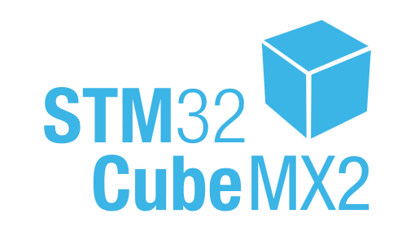
STM32CubeMX Evolution
Faster development, alignment with embedded SW evolution
Data centric: MCU agnostic, using CMSIS-Packs components as input
Upgraded Configuration: Enhanced pinout, clock and IPs settings, more flexible code generation
Porting support: Supporting inter and cross series migration
New Code preview: Live view of generated code with easy copy
Improved UX: New views and highlights, simplified journeys
Enhanced CLI: full access to functionalities through command line
Flexibility on tool used versions
Fast and optimized configuration
Accelerated porting
Easier code access and reuse
Faster and easier configuration
Automated CI/CD support

Slide 11
STM32 IDE Evolution
Faster development, alignment with embedded SW evolution
VS Code
Data Centric: MCU agnostic, using CMSIS-Packs components as input
VSCode based, decoupled from MX: lighter, faster, more evolutive
CMake based, GCC and LLVM support: decoupling projects and build
Modular features addition: flexible install with ‘Bundle manager’ feature
Enhanced UX: simple journeys, internationalization support
Separated CLI: full access to functionalities through command line
Flexibility on tool used versions
Faster install and development
more flexibility, faster build
Flexible install, disk space saving
Easier to use tool
Automated CI/CD support

Slide 12


You can personalize this
last page with a short link
(ex. www.st.com/shortlink)
You can find a complete list of st.com short links on this page:
http://seo.st.com/toolbox/shortcuts/
Find out more at www.st.com

Slide 13

Please remove this page
before publishing the
presentation
For further support in creating a PowerPoint presentation, including graphic assets, formatting tools and additional information on the ST brand
you can visit the ST Brand Portal https://brandportal.st.com

