Slide 1


“SAMVED” HACKATHON 2026
TITLE PAGE
Problem Statement ID – PS-004
Problem Statement Title- Safety & Assistance for Sanitation Workers
Theme- Smart Safety Hand Band For Sanitation Workers
Team ID- MITVPU_SAMVED_RAKSHAK
Team Name- RAKSHAK

Slide 2
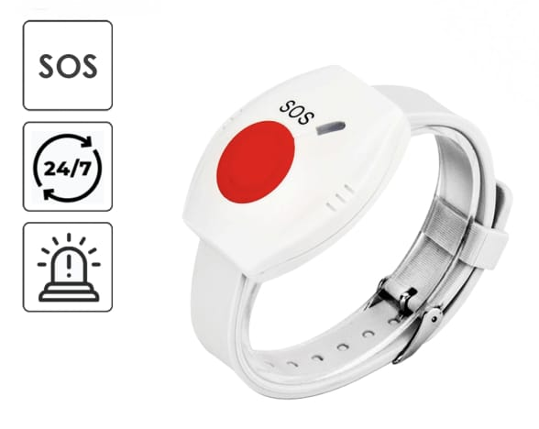
Smart Safety Hand Band For Sanitation Workers
RAKSHAK
Proposed Solution
Wearable safety band for hazardous sewer environments
  Integrated SOS emergency button
  Real-time health monitoring
  (Heart rate & Body temperature)
  Live sewer temperature and toxic gas detection
  Instant alerts to supervisors and emergency teams
  Compact, low-cost, and worker-friendly design

Slide 3
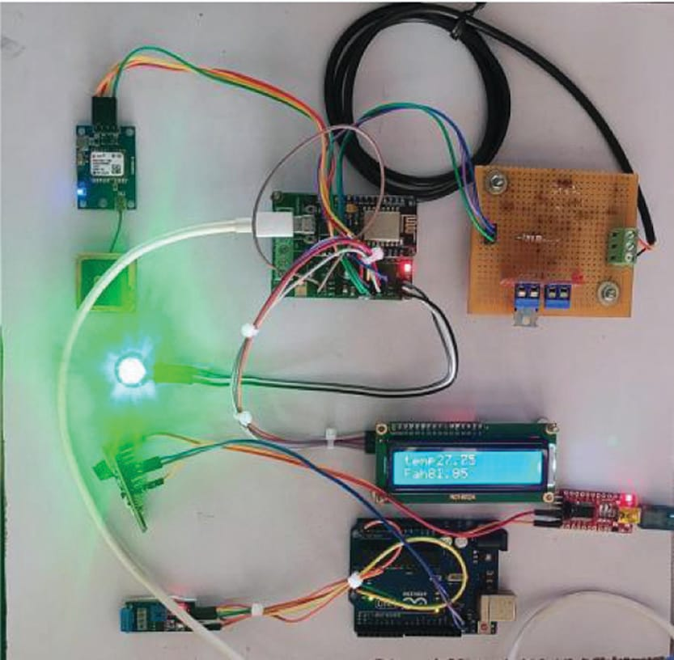
TECHNICAL APPROACH
RAKSHAK
Hardware & Technologies Used
  Microcontroller: ESP32 / Arduino
  Sensors:
  Heartbeat (MAX30100),
  Temperature (DS18B20),
  Gas Sensors (MQ Series)
  Communication: GSM / LoRa / Bluetooth
  Alert System: Buzzer, vibration & mobile/cloud notification
  Flow: Sensors → Controller → Risk Analysis → Alert / SOS → Authority

Slide 4
FEASIBILITY AND VIABILITY
RAKSHAK
Technically feasible using existing IoT components
  Low-cost and scalable for large workforce deployment
  Challenges: Harsh environment & sensor accuracy
  Solutions: Waterproof casing, calibration & threshold-based alerts
  Can be adopted by municipalities and sanitation departments

Slide 5
IMPACT AND BENEFITS
RAKSHAK
Drastically reduces risk of fatalities and accidents
  Ensures real-time worker safety and monitoring
  Social Impact: Protects dignity and lives of sanitation workers
  Economic Impact: Reduces medical and compensation costs
  Environmental Impact: Prevents unattended sewer hazards

Slide 6
RESEARCH AND REFERENCES
RAKSHAK
WHO – Occupational Safety for Sanitation Workers https://www.who.int
  IoT-Based Monitoring and Alert System for Sewage Worker’s Safety
  https://pmc.ncbi.nlm.nih.gov/articles/PMC6103782/
  Smart Safety Monitoring System for Sewage Workers (IJSRSET)
  https://ijsrset.com
  Alerting and Detection of Toxic Gases in Sewage using IoT (IJRASET)
  https://www.ijraset.com
  MAX30100 Heart Rate Sensor Datasheet – Analog Devices
  https://www.analog.com/en/products/max30100.html
  MQ Series Gas Sensor Datasheets
  https://www.sparkfun.com/datasheets/Sensors/Biometric/MQ-135.pdf

Slide 7
RESEARCH AND REFERENCES
RAKSHAK
THANKYOU

