Slide 1





SMART INDIA HACKATHON 2026
Problem Statement ID – SIH26265
Problem Statement Title - Streamlining of Security Deposit / FDR Portal (NidhiTrack)
Theme – Smart Automation
PS Category - Software
Team ID - [Enter from SIH portal]
Team Name – Team- Innovations

Slide 2









NIDHITRACK – IDEA / SOLUTION
PROBLEM STATEMENT
IDEA / SOLUTION
HOW NIDHITRACK ADDRESSES IT
Paper FDRs & registers
Physical submission, manual entry, files get lost
NidhiTrack is an end-to-end digital portal that takes every security deposit / FDR from submission to verified lien, auto-monitoring, renewal and release – one workflow, one audit trail.
Paper FDR + registers
Digital + eSign
Manual bank calls
API / OCR verify
Missed maturity / expiry
Cover lapses before anyone notices
Excel reminders
Auto alerts
Key Features:
eSign submission of SD / EMD / FDR with DigiLocker documents
AI + OCR checks flag duplicate, tampered or expired FDRs
Bank / e-FDR verification and digital lien marking
Auto alerts at 90 / 60 / 30 / 7 days before maturity or expiry
Rule-based refund release on contract completion, with SLA timers
Live dashboard and tamper-proof audit trail for officers and auditors
Months to refund
Rule-based release
Fake or tampered FDRs
Hard to verify with the bank in time
Scattered records
Live dashboard
UNIQUE VALUE PROPOSITION
Slow refunds
Vendors chase offices again and again
One portal, full lifecycle
Zero lapsed cover – never miss a date
No single live view
Officers cannot see status or risk at a glance
Fraud-aware verification
Open APIs: e-procurement, PFMS, banks

Slide 3
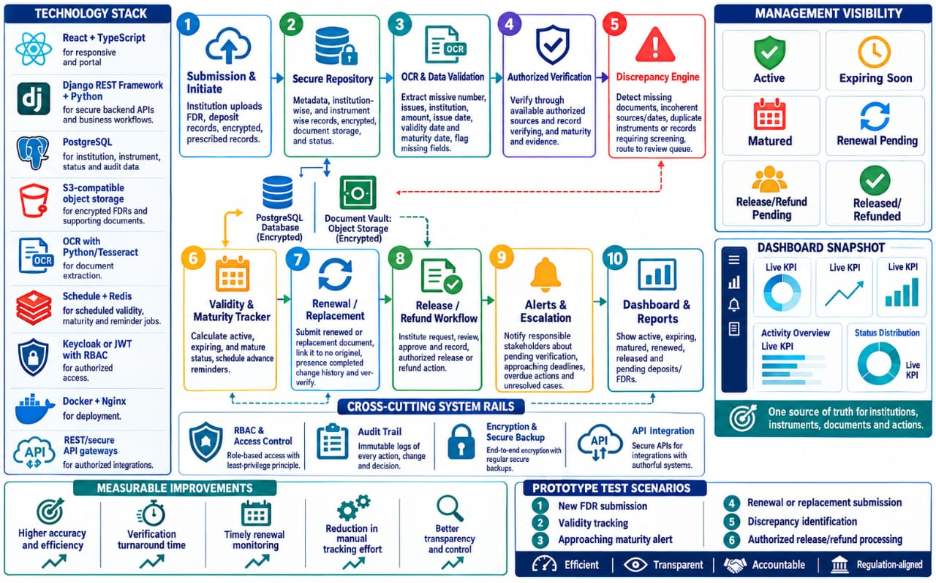




















TECHNICAL APPROACH
PROTOTYPE :
ARCHITECTURE FLOW :
NidhiTrack Dashboard
USERS
PORTAL (React)
CORE SERVICES (FastAPI)
DATA & OUTPUT
1
Contractor / Vendor
Submit & eSign
Workflow engine
PostgreSQL + audit log
Dept. Officer
Track status
OCR + AI fraud checks
Hash-chained ledger
FDR #0231 · Verified ✓
Finance & Audit
Dashboard
Bank / e-FDR verify
SMS / Email / WhatsApp
FDR #0238 · Expires in 28 days
TECH STACK:
Bank
Mobile / SMS
Alert scheduler
Refund via PFMS / Treasury
React
FastAPI
DEPOSIT LIFECYCLE:
PostgreSQL
Python + OCR
1. Submit
2. Verify
3. Lien
4. Monitor
5. Renew
6. Release
Docker
Celery / Redis
Every step is time-stamped in the audit trail and visible on the live dashboard.

Slide 4


FEASIBILITY AND VIABILITY
FEASIBILITY
VIABILITY
Proven building blocks – Web portal, OCR, eSign and SMS are mature, off-the-shelf tech.
Fits existing rules – EMD / performance-security norms set as configurable rules.
Phased bank verification – Start with OCR + bank confirmation; move to bank APIs / e-FDR as banks onboard.
Low cost – Open-source stack; cloud or on-prem hosting.
Scheduler-driven alerts – Nightly jobs track every maturity and expiry date.
Modular & scalable – Per-department rules and plug-in APIs.
Demonstrable MVP – Core flow: submit → verify → alert → release.
Trust & compliance – RBAC, 2FA, encryption, audit trail, DPDP-aligned.
POTENTIAL CHALLENGES
OVERCOME METHODS
Banks may lack uniform APIs for FDR verification and lien marking.
Pluggable bank adapters with OCR + manual fallback; start with pilot banks.
Sensitive financial data and risk of insider misuse.
Role-based access, encryption, 2FA and an immutable audit log.

Slide 5





IMPACT AND BENEFITS
CONTRACTORS & VENDORS
OFFICERS & FINANCE
GOVT & AUDITORS
Submit online, track live and get refunds on time – no repeated office visits or lost FDRs.
One live view of every deposit: maturing, lapsed, under lien or ready to release.
Standard, auditable deposit handling across departments – less leakage, stronger compliance.
Potential Impact on the Target Audience:
Benefits of the Solution:
1
FASTER REFUNDS
Rule-based release cuts waiting time.
Time Saved
Trust
Verification in minutes, not days (pilot target)
Tamper-proof audit trail
2
ZERO LAPSED COVER
Auto alerts before every expiry.
Low Cost
Scalable
3
REDUCED FRAUD
Fake or duplicate FDRs flagged early.
Open-source, low run cost
Any department or PSU
4
TRANSPARENT AUDIT
Every action time-stamped and traceable.
SUBMIT & VERIFY
AUTO MONITORING
FAST, FAIR RELEASE

Slide 6





RESEARCH AND REFERENCES
General Financial Rules, 2017 (Rules 170–171)
Earnest money deposit and performance security norms – Dept. of Expenditure, MoF.
Prototype Demo
(add link)
Idea Video
(add link)
GitHub Repo
(add link)
Project Docs
(add link)
ASPECTS | OTHERS | NIDHITRACK
Submission | Paper / email | Online + eSign
FDR check | Manual bank calls | OCR + AI flags, bank API
Tracking | Excel / registers | Auto alerts at 90/60/30/7 days
Release | File-by-file approvals | Rule-based workflow + SLA timers
Audit | Editable records | Hash-chained, tamper-proof log
Manual for Procurement of Works, 2022
Bid security and performance security practice for public works.
PFMS – Public Financial Management System
Controller General of Accounts; target for refund / payment integration.
Aadhaar eSign & DigiLocker (MeitY)
Paperless signing and document fetch for submissions.
Digital Personal Data Protection Act, 2023
Consent and data-handling principles for user and financial data.

