Slide 1
Titanic Dataset
Presented By
Name : E.ARULRAJ
College name : Jayaraj annapackiam CSI college of engineering
Department : Mechanical engineering

Slide 2
OUTLINE
Problem Statement
Proposed System/Solution
System Development Approach
Algorithm & Deployment
Result
Conclusion
Future Scope
References

Slide 3
Problem Statement
Survival Prediction:Using the dataset, develop a machine learning model to predict whether a passenger survived the Titanic disaster based on various features.
Feature Importance: Determine which features are most important for predicting survival on the Titanic. This can involve feature engineering, data exploration, and various machine learning techniques.
Exploratory Data Analysis (EDA): Conduct an exploratory data analysis to understand the distribution of different features and the relationships between them. For example, exploring survival rates by gender, class, age, etc.
Data Visualization: Create visualizations to better understand the dataset. This can involve histograms, scatter plots, box plots, heatmaps, and other visualization techniques to uncover trends and insights.
Comparison with Other Datasets: Compare the Titanic dataset with other datasets that involve similar contexts, such as other maritime disasters or transportation datasets, to identify commonalities and differences.
Ethical Considerations: Explore the ethical implications of the Titanic dataset, such as gender and class disparities in survival rates, and discuss how these disparities might relate to broader social issues.

Slide 4
Proposed Solution
Define a specific problem related to the Titanic dataset.
This involves: Handling Missing Values: Fill or drop rows/columns with missing data. The Titanic dataset has missing values in "Age," "Cabin," and "Embarked." Strategies like imputation (e.g., mean, median, or mode) or dropping incomplete rows are common. Encoding Categorical Variables: Convert categorical data into numerical format. This might involve one-hot encoding for "Sex," "Embarked," etc.
Feature Scaling/Normalization: Normalize numerical features like "Fare" to ensure consistent scaling across features. Exploratory Data Analysis (EDA) Analyze the dataset to understand its structure and relationships.
Analyzing Correlations: Determine relationships between variables. Correlation matrices and pair plots can reveal significant correlations.
Understanding Class Imbalances: Check for imbalances in the "Survived" variable, which might influence model trainingBinning Numerical Features: Convert continuous data like "Age" into discrete categories or age groups. Interacting Features: Create interaction terms (e.g., between "Pclass" and "Sex"). Model Selection and Training Choose a machine learning model for survival prediction.
Consider: Model Selection: Options include logistic regression, decision trees, random forests, gradient boosting, and others.
Training and Validation: Split the dataset into training and testing sets to evaluate model performance.

Slide 5
System Approach
Survival Prediction: Determining the likelihood of survival based on passenger attributes. Feature Analysis: Understanding the impact of various factors on survival, such as gender, class, age, etc.
Data Acquisition and Understanding Obtain the Titanic dataset and gain a basic understanding of its structure and contents.
Dataset Inspection: Review the dataset's columns, data types, and a sample of records. Contextual Understanding: Learn about the Titanic disaster's historical context to better interpret the data.
Data Preprocessing Prepare the data for analysis and modeling.
Decide how to manage missing values in "Age," "Cabin," and "Embarked." Strategies might include imputation, removal, or creating a special category for missing data.
Encoding Categorical Data: Convert categorical variables like "Sex" and "Embarked" into numerical formats, usually with one-hot encoding or label encoding.
Normalize or standardize numerical features like "Fare" and "Age" to ensure consistent scaling.
Exploratory Data Analysis (EDA) Explore the dataset to understand its distributions, relationships, and potential insights
Feature Engineering Generate new features or transform existing ones to improve model performance Create new features based on existing data, such as family size (combining "SibSp" and "Parch").

Slide 6
Algorithm & Deployment
Algorithm Development
Step 1: Define the Problem Identify the task at hand. In this case, the problem is to predict whether a passenger survived the Titanic disaster based on their attributes.
Step 2: Load and Inspect the Data Load the Titanic dataset into a data frame or a similar data structure. Inspect the data to understand its structure, including the data types of each column and the presence of missing values.
Step 3: Data Preprocessing Handling Missing Data: Deal with missing values in columns like "Age," "Cabin," and "Embarked." Common approaches include: Imputing with mean, median, mode, or using predictive techniques. Dropping rows/columns with excessive missing data. Encoding Categorical Variables: Convert categorical columns into numerical formats, often using one-hot encoding or label encoding. Feature Scaling/Normalization: Normalize numerical data (e.g., "Fare") to maintain uniformity among features.
Step 4: Exploratory Data Analysis (EDA) Descriptive Statistics: Calculate summary statistics like mean, median, and standard deviation. Data Visualization: Create plots to visualize distributions and relationships between features. Common plots include histograms, scatter plots, box plots, and heatmaps. Correlation Analysis: Identify correlations among features, especially in relation to survival.
Step 5: Feature Engineering Derived Features: Create new features from existing ones, like "FamilySize" from "SibSp" and "Parch." Binning: Convert continuous features like "Age" into discrete bins or age groups. Feature Interaction: Generate new features by combining or interacting existing ones

Slide 7
Deployment
Finalize the Model Ensure the model is stable, accurate, and meets your requirements. This involves: Model Evaluation: Validate the model's performance using testing data and various metrics like accuracy, precision, recall, F1-score, and ROC-AUC. Model Optimization: Perform hyperparameter tuning and feature selection to enhance performance. Cross-Validation: Use k-fold cross-validation or similar methods to ensure robustness and avoid overfitting.
Prepare the Deployment Environment Set up the infrastructure to deploy the model. This can include: Hardware Setup: Determine the hardware requirements for the model's deployment. Cloud-based platforms are popular for their scalability and flexibility. Software Setup: Install necessary software, frameworks, and libraries for the model to run. Commonly used frameworks for machine learning deployment include TensorFlow, PyTorch, and Scikit-learn. Containerization: Consider using Docker or similar containerization tools to package the model and its dependencies, ensuring consistency across environments.
Integrate with Existing Systems If applicable, integrate the model with other systems or applications. This might involve: APIs and Microservices: Create APIs to interface with the model, allowing other applications to interact with it. RESTful APIs are common for this purpose. Database Integration: Connect the deployment environment to a database to fetch input data and store results. User Interface: If required, build a user interface or dashboard to interact with the model, allowing users to input data and view results.
Test the Deployment Before full-scale deployment, test the model in the target environment to ensure it functions as expected. This step includes: Functional Testing: Confirm that the model produces expected outputs given specific inputs. Performance Testing: Measure the model's performance under different loads to ensure it can handle realworld use. Security Testing: Check for vulnerabilities and ensure data security, especially when dealing with sensitive information.

Slide 8
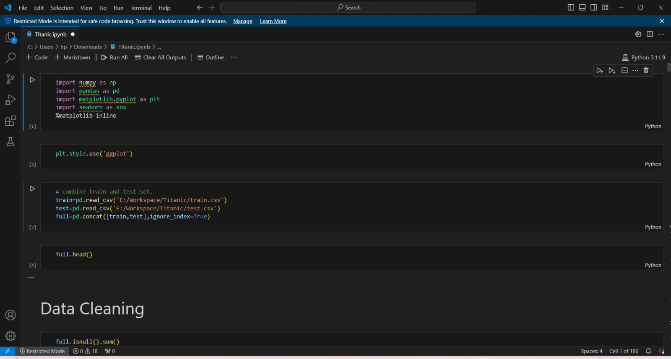
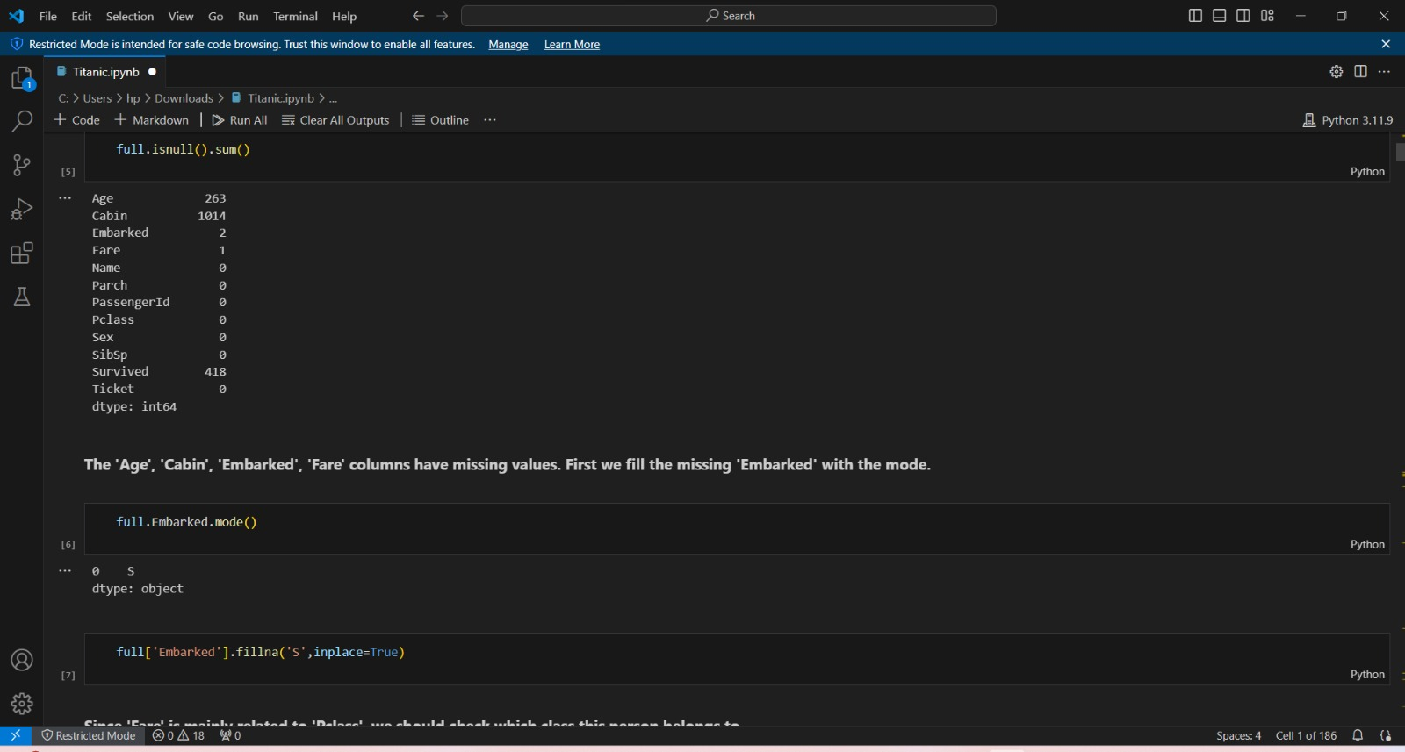
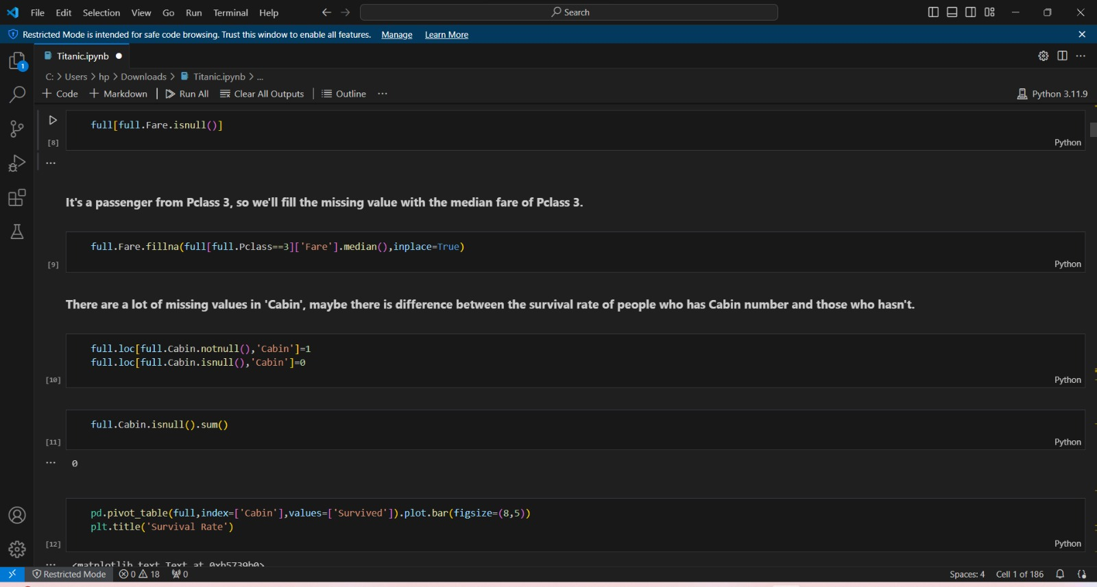
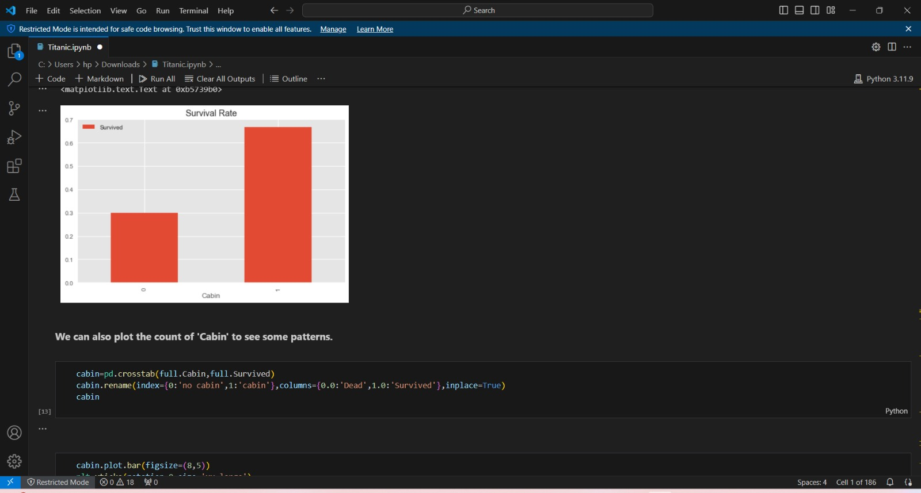
Result

Slide 9
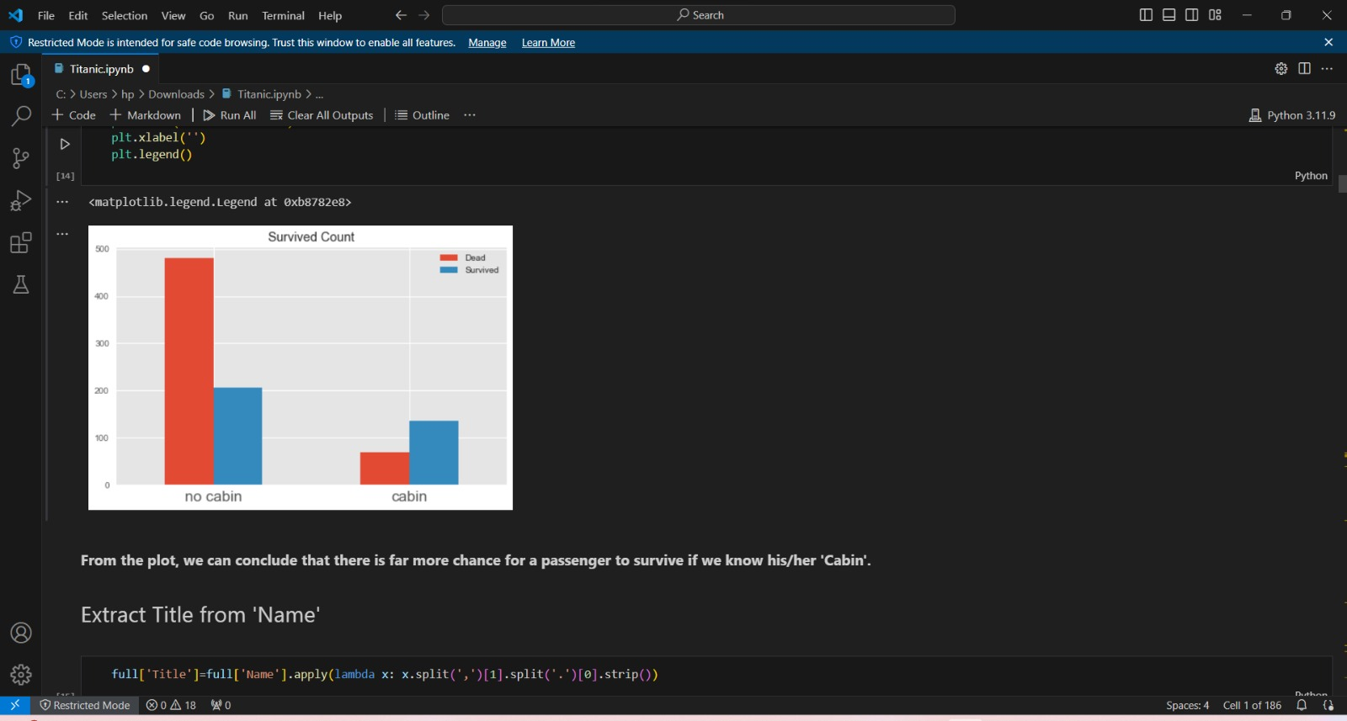
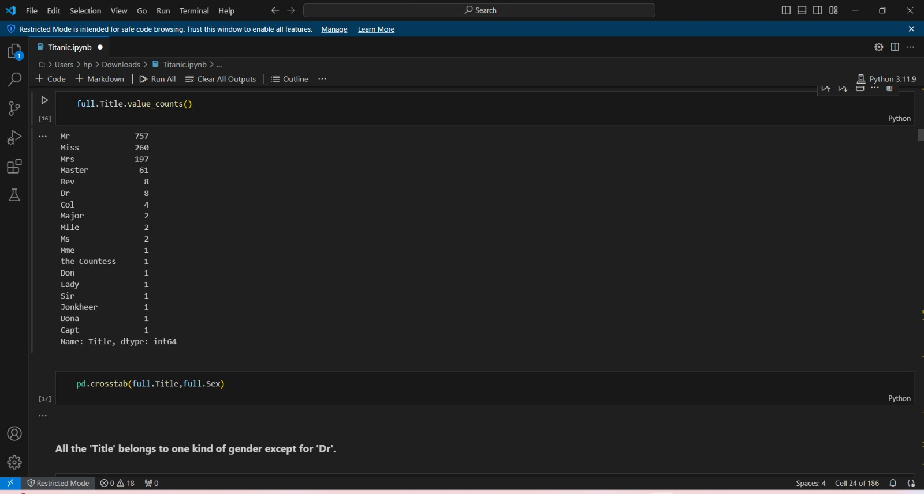
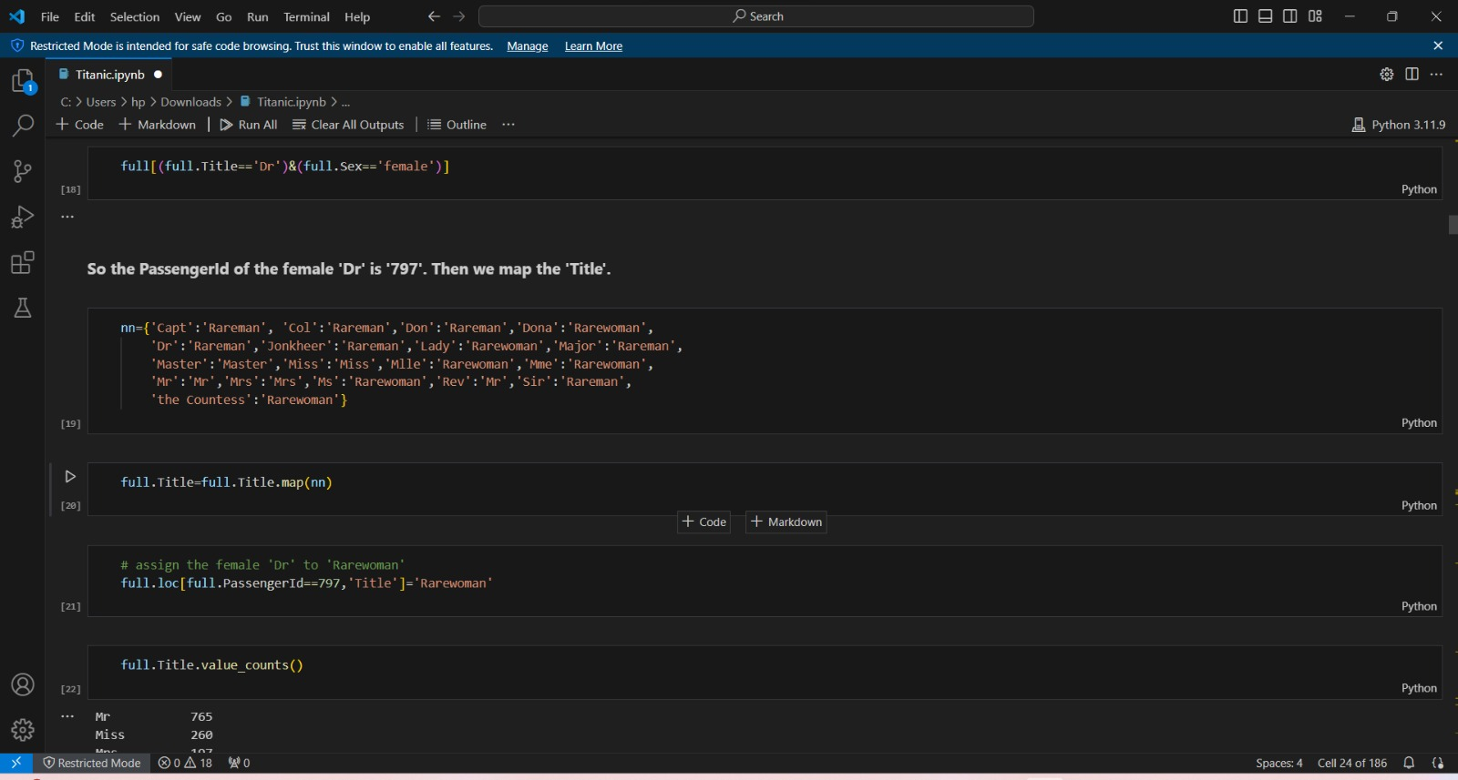
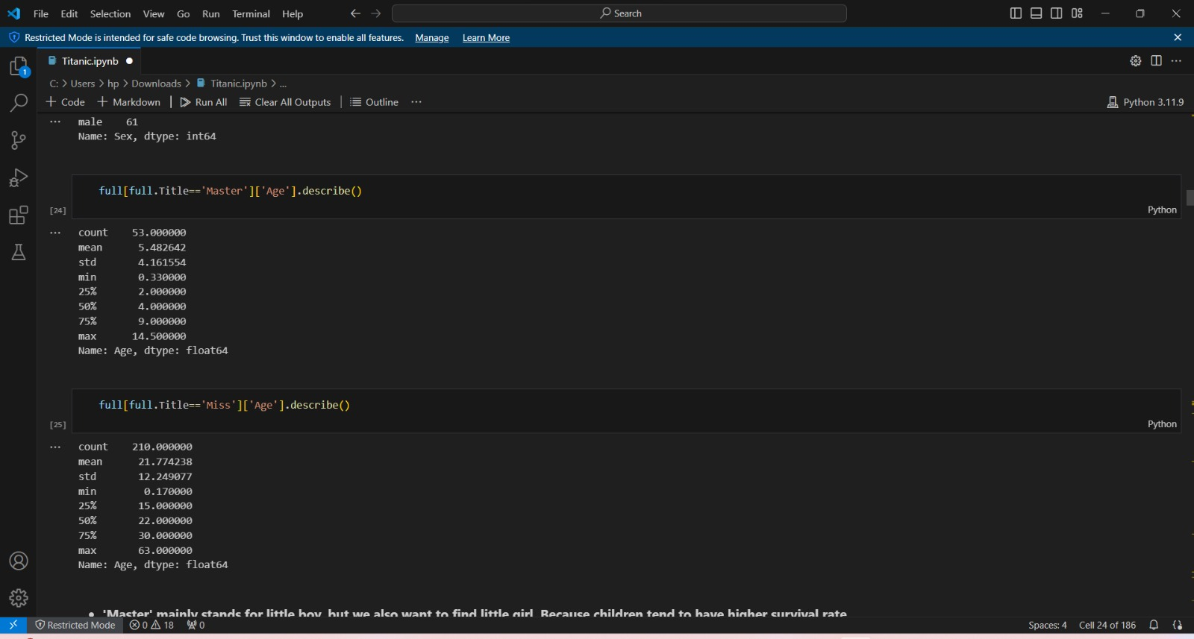

Slide 10
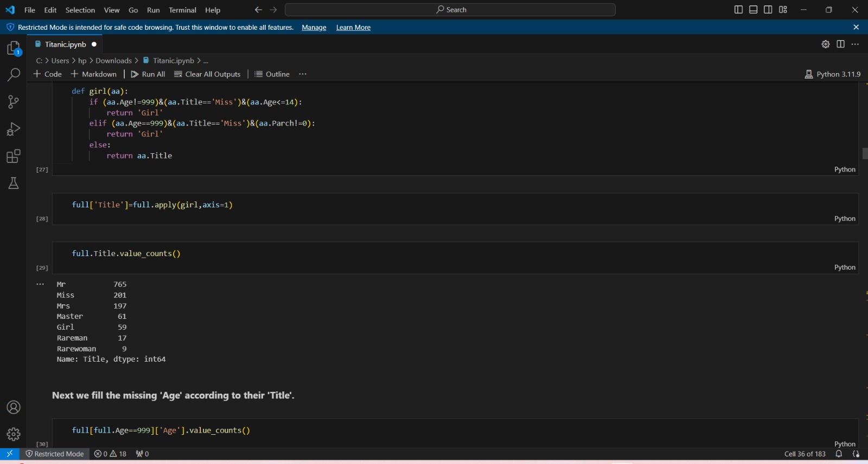
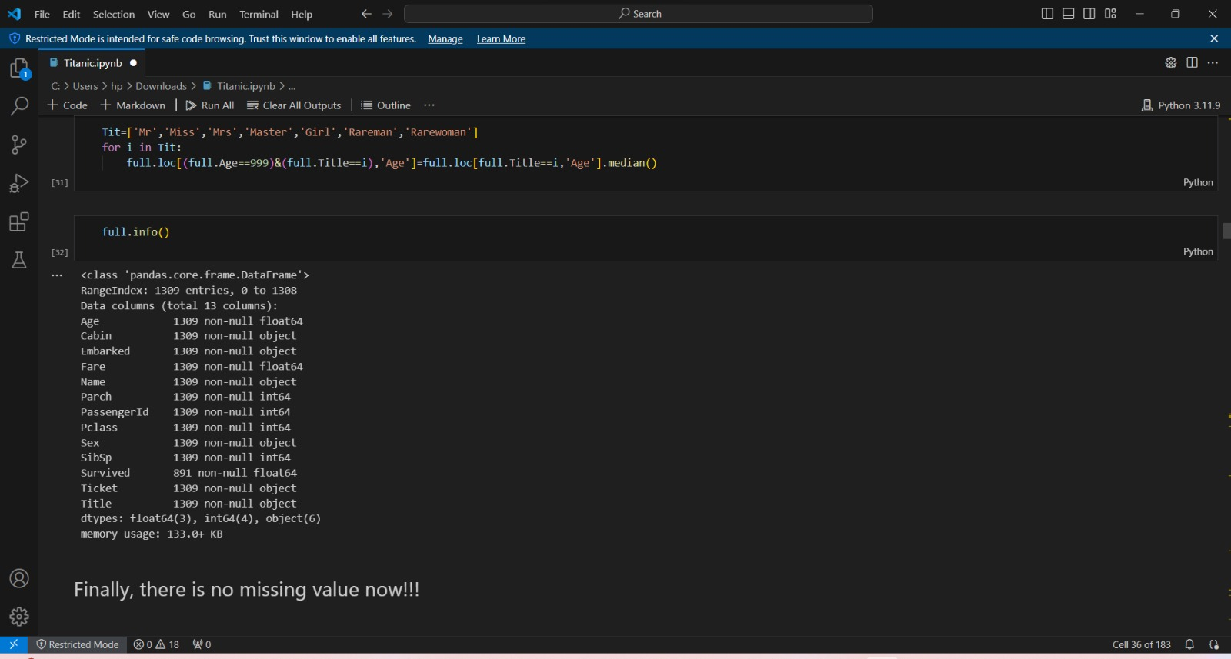
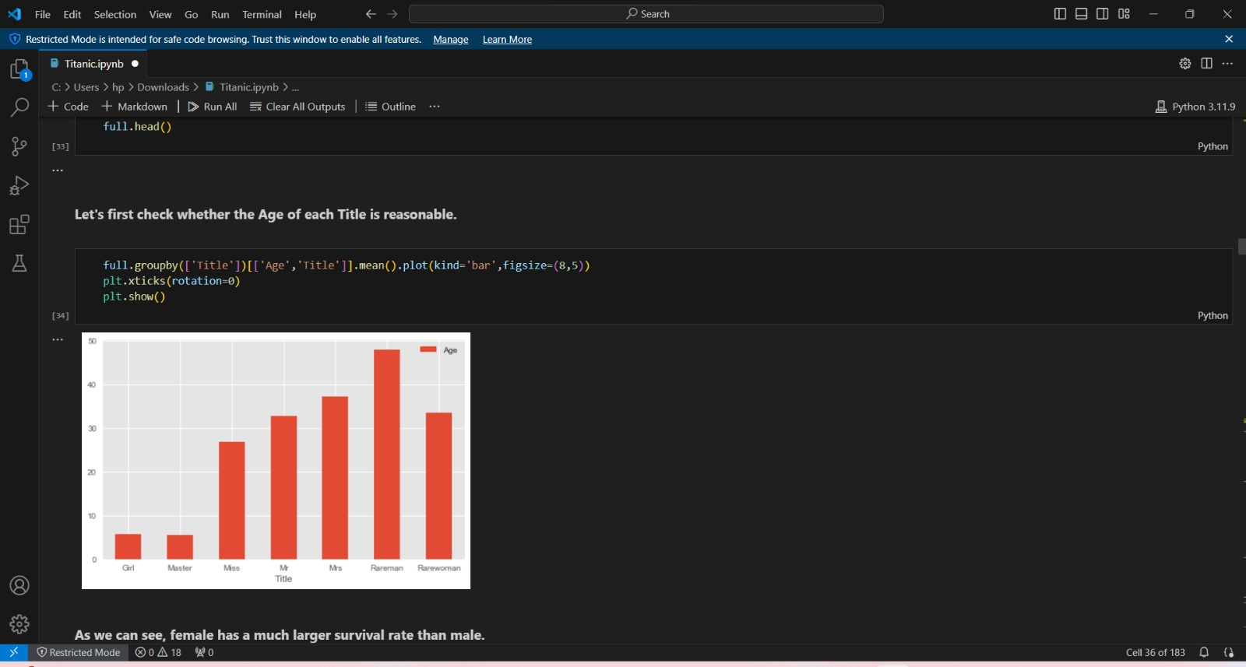
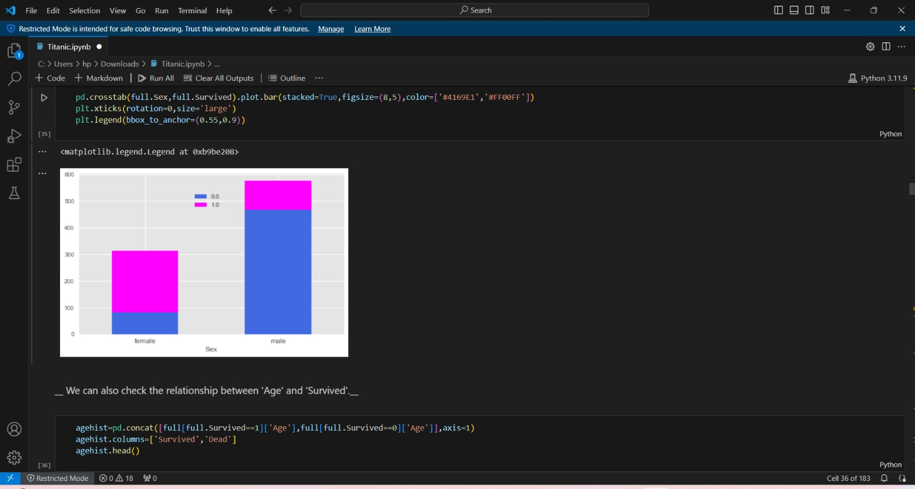

Slide 11
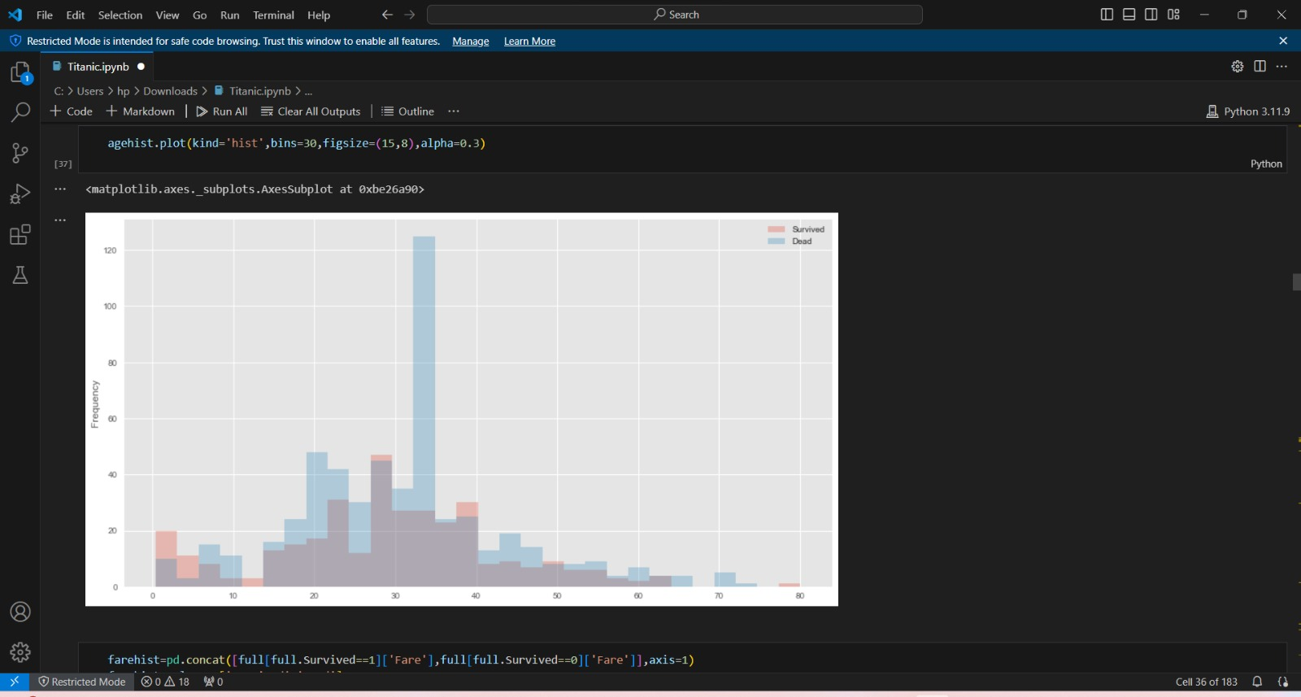
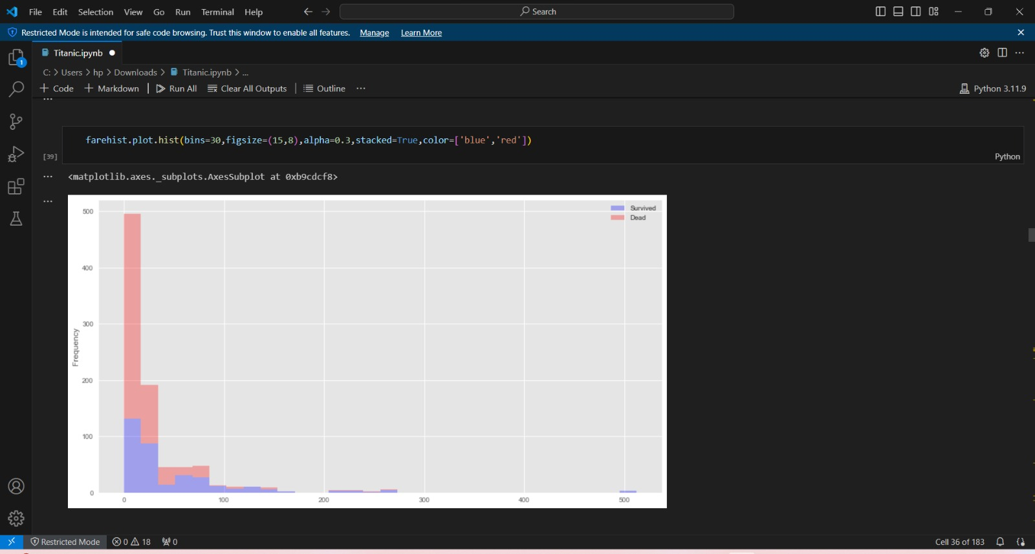
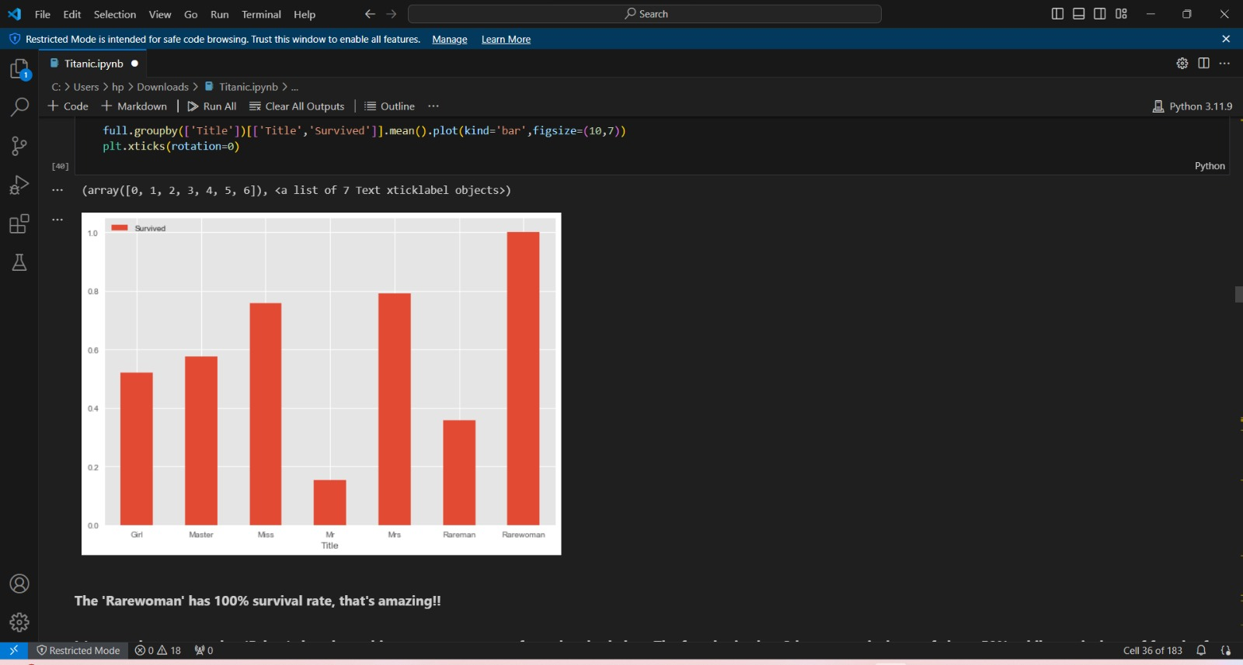
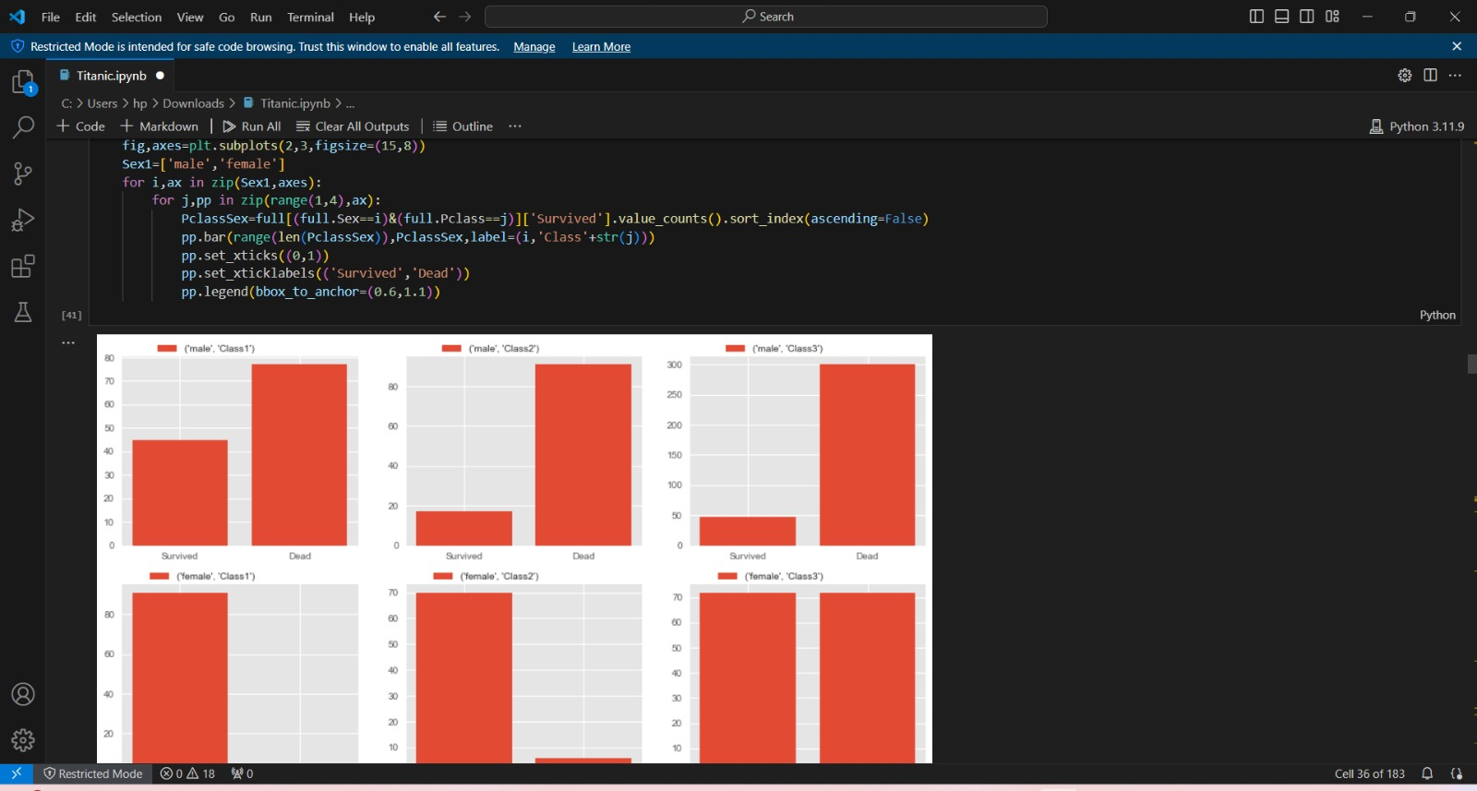

Slide 12
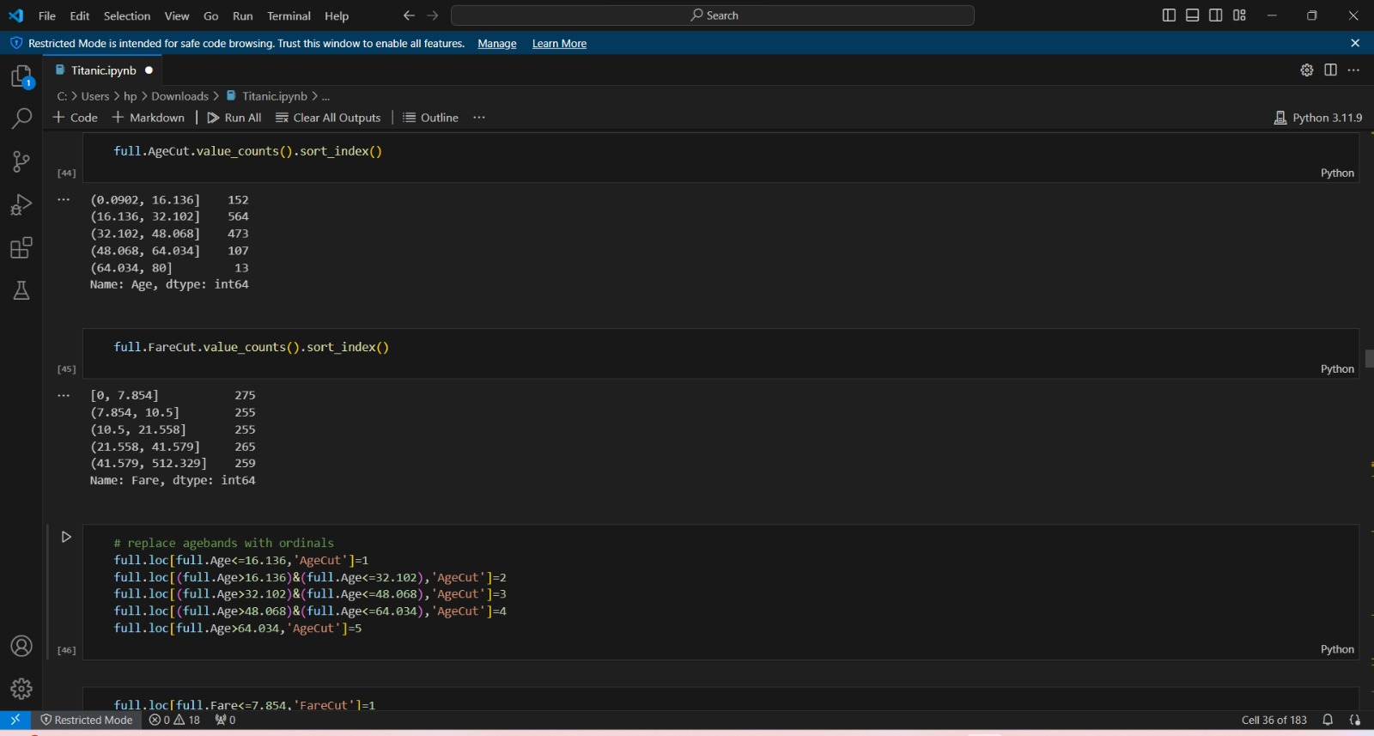
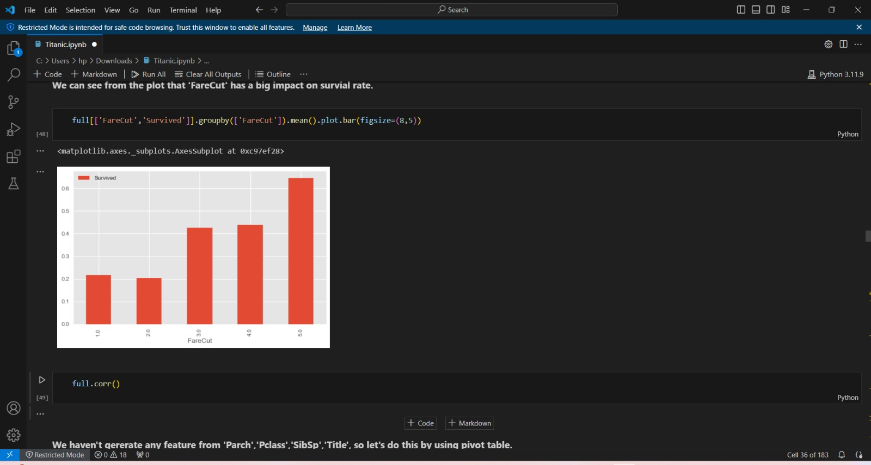
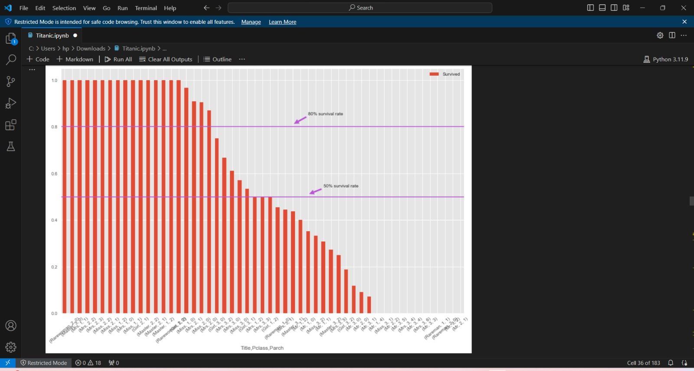
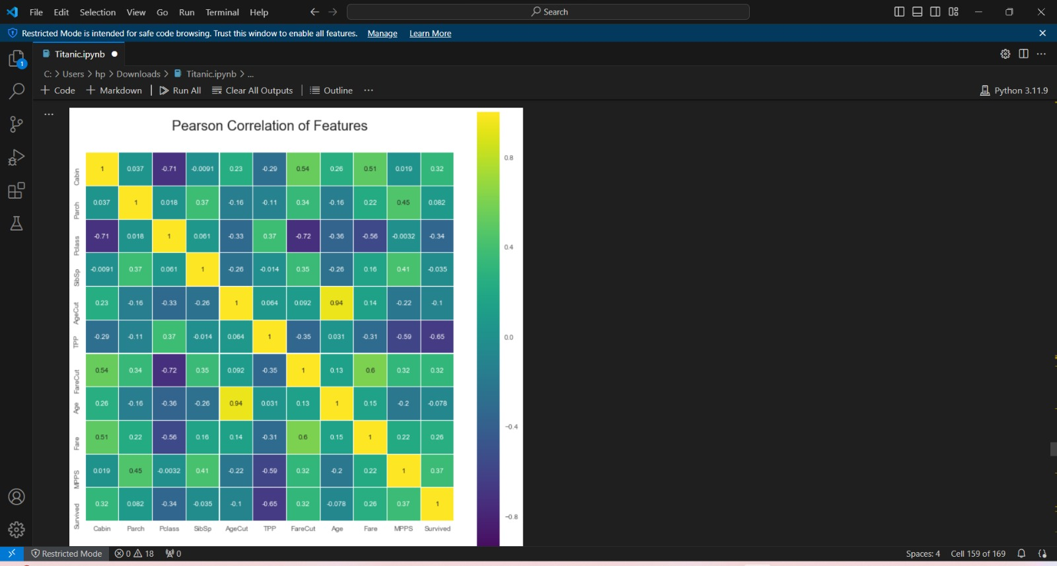

Slide 13
Conclusion
Importance of the Titanic Dataset Historical Context: The dataset is derived from a well-known historical event, making it relatable and interesting for data enthusiasts and machine learning practitioners.
Rich Features: The dataset includes various features like passenger class, gender, age, fare, and more, allowing for in-depth analysis and exploration of relationships between these features and survival.
Popular Benchmark: It is widely used as a benchmark in machine learning competitions, notably Kaggle's Titanic challenge, serving as an entry point for many aspiring data scientists.
Data Preprocessing: Handling missing values, encoding categorical variables, and scaling numerical features are crucial for building effective models.
Exploratory Data Analysis (EDA): Visualizations and correlation analyses provide valuable insights into the dataset's structure and relationships between features.
Feature Engineering: Creating new features or deriving existing ones can enhance model performance. Binning, interaction terms, and derived features contribute to better predictions.
Model Selection and Evaluation: Various algorithms can be used to predict survival, with random forests, gradient boosting, and logistic regression being popular choices. Cross-validation and performance metrics are essential for robust evaluation.

Slide 14
Future scope
Ensemble Learning: Use techniques like boosting, bagging, or stacking to combine multiple models for improved accuracy and robustness.
Deep Learning: Explore neural networks and other deep learning architectures to build sophisticated models.
AutoML: Implement automated machine learning frameworks to identify optimal models and hyperparameters.
Feature Importance: Analyze which features contribute most to survival prediction to understand model behavior.
SHAP and LIME: Use frameworks like SHAP (SHapley Additive exPlanations) and LIME (Local Interpretable Model-agnostic Explanations) to explain model predictions at an individual level.
Model Transparency: Aim for models that provide clear insights into decision-making, essential for deploying models in sensitive contexts.
Resampling Methods: Apply oversampling or undersampling to balance the distribution of survivors and non-survivors in the training data.
Synthetic Data Generation: Use SMOTE (Synthetic Minority Over-sampling Technique) or similar methods to create synthetic data points for the minority clas

Slide 15
References
Kaggle Titanic Dataset: The Kaggle Titanic competition is a popular source for the dataset, offering a downloadable CSV file with passenger data along with a comprehensive guide to get started.
RMS Titanic: Provides historical context about the Titanic disaster, with information about the ship's construction, voyage, and sinking.
Scikit-learn Documentation: Scikit-learn is a widely used machine learning library in Python, with comprehensive documentation and examples for various algorithms.
TensorFlow and Keras Documentation: TensorFlow and Keras are popular deep learning libraries. They provide documentation and tutorials on building machine learning models.
Python Data Science Handbook: This handbook by Jake VanderPlas offers a comprehensive guide to data science in Python, covering libraries like Pandas, NumPy, Matplotlib, and Scikit-learn.
Data Science from Scratch: A book by Joel Grus that introduces the fundamentals of data science and machine learning concepts.
Coursera Data Science Courses: Coursera offers a variety of data science courses, some focusing on the Titanic dataset for practical examples.
Towards Data Science: A Medium publication with a wealth of articles on data science, machine learning, and related topics. It often features tutorials and insights into popular datasets like the Titanic.

Slide 16
THANK YOU

