Slide 1
Avalanche Statistics of Dislocation Plasticity
Presented by: Arun Prakash Ganapathy Supervised by: Dr. Hengxu song
Arun Prakash Ganapathy | The Micromechanical Materials Modelling (MiMM) group | IMFD | TU Bergakademie Freiberg

Slide 2
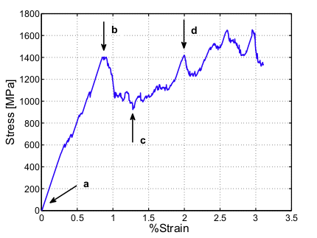
Introduction
What is a Dislocation avalanche?
In macroscopic scale, the plastic deformation appears as smooth curve, but in microscopic scale the deformation happens intermittently i.e.,it takes place through strain bursts. This happens due to dislocation avalanche.
Avalanche starts with dislocation accumulation and formation of dislocation bands. The dislocation gets piled up before the bands whose give away causes avalanches(like opening a flood gate)

Slide 3
Self-Organized Criticality(SOC):
Any Slowly driven non-equilibrium systems self-organize themselves in a critical state where anything can happen within well defined statistical laws
They are Scale-free, intermittent, follows power law distribution and the external driving of the system needs to be much slower than the internal relaxation
Dislocation avalanches also possess the same character with the power law distribution given by P(A) = A^{-τ}
where A - Number of bursts
^{P(A) - Magnitude of bursts}
^{τ - 1.6-2.0}

Slide 4
Measurement of Dislocation avalanches:
Acoustic emission (AE) is a technique used to measure dislocation avalanches because avalanches generate acoustic waves which can be used to describe its properties
Ice is used as a model material to study dislocation dynamics from AE because 1) Ice can be easily grown in laboratory 2) Transparency allows to verify AE is not related to micro-cracking 3)Twinning does not occur in ice 4)and AE transducer can be easily coupled by melting/freezing
One to six piezoelectric transducers of bandwidth 200-750 kHz is attached to the side surface of the cylindrical sample. The dynamic range of the amplitude threshold was set between 30db and 100dB. For each detection above threshold the AE system measures parameters like t_{o} , t_{e} ,δ and A_{o}. Acoustic wave form of a dislocation avalanche is shown as follows

Slide 5
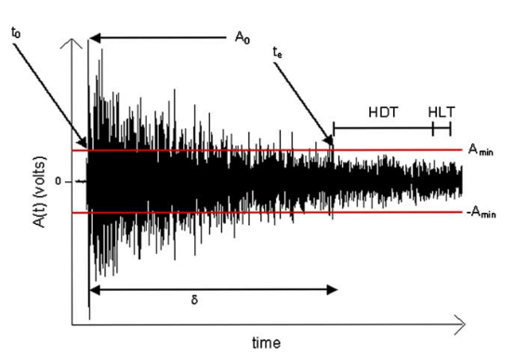
The wave is recorded is then compared with the acoustic wave having same average duration A_{o} which provides information about how fast an avalanche damps from initial propagation velocity

Slide 6
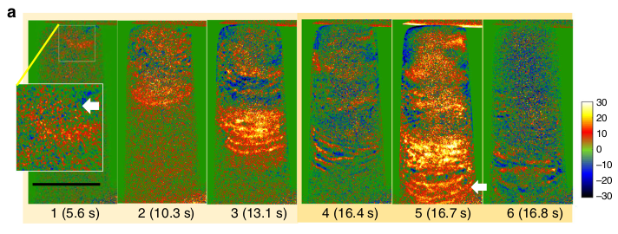
Dislocation avalanches in single crystal:
Dislocation avalanche in a single Al_{0.1}CoCrFeNi crystal characterized by the interaction between dislocation pileup and dislocation band.

Slide 7
Characters of dislocation avalanche in single crystal:
Avalanche in a single crystal is scale invariant, intermittent and the avalanche size distribution follows a power law
The general form of the avalanche strain distribution in a single crystal is given by P(s) = Cs^{-τ} exp[-(s/s_{o})²]
where C is normalization constant and S₀ is the characteristic strain of the largest avalanches
The avalanche size distribution is unaffected by the internal variables like material and crystal structure and also by the applied stress
During the plastic deformation through bursts the instantaneous strain rate my exceed average strain rate by several orders of magnitude

Slide 8
Strain avalanche in sub-micron plasticity of FCC metals:
Since there is not much slip planes in sub-micron level the yield strength and hardening depends on the size of the sample chosen
Stress-strain relationship is characterized by 1)high and stochastic flow stress 2) post yield stress has strain oscillations accompanied with dislocation avalanches
When nickel nano-pillars are studied using 3-D dislocation dynamics it showed the creation and destruction of dipolar loops
When the stress reaches first yield point the dipolar loops interact with boundary leaving behind the pillar trail of debris and the stress starts to rise in order to keep up with the applied strain
When stress reaches critical value the debris become the fresh source of dislocation and the cycle of dislocation starvation and production happens continuously leading to strain oscillations

Slide 9
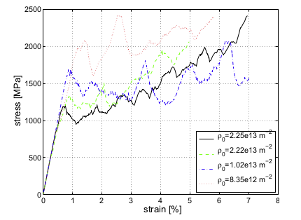
Stress-strain curve of sub-micron plasticity in FCC-metals
From these observations, it is found that the strain avalanching of FCC crystal is dependent on the dislocation density and the presence of dipolar loop. But these parameters are found to have no effect on the universal size distribution of avalanches.

Slide 10
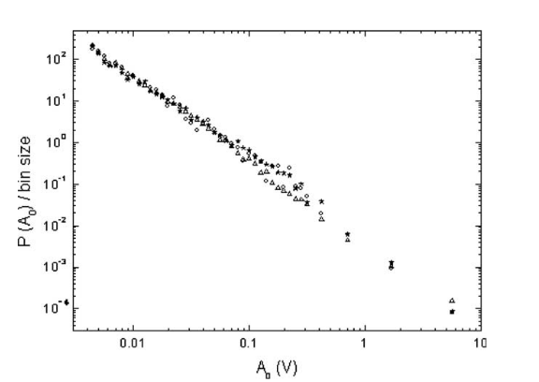
Effect of temperature on avalanches:
To find the effect of temperature on the behaviour of dislocation avalanches uniaxial compression creep test are carried out on ice crystal from -20 to -3⁰C
Even thought the temperature affects the behaviour of individual dislocations like the velocity, relaxation time etc., it does not affect the size distribution of the avalanches
Avalanche size distribution in ice crystal at different temperatures

Slide 11
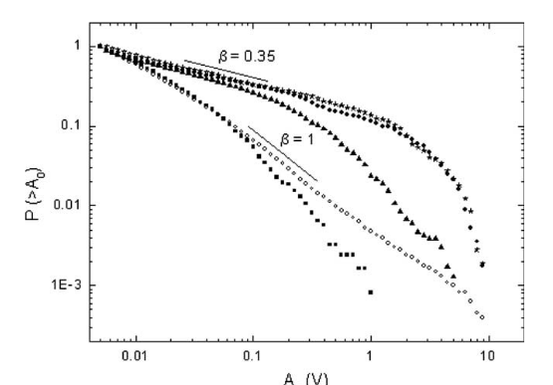
Dislocation avalanches in Polycrystals:
In polycrystals, the propagation of dislocation avalanches is hindered by the presence of Grain boundaries(GBs)
The avalanche size distribution of polycrystals differ from single crystals in two ways 1)Power law exponent is smaller 2) cut-off of power law scaling at larger amplitudes
Avalanche size distribution of polycrystals compared with single crystals

Slide 12
The interaction of dislocations and GBs creates sudden internal stress which breakdown one of the main necessary condition for SOC i.e., an external driving rate much smaller than internal relaxation process
As a consequence the system is forced to relax internal stress through a single large aftershock into neigbouring grain which then triggers the secondary avalanches in the neighbouring grain
This is the main reason for strain hardening in polycrystalline materials during plastic deformation and during the transient creep the level of hardening was found to increase with decreasing grain size
Therefore the presence of grain boundaries affect the scale-free,intermittent, close-to-critical dynamics of the propagation of avalanche size distribution

Slide 13
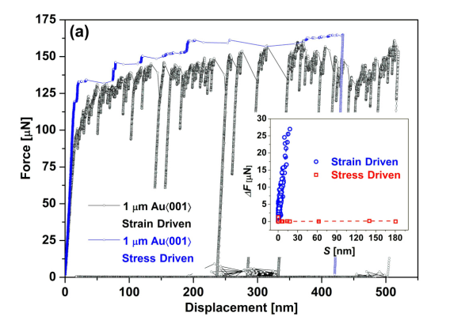
Statistics of dislocation avalanches under different loading modes:
Deformation tests are carried out on microcrystals under force-controlled and displacement controlled loading conditions
Force-displacement curve for microcrystals under different loading conditions

Slide 14
The slip events have larger displacements in stress-driven mode and large overall increments in strain-driven mode
It can be seen from the graph that, the stress is kept approximately in stress driven mode and strain-driven mode is characterised by the force force drops
It is found that the types of deformation mode does not found to have any effect on the scale-free, intermittent, close-to-critical dynamics of dislocation avalanches
But the time series properties like slip sizes and slip frequency depend markedly on the type of loading involved and the slip frequency increases exponentially with increase in plastic strain under stress-driven conditions

Slide 15
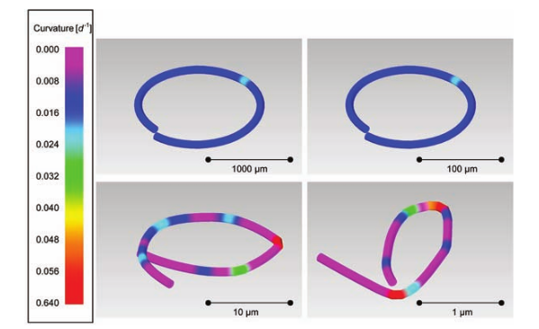
Avalanche behaviour in macroscopic scale:
Since the avalanche strains decrease in inverse proportion to the sample size it is difficult to observe strain bursts in macroscopic samples
Eventhough acoustic emission are recorded during plastic deformation of macroscopic sample it is explained by cut-off of AE energy due to increase in sample size
Experiment conducted on a macroscopic sample (Rod)

Slide 16
Conclusion:
These findings demonstrate that the dislocation avalanches are an intrinsic feature of crystal properties whose properties do not depend on the slip geometry,deformation mode or dynamic properties of dislocations
But in polycrystals the propagation of dislocation avalanche is disturbed by the presence of grain boundaries
By understanding this, the plastic forming on sub-micrometer scale can be controlled by maintaining correspondingly small size grain through out the processing which is given by the strain reduction factor(ξ/L)²
By understanding the dislocation avalanche mechanism that control plasticity in nano and microscales, new materials can be designed with the desired combination of strength and ductility

