Slide 1
Avalanche Statistics in Dislocation Plasticity
Research Seminar and Journal club – SS 2018/19
Presented by: Arun Prakash Ganapathy Supervised by: Dr. Hengxu song
Arun Prakash Ganapathy | Research Seminar and Journal club | TU Bergakademie Freiberg

Slide 2
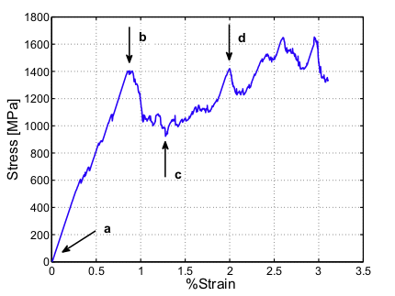
Introduction
What is a Dislocation avalanche?
In macroscopic scale, the plastic deformation appears as smooth curve, but in microscopic scale the deformation happens intermittently i.e.,it takes place through strain bursts. This happens due to dislocation avalanche.
Avalanche starts with dislocation accumulation and formation of dislocation bands. The dislocation gets piled up before the bands whose give away causes avalanches(like opening a flood gate)
Source: The origin of strain avalanches in sub micron plasticity of FCC metals (Tamer Crosby et al)
Characteristic stress-strain curve of a microcrystal

Slide 3
Self-Organized Criticality(SOC):
Any slowly driven non-equilibrium systems self-organize themselves in a critical state where anything can happen within well defined statistical laws
They are Scale-free, intermittent, follows power law distribution and the external driving of the system needs to be much slower than the internal relaxation
The power law distribution of SOC is given by P(A) α A^{-τ}
where A - Number of events
P(A) - Magnitude of the events
^{τ - 1.6-2.0}

Slide 4
Measurement of Dislocation avalanches:
Acoustic emission (AE) is a technique used to measure dislocation avalanches based on the acoustic waves emitted by them
Ice is used as a model material to study dislocation dynamics from AE because 1) Ice can be easily grown in laboratory 2) Transparency allows to verify AE is not related to micro-cracking 3)Twinning does not occur in ice
One to six piezoelectric transducers of bandwidth 200-750 kHz is attached to the side surface of the cylindrical sample. For each detection above threshold, the AE system measures parameters like t_{o} , t_{e} ,δ and A_{o}. Acoustic wave form of a dislocation avalanche is shown as follows

Slide 5
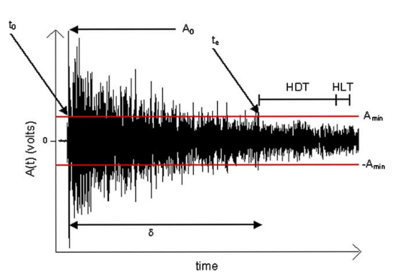
Source: Dislocation avalanches: Role of temperature, grain size and strain hardening (Thiebaud Richeton et al)
Acoustic wave form of a dislocation avalanche
The wave is recorded is then compared with the acoustic wave having same average duration A_{o} which provides information about how fast an avalanche damps from initial propagation velocity

Slide 6
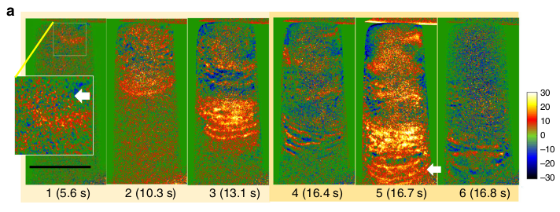
Dislocation avalanches in single crystal:
Source: Dislocation avalanche mechanism in slowly compressed high entropy alloy nanopillars (Yang Hu et al)
Dislocation avalanche in a single Al_{0.1}CoCrFeNi crystal characterized by the interaction between dislocation pileup and dislocation band.

Slide 7
Characters of dislocation avalanche in single crystal:
Avalanche in a single crystal is scale invariant, intermittent and the avalanche size distribution follows a power law
The general form of the avalanche strain distribution in a single crystal is given by P(s) = Cs^{-τ} exp[-(s/s_{o})²]
where C is normalization constant and S₀ is the characteristic strain of the largest avalanches
The avalanche size distribution is unaffected by the internal variables like material and crystal structure and also by the applied stress
During the plastic deformation through bursts the instantaneous strain rate my exceed average strain rate by several orders of magnitude

Slide 8
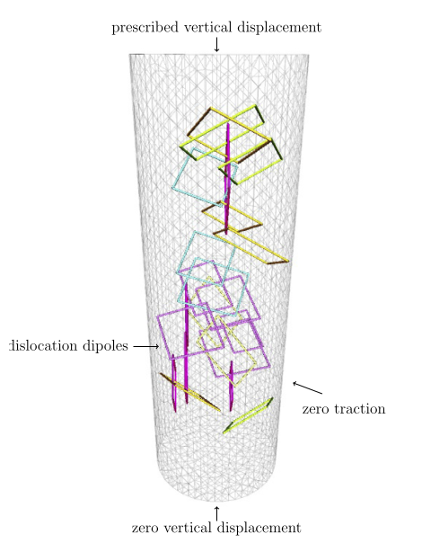
Strain avalanche in sub-micron plasticity of FCC metals:
Since there is not much slip planes in sub-micron level the yield strength and hardening depends on the size of the sample chosen
Stress-strain relationship is characterized by 1)high and stochastic flow stress 2) post yield stress has strain oscillations accompanied with dislocation avalanches
Source: The origin of strain avalanches in sub micron plasticity of FCC metals (Tamer Crosby et al)
Nickel nano pillar considered for observation

Slide 9
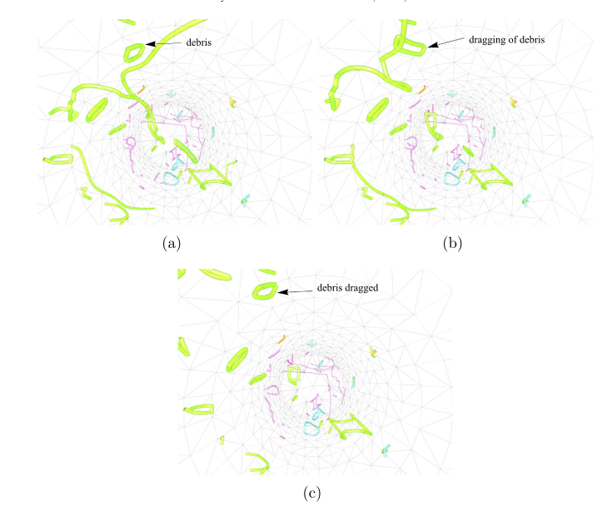
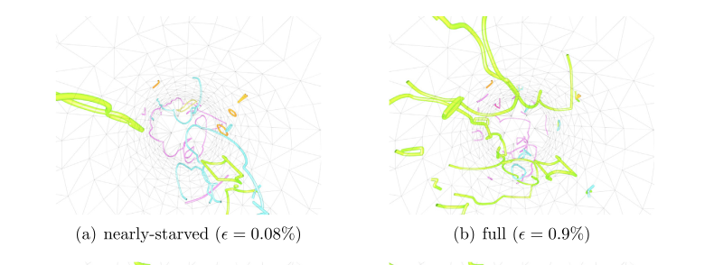
Series of snapshots showing the dragging of debris
Source: The origin of strain avalanches in sub micron plasticity of FCC metals (Tamer Crosby et al)
Snapshots showing evolution of microstructure

Slide 10
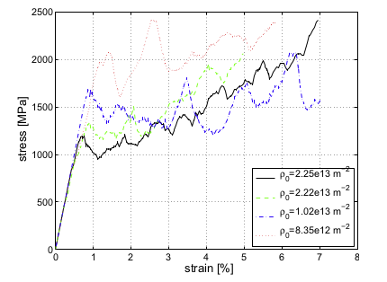
Source: The origin of strain avalanches in sub micron plasticity of FCC metals (Tamer Crosby et al)
Stress-strain curve of sub-micron plasticity in FCC-metals
From these observations, it is found that the strain avalanching of FCC crystal is dependent on the dislocation density and the presence of dipolar loop. But these parameters are found to have no effect on the universal size distribution of avalanches.

Slide 11
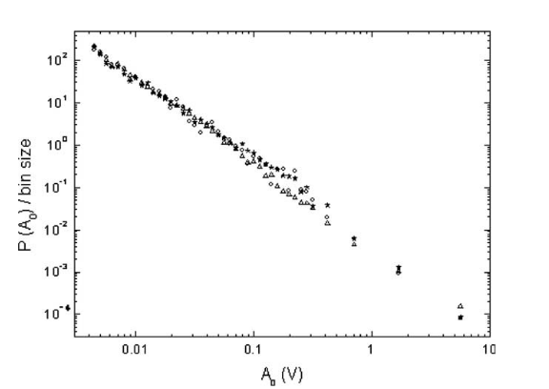
Effect of temperature on avalanches:
To find the effect of temperature on the behaviour of dislocation avalanches uniaxial compression creep test are carried out on ice crystal from -20 to -3⁰C
Even thought the temperature affects the behaviour of individual dislocations like the velocity, relaxation time etc., it does not affect the size distribution of the avalanches
Source: Dislocation avalanches: Role of temperature, grain size and strain hardening (Thiebaud Richeton et al)
Avalanche size distribution in ice crystal at different temperatures

Slide 12
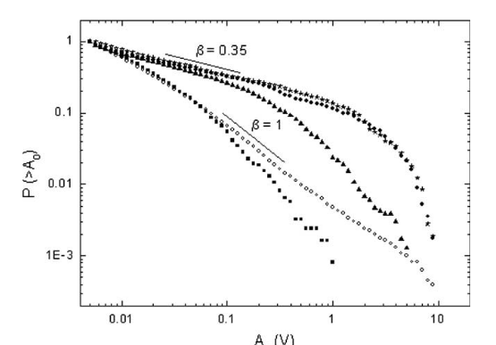
Dislocation avalanches in Polycrystals:
In polycrystals, the propagation of dislocation avalanches is hindered by the presence of Grain boundaries(GBs)
The avalanche size distribution of polycrystals differ from single crystals in two ways 1)Power law exponent is smaller 2) cut-off of power law scaling at larger amplitudes
Source: Dislocation avalanches: Role of temperature, grain size and strain hardening (Thiebaud Richeton et al)
Avalanche size distribution of polycrystals compared with single crystals

Slide 13
The interaction of dislocations and GBs creates sudden internal stress which breakdown one of the main necessary condition for SOC i.e., an external driving rate much smaller than internal relaxation process
As a consequence the system is forced to relax internal stress through a single large aftershock into neigbouring grain which then triggers the secondary avalanches in the neighbouring grain
This is the main reason for strain hardening in polycrystalline materials during plastic deformation
Therefore the presence of grain boundaries affect the scale-free,intermittent, close-to-critical dynamics of the propagation of avalanche size distribution

Slide 14
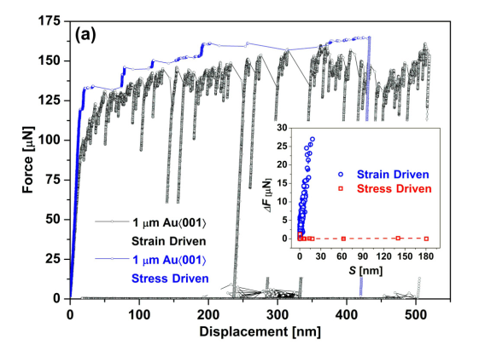
Statistics of dislocation avalanches under different loading modes:
Deformation tests are carried out on microcrystals under force-controlled and displacement controlled loading conditions
Source: Slip statistics of dislocation avalanches under different loading mode (R. Maaß et al)
Force-displacement curve for microcrystals under different loading conditions

Slide 15
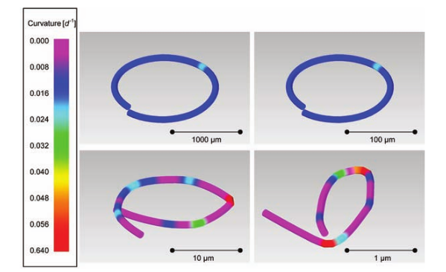
Avalanche behaviour in macroscopic scale:
Since the avalanche strains decrease in inverse proportion to the sample size it is difficult to observe avalanches in macroscopic samples
Eventhough acoustic emission are recorded during plastic deformation of macroscopic sample it is explained by cut-off of AE energy due to dissipated energy (e₀)
Source: Dislocation Avalanches, Strain Bursts, and the Problem of Plastic Forming at the Micrometer Scale (Ferenc F. Csikoret al)
Experiment conducted on a macroscopic sample (Rod)

Slide 16
Conclusion:
These findings demonstrate that the dislocation avalanches are an intrinsic feature of crystal properties which do not depend on the slip geometry,deformation mode or dynamic properties of dislocations
But in polycrystals the propagation of dislocation avalanches is disturbed by the presence of grain boundaries
By understanding this, the plastic forming on sub-micrometer scale can be controlled by maintaining correspondingly small size grain through out the processing which is given by the strain reduction factor(ξ/L)²
By understanding the dislocation avalanche mechanism that control plasticity in nano and microscales, new materials can be designed with the desired combination of strength and ductility

