Slide 1
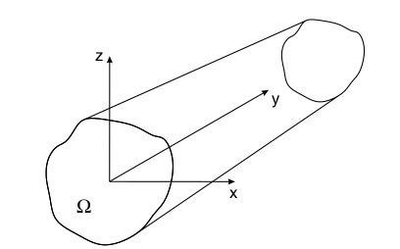
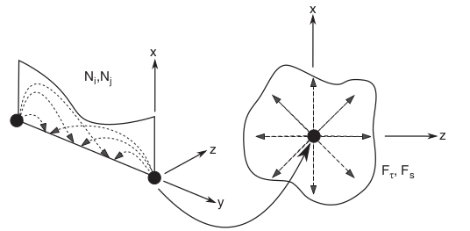
Static analysis of beam structures using refined 1D beam model
Presented by : Arun Prakash Ganapathy (63876) Supervised by: Mr. Jeffy Sabu Abraham

Slide 2
INTRODUCTION
Beam structures are widely used in many engineering applications such as aircraft wings, helicopter blades, concrete beams in constructions etc.,
Classical 1-D models for beams made of isotropic materials are based on Euler-Bernoulli beam and Timoshenko theories.
1D refined models use polynomial expansions (like Taylor,Lagrange polynomials etc.,) to approximate the displacement values across the cross section of the beam.
FE discretization on the axis of the beam element (1D) and an expansion across the cross section (2D) which gives the displacement field.
The displacement function can be written in the compact form as
u = N_{i}(y)F_{τ}(x,z)u_{τi} τ = 1,2,3...M i = 1,2...

Slide 3
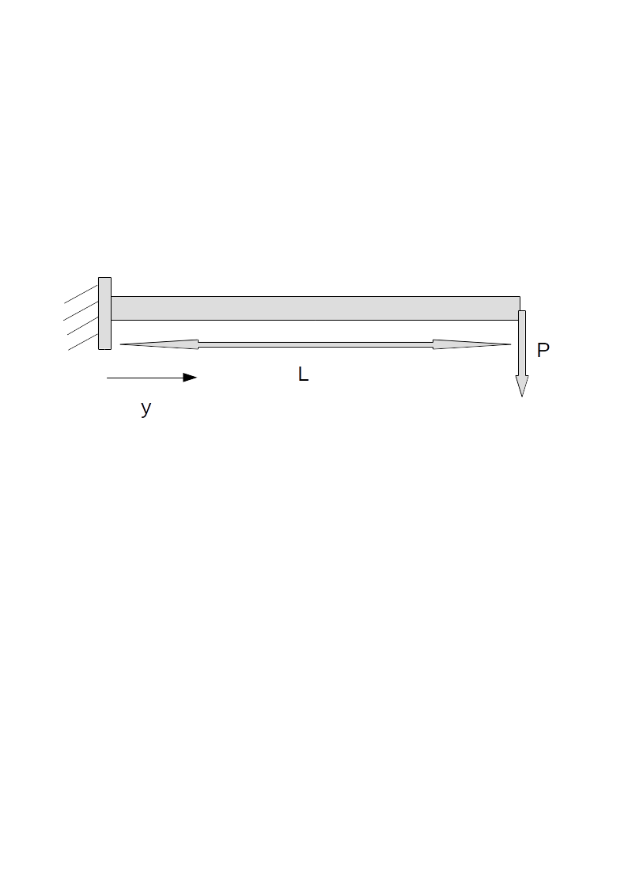
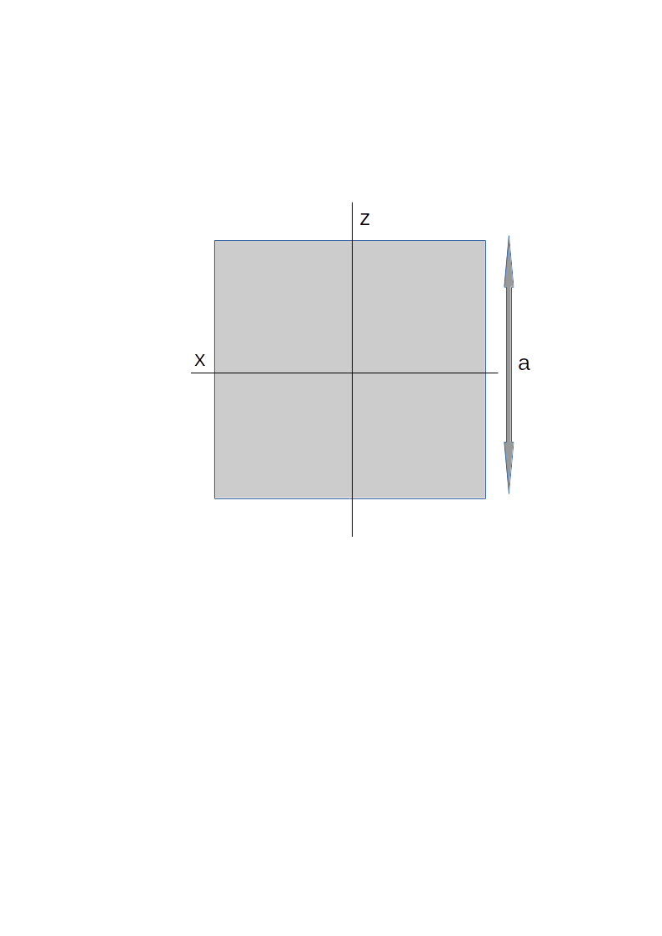
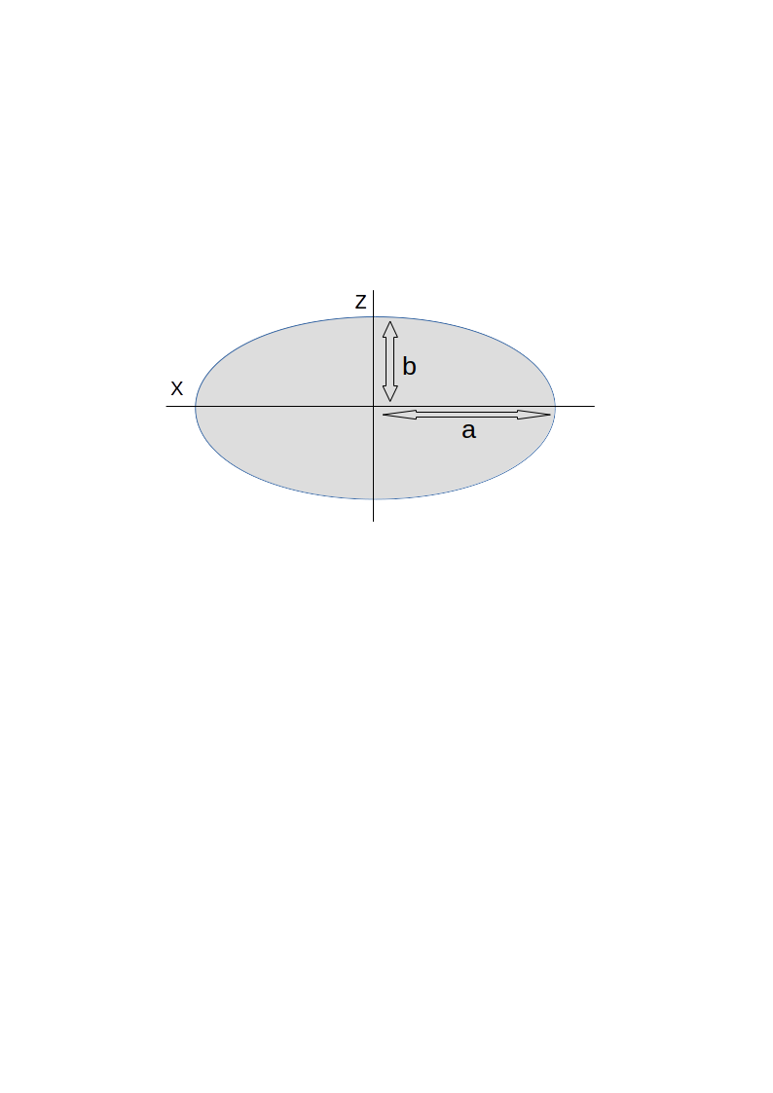
Aim of the project
Cantilever beam
Square cross-section
Elliptical cross-section
Isotropic material of Young’s modulus E and Poisson's ratio ν, has been considered for the analysis of the above beam structures
The aim of this project is to write an FE solver to compute displacements, strains and stresses across the cross-section of the beam using refined 1D beam models and to compare with analytical solutions and FEM software models (NASTRAN)

Slide 4
Theory behind refined beam models
The basic governing equation behind the analysis of static response by principle of virtual displacement is given by the eqn δL_{int} = δL_{ext}
In case of refined 1D models the virtual variation of the internal work is given by δL_{int} = ∫δε^{T} σ dv = δu_{sj} k^{τsij} u_{τ,} where k^{τsij} is the index notation of the stiffness matrix
And the external work is given by δL_{ext} = P δu^{T} = F_{τ} Pδu_{τ}^{T}, where F_{τ} is the expansion function across the cross section
The expansion function considered here are the lagrange polynomial expansion of the displacement variables across the cross-section of the beam
The unknown variables are only displacements of the nodes. No rotation or higher-order variables are used to describe the displacement field

Slide 5
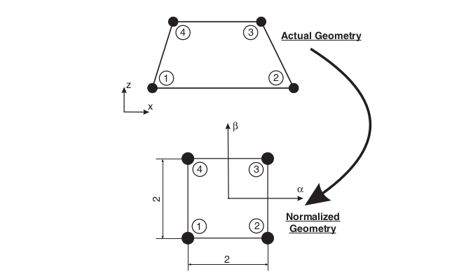
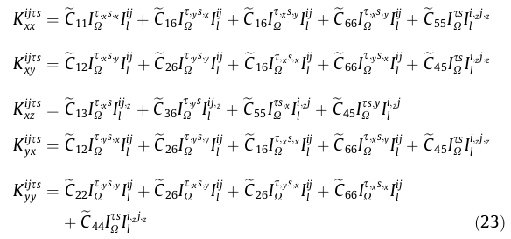
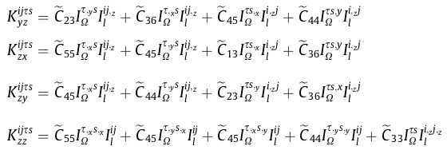
Lagrange expansion polynomial:
1D shape functions along beam axis (Y)
2D Lagrange expansion (L4) across the cross-section
Fundamental nuclei for creating stiffness matrix k^{τsij} :
Source: Finite element analysis of structure through unified formulation (Book by E.Carrera et al)

Slide 6
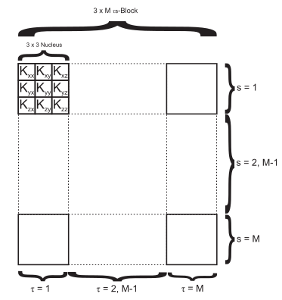
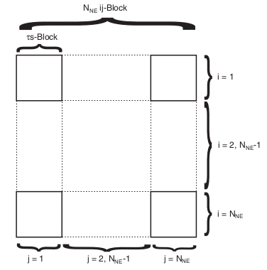
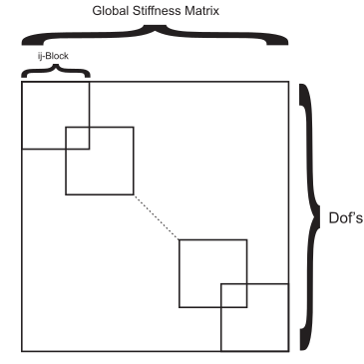
Example:
For a linear beam element (B2) with Lagrange expansion (L4) and for T, s = 2, i = 1 and j = 2
Source: Finite element analysis of structure through unified formulation (Book by E.Carrera et al)
Structure of the stiffness matrix k^{τsij}:

