Slide 1
PS 2024
2nd Year 2nd Sem
Sireesha Puppala

Slide 2
Project Title: Lectures Check
Enhancing Learning Management Systems with AI-driven Content Validation and Analysis

Slide 3
Problem Statement
Dune State University would like all their Professors to record the lectures and upload them to their Learning Management System so that the lectures are available for students to watch anytime. With each video a PDF file too is uploaded. The system needs to validate the video for topic wise coverage. It also needs to match the video content and PDF and show its analysis.

Slide 4
Objective
Develop an AI-powered module using a Language Learning Model that can be integrated with Dune State University's Learning Management System to provide automated validation and analytical insights into the lecture content provided by professors in both video and PDF formats.

Slide 5
Process
Dune State University would like all their Professors to record the lectures and upload them to their Learning Management System so that the lectures are available for students to watch anytime. With each video a PDF file too will be uploaded based on the topics.
The system needs to validate the video for topic wise coverage. It also needs to match the video content and PDF and show its analysis (preferably as percentages and graphs)

Slide 6
Project Description
Uploading Lectures: Professors will record their lectures and upload them to the LMS, ensuring students have access to learning material at any time.
Content Upload: Alongside each video lecture, a corresponding PDF file containing the lecture notes or presentation slides will be uploaded.
LLM Video Analysis:
Implement an LLM that transcribes the audio from the video lectures.
The LLM will analyze the transcribed text to identify key topics covered in the lecture.
Develop algorithms to assess the depth of topic coverage and identify any missing core concepts that are expected to be covered based on the syllabus.
LLM PDF Analysis:
The LLM will process the text within the PDF files to extract topics and subtopics.
Perform semantic analysis to evaluate the relevance and comprehensiveness of the material.

Slide 7
Project Description contd..
Content Matching and Analysis:
The LLM will compare the extracted topics from both the video transcript and PDF to validate that both materials cover the same subjects.
Generate a report that highlights the degree of correlation between video and PDF content.
Interface and Reporting:
Develop a user-friendly interface for professors and administrators to view the analysis reports.
Create dashboards that summarize content coverage, student engagement, and suggestions for improvement.
Student Engagement Analysis (Optional):
Implement sentiment analysis to gauge student engagement and understanding through comments or discussion forums associated with the lecture content.
Use these insights to provide feedback to professors for content improvement.

Slide 8
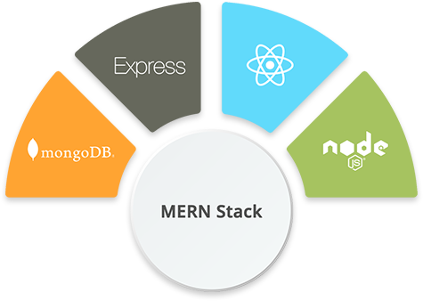
Tech Stack
LLM

Slide 9
Expected Outcome
A robust module that ensures content quality, consistency across different formats, and provides actionable insights for continuous improvement in teaching methodologies and materials.

Slide 10
That is all.

