Slide 1
ANALYSIS REPORT ON PRODUCT TRANSACTION
Agenda
Overall Summary
Total Unit sold: Product-wise
Yearly and Monthly Sales
State-wise : Total Sales Vs Unit Sold Vs Max. Sales
Year-wise: Product Sales
Average Sales and Unit Sold: Product-wise

Slide 2
Overall Summary
Total Courses : 9445
Total Distinct Titles : 1.8M
Total Sale in INR before discout : 46M
Total Sale in INR after discount : 41M
Total Paid Courses : 9445
Total Free course : 0

Slide 3
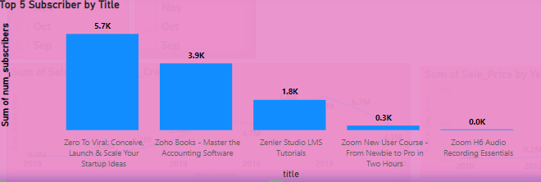
Top 5 Subscriber by Title
The top 5 courses have subscriber numbers of 5.7 for the course “Zero to Viral Conceive Launch & Scale your startup ideas”
Next place 3.9 for the course” Zoho Books,
1.8 for the course “ Zenier Studio LMS tutorials,
0.3 for the course Zoom new user courses.

Slide 4
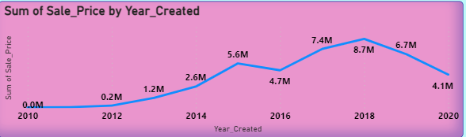
Total Sale by Year created
When the course created , the Sale amount starts in the year 2010 with 0.0M, then gradually increased from 2012 to 2015.
Maximum Sales in the year of 2018, then gradually decreased from 2018 to 2020 ( might be the reason of COVID)
Sale decreased in 2016 and 2020

Slide 5
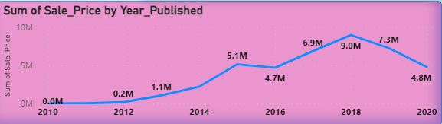
Total Sale by Year Published
When the course published, the Sale amount starts in the year 2010 with 0.0M, then gradually increased from 2012 to 2015.
Maximum Sales in the year of 2018, then gradually decreased from 2018 to 2020 ( might be the reason of COVID)
Sale decreased in 2016 and 2020

Slide 6
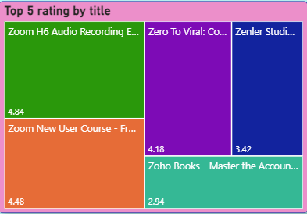
Top 5 Rating by Title
In top 5, the maximum rating is 4.84 for the course Zoom H6 audio recoding
Second top rating is 4.48 for the course Zoon new user course
Third top rating is 4.18 for the course Zero to Viral
The least position in top 5 is 2.94 for the course Zoho Books

Slide 7
Thank You

