Slide 1
Unveiling Insights from Forbes Financial Dataset
Exploring Companies, Trends, and Financial Performance
Presenter: Arunadevi Manickam

Slide 2
Agenda
01
INTRODUCTION
02
DATASET OVERVIEW
03
SUMMARY
04
INSIGHTS
05
CONCLUSION

Slide 3
Introduction
FORBE
The dataset under consideration provides comprehensive financial information and rankings for companies across multiple years.. It covers a wide range of industries and sectors, allowing for sector-specific analysis and comparison.
It includes companies from diverse continents and countries, providing a global perspective on the financial landscape.
Moreover, the dataset's ranking information allows for comparisons among companies based on their performance indicators, such as market value, sales, or profits

Slide 4
Overview of the Dataset
.
Year: The year in which the data was recorded.
Company: The name of the company
Sector: The sector to which the company belongs.
Industry: The specific industry category within the sector.
Continent: The continent where the company is located.
Country: The country where the company is located.
Market Value: The market value of the company, which represents the total market worth of its outstanding shares.

Slide 5
Overview of the Dataset
Sales: The sales revenue generated by the company
Profits: The profits earned by the company, which represent the financial gain after deducting expenses from revenue.
Assets: The total assets owned by the company, including both tangible and intangible assets.
Rank: The rank of the company based on a certain criterion (e.g., market value, sales, or profits)..

Slide 6
Summary
The Total Profit Profits 7831.9252
The Total Sales Sales 111934.721

Slide 7
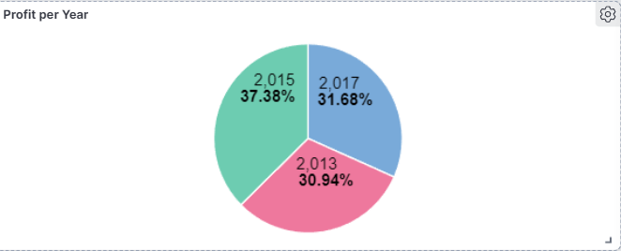
Profits per Year
The year 2015 had the highest profit among the listed years, with a profit value of 2,927.5000. This indicates a strong financial performance and profitability in that particular year.
The year 2017 follows with a profit value of 2,481.4252. This suggests a positive financial performance but slightly lower than the peak year of 2015.
The year 2013 demonstrates a profit value of 2,423.0000. While comparatively lower than the other years, it still represents a respectable level of profitability.

Slide 8
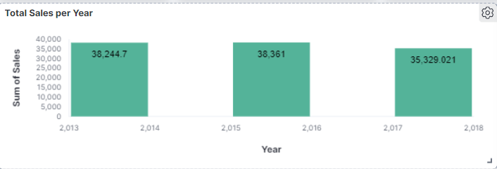
Sales per Year
The year 2015 had the highest sales revenue among the listed years, with sales of 38,361.000 This indicates a strong sales performance and market demand in that particular year.
The year 2013 follows closely behind, with sales revenue of 38,244.700. This suggests a comparable level of sales success and market activity to the peak year of 2015.
The year 2017 demonstrates slightly lower sales revenue, with sales of 35,329.021. This indicates a moderate decline in sales compared to the preceding years.

Slide 9
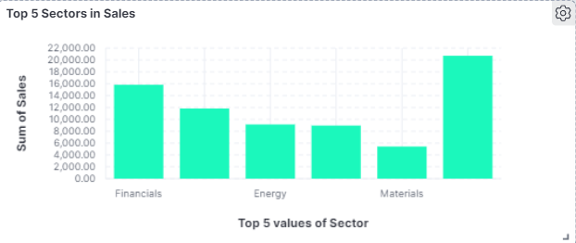
Top 5 Sectors in Sales
The Financials sector has the highest sales revenue, with 15,828.547 (in the respective unit of currency), indicating its strong market position and revenue generation.
The Telecommunication Services sector has the lowest sales revenue, with 2,956.294, suggesting comparatively lower market demand within this sector.

Slide 10
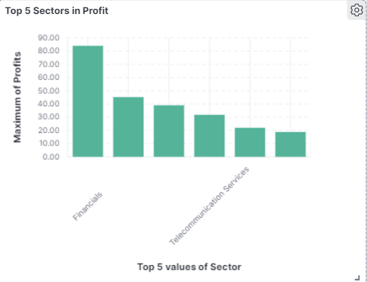
Top 5 Sectors in Profit
The Financials sector has the highest profit, with 1,919.214 (in the respective unit of currency), indicating strong financial performance within this sector.
The Utilities sector has the lowest profit, with 118.149, suggesting comparatively lower profitability within this sector.

Slide 11
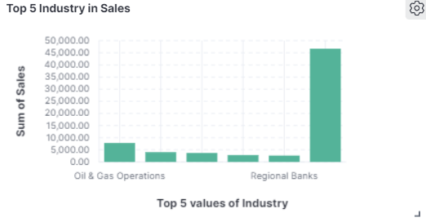
Top 5 Industries in Sales
The Oil & Gas Operations industry has the highest sales revenue, with 7,813.600 (in the respective unit of currency), indicating its significant market presence and revenue generation.
The Regional Banks industry has relatively lower sales revenue, with 2,622.183, suggesting comparatively lower market demand within this industry.

Slide 12
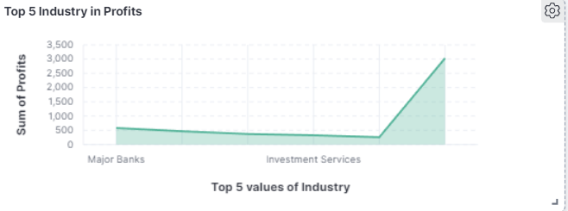
Top 5 Industry in Profit
The Major Banks industry has the highest profit, with 579.939 (in the respective unit of currency), indicating strong financial performance within this industry.
The Telecommunications services industry has relatively lower profit, with 256.839, suggesting comparatively lower profitability within this industry.

Slide 13
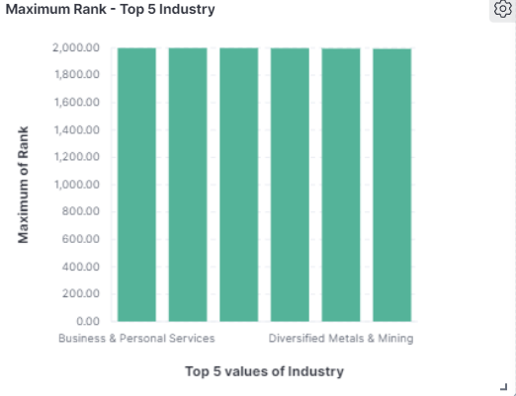
Top 5 Industry in Ranking
Business and Personal Services holds the highest rank among the listed Industry, indicating its strong performance and position within the dataset.
Diversified Metals and Mining follows closely behind, demonstrating a competitive ranking within the dataset.

Slide 14
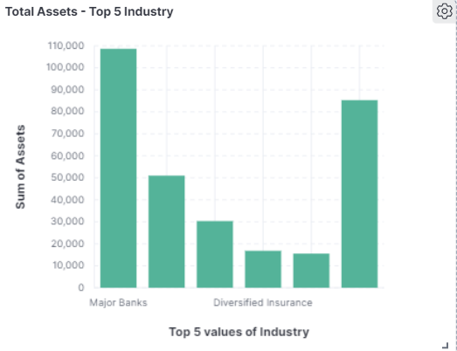
Top 5 Lowest aAssets Companies
Major Banks has the lowest asset value among the listed Industry, indicating relatively lower total assets compared to other Industry in the dataset.
Diversified insurance has a moderately low asset value, suggesting a higher level of total assets compared to the previously mentioned Industry but still relatively lower within the dataset.

Slide 15
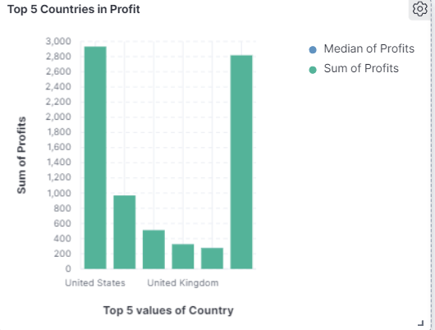
Top 5 Countries in Profit
United States has the highest profit value among the listed countries, indicating a substantial amount of total profit and financial strength.
United Kingdom demonstrating a week profit base and financial stability.

Slide 16
Insights
Sales per Country
Slaes per Year
The United States has the highest sales revenue among the listed countries, indicating a strong market presence and revenue generation.
Russia has the lowest sales revenue among the listed countries, suggesting relatively lower market demand within this country.
Market Value
The year 2015 had the highest sales revenue, indicating a strong sales performance and market demand in that particular year.
The year 2017 demonstrates slightly lower sales revenue, suggesting a moderate decline in sales compared to the preceding years.
Profits
The Major Banks industry has the highest market value, indicating its significant market presence and valuation.
The Utilities sector has a comparatively lower market value, suggesting relatively lower market valuation within this sector.
Sales
The Major Banks industry has the highest profit, indicating strong financial performance within this industry.
The Utilities sector has the lowest profit, suggesting comparatively lower profitability within this sector.
The Financials sector has the highest sales revenue, indicating its strong market position and revenue generation.
The Utilities sector has relatively lower sales revenue, suggesting comparatively lower market demand within this sector.

Slide 17
Insights
Sales per Sector
The Financials sector has the highest sales revenue, indicating its strong market position and revenue generation.
The Telecommunication Services sector has the lowest sales revenue, suggesting comparatively lower market demand within this sector.
Sales per Industry
The Oil & Gas Operations industry has the highest sales revenue, indicating its significant market presence and revenue generation.
The Regional Banks industry has relatively lower sales revenue, suggesting comparatively lower market demand within this industry.
Profit per Industry
Market Vlue per Industry
The Major Banks industry has the highest profit, indicating strong financial performance within this industry.
The Telecommunications services industry has relatively lower profit, suggesting comparatively lower profitability within this industry.
The Major Banks industry has the highest market value, indicating its significant market presence and valuation.
The Telecommunications services industry has a comparatively lower market value, suggesting relatively lower market valuation within this industry.

Slide 18
Company Insights
Apple has the highest market value, indicating its strong market position and high valuation.
BMCE Bank follows closely behind, demonstrating a competitive ranking within the dataset.
Exxon Mobil follows with a significant market value, highlighting its presence in the energy sector.
TechnipFMC has the lowest asset value, indicating relatively lower total assets compared to other companies in the dataset.
Synovus Financial holds the highest rank among the listed companies, indicating its strong performance and position within the dataset.
Fannie Mae has the highest asset value, indicating a substantial amount of total assets and financial strength.

Slide 19
Conclusion
The analysis of the provided financial dataset offers valuable insights into sales, profits, market value, rankings, and asset values across sectors, industries, countries, and companies.
Key findings include the strong sales revenue in the Financials sector, the high profitability of the Major Banks industry, and their significant market value.
The dataset highlights the highest sales revenue in the United States, while Russia exhibits relatively lower market demand.
Specific companies, such as Apple and Exxon Mobil, stand out with their strong market positions and high valuations.
Rankings reveal top-performing companies, with Synovus Financial holding the highest rank, indicating exceptional performance.
TechnipFMC and Fannie Mae represent examples of companies with relatively lower and higher asset values, respectively.
These insights empower businesses, investors, and analysts to make informed decisions by understanding market trends, assessing financial performance, and evaluating competitive positions.

Slide 20
THANK YOU
Insert the Subtitle of Your Presentation

