Slide 1
Unveiling Insights from Forbes Financial Dataset
Exploring Companies, Trends, and Financial Performance
Presenter: Arunadevi Manickam

Slide 2
Agenda
01
INTRODUCTION
02
DATASET OVERVIEW
03
SUMMARY
04
INSIGHTS
05
CONCLUSION

Slide 3
Introduction
FORBE
The dataset under consideration provides comprehensive financial information and rankings for companies across multiple years.. It covers a wide range of industries and sectors, allowing for sector-specific analysis and comparison.
It includes companies from diverse continents and countries, providing a global perspective on the financial landscape.
Moreover, the dataset's ranking information allows for comparisons among companies based on their performance indicators, such as market value, sales, or profits

Slide 4
Overview of the Dataset
.
Year: The year in which the data was recorded.
Company: The name of the company
Sector: The sector to which the company belongs.
Industry: The specific industry category within the sector.
Continent: The continent where the company is located.
Country: The country where the company is located.
Market Value: The market value of the company, which represents the total market worth of its outstanding shares.

Slide 5
Overview of the Dataset
Sales: The sales revenue generated by the company
Profits: The profits earned by the company, which represent the financial gain after deducting expenses from revenue.
Assets: The total assets owned by the company, including both tangible and intangible assets.
Rank: The rank of the company based on a certain criterion (e.g., market value, sales, or profits)..

Slide 6
Summary
The Total Profit Profits 7831.9252
The Total Sales Sales 111934.721

Slide 7
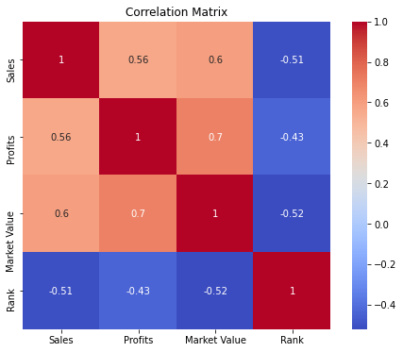
Correlation between Sales,Profits, Market Values and Ranks
+Ve Corrrelation of 0.56 between sales and profit indicates that as sales increase, profits tend to increase as well.
+Ve correlation of 0.6 between sales and market value indicates that companies with higher sales tend to have a higher market value, indicating that investors value companies with strong sales performance.
* +Ve correlation of 0.7 between profit and market value indicates that companies with higher profits generally have a higher market value, indicating that profitability is an important factor for investors when assessing a company's value.
* The negative correlation coefficients of -0.51, -0.43, and -0.52 between rank and sales, profit, and market value, respectively, indicate that companies with higher ranks (lower numerical ranks) tend to have lower sales, profits, and market values. A lower rank implies a higher standing in terms of market value, sales, and profits.

Slide 8
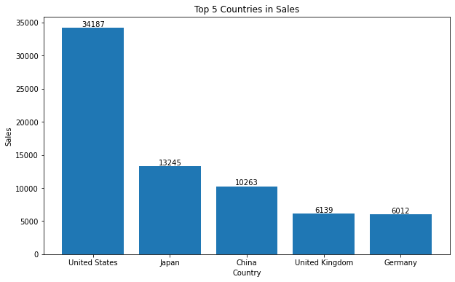
Top 5 Countries in Sales
The United States has the highest sales revenue among the listed countries, with a sales value of 34,187.709
Japan has the second-highest sales revenue, with a sales value of 13,245.985.
China follows closely behind with a sales value of 10,263.017.
The United Kingdom has a comparatively lower but still notable sales revenue of 6,139.789. This suggests a stable market and consumer activity in the UK.
Germany also demonstrates a strong market presence with a sales value of 6,012.301. This highlights Germany's economic strength and consumer demand.

Slide 9
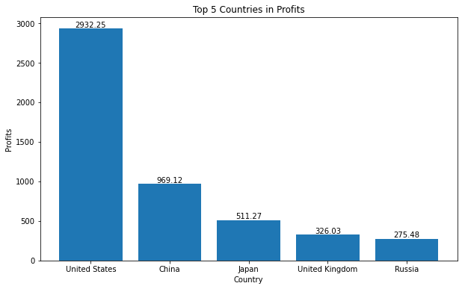
Top 5 Countries in Profits
The United States has the highest profit among the listed countries, with a profit value of 2,932.2522. This indicates strong profitability and financial success in the United States.
China follows with a considerable profit value of 969.1190..
Japan has a comparatively lower but still notable profit value of 511.2650.
The United Kingdom demonstrates a profit value of 326.0330.
Russia rounds out the list with a profit value of 275.4750. While comparatively lower than the other countries, it still signifies a positive financial performance in the Russian market.

Slide 10
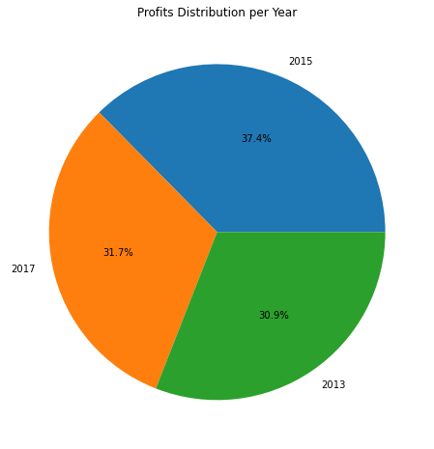
Profits per Year
The year 2015 had the highest profit among the listed years, with a profit value of 2,927.5000. This indicates a strong financial performance and profitability in that particular year.
The year 2017 follows with a profit value of 2,481.4252. This suggests a positive financial performance but slightly lower than the peak year of 2015.
The year 2013 demonstrates a profit value of 2,423.0000. While comparatively lower than the other years, it still represents a respectable level of profitability.

Slide 11
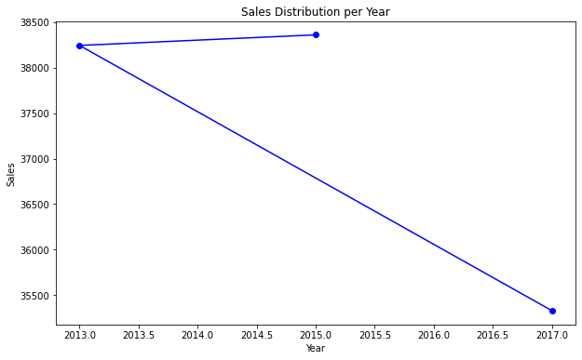
Sales per Year
The year 2015 had the highest sales revenue among the listed years, with sales of 38,361.000 This indicates a strong sales performance and market demand in that particular year.
The year 2013 follows closely behind, with sales revenue of 38,244.700. This suggests a comparable level of sales success and market activity to the peak year of 2015.
The year 2017 demonstrates slightly lower sales revenue, with sales of 35,329.021. This indicates a moderate decline in sales compared to the preceding years.

Slide 12
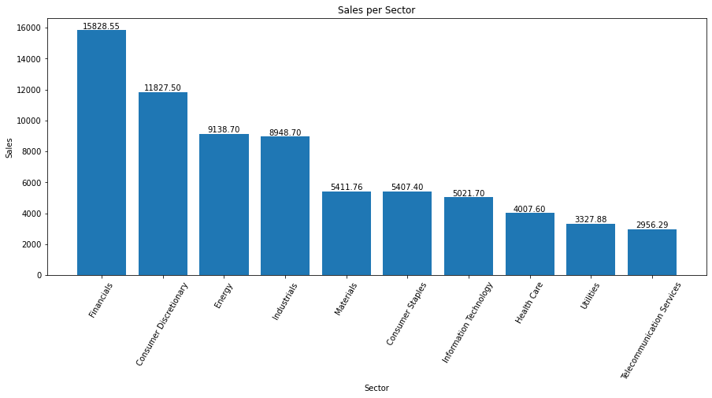
Sales per Sector
The Financials sector has the highest sales revenue, with 15,828.547 (in the respective unit of currency), indicating its strong market position and revenue generation.
The Telecommunication Services sector has the lowest sales revenue, with 2,956.294, suggesting comparatively lower market demand within this sector.

Slide 13
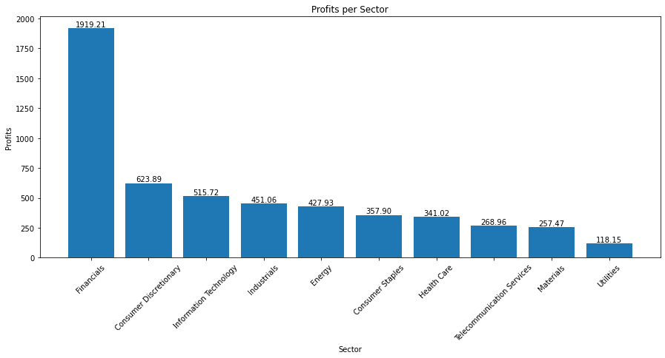
Profits per Sector
The Financials sector has the highest profit, with 1,919.214 (in the respective unit of currency), indicating strong financial performance within this sector.
The Utilities sector has the lowest profit, with 118.149, suggesting comparatively lower profitability within this sector.

Slide 14
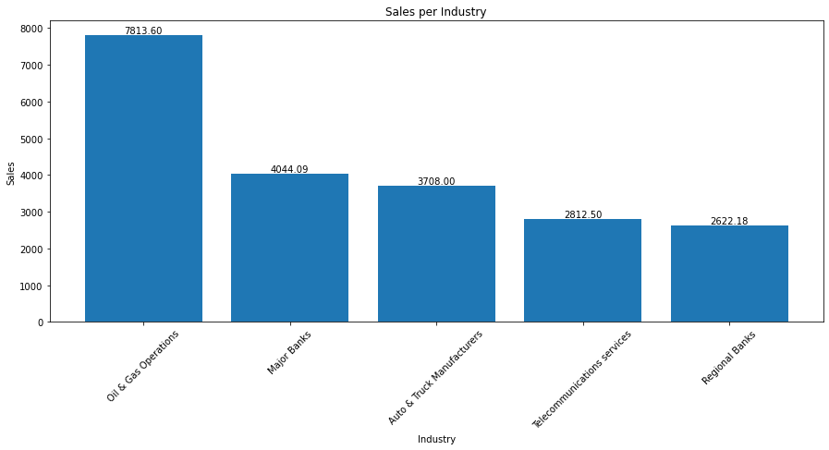
Top 5 Sales per Industry
The Oil & Gas Operations industry has the highest sales revenue, with 7,813.600 (in the respective unit of currency), indicating its significant market presence and revenue generation.
The Regional Banks industry has relatively lower sales revenue, with 2,622.183, suggesting comparatively lower market demand within this industry.

Slide 15
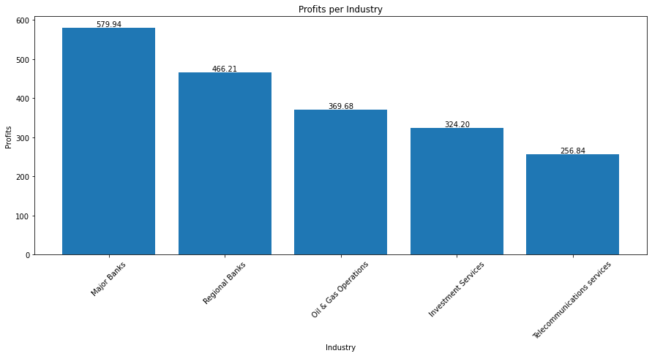
Top 5 Profits per Industry
The Major Banks industry has the highest profit, with 579.939 (in the respective unit of currency), indicating strong financial performance within this industry.
The Telecommunications services industry has relatively lower profit, with 256.839, suggesting comparatively lower profitability within this industry.

Slide 16
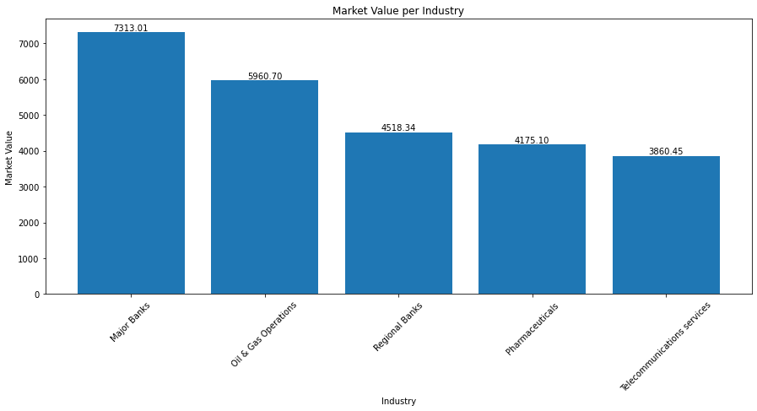
Top 5 Market value per Industry
The Major Banks industry has the highest market value, with 7,313.013 (in the respective unit of currency), indicating its significant market presence and valuation.
The Telecommunications services industry has a comparatively lower market value, with 3,860.452, suggesting relatively lower market valuation within this industry.

Slide 17
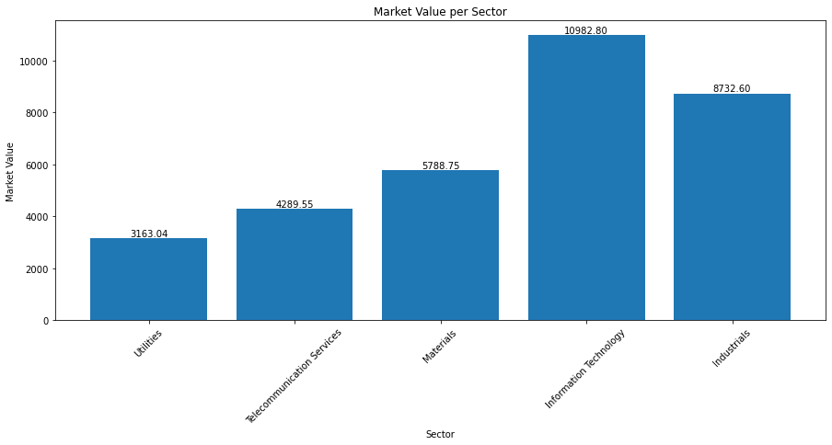
Top 5 Market value per Sector
The Information Technology sector has the highest market value, with 10,982.800 (in the respective unit of currency), indicating its strong market presence and high valuation.
The Utilities sector has a comparatively lower market value, with 3,163.040, suggesting relatively lower market valuation within this sector.

Slide 18
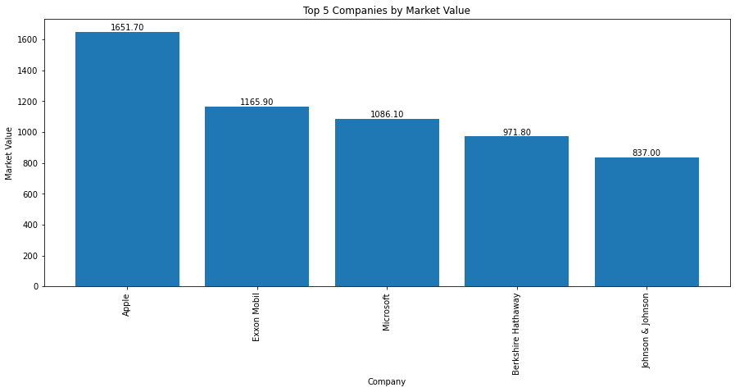
Top 5 Companies per Market value
Apple has the highest market value among the listed companies, with a value of 1651.7 indicating its strong market position and high valuationJohnson & Johnson has a market value of 837.0, showcasing its strong market presence as a leading healthcare company.

Slide 19
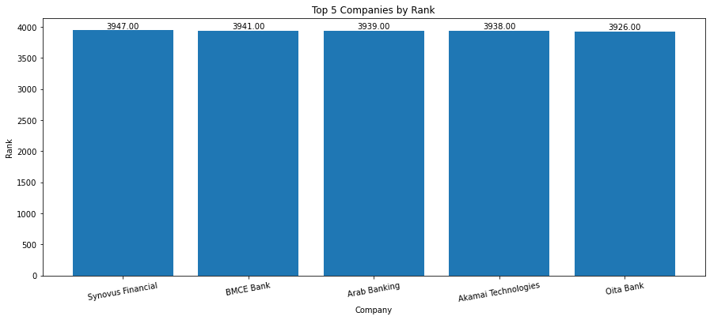
Top 5 Higher rank Companies
Synovus Financial holds the highest rank among the listed companies, indicating its strong performance and position within the dataset.
BMCE Bank follows closely behind, demonstrating a competitive ranking within the dataset.

Slide 20
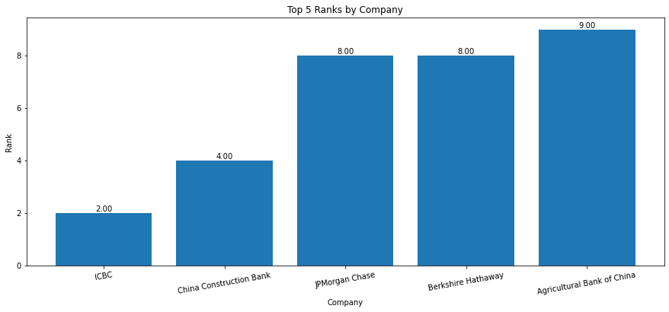
Top 5 Lower rank Companies
ICBC (Industrial and Commercial Bank of China) holds the second rank among the listed companies, highlighting its significant market position and financial strength.
China Construction Bank follows closely behind, holding the fourth rank, indicating its strong performance and position within the dataset.

Slide 21
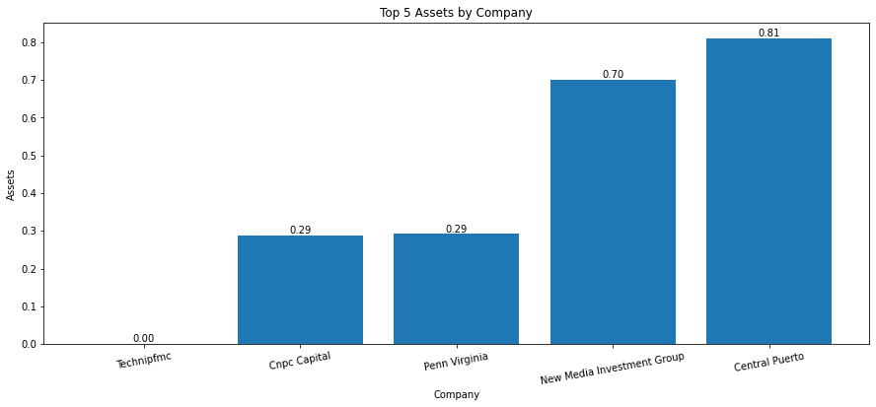
Top 5 Lowest aAssets Companies
TechnipFMC has the lowest asset value among the listed companies, indicating relatively lower total assets compared to other companies in the dataset.
Central Puerto has a moderately low asset value, suggesting a higher level of total assets compared to the previously mentioned companies but still relatively lower within the dataset.

Slide 22
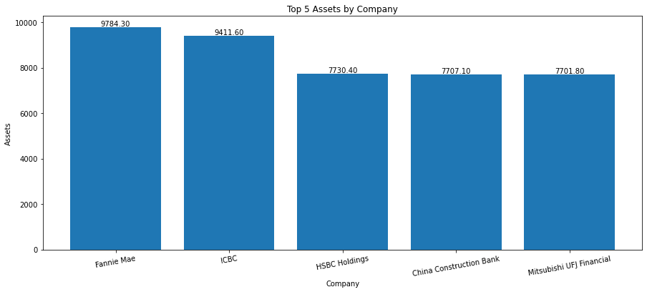
Top 5 Highest assets Companies
Fannie Mae has the highest asset value among the listed companies, indicating a substantial amount of total assets and financial strength.
ICBC (Industrial and Commercial Bank of China) follows closely behind, demonstrating a strong asset base and financial stability.

Slide 23
Insights
Sales per Country
Slaes per Year
The United States has the highest sales revenue among the listed countries, indicating a strong market presence and revenue generation.
Russia has the lowest sales revenue among the listed countries, suggesting relatively lower market demand within this country.
Market Value
The year 2015 had the highest sales revenue, indicating a strong sales performance and market demand in that particular year.
The year 2017 demonstrates slightly lower sales revenue, suggesting a moderate decline in sales compared to the preceding years.
Profits
The Major Banks industry has the highest market value, indicating its significant market presence and valuation.
The Utilities sector has a comparatively lower market value, suggesting relatively lower market valuation within this sector.
Sales
The Major Banks industry has the highest profit, indicating strong financial performance within this industry.
The Utilities sector has the lowest profit, suggesting comparatively lower profitability within this sector.
The Financials sector has the highest sales revenue, indicating its strong market position and revenue generation.
The Utilities sector has relatively lower sales revenue, suggesting comparatively lower market demand within this sector.

Slide 24
Insights
Sales per Sector
The Financials sector has the highest sales revenue, indicating its strong market position and revenue generation.
The Telecommunication Services sector has the lowest sales revenue, suggesting comparatively lower market demand within this sector.
Sales per Industry
The Oil & Gas Operations industry has the highest sales revenue, indicating its significant market presence and revenue generation.
The Regional Banks industry has relatively lower sales revenue, suggesting comparatively lower market demand within this industry.
Profit per Industry
Market Vlue per Industry
The Major Banks industry has the highest profit, indicating strong financial performance within this industry.
The Telecommunications services industry has relatively lower profit, suggesting comparatively lower profitability within this industry.
The Major Banks industry has the highest market value, indicating its significant market presence and valuation.
The Telecommunications services industry has a comparatively lower market value, suggesting relatively lower market valuation within this industry.

Slide 25
Company Insights
Apple has the highest market value, indicating its strong market position and high valuation.
BMCE Bank follows closely behind, demonstrating a competitive ranking within the dataset.
Exxon Mobil follows with a significant market value, highlighting its presence in the energy sector.
TechnipFMC has the lowest asset value, indicating relatively lower total assets compared to other companies in the dataset.
Synovus Financial holds the highest rank among the listed companies, indicating its strong performance and position within the dataset.
Fannie Mae has the highest asset value, indicating a substantial amount of total assets and financial strength.

Slide 26
Conclusion
The analysis of the provided financial dataset offers valuable insights into sales, profits, market value, rankings, and asset values across sectors, industries, countries, and companies.
Key findings include the strong sales revenue in the Financials sector, the high profitability of the Major Banks industry, and their significant market value.
The dataset highlights the highest sales revenue in the United States, while Russia exhibits relatively lower market demand.
Specific companies, such as Apple and Exxon Mobil, stand out with their strong market positions and high valuations.
Rankings reveal top-performing companies, with Synovus Financial holding the highest rank, indicating exceptional performance.
TechnipFMC and Fannie Mae represent examples of companies with relatively lower and higher asset values, respectively.
These insights empower businesses, investors, and analysts to make informed decisions by understanding market trends, assessing financial performance, and evaluating competitive positions.

Slide 27
THANK YOU
Insert the Subtitle of Your Presentation

