Slide 1

PROJECT TITLE
E-CLASSIFIEDS

Slide 2
ADVANTAGES OF PROPOSED SYSTEM
This is a leading Classifieds website.
This website provides different kinds of facilities to the users like Education, Rental, Real Estate, Situations Vacant, Sunday Cinema, Wheels Used Cars, Matrimonial, Job Searching Facility.

Slide 3
MODULES
Education
Rental
Real Estate
Situations Vacant
Sunday Cinema
Wheels-Used Cars
Matrimonial
Searching Facility
Administration

Slide 4
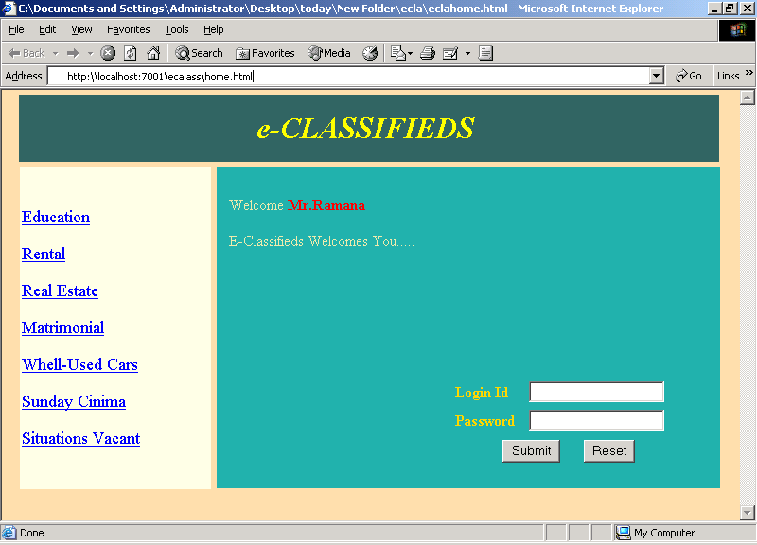
HOME PAGE

Slide 5
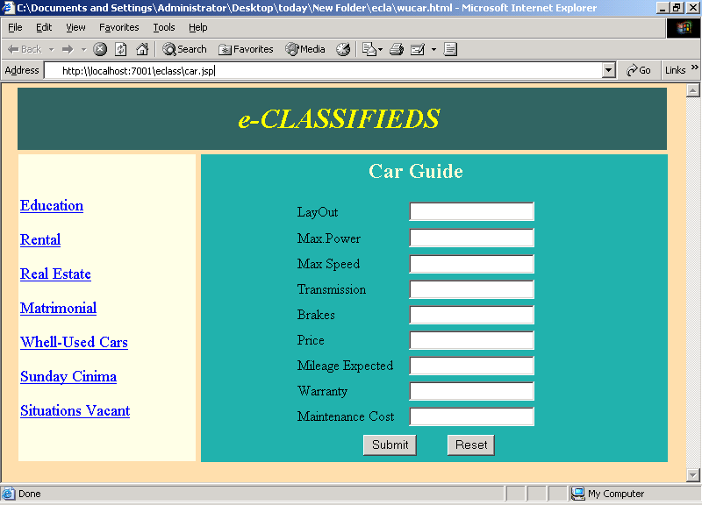
CAR GUIDE

Slide 6
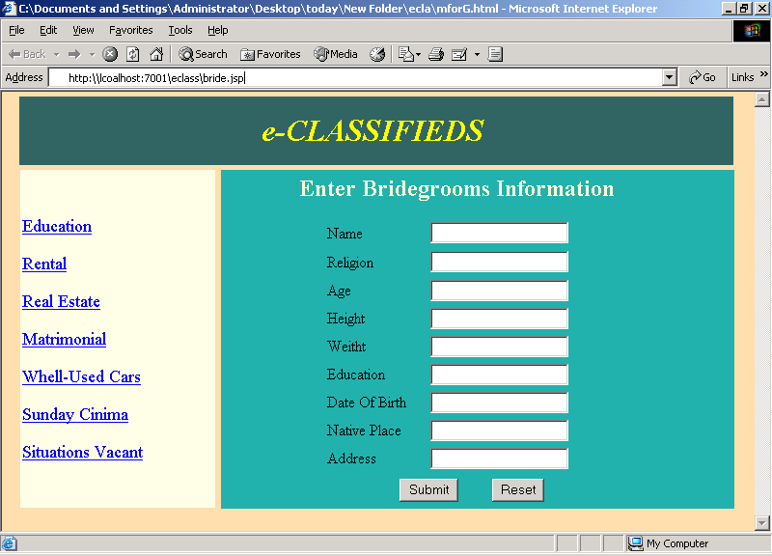
MATRIMONIAL

Slide 7
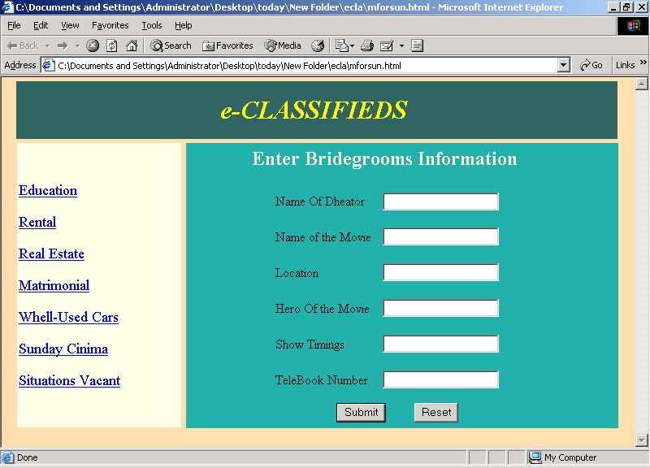
SUNDAY CINEMA

Slide 8
TECHNOLOGIES USED
Java Server Pages / Servlets
HTML
JavaScript
Weblogic7.0(Server)
Oracle8i
Win NT/2000
Pentium III/IV
64-128 MB RAM

