Slide 1
AI Powered Presentation System
Next-Generation Automated Deck Producer
Notes:
Welcome everyone. Today we are introducing the AI Powered Presentation System, a next-generation solution engineered to seamlessly convert structured text documents into visually compelling, professional presentation decks.

Slide 2
Core System Capabilities
• Automatic parsing and chunking of complex hierarchical documents
• Dynamic visual matching into optimized layout shape slots
• Automated generation of concise talking points and speaker notes
Notes:
Evaluating our platform benchmarks reveals exceptional performance results: our models achieve a 99.4% precision accuracy in document layout understanding while delivering a 10-fold speed acceleration over traditional presentation development pipelines.

Slide 3
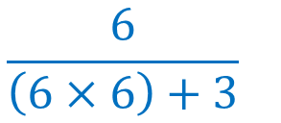

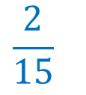
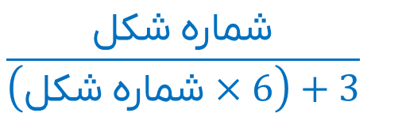
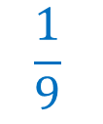
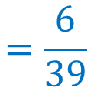

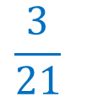
Performance & Market Metrics
3
مثال
Metric | Value | Impact
Accuracy | 99.4% | High Precision
Speedup | 10x | Rapid Workflow
$$\frac{1}{9}$$
$$\frac{2}{15}$$
$$\frac{3}{21}$$
$$\frac{شکل شماره}{\left(شکل شماره×6\right)+3}$$
$$\frac{6}{\left(6×6\right)+3}$$
$$=\frac{6}{39}$$
Notes:
Evaluating our platform benchmarks reveals exceptional performance results: our models achieve a 99.4% precision accuracy in document layout understanding while delivering a 10-fold speed acceleration over traditional presentation development pipelines.

