Slide 1
What words (feelings) would you use to describe your college experience thus far?

Slide 2
College students’ daily emotions
My guesses……
Gallup says…High level of stress and negative emotions
Excitement
Sense of belonging
Enjoyment
Independence
Responsibility
Anxiety
Stress
Sadness
Notes:
The words on the left are my guesses as to what I thought this group might say.
The chart on the right are the results from a Gallup survey in March 2023. Although enjoyment ranked the highest, I was surprised that the next several choices….stress….worry…..loneliness…..sadness…..and anger were all negative emotions.

Slide 3
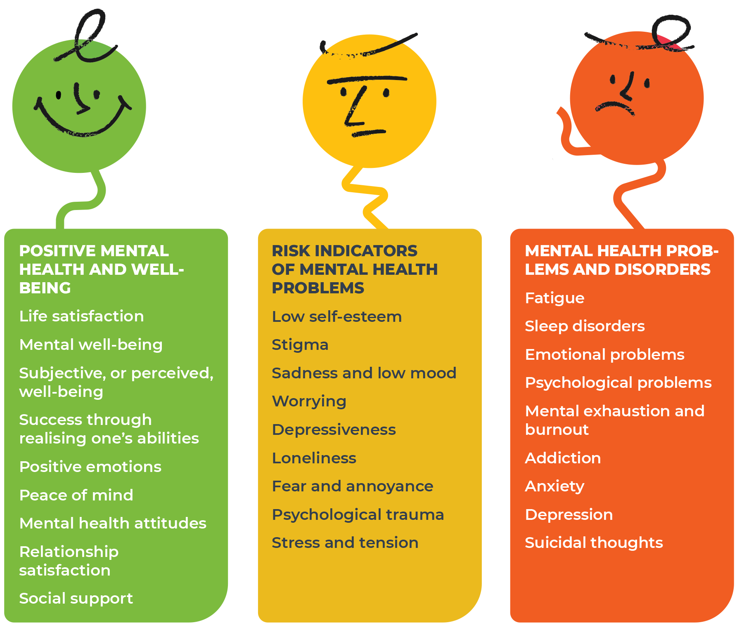
Student emotions are mental health warning signs
Mental Health Spectrum
Source:
Estonian Human Development Report 2023
Notes:
To put the Gallup results in context, here is a chart of the mental health spectrum, with good mental health over in green on the left – which is indicated by positive feelings like happiness, satisfaction, and peace of mind. Bad mental health, over in red on the right, is indicated by problems like anxiety, depression, and suicidal thoughts.
Precursors of bad mental health are shown in the middle yellow column. Note the 5 negative emotions from the Gallup survey all appear word for word here. As these emotions are risk indicators of potential mental health problems, this is a topic all students should pay attention to.

Slide 4
Student mental health in decline
Source: Healthy Minds Network, 2023.
Notes:
Data from the Healthy Minds Network provides further evidence as to why we should take this topic seriously.
Going clockwise from the top left chart, the charts show negative metrics like depression, major depression, suicidal thoughts, anxiety disorder, and eating disorder go from already bad levels in 2018-2019, to worse, in 2021-2022. Depression, for instance, went from 36% to 44%.
These data suggest we are in the midst of a student mental health epidemic.

Slide 5


Unfortunately, it has hit close to home
Notes:
In the 2021-2022 school year, tragically, there were four suicides between WashU and St. Louis University.
For many students, bad mental health starts with stress.

Slide 6
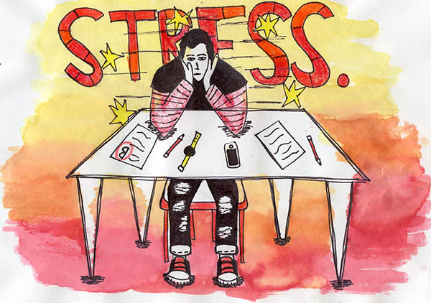
Students’ biggest academic stressors
Source: Inside Higher Ed College Pulse Survey of 3000 students
Notes:
The chart on the right comes from a survey of 3000 college students by Inside Higher Ed. It is easy to relate to some of the academic stressors they identify like doing well on exams or the fallout from a bad grade.
In addition to academic stressors, we feel the pressure to develop our support social support and relationship networks away from home.
And all this stress has an impact on our mental health.

Slide 7
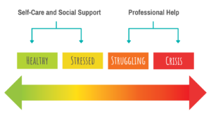
Mental health self-care
Notes:
It is normal for everyone to feel stressed and to bounce back and forth between being feeling mentally healthy and feeling stressed. The key is to avoid the prolonged periods of stress that can tip us into crisis mode.
With mental health self-care we can stay on the left side of the page.

Slide 8
What self-care opportunities do we have to improve our mental wellbeing?

Slide 9
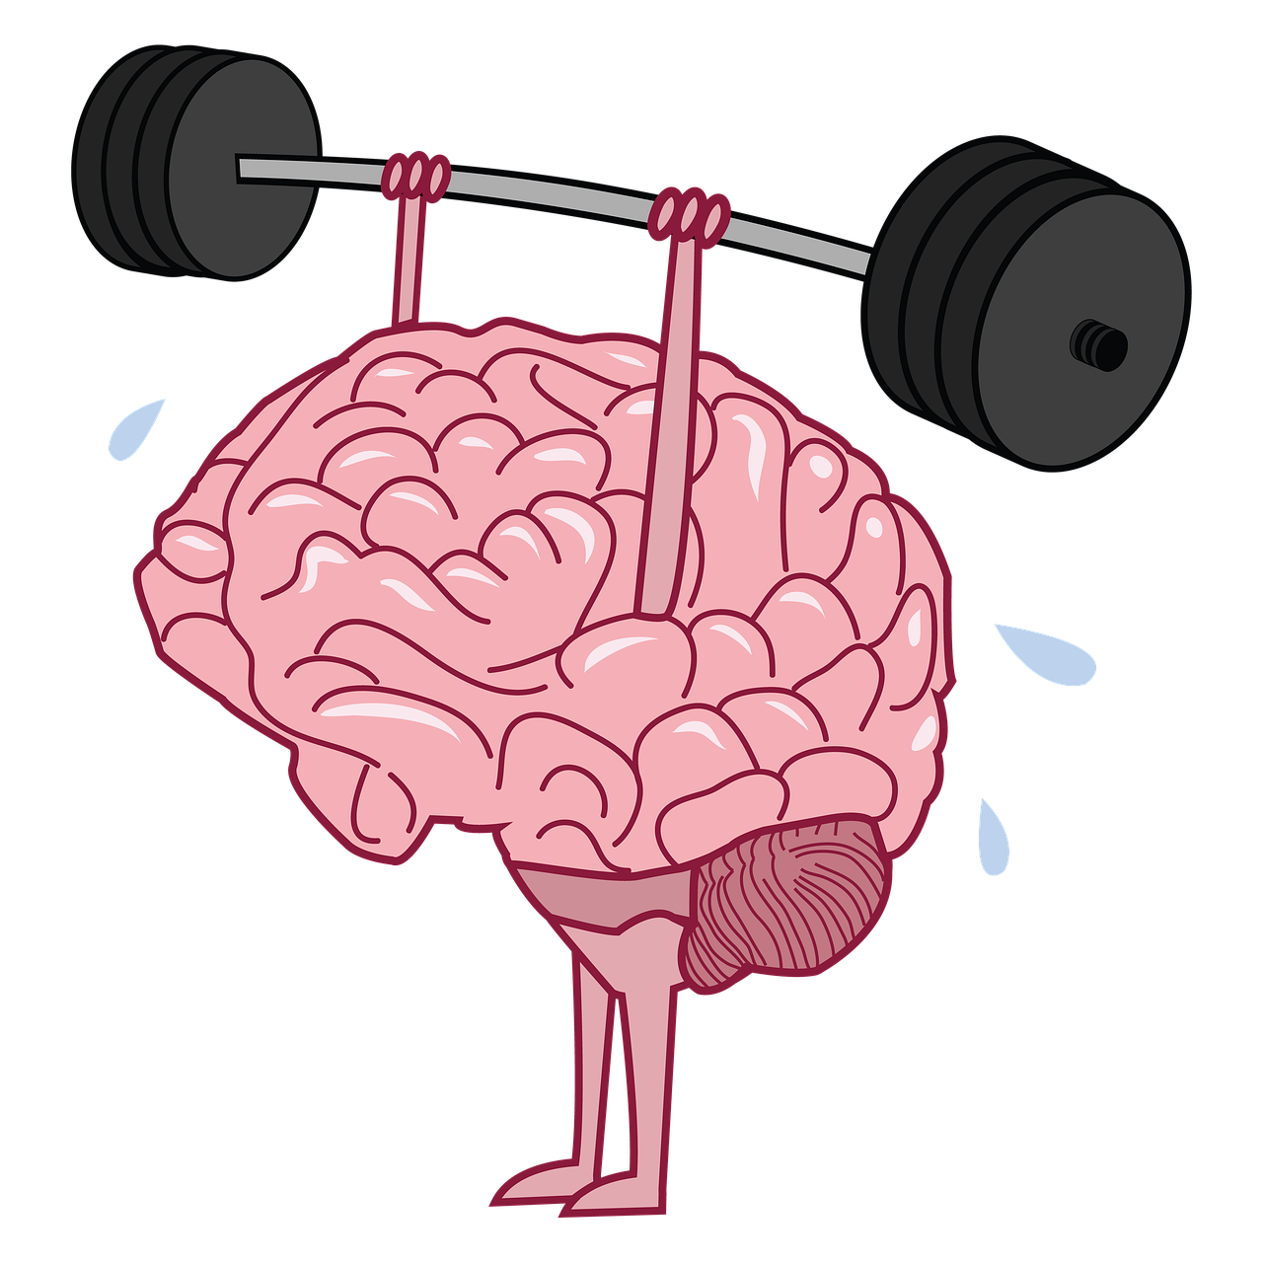
Popular stress busters – Survey results

Slide 10
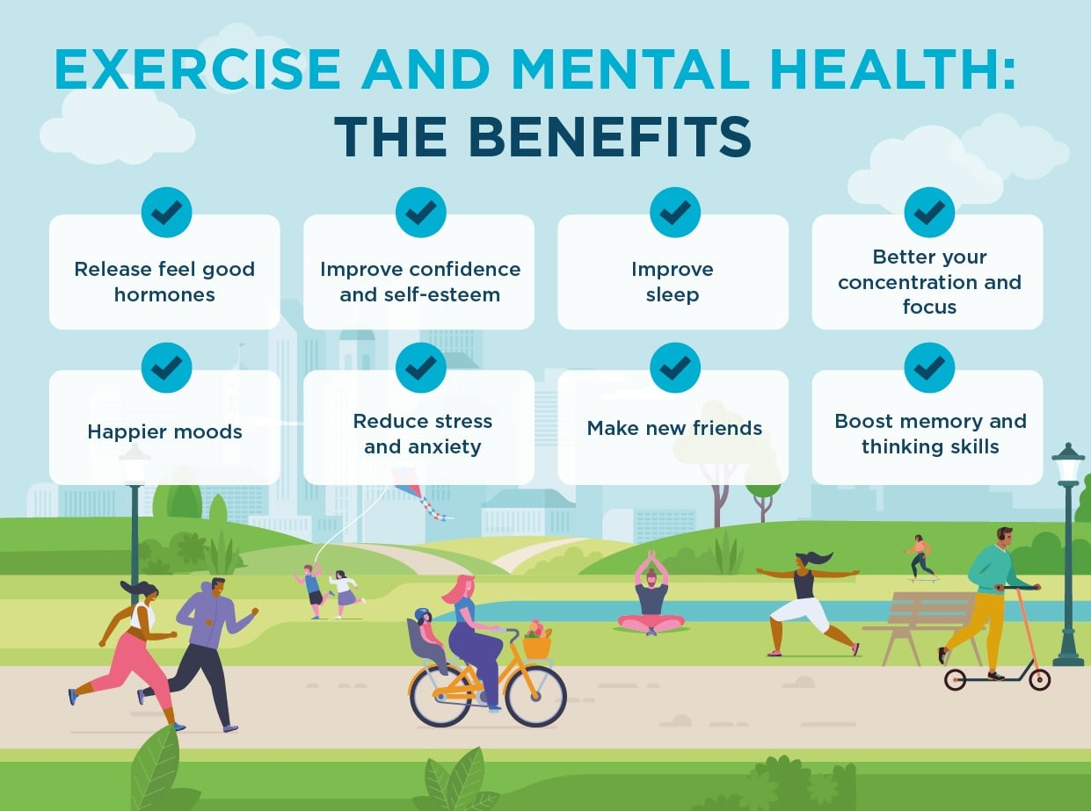
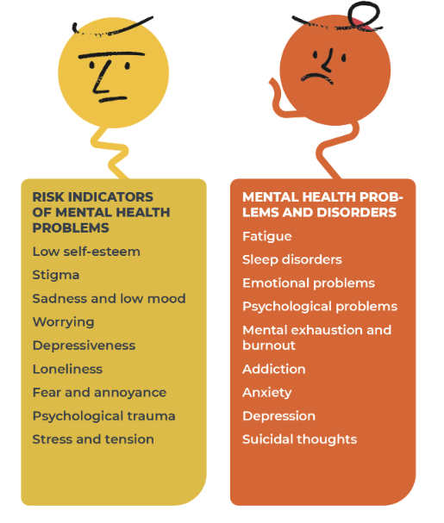
Exercise is associated with numerous mental health benefits

Slide 11

WashU Rec

Slide 12
Mental health and physical activity: Rodriguez-Romo et al. cross-sectional study results
847 undergraduate students
Physical activity under different settings:
Leisure
Commuting
Occupational, and
Total
Standardized questionnaires for measuring physical activity and mental health
Lower mental health score = Better mental health
Higher mental health score = Worse mental health
Source: Physical Activity and Mental Health in Undergraduate Students, 2022.

Slide 13
Happiness and physical activity: A University of Michigan review study
Key findings in studies
Nearly universal positive association
Slightly more is better than slightly less…
2 days per week vs. 1
…but something is better than nothing
1 day per week vs. none
Even just 10 mins makes a difference
Source: A systematic review of the relationship between physical activity and happiness, 2018.

Slide 14
The opportunity - nearly 40% indicated Sedentary/Light Leisure Time activity
Opportunity

Slide 15
Mean happiness scores by activity and setting Survey results
Statistically significant difference in Means

Slide 16

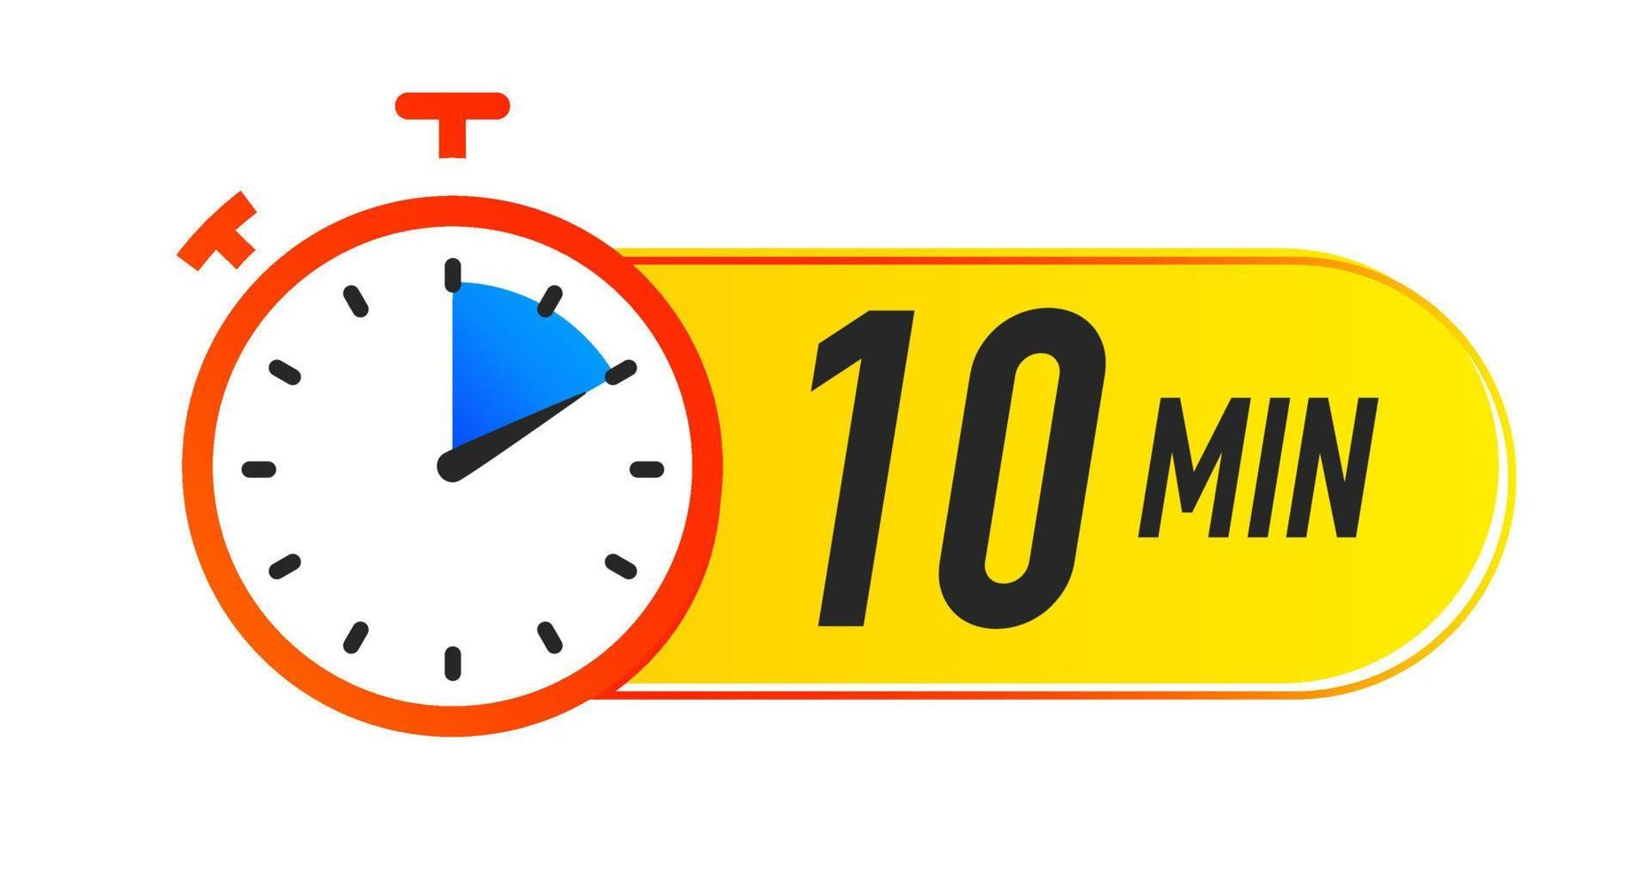
Take 10 to exercise….it is good for you!

