Slide 1
My First Impress
Presentation
ARYAMOL V H

Slide 2
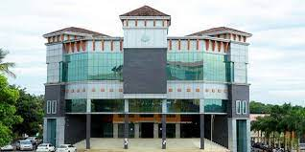
Ilahia college
Ilahia college of enginnering and tecnology is (ICET) is a co-educated minority institution Approved by AICTE and Affliated to KTU

Slide 3
This work is licensed under a Creative Commons Attribution-ShareAlike 3.0 Unported License.
It makes use of the works of Mateus Machado Luna.

