Slide 1
AE646: Scientific Machine Learning for Fluid Mechanics | End-Semester Presentation
Operator Learning for
Parametric Darcy Flow
Fourier Neural Operator (FNO) vs. MLP Baseline: Optimization, Scaling & Solver Comparison
Team PINNacles
Aryamann Srivastava, Varun Sathaye, Atishay Jain, Vedant S. Tiwari
Department of Aerospace Engineering, IIT Kanpur | November 2026

Slide 2
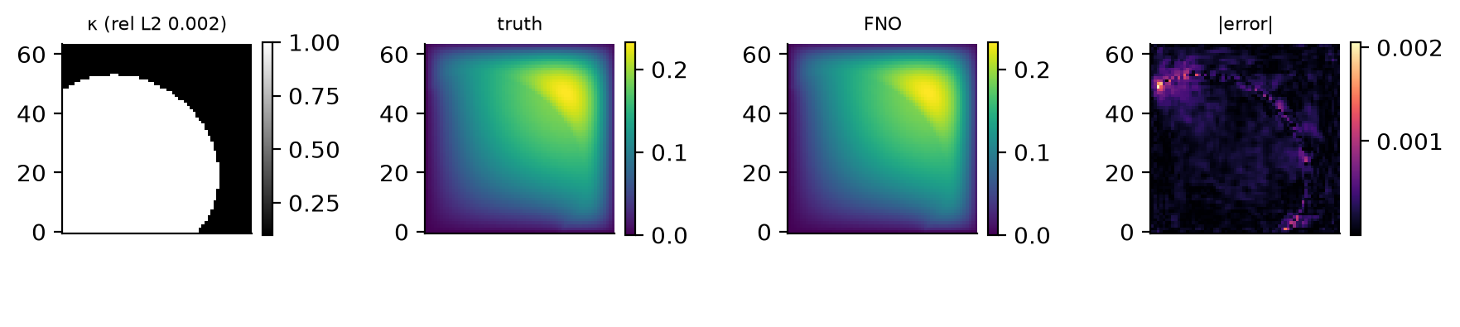
The Task
Predict how fluid pressure spreads through a porous material, quickly
10,000
real simulations (PDEBench)
900 / 100
train / validation samples
Left to right: permeability map (input), true pressure, FNO prediction, error
200
Two models learn this map from data:
FNO: sees the whole field, works with patterns in space.
MLP: a plain fully connected network, no spatial structure.
held-out test samples
Error = relative difference to the true field (smaller is better)
AE646 | Team PINNacles | Stage 3
2 / 12

Slide 3
Where We Started
Stage 2 gave a clear winner, but we suspected we could do much better
0.052
0.08
1.6x
FNO error in Stage 2
MLP error in Stage 2
FNO advantage
How Stage 2 trained both models
Standard squared-error loss
Learning rate that restarted again and again
No data augmentation
Question: was the remaining error about the model, or about how we trained it?
AE646 | Team PINNacles | Stage 3
3 / 12

Slide 4
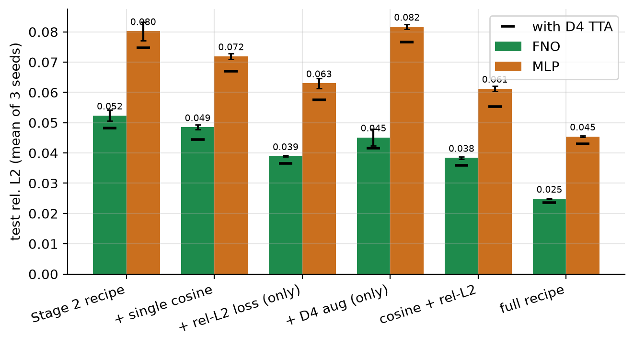
Finding 1: The Training Recipe
Changing how we train, not the model, cut the error roughly in half
Match the loss to the metric
1
Train on relative error, the number we report
One smooth learning-rate decay
2
Instead of repeated restarts
Flip and rotate the inputs
3
Free extra training data (symmetries)
Same model, same budget: FNO error 0.052 to 0.025, MLP 0.080 to 0.045
AE646 | Team PINNacles | Stage 3
4 / 12

Slide 5
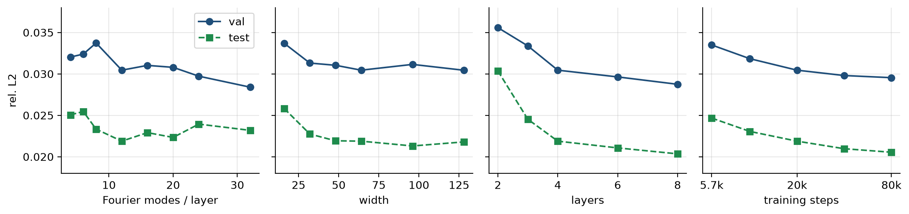
Finding 2: Architecture Matters Little
Width, depth and Fourier modes were tuned one at a time on validation data
Modes, width
Depth, training length
Final choice
almost no effect past modest values
small, steady gains
9.5 M parameters, 8 layers
The training recipe was the big lever; architecture tuning added only a few percent
AE646 | Team PINNacles | Stage 3
5 / 12

Slide 6
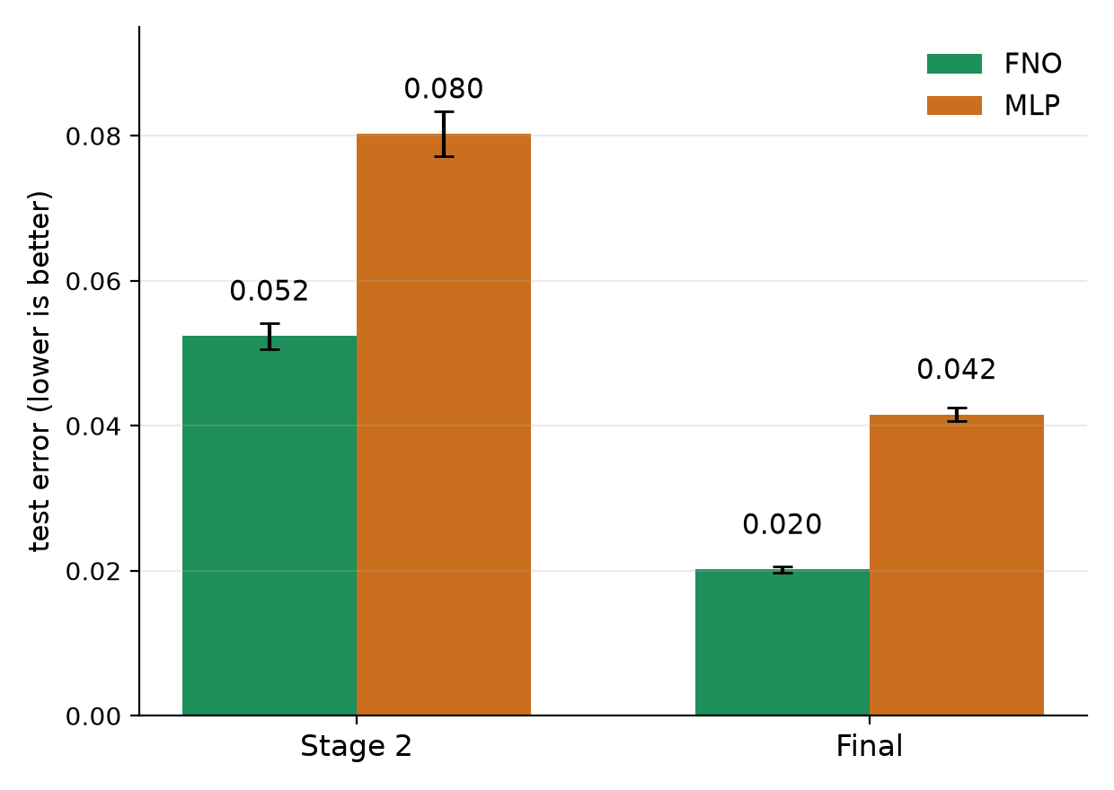
The Final Models
Both models tuned fairly, validation data only, 5 random seeds each
0.0202
0.0415
FNO error, 9.5 M parameters
MLP error, 100.7 M parameters
2x
10x
more accurate
fewer parameters
The gap between FNO and MLP grew from 1.6x to 2x once both were trained well.
Spatial structure helps: the FNO wins with a tenth of the parameters
AE646 | Team PINNacles | Stage 3
6 / 12

Slide 7
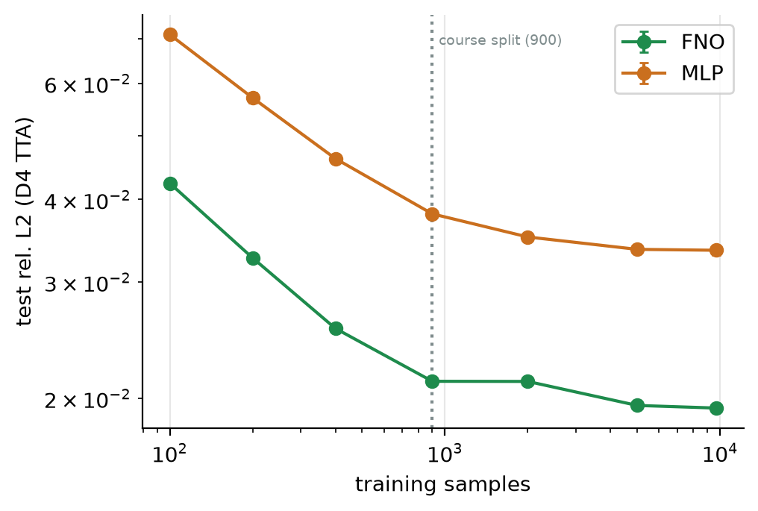
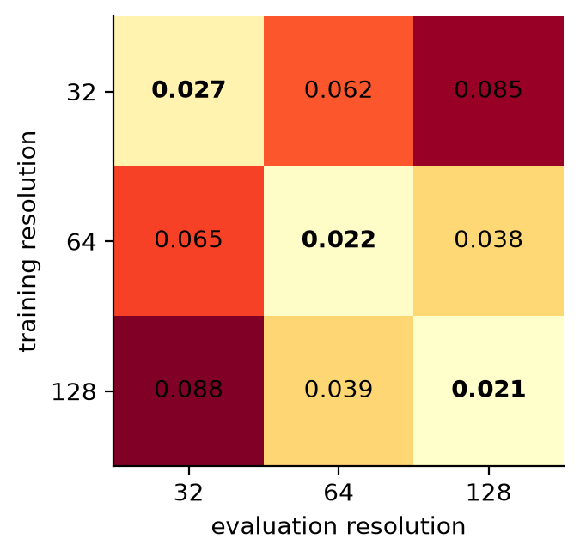
Finding 3: Data and Resolution
The FNO needs less data and can be used on other grid sizes, with a cost
How to read the grid
Rows: grid used for training
Columns: grid used for testing
Numbers: test error
400 samples
Other grid sizes
The FNO already beats an MLP trained on 9,700
Works, but about 2 to 3x worse than a model trained on that grid
More data helps until about 5,000 samples, then error levels off near 0.02
AE646 | Team PINNacles | Stage 3
7 / 12

Slide 8
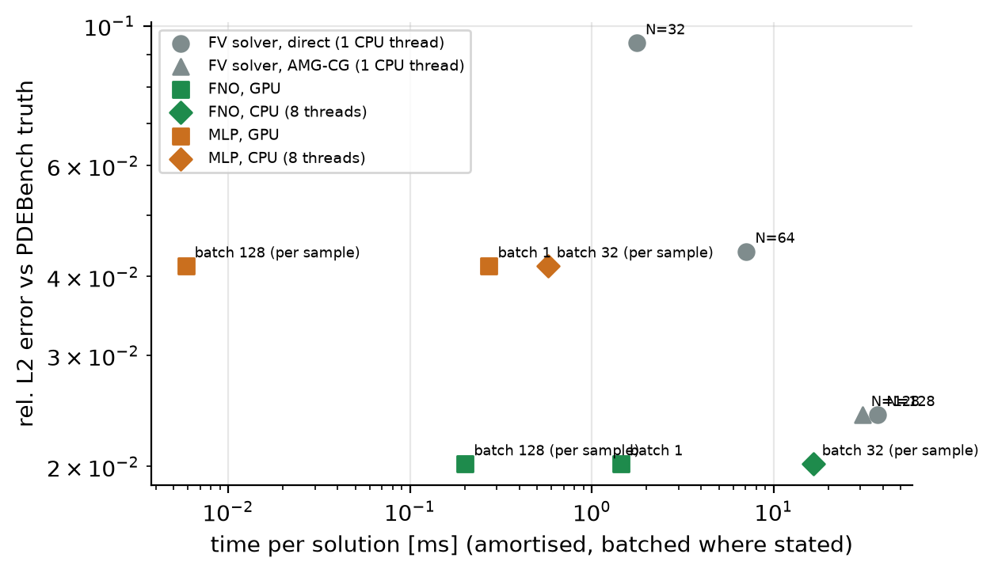
FNO versus a Classical Solver
Compared with a finite-volume solver tuned to the same data
0.020 vs 0.044
FNO vs solver error at 64 x 64
5x to 35x
faster than the solver on a GPU
Not faster
on a single CPU core
Best when used on GPUs and in batches; the solver stays competitive on one core
AE646 | Team PINNacles | Stage 3
8 / 12

Slide 9
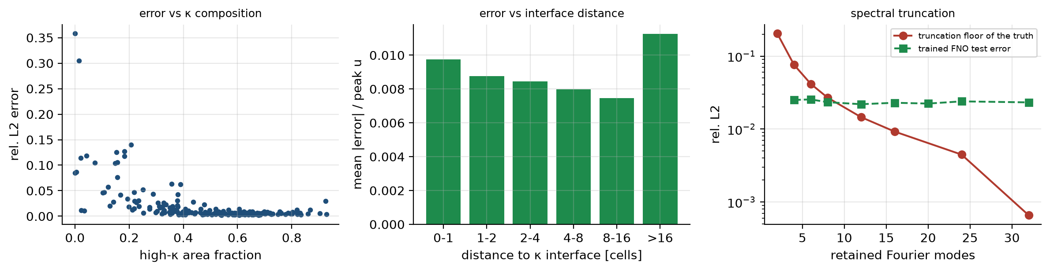
Does It Obey the Physics?
Checks beyond a single error number
0.1157
1.7%
0.0015%
4.25 vs 4.01
boundary level (truth 0.1159)
error in average pressure
pixels with negative pressure
equation residual (truth)
Largest errors: nearly uniform permeability with large pressure, where the amplitude is hard to infer
AE646 | Team PINNacles | Stage 3
9 / 12

Slide 10
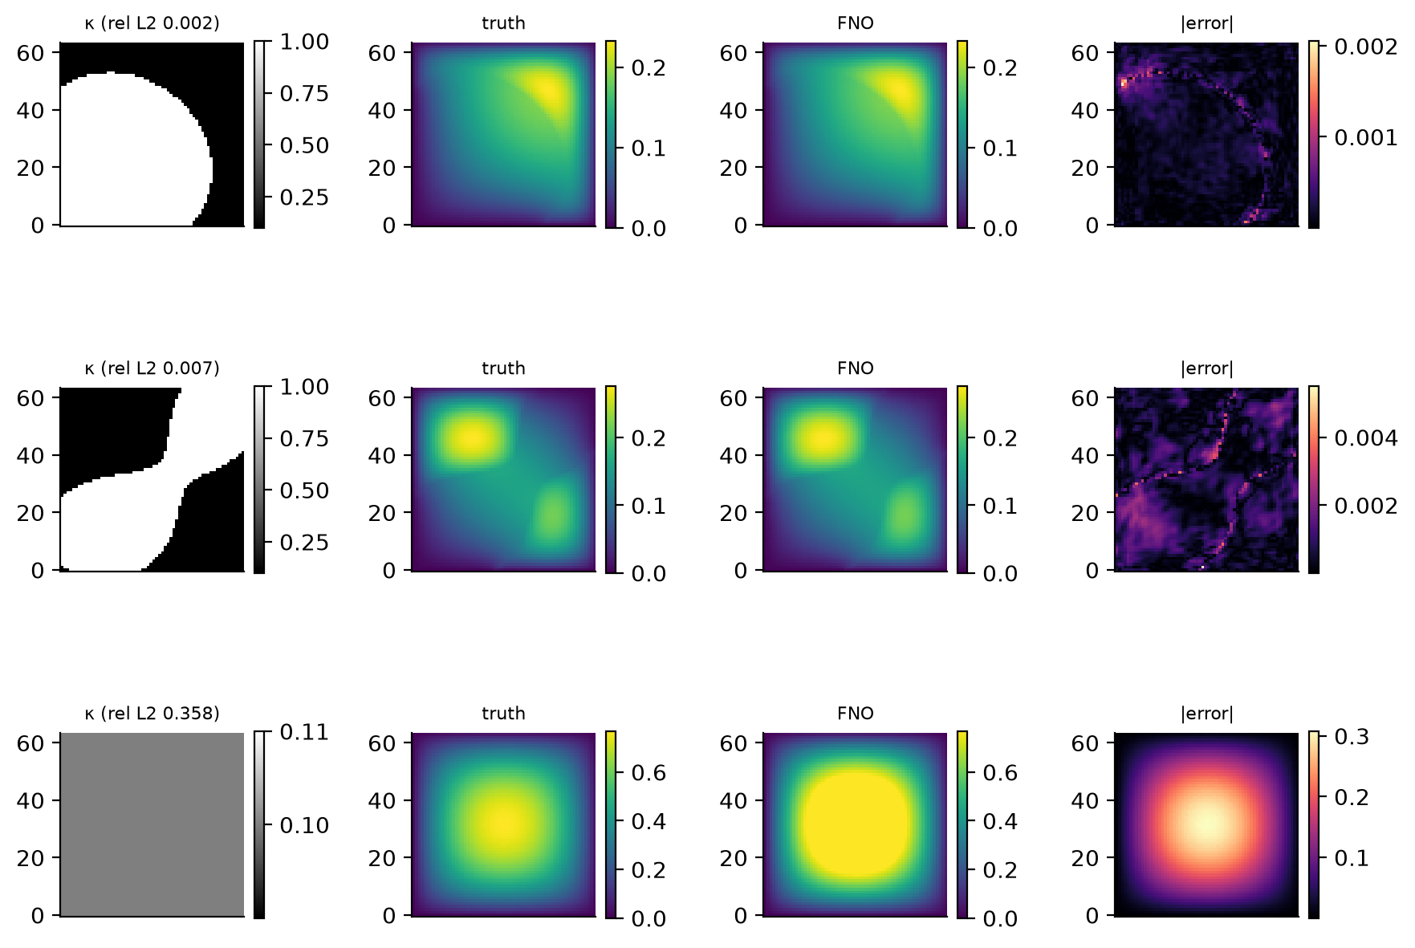
Example Predictions
Best, typical and worst test cases of the final FNO
Best
1
Error 0.2%, almost no visible error
Typical
2
Error 0.7%, shapes match closely
Worst
3
Uniform permeability: right shape, wrong height (36%)
AE646 | Team PINNacles | Stage 3
10 / 12

Slide 11
Summary and Limits
What we learned and what we do not claim
What we learned
Honest limits
Training mattered most
One dataset
1
1
Error halved with a better recipe
Results are about agreement with this data
FNO beats a tuned MLP
Timing caveats
2
2
2x more accurate, 10x fewer parameters
Solver tuned to the data, shared machine
Strong against a solver
Stage 2 speed claim withdrawn
3
3
More accurate at the same grid size
The old reference solver was slow
Better training beat a bigger model, and the FNO stayed accurate and fast
AE646 | Team PINNacles | Stage 3
11 / 12

Slide 12
Team Contributions & AI Declaration
Individual ownership and adherence to AE646 academic integrity guidelines
Aryamann Srivastava
Varun Sathaye
Atishay Jain
Vedant S. Tiwari
Lead Developer
Data & Baseline Verification
Architecture & Ablation Review
Scaling & Diagnostics
• Stage 3 pipeline & D4 augmentation
• Recipe & architecture studies; final models
• Finite-volume solver & latency benchmarks
• Reports, decks & code packaging
• PDEBench train/val/test split verification
• Normalisation & Stage 2 baseline checks
• Solver calibration & timing review
• Section 7 results & presentation
• Training recipe & mode/width/depth sweeps
• Ablation tables & Pareto analysis
• Model-selection protocol verification
• Section 4-5 results & presentation
• Data-scaling & cross-resolution transfer
• Physical diagnostics & residual checks
• Failure mode analysis (uniform kappa)
• Section 6 & 8 results & presentation
AI-Tool-Use Declaration
AI tools were used for coding assistance, debugging, experiment orchestration (Colab/Kaggle GPU runtimes), and LaTeX/PPT drafting.
All numerical results come from real runs on real PDEBench data; no results or metrics were generated or invented. Every line of code, equation, and conclusion is fully owned, verified, and defendable by all team members in the viva.
AE646 | Team PINNacles | Stage 3
12 / 12

