Slide 1
AE646 Stage 3 (Final) Presentation
Optimising a Fourier Neural Operator
for Parametric Darcy Flow
Recipe, architecture, data, resolution, latency, and comparison with a finite-volume solver
Team: PINNacles (Aryamann Srivastava, Varun Sathaye, Atishay Jain, Vedant S. Tiwari)

Slide 2
Recap and Stage 3 Questions
Learning the operator kappa -> u of -div(kappa grad u) = 1, on real PDEBench data
Where Stage 2 ended
Stage 3 questions
• Real PDEBench pipeline: 900 / 100 / 200 split at 64x64, EDA, preprocessing and baseline ablations
• MLP (42 M): 0.082 mean rel. L2; FNO (4.7 M): 0.052
• Speed-up claim vs an FDM solver (1030 ms)
• How much of the FNO error was optimisation, and how much capacity?
• Which architecture choices matter? How much data? Which resolution?
• What does inference cost, and how does the FNO compare with a proper finite-volume solver?
• What does the residual error mean physically?
AE646 Stage 3 Final Evaluation | Team PINNacles
2 / 13

Slide 3
Experimental Protocol
Same split as Stage 2; every choice made on validation data only
• Data: 900 train / 100 val / 200 test real fields (seed 42); 8,800 further real samples used only for the data-scaling study
• Metric: per-sample relative L2 error in physical units, mean over test samples; test set evaluated once per run
• Reference step budget = Stage 2 (100 epochs = 5,700 steps, batch 16); seeds 0-4; sd over seeds reported
• Symmetry: data are D4-invariant; augmentation applied at 128x128 before sub-sampling (valid), test-time averaging over {identity, transpose}
• Baseline given the same effort: MLP tuned on the same footing (capacity sweep, validation selection)
• 142 training runs on one GPU workstation; all configs and metrics stored per run
AE646 Stage 3 Final Evaluation | Team PINNacles
3 / 13

Slide 4
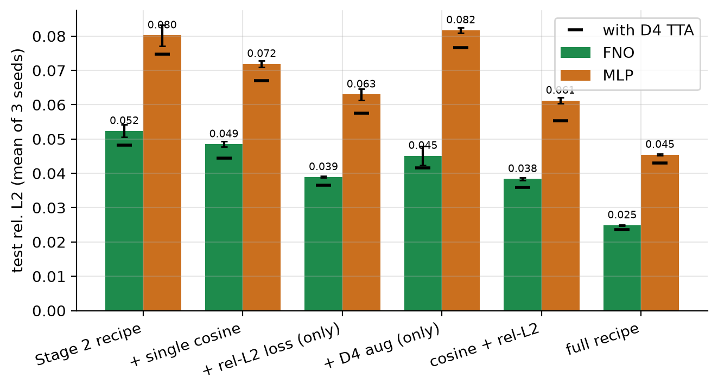
Finding 1: The Training Recipe Limited Stage 2
Same models, same 5,700 steps, 3 seeds - only the recipe changes
Result
• Stage 2 recipe: MSE loss; cosine LR restarted every 200 steps
• Relative-L2 loss: -26%. Single cosine: -7%. D4 augmentation on top: -35%
• FNO 0.0524 -> 0.0249 (2.1x lower); MLP 0.0802 -> 0.0454
• Gains interact: D4 alone does not help under the old recipe
AE646 Stage 3 Final Evaluation | Team PINNacles
4 / 13

Slide 5
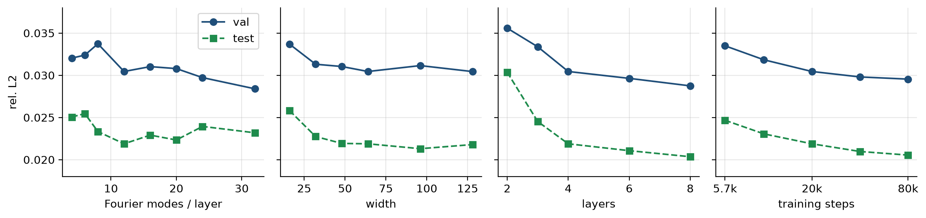
Finding 2: Architecture Choices Matter Little
One-factor sweeps around (12 modes, width 64, 4 layers); selection on validation error
What we learned
• Modes 4 to 32 (0.5 M to 34 M parameters): only 0.022-0.025 test error; width >= 32 saturates
• Depth and training length help slowly: 2 -> 8 layers 0.030 -> 0.020; 5.7k -> 80k steps 0.0247 -> 0.0205
• Learning rate, weight decay, batch size: < 0.001 effect. Validation picks deeper, not wider: (12, 64, 8), 9.5 M
AE646 Stage 3 Final Evaluation | Team PINNacles
5 / 13

Slide 6
Final Models: FNO vs Tuned MLP
60,000 steps, full recipe, 5 seeds, 200 held-out test fields
Model | Params | Mean rel. L2 | Median | With TTA
Stage 2 MLP | 42.0 M | 0.0820 | 0.0695 | -
Stage 2 FNO | 4.7 M | 0.0521 | 0.0398 | -
Final MLP (3x4096) | 100.7 M | 0.0415 +- 0.0009 | 0.0272 | 0.0386
Final FNO (w64, L8) | 9.5 M | 0.0202 +- 0.0004 | 0.0070 | 0.0200
Take-aways
• FNO error 2.05x lower than an equally tuned MLP (Stage 2 gap: 1.6x) with 10.6x fewer parameters; 2.6x lower than the Stage 2 FNO
• Median FNO error is 0.7%: the mean is dominated by a small tail (next slides)
• Training the final FNO: about 32 minutes on one shared GPU
AE646 Stage 3 Final Evaluation | Team PINNacles
6 / 13

Slide 7
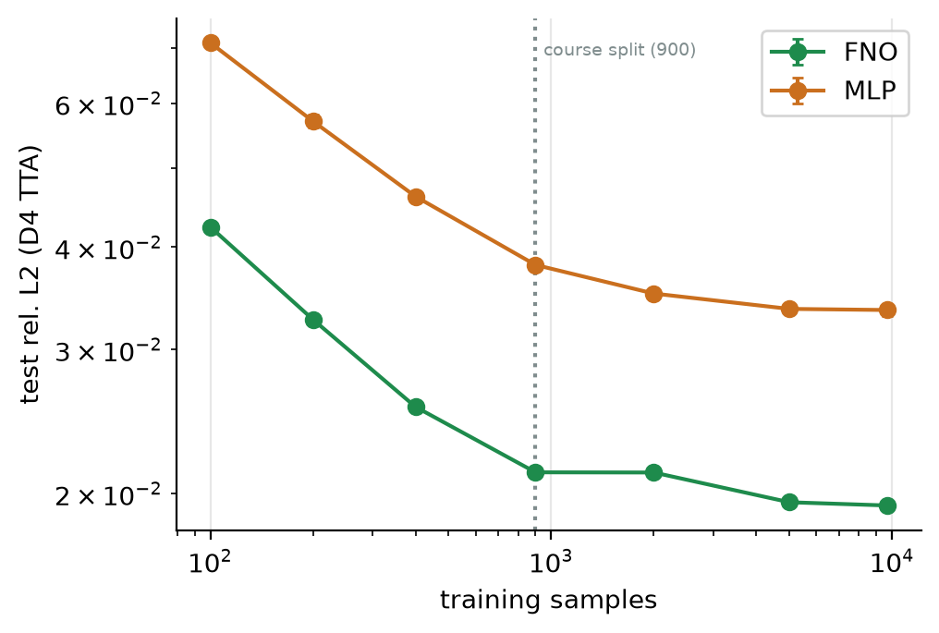
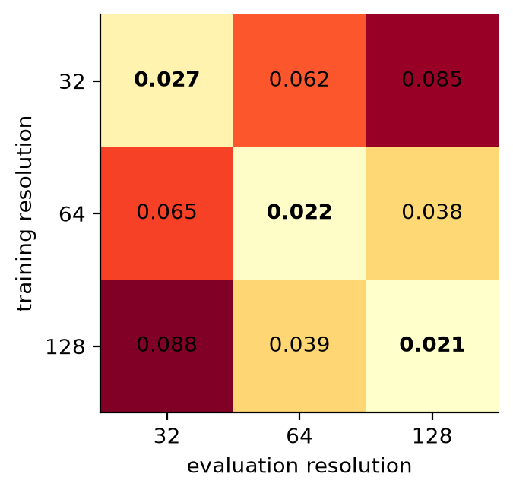
Finding 3: Data Scaling and Resolution
FNO vs MLP with 100 to 9,700 samples; train-vs-evaluation resolution matrix
• FNO with 400 samples beats the MLP with 9,700; FNO plateaus near 0.0195 for >= 5,000 samples
• Zero-shot transfer 64 -> 128: 0.038 (native 128: 0.021); 64 -> 32: 0.065: useful, but 1.7-3x worse than native resolution
AE646 Stage 3 Final Evaluation | Team PINNacles
7 / 13

Slide 8
Finding 4: Comparison with a Finite-Volume Solver
Correction to Stage 2: the old FDM reference was inefficient - the 1443x / 7740x speed-ups are withdrawn
Grid | Calibrated FV | Error vs truth | Direct LU | AMG-CG
32 x 32 | harmonic, b = 0.7 | 0.094 | 1.8 ms | 5.5 ms
64 x 64 | harmonic, b = 0.8 | 0.044 | 7.1 ms | 11.6 ms
128 x 128 | arithmetic, b = 1.05 | 0.024 | 37.4 ms | 30.7 ms
FNO, 64 x 64 (GPU) | 9.5 M parameters | 0.020 | 1.4 ms (b=1) | 0.20 ms (batched)
How to read it
• Vectorised solver; boundary distance b calibrated on validation data (PDEBench's truth behaves as if the Dirichlet boundary were ~1 cell outside the array)
• At equal resolution the FNO agrees with the data 2.2x better; partly because it learns the generator's own discretisation
• Single CPU thread: FNO 37 ms at batch 1 - NOT faster than the 64^2 solver (7 ms); the gain is GPU batching
AE646 Stage 3 Final Evaluation | Team PINNacles
8 / 13

Slide 9
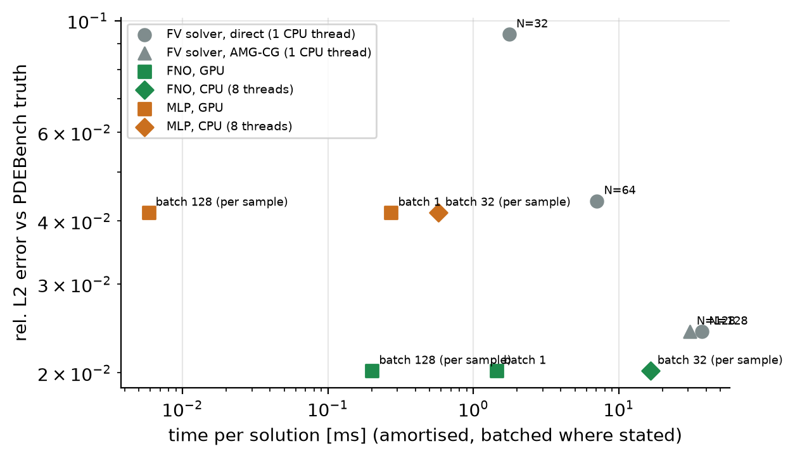
Inference Cost: Error vs Time per Solution
CUDA-event timing on an idle GPU; CPU numbers from the workstation CPU (indicative)
Latency at 64 x 64
• FNO (9.5 M): 1.44 ms at batch 1, 0.20 ms per sample at batch 128
• 5x (batch 1) to 35x (batched) faster than the 64^2 solver, and 26-187x faster than the 128^2 solver
• MLP: 0.006 ms/sample but 2x worse accuracy
• TF32 gives no gain; bfloat16 unsupported for complex FFT
• Break-even vs the 128^2 solver: ~5e4 solves
AE646 Stage 3 Final Evaluation | Team PINNacles
9 / 13

Slide 10
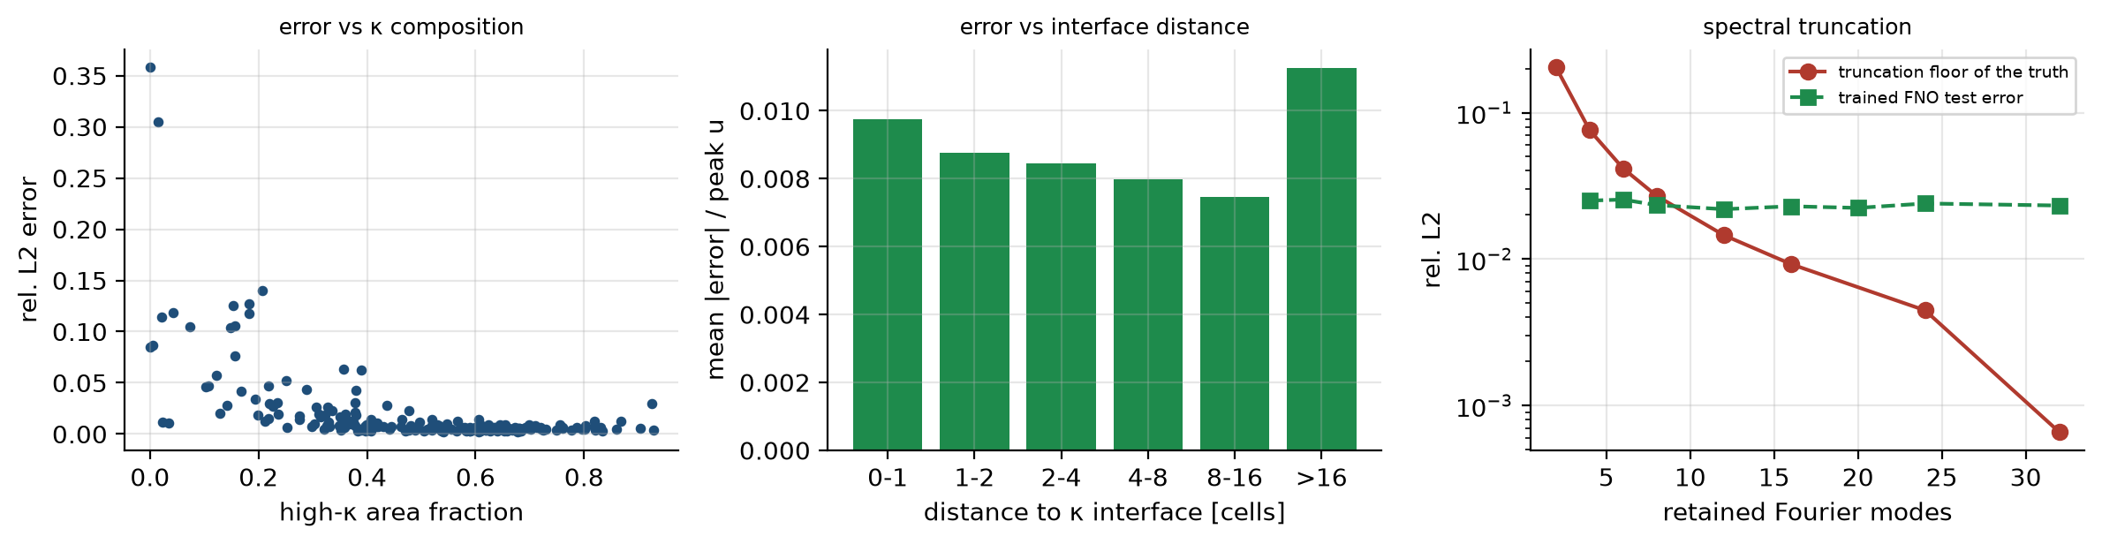
Physical Interpretation
Final FNO on the 200 test fields
• Physics respected: PDE residual within 6% of the truth's own; mean pressure to 1.7%; boundary ring ratio 0.1157 vs 0.1159; 1.5e-5 of pixels negative
• Error is NOT concentrated at interfaces (0.0098 next to them vs 0.0075 at 8-16 cells); largest in large low-kappa regions with high pressure (r = 0.61 with peak u)
• Spectral: truth needs ~12 modes (1.5% truncation error), but a 4-mode FNO still reaches 2.5%: the bypass, nonlinearity and depth regenerate high frequencies
AE646 Stage 3 Final Evaluation | Team PINNacles
10 / 13

Slide 11
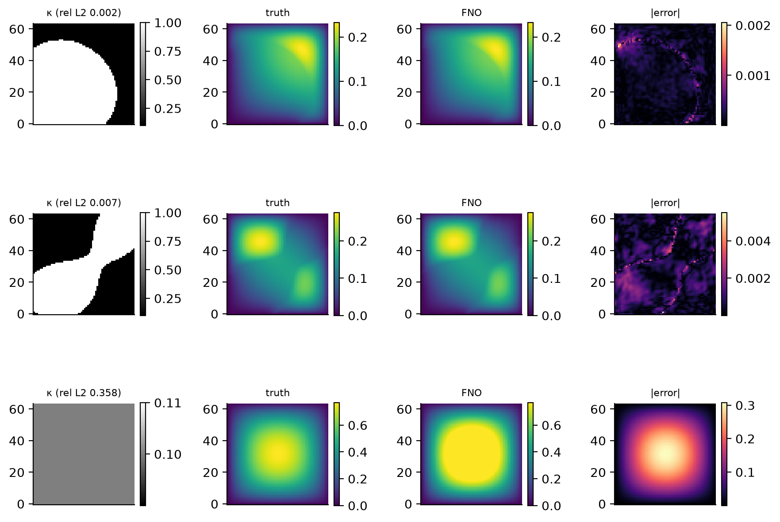
Best, Median and Worst Test Sample
kappa | truth | FNO | absolute error
Reading the figure
• Best 0.002, median 0.007
• Worst 0.358: uniform kappa = 0.1; correct shape, saturated amplitude
• The two uniform fields have errors 0.358 and 0.085; without them the mean falls from 2.0% to 1.8%
• Since u ~ 1/kappa for uniform kappa, a scale-normalised formulation could remove this failure (not tested)
AE646 Stage 3 Final Evaluation | Team PINNacles
11 / 13

Slide 12
Limitations and Honest Notes
What the results do and do not show
• One PDE, one dataset, binary kappa, f = 1; the plateau and scaling laws may not transfer
• Top architectures differ by less than seed noise; single seed per sweep point (final models: 5 seeds)
• Stage 2 absolute errors reflected a sub-optimal recipe (same for both models, so the comparison was fair); Stage 2 speed-up figures withdrawn
• Solver was calibrated to the dataset: the comparison measures agreement with PDEBench, not fidelity to the continuous PDE; single-thread, uncompiled solver
• Timings on a shared machine: CPU numbers are indicative; GPU timing on an idle GPU
AE646 Stage 3 Final Evaluation | Team PINNacles
12 / 13

Slide 13
Summary
Recipe
Relative-L2 loss + single cosine + D4 augmentation halve the FNO error at equal cost (0.052 -> 0.025)
Final
FNO 9.5 M: 0.0202 +- 0.0004 vs tuned MLP 100.7 M: 0.0415 +- 0.0009 (5 seeds): 2.05x, 10.6x fewer parameters
Limits
Insensitive to modes/width; plateaus near 2% for >= 5,000 samples; zero-shot resolution transfer is moderate
Solver
2.2x more accurate than a calibrated FV solver at 64x64 and 5-35x faster on GPU; not faster on one CPU core
Physics
Respects BC, positivity, discrete PDE; residual error sits in uniform / low-contrast, high-amplitude fields
Thank you - Questions welcome

