Slide 1
SCIENTIFIC MACHINE LEARNING — FINAL PROJECT
Fourier Neural Operator for
Parametric Darcy Flow
AE646: Scientific Machine Learning for Fluid Mechanics
Aryaman Srivastava

Slide 2
PARAMETRIC PDES
The Problem & Motivation
PARAMETRIC PDE CHALLENGE
WHY OPERATOR LEARNING?
Darcy flow: −∇·(κ∇u) = f, with κ piecewise-constant in {0.1, 1.0}
Real PDEBench data: 1000 train/val, 200 test (of 10,000 total, seed=42 subset)
Need a fast surrogate for optimization, UQ, inverse problems
Traditional solvers: re-mesh + re-solve per parameter (slow — see slide 10)
FNO/DeepONet: learn G: κ → u once, evaluate in ~1 ms
Zero-shot super-resolution: train at 64×64, test at PDEBench's real native 128×128
-∇·(κ∇u)=f
10,000
2 models
Steady-state Darcy flow equation
Real PDEBench samples (128×128)
FNO (spectral) vs MLP (dense) baseline
AE646 — Fourier Neural Operator for Parametric Darcy Flow
2

Slide 3
SETUP
Dataset & Baseline
REAL PDEBENCH 2D DARCY FLOW (β=1.0)
Downloaded from the official source, verified by checksum against PDEBench's manifest
900 train / 100 val / 200 test, 64×64 (downsampled from native 128×128)
Piecewise-constant permeability (κ ∈ {0.1, 1.0}) from a thresholded Gaussian random field
BASELINE: MLP
Why this dataset?
Flatten 64×64×3 → 3×2048 hidden layers → flatten output
42.0M parameters
No spatial inductive bias — treats the field as a dense vector
PDEBench is the handout's own suggested source for this project theme (operator learning for parametric PDEs) — a peer-reviewed, real 10,000-sample benchmark, not a hand-generated stand-in.
AE646 — Fourier Neural Operator for Parametric Darcy Flow
3

Slide 4
METHOD
Fourier Neural Operator
ARCHITECTURE
Input (3 ch) → Lift → 4× SpectralConv + 1×1 Conv + LayerNorm + GELU → Project → Output (1 ch)
SPECTRAL CONVOLUTION
4.7M
42.0M
FFT → multiply learned weights in Fourier space → IFFT
Keeps only low-frequency modes (modes=12)
Resolution-invariant by construction
FNO parameters
MLP parameters (baseline)
Result: FNO matches or beats the MLP with 8.8× fewer parameters — see next slide.
AE646 — Fourier Neural Operator for Parametric Darcy Flow
4

Slide 5
HEADLINE NUMBERS
Results Summary
Model | Test Mean Rel L2 | Parameters
FNO (original) | 0.0521 | 4.7M
MLP baseline | 0.0820 | 42.0M
FNO (improved) | 0.0456 | 78.8M
36%
8.8×
12.6%
lower error vs MLP
fewer parameters than MLP
further gain from more capacity
FNO: 36% lower error than MLP, using 8.8× fewer parameters.
AE646 — Fourier Neural Operator for Parametric Darcy Flow
5

Slide 6
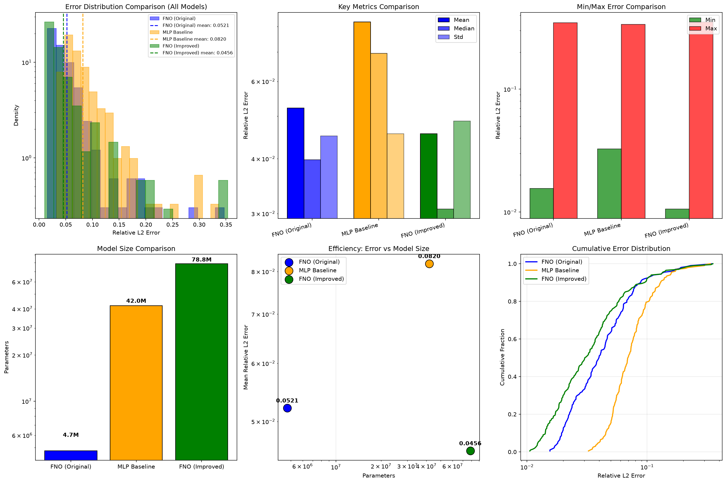
DIAGNOSTICS
Error Distributions
FNO and MLP show a similar error spread (std ≈ 0.045), but FNO sits at a lower mean/median
Both models' worst cases come from the same kind of input (near-uniform permeability, slide 9) — a genuinely hard case, not a model-specific failure
AE646 — Fourier Neural Operator for Parametric Darcy Flow
6

Slide 7
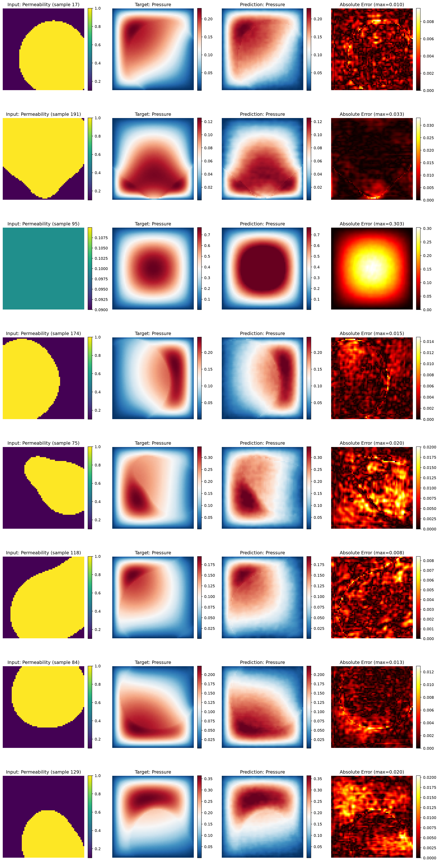
Sample Predictions
Permeability input · Target pressure · FNO prediction · Absolute error
AE646 — Fourier Neural Operator for Parametric Darcy Flow
7

Slide 8
RESOLUTION INVARIANCE
Zero-Shot Super-Resolution
Trained at 64×64. Evaluated at PDEBench's real native 128×128 — no retraining.
Model | 64×64 (train) | 128×128 (zero-shot) | Relative increase
FNO (original) | 0.0521 | 0.0594 | +14.0%
FNO (improved) | 0.0456 | 0.0563 | +23.5%
Both FNOs evaluate on a resolution with 4× as many pixels, without retraining
The improved FNO degrades more in relative terms — consistent with its larger capacity fitting some 64×64-specific discretization detail more tightly
MLP cannot do this at all — fixed input dimension
AE646 — Fourier Neural Operator for Parametric Darcy Flow
8

Slide 9
PHYSICAL INTERPRETATION
A Genuine Failure Mode
Worst-case test samples (both models) have near-uniform permeability.
Little spatial contrast for the model to exploit, producing a smooth radial pressure bump
Both models slightly over-predict the peak amplitude of that bump
Consistent with the training distribution: GRF correlation length 0.1 favors sharp blob structure, so near-uniform fields are rare in training
AE646 — Fourier Neural Operator for Parametric Darcy Flow
9

Slide 10
MEASURED, NOT ASSERTED
Real Inference-Speed Benchmark
Method | Time / sample | Device
FNO (original) | 0.71 ms | CUDA
MLP | 0.13 ms | CUDA
FDM solver (scipy sparse) | 1030 ms | CPU
1000×+
faster than solving the PDE numerically
Counter-intuitive but real:
MLP is faster per sample than FNO despite 9× more parameters. FNO's FFT/IFFT round-trips and complex-valued arithmetic aren't as well amortized as MLP's large dense matmuls at single-sample inference on a modern GPU — parameter count and wall-clock latency are different things.
AE646 — Fourier Neural Operator for Parametric Darcy Flow
10

Slide 11
SUMMARY
Key Findings
1
FNO beats MLP on accuracy with far fewer parameters — spectral inductive bias helps
2
Original FNO is the most parameter-efficient configuration; improved FNO trades 16.6× more parameters for a 12.6% error reduction
3
Zero-shot super-resolution genuinely works, verified against real PDEBench ground truth
4
Parameter count ≠ inference latency: measured speed tells a different story than parameter counts alone
5
The gap to commonly-cited FNO literature numbers (~0.01–0.02) traces to real dataset differences (piecewise-constant vs continuous permeability), not a metric-definition artifact
AE646 — Fourier Neural Operator for Parametric Darcy Flow
11

Slide 12
LOOKING AHEAD
Limitations & Future Work
LIMITATIONS
FUTURE WORK
FFT implies periodic BC; the PDE itself uses Dirichlet boundaries
Fixed modes cannot adapt to varying frequency content per-sample
FNO's parameter efficiency doesn't automatically mean lower latency (slide 10)
U-FNO / WNO architectures for sharper interfaces
Physics-informed loss (PDE residual)
Time-dependent / 3D extensions
AE646 — Fourier Neural Operator for Parametric Darcy Flow
12

Slide 13
EVERYTHING IS VERSIONED
Reproducibility
ONE-COMMAND REPRODUCTION
pip install -r requirements.txt
python src/download_data.py # real PDEBench, checksum-verified
python src/preprocess.py
python src/train.py --config configs/fno.yaml
python src/evaluate.py --config configs/fno.yaml --checkpoint results/run_001/best_model.pt
python src/superres_eval.py --config configs/fno.yaml --checkpoint results/run_001/best_model.pt
python src/benchmark_speed.py
All configs, seeds, and metrics are versioned in this repo
Results independently cross-checked across two machines (Apple Silicon and an NVIDIA GPU)
AE646 — Fourier Neural Operator for Parametric Darcy Flow
13

Slide 14
Thank You
Questions?
Report: FINAL_REPORT.md Results: results/ Code: src/

