Slide 1
UGP Presentation
Forecasting Real Airfoil Wakes :
Neural Operators on PIV Measurements
Aryamann Srivastava, 4th year Undergraduate, Dept. of AE
NeurIPS 2026 RealPDE Competition - Track 1 : Sim2Real
Notes:
Title slide. One line of context: this is an international competition run alongside NeurIPS, and the data is real water-tunnel PIV, not simulation.

Slide 2
What is Covered
1
2
3
4
5
The problem statement
The method
The scoring
What we tried
Where we stand
Forecasting future frames
What the model does
Five Metrics to score on
Including the failures
Against several teams
UGP | NeurIPS 2026 RealPDE Competition, Track 1 (Sim2Real)
2 / 21
Notes:
Roadmap. Flag that the first half is deliberately slow for people without an ML background, and the second half is results and positioning.

Slide 3
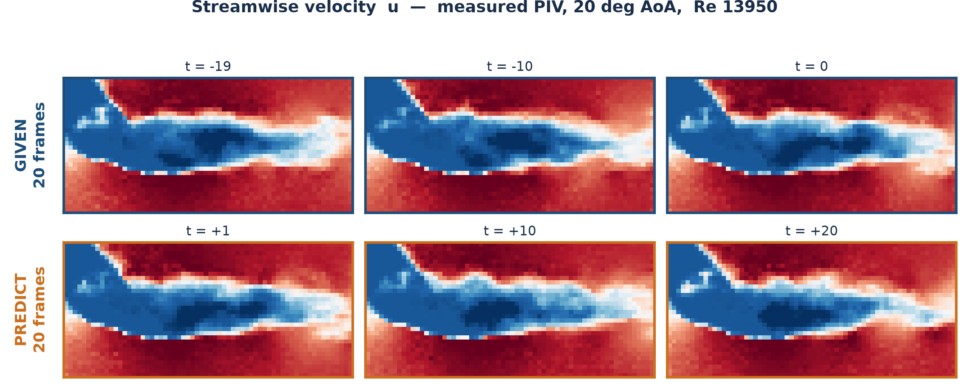
This Is the Data
Streamwise velocity, measured by PIV in a water tunnel
Given the top row → predict the bottom row.
UGP | NeurIPS 2026 RealPDE Competition, Track 1 (Sim2Real)
3 / 21
Notes:
Walk them through the picture. NACA4418 airfoil, 20 degrees angle of attack, Re 13,950. Blue is slow fluid, red is fast. The dark blue lobe is the separated wake. Note the speckle — that is genuine measurement noise from the PIV cross-correlation, not a rendering artefact. The task is: see the top three frames (and 17 others), produce the bottom three (and 17 others). Twenty frames in, twenty frames out. Mention that in the real competition the test runs are at Reynolds numbers we never trained on.

Slide 4
The Task, in a Nutshell
One sentence, then the numbers
Given 20 measured frames, predict the next 20.
32 × 64
2
81
69,000
grid points per frame
velocity components u, v
training runs
real frames total
Conditions
Training
Reynolds 3,750 – 26,700 ; angle of attack 0° – 20°
Testing
unseen conditions, reaching Re 27,975 which happens to be above the training maximum
UGP | NeurIPS 2026 RealPDE Competition, Track 1 (Sim2Real)
4 / 21
Notes:
Keep this short. The one number that matters is the last line: the test set extrapolates beyond the training range in Reynolds number, so this is not interpolation. Pressure is in the tensor but identically zero — PIV cannot measure it.

Slide 5
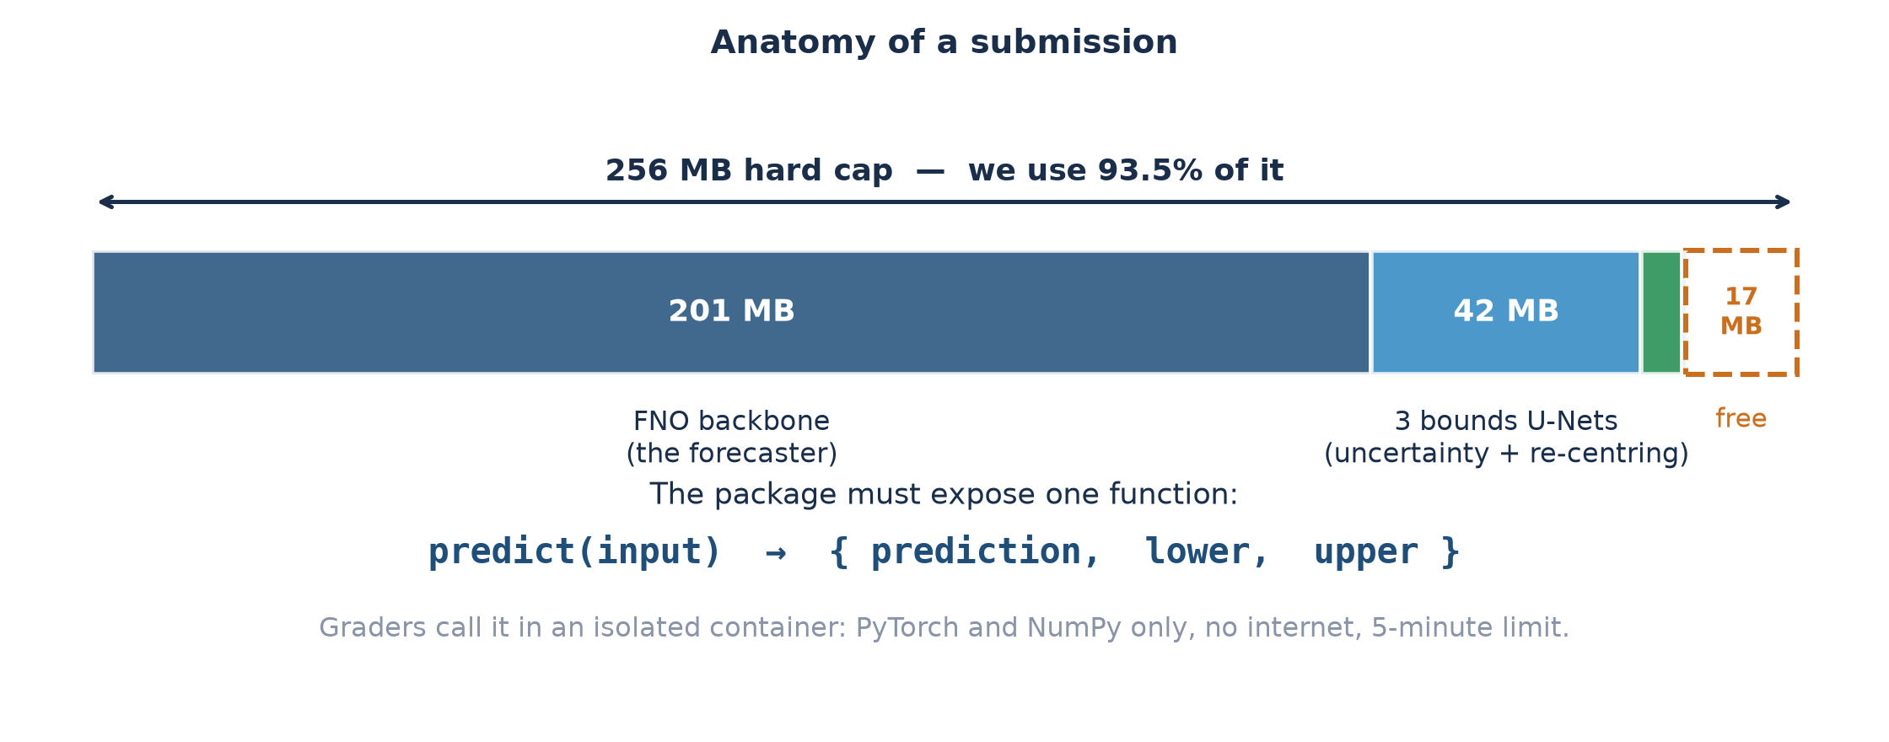
What We Actually Submit
A working program
A 250 MB zip. The graders import it, hand it 20 frames, and read back three arrays.
UGP | NeurIPS 2026 RealPDE Competition, Track 1 (Sim2Real)
5 / 21
Notes:
Make the deliverable concrete before talking about methods. We submit a zip containing model weights plus a Python file exposing one function, predict(). The graders run it inside an isolated container with no internet, PyTorch and NumPy only, and a 5-minute budget. It returns three arrays: the forecast, and a lower and upper bound for every single value. The size bar shows why everything is tight: the forecasting model alone eats 201 of the 256 MB, which is why we could never simply ensemble several models.

Slide 6
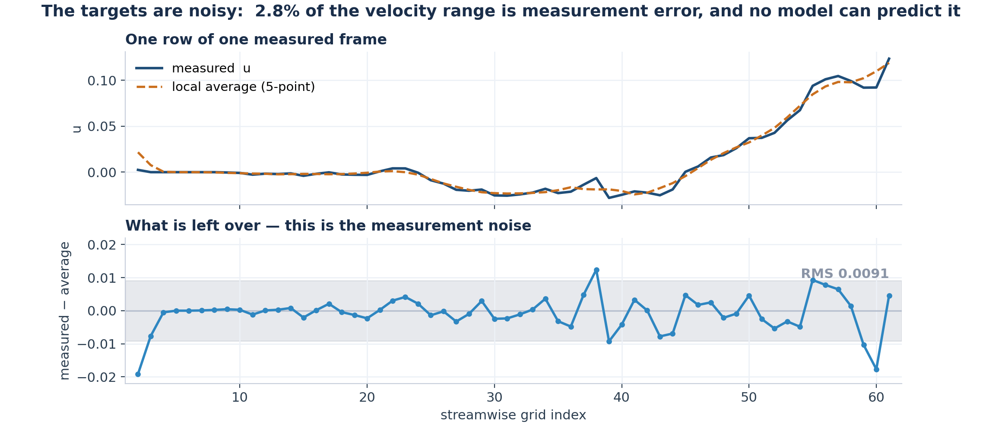
Why This Is Hard
Three independent difficulties
Turbulence
Extrapolation
Irreducible noise
Small errors amplify.
20 frames is a long horizon.
Test conditions were
never seen in training.
The targets themselves
are noisy measurements.
UGP | NeurIPS 2026 RealPDE Competition, Track 1 (Sim2Real)
6 / 21
Notes:
On the third point — the plot shows one row of one frame. The jitter is measurement noise. No model can predict that, so a floor on achievable error exists. This becomes important later: it is why chasing accuracy forever does not pay, and why the uncertainty channel is where the value is.

Slide 7
The Rules
Constraints to ensure before every decision
256 MB
5 minutes
1 per day
Top 10 only
total package size.
The given model is 201 MB.
hard runtime limit,
and speed is scored.
submissions. One real
measurement per 24 h.
are shortlisted for the
final private re-scoring.
One measurement per day makes guessing unaffordable.
Every submission had to be justified by a written prediction, and every prediction checked afterwards.
UGP | NeurIPS 2026 RealPDE Competition, Track 1 (Sim2Real)
7 / 21
Notes:
This slide explains the whole working style. With 24 hours between measurements you cannot iterate by trial and error — you must predict, submit, then reconcile. Most of what follows is the consequence of that constraint.

Slide 8
How a Submission Is Scored
Five channels to score on : the combining weights were never published
rel_l2
46.7%
We recovered the
hidden weights
overall velocity error
tke
turbulent kinetic energy
10.0%
Built an MCP tool for the coda bench leaderboard which helped in predicting weights of all metrics
mvpe
error at 9 wake probes
9.4%
time
how fast the code runs
9.7%
This turned revealed that uncertainty is worth a quarter of the score.
sps
quality of the UNCERTAINTY
24.7%
UGP | NeurIPS 2026 RealPDE Competition, Track 1 (Sim2Real)
8 / 21
Notes:
The organisers publish the five channel scores but not how they combine into the final number. We solved for the weights by least squares across 40 leaderboard rows and got a fit accurate to 0.005. That is what let us decide where to spend effort — and it showed the uncertainty channel, which we had been ignoring, was worth 24.7%.

Slide 9
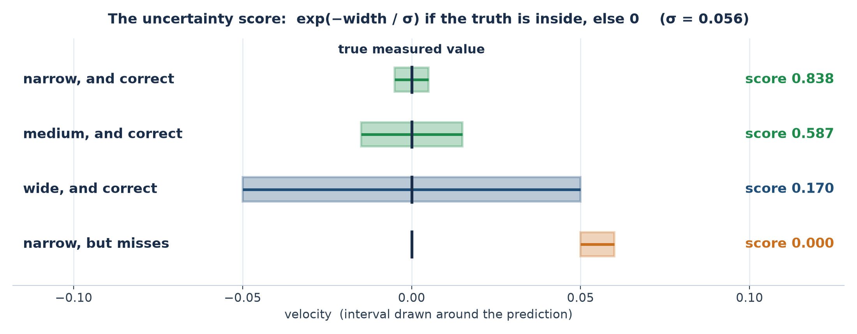
The Unusual Channel: Uncertainty
We may return a lower and upper bound for every value
Narrow and correct is the only thing that pays. Being cautious is punished almost as hard as being wrong.
UGP | NeurIPS 2026 RealPDE Competition, Track 1 (Sim2Real)
9 / 21
Notes:
Work through the four rows. Key consequence for later: because the reward decays exponentially with width, this channel is set by the TYPICAL error, whereas the accuracy channel is an L2 norm dominated by the WORST errors. They are nearly independent objectives — a model can be no more accurate overall and still win this channel outright.

Slide 10
The Tool built
MCP using Codabench API’s public endpoint
The problem
What it bought us
• The leaderboard shows one number per team.
• That number hides which of the five channels you are losing on.
• With one submission per day, spending them to find out is unaffordable.
• Showed uncertainty had a whopping 25% weightage.
• Concludes that SPS is the metric to be the most focussed on because it is the most volatile.
• Let us reverse-engineer the leader's model-vs-uncertainty split.
What I built
Is this allowed?
• A small tool that reads Codabench's public API directly.
• Pulls every team's per-channel scores, not just the total.
• Refreshes the standings on demand during analysis.
Yes. It reads the same public endpoint the website itself uses which we use for offline analysis on our local.
UGP | NeurIPS 2026 RealPDE Competition, Track 1 (Sim2Real)
10 / 21
Notes:
Be upfront about the legality question because someone will ask. Codabench serves the leaderboard to the browser through a public REST endpoint, and at the time it exposed per-channel subscores for every submission. We read that endpoint programmatically instead of clicking through the website. No authentication, no private data, nothing hidden. The competition rules forbid network calls from inside the submitted code during evaluation — that is a completely different thing, and our submission makes none. Worth noting the endpoint has since been restricted, so only totals are public now.

Slide 11
Approach 1 of 3: The Model
Improving the forecast itself
Fine-tuning
continue training the given simulation model on our 81 real runs
Model soup
train several times, then average the weights
Ensembling
run several models, average the answers, provide an offset if needed
TKE head
a second network that rescales the predicted fluctuations
Six weeks of this made the model better on unseen Reynolds numbers.
UGP | NeurIPS 2026 RealPDE Competition, Track 1 (Sim2Real)
11 / 21
Notes:
Fine-tuning was the single biggest step — it took us from roughly 77 to 78.45. Model soup means training several times from different random starts and averaging the weights; it cancels each run's idiosyncrasies. The TKE head was worth +2.21 on that channel alone. But flag the caveat now and pay it off on slide 18 — this is the thread of the talk.

Slide 12
Approach 2 of 3: Uncertainty
24.7% of the score, and free of the accuracy channels
How our bounds are produced
1
a network predicts how wrong the forecast will be, per point
2
that is sorted into 24 bins;
a table gives each a width
3
a third network re-centers
the interval where it covers best
Only the bounds move, so the forecast stays byte-identical and the accuracy channels provably cannot change.
Why this became the focus
Uncertainty explained ~68% of our gap to first place. One rival matched our accuracy to three decimals and still scored 0.58 higher implies the channels are independent.
UGP | NeurIPS 2026 RealPDE Competition, Track 1 (Sim2Real)
12 / 21
Notes:
The green box is the important one for a sceptical audience: because the prediction array is untouched, these submissions carry zero accuracy risk. We verified that byte-for-byte before shipping each one. Every gain since 21 September came from this channel with the model completely frozen.

Slide 13
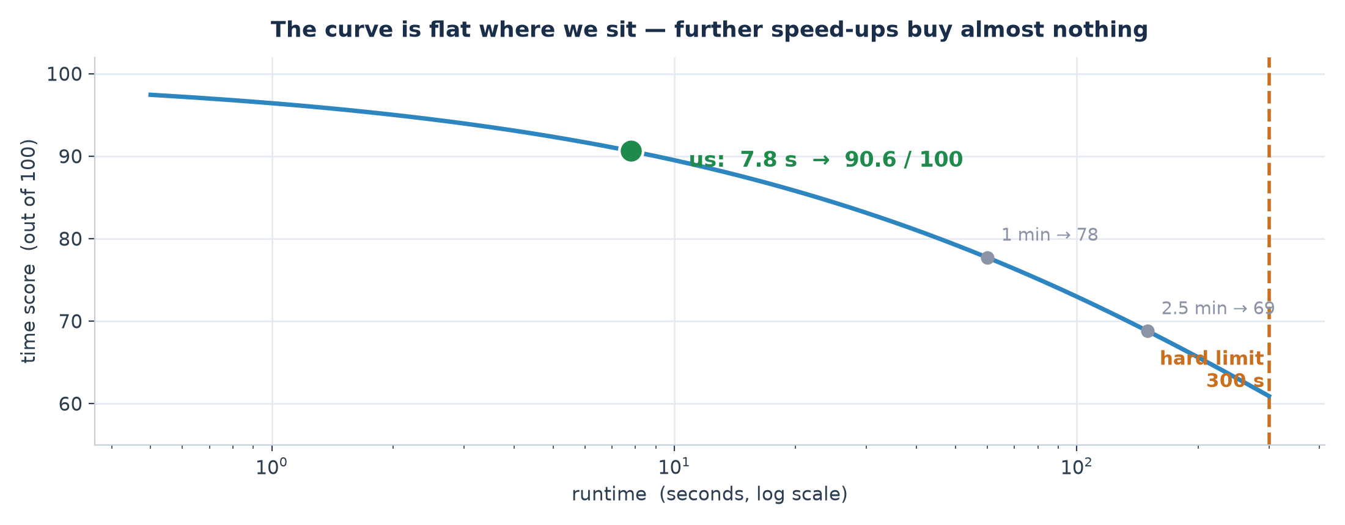
Approach 3 of 3: Speed
Why runtime is scored at all, and how much it was worth
What we did
Why we stopped
• Moved per-point work off the CPU onto the GPU.
• Merged three small networks into one.
• Stored weights at half precision.
We are already on the flat part of the curve. Going from 7.8 s to 4 s would gain only +0.25 of a point and the one change big enough to matter destroyed accuracy.
UGP | NeurIPS 2026 RealPDE Competition, Track 1 (Sim2Real)
13 / 21
Notes:
Start with the curve, because the formula is unintuitive. The score is 100/(1 + sqrt(t/728.96)). It is deliberately gentle: taking 2.5 minutes still scores 65, and the hard failure is only at 5 minutes. We run in 7.8 seconds, which scores 90.6 — we are far out on the flat part, so further speed-ups buy almost nothing. That is the point of the slide: we did the cheap engineering (GPU, merged networks, half precision), confirmed we were in the flat region, and stopped. One tempting idea — cutting the model's internal padding — gave a genuine 1.74x speed-up and wrecked accuracy by 60 times more than the time gain was worth. We priced it before submitting rather than after.

Slide 14
Inside Each Submission
What actually changed, and what it was worth
submission
what changed
model underneath
score
SOUP_v1
fine-tune on real data, then average several runs' weights
FNO soup
78.45
SHIFT_v2
ADDED UNCERTAINTY: U-Net + 24-bin width table + off-centre intervals
+ W96 U-Net
79.25
TMEAN
correct a constant offset in the time-mean
same
79.37
SV2
retrain the backbone on more of the real data
soup_v2
79.46
SPEED_SAFE
host-side speed fixes; outputs bit-identical
same
79.49
FITA1B
a better fine-tuned backbone
FITA1B FNO
79.49
FA1BMT
ADDED THE TKE HEAD: rescale predicted fluctuations
+ TKE net
79.59
FA1BMLOT7
move the blank-region mask onto the GPU
same
79.75
LUT150
reshape the per-bin interval widths
same (frozen)
79.86
NARROW080
multiply every interval width by 0.80
same (frozen)
80.06
The last two changed only the interval widths, the forecast was byte-identical.
UGP | NeurIPS 2026 RealPDE Competition, Track 1 (Sim2Real)
14 / 21
Notes:
This is the 'specific steps' table. Three rows carry most of the story, highlighted in orange. SHIFT_v2 is where the uncertainty machinery was added at all — the largest single jump in the project. FA1BMT added the TKE head. NARROW080 is the final one, and it is the cleanest illustration of the whole approach: the forecasting model is completely frozen and byte-identical, we only multiplied every interval width by 0.80, and that was worth +0.20. Note the 'model underneath' column: after FITA1B the backbone stops changing entirely. Everything after that is uncertainty and engineering.

Slide 15
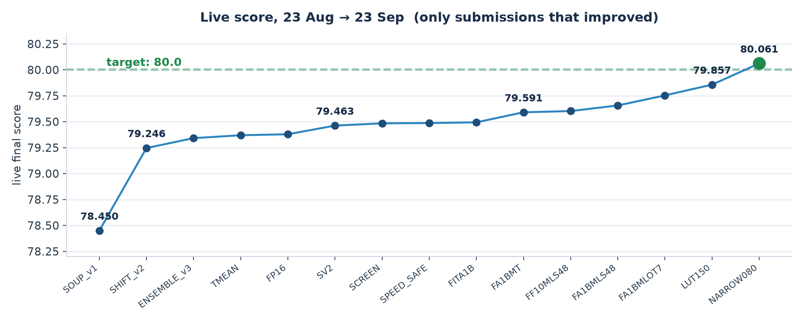
The Steps That Moved the Score
Only submissions that improved on the best so far
The last two steps changed only the bounds and the forecast was byte-identical.
UGP | NeurIPS 2026 RealPDE Competition, Track 1 (Sim2Real)
15 / 21
Notes:
Point out three places: SHIFT_v2 is where the uncertainty channel was added — the largest single jump. FA1BMT is the TKE head. The final two points are pure bounds calibration with the model frozen. Also note the flat stretch in the middle: that is six weeks of accuracy work producing almost nothing, which is the puzzle slide 18 resolves.

Slide 16
Getting It Wrong, Then Right
22 – 23 September
22 Sep - the mistake
23 Sep - the recovery
Predicted
+0.11 (widen the intervals 20%)
Predicted
+0.31 (narrow them instead)
Actual
−0.48 - worst submission in weeks
Actual
+0.20 - crossing 80 for the first time
Cause
a calibration constant was 2.14× too large
Now
the curve is pinned; this lever is finished
A wrong prediction that was written down in advance becomes a measurement.
UGP | NeurIPS 2026 RealPDE Competition, Track 1 (Sim2Real)
16 / 21
Notes:
This is the slide that front-runs the obvious question, so do not skip it. The failed submission is what let us solve for the calibration constant — one equation, one unknown. The answer was 1.00, not 2.14, meaning the intervals should have been narrowed all along. Root cause: an earlier successful change had altered interval shape and width together and we credited the gain to width. The next day's submission, built on the corrected constant, crossed 80.

Slide 17
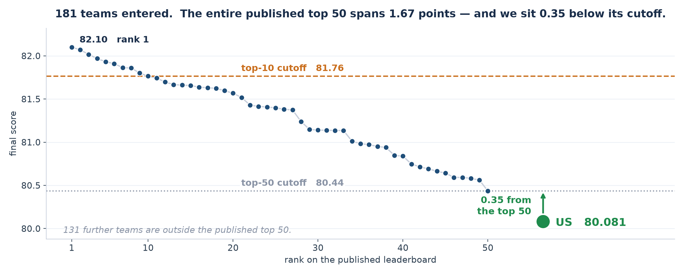
Where We Stand
Current Rank - 61 out of 181 teams remaining after elimination
We are currently 2.5% behind the leader.
UGP | NeurIPS 2026 RealPDE Competition, Track 1 (Sim2Real)
17 / 21
Notes:
Be straightforward here. We are at 80.06, rank 1 is 82.10, the top-10 cutoff is 81.74. In relative terms that is a 2.5% difference, but the field is so tightly packed that 2.5% spans rank 1 to outside the top 50. The left panel is there to make the scale honest — every team is inside one dot on the full range.

Slide 18
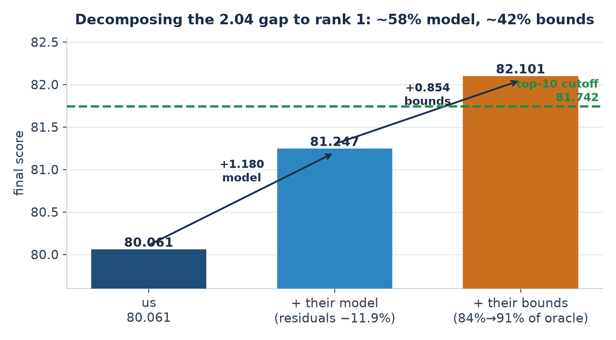
What the Gap Consists Of
Reverse-engineered from the rank-1 competitor's published scores
How we know
• Their errors are 10–16% smaller and they are 30% FASTER.
• Faster AND more accurate cannot come from tuning.
• Against a perfect-uncertainty : we are at 83.6%, they are at 90.7%.
So: ~58% better model, ~42% better uncertainty.
After giving considerable time, the main finding is that local tests cannot measure the thing we are tuning
UGP | NeurIPS 2026 RealPDE Competition, Track 1 (Sim2Real)
18 / 21
Notes:
Explain the oracle: for a given set of forecast errors there is a best possible set of intervals — knowing each error exactly and sizing the interval to just cover it. That is an upper bound no method can beat. We reach 83.6% of it; the leader reaches 90.7%. This is how we separated 'they have a better model' from 'they have better uncertainty' using only published numbers.

Slide 19
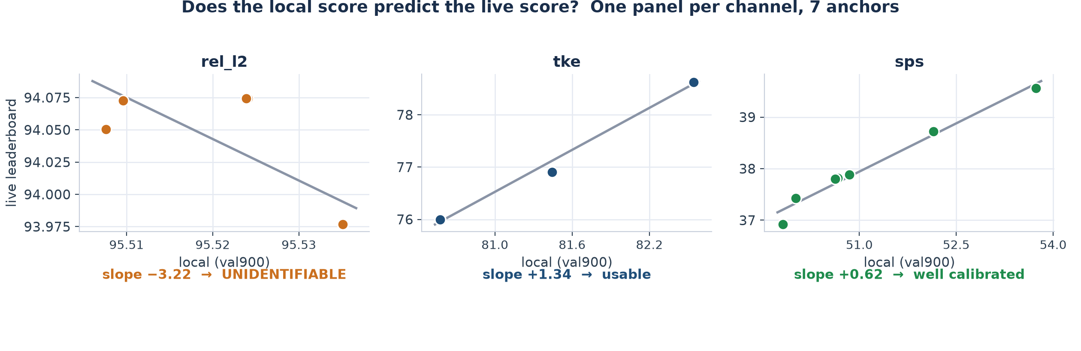
Main Finding
Our offline test cannot measure the thing we were tuning
For accuracy the slope is −3.2 i.e. meaningless. The offline score varies 3× less than the real one.
UGP | NeurIPS 2026 RealPDE Competition, Track 1 (Sim2Real)
19 / 21
Notes:
Each point is one past submission: its offline score against the score it actually got. For a useful test these should lie on a rising line. For rel_l2 they do not — the fit is negative and meaningless, because our offline score spans 0.028 while the live score spans 0.098. The test has no resolution in that channel. The uncertainty panel, by contrast, is clean: slope 0.62, and that matches a factor we derived independently from a single live anchor. This is the result I would most like feedback on.

Slide 20
What We Tested and Closed
Negative results, each with a number
Extra inputs for the uncertainty model
+0.0005
Sensitivity of the forecast to its input
0.000
Averaging three uncertainty estimates
+0.0004
A new uncertainty net trained on the true score
−0.0004
U-Net - the benchmark's best architecture
−16%
Joint simulation + real training, 3 variants
0
Each one closes a direction with a measurement rather than an opinion.
UGP | NeurIPS 2026 RealPDE Competition, Track 1 (Sim2Real)
20 / 21
Notes:
Do not read every row. Pick two: the U-Net result, because it is the benchmark's own best-ranked architecture and it is 16% worse on our data — published rankings do not transfer. And the last row: adding 81,000 simulation frames to training did not beat the starting checkpoint in any of three configurations, which is what told us the model is converged.

Slide 21
Where We Are and What Is Next
24 September 2026
80.081
82.101
81.765
61
our score
rank 1
top-10 cutoff
Leaderboard rank
The ceiling, measured
Next
Even a mathematically PERFECT uncertainty model scores 81.727 - still below the 81.765 cutoff.
• Ship the final calibrated submission (~80.11).
• Explore other(if any) routes remaining.
• Rebuild the uncertainty stack on it.
• Write up the calibration finding.
So a top-10 place provably requires a better underlying model, not better bounds, and the model is converged.
UGP | NeurIPS 2026 RealPDE Competition, Track 1 (Sim2Real)
21 / 21
Notes:
Close on the honest position. The 80 target is met. Top 10 is not reachable in the days left, and we can prove why rather than guess — that is the perfect-uncertainty number. The identified next step is pretraining our own backbone on the released simulation data, because the evidence says that is where the leaders' advantage comes from: outside pretrained models are banned, so there is nowhere else it can be. That is a multi-day training job, which is exactly why it did not fit inside the competition window.

