Slide 1
UGP Final Presentation · Parts I and II
Neural Networks for Fluid Flow
Part I: real airfoil wakes · Part II: pretraining
Aryamann Srivastava, 4th year Undergraduate, Dept. of AE
Supervisor: Prof. Rajesh Ranjan · November 2026
Notes:
Good morning, sir. My UGP had two parts. In Part I, I forecast a real airfoil wake in the NeurIPS RealPDE competition. In Part II, I rebuilt Microsoft's Aurora model to answer the question Part I left open: what does pretraining data actually buy?

Slide 2
What is Covered
1
2
3
4
5
Part I: the problem
Part I: our approach
Part I: the result
Part II: the question
Part II: the findings
Forecasting a real wake
Model, scoring, bands
80.1 score
What pretraining buys
Five results, next steps
Part I | Forecasting real airfoil wakes
2 / 40
Notes:
The plan: first the competition, its problem, our approach and the result. Then the question it left open, and what Part II found.

Slide 3
Part I
Forecasting Real Airfoil Wakes :
Neural Operators on PIV Measurements
NeurIPS 2026 RealPDE Competition · Track 1: Sim2Real
Notes:
Part I: forecasting real airfoil wakes in the NeurIPS 2026 RealPDE competition.

Slide 4
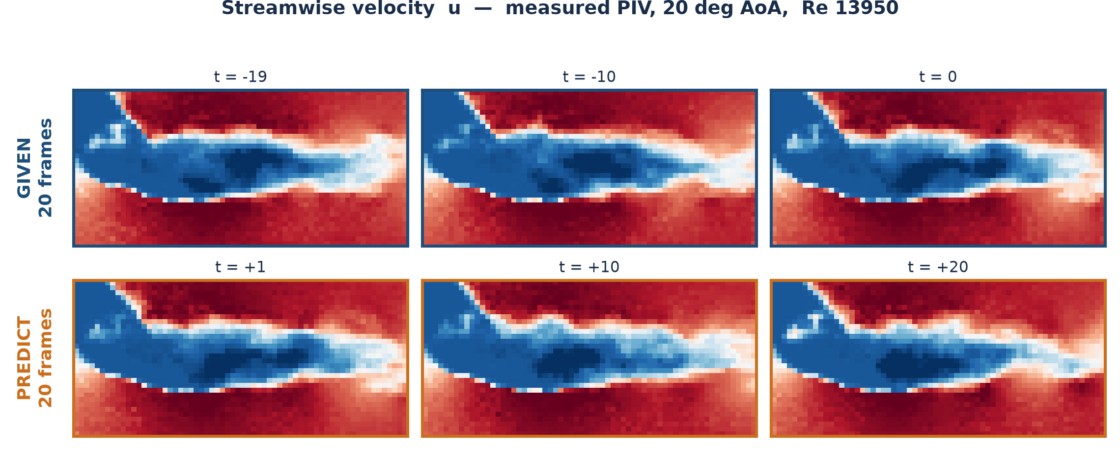
This Is the Data
Streamwise velocity, measured by PIV in a water tunnel
Given the top row → predict the bottom row.
Part I | Forecasting real airfoil wakes
4 / 40
Notes:
Walk them through the picture. NACA4418 airfoil, 20 degrees angle of attack, Re 13,950. Blue is slow fluid, red is fast. The dark blue lobe is the separated wake. Note the speckle, that is genuine measurement noise from the PIV cross-correlation, not a rendering artefact. The task is: see the top three frames (and 17 others), produce the bottom three (and 17 others). Twenty frames in, twenty frames out. Mention that in the real competition the test runs are at Reynolds numbers we never trained on.

Slide 5
The Task, in a Nutshell
One sentence, then the numbers
Given 20 measured frames, predict the next 20.
32 × 64
2
81
69,000
grid points per frame
velocity components u, v
training runs
real frames total
Conditions
Training
Reynolds 3,750 – 26,700 ; angle of attack 0° – 20°
Testing
unseen conditions, reaching Re 27,975 which happens to be above the training maximum
Part I | Forecasting real airfoil wakes
5 / 40
Notes:
Keep this short. The one number that matters is the last line: the test set extrapolates beyond the training range in Reynolds number, so this is not interpolation. Pressure is in the tensor but identically zero, PIV cannot measure it.

Slide 6
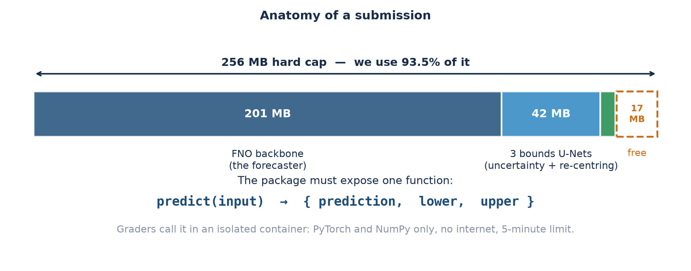
What We Actually Submit
A working program
A 250 MB zip. The graders import it, hand it 20 frames, and read back three arrays.
Part I | Forecasting real airfoil wakes
6 / 40
Notes:
Make the deliverable concrete before talking about methods. We submit a zip containing model weights plus a Python file exposing one function, predict(). The graders run it inside an isolated container with no internet, PyTorch and NumPy only, and a 5-minute budget. It returns three arrays: the forecast, and a lower and upper bound for every single value. The size bar shows why everything is tight: the forecasting model alone eats 201 of the 256 MB, which is why we could never simply ensemble several models.

Slide 7
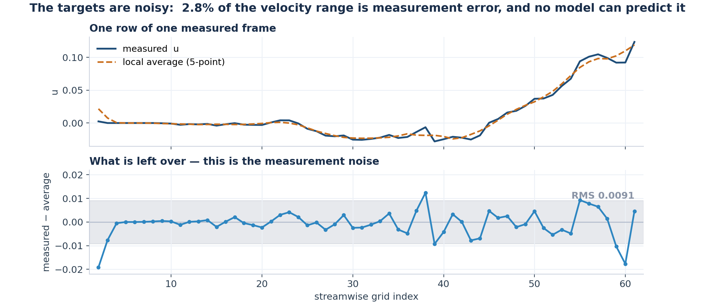
Why This Is Hard
Three independent difficulties
Turbulence
Extrapolation
Irreducible noise
Small errors amplify.
20 frames is a long horizon.
Test conditions were
never seen in training.
The targets themselves
are noisy measurements.
Part I | Forecasting real airfoil wakes
7 / 40
Notes:
On the third point, the plot shows one row of one frame. The jitter is measurement noise. No model can predict that, so a floor on achievable error exists. This becomes important later: it is why chasing accuracy forever does not pay, and why the uncertainty channel is where the value is.

Slide 8
The Rules
Constraints to ensure before every decision
256 MB
5 minutes
1 per day
Top 10 only
total package size.
The given model is 201 MB.
hard runtime limit,
and speed is scored.
submissions. One real
measurement per 24 h.
are shortlisted for the
final private re-scoring.
One measurement per day makes guessing unaffordable.
Every submission had to be justified by a written prediction, and every prediction checked afterwards.
Part I | Forecasting real airfoil wakes
8 / 40
Notes:
This slide explains the whole working style. With 24 hours between measurements you cannot iterate by trial and error, you must predict, submit, then reconcile. Most of what follows is the consequence of that constraint.

Slide 9
How a Submission Is Scored
Five channels to score on : the combining weights were never published
rel_l2
46.7%
We recovered the
hidden weights
overall velocity error
tke
turbulent kinetic energy
10.0%
Built a small tool that reads the public Codabench leaderboard, which let us solve for the weights of all metrics
mvpe
error at 9 wake probes
9.4%
time
how fast the code runs
9.7%
This turned revealed that uncertainty is worth a quarter of the score.
sps
quality of the UNCERTAINTY
24.7%
Part I | Forecasting real airfoil wakes
9 / 40
Notes:
The organisers publish the five channel scores but not how they combine into the final number. We solved for the weights by least squares across 40 leaderboard rows and got a fit accurate to 0.005. That is what let us decide where to spend effort, and it showed the uncertainty channel, which we had been ignoring, was worth 24.7%.

Slide 10
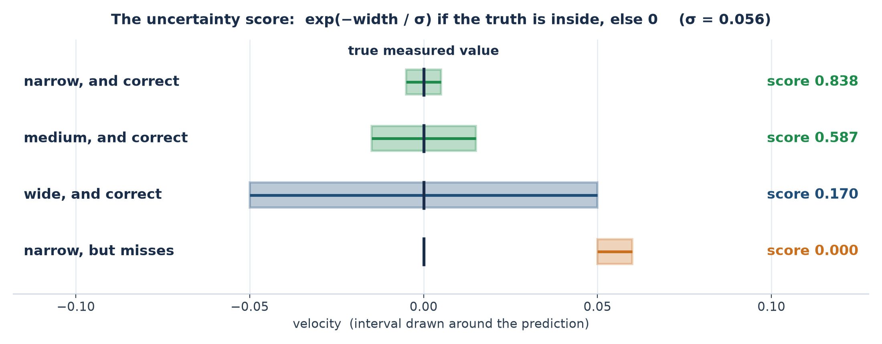
The Unusual Channel: Uncertainty
We may return a lower and upper bound for every value
Narrow and correct is the only thing that pays. Being cautious is punished almost as hard as being wrong.
Part I | Forecasting real airfoil wakes
10 / 40
Notes:
Work through the four rows. Key consequence for later: because the reward decays exponentially with width, this channel is set by the TYPICAL error, whereas the accuracy channel is an L2 norm dominated by the WORST errors. They are nearly independent objectives, a model can be no more accurate overall and still win this channel outright.

Slide 11
The Tool built
A small tool reading Codabench's public leaderboard endpoint
The problem
What it bought us
• The leaderboard shows one number per team.
• That number hides which of the five channels you are losing on.
• With one submission per day, spending them to find out is unaffordable.
• Showed uncertainty had a whopping 25% weightage.
• Concludes that SPS is the metric to be the most focussed on because it is the most volatile.
• Let us reverse-engineer the leader's model-vs-uncertainty split.
What I built
Is this allowed?
• A small tool that reads Codabench's public API directly.
• Pulls every team's per-channel scores, not just the total.
• Refreshes the standings on demand during analysis.
Yes. It reads the same public endpoint the website itself uses which we use for offline analysis on our local.
Part I | Forecasting real airfoil wakes
11 / 40
Notes:
Be upfront about the legality question because someone will ask. Codabench serves the leaderboard to the browser through a public REST endpoint, and at the time it exposed per-channel subscores for every submission. We read that endpoint programmatically instead of clicking through the website. No authentication, no private data, nothing hidden. The competition rules forbid network calls from inside the submitted code during evaluation, that is a completely different thing, and our submission makes none. Worth noting the endpoint has since been restricted, so only totals are public now.

Slide 12
Approach 1 of 3: The Model
Improving the forecast itself
Fine-tuning
continue training the given simulation model on our 81 real runs
Model soup
train several times, then average the weights
Ensembling
run several models, average the answers, provide an offset if needed
TKE head
a second network that rescales the predicted fluctuations
Six weeks of this made the model better on unseen Reynolds numbers.
Part I | Forecasting real airfoil wakes
12 / 40
Notes:
Fine-tuning was the single biggest step, it took us from roughly 77 to 78.45. Model soup means training several times from different random starts and averaging the weights; it cancels each run's idiosyncrasies. The TKE head was worth +2.21 on that channel alone. But flag the caveat now and pay it off on slide 18, this is the thread of the talk.

Slide 13
Approach 2 of 3: Uncertainty
Uncertainty is 24.7% of the score. Here is how we draw the bands
Three simple steps
1
Guess the error: a network estimates how wrong the forecast is at each point
2
Choose the width: expect a big error, draw a wide band; expect a small one, draw a narrow band
3
Centre it: shift the band to where it is most likely to catch the truth
The forecast itself is never changed, so improving the bands cannot hurt accuracy.
In plain words
Like a weather forecast: “20°C, give or take 2”. We give the forecast and the “give or take” for every point. A small “give or take” that still turns out right earns the most points.
Part I | Forecasting real airfoil wakes
13 / 40
Notes:
Uncertainty is a quarter of the score, so this was our biggest opportunity. It works in three simple steps. First, a network guesses how wrong the forecast will be at each point. Second, we turn that guess into a band width: a big expected error gets a wide band, a small one gets a narrow band. Third, we shift the band to where it is most likely to catch the truth. Think of a weather forecast saying 20 degrees, give or take 2. The give or take is our band. And the forecast itself is never touched, so improving the bands can never hurt accuracy.

Slide 14
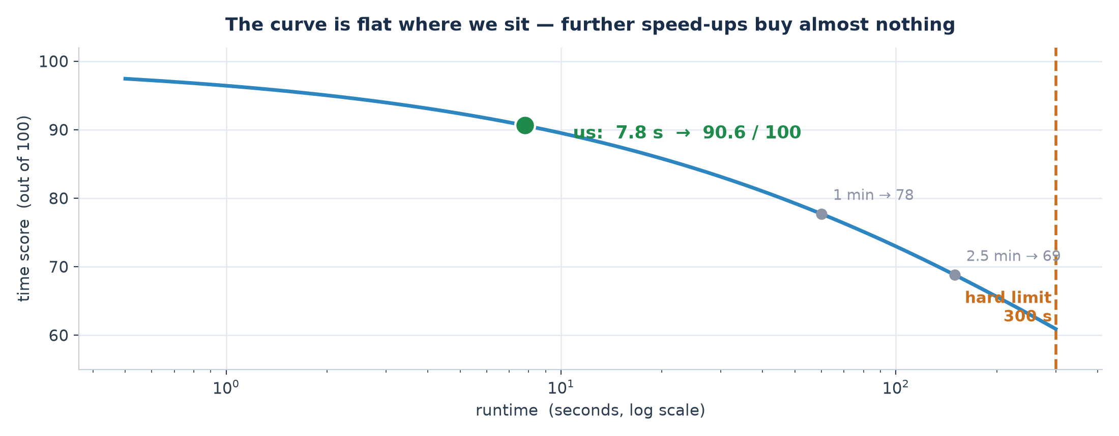
Approach 3 of 3: Speed
Why runtime is scored at all, and how much it was worth
What we did
Why we stopped
• Moved per-point work off the CPU onto the GPU.
• Merged three small networks into one.
• Stored weights at half precision.
We are already on the flat part of the curve. Going from 7.8 s to 4 s would gain only +0.25 of a point and the one change big enough to matter destroyed accuracy.
Part I | Forecasting real airfoil wakes
14 / 40
Notes:
Start with the curve, because the formula is unintuitive. The score is 100/(1 + sqrt(t/728.96)). It is deliberately gentle: taking 2.5 minutes still scores 65, and the hard failure is only at 5 minutes. We run in 7.8 seconds, which scores 90.6, we are far out on the flat part, so further speed-ups buy almost nothing. That is the point of the slide: we did the cheap engineering (GPU, merged networks, half precision), confirmed we were in the flat region, and stopped. One tempting idea, cutting the model's internal padding, gave a genuine 1.74x speed-up and wrecked accuracy by 60 times more than the time gain was worth. We priced it before submitting rather than after.

Slide 15
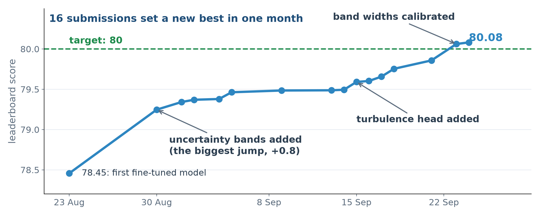
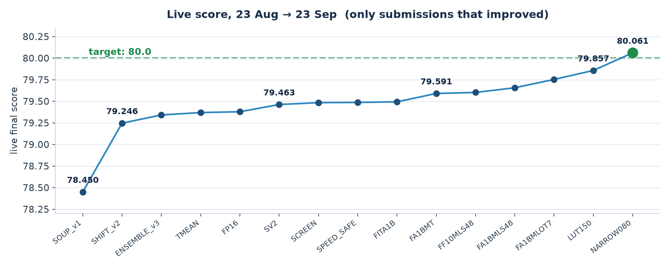
Score Progression
Every submission that set a new best, on the day it was scored (23 Aug to 24 Sep)
16 submissions set a new best, from 78.45 to 80.08. The last two steps changed only the bands.
Part I | Forecasting real airfoil wakes
15 / 40
Notes:
This is the score progression over the month, one point per submission that set a new best, placed on the day it was scored. The first big jump, on 30 August, is when we added the uncertainty bands. The turbulence head came in mid September, and in the last days we calibrated the band widths, which took us across our target of 80. The last two steps changed only the bands; the forecast was identical.

Slide 16
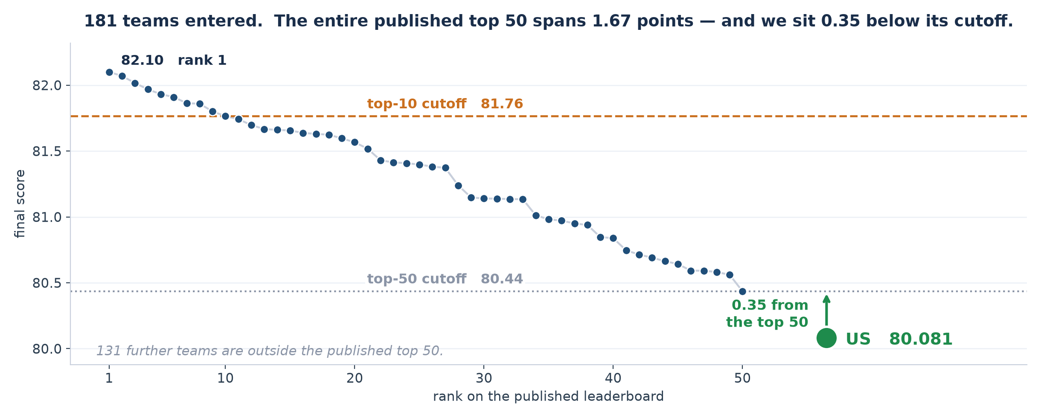
Where We Stand
Development leaderboard on 24 September 2026: 181 teams
A very tight field: 2.5% separates rank 1 from outside the top 50.
Part I | Forecasting real airfoil wakes
16 / 40
Notes:
Be straightforward here. We are at 80.06, rank 1 is 82.10, the top-10 cutoff is 81.74. In relative terms that is a 2.5% difference, but the field is so tightly packed that 2.5% spans rank 1 to outside the top 50. The left panel is there to make the scale honest, every team is inside one dot on the full range.

Slide 17
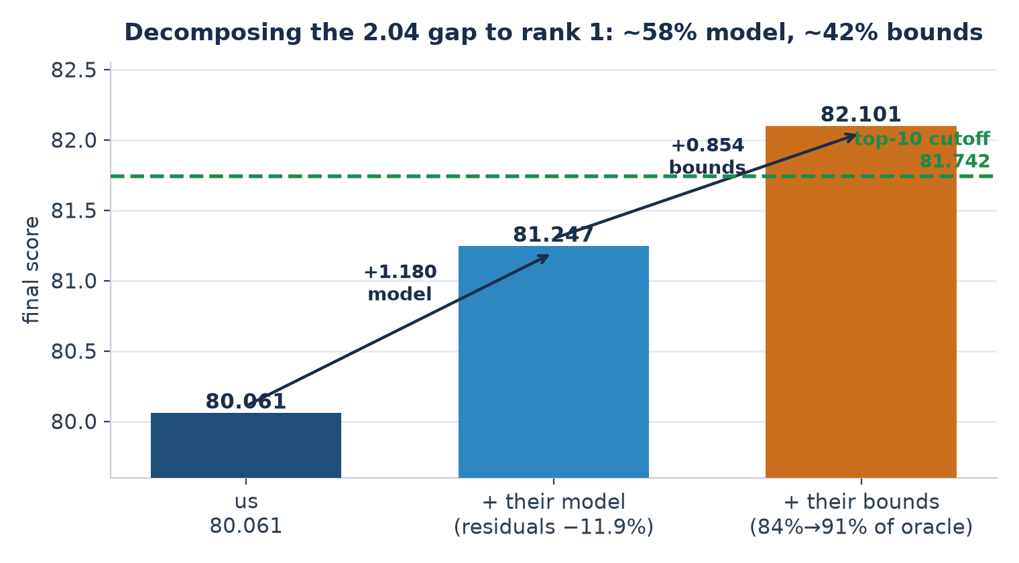
What the Gap Consists Of
Reverse-engineered from the rank-1 competitor's published scores
How we know
• Their errors are 10–16% smaller and they are 30% FASTER.
• Faster AND more accurate cannot come from tuning.
• Against a perfect-uncertainty : we are at 83.6%, they are at 90.7%.
So: ~58% better model, ~42% better uncertainty.
Part I | Forecasting real airfoil wakes
17 / 40
Notes:
Explain the oracle: for a given set of forecast errors there is a best possible set of intervals, knowing each error exactly and sizing the interval to just cover it. That is an upper bound no method can beat. We reach 83.6% of it; the leader reaches 90.7%. This is how we separated 'they have a better model' from 'they have better uncertainty' using only published numbers.

Slide 18
Part I: Where We Landed
Final development leaderboard, about 182 teams
80.081
72.65
81.901
82.218
our score
organisers' baseline
top-10 cutoff
development leader
The ceiling, measured
What it led to
Even a mathematically PERFECT uncertainty model scores 81.727, below the top-10 cutoff (81.765 on 24 Sep).
• Finished just outside the top 50: the whole top 50 sat within 1.6 points.
• The forecast, not the bands, was the limit.
• Open question: would pretraining on related data have helped?
• Part II answers it on a flow we control.
So a top-10 place provably requires a better underlying model, not better bounds, and the model is converged.
Part I | Forecasting real airfoil wakes
18 / 40
Notes:
Where Part I landed. Our development score was 80.08, against the organisers' baseline of 72.65. The top-10 cutoff was 81.90 and the leader 82.22. Even perfect uncertainty bands would not reach the top ten, so the forecast itself was the limit. We finished just outside the top 50 in a very tight field, and the project left one question open: would pretraining on related data have helped?

Slide 19
Part II
What Does Pretraining Really Buy?
Rebuilding Aurora, a large weather AI model, from scratch in JAX, and testing what makes it work on swirling fluid flow
Notes:
Part II answers that question: what does pretraining data really buy? I rebuilt Aurora, a large weather model, from scratch in JAX and tested it on a swirling flow where I control the data.

Slide 20
Where We Started
UGP-I ended with a question it could not test
UGP-I: RealPDE competition
The question it left open
NeurIPS 2026, sim-to-real track
Would a model pretrained on lots of related data have done better?
80.08
development-phase score
Outside pretrained models were banned
Too little real data to try it
So UGP-II builds a setting where it can be tested properly
Task: forecast real, measured airflow past a wing, from only 81 lab recordings
Part II | What pretraining data buys
20 / 40
Notes:
In UGP-I, I took part in the RealPDE competition at NeurIPS 2026, forecasting real measured airflow past a wing, and scored 80.08. It ended with an open question: would a model pretrained on lots of related data have done better? I could not test that, because outside pretrained models were banned and there were only 81 real recordings. UGP-II builds a setting where I can test it properly.

Slide 21
The Big Idea: Pretrain, Then Fine-tune
How today's large scientific AI models are trained
1
Pretrain
2
Fine-tune
3
Predict
Learn from lots of related data
Brief practice on the actual task
Use it on new cases
Pretrained
From scratch
Like a student who studies every chapter, then practises the exam chapter
Studies only the exam chapter
Part II | What pretraining data buys
21 / 40
Notes:
Quick background on how these models are trained. First, pretraining: learn from lots of related data. Then a short fine-tuning on the actual task. Think of a student who studies every chapter, then practises the exam chapter. Training from scratch is studying only the exam chapter. Throughout the project, I compare these two.

Slide 22
Aurora Says It Works, But Not Why
Microsoft's weather foundation model
But which ingredient of the data creates that gain?
25%
Amount
Variety
How much data
How many kinds of flow
better than training from scratch
Format
Closeness
1.3 billion parameters, pretrained on over a million hours of Earth-system data
Mixed grids and variables
How similar to the task
Aurora changes all four at once, and one rerun would need a lot of GPUs
Part II | What pretraining data buys
22 / 40
Notes:
Aurora is the best-known example. It has 1.3 billion parameters and reports that pretraining beats training from scratch by 25%. But its pretraining data differs in amount, variety, format and closeness to the task all at once, so it cannot say which one helps. Rerunning that comparison would need a lot of GPUs. That is the gap I target.

Slide 23
Our Goal
Rebuild Aurora from scratch in JAX, then use it to find out which property of the pretraining data creates the benefit
1
2
3
4
Rebuild
Create
Test
Check
Aurora from scratch in JAX, at small scale
our own data solver: a fluid simulator
each ingredient, one at a time
the answer on real lab data
Part II | What pretraining data buys
23 / 40
Notes:
So my goal has two parts. Rebuild Aurora from scratch in JAX, then use it to find out which property of the pretraining data creates the benefit. Four objectives: rebuild Aurora at small scale, build my own data solver, test each ingredient one at a time, and finally check the answer on the real lab data from UGP-I.

Slide 24
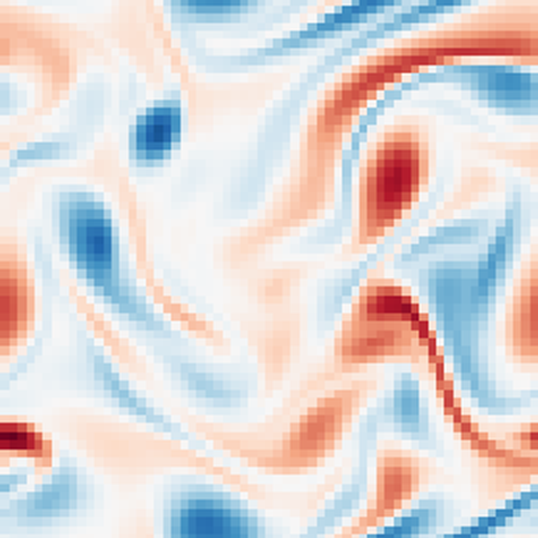
Why Kolmogorov Flow?
A classic test case: fluid in a box, kept moving by a steady push
1
We create the data
Any amount, any setting, at no cost
2
Two simple knobs
Change how the flow behaves, one at a time
3
Real turbulence
Chaotic, so forecasting it is a genuine challenge
4
Exact answers
Every prediction is scored against the true flow
Spin of the fluid: red one way, blue the other
Part II | What pretraining data buys
24 / 40
Notes:
I chose Kolmogorov flow, a classic test case: fluid in a box, kept moving by a steady push. The big advantage is that I generate the data myself, in any amount and any setting. Two simple knobs change how it behaves. It is genuinely turbulent, so forecasting it is hard. And I always know the exact true answer to score against.

Slide 25
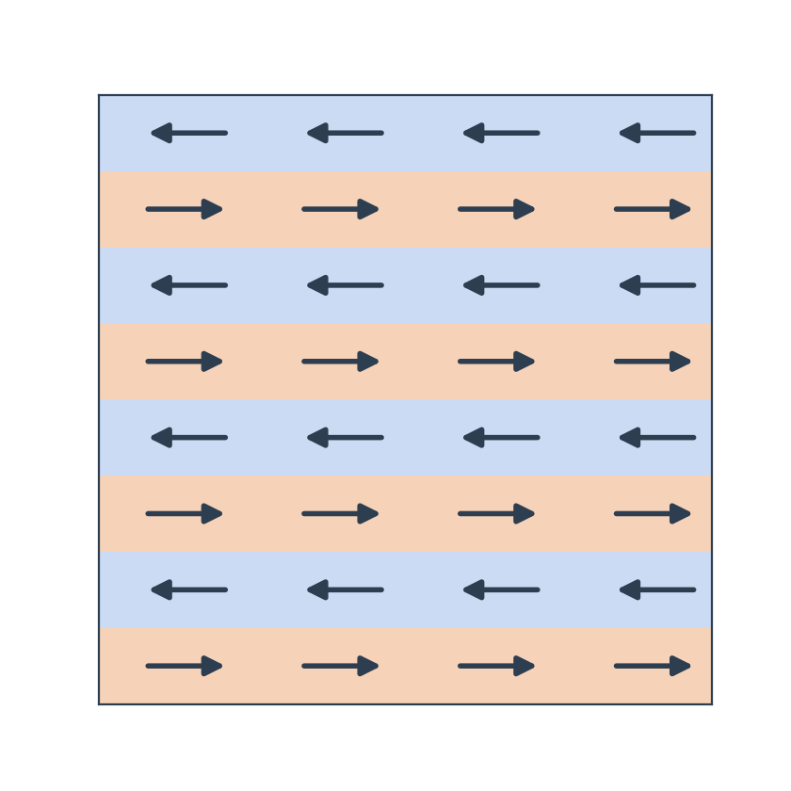
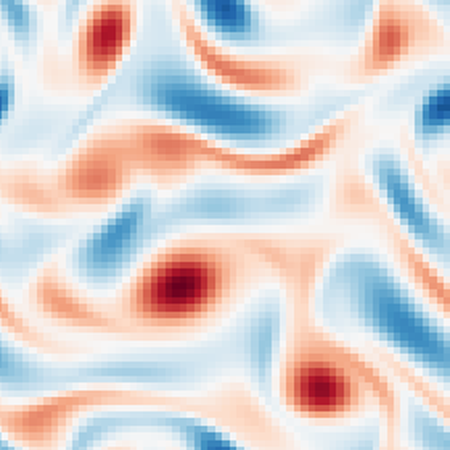
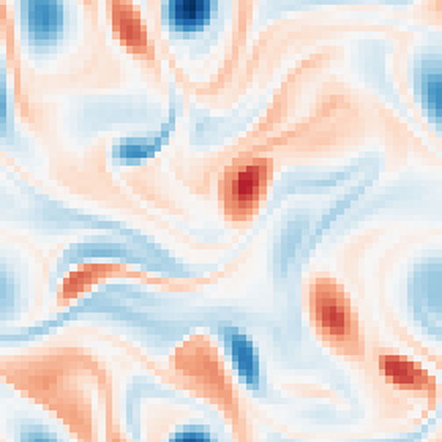
Two Knobs Define Each Flow
Re 100
Re 300
Re 1000
calm
wild
Stirring pattern (kf)
Reynolds number (Re)
Bands of fluid pushed left and right; kf = number of band pairs. Target: 4
How wild the flow gets: thick like honey at low Re, thin like water at high Re. Target: 300
Part II | What pretraining data buys
25 / 40
Notes:
These are the two knobs. On the left is the stirring pattern, kf: bands of fluid pushed left and right, and kf is the number of band pairs. On the right is the Reynolds number: how wild the flow gets, from calm at 100 to turbulent at 1000. My test task is Reynolds number 300 with kf 4, and the model never sees that setting during pretraining.

Slide 26
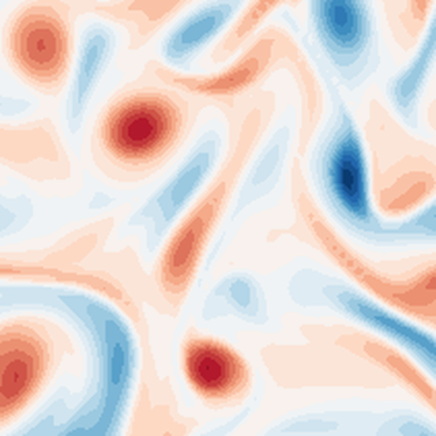
The Task: Predict the Next Moment
Two snapshots in, one snapshot out
AI model
a moment ago
now
next moment
Illustrative snapshots
Longer forecasts
Feed each prediction back in as the new input, step after step. We test 20 steps ahead.
Part II | What pretraining data buys
26 / 40
Notes:
The model's job is simple. It sees the flow at two consecutive moments and predicts the next one; two inputs let it see the motion. For longer forecasts, each prediction is fed back in as the next input, step after step. I test up to 20 steps ahead.

Slide 27
How We Measure Success
Every prediction is compared with the true simulated flow
Error
Beat the lazy guess
How far the prediction is from the truth
Must do better than "nothing changes"
0% = perfect
the minimum bar
Long-forecast drift
Pretraining gain
Average error over 20 steps of feeding predictions back
How much lower the error is than training from scratch
stability
the key number
Part II | What pretraining data buys
27 / 40
Notes:
I use four measures. Error: how far the prediction is from the truth. The lazy guess, 'nothing changes', is the minimum bar any model must beat. Long-forecast drift measures stability over 20 steps. And the key number, pretraining gain: how much lower the error is than a model trained from scratch on the same data and budget.

Slide 28
What We Built
Four verified pieces, each tested before use
Fluid simulator
Dataset
Aurora copy
Experiment system
10⁻⁹
326
5.1 M
1 → 1
energy balance error: physically exact
simulations across 33 flow settings
parameters; matches Aurora's own code to 10⁻⁷
one settings file gives one run and one result row
Part II | What pretraining data buys
28 / 40
Notes:
I built four pieces, each tested before use. A fluid simulator whose energy balance is exact to about one part in a billion. A dataset of 326 simulations across 33 flow settings. A copy of Aurora with 5.1 million parameters that matches Aurora's own code to seven decimal places. And an experiment system where one settings file gives one run and one recorded result.

Slide 29
Inside the Model
Same building blocks as Aurora, written from scratch in JAX
Two snapshots
Cut into patches
Patches share information
Zoom out and back in
Next snapshot
the flow now and a moment ago
256 small squares
attention, inside local windows
see big and small swirls
the forecast
Attention: each patch learns which other patches matter for predicting it
Zooming: coarse views capture large swirls, fine views keep the detail
Part II | What pretraining data buys
29 / 40
Notes:
Inside, the model uses Aurora's building blocks. It cuts each snapshot into 256 small patches. Each patch gathers information from the patches that matter to it; this is called attention, done in small windows for speed. Then the model zooms out to see the big swirls and back in to keep the detail, and outputs the next snapshot.

Slide 30
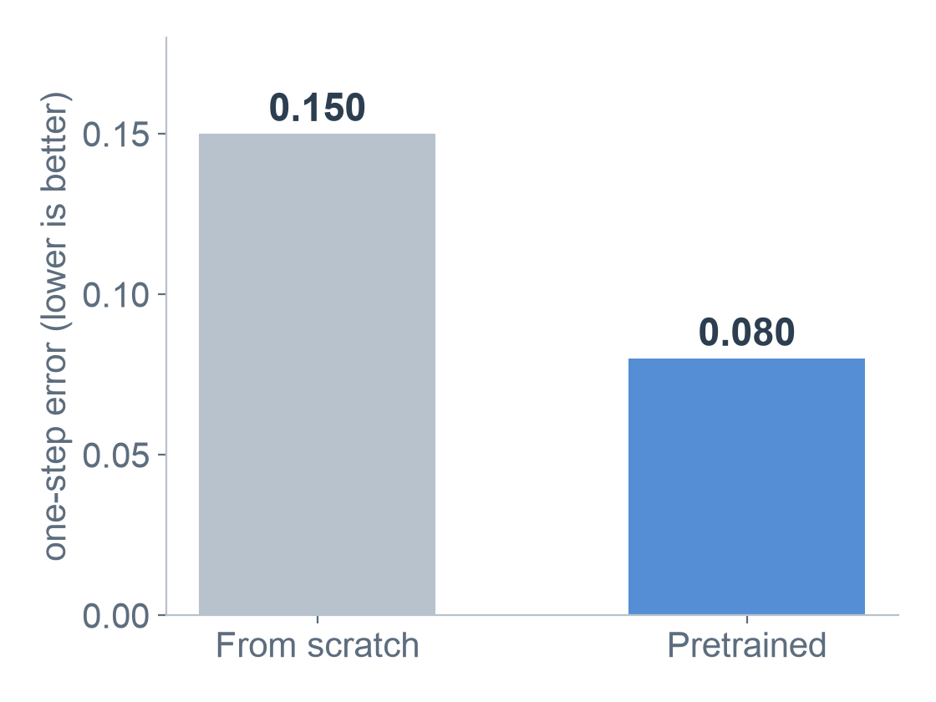

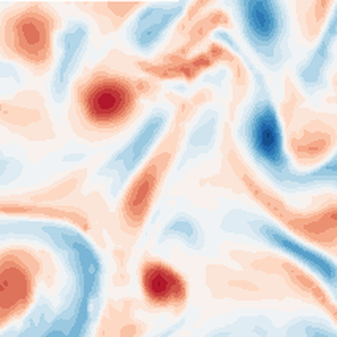
Result 1: Pretraining Halves the Error
42–50% lower one-step error, in every setup tested
Truth
Pretrained
From scratch
Colours show the fluid's spin: red one way, blue the other, white still. One step ahead on a flow never seen in training: the pretrained forecast is closer to the truth (error 0.19 vs 0.28).
Part II | What pretraining data buys
30 / 40
Notes:
First result: pretraining halves the error. A model trained from scratch has an error of 0.150; the pretrained one gets 0.080, which is 42 to 50% better in every setup tested. On the right, the colours show the fluid's spin. Starting from the same moment, the pretrained model's next-step forecast is closer to the truth than the scratch model's.

Slide 31
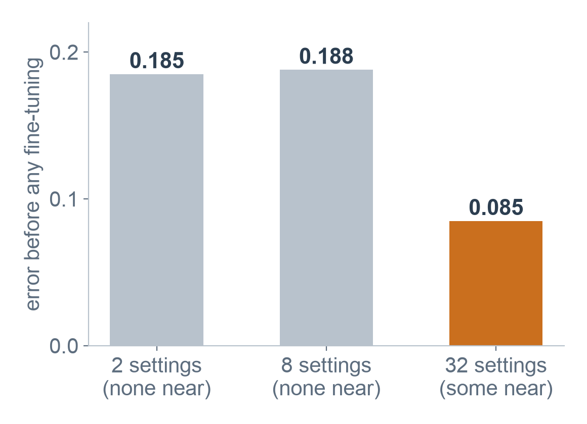
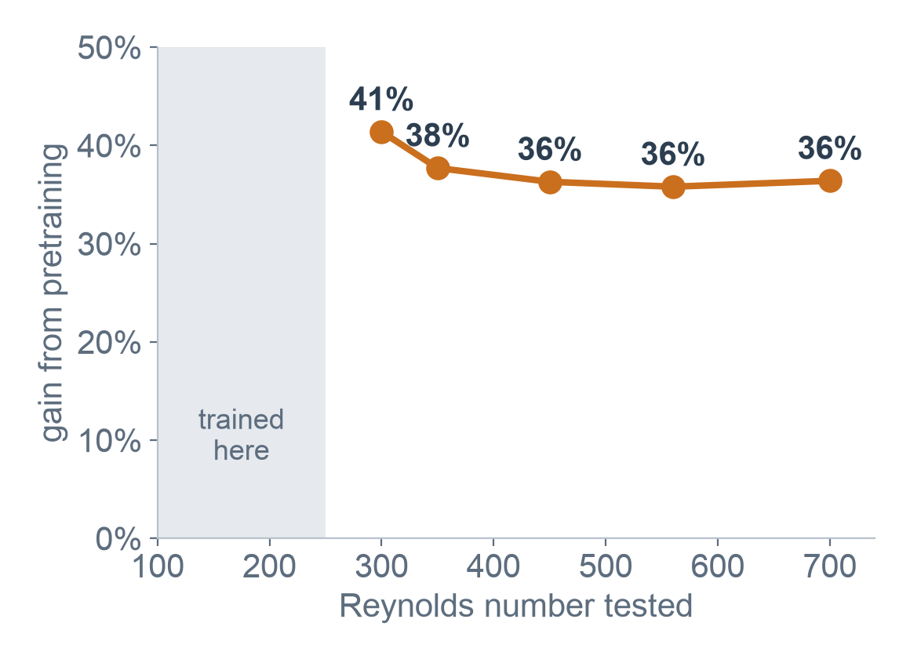
Result 2: Closeness Matters Most
More data or more variety added nothing; being near the task did
Data near the task gives a far better start
The gain holds far beyond the training range
Part II | What pretraining data buys
31 / 40
Notes:
Second, and the main answer to my question: closeness matters most. Adding more data or more variety did not change the gain. But the pretraining mix that contained settings near the task gave a far better starting point, 0.085 against about 0.19. On the right: even when tested well beyond the training range, pretraining still gives a 36 to 41% gain.

Slide 32
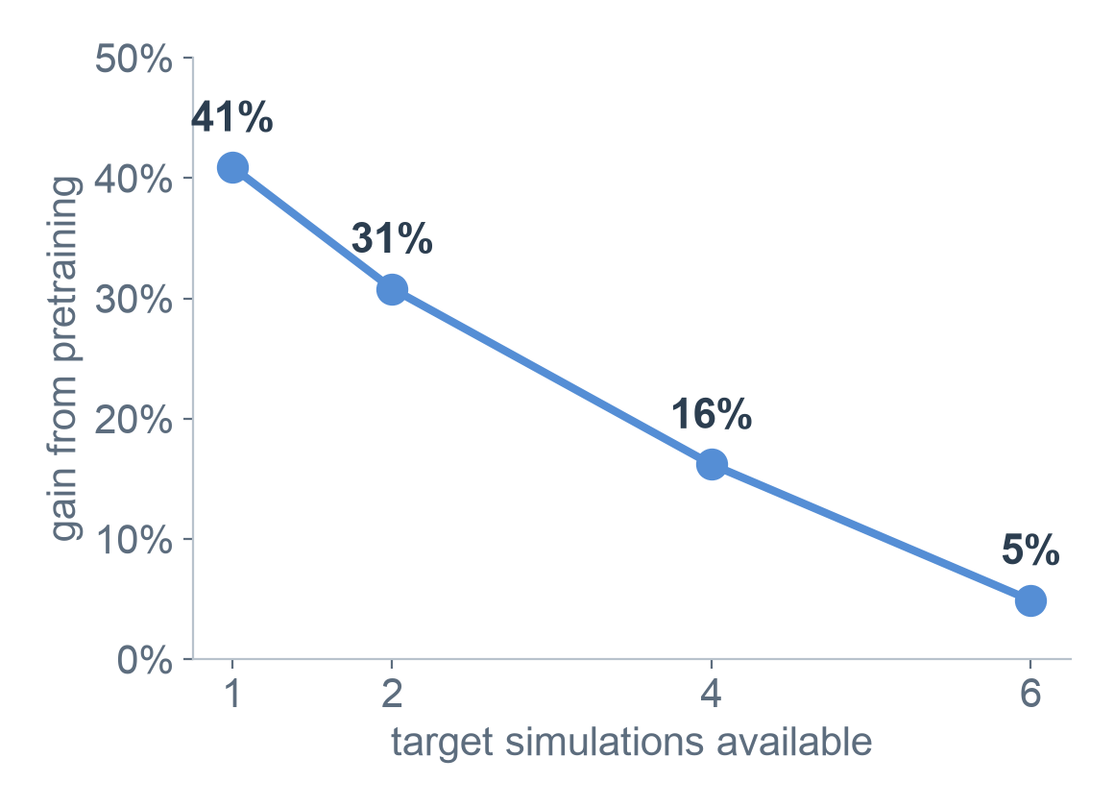
Result 3: Most Valuable When Data Is Scarce
Pretraining pays off most when the task has little data of its own
41%
gain with a single target simulation
Ready out of the box
Even without fine-tuning, the pretrained model is within 6% of the best fine-tuned result
Part II | What pretraining data buys
32 / 40
Notes:
Third: pretraining is most valuable when task data is scarce. With a single target simulation it gives a 41% gain, and as more target data becomes available, training from scratch catches up. Even without any fine-tuning, the pretrained model is already within 6% of the best fine-tuned result.

Slide 33
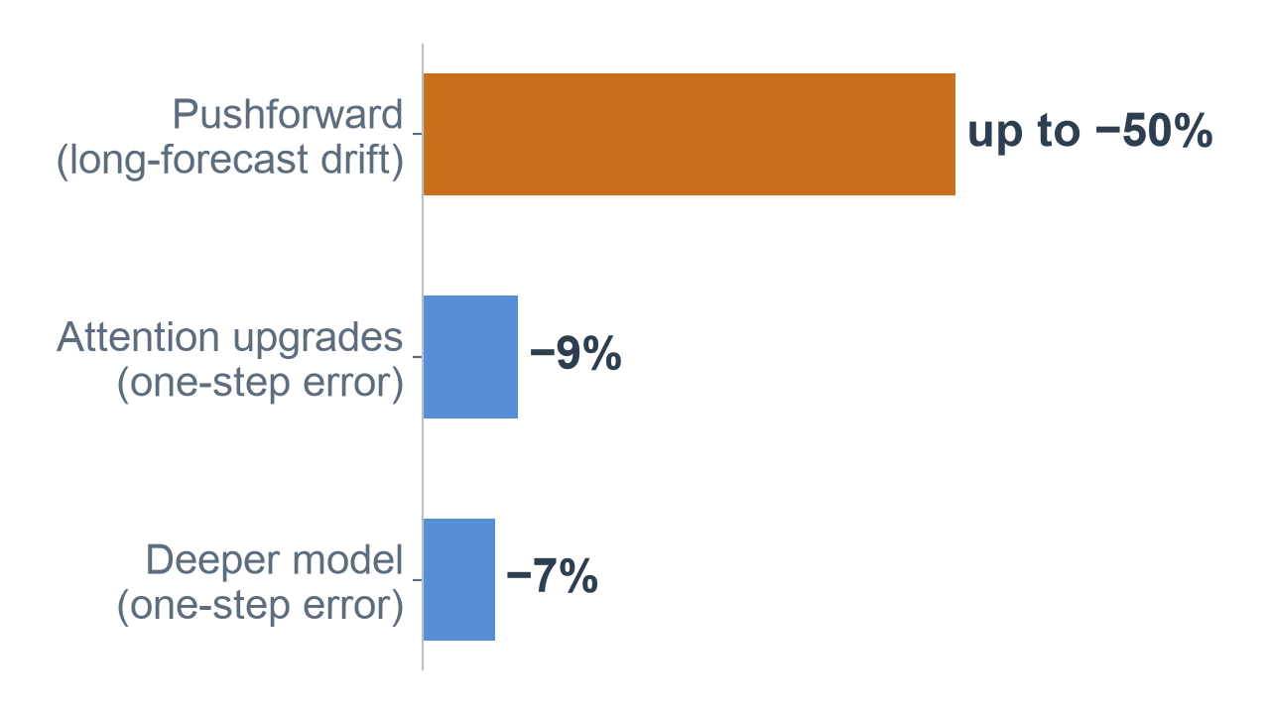
Result 4: What Makes the Model Better
Measured improvements from individual design choices
Pushforward
Train on the model's own predictions, so long forecasts stay steady
Attention upgrades
Two small changes, about the gain of doubling the depth at a fraction of the cost
Cheap fine-tuning (LoRA)
Corrects systematic errors: up to 71% where the base model is off
Part II | What pretraining data buys
33 / 40
Notes:
Fourth: what makes the model better. The biggest win is pushforward, training the model on its own predictions, which cuts long-forecast drift by up to half. Two small attention upgrades give about 9% at very little cost, and a deeper model about 7%. Cheap fine-tuning, called LoRA, corrects systematic errors: up to 71% in one case.

Slide 34
Result 5: Tested on Real Lab Data
Back to UGP-I: real, measured airflow past a wing (scores out of 100, higher is better)
UGP-I: competition development set
Model | Accuracy | Fluctuations | Mean flow | Overall
Organisers' FNO (kit baseline) | 94.2 | 74.0 | 92.8 | 72.7
Our UGP-I entry (fine-tuned FNO + extras) | 94.0 | 78.6 | 93.2 | 80.1
UGP-II: our held-out real recordings
Model | Accuracy | Fluctuations | Mean flow | Overall
Organisers' FNO (fine-tuned on real data) | 95.5 | 75.9 | 96.1 | n/a
Our Aurora rebuild, real data only | 94.7 | 75.6 | 94.2 | n/a
Our Aurora rebuild, simulation-pretrained | 94.8 | 76.1 | 94.4 | n/a
Our rebuilt Aurora, seeing only 2 past frames (FNO: 20), comes within 1 point of the organisers' FNO, and simulation pretraining adds under 0.1: on real data, the real data is what counts.
The two test sets differ, so compare within each table. "Overall" also includes speed and uncertainty scores, which UGP-II did not measure.
Part II | What pretraining data buys
34 / 40
Notes:
Finally, I went back to the real UGP-I airflow data. On top: my UGP-I entry scored 80.1 overall, against 72.7 for the organisers' baseline. Below, on held-out real recordings, my rebuilt Aurora scores 94.7 accuracy, within one point of the organisers' FNO, while seeing only 2 past frames instead of 20. Simulation pretraining adds under 0.1, so on real data, the real data is what counts.

Slide 35
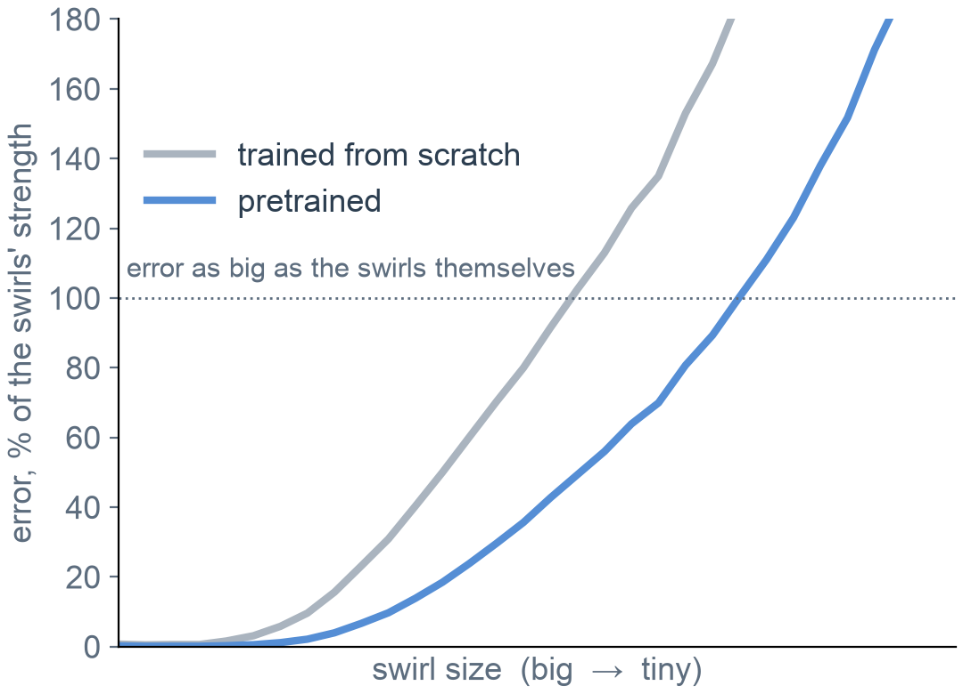
What Still Limits Accuracy
We examined the 30 trained models to see where the remaining error lives
Tiny swirls
Big swirls are almost perfect (error under 1%); the error lives in the smallest swirls
The spin field
About 70% of all error is in the spin (vorticity), the field richest in tiny swirls
Data, not training time
Trained from scratch, the model memorises its 2 examples (32× better on them); pretrained models do not (1.2×)
Part II | What pretraining data buys
35 / 40
Notes:
After the review, I examined the 30 trained models to find what still limits them, without any new training. Three things. The big swirls are almost perfect; the error lives in the tiniest swirls. About 70% of the error is in the spin field, which has the most tiny swirls. And the model trained from scratch memorises its two examples, so longer training cannot fix it; the pretrained models do not memorise.

Slide 36
Key Takeaways
Pretraining halves next-step forecast error
1
Closeness to the task matters more than amount or variety
2
The biggest payoff comes when task data is scarce
3
Training on its own predictions keeps long forecasts steady
4
Building the physics in keeps 20-step forecasts 13% steadier
5
Part II | What pretraining data buys
36 / 40
Notes:
To sum up: pretraining halves next-step error. The main answer to my question is that closeness to the task matters more than amount or variety. The payoff is biggest when task data is scarce. Training on its own predictions keeps long forecasts steady. And building the physics into the model keeps 20-step forecasts 13 percent steadier.

Slide 37
Future Work
Where the current project can be taken further
1
Physics built in
Tested: predicting only the spin and deriving the rest cut 20-step error by 13%; next, add pushforward
2
Steadier long forecasts
Build on pushforward so predictions stay accurate many steps ahead
3
Richer input history
Let the model know the order of its input frames, and see more of the past
4
Scale and real data
A larger model and dataset, and better transfer from simulation to real measurements
Part II | What pretraining data buys
37 / 40
Notes:
There are four ways to take this further. First, build the physics in. I already ran the first test: the model predicts only the spin, and the other fields are worked out from it exactly. The flow's rules then always hold, and 20-step forecasts improve by 13%. Next is combining it with pushforward. Then steadier long forecasts, a longer and ordered input history, and scaling up with better transfer to real measurements.

Slide 38
Both Parts Together
What UGP-I and UGP-II teach as one project
Know what you are measured on: hidden score weights (I), next step vs long forecasts (II)
1
Pretraining helps when it is close to the task and target data are scarce
2
Far-away simulations did not help on the real wake (I and II)
3
Physics helps only when it is true for the data: hurt on camera data, helped on simulation
4
Write the prediction down first: every surprise becomes a result
5
Part II | What pretraining data buys
38 / 40
Notes:
Putting both parts together. Know what you are measured on. Pretraining helps when it is close to the task and target data is scarce, and far-away simulations did not help on the real wake. Physics helps only when it is true for the data: it hurt on the camera data in Part I and helped on the simulation in Part II. And writing predictions down first turns every surprise into a result.

Slide 39
Appendix
The details are in the final report, not on the slides
A. Part I: the scoring formulas, the uncertainty bands, the component ablation and the directions we closed
B. Part II: the solver, dataset, model and training details
C. All eleven Part II experiments and the full prediction record
D. Deriving velocity and pressure from the spin, and a glossary
Final report: UGP_Final_Report.pdf
Part I code and record: github.com/ARYAMANN7279/RealPDE-Track1
Part II code and results: github.com/ARYAMANN7279/aurora-from-scratch-jax
Part II | What pretraining data buys
39 / 40
Notes:
The details are in the final report's appendices: the scoring formulas, the model and data, all eleven experiments with the prediction record, and the physics derivation. I am happy to go into any of them.

Slide 40
UGP · Parts I and II
Thank You
Part I: github.com/ARYAMANN7279/RealPDE-Track1
Part II: github.com/ARYAMANN7279/aurora-from-scratch-jax
Notes:
Thank you, sir. I am happy to take questions.

