Slide 1

How Machines See : The Science and Application of Computer Vision
Seminar (CS-329)
Department of Computer Science and Engineering
National Institute of Technology Hamirpur
Aryan Puri
22BEC032

Slide 2
Table of contents
What does Computer Vison means
How Machines See an Image
How Computer Vision Works
Core Algorithms Used
Applications of Computer Vision
Tools and Technology Used
Conclusions

Slide 3
What does Computer Vision means
Computer vision is a field of AI that uses machine learning to teach computers to derive meaningful information from digital images, videos and other visual inputs and to make recommendations or take actions [1].
Everyday examples: Face unlock, self-driving cars, Google Lens.

Slide 4
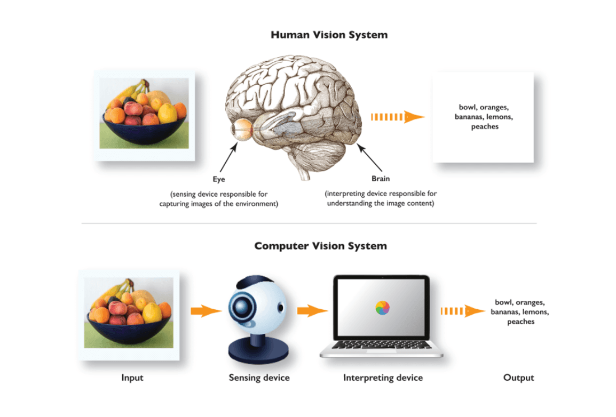
Figure1 : Human Vision vs Computer Vision [2]

Slide 5

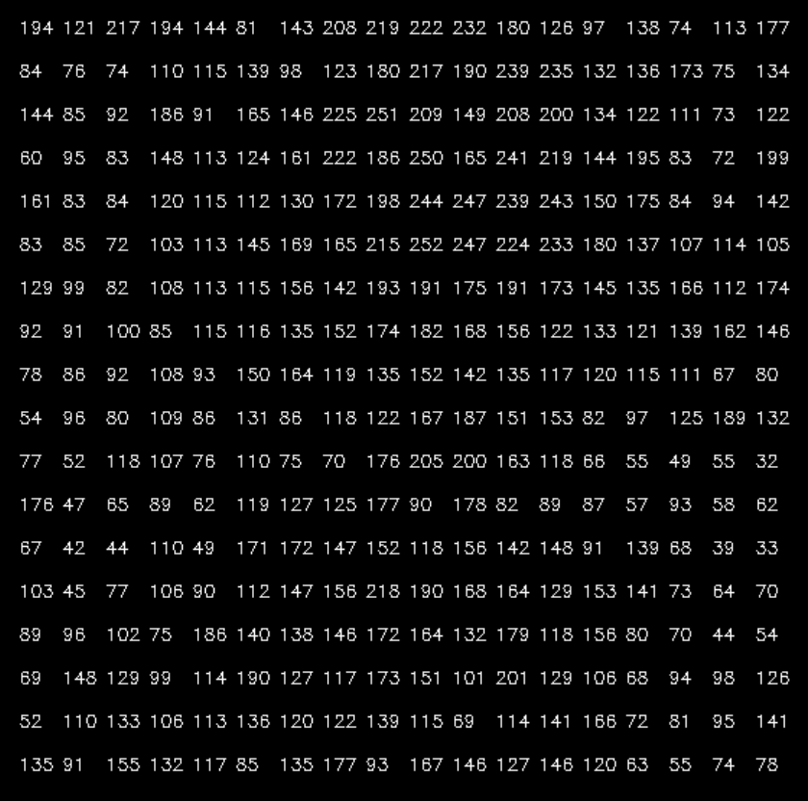
How machines see an image
Figure 2 : Original Image [3]
Figure 3 : Pixelated Image [3]

Slide 6
How computer Vision works

Slide 7
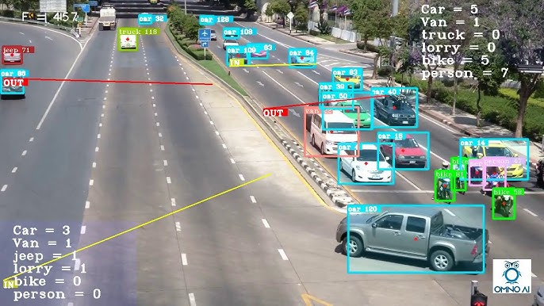
Applications of Computer Vision

Slide 8
References Used
[1] IBM, What is computer vision, URL , [Accessed: Feb. 2, 2025].
[2] Hmrishav Bandyopadhyay, Human Vision Vs Computer Vision, V7labs, URL, [Accessed: Feb. 2, 2025].
[3] ARYAN-PURI, OpenCV-Learning, GitHub, URL, [Accessed: Feb. 2, 2025].
[4]

