Slide 1

How Machines See : The Science and Application of Computer Vision
Seminar (CS-329)
Presented By: Aryan Puri
Roll No. : 22BEC032
Department of Computer Science and Engineering
National Institute of Technology Hamirpur

Slide 2
Table of contents
What does Computer Vision means
How Machines See an Image
How it Works
Applications
Tools and Technology Used
Challenges
Conclusions

Slide 3
What does Computer Vision means
Computer vision is a field of AI that uses machine learning to teach computers to derive meaningful information from digital images, videos and other visual inputs and to make recommendations or take actions [1].
Everyday examples: Face unlock, self-driving cars, Google Lens.

Slide 4
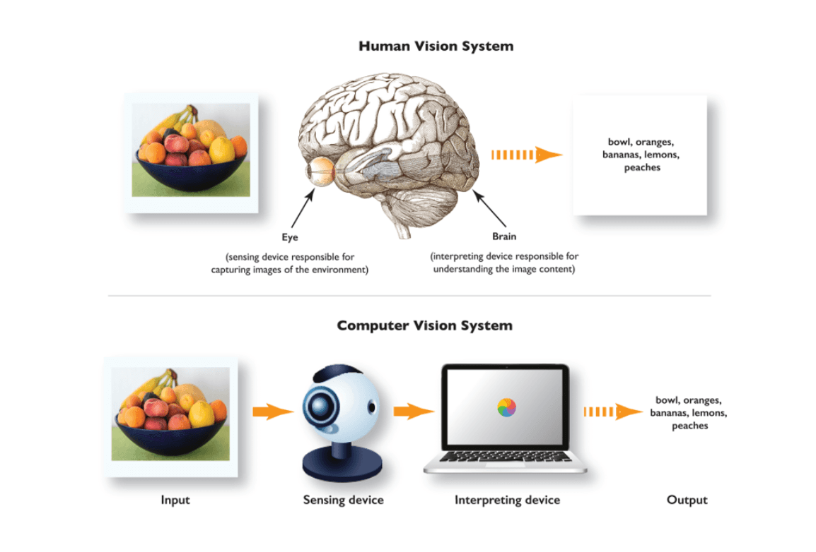
Figure1 : Human Vision vs Computer Vision [2]

Slide 5
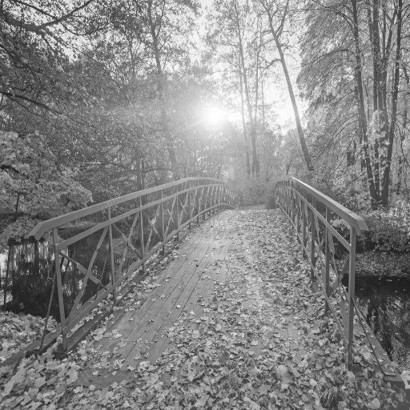
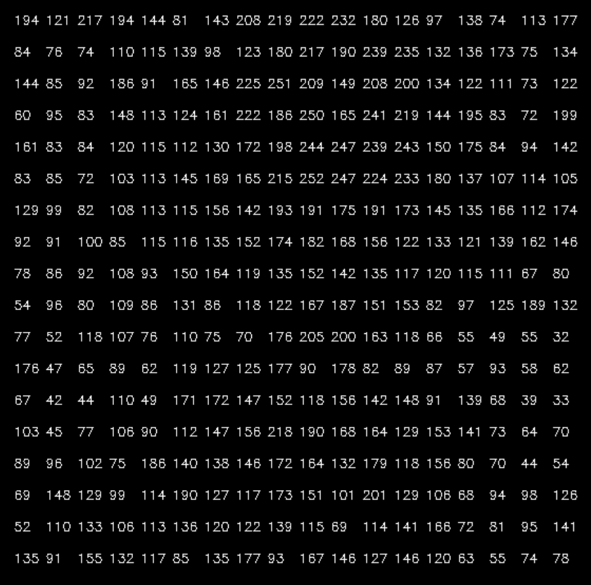
How machines see an image
Figure 2 : Original Image [3]
Figure 3 : Pixelated Image [3]

Slide 6
How computer Vision works
Acquiring the image from a Source (Camera , Sensors)
Image Acquisition
Digitization, Enhancing the quality of Image by basic operations (filtering , restorations etc.)
Pre-processing
Extract the corners, edges, contours of the objects in the image
Feature Extraction
Raw pixelated data is used as input to ML or CNN Models to identify the type of object
Classification & Recognition
Once the objects are identified, we can use them to take a particular action
Output & Action

Slide 7
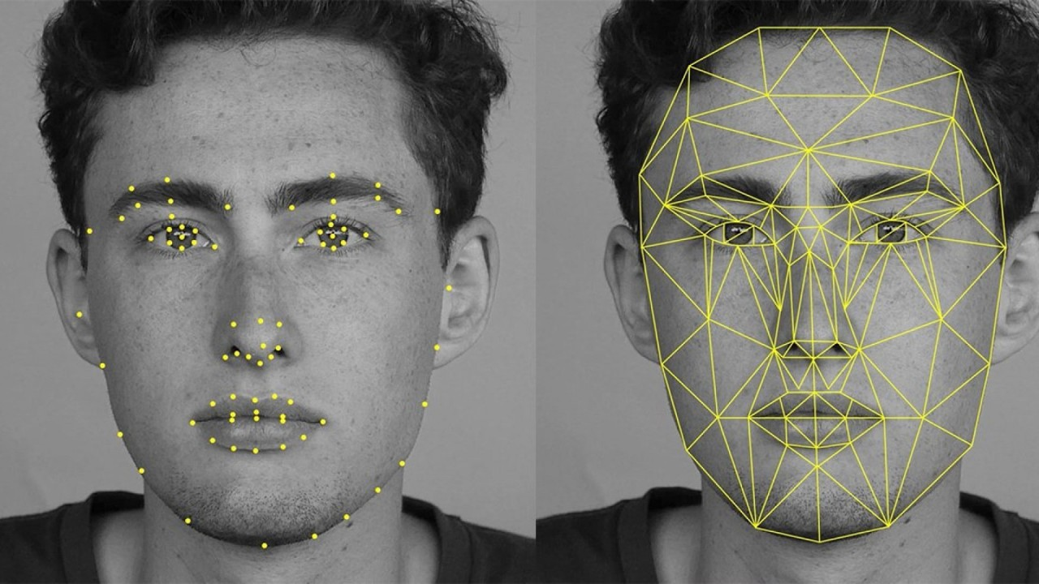
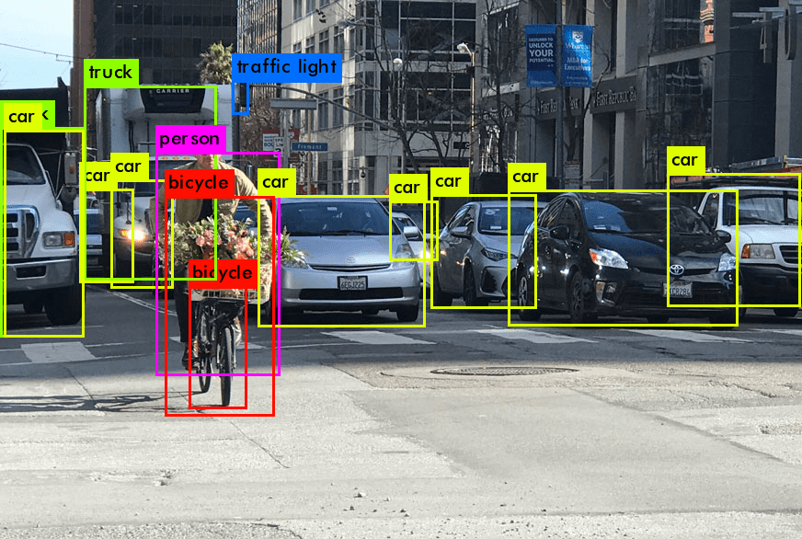
Applications of Computer Vision
Figure 4 : Face Recognition [6]
Figure 5: Object Detection [7]
Face Attendance System
Face Locks
Forensic facial reconstruction
Retail & E-commerce

Slide 8
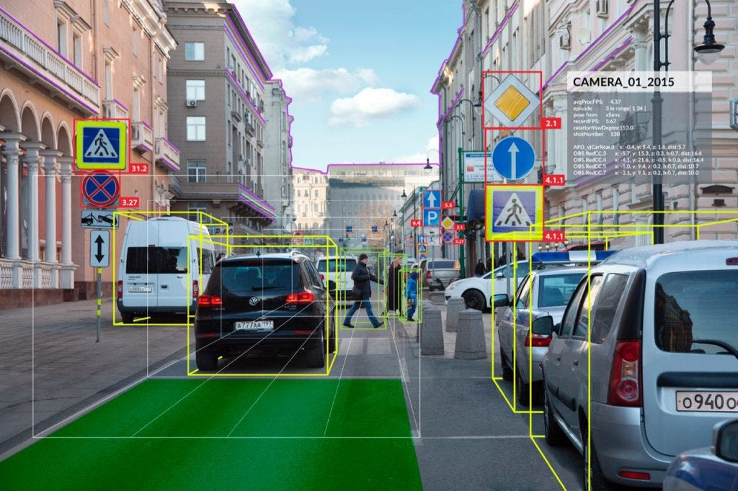
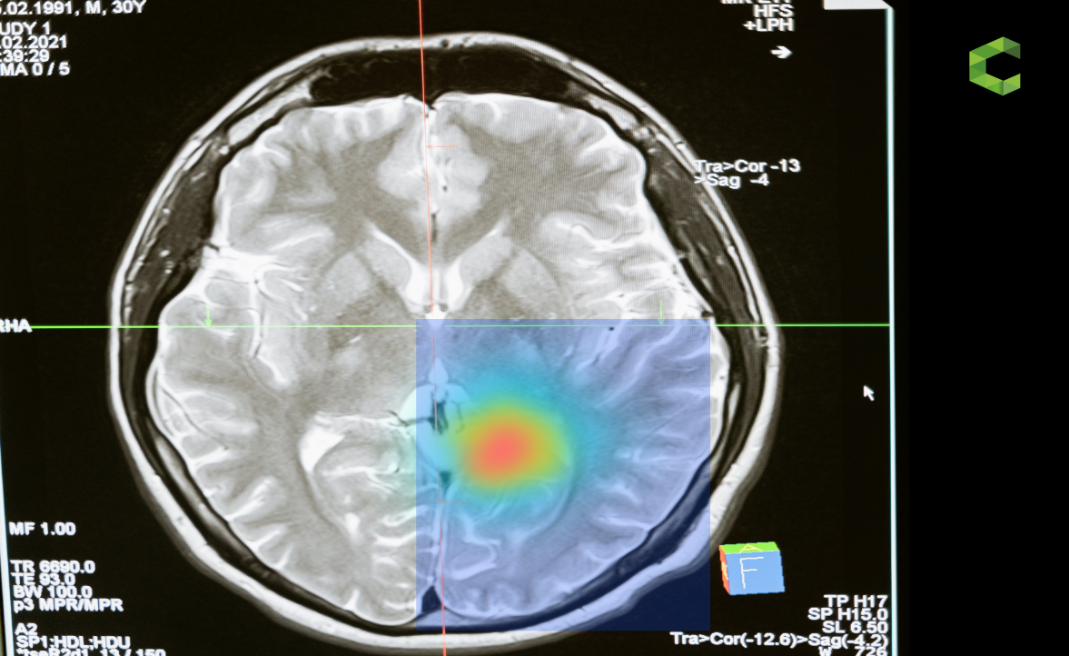
Applications of Computer Vision
Figure 6 : Self Driving Cars [5]
Figure 5: HealthCare [4]
Uses maps to set source and destination.
Use Computer Vision Object Detection to Identify the obstacles in the road and traffic lights.
Used to analyse medical reports like X-Rays, MRI etc.
Helps in the diagnosis of disease

Slide 9
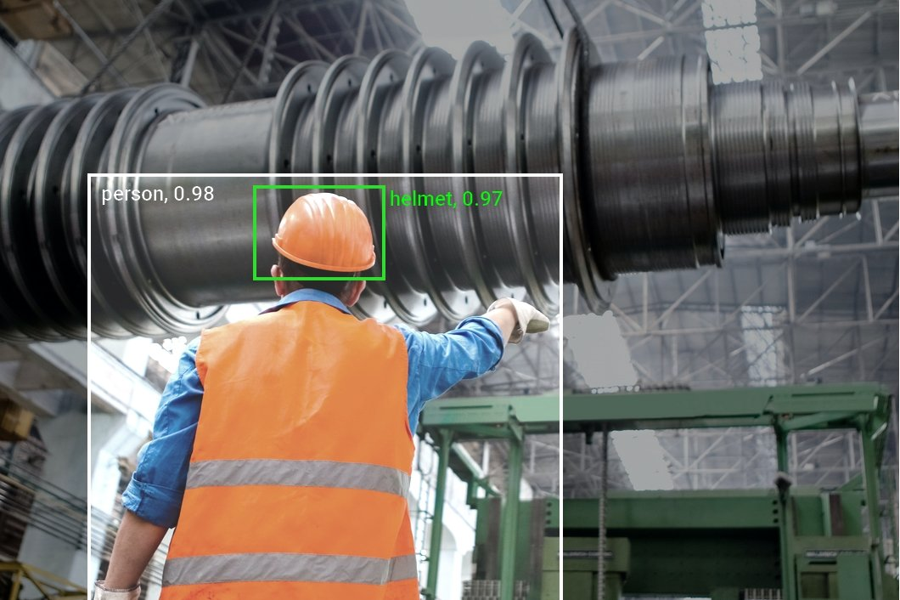

Applications of Computer Vision
Figure 6 : Monitoring Task [8]
Figure 5: Google Lens [9]
Used for monitor the tasks in a manufacturing Industries.
Google Lens also uses object detection to show the similar results of objects on web.
Google Lens also identify text in an image and convert in into digital text.

Slide 10

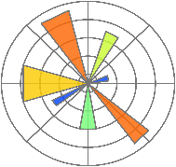






Tools and Technologies Used
Libraries and Frameworks:
Programming Languages:
Hardware:
High Performance GPUs and TPUs are Required.
Edge AI devices that helps to run our AI Model Locally.
Core Algorithms:
YOLO(You Only Look Once)-used for object detection
CNN(Convolutional Neural Networks)-used for classification and recognition of objects
Canny Edge Detector-used for detecting the edges of objects in the image.

Slide 11
Challenges
High Computational Cost :
1920 x 1080 pixels are there in HD Image, require large computational power. [10]
Loss of Information :
Analog Intensities are digitized into digital form result in loss of data. [10]
Data Quality and Quantity :
To train a model a large data set of good quality is required, require a lot of time. [10]

Slide 12
Challenges
Variability and Complexity :
Changes in lighting condition may affect object recognition.
Viewpoint variation, object may appear different from different angles.
Occlusion of objects making it hard to detect correctly.
If the object do not have a fixed shape then it is hard to recognize, ex-smoke, fire etc. [10]
Ethical & Privacy Concerns :
CV-based surveillance raises privacy concerns.
CV can be used to create fake videos and manipulate media(Deep fake). [10]

Slide 13
Conclusions
Computer Vision Enables Intelligent Decision making
By analysing visual data and take actions based on it with speed and accuracy.
Multi-Step Process for Object Recognition
Involve acquisition, preprocessing, feature-extraction, classification & recognition, output.
Wide Range of Applications
From face recognition and self-driving cars to healthcare and industrial monitoring.

Slide 14
References Used
[1] What is computer vision, IBM, [Available at: https://www.ibm.com/think/topics/computer-vision], [Accessed: Feb. 12, 2025].
[2] Hmrishav Bandyopadhyay, Human Vision Vs Computer Vision Image, V7labs, [Available at: https://www.v7labs.com/blog/what-is-computer-vision], [Accessed: Feb. 12, 2025].
[3] ARYAN-PURI, OpenCV-Learning, GitHub, [Available at: https://github.com/ARYAN-PURI/OpenCV-Learning/blob/main/8.py], [Accessed: Feb. 12, 2025].
[4] top-11-computer-vision-applications-in-healthcare Image, Plugger.AI, [Available at: https://www.plugger.ai/blog/top-11-computer-vision-applications-in-healthcare], [Accessed: Feb. 13, 2025].

Slide 15
References Used
[5] computer-vision-applications-in-self-driving-cars Image, becominghuman.AI, [Available at: https://becominghuman.ai/computer-vision-applications-in-self-driving-cars-610561e14118], [Accessed: Feb. 13, 2025].
[6] Harry Thapa, ai-machine-learning-facial-recognition Image, Linkedin, [Available at: https://www.linkedin.com/pulse/ai-machine-learning-facial-recognition-opencv-hemant-thapa], [Accessed: Feb. 13, 2025].
[7] Object Detection Image, YoloV8, [Available at: https://visionplatform.ai/yolov8], [Accessed: Feb. 13, 2025].
[8] computer-vision-in-manufacturing Image, viso.ai, [Available at: https://viso.ai/applications/computer-vision-in-manufacturing], [Accessed: Feb. 3, 2025].

Slide 16
References Used
[9] Google Lens Image, beebom, [Available at: https://beebom.com/how-use-google-lens], [Accessed: Feb. 13, 2025].
[10] computer-vision-problems, OpenCv.Org, [Available at: https://opencv.org/blog/computer-vision-problems], [Accessed: Feb. 14, 2025].
[11] Neha Bagawari, Tarushi Khanna, Computer Vision And Its Application Areas, GLIMPSE -Journal of Computer Science •Vol. 1(1) , JANUARY-JUNE 2022, pp. 7-10, akgec, [Available at: https://www.akgec.ac.in/wp-content/uploads/2024/01/Jan-Jun2022_2.pdf], [Accessed: Feb. 14, 2025].

Slide 17


