Slide 1
Real-Time Causal Ads Optimization: An Integrated Web-Based Data Collection and Automated Analysis Pipeline
Darshan Deepak Arugollu
Aryan Siddhabathula

Slide 2
Problem Statement
Measure true impact of ads on user conversions.
Identify which users benefit most from seeing ads.

Slide 3
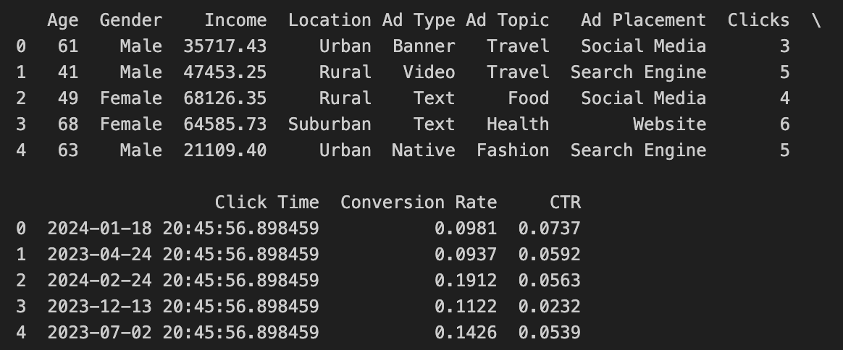
Dataset Overview
10,000 user records.
Features: Age, Gender, Income, Location.
Ad Types: Video, Native, Text, Banner.
Ad Placements: Social Media, Website, Search.
Target Variables: Clicks, CTR (Click-Through Rate), Conversion Rate.

Slide 4
Libraries and Setup
Pandas: For structured data handling and transformations.
Matplotlib: For creating static and customized plots.
NumPy: For numerical operations and efficient array handling.
Seaborn: For advanced statistical data visualizations.
Scikit-learn:
LabelEncoder & StandardScaler: Encoding categorical data and standardizing numerical data.
Logistic Regression & Nearest Neighbors: Used for Propensity Score Matching (PSM).
EconML Library:
CausalForestDML: For estimating Heterogeneous Treatment Effects (HTE).
Random Forest Regressor:
Used within Causal Forest for flexible non-linear relationship modeling.

Slide 5
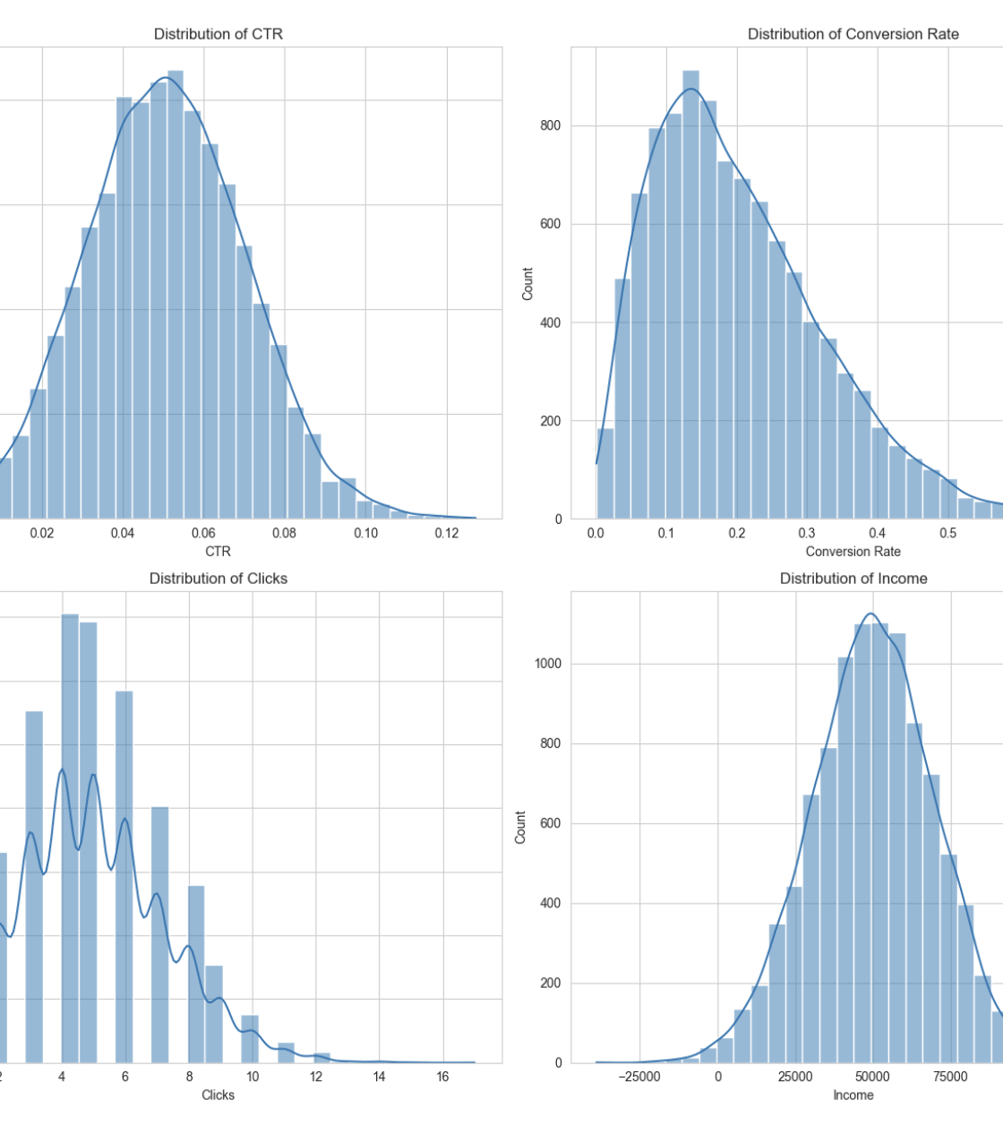
EDA Insights (User Behavior)
CTR:
Right-skewed.
Most users 3–6% CTR.
Few users >8%.
➔ Moderate engagement.
Conversion Rate:
Heavily right-skewed.
Most between 10–20%.
➔ Conversions harder than clicks.
Clicks:
Multimodal.
Common: 2–6 clicks.
➔ Different user groups.
Income:
Normal distribution.
Centered at ~$50,000.
➔ Focus on middle-income users.

Slide 6
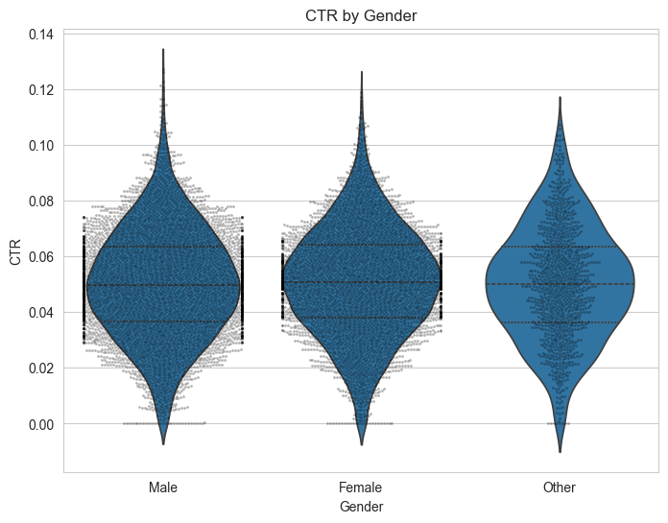
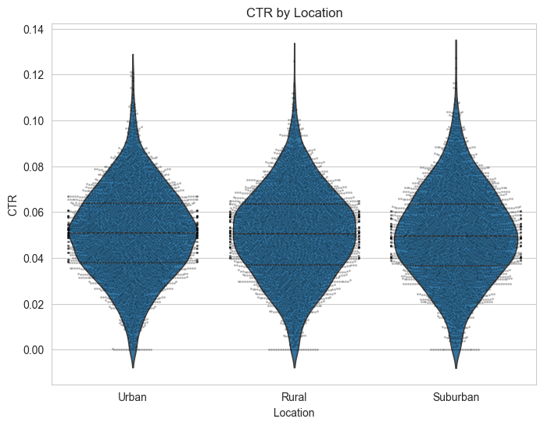
CTR Trends
Gender: Similar CTR distributions.
Location: No major differences.
Video Ads: No CTR boost.
Social Media Ads: Slight CTR improvement.
Website Ads: Lower CTR.

Slide 7
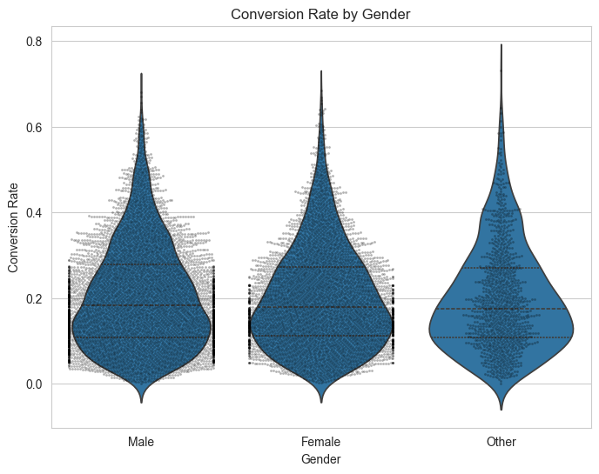
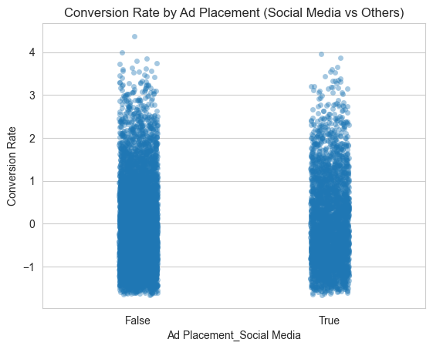
Conversion Rate Trends
Gender: No significant differences.
Social Media: Slightly higher conversions.
Website: Lower conversions.

Slide 8
Causal Inference Setup
Defined Treatment = Clicked Ad.
Control = Did Not Click.
Propensity Score Matching:
Logistic Regression to predict likelihood.
Nearest Neighbor Matching to balance groups.

Slide 9
Average Treatment Effect (ATE)
ATE = 2.35%.
Users who clicked ads had 2.35% higher conversion rate.
Ads are modestly effective overall.
ATE= Mean(Conversion Rate∣Treatment=1)−Mean(Conversion Rate∣Treatment=0)

Slide 10
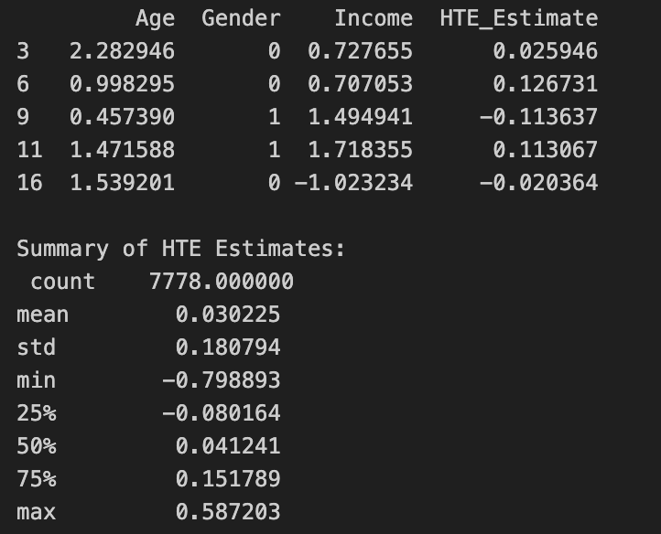
Heterogeneous Treatment Effects (HTE)
Mean HTE: Ads increase conversion by ~3% on average.
High variability: Some users benefit a lot, some are negatively affected.
Extremes:
Max HTE = +58.7% (biggest gainers)
Min HTE = -79.8% (biggest losers)
Key Insight: Ads work overall, but personalized targeting could improve performance.

Slide 11
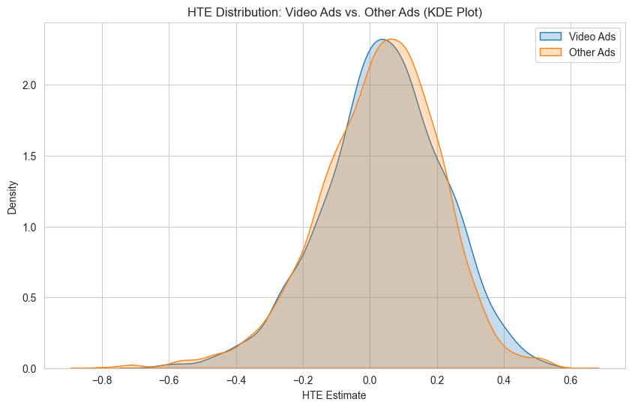
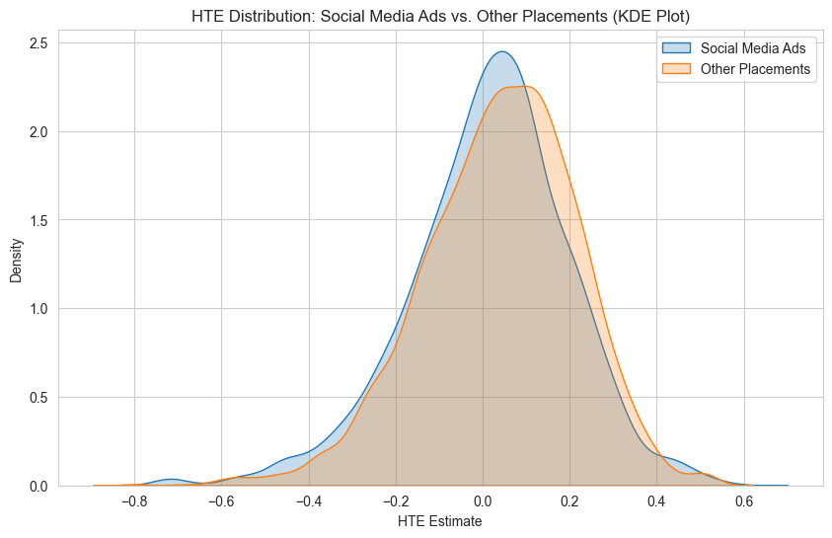
HTE Visualizations
Gender: No major HTE difference.
Video Ads: Similar HTE to others.
Social Media Ads: Slightly better HTE distribution.
Age and Income: No clear relationship with HTE.

