Slide 1

Network Traffic Analyzer
To develop a software tool that captures and analyzes network traffic, providing insights into traffic patterns, protocol usage, and potential security threats to assist network administrators and security analysts in monitoring and securing network environments.
by Aryan Bhaskar
Arin Aggarwal

Slide 2
Project Abstract
Overview
Key Objectives
Approach
This project captures and analyze network traffic, allowing users to monitor activity, identify protocols, and detect security threats. It features packet capture, data analysis, reporting, and visualization, accessible via CLI and GUI.
Capture and analyze network traffic, providing insights into traffic patterns, protocol usage, and potential security threats within a network environment.
NTA captures and analyzes network packets using the Pcap library, providing insights through reports and visualizations via CLI and GUI interfaces.

Slide 3

Project Goals and Objectives
Capture and analyze network traffic
1
2
Provide insights into traffic patterns,
and security threats
Generate reports and visualizations
based on analyzed data
3

Slide 4

Alignment with UN Sustainable Development Goals (SDGs)
SDG 9 : Industry, Innovation, and Infrastructure
SDG 11 : Sustainable Cities
and Communities
Promotes robust network security and infrastructure
Supports smart city networks by traffic monitoring and security
SDG 16 :Peace, Justice,
and Strong Institutions
SDG 17: Partnerships for the Goals
Helps prevent cyber threats and fosters trust in digital systems
Strengthen global partnerships to support and achieve the SDGs.

Slide 5





Methodology and Approach
Packet Analysis and Filtering
Anomalyzer captures network traffic packets using the Scapy library, filtering them to analyze IP-based data,
Integrated HTTP Log Parsing
Captures HTTP requests and responses, extracting valuable details like methods, URLs, headers, and bodies.
JSON Export for API Compatibility:
Analyzer exports all captured information, including IP addresses and HTTP logs, into a structured JSON file.
Menu-Driven User Interface
Provides a straightforward, interactive menu that allows users to start packet sniffing, save captured data, and exit the program

Slide 6




Expected Outcomes and Impact
Network Security
Performance
Analysis
Improved network security through real-time traffic analysis and threat detection.
Optimized network performance, ensuring efficient data flow and minimizing disruptions.
Clear, actionable insights for network administrators and security analysts.

Slide 7

Key Project Deliverables
Network Traffic Analyzer Software
Fully functional application with packet capture, analysis, and reporting features.
User Interface
Both CLI and GUI for interaction with the software.
Reports and Visualizations
Generated based on network traffic analysis.

Slide 8

Next Steps and Conclusion
1
Scale and Expand
2
Forge Partnerships
Replicate the successful model in other regions and continue to grow the project's impact.
Collaborate with government, Cyber sector, and institutions to further strengthen the initiative.
3
Monitor and Evaluate
Continuously assess the project's performance and make adjustments to optimize its effectiveness.

Slide 9
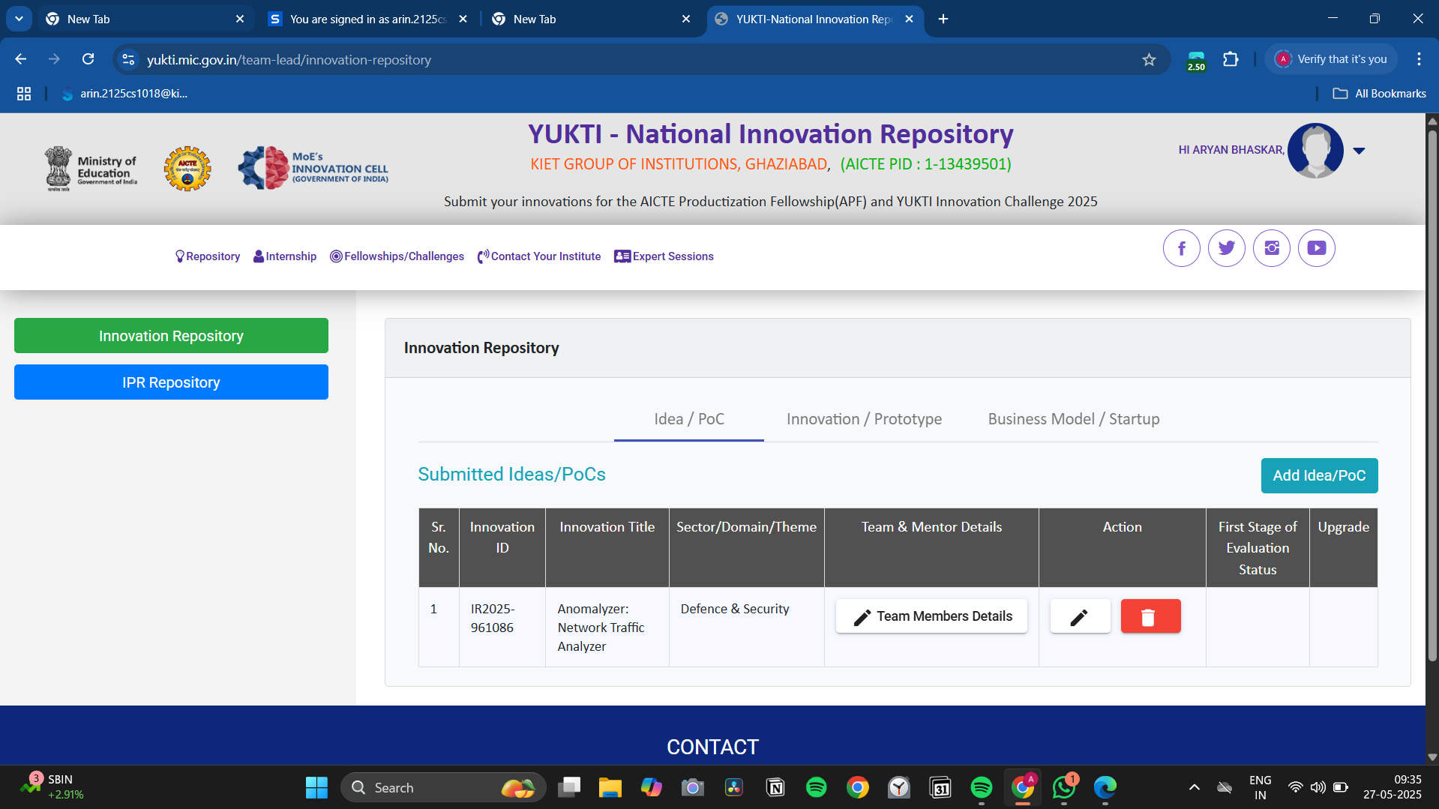

Slide 10
