Slide 1


Project review: CAR-PRICE PREDICTION USING KERAS AND DEEP LEARNING METHODS WITH DATA ANALYSIS TECHNIQUES
DONE BY -
ARYAN SHIV SIDDHABATHULA – B13 29
Vunamati satyanarayanA – b13 55
N Tejaswi – b13 38
M shiva ganesh – b13 54

Slide 2


Cars have been a major asset in influencing the growth of automobile sector, with an increase in automobile, it has eventually resulted in giving humans more freedom and accessibility to jobs and services. The substantial growth in usage of cars has influenced the cost factor in the market, resulting in latest produced cars not being affordable to many customers for various factors that include prices that are deemed expensive, reduced availability and financial incapability. In order to bring an ideal car for every individual, we need to create a model that satisfies all the factors that a buyer is looking for, including the economical aspects, so that they chose the best car at their affordable prices. Therefore, we need a model that depicts a higher accuracy rate that is required to estimate the right price of a car satisfying both the buyer and the merchandiser.

Slide 3
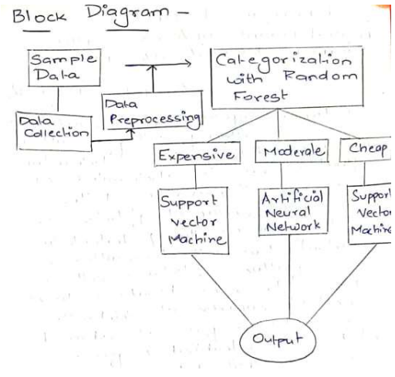
Problem Statement:
While designing the model, we will come across real time situations where the seller might not be impressed by the price suggested to sell of his/her vehicle. Considering human factors might be an issue while predicting a machine learning model. The model we build will contain aspects that will help us build a high precision model. Keeping in mind the needs of the buyer as well. The main idea is to create a highly precise model by training, testing and validating the datasets. In contrast to, our primary reference paper, we look to attain results with lower error rates and higher significance value. Further Visualizing using Data Analytics Techniques.

Slide 4
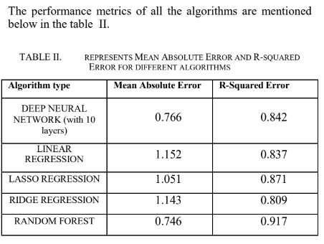
PRIMARY REFERENCE PAPER
Link: Click here to access the primary reference paper
The primary reference paper depicts the usage of a car price prediction model using Machine Learning Methods. It states that the algorithm provided by Machine Learning displays better performance metrics when compared to deep learning.
The inference provided through this reference paper has its own arguments.
This urges a need to built a higher précised model and we believe that Deep Learning is a vast field and has evolved over the years, further making us work towards building a better model through its methods.

Slide 5
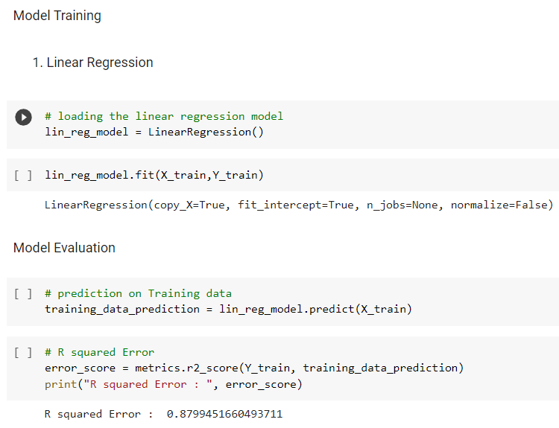
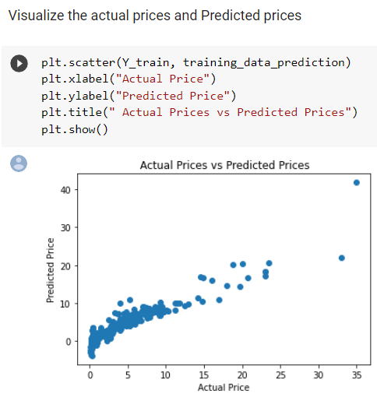
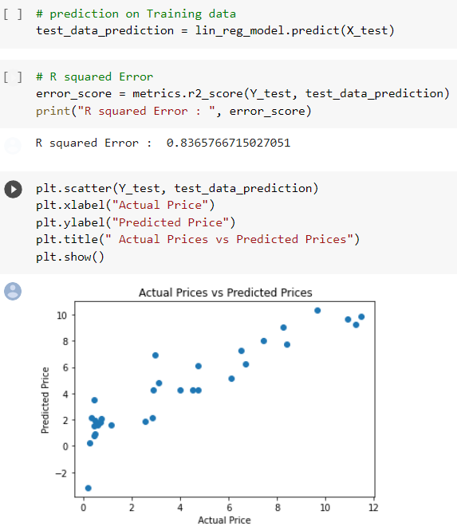
CODING RESULTS BASED ON THE DATASET PROVIDED IN THE REFERENCE PAPER -
LINEAR REGRESSION
Linear Regression is a machine learning algorithm based on supervised learning. It performs a regression task. Regression models a target prediction value based on independent variables. It is mostly used for finding out the relationship between variables and forecasting.

Slide 6
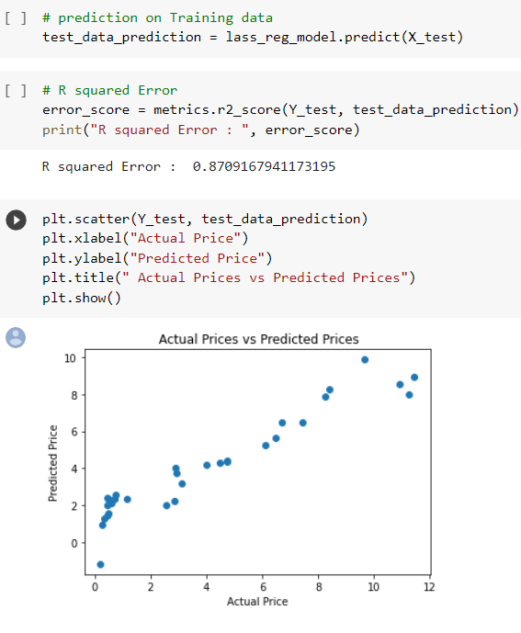
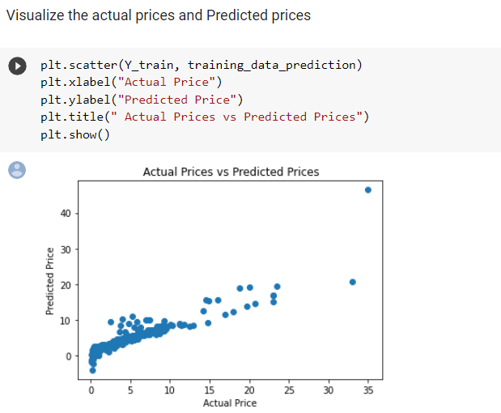
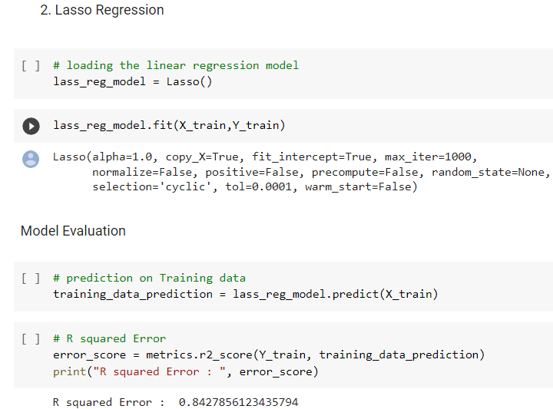
LASSO REGRESSION
Lasso regression analysis is a shrinkage and variable selection method for linear regression models. The goal of lasso regression is to obtain the subset of predictors that minimizes prediction error for a quantitative response variable. The lasso does this by imposing a constraint on the model parameters that causes regression coefficients for some variables to shrink toward zero. Variables with a regression coefficient equal to zero after the shrinkage process are excluded from the model. Variables with non-zero regression coefficients variables are most strongly associated with the response variable

Slide 7
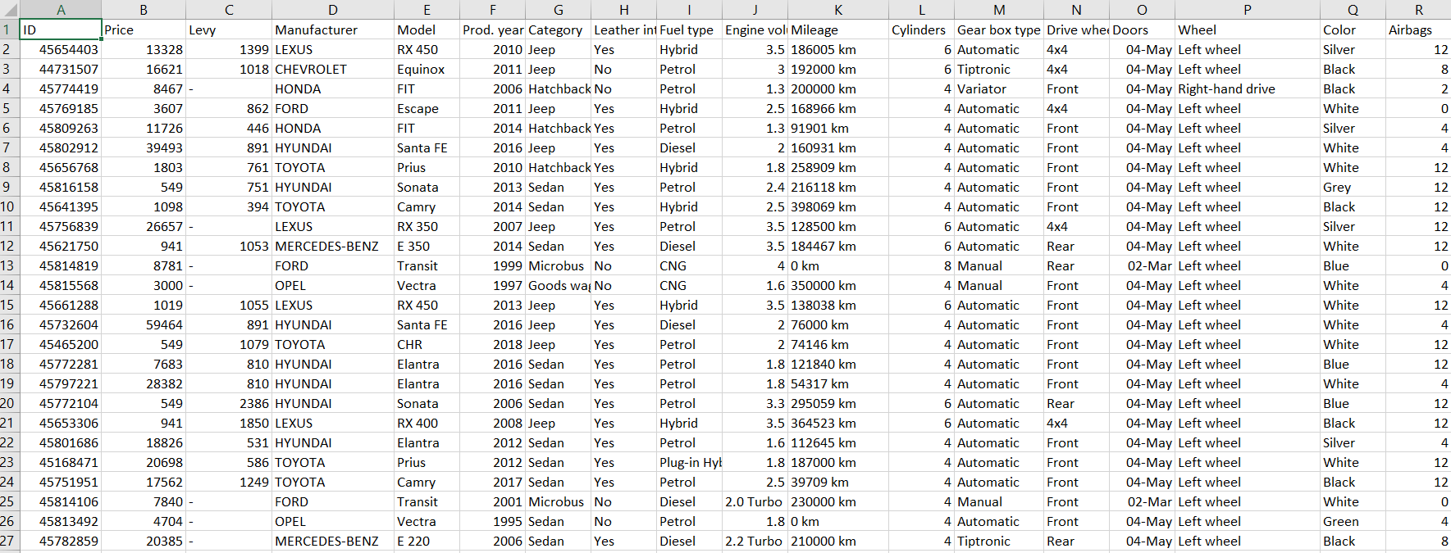
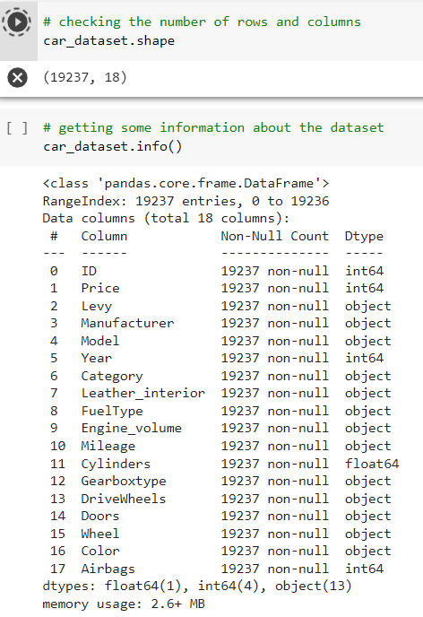
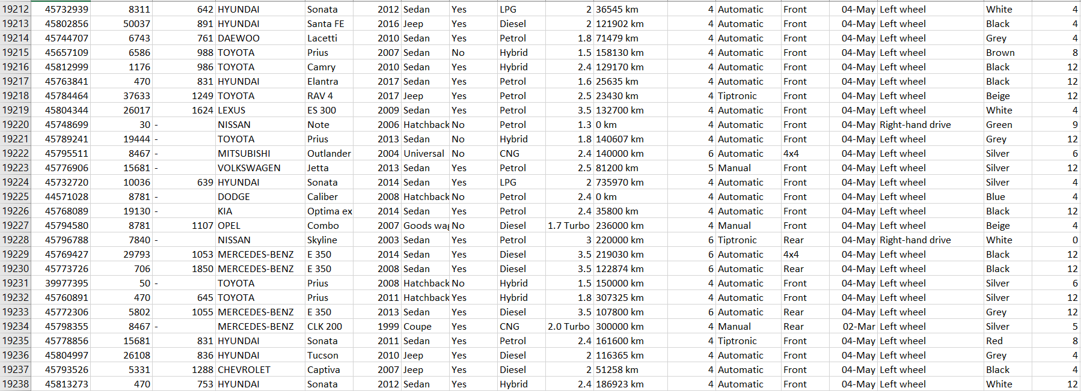
DATASET

Slide 8
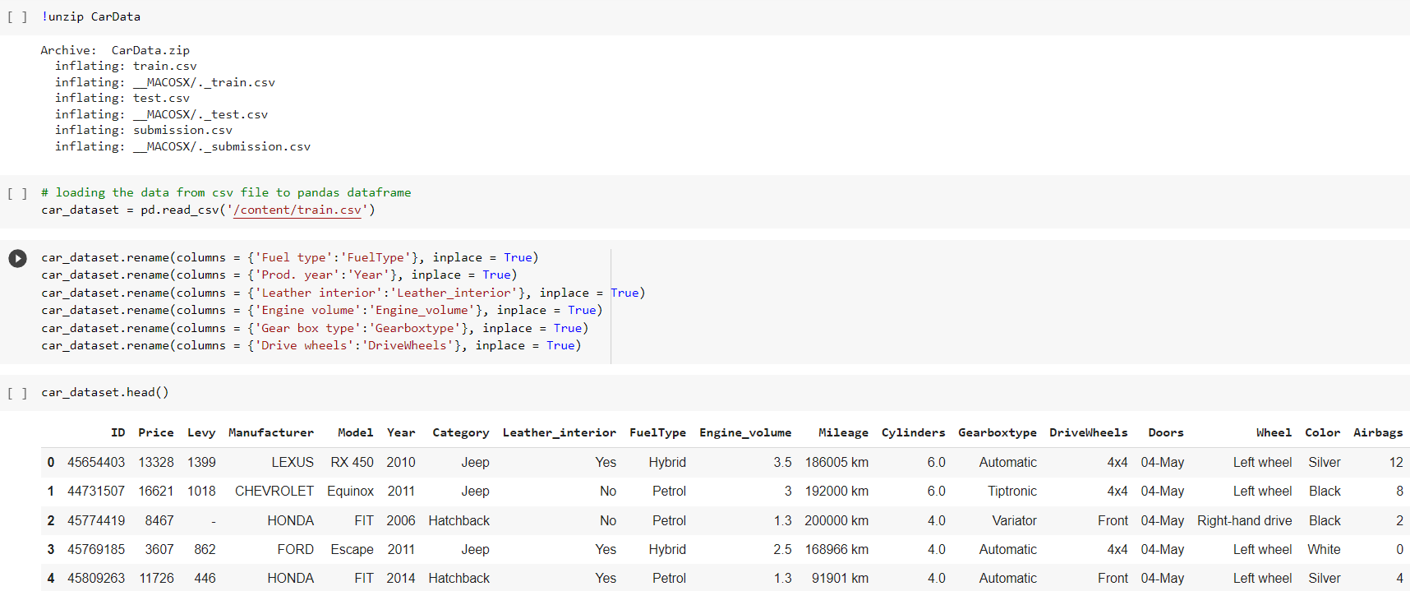
Data cleansing or data cleaning is the process of detecting and correcting corrupt or inaccurate records from a record set, table, or database and refers to identifying incomplete, incorrect, inaccurate or irrelevant parts of the data and then replacing, modifying, or deleting the dirty or coarse data.
DATA CLEANING -

Slide 9
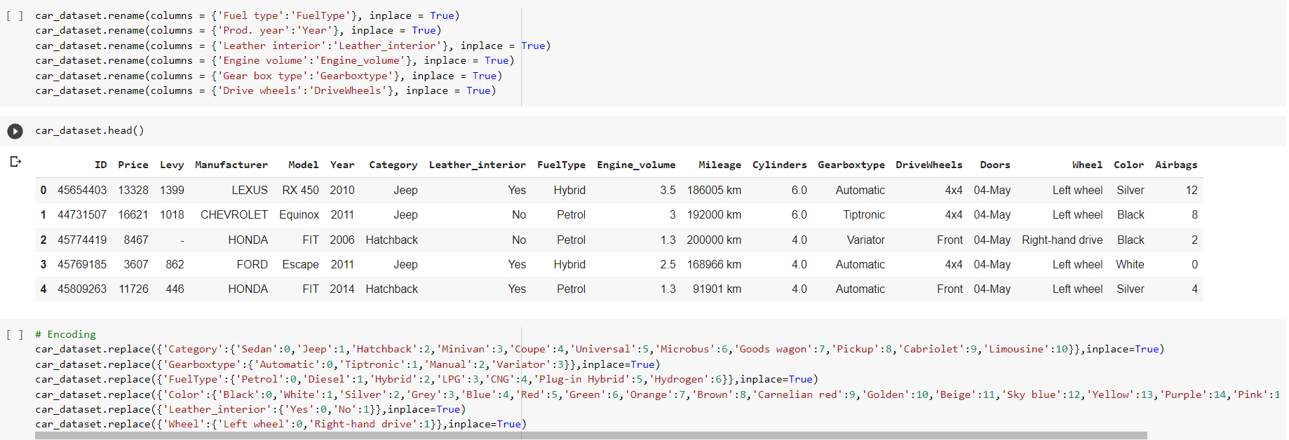
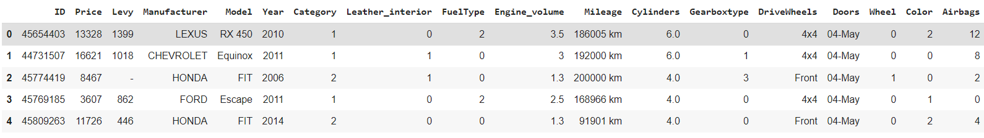

Slide 10
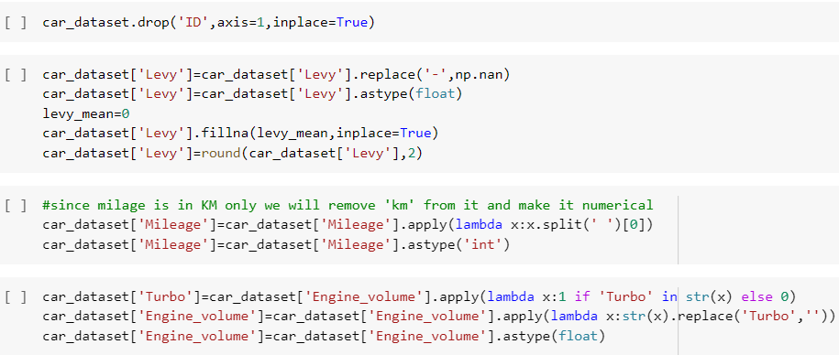
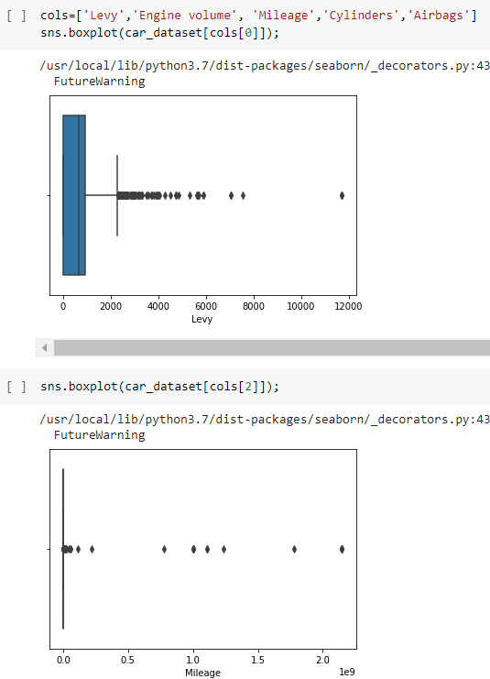
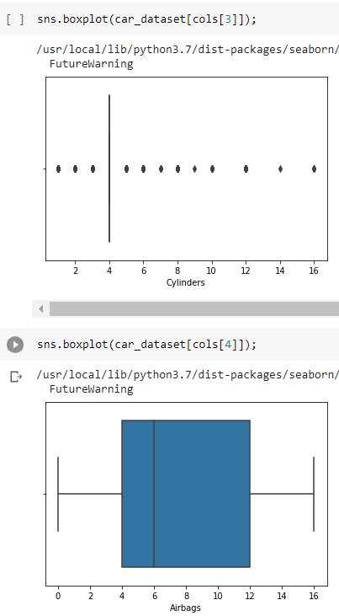
Identifying undefined values and outliers -

Slide 11
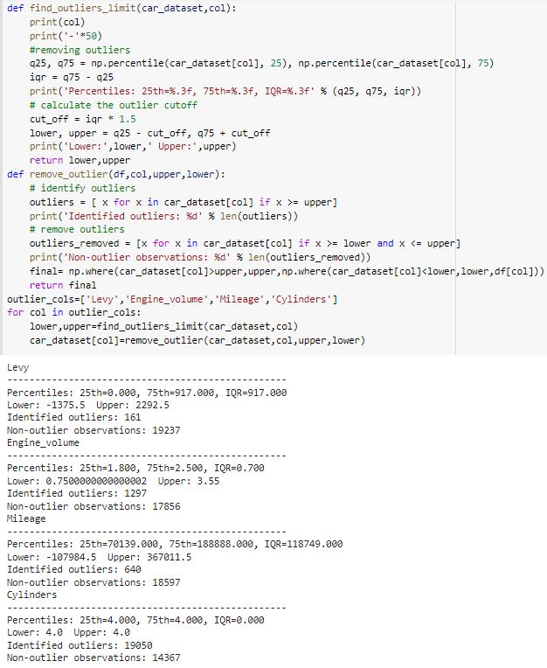
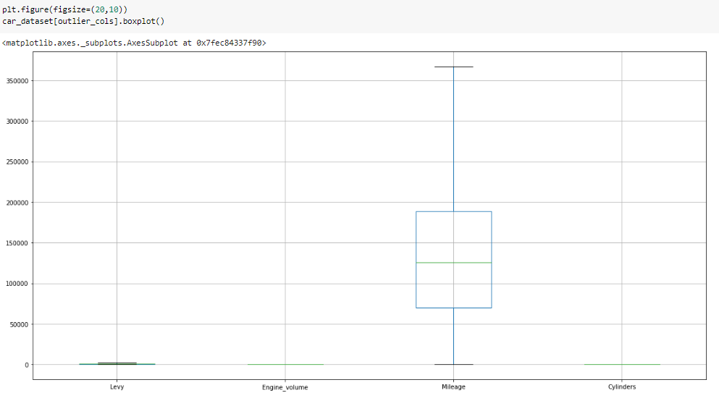
Removing outliers

Slide 12
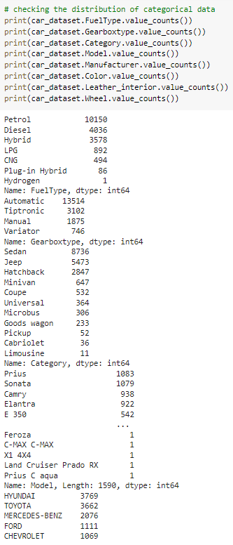
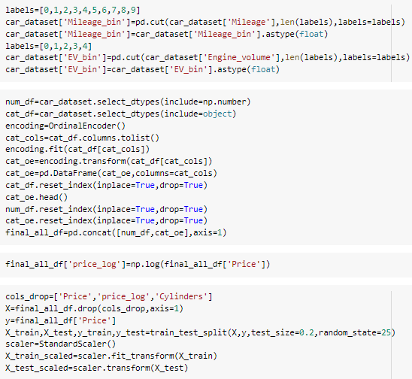
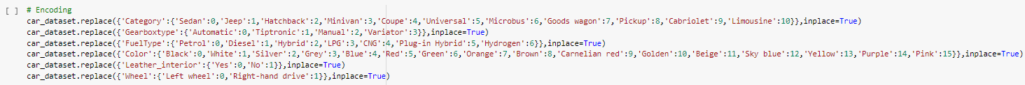
DATA NORMALIZATION & DATA TRANSFORMATION

Slide 13
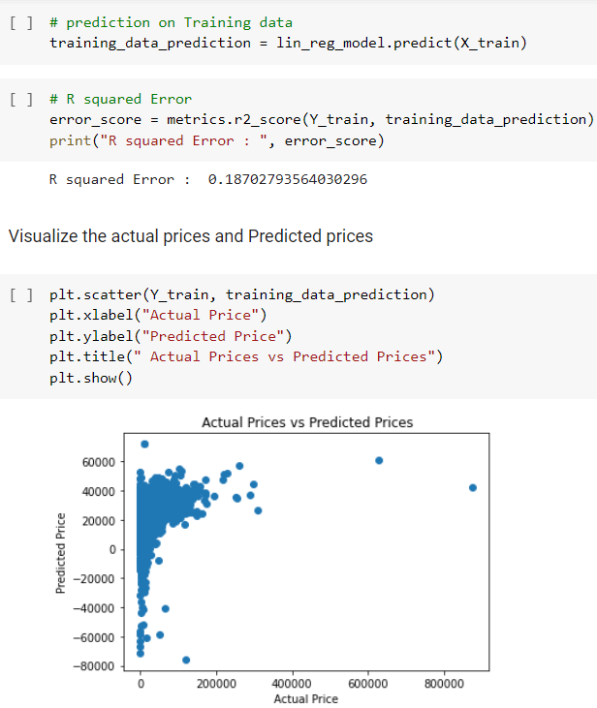
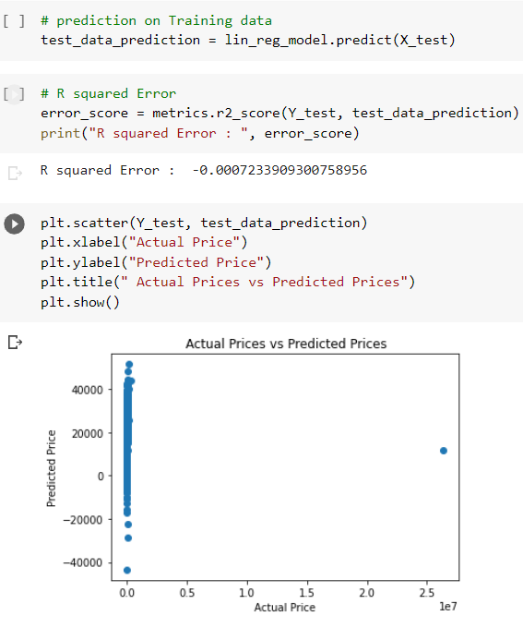
USING THE CONCEPTS AND INFERENCES OF THE REFERENCE PAPER, WE APPLY THE SAME TECHNIQUES TO OUR DATASET
The negative R-squared value means that your prediction tends to be less accurate that the average value of the data set over time. That doesn’t shock me that it could happen, but it surprises me given how you are describing your analysis set up. If that is occurring, it shouldn’t be too difficult to detect just by plotting the true data, your predicted data, and a simple average. If your predicted results are actually that bad, they should be visually well off from the true data.
LINEAR REGRESSION

Slide 14
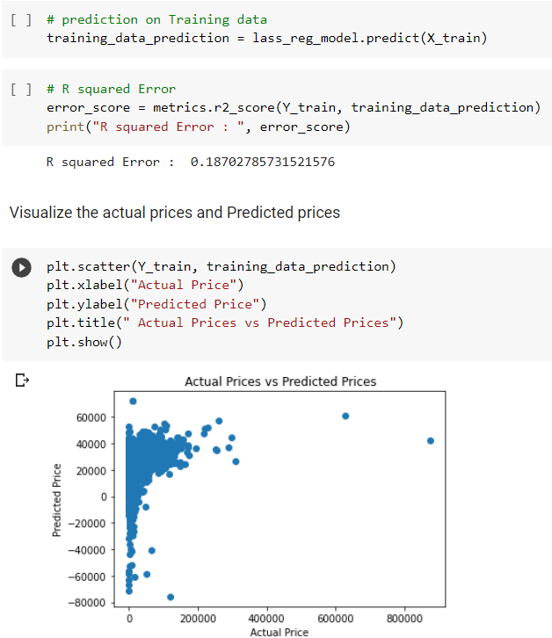
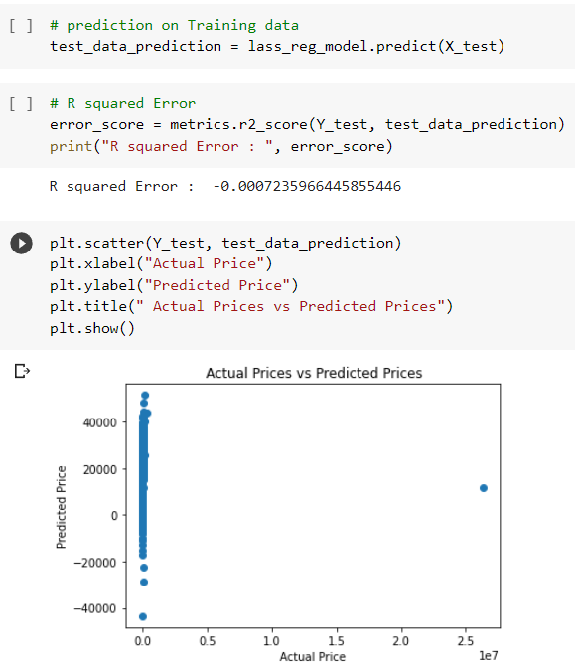
LASSO REGRESSION
An R2 of 1.0 is the best. It means you have no error in your regression. An R2 of 0 means your regression is no better than taking the mean value, i.e. you are not using any information from the other variables.
A Negative R2 means you are doing worse than the mean value. However maybe summed squared error isn’t the metric that matters most to you and this is OK. (For instance, maybe you care most about mean absolute error instead)

Slide 15
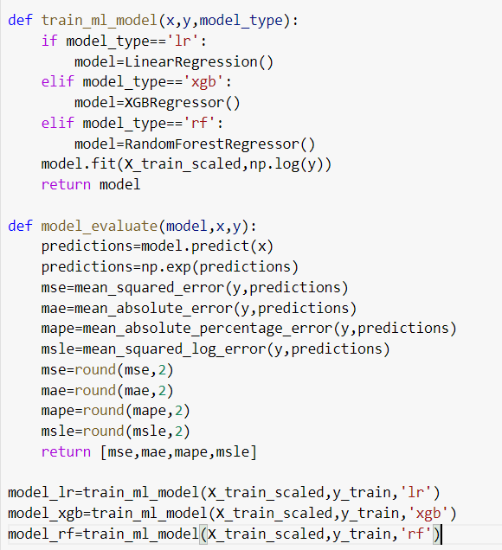
DEEP LEARNING AND FEATURED ML ALGORITHMS–
Linear Regression is a machine learning algorithm based on supervised learning. It performs a regression task. Regression models a target prediction value based on independent variables
Gradient boosting refers to a class of ensemble machine learning algorithms that can be used for classification or regression predictive modeling problems.
Ensembles are constructed from decision tree models. Trees are added one at a time to the ensemble and fit to correct the prediction errors made by prior models. This is a type of ensemble machine learning model referred to as boosting.
Models are fit using any arbitrary differentiable loss function and gradient descent optimization algorithm. This gives the technique its name, “gradient boosting,” as the loss gradient is minimized as the model is fit, much like a neural network.
Random Forest Regression is a supervised learning algorithm that uses ensemble learning method for regression. Ensemble learning method is a technique that combines predictions from multiple machine learning algorithms to make a more accurate prediction than a single model.

Slide 16
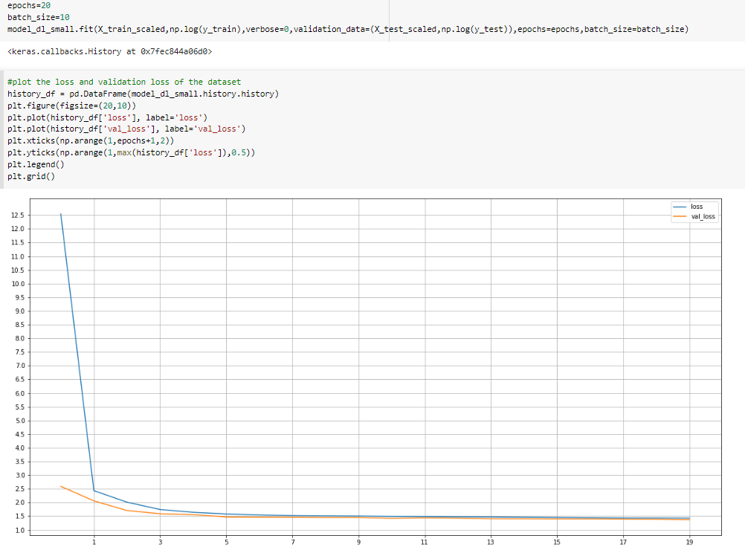
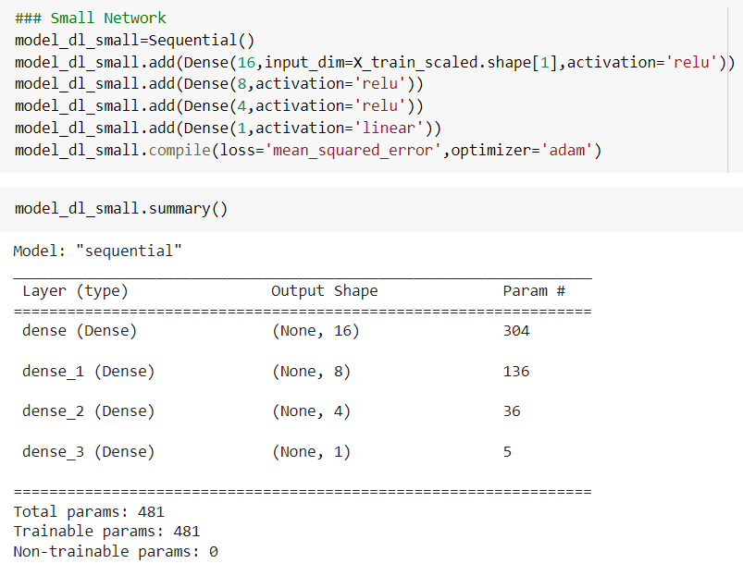
Deep Learning with lesser number of hidden layers

Slide 17
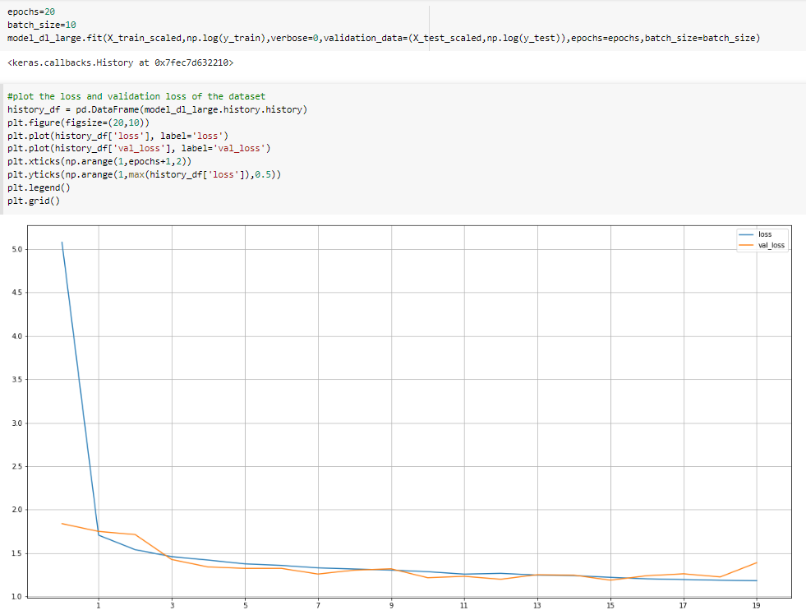
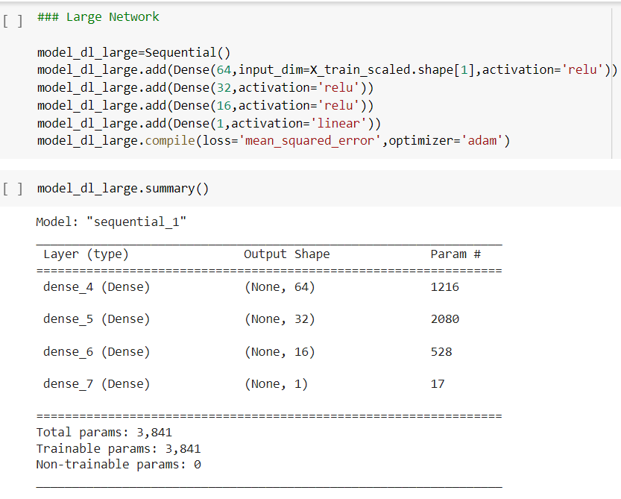
Deep Learning with higher number of hidden layers

Slide 18
In a Keras layer, the input shape is generally the shape of the input data provided to the Keras model while training. The model cannot know the shape of the training data. The shape of other tensors(layers) is computed automatically
An Activation Function decides whether a neuron should be activated or not. This means that it will decide whether the neuron's input to the network is important or not in the process of prediction using simpler mathematical operations
Pooling layers are used to reduce the dimensions of the feature maps. Thus, it reduces the number of parameters to learn and the amount of computation performed in the network.
The pooling layer summarises the features present in a region of the feature map generated by a convolution layer. So, further operations are performed on summarised features instead of precisely positioned features generated by the convolution layer. This makes the model more robust to variations in the position of the features in the input image
Activation function decides, whether a neuron should be activated or not by calculating weighted sum and further adding bias with it. The purpose of the activation function is to introduce non-linearity into the output of a neuron

Slide 19
The rectified linear activation function or ReLU for short is a piecewise linear function that will output the input directly if it is positive, otherwise, it will output zero. It has become the default activation function for many types of neural networks because a model that uses it is easier to train and often achieves better performance.
Softmax is a mathematical function that converts a vector of numbers into a vector of probabilities, where the probabilities of each value are proportional to the relative scale of each value in the vector.
The most common use of the softmax function in applied machine learning is in its use as an activation function in a neural network model. Specifically, the network is configured to output N values, one for each class in the classification task, and the softmax function is used to normalize the outputs, converting them from weighted sum values into probabilities that sum to one. Each value in the output of the softmax function is interpreted as the probability of membership for each class

Slide 20
The loss function is a method of evaluating how well your machine learning algorithm models your featured data set. In other words, loss functions are a measurement of how good your model is in terms of predicting the expected outcome
Optimizers are algorithms or methods used to change the attributes of your neural network such as weights and learning rate in order to reduce the losses. Optimizers help to get results faster
Adam is a replacement optimization algorithm for stochastic gradient descent for training deep learning models
The Mean Squared Error measures how close a regression line is to a set of data points. It is a risk function corresponding to the expected value of the squared error loss. Mean square error is calculated by taking the average, specifically the mean, of errors squared from data as it relates to a function
Stochastic gradient descent is an optimization algorithm often used in machine learning applications to find the model parameters that correspond to the best fit between predicted and actual outputs

Slide 21
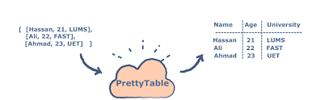
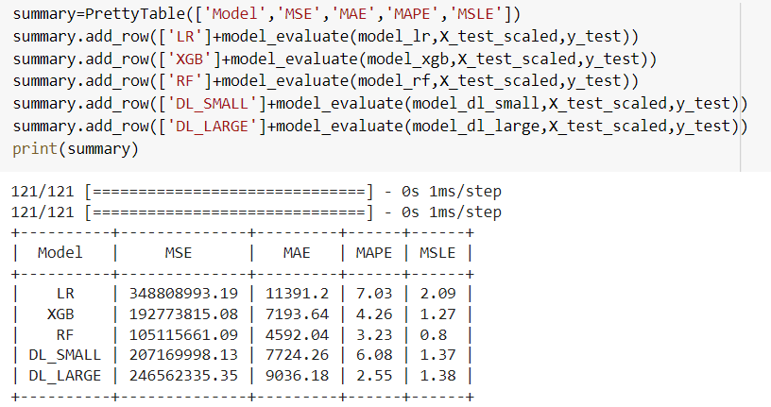
Pretty-Table is a Python library that is used to represent tabular data in visually appealing ASCII tables

Slide 22
Mean Absolute Error refers to the magnitude of difference between the prediction of an observation and the true value of that observation
The Mean Squared Error (MSE) or Mean Squared Deviation (MSD) of an estimator measures the average of error squares i.e. the average squared difference between the estimated values and true value. It is a risk function, corresponding to the expected value of the squared error loss. It is always non – negative and values close to zero are better. The MSE is the second moment of the error (about the origin) and thus incorporates both the variance of the estimator and its bias.
Mean Absolute Percentage Error (MAPE) is a statistical measure to define the accuracy of a machine learning algorithm on a particular dataset. MAPE can be considered as a loss function to define the error termed by the model evaluation
Mean squared logarithmic error (MSLE) can be interpreted as a measure of the ratio between the true and predicted values

Slide 23
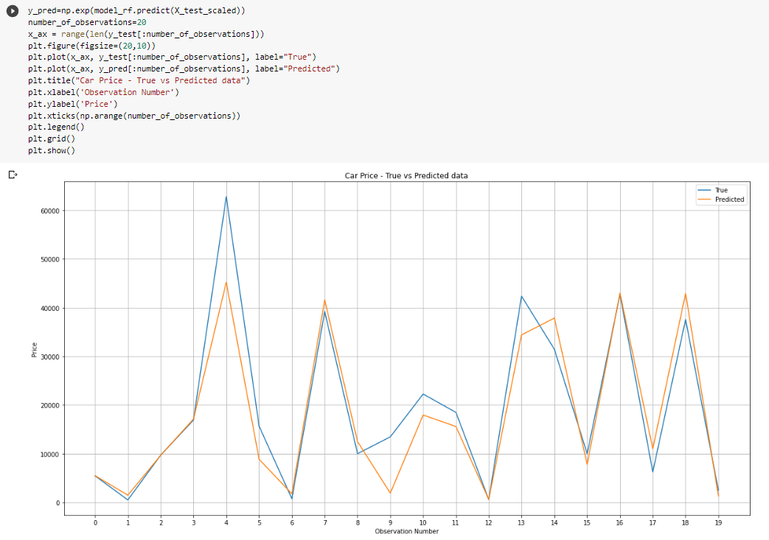
Car-Price Prediction:
True vs Predicted Data
Graphical Representation

