Slide 1
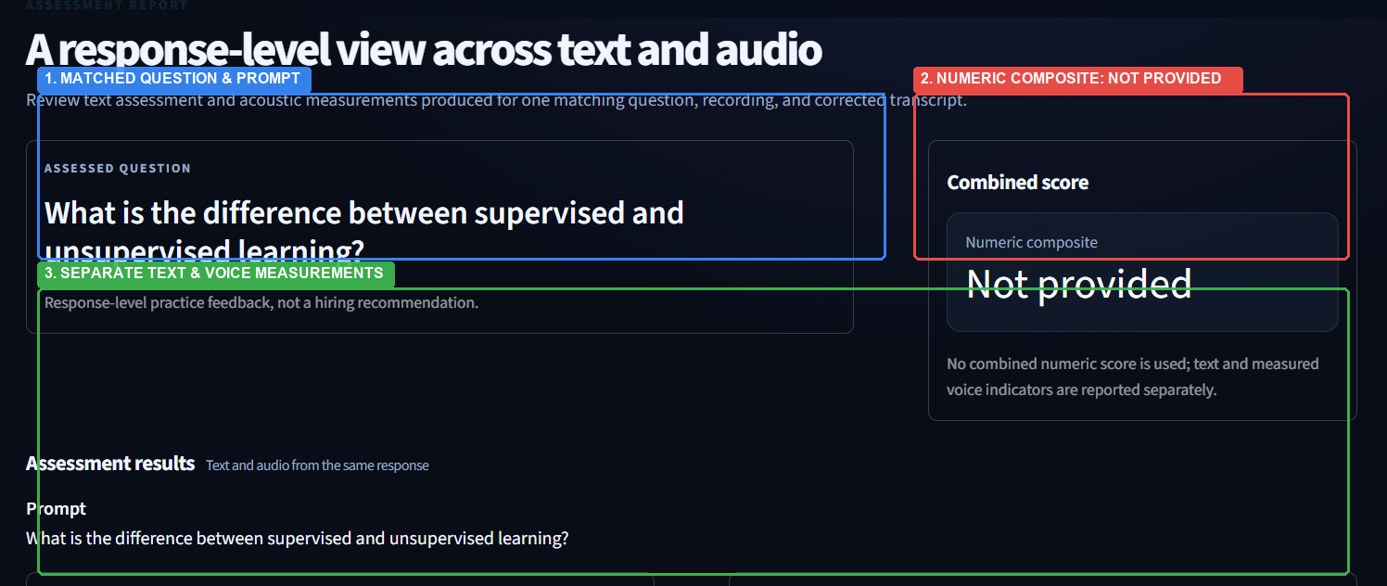
Multimodal Assessment Report - System Output
Actual System Output | Response-Level Evaluation Across Text & Acoustic Modalities
1. Response-Level Scope & Grounding
• Three-Way Coupling: Evaluation is tightly bounded to one matching question, candidate audio file, and reviewed transcript.
• Context Integrity: The report signature invalidates automatically if the question, audio digest, or transcript is altered.
2. Separate Modality Extraction
• Text Pipeline: TF-IDF reference cosine similarity, domain keyword overlap, question alignment, and structural flow heuristics.
• Acoustic Pipeline: Librosa audio feature extraction: duration, speaking rate (WPM), pause ratio, pitch (F₀), RMS energy, and 13 MFCCs.
3. Combined Numeric Score: NOT PROVIDED
• Current UI Status: The system explicitly renders: 'Numeric composite: Not provided'.
• Explicit Architectural Policy: The current implementation does NOT calculate a combined numeric multimodal score.
• Scientific Honesty: No artificial weighted averages, invented percentages, or synthetic performance tiers are manufactured.
• Isolated Diagnostic Value: Text quality and vocal delivery indicators are reported separately so learners receive actionable, unblurred feedback.
ACTUAL SYSTEM SCREENSHOT (Streamlit Interface | Multimodal Report Page)
Live evaluation of response to question: 'What is the difference between supervised and unsupervised learning?' The interface demonstrates complete three-way alignment between matching prompt, audio signal, and verbatim transcription, while strictly preserving modal separation.

