Slide 1
Алгоритм динамической трансформации временной шкалы
Dynamic Time Warping (DTW)

Slide 2
Источники
https://enriquegit.github.io/behavior-free/
https://en.wikipedia.org/wiki/Dynamic_time_warping
https://github.com/e-alizadeh/medium/blob/master/notebooks/intro_to_dtw.ipynb

Slide 3
План
Идея
Матрица расстояний и алгоритм её построения
Построение матрицы трансформаций по матрице расстояний
Реализация алгоритма DTW на Python
Path = warping function? Что такое трансформирующая функция и её свойства
Применение DTW к распознаванию жестов

Slide 4
Идея
Этот метод применяется когда нам нужно сравнить два временных ряда (последовательности чисел, которые нумеруются временем или зависят от времени), причём эти временные ряды разной длины!

Slide 5
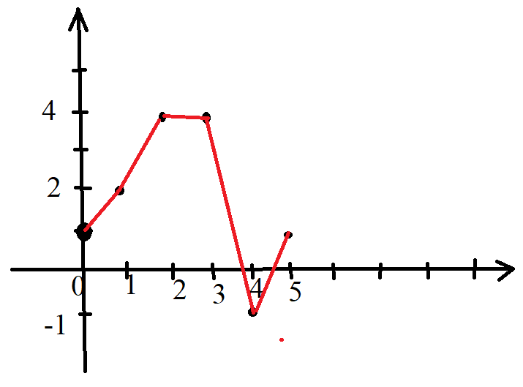
Идея
Если последовательности изображать графически, откладывая по горизонтали номер (время), а по вертикали значение последовательности, то получим график, который нарисуем как ломаную линию:
Например 1, 2, 4, 4, -1, 0, 0.7 выглядит так

Slide 6
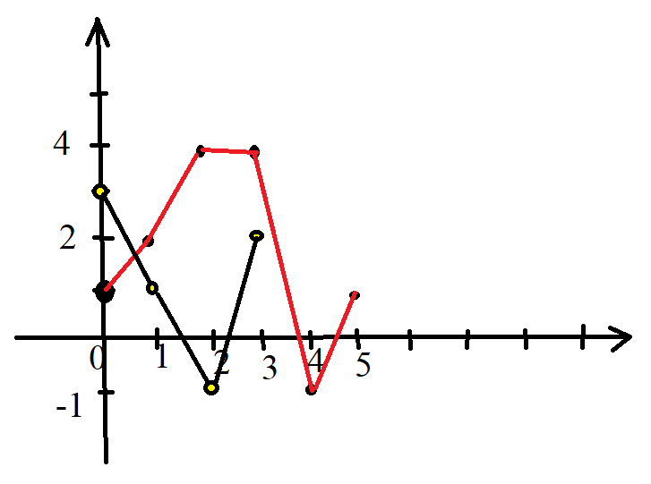
Идея
X = 1, 2, 4, 4, -1, 0, 0.7 Добавим к ней последовательность
Y = 3, 1, -1, 2
Каково же расстояние между этими
графиками или последовательностями?
Нужно просто найти всевозможные расс-
тояния между элементами последователь-
ностей, а потом выбрать определённую специальным алгоритмом сумму этих расстояний.

Slide 7
Идея
Далее находится отображение одной последовательности индексов на другую последовательность индексов.
Поскольку последовательности имеют разное число элементов, то это отображение не будет взаимно-однозначным. Т.е. где-то одному элементу первой последовательности будет соответствовать несколько элементов другой последовательности (или наоборот).

Slide 8
Алгоритм построения матрицы расстояний
cost matrix

Slide 9
Рассмотрим 2 последовательности чисел: S = (2,2,3,3,3) и
T = (2,2,2,4,4,3,1). Первую последовательность разместим по вертикали, а вторую по горизонтали
S T | 2 | 2 | 2 | 4 | 4 | 3 | 1
2
2
3
3
3

Slide 10
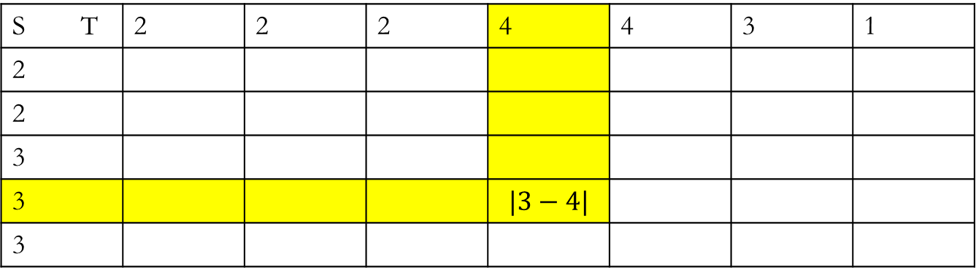

Внутри таблицы будем записывать расстояние между любым числом первой строки и любым числом из первого столбца. Расстояние может быть любым, но мы возьмём $d\left(s_{i},t_{j}\right)=\left|s_{i}−t_{j}\right|.$
S T | 2 | 2 | 2 | 4 | 4 | 3 | 1
2
2
3
3 |  |  |  | $$|3−4|$$
3

Slide 11
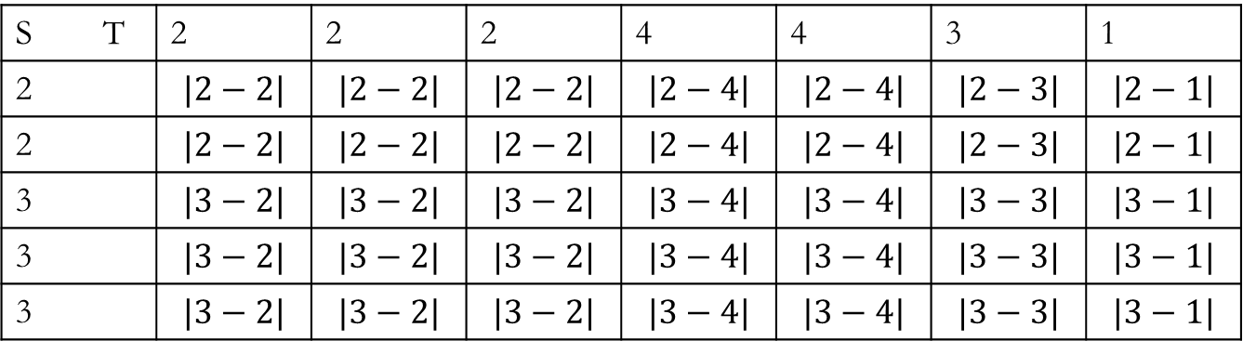
И заполним таким образом таблицу
S T | 2 | 2 | 2 | 4 | 4 | 3 | 1
2 | $$|2−2|$$ | $$|2−2|$$ | $$|2−2|$$ | $$|2−4|$$ | $$|2−4|$$ | $$|2−3|$$ | $$|2−1|$$
2 | $$|2−2|$$ | $$|2−2|$$ | $$|2−2|$$ | $$|2−4|$$ | $$|2−4|$$ | $$|2−3|$$ | $$|2−1|$$
3 | $$|3−2|$$ | $$|3−2|$$ | $$|3−2|$$ | $$|3−4|$$ | $$|3−4|$$ | $$|3−3|$$ | $$|3−1|$$
3 | $$|3−2|$$ | $$|3−2|$$ | $$|3−2|$$ | $$|3−4|$$ | $$|3−4|$$ | $$|3−3|$$ | $$|3−1|$$
3 | $$|3−2|$$ | $$|3−2|$$ | $$|3−2|$$ | $$|3−4|$$ | $$|3−4|$$ | $$|3−3|$$ | $$|3−1|$$

Slide 12
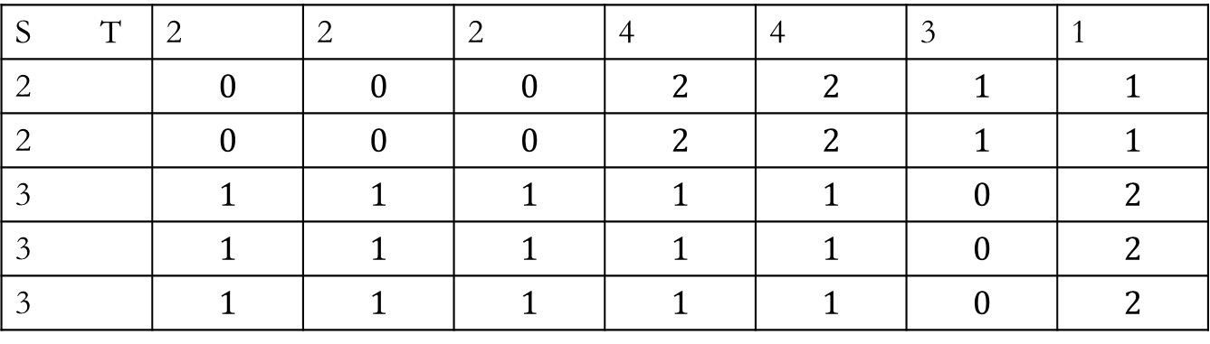
И заполним таким образом таблицу
S T | 2 | 2 | 2 | 4 | 4 | 3 | 1
2 | $$0$$ | $$0$$ | $$0$$ | $$2$$ | $$2$$ | $$1$$ | $$1$$
2 | $$0$$ | $$0$$ | $$0$$ | $$2$$ | $$2$$ | $$1$$ | $$1$$
3 | $$1$$ | $$1$$ | $$1$$ | $$1$$ | $$1$$ | $$0$$ | $$2$$
3 | $$1$$ | $$1$$ | $$1$$ | $$1$$ | $$1$$ | $$0$$ | $$2$$
3 | $$1$$ | $$1$$ | $$1$$ | $$1$$ | $$1$$ | $$0$$ | $$2$$

Slide 13
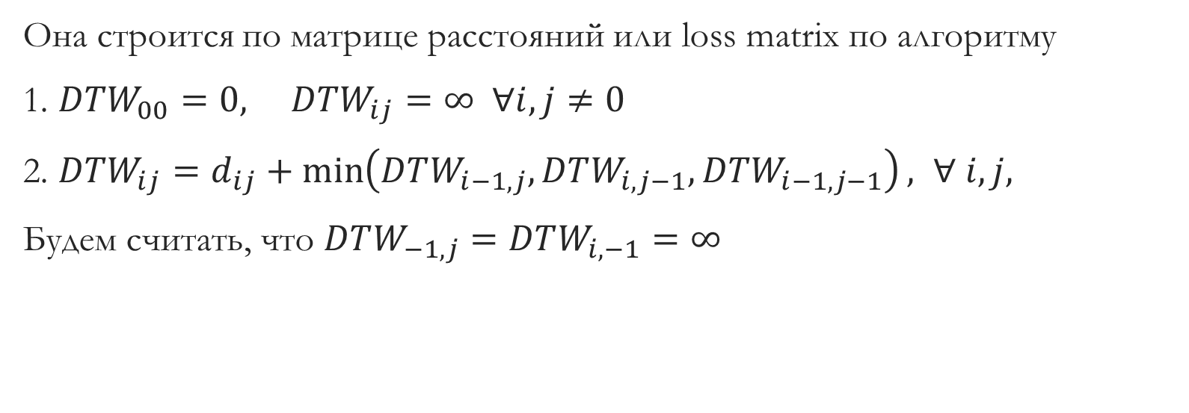
Построение матрицы трансформаций (Dynamic Time Warping)
Она строится по матрице расстояний или loss matrix по алгоритму
1. $DTW_{00}=0, DTW_{ij}=∞ ∀i,j≠0$
2. $DTW_{ij}=d_{ij}+\min\left(DTW_{i−1,j},DTW_{i,j−1},DTW_{i−1,j−1}\right), ∀ i,j,$
Будем считать, что $DTW_{−1,j}=DTW_{i,−1}=∞$

Slide 14
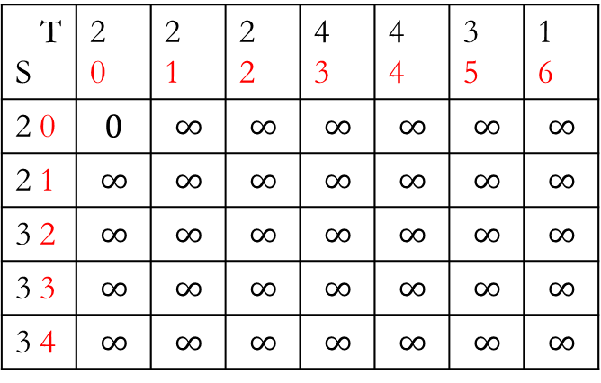
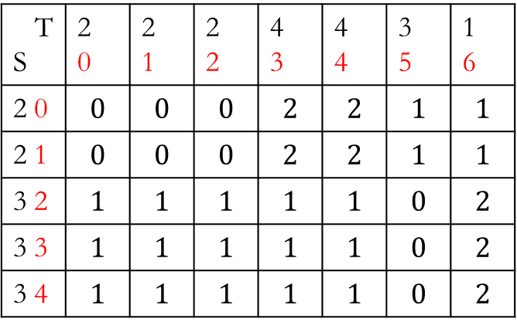
T S | 2 0 | 2 1 | 2 2 | 4 3 | 4 4 | 3 5 | 1 6
2 0 | $$0$$ | $$0$$ | $$0$$ | $$2$$ | $$2$$ | $$1$$ | $$1$$
2 1 | $$0$$ | $$0$$ | $$0$$ | $$2$$ | $$2$$ | $$1$$ | $$1$$
3 2 | $$1$$ | $$1$$ | $$1$$ | $$1$$ | $$1$$ | $$0$$ | $$2$$
3 3 | $$1$$ | $$1$$ | $$1$$ | $$1$$ | $$1$$ | $$0$$ | $$2$$
3 4 | $$1$$ | $$1$$ | $$1$$ | $$1$$ | $$1$$ | $$0$$ | $$2$$
T S | 2 0 | 2 1 | 2 2 | 4 3 | 4 4 | 3 5 | 1 6
2 0 | $$0$$ | $$∞$$ | $$∞$$ | $$∞$$ | $$∞$$ | $$∞$$ | $$∞$$
2 1 | $$∞$$ | $$∞$$ | $$∞$$ | $$∞$$ | $$∞$$ | $$∞$$ | $$∞$$
3 2 | $$∞$$ | $$∞$$ | $$∞$$ | $$∞$$ | $$∞$$ | $$∞$$ | $$∞$$
3 3 | $$∞$$ | $$∞$$ | $$∞$$ | $$∞$$ | $$∞$$ | $$∞$$ | $$∞$$
3 4 | $$∞$$ | $$∞$$ | $$∞$$ | $$∞$$ | $$∞$$ | $$∞$$ | $$∞$$

Slide 15
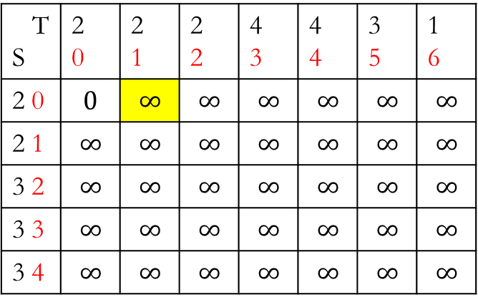
T S | 2 0 | 2 1 | 2 2 | 4 3 | 4 4 | 3 5 | 1 6
2 0 | $$0$$ | $$0$$ | $$0$$ | $$2$$ | $$2$$ | $$1$$ | $$1$$
2 1 | $$0$$ | $$0$$ | $$0$$ | $$2$$ | $$2$$ | $$1$$ | $$1$$
3 2 | $$1$$ | $$1$$ | $$1$$ | $$1$$ | $$1$$ | $$0$$ | $$2$$
3 3 | $$1$$ | $$1$$ | $$1$$ | $$1$$ | $$1$$ | $$0$$ | $$2$$
3 4 | $$1$$ | $$1$$ | $$1$$ | $$1$$ | $$1$$ | $$0$$ | $$2$$
T S | 2 0 | 2 1 | 2 2 | 4 3 | 4 4 | 3 5 | 1 6
2 0 | $$0$$ | $$∞$$ | $$∞$$ | $$∞$$ | $$∞$$ | $$∞$$ | $$∞$$
2 1 | $$∞$$ | $$∞$$ | $$∞$$ | $$∞$$ | $$∞$$ | $$∞$$ | $$∞$$
3 2 | $$∞$$ | $$∞$$ | $$∞$$ | $$∞$$ | $$∞$$ | $$∞$$ | $$∞$$
3 3 | $$∞$$ | $$∞$$ | $$∞$$ | $$∞$$ | $$∞$$ | $$∞$$ | $$∞$$
3 4 | $$∞$$ | $$∞$$ | $$∞$$ | $$∞$$ | $$∞$$ | $$∞$$ | $$∞$$

Slide 16

T S | 2 0 | 2 1 | 2 2 | 4 3 | 4 4 | 3 5 | 1 6
2 0 | $$0$$ | $$0$$ | $$0$$ | $$2$$ | $$2$$ | $$1$$ | $$1$$
2 1 | $$0$$ | $$0$$ | $$0$$ | $$2$$ | $$2$$ | $$1$$ | $$1$$
3 2 | $$1$$ | $$1$$ | $$1$$ | $$1$$ | $$1$$ | $$0$$ | $$2$$
3 3 | $$1$$ | $$1$$ | $$1$$ | $$1$$ | $$1$$ | $$0$$ | $$2$$
3 4 | $$1$$ | $$1$$ | $$1$$ | $$1$$ | $$1$$ | $$0$$ | $$2$$
T S | 2 0 | 2 1 | 2 2 | 4 3 | 4 4 | 3 5 | 1 6
2 0 | $$0$$ | $$∞$$ | $$∞$$ | $$∞$$ | $$∞$$ | $$∞$$ | $$∞$$
2 1 | $$∞$$ | $$∞$$ | $$∞$$ | $$∞$$ | $$∞$$ | $$∞$$ | $$∞$$
3 2 | $$∞$$ | $$∞$$ | $$∞$$ | $$∞$$ | $$∞$$ | $$∞$$ | $$∞$$
3 3 | $$∞$$ | $$∞$$ | $$∞$$ | $$∞$$ | $$∞$$ | $$∞$$ | $$∞$$
3 4 | $$∞$$ | $$∞$$ | $$∞$$ | $$∞$$ | $$∞$$ | $$∞$$ | $$∞$$

Slide 17

T S | 2 0 | 2 1 | 2 2 | 4 3 | 4 4 | 3 5 | 1 6
2 0 | $$0$$ | $$0$$ | $$0$$ | $$2$$ | $$2$$ | $$1$$ | $$1$$
2 1 | $$0$$ | $$0$$ | $$0$$ | $$2$$ | $$2$$ | $$1$$ | $$1$$
3 2 | $$1$$ | $$1$$ | $$1$$ | $$1$$ | $$1$$ | $$0$$ | $$2$$
3 3 | $$1$$ | $$1$$ | $$1$$ | $$1$$ | $$1$$ | $$0$$ | $$2$$
3 4 | $$1$$ | $$1$$ | $$1$$ | $$1$$ | $$1$$ | $$0$$ | $$2$$
T S | 2 0 | 2 1 | 2 2 | 4 3 | 4 4 | 3 5 | 1 6
2 0 | $$0$$ | $$0$$ | $$∞$$ | $$∞$$ | $$∞$$ | $$∞$$ | $$∞$$
2 1 | $$∞$$ | $$∞$$ | $$∞$$ | $$∞$$ | $$∞$$ | $$∞$$ | $$∞$$
3 2 | $$∞$$ | $$∞$$ | $$∞$$ | $$∞$$ | $$∞$$ | $$∞$$ | $$∞$$
3 3 | $$∞$$ | $$∞$$ | $$∞$$ | $$∞$$ | $$∞$$ | $$∞$$ | $$∞$$
3 4 | $$∞$$ | $$∞$$ | $$∞$$ | $$∞$$ | $$∞$$ | $$∞$$ | $$∞$$

Slide 18
T S | 2 0 | 2 1 | 2 2 | 4 3 | 4 4 | 3 5 | 1 6
2 0 | $$0$$ | $$0$$ | $$0$$ | $$2$$ | $$2$$ | $$1$$ | $$1$$
2 1 | $$0$$ | $$0$$ | $$0$$ | $$2$$ | $$2$$ | $$1$$ | $$1$$
3 2 | $$1$$ | $$1$$ | $$1$$ | $$1$$ | $$1$$ | $$0$$ | $$2$$
3 3 | $$1$$ | $$1$$ | $$1$$ | $$1$$ | $$1$$ | $$0$$ | $$2$$
3 4 | $$1$$ | $$1$$ | $$1$$ | $$1$$ | $$1$$ | $$0$$ | $$2$$
T S | 2 0 | 2 1 | 2 2 | 4 3 | 4 4 | 3 5 | 1 6
2 0 | $$0$$ | $$0$$ | $$∞$$ | $$∞$$ | $$∞$$ | $$∞$$ | $$∞$$
2 1 | $$∞$$ | $$∞$$ | $$∞$$ | $$∞$$ | $$∞$$ | $$∞$$ | $$∞$$
3 2 | $$∞$$ | $$∞$$ | $$∞$$ | $$∞$$ | $$∞$$ | $$∞$$ | $$∞$$
3 3 | $$∞$$ | $$∞$$ | $$∞$$ | $$∞$$ | $$∞$$ | $$∞$$ | $$∞$$
3 4 | $$∞$$ | $$∞$$ | $$∞$$ | $$∞$$ | $$∞$$ | $$∞$$ | $$∞$$

Slide 19
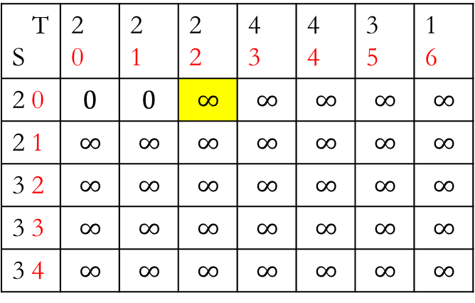

T S | 2 0 | 2 1 | 2 2 | 4 3 | 4 4 | 3 5 | 1 6
2 0 | $$0$$ | $$0$$ | $$0$$ | $$2$$ | $$2$$ | $$1$$ | $$1$$
2 1 | $$0$$ | $$0$$ | $$0$$ | $$2$$ | $$2$$ | $$1$$ | $$1$$
3 2 | $$1$$ | $$1$$ | $$1$$ | $$1$$ | $$1$$ | $$0$$ | $$2$$
3 3 | $$1$$ | $$1$$ | $$1$$ | $$1$$ | $$1$$ | $$0$$ | $$2$$
3 4 | $$1$$ | $$1$$ | $$1$$ | $$1$$ | $$1$$ | $$0$$ | $$2$$
T S | 2 0 | 2 1 | 2 2 | 4 3 | 4 4 | 3 5 | 1 6
2 0 | $$0$$ | $$0$$ | $$∞$$ | $$∞$$ | $$∞$$ | $$∞$$ | $$∞$$
2 1 | $$∞$$ | $$∞$$ | $$∞$$ | $$∞$$ | $$∞$$ | $$∞$$ | $$∞$$
3 2 | $$∞$$ | $$∞$$ | $$∞$$ | $$∞$$ | $$∞$$ | $$∞$$ | $$∞$$
3 3 | $$∞$$ | $$∞$$ | $$∞$$ | $$∞$$ | $$∞$$ | $$∞$$ | $$∞$$
3 4 | $$∞$$ | $$∞$$ | $$∞$$ | $$∞$$ | $$∞$$ | $$∞$$ | $$∞$$

Slide 20
T S | 2 0 | 2 1 | 2 2 | 4 3 | 4 4 | 3 5 | 1 6
2 0 | $$0$$ | $$0$$ | $$0$$ | $$2$$ | $$2$$ | $$1$$ | $$1$$
2 1 | $$0$$ | $$0$$ | $$0$$ | $$2$$ | $$2$$ | $$1$$ | $$1$$
3 2 | $$1$$ | $$1$$ | $$1$$ | $$1$$ | $$1$$ | $$0$$ | $$2$$
3 3 | $$1$$ | $$1$$ | $$1$$ | $$1$$ | $$1$$ | $$0$$ | $$2$$
3 4 | $$1$$ | $$1$$ | $$1$$ | $$1$$ | $$1$$ | $$0$$ | $$2$$
T S | 2 0 | 2 1 | 2 2 | 4 3 | 4 4 | 3 5 | 1 6
2 0 | $$0$$ | $$0$$ | $$∞$$ | $$∞$$ | $$∞$$ | $$∞$$ | $$∞$$
2 1 | $$∞$$ | $$∞$$ | $$∞$$ | $$∞$$ | $$∞$$ | $$∞$$ | $$∞$$
3 2 | $$∞$$ | $$∞$$ | $$∞$$ | $$∞$$ | $$∞$$ | $$∞$$ | $$∞$$
3 3 | $$∞$$ | $$∞$$ | $$∞$$ | $$∞$$ | $$∞$$ | $$∞$$ | $$∞$$
3 4 | $$∞$$ | $$∞$$ | $$∞$$ | $$∞$$ | $$∞$$ | $$∞$$ | $$∞$$

Slide 21

T S | 2 0 | 2 1 | 2 2 | 4 3 | 4 4 | 3 5 | 1 6
2 0 | $$0$$ | $$0$$ | $$0$$ | $$2$$ | $$2$$ | $$1$$ | $$1$$
2 1 | $$0$$ | $$0$$ | $$0$$ | $$2$$ | $$2$$ | $$1$$ | $$1$$
3 2 | $$1$$ | $$1$$ | $$1$$ | $$1$$ | $$1$$ | $$0$$ | $$2$$
3 3 | $$1$$ | $$1$$ | $$1$$ | $$1$$ | $$1$$ | $$0$$ | $$2$$
3 4 | $$1$$ | $$1$$ | $$1$$ | $$1$$ | $$1$$ | $$0$$ | $$2$$
T S | 2 0 | 2 1 | 2 2 | 4 3 | 4 4 | 3 5 | 1 6
2 0 | $$0$$ | $$0$$ | $$0$$ | $$∞$$ | $$∞$$ | $$∞$$ | $$∞$$
2 1 | $$∞$$ | $$∞$$ | $$∞$$ | $$∞$$ | $$∞$$ | $$∞$$ | $$∞$$
3 2 | $$∞$$ | $$∞$$ | $$∞$$ | $$∞$$ | $$∞$$ | $$∞$$ | $$∞$$
3 3 | $$∞$$ | $$∞$$ | $$∞$$ | $$∞$$ | $$∞$$ | $$∞$$ | $$∞$$
3 4 | $$∞$$ | $$∞$$ | $$∞$$ | $$∞$$ | $$∞$$ | $$∞$$ | $$∞$$

Slide 22
T S | 2 0 | 2 1 | 2 2 | 4 3 | 4 4 | 3 5 | 1 6
2 0 | $$0$$ | $$0$$ | $$0$$ | $$2$$ | $$2$$ | $$1$$ | $$1$$
2 1 | $$0$$ | $$0$$ | $$0$$ | $$2$$ | $$2$$ | $$1$$ | $$1$$
3 2 | $$1$$ | $$1$$ | $$1$$ | $$1$$ | $$1$$ | $$0$$ | $$2$$
3 3 | $$1$$ | $$1$$ | $$1$$ | $$1$$ | $$1$$ | $$0$$ | $$2$$
3 4 | $$1$$ | $$1$$ | $$1$$ | $$1$$ | $$1$$ | $$0$$ | $$2$$
T S | 2 0 | 2 1 | 2 2 | 4 3 | 4 4 | 3 5 | 1 6
2 0 | $$0$$ | $$0$$ | $$0$$ | $$∞$$ | $$∞$$ | $$∞$$ | $$∞$$
2 1 | $$∞$$ | $$∞$$ | $$∞$$ | $$∞$$ | $$∞$$ | $$∞$$ | $$∞$$
3 2 | $$∞$$ | $$∞$$ | $$∞$$ | $$∞$$ | $$∞$$ | $$∞$$ | $$∞$$
3 3 | $$∞$$ | $$∞$$ | $$∞$$ | $$∞$$ | $$∞$$ | $$∞$$ | $$∞$$
3 4 | $$∞$$ | $$∞$$ | $$∞$$ | $$∞$$ | $$∞$$ | $$∞$$ | $$∞$$

Slide 23
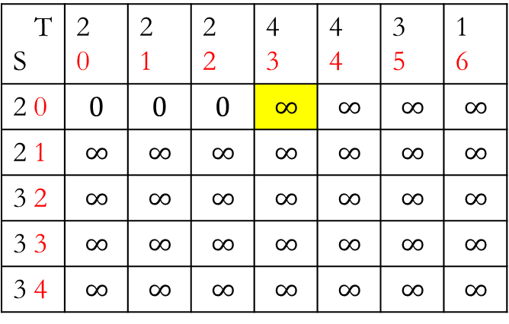

T S | 2 0 | 2 1 | 2 2 | 4 3 | 4 4 | 3 5 | 1 6
2 0 | $$0$$ | $$0$$ | $$0$$ | $$2$$ | $$2$$ | $$1$$ | $$1$$
2 1 | $$0$$ | $$0$$ | $$0$$ | $$2$$ | $$2$$ | $$1$$ | $$1$$
3 2 | $$1$$ | $$1$$ | $$1$$ | $$1$$ | $$1$$ | $$0$$ | $$2$$
3 3 | $$1$$ | $$1$$ | $$1$$ | $$1$$ | $$1$$ | $$0$$ | $$2$$
3 4 | $$1$$ | $$1$$ | $$1$$ | $$1$$ | $$1$$ | $$0$$ | $$2$$
T S | 2 0 | 2 1 | 2 2 | 4 3 | 4 4 | 3 5 | 1 6
2 0 | $$0$$ | $$0$$ | $$0$$ | $$∞$$ | $$∞$$ | $$∞$$ | $$∞$$
2 1 | $$∞$$ | $$∞$$ | $$∞$$ | $$∞$$ | $$∞$$ | $$∞$$ | $$∞$$
3 2 | $$∞$$ | $$∞$$ | $$∞$$ | $$∞$$ | $$∞$$ | $$∞$$ | $$∞$$
3 3 | $$∞$$ | $$∞$$ | $$∞$$ | $$∞$$ | $$∞$$ | $$∞$$ | $$∞$$
3 4 | $$∞$$ | $$∞$$ | $$∞$$ | $$∞$$ | $$∞$$ | $$∞$$ | $$∞$$

Slide 24
T S | 2 0 | 2 1 | 2 2 | 4 3 | 4 4 | 3 5 | 1 6
2 0 | $$0$$ | $$0$$ | $$0$$ | $$2$$ | $$2$$ | $$1$$ | $$1$$
2 1 | $$0$$ | $$0$$ | $$0$$ | $$2$$ | $$2$$ | $$1$$ | $$1$$
3 2 | $$1$$ | $$1$$ | $$1$$ | $$1$$ | $$1$$ | $$0$$ | $$2$$
3 3 | $$1$$ | $$1$$ | $$1$$ | $$1$$ | $$1$$ | $$0$$ | $$2$$
3 4 | $$1$$ | $$1$$ | $$1$$ | $$1$$ | $$1$$ | $$0$$ | $$2$$
T S | 2 0 | 2 1 | 2 2 | 4 3 | 4 4 | 3 5 | 1 6
2 0 | $$0$$ | $$0$$ | $$0$$ | $$∞$$ | $$∞$$ | $$∞$$ | $$∞$$
2 1 | $$∞$$ | $$∞$$ | $$∞$$ | $$∞$$ | $$∞$$ | $$∞$$ | $$∞$$
3 2 | $$∞$$ | $$∞$$ | $$∞$$ | $$∞$$ | $$∞$$ | $$∞$$ | $$∞$$
3 3 | $$∞$$ | $$∞$$ | $$∞$$ | $$∞$$ | $$∞$$ | $$∞$$ | $$∞$$
3 4 | $$∞$$ | $$∞$$ | $$∞$$ | $$∞$$ | $$∞$$ | $$∞$$ | $$∞$$

Slide 25

T S | 2 0 | 2 1 | 2 2 | 4 3 | 4 4 | 3 5 | 1 6
2 0 | $$0$$ | $$0$$ | $$0$$ | $$2$$ | $$2$$ | $$1$$ | $$1$$
2 1 | $$0$$ | $$0$$ | $$0$$ | $$2$$ | $$2$$ | $$1$$ | $$1$$
3 2 | $$1$$ | $$1$$ | $$1$$ | $$1$$ | $$1$$ | $$0$$ | $$2$$
3 3 | $$1$$ | $$1$$ | $$1$$ | $$1$$ | $$1$$ | $$0$$ | $$2$$
3 4 | $$1$$ | $$1$$ | $$1$$ | $$1$$ | $$1$$ | $$0$$ | $$2$$
T S | 2 0 | 2 1 | 2 2 | 4 3 | 4 4 | 3 5 | 1 6
2 0 | $$0$$ | $$0$$ | $$0$$ | $$2$$ | $$∞$$ | $$∞$$ | $$∞$$
2 1 | $$∞$$ | $$∞$$ | $$∞$$ | $$∞$$ | $$∞$$ | $$∞$$ | $$∞$$
3 2 | $$∞$$ | $$∞$$ | $$∞$$ | $$∞$$ | $$∞$$ | $$∞$$ | $$∞$$
3 3 | $$∞$$ | $$∞$$ | $$∞$$ | $$∞$$ | $$∞$$ | $$∞$$ | $$∞$$
3 4 | $$∞$$ | $$∞$$ | $$∞$$ | $$∞$$ | $$∞$$ | $$∞$$ | $$∞$$

Slide 26
T S | 2 0 | 2 1 | 2 2 | 4 3 | 4 4 | 3 5 | 1 6
2 0 | $$0$$ | $$0$$ | $$0$$ | $$2$$ | $$2$$ | $$1$$ | $$1$$
2 1 | $$0$$ | $$0$$ | $$0$$ | $$2$$ | $$2$$ | $$1$$ | $$1$$
3 2 | $$1$$ | $$1$$ | $$1$$ | $$1$$ | $$1$$ | $$0$$ | $$2$$
3 3 | $$1$$ | $$1$$ | $$1$$ | $$1$$ | $$1$$ | $$0$$ | $$2$$
3 4 | $$1$$ | $$1$$ | $$1$$ | $$1$$ | $$1$$ | $$0$$ | $$2$$
T S | 2 0 | 2 1 | 2 2 | 4 3 | 4 4 | 3 5 | 1 6
2 0 | $$0$$ | $$0$$ | $$0$$ | $$2$$ | $$∞$$ | $$∞$$ | $$∞$$
2 1 | $$∞$$ | $$∞$$ | $$∞$$ | $$∞$$ | $$∞$$ | $$∞$$ | $$∞$$
3 2 | $$∞$$ | $$∞$$ | $$∞$$ | $$∞$$ | $$∞$$ | $$∞$$ | $$∞$$
3 3 | $$∞$$ | $$∞$$ | $$∞$$ | $$∞$$ | $$∞$$ | $$∞$$ | $$∞$$
3 4 | $$∞$$ | $$∞$$ | $$∞$$ | $$∞$$ | $$∞$$ | $$∞$$ | $$∞$$

Slide 27
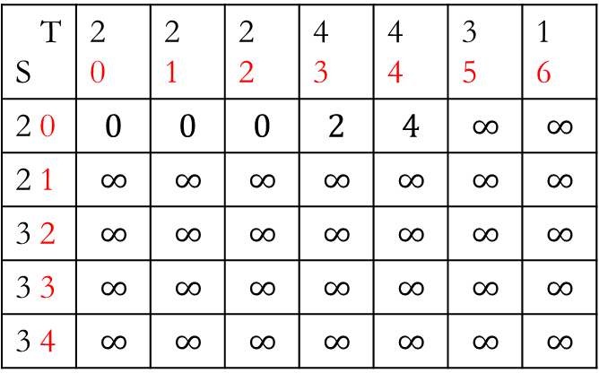
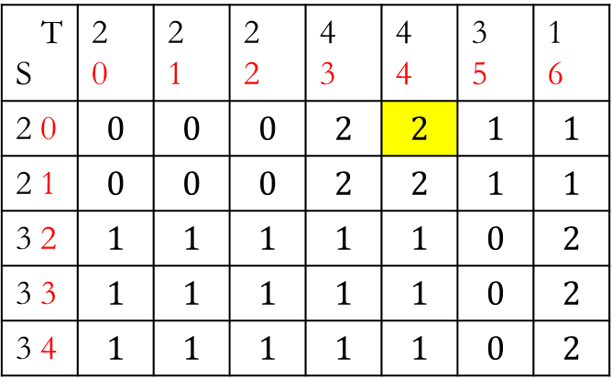
T S | 2 0 | 2 1 | 2 2 | 4 3 | 4 4 | 3 5 | 1 6
2 0 | $$0$$ | $$0$$ | $$0$$ | $$2$$ | $$2$$ | $$1$$ | $$1$$
2 1 | $$0$$ | $$0$$ | $$0$$ | $$2$$ | $$2$$ | $$1$$ | $$1$$
3 2 | $$1$$ | $$1$$ | $$1$$ | $$1$$ | $$1$$ | $$0$$ | $$2$$
3 3 | $$1$$ | $$1$$ | $$1$$ | $$1$$ | $$1$$ | $$0$$ | $$2$$
3 4 | $$1$$ | $$1$$ | $$1$$ | $$1$$ | $$1$$ | $$0$$ | $$2$$
T S | 2 0 | 2 1 | 2 2 | 4 3 | 4 4 | 3 5 | 1 6
2 0 | $$0$$ | $$0$$ | $$0$$ | $$2$$ | $$4$$ | $$∞$$ | $$∞$$
2 1 | $$∞$$ | $$∞$$ | $$∞$$ | $$∞$$ | $$∞$$ | $$∞$$ | $$∞$$
3 2 | $$∞$$ | $$∞$$ | $$∞$$ | $$∞$$ | $$∞$$ | $$∞$$ | $$∞$$
3 3 | $$∞$$ | $$∞$$ | $$∞$$ | $$∞$$ | $$∞$$ | $$∞$$ | $$∞$$
3 4 | $$∞$$ | $$∞$$ | $$∞$$ | $$∞$$ | $$∞$$ | $$∞$$ | $$∞$$

Slide 28
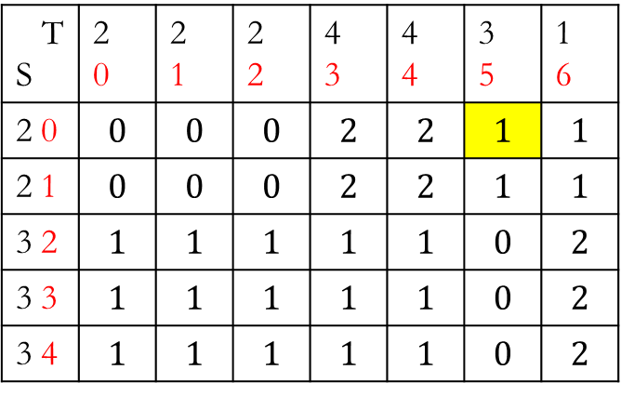
T S | 2 0 | 2 1 | 2 2 | 4 3 | 4 4 | 3 5 | 1 6
2 0 | $$0$$ | $$0$$ | $$0$$ | $$2$$ | $$2$$ | $$1$$ | $$1$$
2 1 | $$0$$ | $$0$$ | $$0$$ | $$2$$ | $$2$$ | $$1$$ | $$1$$
3 2 | $$1$$ | $$1$$ | $$1$$ | $$1$$ | $$1$$ | $$0$$ | $$2$$
3 3 | $$1$$ | $$1$$ | $$1$$ | $$1$$ | $$1$$ | $$0$$ | $$2$$
3 4 | $$1$$ | $$1$$ | $$1$$ | $$1$$ | $$1$$ | $$0$$ | $$2$$
T S | 2 0 | 2 1 | 2 2 | 4 3 | 4 4 | 3 5 | 1 6
2 0 | $$0$$ | $$0$$ | $$0$$ | $$2$$ | $$4$$ | $$∞$$ | $$∞$$
2 1 | $$∞$$ | $$∞$$ | $$∞$$ | $$∞$$ | $$∞$$ | $$∞$$ | $$∞$$
3 2 | $$∞$$ | $$∞$$ | $$∞$$ | $$∞$$ | $$∞$$ | $$∞$$ | $$∞$$
3 3 | $$∞$$ | $$∞$$ | $$∞$$ | $$∞$$ | $$∞$$ | $$∞$$ | $$∞$$
3 4 | $$∞$$ | $$∞$$ | $$∞$$ | $$∞$$ | $$∞$$ | $$∞$$ | $$∞$$

Slide 29

T S | 2 0 | 2 1 | 2 2 | 4 3 | 4 4 | 3 5 | 1 6
2 0 | $$0$$ | $$0$$ | $$0$$ | $$2$$ | $$2$$ | $$1$$ | $$1$$
2 1 | $$0$$ | $$0$$ | $$0$$ | $$2$$ | $$2$$ | $$1$$ | $$1$$
3 2 | $$1$$ | $$1$$ | $$1$$ | $$1$$ | $$1$$ | $$0$$ | $$2$$
3 3 | $$1$$ | $$1$$ | $$1$$ | $$1$$ | $$1$$ | $$0$$ | $$2$$
3 4 | $$1$$ | $$1$$ | $$1$$ | $$1$$ | $$1$$ | $$0$$ | $$2$$
T S | 2 0 | 2 1 | 2 2 | 4 3 | 4 4 | 3 5 | 1 6
2 0 | $$0$$ | $$0$$ | $$0$$ | $$2$$ | $$4$$ | $$1$$ | $$∞$$
2 1 | $$∞$$ | $$∞$$ | $$∞$$ | $$∞$$ | $$∞$$ | $$∞$$ | $$∞$$
3 2 | $$∞$$ | $$∞$$ | $$∞$$ | $$∞$$ | $$∞$$ | $$∞$$ | $$∞$$
3 3 | $$∞$$ | $$∞$$ | $$∞$$ | $$∞$$ | $$∞$$ | $$∞$$ | $$∞$$
3 4 | $$∞$$ | $$∞$$ | $$∞$$ | $$∞$$ | $$∞$$ | $$∞$$ | $$∞$$

Slide 30

T S | 2 0 | 2 1 | 2 2 | 4 3 | 4 4 | 3 5 | 1 6
2 0 | $$0$$ | $$0$$ | $$0$$ | $$2$$ | $$2$$ | $$1$$ | $$1$$
2 1 | $$0$$ | $$0$$ | $$0$$ | $$2$$ | $$2$$ | $$1$$ | $$1$$
3 2 | $$1$$ | $$1$$ | $$1$$ | $$1$$ | $$1$$ | $$0$$ | $$2$$
3 3 | $$1$$ | $$1$$ | $$1$$ | $$1$$ | $$1$$ | $$0$$ | $$2$$
3 4 | $$1$$ | $$1$$ | $$1$$ | $$1$$ | $$1$$ | $$0$$ | $$2$$
T S | 2 0 | 2 1 | 2 2 | 4 3 | 4 4 | 3 5 | 1 6
2 0 | $$0$$ | $$0$$ | $$0$$ | $$2$$ | $$4$$ | $$5$$ | $$∞$$
2 1 | $$∞$$ | $$∞$$ | $$∞$$ | $$∞$$ | $$∞$$ | $$∞$$ | $$∞$$
3 2 | $$∞$$ | $$∞$$ | $$∞$$ | $$∞$$ | $$∞$$ | $$∞$$ | $$∞$$
3 3 | $$∞$$ | $$∞$$ | $$∞$$ | $$∞$$ | $$∞$$ | $$∞$$ | $$∞$$
3 4 | $$∞$$ | $$∞$$ | $$∞$$ | $$∞$$ | $$∞$$ | $$∞$$ | $$∞$$

Slide 31

Cost matrix DTW matrix
T S | 2 0 | 2 1 | 2 2 | 4 3 | 4 4 | 3 5 | 1 6
2 0 | $$0$$ | $$0$$ | $$0$$ | $$2$$ | $$2$$ | $$1$$ | $$1$$
2 1 | $$0$$ | $$0$$ | $$0$$ | $$2$$ | $$2$$ | $$1$$ | $$1$$
3 2 | $$1$$ | $$1$$ | $$1$$ | $$1$$ | $$1$$ | $$0$$ | $$2$$
3 3 | $$1$$ | $$1$$ | $$1$$ | $$1$$ | $$1$$ | $$0$$ | $$2$$
3 4 | $$1$$ | $$1$$ | $$1$$ | $$1$$ | $$1$$ | $$0$$ | $$2$$
T S | 2 0 | 2 1 | 2 2 | 4 3 | 4 4 | 3 5 | 1 6
2 0 | $$0$$ | $$0$$ | $$0$$ | $$2$$ | $$4$$ | $$5$$ | $$6$$
2 1 | $$∞$$ | $$∞$$ | $$∞$$ | $$∞$$ | $$∞$$ | $$∞$$ | $$∞$$
3 2 | $$∞$$ | $$∞$$ | $$∞$$ | $$∞$$ | $$∞$$ | $$∞$$ | $$∞$$
3 3 | $$∞$$ | $$∞$$ | $$∞$$ | $$∞$$ | $$∞$$ | $$∞$$ | $$∞$$
3 4 | $$∞$$ | $$∞$$ | $$∞$$ | $$∞$$ | $$∞$$ | $$∞$$ | $$∞$$

Slide 32

Cost matrix DTW matrix
T S | 2 0 | 2 1 | 2 2 | 4 3 | 4 4 | 3 5 | 1 6
2 0 | $$0$$ | $$0$$ | $$0$$ | $$2$$ | $$2$$ | $$1$$ | $$1$$
2 1 | $$0$$ | $$0$$ | $$0$$ | $$2$$ | $$2$$ | $$1$$ | $$1$$
3 2 | $$1$$ | $$1$$ | $$1$$ | $$1$$ | $$1$$ | $$0$$ | $$2$$
3 3 | $$1$$ | $$1$$ | $$1$$ | $$1$$ | $$1$$ | $$0$$ | $$2$$
3 4 | $$1$$ | $$1$$ | $$1$$ | $$1$$ | $$1$$ | $$0$$ | $$2$$
T S | 2 0 | 2 1 | 2 2 | 4 3 | 4 4 | 3 5 | 1 6
2 0 | $$0$$ | $$0$$ | $$0$$ | $$2$$ | $$4$$ | $$5$$ | $$6$$
2 1 | $$0$$ | $$∞$$ | $$∞$$ | $$∞$$ | $$∞$$ | $$∞$$ | $$∞$$
3 2 | $$1$$ | $$∞$$ | $$∞$$ | $$∞$$ | $$∞$$ | $$∞$$ | $$∞$$
3 3 | $$2$$ | $$∞$$ | $$∞$$ | $$∞$$ | $$∞$$ | $$∞$$ | $$∞$$
3 4 | $$3$$ | $$∞$$ | $$∞$$ | $$∞$$ | $$∞$$ | $$∞$$ | $$∞$$

Slide 33
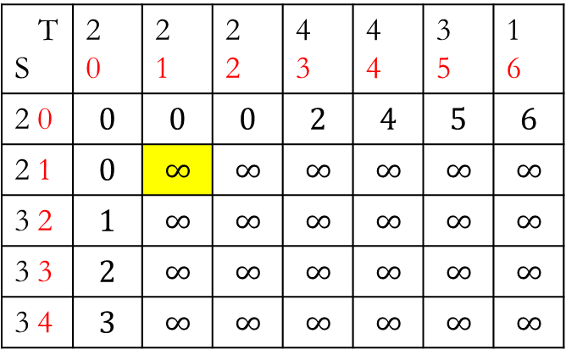
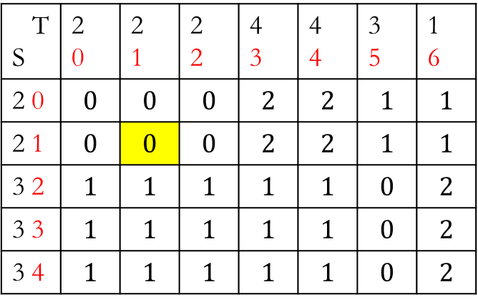
Cost matrix DTW matrix
T S | 2 0 | 2 1 | 2 2 | 4 3 | 4 4 | 3 5 | 1 6
2 0 | $$0$$ | $$0$$ | $$0$$ | $$2$$ | $$2$$ | $$1$$ | $$1$$
2 1 | $$0$$ | $$0$$ | $$0$$ | $$2$$ | $$2$$ | $$1$$ | $$1$$
3 2 | $$1$$ | $$1$$ | $$1$$ | $$1$$ | $$1$$ | $$0$$ | $$2$$
3 3 | $$1$$ | $$1$$ | $$1$$ | $$1$$ | $$1$$ | $$0$$ | $$2$$
3 4 | $$1$$ | $$1$$ | $$1$$ | $$1$$ | $$1$$ | $$0$$ | $$2$$
T S | 2 0 | 2 1 | 2 2 | 4 3 | 4 4 | 3 5 | 1 6
2 0 | $$0$$ | $$0$$ | $$0$$ | $$2$$ | $$4$$ | $$5$$ | $$6$$
2 1 | $$0$$ | $$∞$$ | $$∞$$ | $$∞$$ | $$∞$$ | $$∞$$ | $$∞$$
3 2 | $$1$$ | $$∞$$ | $$∞$$ | $$∞$$ | $$∞$$ | $$∞$$ | $$∞$$
3 3 | $$2$$ | $$∞$$ | $$∞$$ | $$∞$$ | $$∞$$ | $$∞$$ | $$∞$$
3 4 | $$3$$ | $$∞$$ | $$∞$$ | $$∞$$ | $$∞$$ | $$∞$$ | $$∞$$

Slide 34
Cost matrix DTW matrix
T S | 2 0 | 2 1 | 2 2 | 4 3 | 4 4 | 3 5 | 1 6
2 0 | $$0$$ | $$0$$ | $$0$$ | $$2$$ | $$2$$ | $$1$$ | $$1$$
2 1 | $$0$$ | $$0$$ | $$0$$ | $$2$$ | $$2$$ | $$1$$ | $$1$$
3 2 | $$1$$ | $$1$$ | $$1$$ | $$1$$ | $$1$$ | $$0$$ | $$2$$
3 3 | $$1$$ | $$1$$ | $$1$$ | $$1$$ | $$1$$ | $$0$$ | $$2$$
3 4 | $$1$$ | $$1$$ | $$1$$ | $$1$$ | $$1$$ | $$0$$ | $$2$$
T S | 2 0 | 2 1 | 2 2 | 4 3 | 4 4 | 3 5 | 1 6
2 0 | $$0$$ | $$0$$ | $$0$$ | $$2$$ | $$4$$ | $$5$$ | $$6$$
2 1 | $$0$$ | $$∞$$ | $$∞$$ | $$∞$$ | $$∞$$ | $$∞$$ | $$∞$$
3 2 | $$1$$ | $$∞$$ | $$∞$$ | $$∞$$ | $$∞$$ | $$∞$$ | $$∞$$
3 3 | $$2$$ | $$∞$$ | $$∞$$ | $$∞$$ | $$∞$$ | $$∞$$ | $$∞$$
3 4 | $$3$$ | $$∞$$ | $$∞$$ | $$∞$$ | $$∞$$ | $$∞$$ | $$∞$$

Slide 35

Loss matrix DTW matrix
T S | 2 0 | 2 1 | 2 2 | 4 3 | 4 4 | 3 5 | 1 6
2 0 | $$0$$ | $$0$$ | $$0$$ | $$2$$ | $$2$$ | $$1$$ | $$1$$
2 1 | $$0$$ | $$0$$ | $$0$$ | $$2$$ | $$2$$ | $$1$$ | $$1$$
3 2 | $$1$$ | $$1$$ | $$1$$ | $$1$$ | $$1$$ | $$0$$ | $$2$$
3 3 | $$1$$ | $$1$$ | $$1$$ | $$1$$ | $$1$$ | $$0$$ | $$2$$
3 4 | $$1$$ | $$1$$ | $$1$$ | $$1$$ | $$1$$ | $$0$$ | $$2$$
T S | 2 0 | 2 1 | 2 2 | 4 3 | 4 4 | 3 5 | 1 6
2 0 | $$0$$ | $$0$$ | $$0$$ | $$2$$ | $$4$$ | $$5$$ | $$6$$
2 1 | $$0$$ | $$0$$ | $$∞$$ | $$∞$$ | $$∞$$ | $$∞$$ | $$∞$$
3 2 | $$1$$ | $$∞$$ | $$∞$$ | $$∞$$ | $$∞$$ | $$∞$$ | $$∞$$
3 3 | $$2$$ | $$∞$$ | $$∞$$ | $$∞$$ | $$∞$$ | $$∞$$ | $$∞$$
3 4 | $$3$$ | $$∞$$ | $$∞$$ | $$∞$$ | $$∞$$ | $$∞$$ | $$∞$$

Slide 36
Loss matrix DTW matrix
T S | 2 0 | 2 1 | 2 2 | 4 3 | 4 4 | 3 5 | 1 6
2 0 | $$0$$ | $$0$$ | $$0$$ | $$2$$ | $$2$$ | $$1$$ | $$1$$
2 1 | $$0$$ | $$0$$ | $$0$$ | $$2$$ | $$2$$ | $$1$$ | $$1$$
3 2 | $$1$$ | $$1$$ | $$1$$ | $$1$$ | $$1$$ | $$0$$ | $$2$$
3 3 | $$1$$ | $$1$$ | $$1$$ | $$1$$ | $$1$$ | $$0$$ | $$2$$
3 4 | $$1$$ | $$1$$ | $$1$$ | $$1$$ | $$1$$ | $$0$$ | $$2$$
T S | 2 0 | 2 1 | 2 2 | 4 3 | 4 4 | 3 5 | 1 6
2 0 | $$0$$ | $$0$$ | $$0$$ | $$2$$ | $$4$$ | $$5$$ | $$6$$
2 1 | $$0$$ | $$0$$ | $$∞$$ | $$∞$$ | $$∞$$ | $$∞$$ | $$∞$$
3 2 | $$1$$ | $$∞$$ | $$∞$$ | $$∞$$ | $$∞$$ | $$∞$$ | $$∞$$
3 3 | $$2$$ | $$∞$$ | $$∞$$ | $$∞$$ | $$∞$$ | $$∞$$ | $$∞$$
3 4 | $$3$$ | $$∞$$ | $$∞$$ | $$∞$$ | $$∞$$ | $$∞$$ | $$∞$$

Slide 37
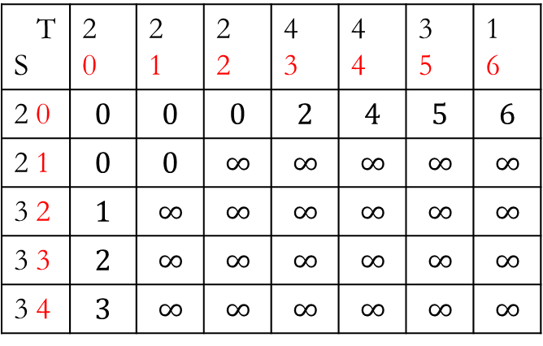
Cost matrix DTW matrix
T S | 2 0 | 2 1 | 2 2 | 4 3 | 4 4 | 3 5 | 1 6
2 0 | $$0$$ | $$0$$ | $$0$$ | $$2$$ | $$2$$ | $$1$$ | $$1$$
2 1 | $$0$$ | $$0$$ | $$0$$ | $$2$$ | $$2$$ | $$1$$ | $$1$$
3 2 | $$1$$ | $$1$$ | $$1$$ | $$1$$ | $$1$$ | $$0$$ | $$2$$
3 3 | $$1$$ | $$1$$ | $$1$$ | $$1$$ | $$1$$ | $$0$$ | $$2$$
3 4 | $$1$$ | $$1$$ | $$1$$ | $$1$$ | $$1$$ | $$0$$ | $$2$$
T S | 2 0 | 2 1 | 2 2 | 4 3 | 4 4 | 3 5 | 1 6
2 0 | $$0$$ | $$0$$ | $$0$$ | $$2$$ | $$4$$ | $$5$$ | $$6$$
2 1 | $$0$$ | $$0$$ | $$∞$$ | $$∞$$ | $$∞$$ | $$∞$$ | $$∞$$
3 2 | $$1$$ | $$∞$$ | $$∞$$ | $$∞$$ | $$∞$$ | $$∞$$ | $$∞$$
3 3 | $$2$$ | $$∞$$ | $$∞$$ | $$∞$$ | $$∞$$ | $$∞$$ | $$∞$$
3 4 | $$3$$ | $$∞$$ | $$∞$$ | $$∞$$ | $$∞$$ | $$∞$$ | $$∞$$

Slide 38
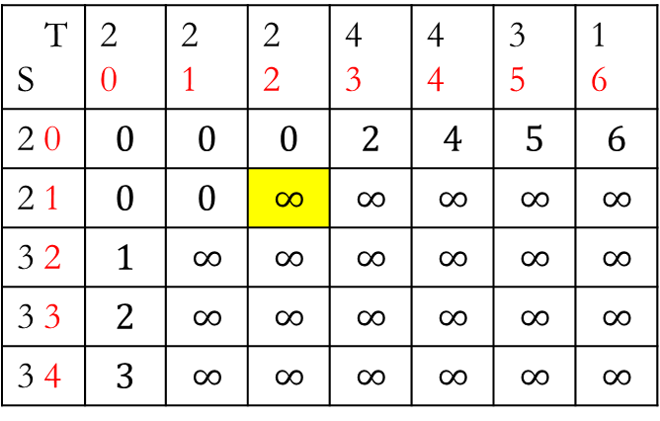

Cost matrix DTW matrix
T S | 2 0 | 2 1 | 2 2 | 4 3 | 4 4 | 3 5 | 1 6
2 0 | $$0$$ | $$0$$ | $$0$$ | $$2$$ | $$2$$ | $$1$$ | $$1$$
2 1 | $$0$$ | $$0$$ | $$0$$ | $$2$$ | $$2$$ | $$1$$ | $$1$$
3 2 | $$1$$ | $$1$$ | $$1$$ | $$1$$ | $$1$$ | $$0$$ | $$2$$
3 3 | $$1$$ | $$1$$ | $$1$$ | $$1$$ | $$1$$ | $$0$$ | $$2$$
3 4 | $$1$$ | $$1$$ | $$1$$ | $$1$$ | $$1$$ | $$0$$ | $$2$$
T S | 2 0 | 2 1 | 2 2 | 4 3 | 4 4 | 3 5 | 1 6
2 0 | $$0$$ | $$0$$ | $$0$$ | $$2$$ | $$4$$ | $$5$$ | $$6$$
2 1 | $$0$$ | $$0$$ | $$∞$$ | $$∞$$ | $$∞$$ | $$∞$$ | $$∞$$
3 2 | $$1$$ | $$∞$$ | $$∞$$ | $$∞$$ | $$∞$$ | $$∞$$ | $$∞$$
3 3 | $$2$$ | $$∞$$ | $$∞$$ | $$∞$$ | $$∞$$ | $$∞$$ | $$∞$$
3 4 | $$3$$ | $$∞$$ | $$∞$$ | $$∞$$ | $$∞$$ | $$∞$$ | $$∞$$

Slide 39
Cost matrix DTW matrix
T S | 2 0 | 2 1 | 2 2 | 4 3 | 4 4 | 3 5 | 1 6
2 0 | $$0$$ | $$0$$ | $$0$$ | $$2$$ | $$2$$ | $$1$$ | $$1$$
2 1 | $$0$$ | $$0$$ | $$0$$ | $$2$$ | $$2$$ | $$1$$ | $$1$$
3 2 | $$1$$ | $$1$$ | $$1$$ | $$1$$ | $$1$$ | $$0$$ | $$2$$
3 3 | $$1$$ | $$1$$ | $$1$$ | $$1$$ | $$1$$ | $$0$$ | $$2$$
3 4 | $$1$$ | $$1$$ | $$1$$ | $$1$$ | $$1$$ | $$0$$ | $$2$$
T S | 2 0 | 2 1 | 2 2 | 4 3 | 4 4 | 3 5 | 1 6
2 0 | $$0$$ | $$0$$ | $$0$$ | $$2$$ | $$4$$ | $$5$$ | $$6$$
2 1 | $$0$$ | $$0$$ | $$∞$$ | $$∞$$ | $$∞$$ | $$∞$$ | $$∞$$
3 2 | $$1$$ | $$∞$$ | $$∞$$ | $$∞$$ | $$∞$$ | $$∞$$ | $$∞$$
3 3 | $$2$$ | $$∞$$ | $$∞$$ | $$∞$$ | $$∞$$ | $$∞$$ | $$∞$$
3 4 | $$3$$ | $$∞$$ | $$∞$$ | $$∞$$ | $$∞$$ | $$∞$$ | $$∞$$

Slide 40

Cost matrix DTW matrix
T S | 2 0 | 2 1 | 2 2 | 4 3 | 4 4 | 3 5 | 1 6
2 0 | $$0$$ | $$0$$ | $$0$$ | $$2$$ | $$2$$ | $$1$$ | $$1$$
2 1 | $$0$$ | $$0$$ | $$0$$ | $$2$$ | $$2$$ | $$1$$ | $$1$$
3 2 | $$1$$ | $$1$$ | $$1$$ | $$1$$ | $$1$$ | $$0$$ | $$2$$
3 3 | $$1$$ | $$1$$ | $$1$$ | $$1$$ | $$1$$ | $$0$$ | $$2$$
3 4 | $$1$$ | $$1$$ | $$1$$ | $$1$$ | $$1$$ | $$0$$ | $$2$$
T S | 2 0 | 2 1 | 2 2 | 4 3 | 4 4 | 3 5 | 1 6
2 0 | $$0$$ | $$0$$ | $$0$$ | $$2$$ | $$4$$ | $$5$$ | $$6$$
2 1 | $$0$$ | $$0$$ | $$0$$ | $$∞$$ | $$∞$$ | $$∞$$ | $$∞$$
3 2 | $$1$$ | $$∞$$ | $$∞$$ | $$∞$$ | $$∞$$ | $$∞$$ | $$∞$$
3 3 | $$2$$ | $$∞$$ | $$∞$$ | $$∞$$ | $$∞$$ | $$∞$$ | $$∞$$
3 4 | $$3$$ | $$∞$$ | $$∞$$ | $$∞$$ | $$∞$$ | $$∞$$ | $$∞$$

Slide 41
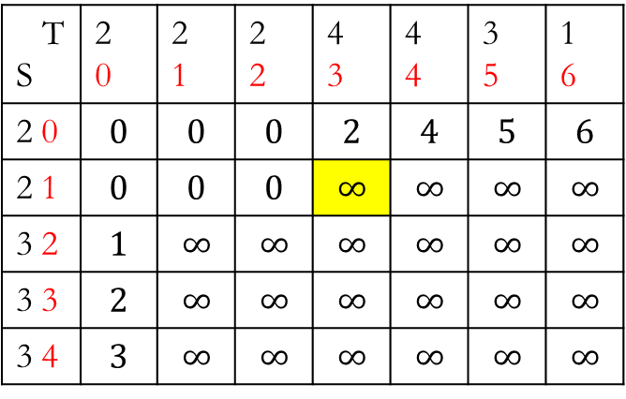
Cost matrix DTW matrix
T S | 2 0 | 2 1 | 2 2 | 4 3 | 4 4 | 3 5 | 1 6
2 0 | $$0$$ | $$0$$ | $$0$$ | $$2$$ | $$2$$ | $$1$$ | $$1$$
2 1 | $$0$$ | $$0$$ | $$0$$ | $$2$$ | $$2$$ | $$1$$ | $$1$$
3 2 | $$1$$ | $$1$$ | $$1$$ | $$1$$ | $$1$$ | $$0$$ | $$2$$
3 3 | $$1$$ | $$1$$ | $$1$$ | $$1$$ | $$1$$ | $$0$$ | $$2$$
3 4 | $$1$$ | $$1$$ | $$1$$ | $$1$$ | $$1$$ | $$0$$ | $$2$$
T S | 2 0 | 2 1 | 2 2 | 4 3 | 4 4 | 3 5 | 1 6
2 0 | $$0$$ | $$0$$ | $$0$$ | $$2$$ | $$4$$ | $$5$$ | $$6$$
2 1 | $$0$$ | $$0$$ | $$0$$ | $$∞$$ | $$∞$$ | $$∞$$ | $$∞$$
3 2 | $$1$$ | $$∞$$ | $$∞$$ | $$∞$$ | $$∞$$ | $$∞$$ | $$∞$$
3 3 | $$2$$ | $$∞$$ | $$∞$$ | $$∞$$ | $$∞$$ | $$∞$$ | $$∞$$
3 4 | $$3$$ | $$∞$$ | $$∞$$ | $$∞$$ | $$∞$$ | $$∞$$ | $$∞$$

Slide 42

Loss matrix DTW matrix
T S | 2 0 | 2 1 | 2 2 | 4 3 | 4 4 | 3 5 | 1 6
2 0 | $$0$$ | $$0$$ | $$0$$ | $$2$$ | $$2$$ | $$1$$ | $$1$$
2 1 | $$0$$ | $$0$$ | $$0$$ | $$2$$ | $$2$$ | $$1$$ | $$1$$
3 2 | $$1$$ | $$1$$ | $$1$$ | $$1$$ | $$1$$ | $$0$$ | $$2$$
3 3 | $$1$$ | $$1$$ | $$1$$ | $$1$$ | $$1$$ | $$0$$ | $$2$$
3 4 | $$1$$ | $$1$$ | $$1$$ | $$1$$ | $$1$$ | $$0$$ | $$2$$
T S | 2 0 | 2 1 | 2 2 | 4 3 | 4 4 | 3 5 | 1 6
2 0 | $$0$$ | $$0$$ | $$0$$ | $$2$$ | $$4$$ | $$5$$ | $$6$$
2 1 | $$0$$ | $$0$$ | $$0$$ | $$∞$$ | $$∞$$ | $$∞$$ | $$∞$$
3 2 | $$1$$ | $$∞$$ | $$∞$$ | $$∞$$ | $$∞$$ | $$∞$$ | $$∞$$
3 3 | $$2$$ | $$∞$$ | $$∞$$ | $$∞$$ | $$∞$$ | $$∞$$ | $$∞$$
3 4 | $$3$$ | $$∞$$ | $$∞$$ | $$∞$$ | $$∞$$ | $$∞$$ | $$∞$$

Slide 43

Cost matrix DTW matrix
T S | 2 0 | 2 1 | 2 2 | 4 3 | 4 4 | 3 5 | 1 6
2 0 | $$0$$ | $$0$$ | $$0$$ | $$2$$ | $$2$$ | $$1$$ | $$1$$
2 1 | $$0$$ | $$0$$ | $$0$$ | $$2$$ | $$2$$ | $$1$$ | $$1$$
3 2 | $$1$$ | $$1$$ | $$1$$ | $$1$$ | $$1$$ | $$0$$ | $$2$$
3 3 | $$1$$ | $$1$$ | $$1$$ | $$1$$ | $$1$$ | $$0$$ | $$2$$
3 4 | $$1$$ | $$1$$ | $$1$$ | $$1$$ | $$1$$ | $$0$$ | $$2$$
T S | 2 0 | 2 1 | 2 2 | 4 3 | 4 4 | 3 5 | 1 6
2 0 | $$0$$ | $$0$$ | $$0$$ | $$2$$ | $$4$$ | $$5$$ | $$6$$
2 1 | $$0$$ | $$0$$ | $$0$$ | $$2$$ | $$∞$$ | $$∞$$ | $$∞$$
3 2 | $$1$$ | $$∞$$ | $$∞$$ | $$∞$$ | $$∞$$ | $$∞$$ | $$∞$$
3 3 | $$2$$ | $$∞$$ | $$∞$$ | $$∞$$ | $$∞$$ | $$∞$$ | $$∞$$
3 4 | $$3$$ | $$∞$$ | $$∞$$ | $$∞$$ | $$∞$$ | $$∞$$ | $$∞$$

Slide 44
Cost matrix DTW matrix
T S | 2 0 | 2 1 | 2 2 | 4 3 | 4 4 | 3 5 | 1 6
2 0 | $$0$$ | $$0$$ | $$0$$ | $$2$$ | $$2$$ | $$1$$ | $$1$$
2 1 | $$0$$ | $$0$$ | $$0$$ | $$2$$ | $$2$$ | $$1$$ | $$1$$
3 2 | $$1$$ | $$1$$ | $$1$$ | $$1$$ | $$1$$ | $$0$$ | $$2$$
3 3 | $$1$$ | $$1$$ | $$1$$ | $$1$$ | $$1$$ | $$0$$ | $$2$$
3 4 | $$1$$ | $$1$$ | $$1$$ | $$1$$ | $$1$$ | $$0$$ | $$2$$
T S | 2 0 | 2 1 | 2 2 | 4 3 | 4 4 | 3 5 | 1 6
2 0 | $$0$$ | $$0$$ | $$0$$ | $$2$$ | $$4$$ | $$5$$ | $$6$$
2 1 | $$0$$ | $$0$$ | $$0$$ | $$2$$ | $$∞$$ | $$∞$$ | $$∞$$
3 2 | $$1$$ | $$∞$$ | $$∞$$ | $$∞$$ | $$∞$$ | $$∞$$ | $$∞$$
3 3 | $$2$$ | $$∞$$ | $$∞$$ | $$∞$$ | $$∞$$ | $$∞$$ | $$∞$$
3 4 | $$3$$ | $$∞$$ | $$∞$$ | $$∞$$ | $$∞$$ | $$∞$$ | $$∞$$

Slide 45

Cost matrix DTW matrix
T S | 2 0 | 2 1 | 2 2 | 4 3 | 4 4 | 3 5 | 1 6
2 0 | $$0$$ | $$0$$ | $$0$$ | $$2$$ | $$2$$ | $$1$$ | $$1$$
2 1 | $$0$$ | $$0$$ | $$0$$ | $$2$$ | $$2$$ | $$1$$ | $$1$$
3 2 | $$1$$ | $$1$$ | $$1$$ | $$1$$ | $$1$$ | $$0$$ | $$2$$
3 3 | $$1$$ | $$1$$ | $$1$$ | $$1$$ | $$1$$ | $$0$$ | $$2$$
3 4 | $$1$$ | $$1$$ | $$1$$ | $$1$$ | $$1$$ | $$0$$ | $$2$$
T S | 2 0 | 2 1 | 2 2 | 4 3 | 4 4 | 3 5 | 1 6
2 0 | $$0$$ | $$0$$ | $$0$$ | $$2$$ | $$4$$ | $$5$$ | $$6$$
2 1 | $$0$$ | $$0$$ | $$0$$ | $$2$$ | $$∞$$ | $$∞$$ | $$∞$$
3 2 | $$1$$ | $$∞$$ | $$∞$$ | $$∞$$ | $$∞$$ | $$∞$$ | $$∞$$
3 3 | $$2$$ | $$∞$$ | $$∞$$ | $$∞$$ | $$∞$$ | $$∞$$ | $$∞$$
3 4 | $$3$$ | $$∞$$ | $$∞$$ | $$∞$$ | $$∞$$ | $$∞$$ | $$∞$$

Slide 46
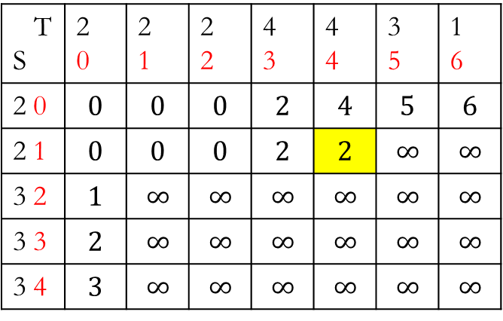
Cost matrix DTW matrix
T S | 2 0 | 2 1 | 2 2 | 4 3 | 4 4 | 3 5 | 1 6
2 0 | $$0$$ | $$0$$ | $$0$$ | $$2$$ | $$2$$ | $$1$$ | $$1$$
2 1 | $$0$$ | $$0$$ | $$0$$ | $$2$$ | $$2$$ | $$1$$ | $$1$$
3 2 | $$1$$ | $$1$$ | $$1$$ | $$1$$ | $$1$$ | $$0$$ | $$2$$
3 3 | $$1$$ | $$1$$ | $$1$$ | $$1$$ | $$1$$ | $$0$$ | $$2$$
3 4 | $$1$$ | $$1$$ | $$1$$ | $$1$$ | $$1$$ | $$0$$ | $$2$$
T S | 2 0 | 2 1 | 2 2 | 4 3 | 4 4 | 3 5 | 1 6
2 0 | $$0$$ | $$0$$ | $$0$$ | $$2$$ | $$4$$ | $$5$$ | $$6$$
2 1 | $$0$$ | $$0$$ | $$0$$ | $$2$$ | $$2$$ | $$∞$$ | $$∞$$
3 2 | $$1$$ | $$∞$$ | $$∞$$ | $$∞$$ | $$∞$$ | $$∞$$ | $$∞$$
3 3 | $$2$$ | $$∞$$ | $$∞$$ | $$∞$$ | $$∞$$ | $$∞$$ | $$∞$$
3 4 | $$3$$ | $$∞$$ | $$∞$$ | $$∞$$ | $$∞$$ | $$∞$$ | $$∞$$

Slide 47
Cost matrix DTW matrix
T S | 2 0 | 2 1 | 2 2 | 4 3 | 4 4 | 3 5 | 1 6
2 0 | $$0$$ | $$0$$ | $$0$$ | $$2$$ | $$2$$ | $$1$$ | $$1$$
2 1 | $$0$$ | $$0$$ | $$0$$ | $$2$$ | $$2$$ | $$1$$ | $$1$$
3 2 | $$1$$ | $$1$$ | $$1$$ | $$1$$ | $$1$$ | $$0$$ | $$2$$
3 3 | $$1$$ | $$1$$ | $$1$$ | $$1$$ | $$1$$ | $$0$$ | $$2$$
3 4 | $$1$$ | $$1$$ | $$1$$ | $$1$$ | $$1$$ | $$0$$ | $$2$$
T S | 2 0 | 2 1 | 2 2 | 4 3 | 4 4 | 3 5 | 1 6
2 0 | $$0$$ | $$0$$ | $$0$$ | $$2$$ | $$4$$ | $$5$$ | $$6$$
2 1 | $$0$$ | $$0$$ | $$0$$ | $$2$$ | $$2$$ | $$∞$$ | $$∞$$
3 2 | $$1$$ | $$∞$$ | $$∞$$ | $$∞$$ | $$∞$$ | $$∞$$ | $$∞$$
3 3 | $$2$$ | $$∞$$ | $$∞$$ | $$∞$$ | $$∞$$ | $$∞$$ | $$∞$$
3 4 | $$3$$ | $$∞$$ | $$∞$$ | $$∞$$ | $$∞$$ | $$∞$$ | $$∞$$

Slide 48

Cost matrix DTW matrix
T S | 2 0 | 2 1 | 2 2 | 4 3 | 4 4 | 3 5 | 1 6
2 0 | $$0$$ | $$0$$ | $$0$$ | $$2$$ | $$2$$ | $$1$$ | $$1$$
2 1 | $$0$$ | $$0$$ | $$0$$ | $$2$$ | $$2$$ | $$1$$ | $$1$$
3 2 | $$1$$ | $$1$$ | $$1$$ | $$1$$ | $$1$$ | $$0$$ | $$2$$
3 3 | $$1$$ | $$1$$ | $$1$$ | $$1$$ | $$1$$ | $$0$$ | $$2$$
3 4 | $$1$$ | $$1$$ | $$1$$ | $$1$$ | $$1$$ | $$0$$ | $$2$$
T S | 2 0 | 2 1 | 2 2 | 4 3 | 4 4 | 3 5 | 1 6
2 0 | $$0$$ | $$0$$ | $$0$$ | $$2$$ | $$4$$ | $$5$$ | $$6$$
2 1 | $$0$$ | $$0$$ | $$0$$ | $$2$$ | $$4$$ | $$∞$$ | $$∞$$
3 2 | $$1$$ | $$∞$$ | $$∞$$ | $$∞$$ | $$∞$$ | $$∞$$ | $$∞$$
3 3 | $$2$$ | $$∞$$ | $$∞$$ | $$∞$$ | $$∞$$ | $$∞$$ | $$∞$$
3 4 | $$3$$ | $$∞$$ | $$∞$$ | $$∞$$ | $$∞$$ | $$∞$$ | $$∞$$

Slide 49
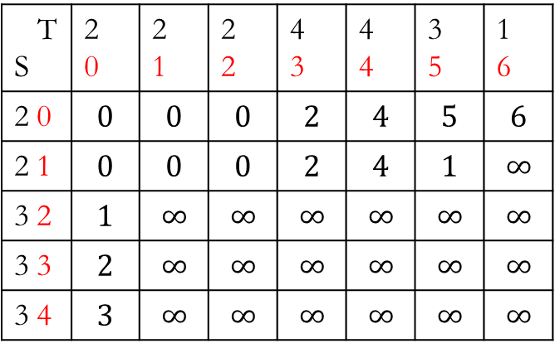
Cost matrix DTW matrix
T S | 2 0 | 2 1 | 2 2 | 4 3 | 4 4 | 3 5 | 1 6
2 0 | $$0$$ | $$0$$ | $$0$$ | $$2$$ | $$2$$ | $$1$$ | $$1$$
2 1 | $$0$$ | $$0$$ | $$0$$ | $$2$$ | $$2$$ | $$1$$ | $$1$$
3 2 | $$1$$ | $$1$$ | $$1$$ | $$1$$ | $$1$$ | $$0$$ | $$2$$
3 3 | $$1$$ | $$1$$ | $$1$$ | $$1$$ | $$1$$ | $$0$$ | $$2$$
3 4 | $$1$$ | $$1$$ | $$1$$ | $$1$$ | $$1$$ | $$0$$ | $$2$$
T S | 2 0 | 2 1 | 2 2 | 4 3 | 4 4 | 3 5 | 1 6
2 0 | $$0$$ | $$0$$ | $$0$$ | $$2$$ | $$4$$ | $$5$$ | $$6$$
2 1 | $$0$$ | $$0$$ | $$0$$ | $$2$$ | $$4$$ | $$1$$ | $$∞$$
3 2 | $$1$$ | $$∞$$ | $$∞$$ | $$∞$$ | $$∞$$ | $$∞$$ | $$∞$$
3 3 | $$2$$ | $$∞$$ | $$∞$$ | $$∞$$ | $$∞$$ | $$∞$$ | $$∞$$
3 4 | $$3$$ | $$∞$$ | $$∞$$ | $$∞$$ | $$∞$$ | $$∞$$ | $$∞$$

Slide 50
Cost matrix DTW matrix
T S | 2 0 | 2 1 | 2 2 | 4 3 | 4 4 | 3 5 | 1 6
2 0 | $$0$$ | $$0$$ | $$0$$ | $$2$$ | $$2$$ | $$1$$ | $$1$$
2 1 | $$0$$ | $$0$$ | $$0$$ | $$2$$ | $$2$$ | $$1$$ | $$1$$
3 2 | $$1$$ | $$1$$ | $$1$$ | $$1$$ | $$1$$ | $$0$$ | $$2$$
3 3 | $$1$$ | $$1$$ | $$1$$ | $$1$$ | $$1$$ | $$0$$ | $$2$$
3 4 | $$1$$ | $$1$$ | $$1$$ | $$1$$ | $$1$$ | $$0$$ | $$2$$
T S | 2 0 | 2 1 | 2 2 | 4 3 | 4 4 | 3 5 | 1 6
2 0 | $$0$$ | $$0$$ | $$0$$ | $$2$$ | $$4$$ | $$5$$ | $$6$$
2 1 | $$0$$ | $$0$$ | $$0$$ | $$2$$ | $$4$$ | $$1$$ | $$∞$$
3 2 | $$1$$ | $$∞$$ | $$∞$$ | $$∞$$ | $$∞$$ | $$∞$$ | $$∞$$
3 3 | $$2$$ | $$∞$$ | $$∞$$ | $$∞$$ | $$∞$$ | $$∞$$ | $$∞$$
3 4 | $$3$$ | $$∞$$ | $$∞$$ | $$∞$$ | $$∞$$ | $$∞$$ | $$∞$$

Slide 51

Cost matrix DTW matrix
T S | 2 0 | 2 1 | 2 2 | 4 3 | 4 4 | 3 5 | 1 6
2 0 | $$0$$ | $$0$$ | $$0$$ | $$2$$ | $$2$$ | $$1$$ | $$1$$
2 1 | $$0$$ | $$0$$ | $$0$$ | $$2$$ | $$2$$ | $$1$$ | $$1$$
3 2 | $$1$$ | $$1$$ | $$1$$ | $$1$$ | $$1$$ | $$0$$ | $$2$$
3 3 | $$1$$ | $$1$$ | $$1$$ | $$1$$ | $$1$$ | $$0$$ | $$2$$
3 4 | $$1$$ | $$1$$ | $$1$$ | $$1$$ | $$1$$ | $$0$$ | $$2$$
T S | 2 0 | 2 1 | 2 2 | 4 3 | 4 4 | 3 5 | 1 6
2 0 | $$0$$ | $$0$$ | $$0$$ | $$2$$ | $$4$$ | $$5$$ | $$6$$
2 1 | $$0$$ | $$0$$ | $$0$$ | $$2$$ | $$4$$ | $$5$$ | $$∞$$
3 2 | $$1$$ | $$∞$$ | $$∞$$ | $$∞$$ | $$∞$$ | $$∞$$ | $$∞$$
3 3 | $$2$$ | $$∞$$ | $$∞$$ | $$∞$$ | $$∞$$ | $$∞$$ | $$∞$$
3 4 | $$3$$ | $$∞$$ | $$∞$$ | $$∞$$ | $$∞$$ | $$∞$$ | $$∞$$

Slide 52

Cost matrix DTW matrix
T S | 2 0 | 2 1 | 2 2 | 4 3 | 4 4 | 3 5 | 1 6
2 0 | $$0$$ | $$0$$ | $$0$$ | $$2$$ | $$2$$ | $$1$$ | $$1$$
2 1 | $$0$$ | $$0$$ | $$0$$ | $$2$$ | $$2$$ | $$1$$ | $$1$$
3 2 | $$1$$ | $$1$$ | $$1$$ | $$1$$ | $$1$$ | $$0$$ | $$2$$
3 3 | $$1$$ | $$1$$ | $$1$$ | $$1$$ | $$1$$ | $$0$$ | $$2$$
3 4 | $$1$$ | $$1$$ | $$1$$ | $$1$$ | $$1$$ | $$0$$ | $$2$$
T S | 2 0 | 2 1 | 2 2 | 4 3 | 4 4 | 3 5 | 1 6
2 0 | $$0$$ | $$0$$ | $$0$$ | $$2$$ | $$4$$ | $$5$$ | $$6$$
2 1 | $$0$$ | $$0$$ | $$0$$ | $$2$$ | $$4$$ | $$5$$ | $$1$$
3 2 | $$1$$ | $$∞$$ | $$∞$$ | $$∞$$ | $$∞$$ | $$∞$$ | $$∞$$
3 3 | $$2$$ | $$∞$$ | $$∞$$ | $$∞$$ | $$∞$$ | $$∞$$ | $$∞$$
3 4 | $$3$$ | $$∞$$ | $$∞$$ | $$∞$$ | $$∞$$ | $$∞$$ | $$∞$$

Slide 53

Cost matrix DTW matrix
T S | 2 0 | 2 1 | 2 2 | 4 3 | 4 4 | 3 5 | 1 6
2 0 | $$0$$ | $$0$$ | $$0$$ | $$2$$ | $$2$$ | $$1$$ | $$1$$
2 1 | $$0$$ | $$0$$ | $$0$$ | $$2$$ | $$2$$ | $$1$$ | $$1$$
3 2 | $$1$$ | $$1$$ | $$1$$ | $$1$$ | $$1$$ | $$0$$ | $$2$$
3 3 | $$1$$ | $$1$$ | $$1$$ | $$1$$ | $$1$$ | $$0$$ | $$2$$
3 4 | $$1$$ | $$1$$ | $$1$$ | $$1$$ | $$1$$ | $$0$$ | $$2$$
T S | 2 0 | 2 1 | 2 2 | 4 3 | 4 4 | 3 5 | 1 6
2 0 | $$0$$ | $$0$$ | $$0$$ | $$2$$ | $$4$$ | $$5$$ | $$6$$
2 1 | $$0$$ | $$0$$ | $$0$$ | $$2$$ | $$4$$ | $$5$$ | $$6$$
3 2 | $$1$$ | $$∞$$ | $$∞$$ | $$∞$$ | $$∞$$ | $$∞$$ | $$∞$$
3 3 | $$2$$ | $$∞$$ | $$∞$$ | $$∞$$ | $$∞$$ | $$∞$$ | $$∞$$
3 4 | $$3$$ | $$∞$$ | $$∞$$ | $$∞$$ | $$∞$$ | $$∞$$ | $$∞$$

Slide 54

Cost matrix DTW matrix
T S | 2 0 | 2 1 | 2 2 | 4 3 | 4 4 | 3 5 | 1 6
2 0 | $$0$$ | $$0$$ | $$0$$ | $$2$$ | $$2$$ | $$1$$ | $$1$$
2 1 | $$0$$ | $$0$$ | $$0$$ | $$2$$ | $$2$$ | $$1$$ | $$1$$
3 2 | $$1$$ | $$1$$ | $$1$$ | $$1$$ | $$1$$ | $$0$$ | $$2$$
3 3 | $$1$$ | $$1$$ | $$1$$ | $$1$$ | $$1$$ | $$0$$ | $$2$$
3 4 | $$1$$ | $$1$$ | $$1$$ | $$1$$ | $$1$$ | $$0$$ | $$2$$
T S | 2 0 | 2 1 | 2 2 | 4 3 | 4 4 | 3 5 | 1 6
2 0 | $$0$$ | $$0$$ | $$0$$ | $$2$$ | $$4$$ | $$5$$ | $$6$$
2 1 | $$0$$ | $$0$$ | $$0$$ | $$2$$ | $$4$$ | $$5$$ | $$6$$
3 2 | $$1$$ | $$1$$ | $$1$$ | $$1$$ | $$2$$ | $$2$$ | $$4$$
3 3 | $$2$$ | $$2$$ | $$2$$ | $$2$$ | $$2$$ | $$2$$ | $$4$$
3 4 | $$3$$ | $$3$$ | $$3$$ | $$3$$ | $$3$$ | $$2$$ | $$4$$

Slide 55
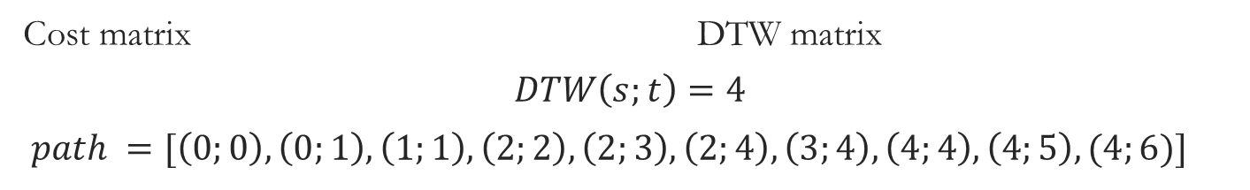
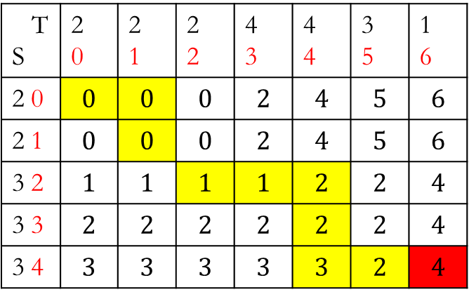
Cost matrix DTW matrix
$$DTW\left(s;t\right)=4$$
$path =[\left(0;0\right),\left(0;1\right),\left(1;1\right),\left(2;2\right),\left(2;3\right),\left(2;4\right),\left(3;4\right),\left(4;4\right),\left(4;5\right),(4;6)]$
T S | 2 0 | 2 1 | 2 2 | 4 3 | 4 4 | 3 5 | 1 6
2 0 | $$0$$ | $$0$$ | $$0$$ | $$2$$ | $$2$$ | $$1$$ | $$1$$
2 1 | $$0$$ | $$0$$ | $$0$$ | $$2$$ | $$2$$ | $$1$$ | $$1$$
3 2 | $$1$$ | $$1$$ | $$1$$ | $$1$$ | $$1$$ | $$0$$ | $$2$$
3 3 | $$1$$ | $$1$$ | $$1$$ | $$1$$ | $$1$$ | $$0$$ | $$2$$
3 4 | $$1$$ | $$1$$ | $$1$$ | $$1$$ | $$1$$ | $$0$$ | $$2$$
T S | 2 0 | 2 1 | 2 2 | 4 3 | 4 4 | 3 5 | 1 6
2 0 | $$0$$ | $$0$$ | $$0$$ | $$2$$ | $$4$$ | $$5$$ | $$6$$
2 1 | $$0$$ | $$0$$ | $$0$$ | $$2$$ | $$4$$ | $$5$$ | $$6$$
3 2 | $$1$$ | $$1$$ | $$1$$ | $$1$$ | $$2$$ | $$2$$ | $$4$$
3 3 | $$2$$ | $$2$$ | $$2$$ | $$2$$ | $$2$$ | $$2$$ | $$4$$
3 4 | $$3$$ | $$3$$ | $$3$$ | $$3$$ | $$3$$ | $$2$$ | $$4$$

Slide 56
Cost matrix DTW matrix
$$DTW\left(s;t\right)=4$$
$path =[\left(0;0\right),\left(0;1\right),\left(1;1\right),\left(2;2\right),\left(2;3\right),\left(2;4\right),\left(3;4\right),\left(4;4\right),\left(4;5\right),(4;6)]$
T S | 2 0 | 2 1 | 2 2 | 4 3 | 4 4 | 3 5 | 1 6
2 0 | $$0$$ | $$0$$ | $$0$$ | $$2$$ | $$2$$ | $$1$$ | $$1$$
2 1 | $$0$$ | $$0$$ | $$0$$ | $$2$$ | $$2$$ | $$1$$ | $$1$$
3 2 | $$1$$ | $$1$$ | $$1$$ | $$1$$ | $$1$$ | $$0$$ | $$2$$
3 3 | $$1$$ | $$1$$ | $$1$$ | $$1$$ | $$1$$ | $$0$$ | $$2$$
3 4 | $$1$$ | $$1$$ | $$1$$ | $$1$$ | $$1$$ | $$0$$ | $$2$$
T S | 2 0 | 2 1 | 2 2 | 4 3 | 4 4 | 3 5 | 1 6
2 0 | $$0$$ | $$0$$ | $$0$$ | $$2$$ | $$4$$ | $$5$$ | $$6$$
2 1 | $$0$$ | $$0$$ | $$0$$ | $$2$$ | $$4$$ | $$5$$ | $$6$$
3 2 | $$1$$ | $$1$$ | $$1$$ | $$1$$ | $$2$$ | $$2$$ | $$4$$
3 3 | $$2$$ | $$2$$ | $$2$$ | $$2$$ | $$2$$ | $$2$$ | $$4$$
3 4 | $$3$$ | $$3$$ | $$3$$ | $$3$$ | $$3$$ | $$2$$ | $$4$$

Slide 57
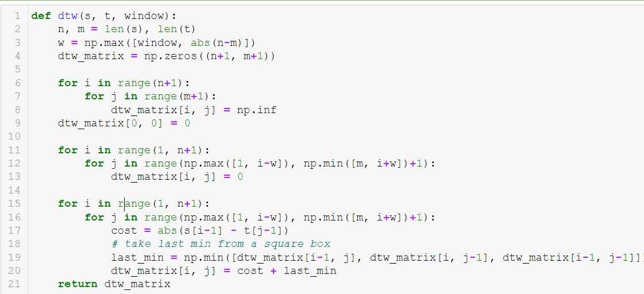
Реализация па Python

Slide 58

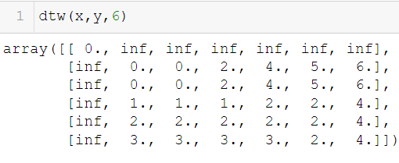
Реализация на Python

Slide 59





Path = warping function?
$$path =[\left(0;0\right),\left(0;1\right),\left(1;1\right),\left(2;2\right),\left(2;3\right),\left(2;4\right),\left(3;4\right),\left(4;4\right),\left(4;5\right),(4;6)]$$
T S | 2 0 | 2 1 | 2 2 | 4 3 | 4 4 | 3 5 | 1 6
2 0 | $$0$$ | $$0$$ | $$0$$ | $$2$$ | $$4$$ | $$5$$ | $$6$$
2 1 | $$0$$ | $$0$$ | $$0$$ | $$2$$ | $$4$$ | $$5$$ | $$6$$
3 2 | $$1$$ | $$1$$ | $$1$$ | $$1$$ | $$2$$ | $$2$$ | $$4$$
3 3 | $$2$$ | $$2$$ | $$2$$ | $$2$$ | $$2$$ | $$2$$ | $$4$$
3 4 | $$3$$ | $$3$$ | $$3$$ | $$3$$ | $$3$$ | $$2$$ | $$4$$
T S | 2 0 | 2 1 | 2 2 | 4 3 | 4 4 | 3 5 | 1 6
2 0 | $$0$$ | $$0$$ | $$0$$ | $$2$$ | $$4$$ | $$5$$ | $$6$$
2 1 | $$0$$ | $$0$$ | $$0$$ | $$2$$ | $$4$$ | $$5$$ | $$6$$
3 2 | $$1$$ | $$1$$ | $$1$$ | $$1$$ | $$2$$ | $$2$$ | $$4$$
3 3 | $$2$$ | $$2$$ | $$2$$ | $$2$$ | $$2$$ | $$2$$ | $$4$$
3 4 | $$3$$ | $$3$$ | $$3$$ | $$3$$ | $$3$$ | $$2$$ | $$4$$
$$x$$
$$y$$

Slide 60
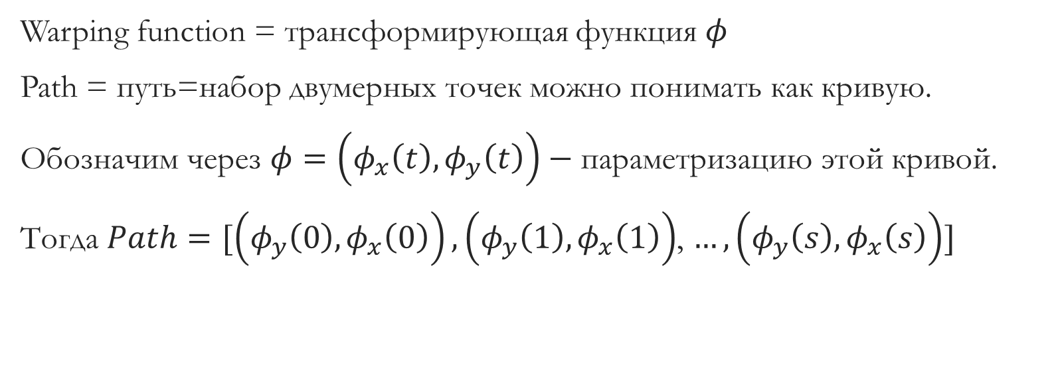
Пару замечаний об ограничениях на путь
Warping function = трансформирующая функция $φ$
Path = путь=набор двумерных точек можно понимать как кривую.
Обозначим через $φ=\left(φ_{x}\left(t\right), φ_{y}\left(t\right)\right)−$ параметризацию этой кривой.
Тогда $Path=[\left(φ_{y}\left(0\right), φ_{x}\left(0\right)\right),\left(φ_{y}\left(1\right), φ_{x}\left(1\right)\right)$, $…,\left(φ_{y}\left(s\right), φ_{x}\left(s\right)\right)]$

Slide 61

Пару замечаний об ограничениях на путь
$path=[\left(φ_{y}\left(0\right), φ_{x}\left(0\right)\right),\left(φ_{y}\left(1\right), φ_{x}\left(1\right)\right)$, $…,\left(φ_{y}\left(s\right), φ_{x}\left(s\right)\right)]$
$$path =[\left(0;0\right),\left(0;1\right),\left(1;1\right),\left(2;2\right),\left(2;3\right),\left(2;4\right),\left(3;4\right),\left(4;4\right),\left(4;5\right),(4;6)]$$

Slide 62
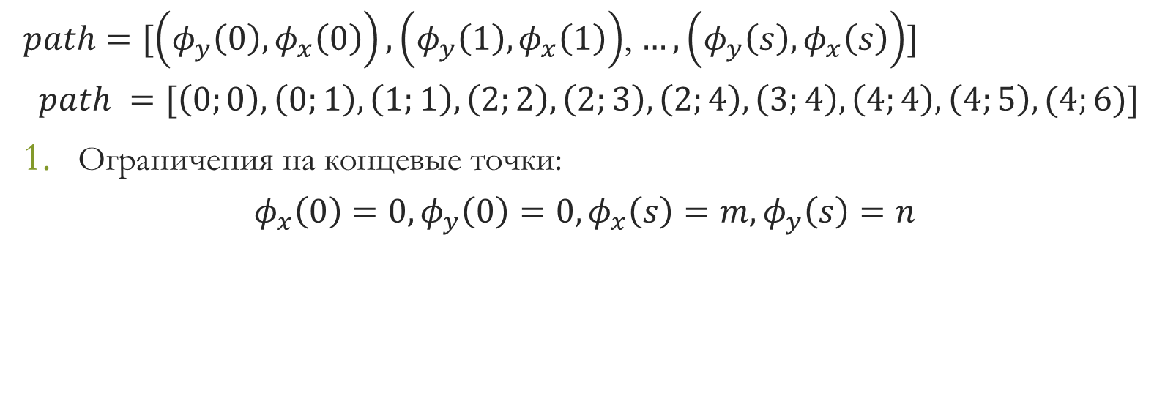
Пару замечаний об ограничениях на путь
$path=[\left(φ_{y}\left(0\right), φ_{x}\left(0\right)\right),\left(φ_{y}\left(1\right), φ_{x}\left(1\right)\right)$, $…,\left(φ_{y}\left(s\right), φ_{x}\left(s\right)\right)]$
$$path =[\left(0;0\right),\left(0;1\right),\left(1;1\right),\left(2;2\right),\left(2;3\right),\left(2;4\right),\left(3;4\right),\left(4;4\right),\left(4;5\right),(4;6)]$$
Ограничения на концевые точки:
$$φ_{x}\left(0\right)=0, φ_{y}\left(0\right)=0, φ_{x}\left(s\right)=m, φ_{y}\left(s\right)=n$$

Slide 63

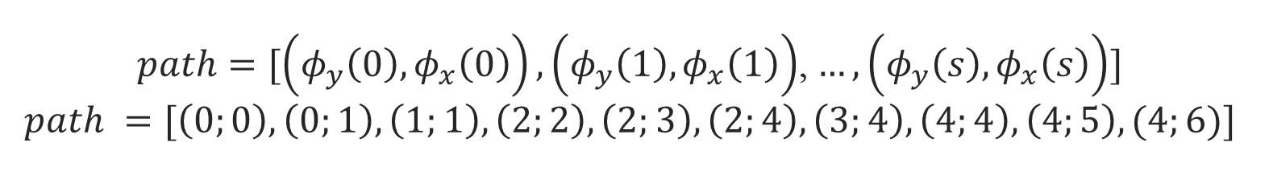
$path=[\left(φ_{y}\left(0\right), φ_{x}\left(0\right)\right),\left(φ_{y}\left(1\right), φ_{x}\left(1\right)\right)$, $…,\left(φ_{y}\left(s\right), φ_{x}\left(s\right)\right)]$ $$path =[\left(0;0\right),\left(0;1\right),\left(1;1\right),\left(2;2\right),\left(2;3\right),\left(2;4\right),\left(3;4\right),\left(4;4\right),\left(4;5\right),(4;6)]$$
2. Монотонность :
$$φ_{x}\left(t\right)≤φ_{x}\left(t+1\right), φ_{y}\left(t\right)≤φ_{y}\left(t+1\right)$$
$$path =[\left(0;0\right),\left(0;1\right),\left(1;1\right),\left(2;2\right),\left(2;3\right),\left(2;4\right),\left(3;4\right),\left(4;4\right),\left(4;5\right),(4;6)]$$

Slide 64




$path=[\left(φ_{y}\left(0\right), φ_{x}\left(0\right)\right),\left(φ_{y}\left(1\right), φ_{x}\left(1\right)\right)$, $…,\left(φ_{y}\left(s\right), φ_{x}\left(s\right)\right)]$ $$path =[\left(0;0\right),\left(0;1\right),\left(1;1\right),\left(2;2\right),\left(2;3\right),\left(2;4\right),\left(3;4\right),\left(4;4\right),\left(4;5\right),(4;6)]$$
2. Монотонность (рост координат):
$$φ_{x}\left(t\right)≤φ_{x}\left(t+1\right), φ_{y}\left(t\right)≤φ_{y}\left(t+1\right)$$
T S | 2 0 | 2 1 | 2 2 | 4 3 | 4 4 | 3 5 | 1 6
2 0 | $$0$$ | $$0$$ | $$0$$ | $$2$$ | $$4$$ | $$5$$ | $$6$$
2 1 | $$0$$ | $$0$$ | $$0$$ | $$2$$ | $$4$$ | $$5$$ | $$6$$
3 2 | $$1$$ | $$1$$ | $$1$$ | $$1$$ | $$2$$ | $$2$$ | $$4$$
3 3 | $$2$$ | $$2$$ | $$2$$ | $$2$$ | $$2$$ | $$2$$ | $$4$$
3 4 | $$3$$ | $$3$$ | $$3$$ | $$3$$ | $$3$$ | $$2$$ | $$4$$
$$x$$
$$y$$

Slide 65

$path=[\left(φ_{y}\left(0\right), φ_{x}\left(0\right)\right),\left(φ_{y}\left(1\right), φ_{x}\left(1\right)\right)$, $…,\left(φ_{y}\left(s\right), φ_{x}\left(s\right)\right)]$ $$path =[\left(0;0\right),\left(0;1\right),\left(1;1\right),\left(2;2\right),\left(2;3\right),\left(2;4\right),\left(3;4\right),\left(4;4\right),\left(4;5\right),(4;6)]$$
3. Рост координат не более чем на единицу:
$$φ_{x}\left(t+1\right)−φ_{x}\left(t\right)≤1, φ_{y}\left(t+1\right)−φ_{y}\left(t\right)≤1$$
T S | 2 0 | 2 1 | 2 2 | 4 3 | 4 4 | 3 5 | 1 6
2 0 | $$0$$ | $$0$$ | $$0$$ | $$2$$ | $$4$$ | $$5$$ | $$6$$
2 1 | $$0$$ | $$0$$ | $$0$$ | $$2$$ | $$4$$ | $$5$$ | $$6$$
3 2 | $$1$$ | $$1$$ | $$1$$ | $$1$$ | $$2$$ | $$2$$ | $$4$$
3 3 | $$2$$ | $$2$$ | $$2$$ | $$2$$ | $$2$$ | $$2$$ | $$4$$
3 4 | $$3$$ | $$3$$ | $$3$$ | $$3$$ | $$3$$ | $$2$$ | $$4$$
$$x$$
$$y$$

Slide 66
$path=[\left(φ_{y}\left(0\right), φ_{x}\left(0\right)\right),\left(φ_{y}\left(1\right), φ_{x}\left(1\right)\right)$, $…,\left(φ_{y}\left(s\right), φ_{x}\left(s\right)\right)]$ $$path =[\left(0;0\right),\left(0;1\right),\left(1;1\right),\left(2;2\right),\left(2;3\right),\left(2;4\right),\left(3;4\right),\left(4;4\right),\left(4;5\right),(4;6)]$$
3. Рост координат не более чем на единицу:
$$φ_{x}\left(t+1\right)−φ_{x}\left(t\right)≤1, φ_{y}\left(t+1\right)−φ_{y}\left(t\right)≤1$$
T S | 2 0 | 2 1 | 2 2 | 4 3 | 4 4 | 3 5 | 1 6
2 0 | $$0$$ | $$0$$ | $$0$$ | $$2$$ | $$4$$ | $$5$$ | $$6$$
2 1 | $$0$$ | $$0$$ | $$0$$ | $$2$$ | $$4$$ | $$5$$ | $$6$$
3 2 | $$1$$ | $$1$$ | $$1$$ | $$1$$ | $$2$$ | $$2$$ | $$4$$
3 3 | $$2$$ | $$2$$ | $$2$$ | $$2$$ | $$2$$ | $$2$$ | $$4$$
3 4 | $$3$$ | $$3$$ | $$3$$ | $$3$$ | $$3$$ | $$2$$ | $$4$$
$$x$$
$$y$$

Slide 67

$path=[\left(φ_{y}\left(0\right), φ_{x}\left(0\right)\right),\left(φ_{y}\left(1\right), φ_{x}\left(1\right)\right)$, $…,\left(φ_{y}\left(s\right), φ_{x}\left(s\right)\right)]$ $$path =[\left(0;0\right),\left(0;1\right),\left(1;1\right),\left(2;2\right),\left(2;3\right),\left(2;4\right),\left(3;4\right),\left(4;4\right),\left(4;5\right),(4;6)]$$
Свойства 2 и 3 можно записать компактно:
$$φ_{x}\left(t+1\right)−φ_{x}\left(t\right)≤1, φ_{y}\left(t+1\right)−φ_{y}\left(t\right)≤1$$

Slide 68

$path=[\left(φ_{y}\left(0\right), φ_{x}\left(0\right)\right),\left(φ_{y}\left(1\right), φ_{x}\left(1\right)\right)$, $…,\left(φ_{y}\left(s\right), φ_{x}\left(s\right)\right)]$ $$path =[\left(0;0\right),\left(0;1\right),\left(1;1\right),\left(2;2\right),\left(2;3\right),\left(2;4\right),\left(3;4\right),\left(4;4\right),\left(4;5\right),(4;6)]$$
Свойства 2 и 3 можно записать компактно:
$$0≤φ_{x}\left(t+1\right)−φ_{x}\left(t\right)≤1, {0≤φ}_{y}\left(t+1\right)−φ_{y}\left(t\right)≤1$$
T S | 2 0 | 2 1 | 2 2 | 4 3 | 4 4 | 3 5 | 1 6
2 0 | $$0$$ | $$0$$ | $$0$$ | $$2$$ | $$4$$ | $$5$$ | $$6$$
2 1 | $$0$$ | $$0$$ | $$0$$ | $$2$$ | $$4$$ | $$5$$ | $$6$$
3 2 | $$1$$ | $$1$$ | $$1$$ | $$1$$ | $$2$$ | $$2$$ | $$4$$
3 3 | $$2$$ | $$2$$ | $$2$$ | $$2$$ | $$2$$ | $$2$$ | $$4$$
3 4 | $$3$$ | $$3$$ | $$3$$ | $$3$$ | $$3$$ | $$2$$ | $$4$$
$$x$$
$$y$$

Slide 69
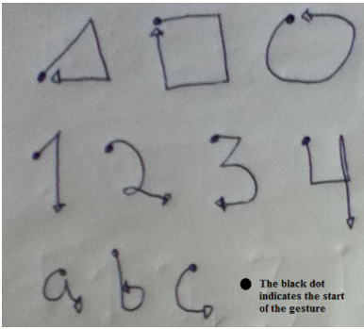
Распознавание жестов

Slide 70

$$Magnitude \left(\vec{a}\right)= \sqrt{a_{x}^{2}\left(t\right)+a_{y}^{2}\left(t\right)+a_{z}^{2}\left(t\right)}$$
$\vec{a}= \left(a_{x}\left(t\right),a_{y}\left(t\right),a_{z}\left(t\right)\right)−$ ускорения за время $t.$

Slide 71
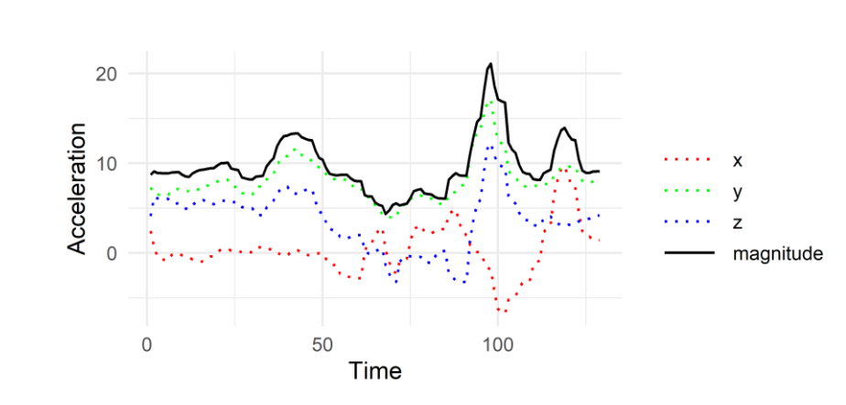
Графики координатных ускорений и магнитуды

Slide 72
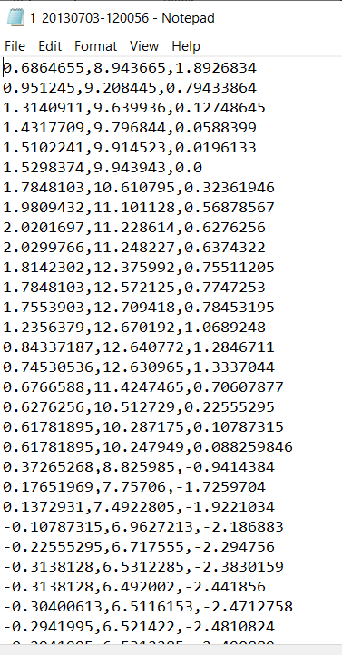
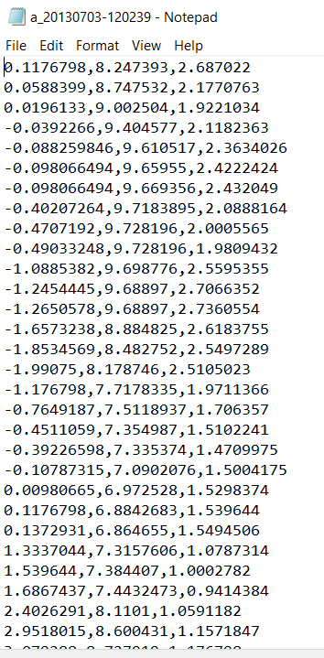
DTW
60 значений
82 значения

Slide 73
Для прогноза жеста берём его координаты из тестового датасета и вычисляем по всем остальным тренировочным наименьшее расстояние. Используя это расстояние и матрицу расстояний находим название класса
Prediction
DTW(query, Train)
Min, argmin = prediction
Ground truth

Slide 74
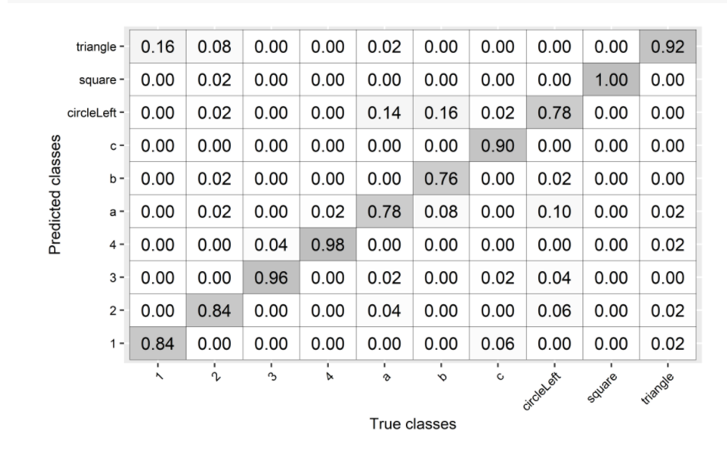
Confusion matrix/Матрица несооответствий

