Slide 1
Mathematical Methods of Solid Mechanics
Aliaksandr Radyna Assoc. Prof.
DUT-BSU Joint Institute

Slide 2
The plan of the control works
The course has 24 lessons
after 10th or 11th lesson I will give a first control work (25 score)
after 20th lesson I will give a second control work (25 score)
after 24th lesson I will give a final control work (50 score)
Total score will be derived by the results of above 3 works

Slide 3
Textbooks and References
Basic
[1] P.P.G. Dyke. An introduction to Laplace Transforms and Fourier series. Springer (2004).
[2] G. Tolstov. Fourier series. Dover Publications, Inc. (1976).
Advanced
[3] D.W. Kammler. A first course in Fourier Analysis. CUP (2008).
[4] R. Bracewell. The Fourier transform and its applications. 3ed MGH (2000)

Slide 4
Laplace Transform
Improper Riemann Integral

Slide 5
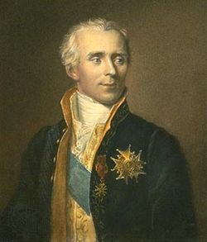
Pierre-Simon, marquis de Laplace 23 March 1749 – 5 March 1827)
was a French scholar and polymath whose work was important to the development of engineering, mathematics, statistics, physics, astronomy, and philosophy. He summarized and extended the work of his predecessors in his five-volume Mécanique Céleste (Celestial Mechanics) (1799–1825). This work translated the geometric study of classical mechanics to one based on calculus, opening up a broader range of problems. In statistics, the Bayesian interpretation of probability was developed mainly by Laplace.

Slide 6
Laplace formulated Laplace's equation, and pioneered the Laplace transform which appears in many branches of mathematical physics, a field that he took a leading role in forming. The Laplacian differential operator, widely used in mathematics, is also named after him. He restated and developed the nebular hypothesis of the origin of the Solar System and was one of the first scientists to postulate the existence of black holes and the notion of gravitational collapse.
Laplace is remembered as one of the greatest scientists of all time. Sometimes referred to as the French Newton or Newton of France, he has been described as possessing a phenomenal natural mathematical faculty superior to that of any of his contemporaries. He was Napoleon's examiner when Napoleon attended the École Militaire in Paris in 1784. Laplace became a count of the Empire in 1806 and was named a marquis in 1817, after the Bourbon Restoration. Details see in Wikipedia by the address https://en.wikipedia.org/wiki/Pierre-Simon_Laplace

Slide 7
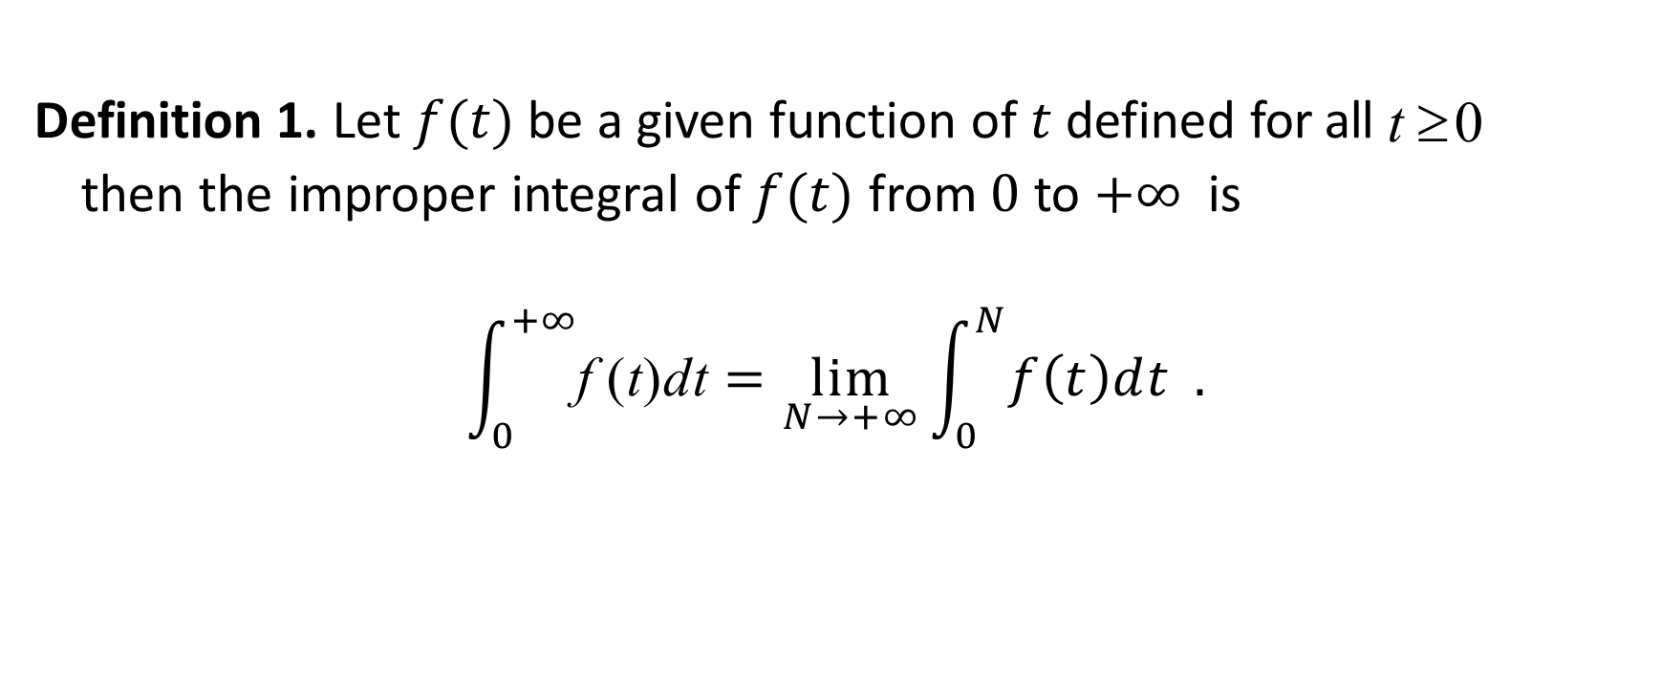
Definition of Improper Riemann Integral
Definition 1. Let $f(t)$ be a given function of $t$ defined for all t ≥ 0
then the improper integral of $f(t)$ from $0$ to $+∞$ is
$$\int_{0}^{+∞}{\text{f} \text{(}\text{t}\text{)}\text{dt}}=\lim_{N→+∞}\int_{0}^{N}{f\left(t\right)dt} .$$

Slide 8

Example 1. Let $f\left(t\right)=\frac{1}{1+t^{2}}.$ Than
$$\int_{0}^{+∞}{\frac{1}{1+t^{2}}dt=\lim_{N→+∞}{\int_{0}^{N}{\frac{1}{1+t^{2}}dt}}}$$
$$=\lim_{N→+∞}{\arctan{t{\left.​\right|}_{0}^{N}}}=\lim_{N→+∞}(arctan{N−\arctan{0)}}$$
$$=\lim_{N→+∞}\arctan{N=\frac{π}{2}}$$

Slide 9
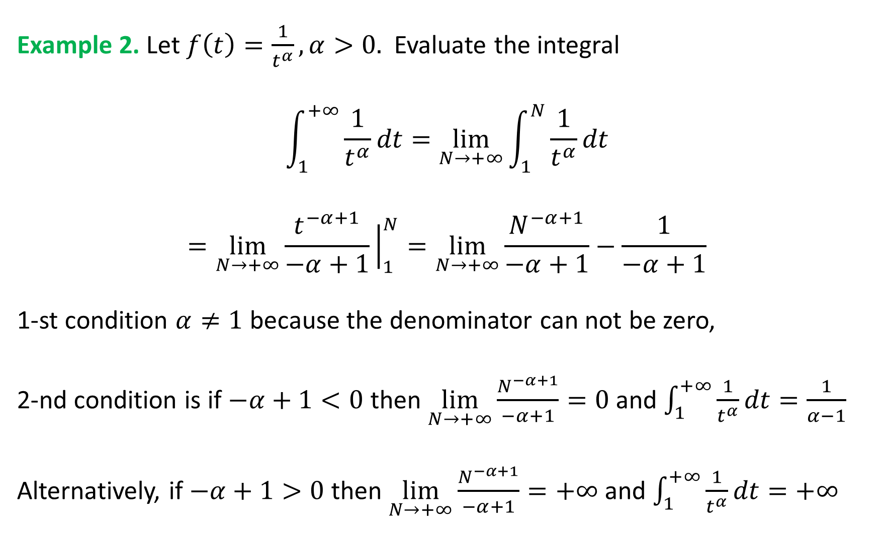
Example 2. Let $f\left(t\right)=\frac{1}{t^{α}}, α>0.$ Evaluate the integral
$$\int_{1}^{+∞}{\frac{1}{t^{α}}dt=\lim_{N→+∞}{\int_{1}^{N}{\frac{1}{t^{α}}dt}}}$$
$$=\lim_{N→+∞}{\frac{t^{−α+1}}{−α+1}{{\left.​\right|}_{1}^{N}}}=\lim_{N→+∞}\frac{N^{−α+1}}{−α+1}−\frac{1}{−α+1}$$
1-st condition $α≠1$ because the denominator can not be zero,
2-nd condition is if $−α+1<0$ then $\lim_{N→+∞}\frac{N^{−α+1}}{−α+1}=0$ and $\int_{1}^{+∞}{\frac{1}{t^{α}}dt=\frac{1}{α−1}}$
Alternatively, if $−α+1>0$ then $\lim_{N→+∞}\frac{N^{−α+1}}{−α+1}=+∞$ and $\int_{1}^{+∞}{\frac{1}{t^{α}}dt=+∞}$

Slide 10
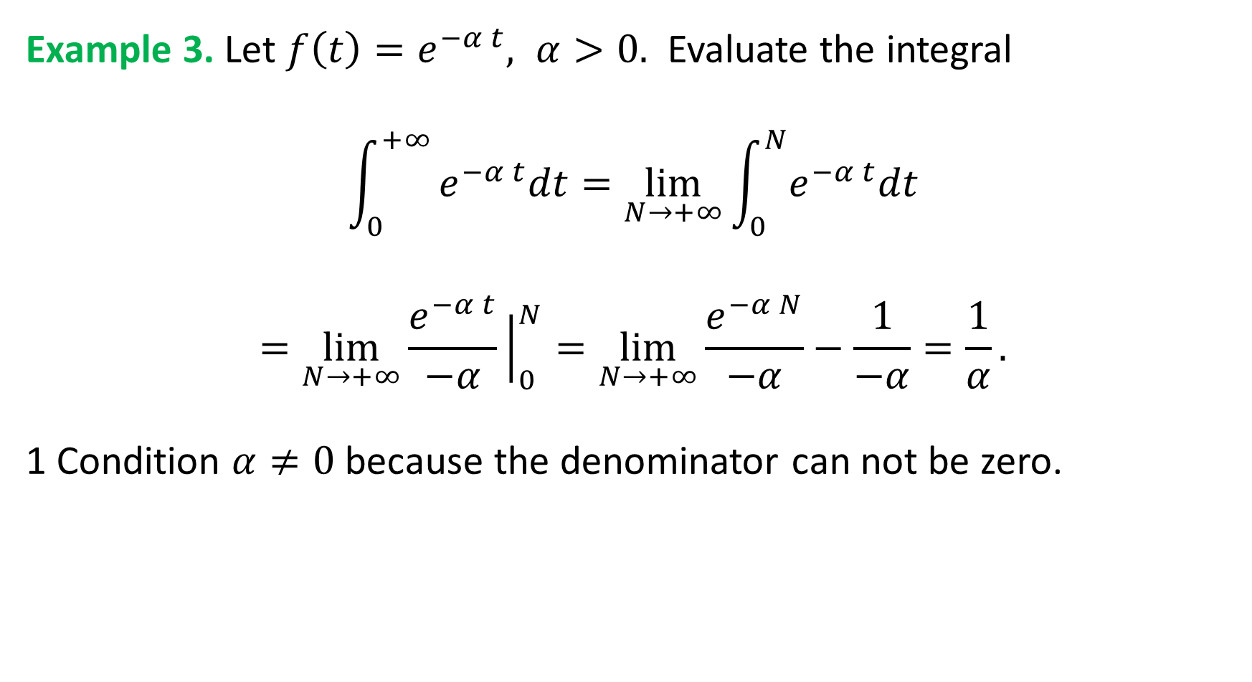
Example 3. Let $f\left(t\right)=e^{−α t}, α>0.$ Evaluate the integral
$$\int_{0}^{+∞}{e^{−α t}dt=\lim_{N→+∞}{\int_{0}^{N}{e^{−α t}dt}}}$$
$$=\lim_{N→+∞}{\frac{e^{−α t}}{−α}{{\left.​\right|}_{0}^{N}}}=\lim_{N→+∞}\frac{e^{−α N}}{−α}−\frac{1}{−α}=\frac{1}{α}.$$
1 Condition $α≠0$ because the denominator can not be zero.

Slide 11

Note. Further, for the sake of simplicity in calculations we shall omit the word “$lim⁡$” and shall use
$$\frac{e^{−α t}}{−α}{{\left.​\right|}_{0}^{+∞}}$$
Instead of
$$\lim_{N→+∞}{\frac{e^{−α t}}{−α}{{\left.​\right|}_{0}^{N}}}$$

Slide 12
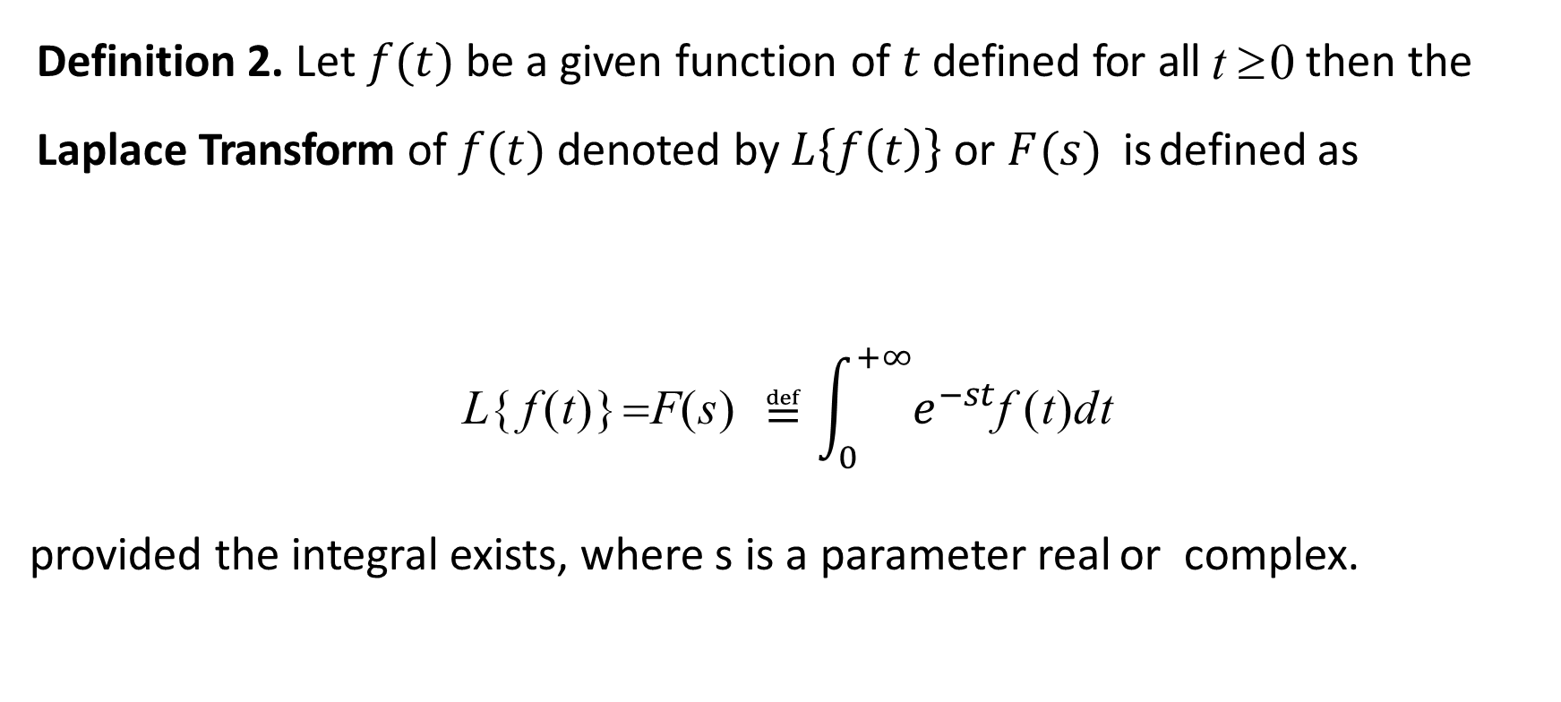
Definition of Laplace Transform
Definition 2. Let $f(t)$ be a given function of $t$defined for all t ≥ 0 then the Laplace Transform of $f(t)$ denoted by $L\left\{f\left(t\right)\right\}$or $F(s)$ is defined as
$$\text{L}\text{\{ }\text{f} \text{(}\text{t}\text{)\}} \text{=}\text{F}\text{(}\text{s}\text{)} ≝\int_{0}^{+∞}{e^{−st}\text{f} \text{(}\text{t}\text{)}\text{dt}}$$
provided the integral exists, where s is a parameter real or complex.

Slide 13
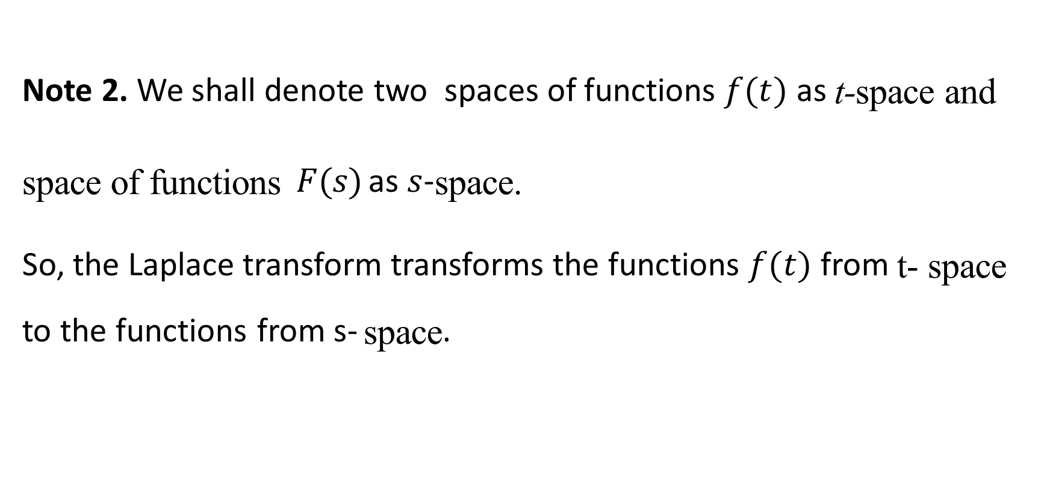
Definition of Laplace Transform
Note 2. We shall denote two spaces of functions $f(t)$ as t-space and space of functions $F(s)$ as $s$-space.
So, the Laplace transform transforms the functions $f(t)$ from t- space to the functions from s- space.

Slide 14
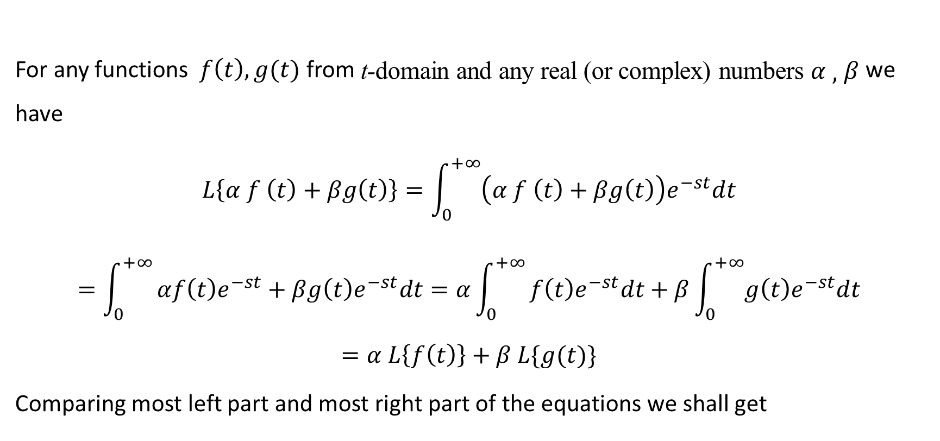
Linearity of Laplace Transform
For any functions $f\left(t\right), g(t)$ from t-domain and any real (or complex) numbers $α , β$ we have
$$L\left\{α f \left(t\right)+βg\left(t\right)\right\}=\int_{0}^{+∞}{\left(α f \left(t\right)+βg\left(t\right)\right)e^{−st}dt}$$
$$=\int_{0}^{+∞}{αf\left(t\right)e^{−st}+βg\left(t\right)e^{−st}dt=α\int_{0}^{+∞}{f\left(t\right)e^{−st}dt+β\int_{0}^{+∞}{g\left(t\right)e^{−st}dt}}}$$
$$=α L\left\{f\left(t\right)\right\}+β L\{g(t)\}$$
Comparing most left part and most right part of the equations we shall get

Slide 15


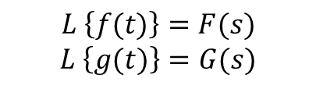

Linearity of Laplace Transform
$$L\left\{α f \left(t\right)+βg\left(t\right)\right\}=α L\left\{f\left(t\right)\right\}+β L\{g(t)\}$$
$$α f \left(t\right)+βg\left(t\right)↦α F\left(s\right)+βG\left(s\right)$$
t-space
s-space
$$L \left\{f(t)\right\}=F(s)$$
$$L \left\{g(t)\right\}=G(s)$$
$$α F\left(s\right)+βG\left(s\right)$$
$$α f \left(t\right)+βg\left(t\right)$$

Slide 16

Laplace Transform of some Elementary Functions
Exercise 1. Prove the equality
$$L\{1\}=\frac{1}{s}$$
Proof. By definition
$$L\{1\}=\int_{0}^{+∞}{e^{−st}⋅1dt={\left[−\frac{e^{−st}}{s}\right]}_{t=0}^{t=+∞}=\frac{1}{s}}$$

Slide 17
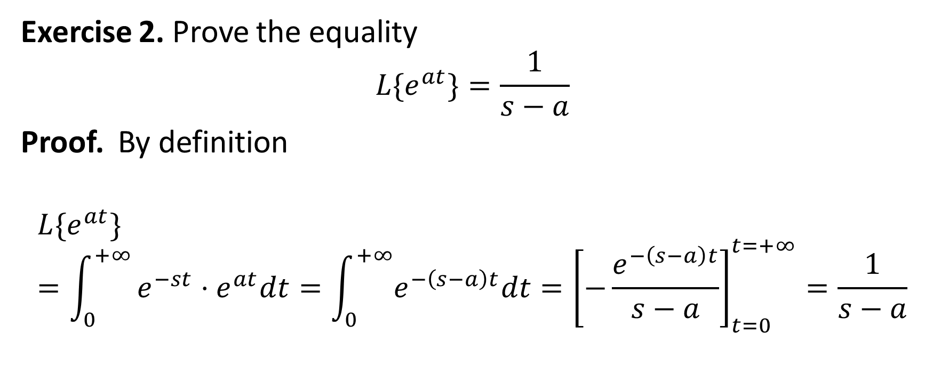
Laplace Transform of some Elementary Functions
Exercise 2. Prove the equality
$$L\{e^{at}\}=\frac{1}{s−a}$$
Proof. By definition
$$L\{e^{at}\}=\int_{0}^{+∞}{e^{−st}⋅e^{at}dt=\int_{0}^{+∞}{e^{−\left(s−a\right)t}dt}={\left[−\frac{e^{−\left(s−a\right)t}}{s−a}\right]}_{t=0}^{t=+∞}=\frac{1}{s−a}}$$

Slide 18
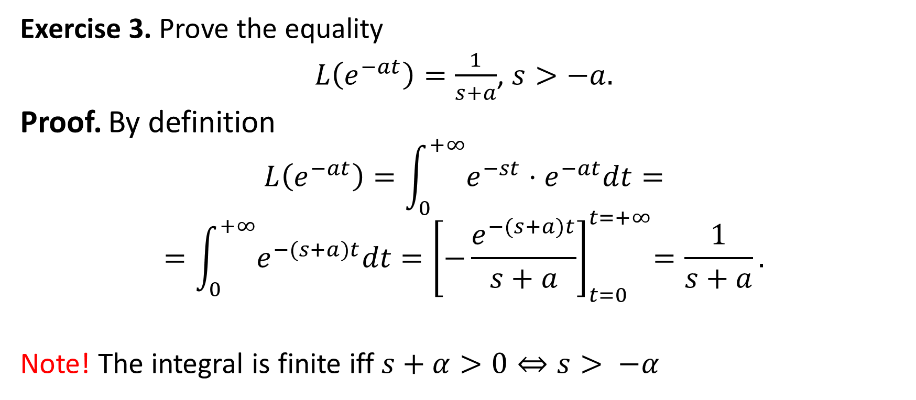
Exercise 3. Prove the equality
$L\left(e^{−at}\right)=\frac{1}{s+a}$, $s>−a.$
Proof. By definition
$$L\left(e^{−at}\right)=\int_{0}^{+∞}{e^{−st}⋅e^{−at}dt=}$$
$$=\int_{0}^{+∞}{e^{−(s+a)t}dt}{=\left[−\frac{e^{−(s+a)t}}{s+a}\right]}_{t=0}^{t=+∞}=\frac{1}{s+a}.$$
Note! The integral is finite iff $s+α>0⇔s> −α$

Slide 19

Exercise 4. Prove the equality
$L\{sinh at\}=\frac{a}{s^{2}−a^{2}}$, $s>|a|.$
Proof. By definition
$$L\{sinh at\}=L\left\{\frac{e^{at}−e^{−at}}{2}\right\}=\frac{L\{e^{at}\}−L\{e^{−at}\}}{2}=\frac{\frac{1}{2}}{s−a}−\frac{\frac{1}{2}}{s+a}=$$
$$=\frac{a}{s^{2}−a^{2}}.$$
Note! The integral is finite iff $s+a>0\& s−a>0⇔s>|a|$

Slide 20

Exercise 5. Prove the equality
$L\{cosh at\}=\frac{s}{s^{2}−a^{2}}$, $s>|a|.$
Proof. By definition
$$L\left\{cosh at\right\}=L\left\{\frac{e^{at}+e^{−at}}{2}\right\}=\frac{L\left\{e^{at}\right\}+L\left\{e^{−at}\right\}}{2}=\frac{\frac{1}{2}}{s−a}+\frac{\frac{1}{2}}{s+a}=$$
$$=\frac{s}{s^{2}−a^{2}}.$$
Note! The integral is finite iff $s+a>0 \& s−a>0⇔s>|a|$

Slide 21
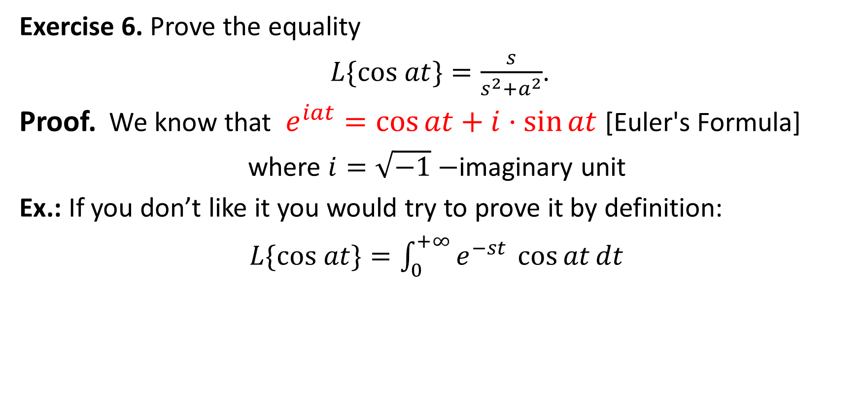
Exercise 6. Prove the equality
$L\{cos at\}=\frac{s}{s^{2}+a^{2}}$.
Proof. We know that $e^{iat}=\cos{at+i⋅\sin{at}}$ [Euler's Formula]
where $i=\sqrt{−1}−$imaginary unit
Ex.: If you don’t like it you would try to prove it by definition:
$L\{cos at\}=\int_{0}^{+∞}{e^{−st }\cos{at}dt}$

Slide 22
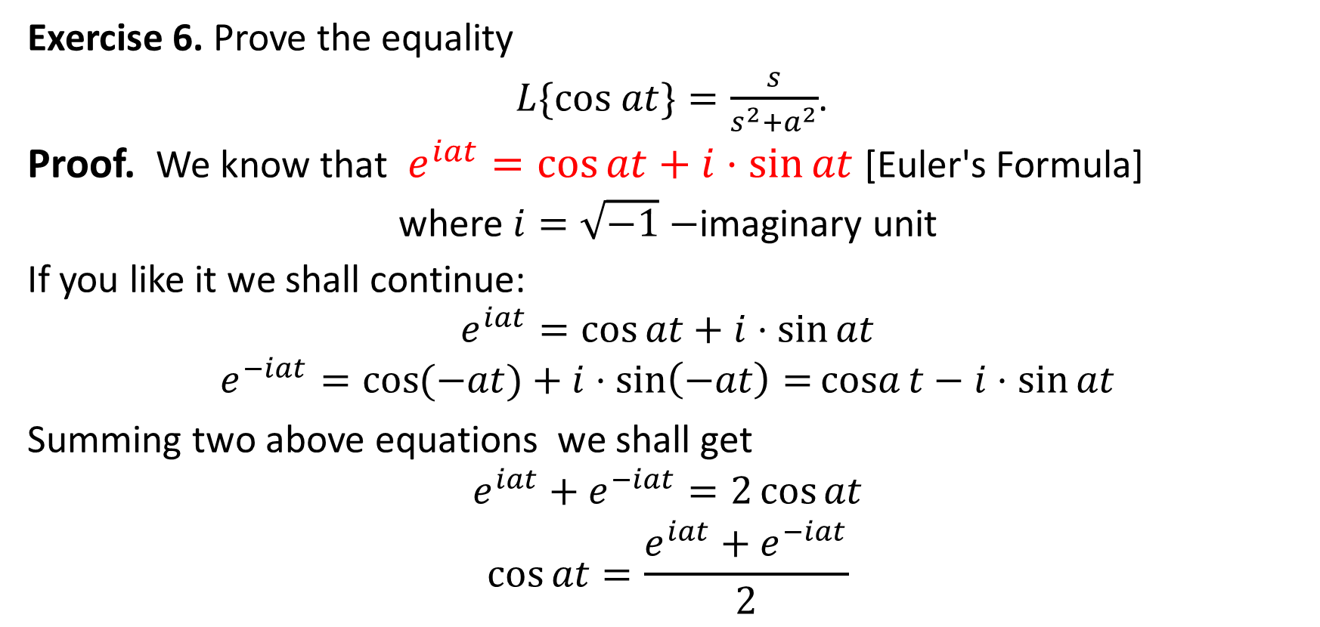
Exercise 6. Prove the equality
$L\{cos at\}=\frac{s}{s^{2}+a^{2}}$.
Proof. We know that $e^{iat}=\cos{at+i⋅\sin{at}}$ [Euler's Formula]
where $i=\sqrt{−1}−$imaginary unit
If you like it we shall continue:
$$e^{iat}=\cos{at+i⋅\sin{at}}$$
$$e^{−iat}=\cos{(−at)+i⋅\sin\left(−at\right)=}\operatorname{cosa}{t−i⋅\sin{at}}$$
Summing two above equations we shall get
$$e^{iat}+e^{−iat}=2\cos{at}$$
$$\cos{at=\frac{e^{iat}+e^{−iat}}{2}}$$

Slide 23

$$L\{cos at\}=L\left\{\frac{e^{iat}+e^{−iat}}{2}\right\}=\frac{L\{e^{iat}\}+L\{e^{−iat}\}}{2}$$
$$=\frac{\frac{1}{2}}{s−ia}+\frac{\frac{1}{2}}{s+ia}=\frac{s}{s^{2}+a^{2}}.$$

Slide 24
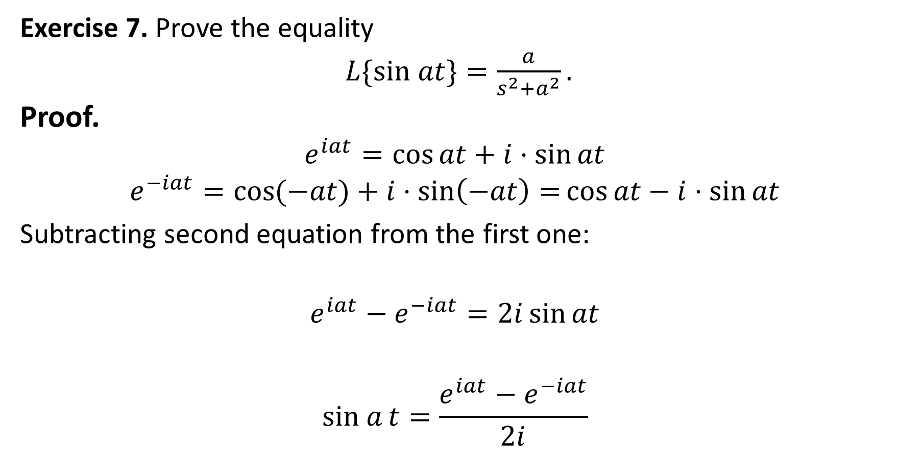
Exercise 7. Prove the equality
$L\{sin at\}=\frac{a}{s^{2}+a^{2}}.$
Proof.
$$e^{iat}=\cos{at+i⋅\sin{at}}$$
$$e^{−iat}=\cos{(−at)+i⋅\sin\left(−at\right)=}\cos{at−i⋅\sin{at}}$$
Subtracting second equation from the first one:
$$e^{iat}−e^{−iat}=2i\sin{at}$$
$$sin a{t=\frac{e^{iat}−e^{−iat}}{2i}}$$

Slide 25

$$L\{sin at\}=L\left\{\frac{e^{iat}−e^{−iat}}{2i}\right\}=\frac{L\{e^{iat}\}−L\{e^{−iat}\}}{2i}$$
$$=\frac{\frac{1}{2i}}{s−ia}+\frac{\frac{1}{2i}}{s+ia} =\frac{a}{s^{2}+a^{2}}.$$

Slide 26
Table of Laplace transforms

Slide 27
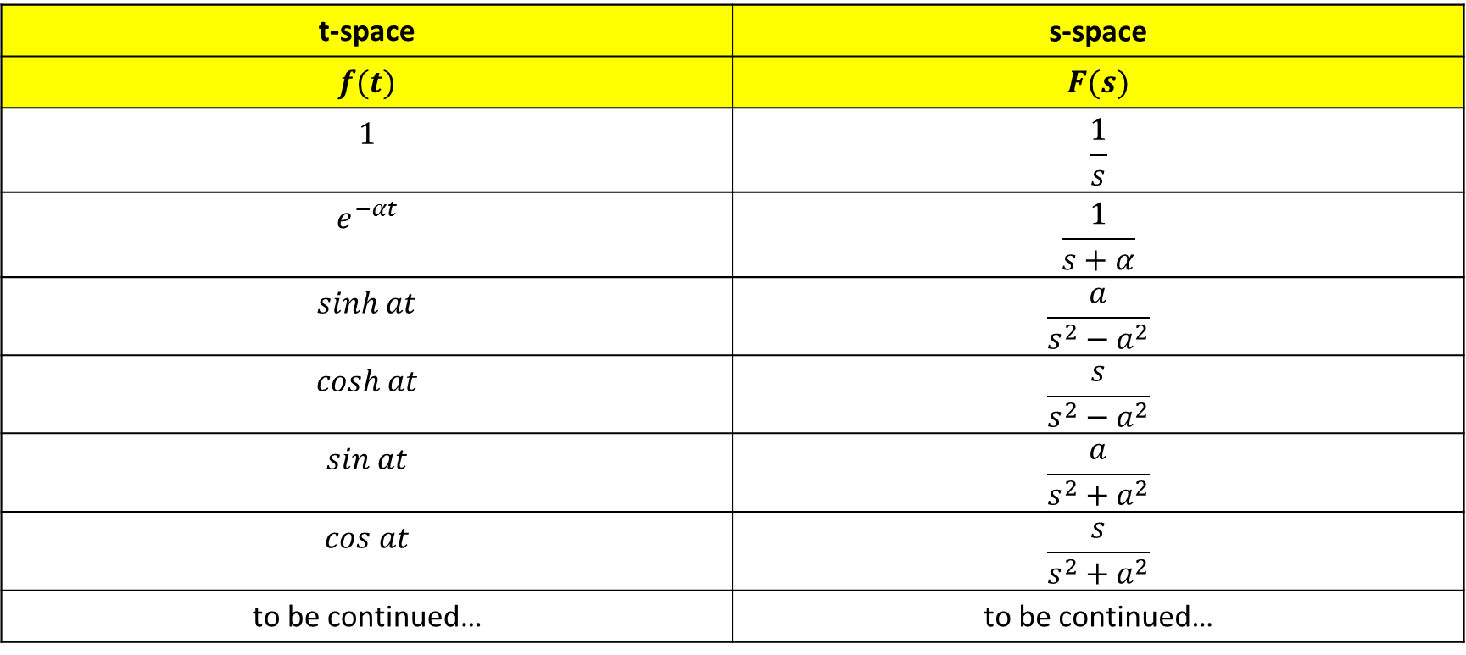
Table of Laplace transforms
t-space | s-space
$$f(t)$$ | $$F(s)$$
$$1$$ | $$\frac{1}{s}$$
$$e^{−αt}$$ | $$\frac{1}{s+α}$$
$$sinh at$$ | $$\frac{a}{s^{2}−a^{2}}$$
$$cosh at$$ | $$\frac{s}{s^{2}−a^{2}}$$
$$sin at$$ | $$\frac{a}{s^{2}+a^{2}}$$
$$cos at$$ | $$\frac{s}{s^{2}+a^{2}}$$
to be continued… | to be continued…

Slide 28
Admissible functions for Laplace transform

Slide 29
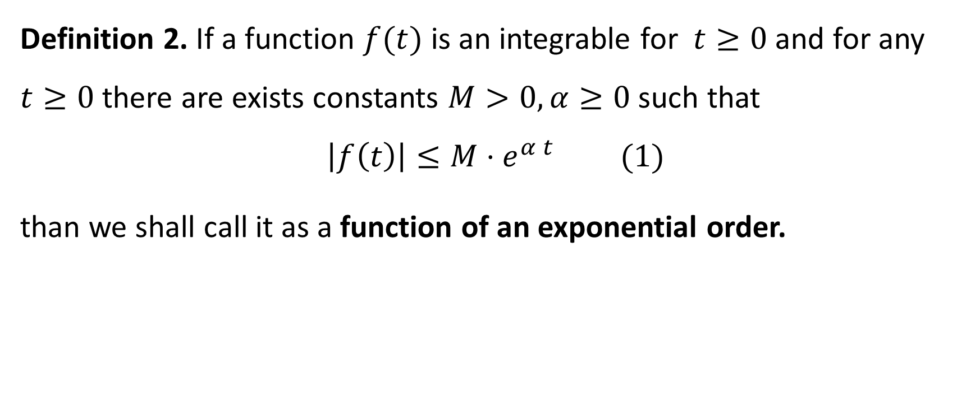
Integrable functions of exponential growth
Definition 2. If a function $f(t)$ is an integrable for $t≥0$ and for any $t≥0$ there are exists constants $M>0, α≥0$ such that
$$\left|f\left(t\right)\right|≤M⋅e^{α t} (1)$$
than we shall call it as a function of an exponential order.

Slide 30

Using
$$\left|f\left(t\right)\right|≤M⋅e^{α t} (1)$$
we may conclude that
$$|\int_{0}^{+∞}{f\left(t\right)e^{−st}dt|≤\int_{0}^{+∞}{\left|f\left(t\right)e^{−st}\right|dt≤}\int_{0}^{+∞}{M⋅e^{αt}e^{−st}dt}}$$
$$=\frac{Me^{\left(α−s\right)t}}{α−s}{\left.​\right|}_{0}^{+∞}\overset{α<s}{=}\frac{Me^{\left(α−s\right)⋅(+∞)}}{α−s}−\frac{Me^{\left(α−s\right)⋅0}}{α−s}=\frac{M}{s−α}<+∞ \underset{⇔}{‼!}s>α$$

Slide 31
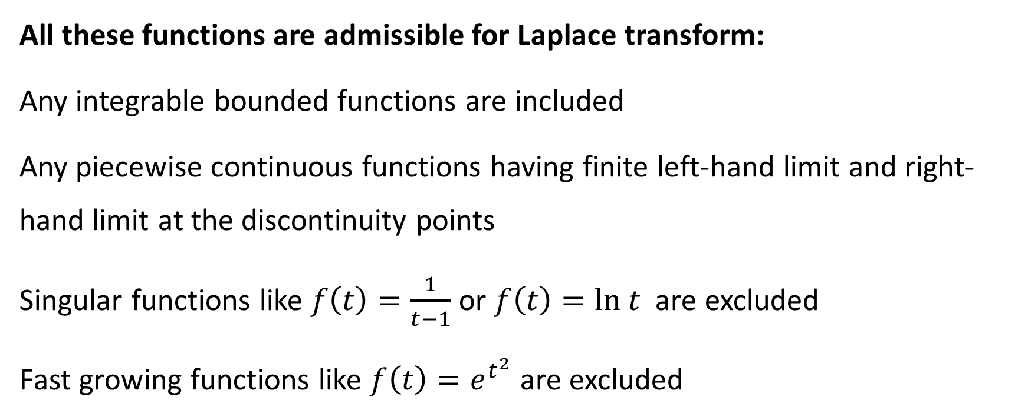
Integrable functions of exponential growth
All these functions are admissible for Laplace transform:
Any integrable bounded functions are included
Any piecewise continuous functions having finite left-hand limit and right-hand limit at the discontinuity points
Singular functions like $f\left(t\right)=\frac{1}{t−1}$ or $f\left(t\right)=ln t$ are excluded
Fast growing functions like $f\left(t\right)=e^{t^{2}}$ are excluded

Slide 32
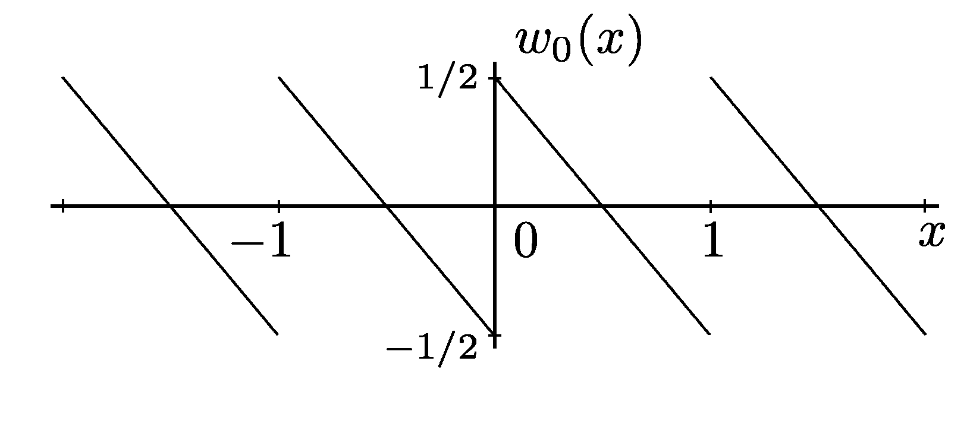
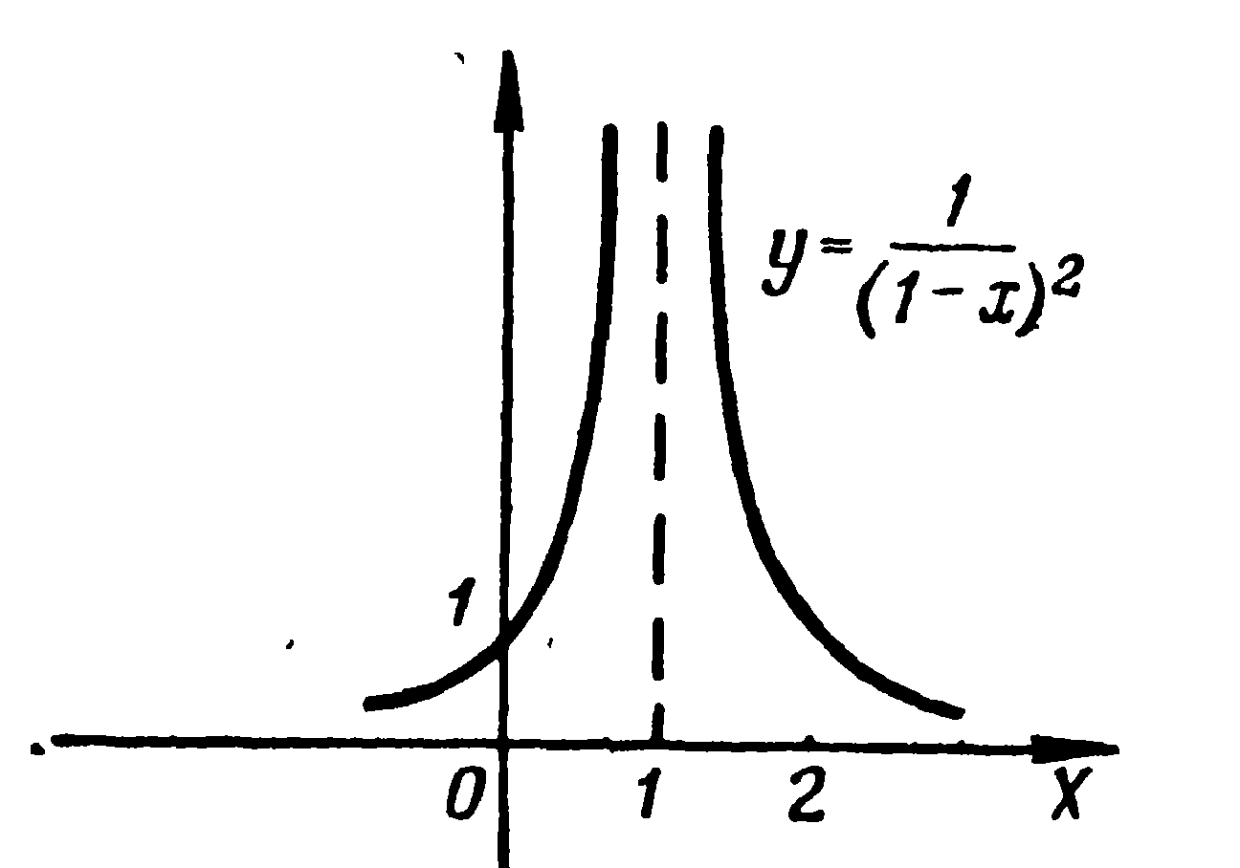
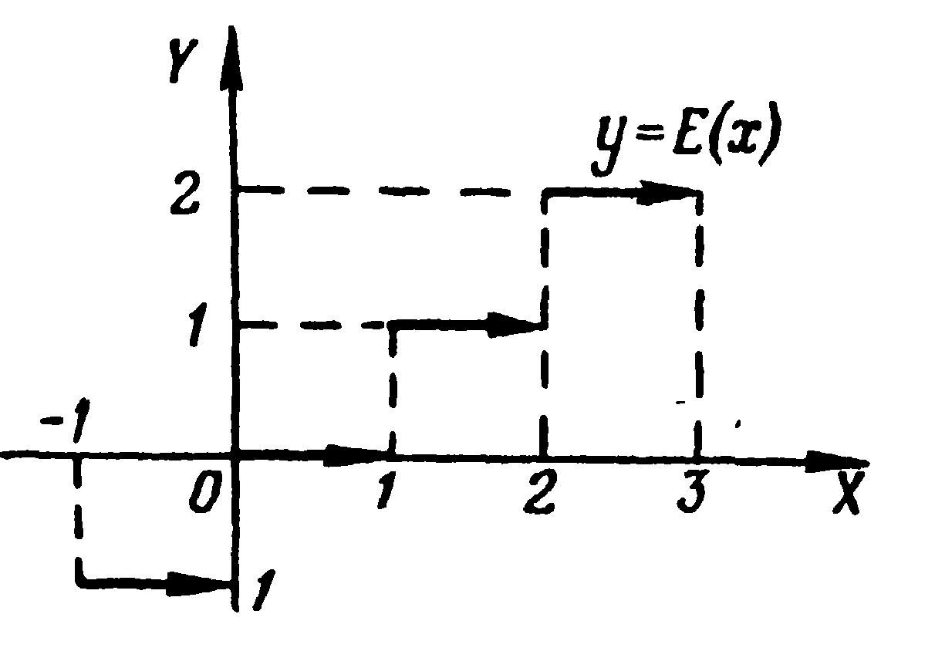
Admissible and not admissible functions for LT
included
excluded

Slide 33
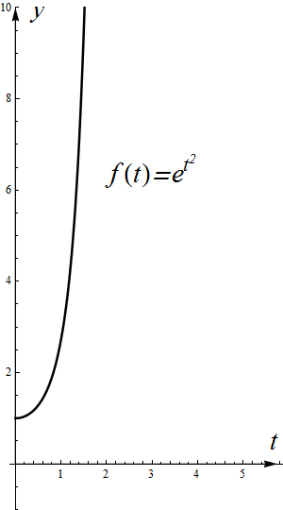
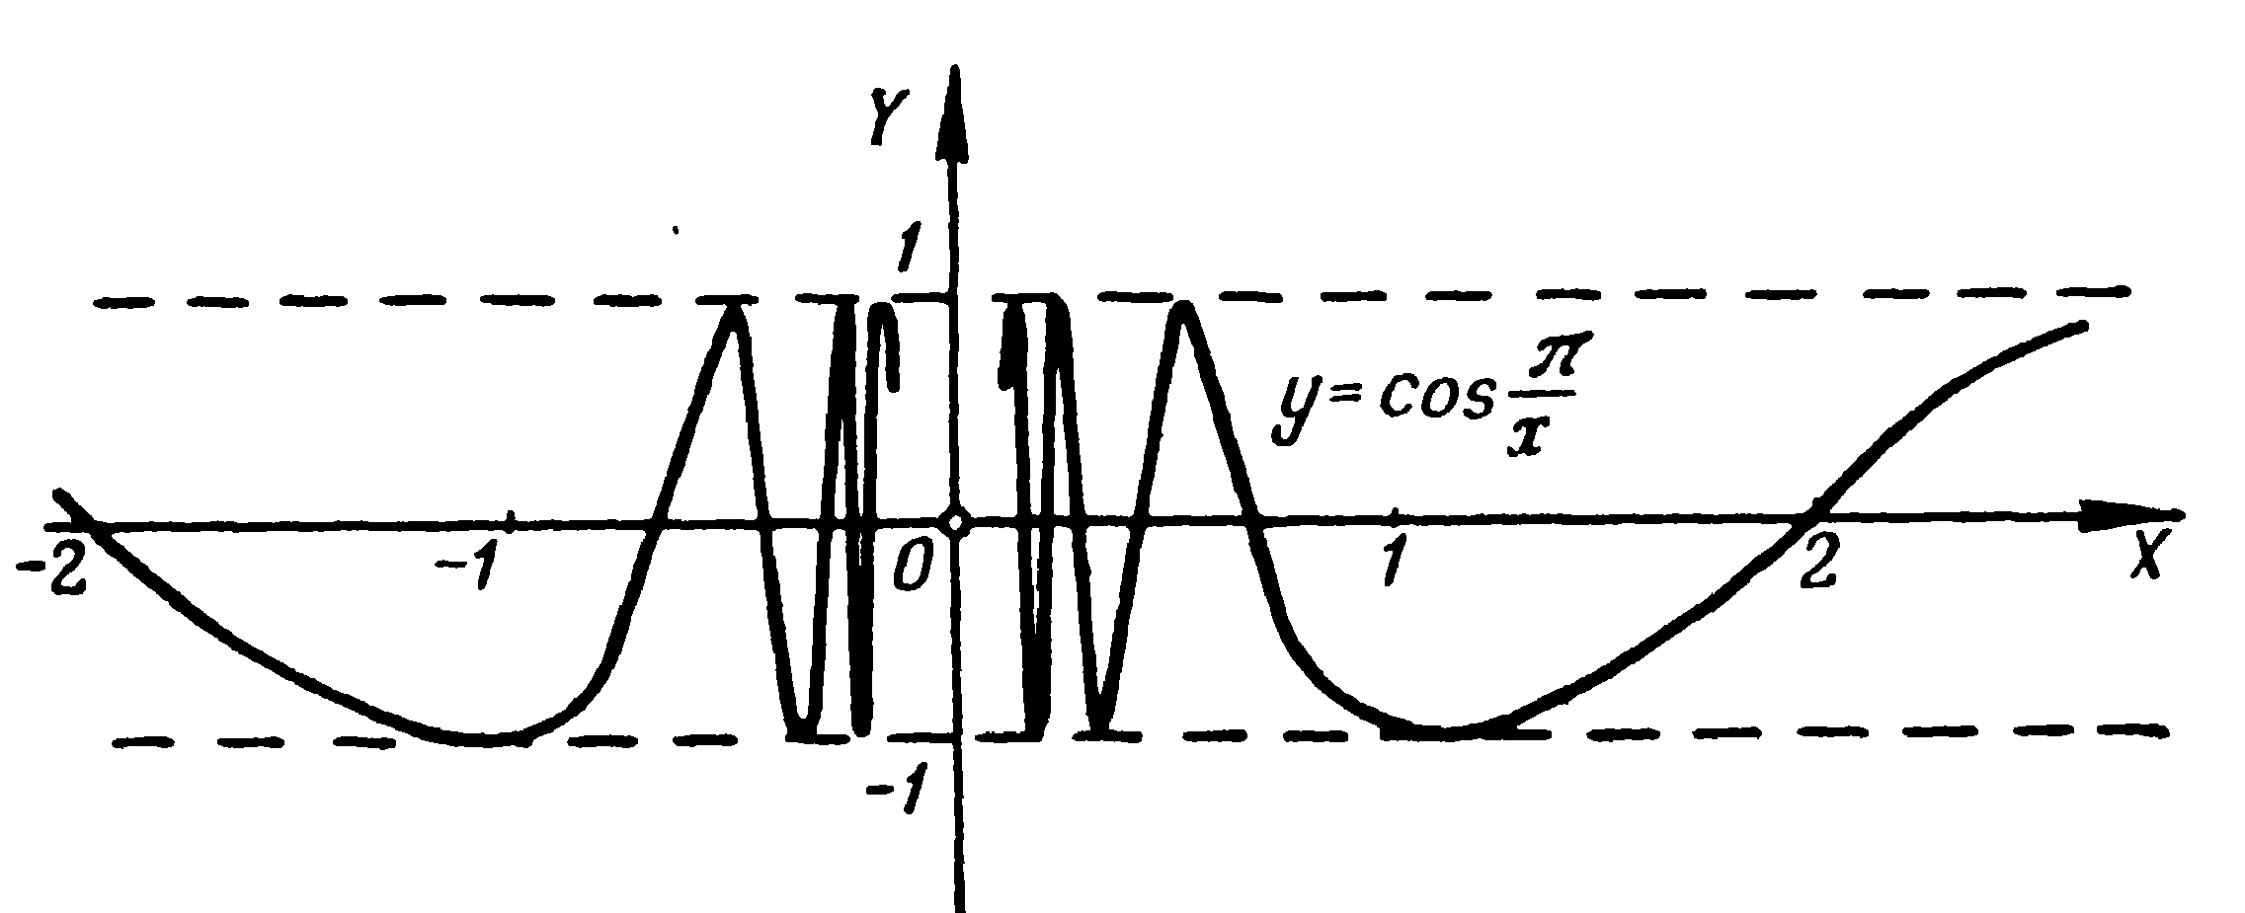
Admissible and not admissible functions for LT
included
excluded

Slide 34
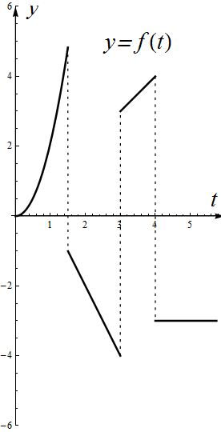
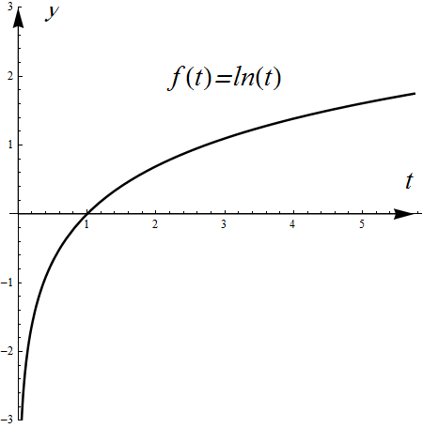
Admissible and not admissible functions for LT
included
excluded

Slide 35
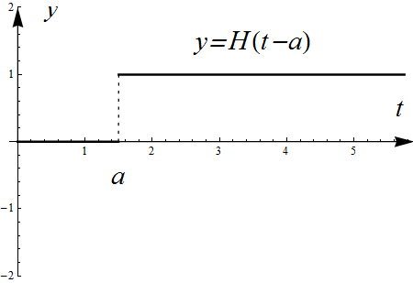
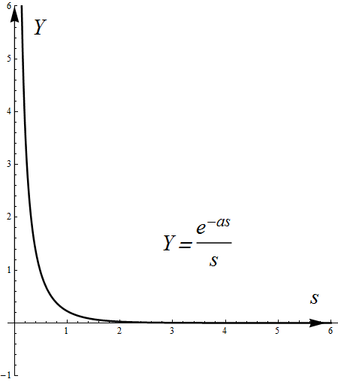
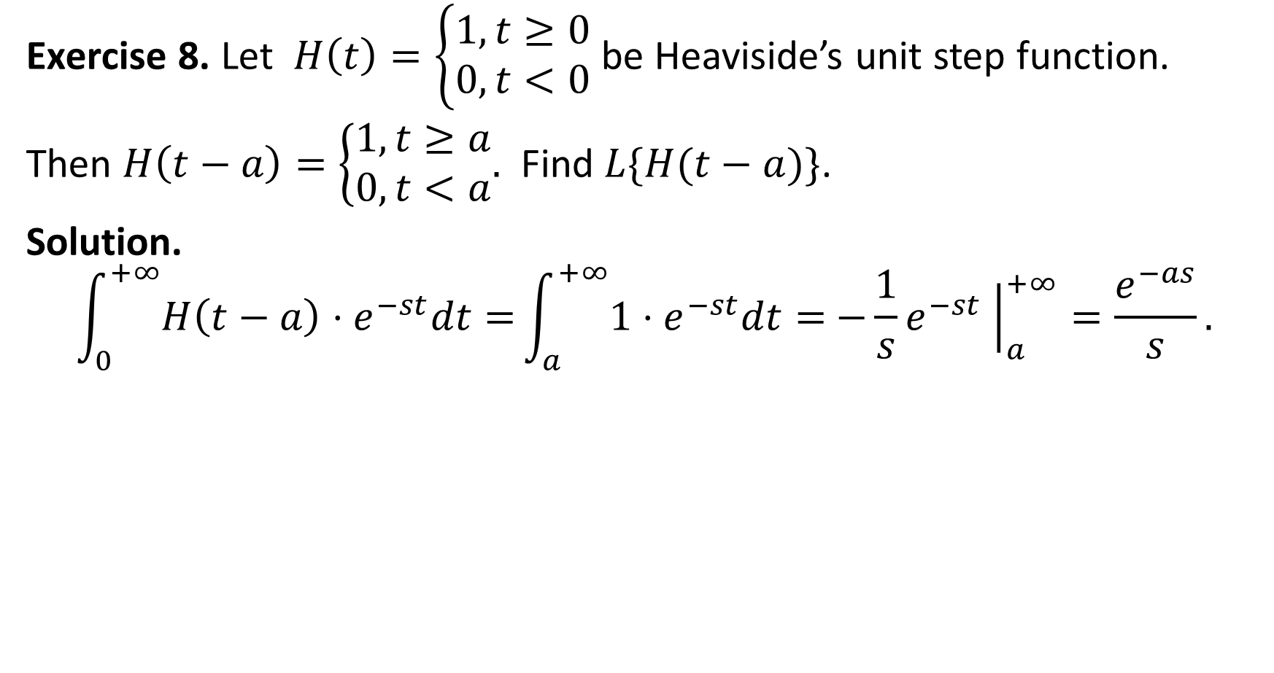
Exercise 8. Let $H\left(t\right)=\left\{\begin{aligned}1, t≥0 \\ 0, t<0\end{aligned}\right.$ be Heaviside’s unit step function.
Then $H\left(t−a\right)=\left\{\begin{aligned}1, t≥a \\ 0, t<a\end{aligned}.\right.$ Find $L\{H(t−a)\}$.
Solution.
$$\int_{0}^{+∞}{H\left(t−a\right)⋅e^{−st}dt=}\int_{a}^{+∞}{1⋅e^{−st}dt=}{−\frac{1}{s}e}^{−st}{\left.​\right|}_{a}^{+∞}=\frac{e^{−as}}{s}.$$

Slide 36
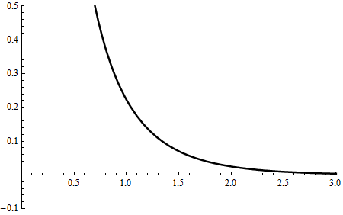

Slide 37
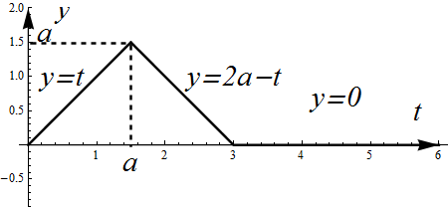

Example 9. Let $f\left(t\right)=\left\{\begin{aligned}t, t∈[0;a] \\ 2a−t, t∈[a;2a] \\ 0, t∈[2a; +∞)\end{aligned}\right.$.

Slide 38

Solution.
$$\int_{0}^{+∞}{f(t)⋅e^{−st}dt=}\int_{0}^{a}{t⋅e^{−st}dt+\int_{a}^{2a}{(2a−t)⋅e^{−st}dt}}$$
Let us consider the first one integral:

Slide 39

$$\int_{0}^{a}{t⋅e^{−st}dt\overset{By parts}{=}−\frac{1}{s}\int_{0}^{a}{t de^{−st}=−\frac{1}{s}t⋅e^{−st}{\left.​\right|}_{t=0}^{t=a}+\frac{1}{s}\int_{0}^{a}{e^{−st}dt}}}$$
$$=−\frac{1}{s}a⋅e^{−as}−\frac{1}{s^{2}}e^{−st}{\left.​\right|}_{t=0}^{t=a}=−\frac{a e^{−as}}{s}−\frac{e^{−as}}{s^{2}}+\frac{1}{s^{2}}.$$
Let us consider the second one integral:

Slide 40

$$\int_{a}^{2a}{\left(2a−t\right)⋅e^{−st}dt}\overset{τ=2a−t}{=}\int_{a}^{0}{τe^{−s \left(2a−τ\right)}}d\left(−τ\right)$$
$$=e^{−2as}\int_{0}^{a}{τe^{sτ}}dτ\overset{By parts}{=} \frac{e^{−2as}}{s}\int_{0}^{a}{τ d e^{sτ}}$$
$$=\frac{e^{−2as}}{s}\left(τ e^{sτ}{\left.​\right|}_{τ=0}^{τ=a}−\int_{0}^{a}{ e^{sτ}}dτ\right)=\frac{e^{−2as}}{s}\left(a e^{as}−\frac{e^{as}−1}{s}\right)$$
$$=\frac{a e^{−as}}{s}−\frac{e^{−as}}{s^{2}}+\frac{e^{−2as}}{s^{2}}.$$

Slide 41

Summing both integrals we shall get
$$\int_{0}^{+∞}{f(t)⋅e^{−st}dt=}−\frac{a e^{−as}}{s}−\frac{e^{−as}}{s^{2}}+\frac{1}{s^{2}}+\frac{a e^{−as}}{s}−\frac{e^{−as}}{s^{2}}+\frac{e^{−2as}}{s^{2}}$$
$$=\frac{1−2e^{−as}+e^{−2as}}{s^{2}}={\left(\frac{e^{−as}−1}{s}\right)}^{2}.$$
The answer is $F\left(s\right)={\left(\frac{e^{−as}−1}{s}\right)}^{2}$

Slide 42
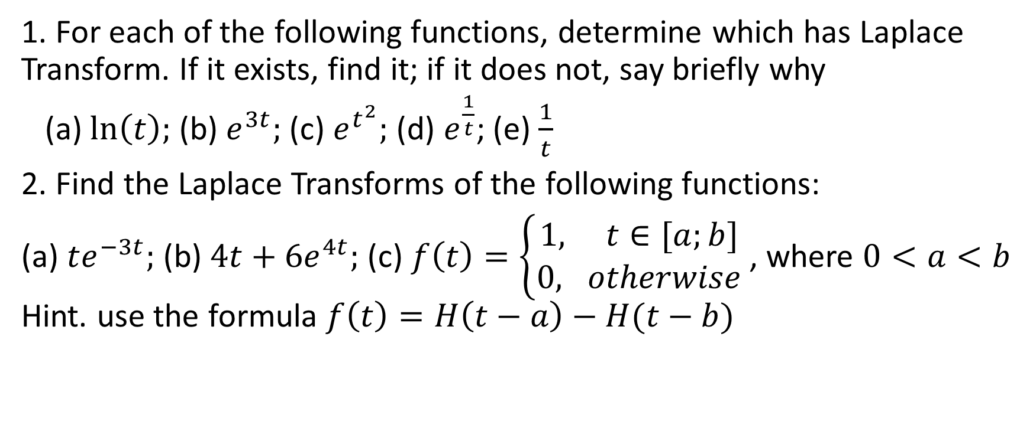
Homework
1. For each of the following functions, determine which has Laplace Transform. If it exists, find it; if it does not, say briefly why
(a) $\ln\left(t\right);$ (b) $e^{3t};$ (c) $e^{t^{2}};$ (d) $e^{\frac{1}{t}}$; (e) $\frac{1}{t}$
2. Find the Laplace Transforms of the following functions:
(a) $te^{−3t};$ (b) $4t+6e^{4t};$(c) $f\left(t\right)=\left\{\begin{aligned}1, t∈[a;b] \\ 0, otherwise\end{aligned}\right.$ , where $0<a<b$ Hint. use the formula $f\left(t\right)=H\left(t−a\right)−H(t−b)$

