Slide 1
Mathematical Methods of Solid Mechanics
Aliaksandr Radyna Assoc. Prof.
DUT-BSU Joint Institute

Slide 2
Derivative property of the Laplace Transform

Slide 3

Solutions to the home exercises
1. Using Theorems 1 and 2 find the Laplace Transforms of the following functions:
(a) $t^{2}e^{3t}$
Solution.
Since $L\left\{t^{2}\right\}=\frac{2!}{s^{3}}$ then by Th.1 $L\left\{t^{2}e^{3t}\right\}=\frac{2!}{{\left(s−3\right)}^{3}};$

Slide 4
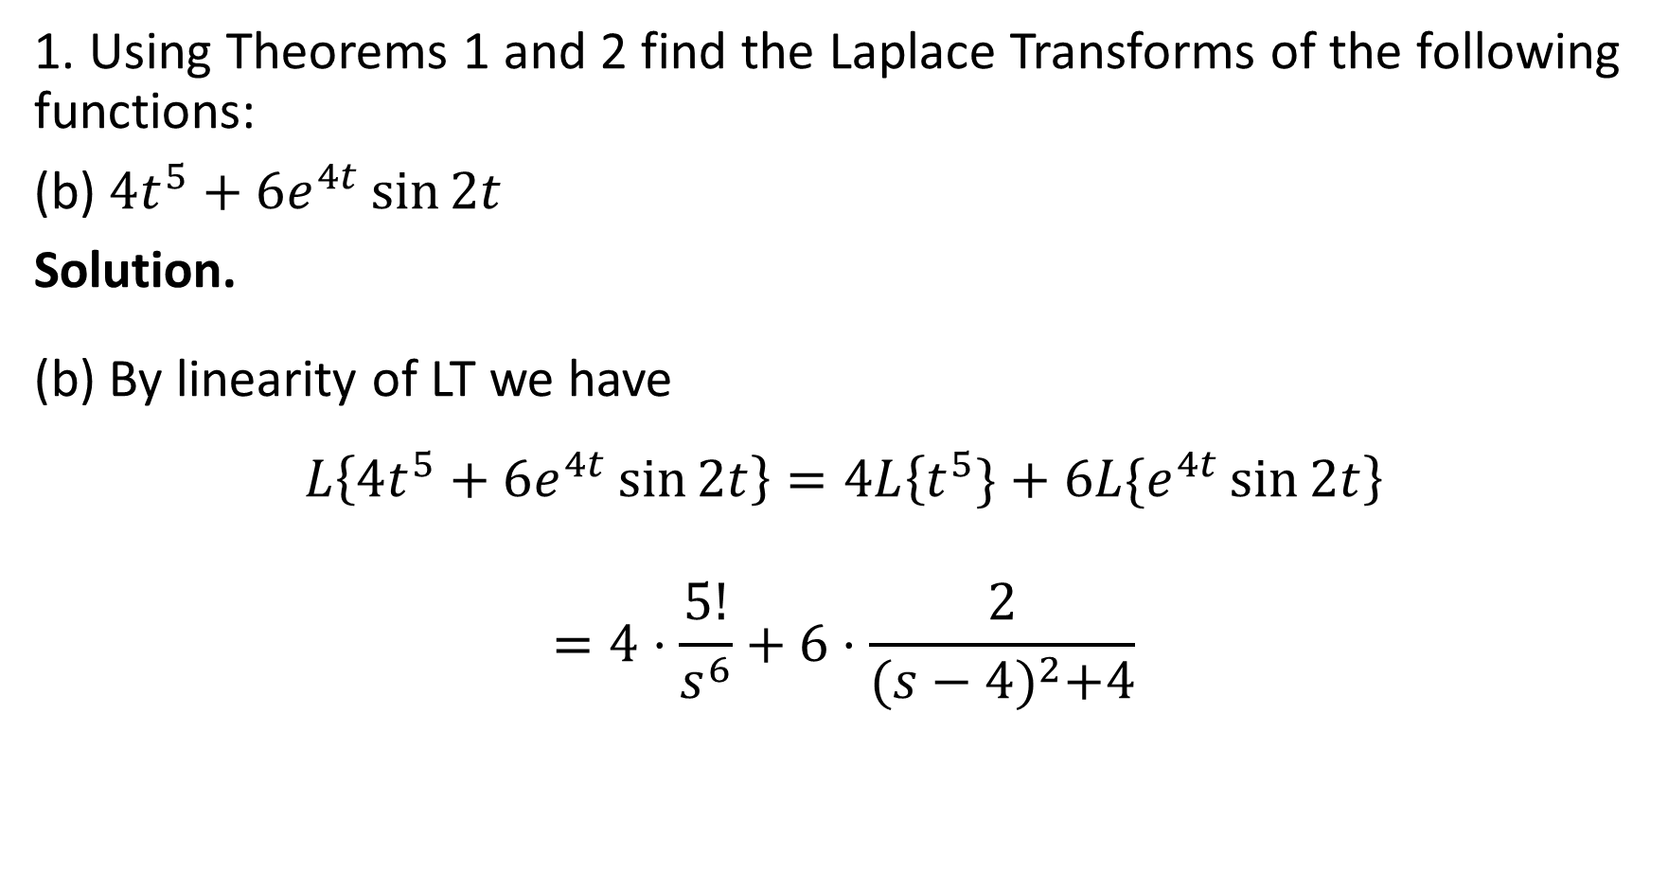
Solutions to the home exercises
1. Using Theorems 1 and 2 find the Laplace Transforms of the following functions:
(b) $4t^{5}+6e^{4t}\sin{2t}$
Solution.
(b) By linearity of LT we have
$$L\left\{4t^{5}+6e^{4t}\sin{2t}\right\}=4L\left\{t^{5}\}+6L\{e^{4t}\sin{2t}\right\}$$
$$=4⋅\frac{5!}{s^{6}}+6⋅\frac{2}{{(s−4)}^{2}+4}$$

Slide 5
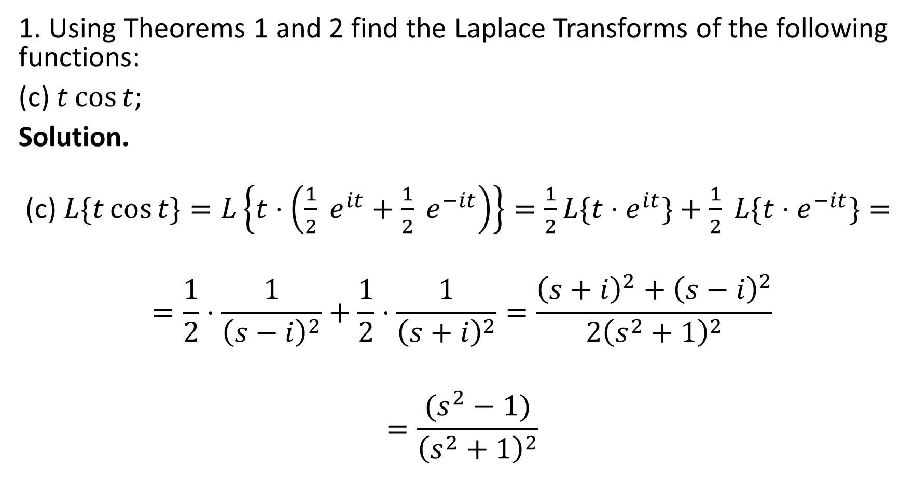
Solutions to the home exercises
1. Using Theorems 1 and 2 find the Laplace Transforms of the following functions:
(c) $t\cos{t}$;
Solution.
(c) $L\{t\cos{t\}=L\left\{t⋅\left(\frac{1}{2} e^{it}+\frac{1}{2} e^{−it}\right)\right\}=\frac{1}{2}L\{t⋅e^{it}\}+\frac{1}{2} {L\{t⋅e}^{−it}\}=}$
$$=\frac{1}{2}⋅\frac{1}{{\left(s−i\right)}^{2}}+\frac{1}{2}⋅\frac{1}{{\left(s+i\right)}^{2}}=\frac{{\left(s+i\right)}^{2}+{\left(s−i\right)}^{2}}{{2\left(s^{2}+1\right)}^{2}}$$
$$=\frac{(s^{2}−1)}{{\left(s^{2}+1\right)}^{2}}$$

Slide 6

Solutions to the home exercises
1. Using Theorems 1 and 2 find the Laplace Transforms of the following functions:
(d) $f\left(t\right)=\left\{\begin{aligned}t, t∈\left[0;1\right]; \\ 2−t, t∈\left[1;2\right]; \\ 0, otherwise\end{aligned}\right.$ Hint. use the Unit step function $H\left(t\right)$

Slide 7
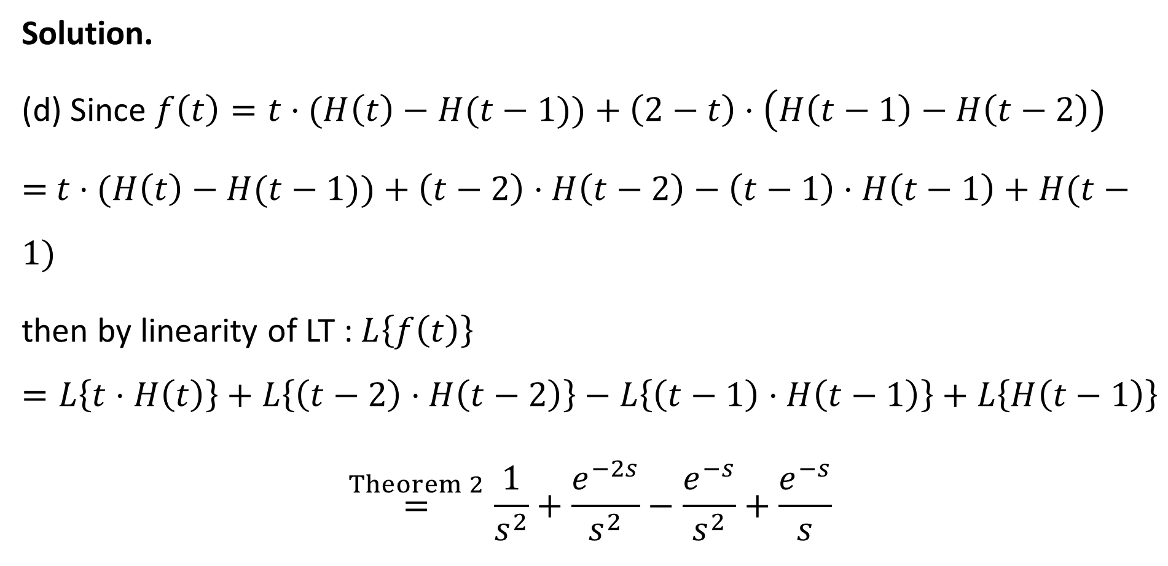
Solutions to the home exercises
Solution.
(d) Since $f\left(t\right)=t⋅(H\left(t\right)−H(t−1))+\left(2−t\right)⋅\left(H\left(t−1\right)−H\left(t−2\right)\right)$
$=$ $t⋅(H\left(t\right)−H(t−1))+\left(t−2\right)⋅H\left(t−2\right)−\left(t−1\right)⋅H\left(t−1\right)+H(t−1)$
then by linearity of LT : $L\left\{f\left(t\right)\right\}$
$$=L\left\{t⋅H\left(t\right)\right\}+L\left\{\left(t−2\right)⋅H\left(t−2\right)\right\}−L\left\{\left(t−1\right)⋅H\left(t−1\right)\right\}+L\left\{H\left(t−1\right)\right\}$$
$$\overset{Theorem 2}{=}\frac{1}{s^{2}}+\frac{e^{−2s}}{s^{2}}−\frac{e^{−s}}{s^{2}}+\frac{e^{−s}}{s}$$

Slide 8

Solutions to the home exercises
2. Use the property of Theorem 4 to determine the following Laplace Transforms:
(a) $t\sinh{t}$; (b) $t^{2}\cos{t}.$

Slide 9
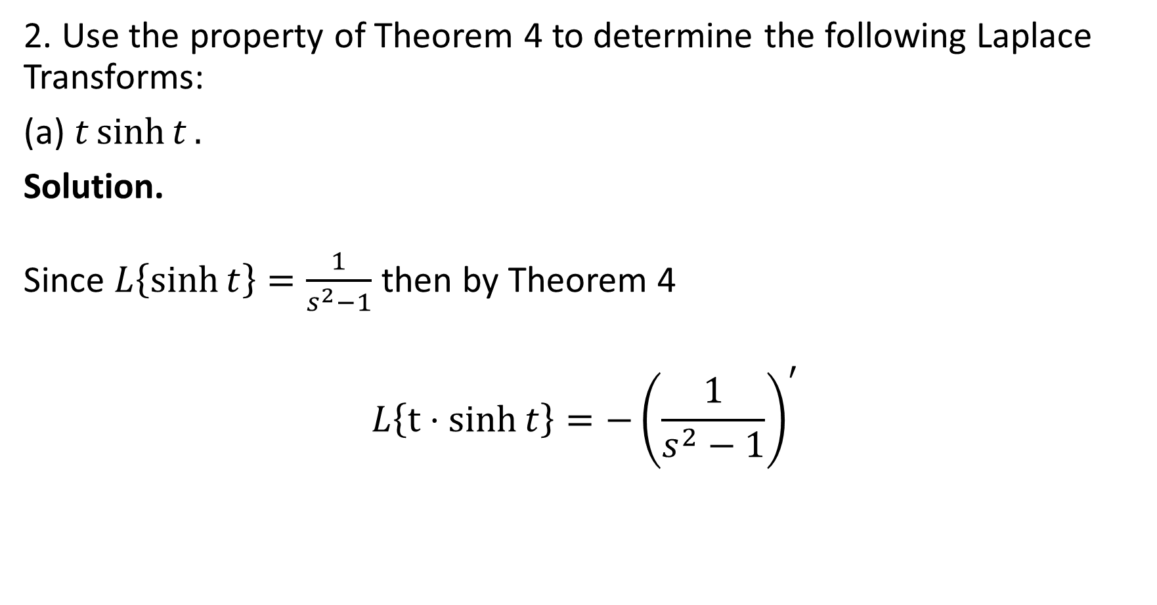
Solutions to the home exercises
2. Use the property of Theorem 4 to determine the following Laplace Transforms:
(a) $t\sinh{t}.$
Solution.
Since $L\left\{\sinh{t}\right\}=\frac{1}{s^{2}−1}$ then by Theorem 4
$$L\left\{t⋅sinh{t}\right\}=−{\left(\frac{1}{s^{2}−1}\right)}^{′}$$

Slide 10
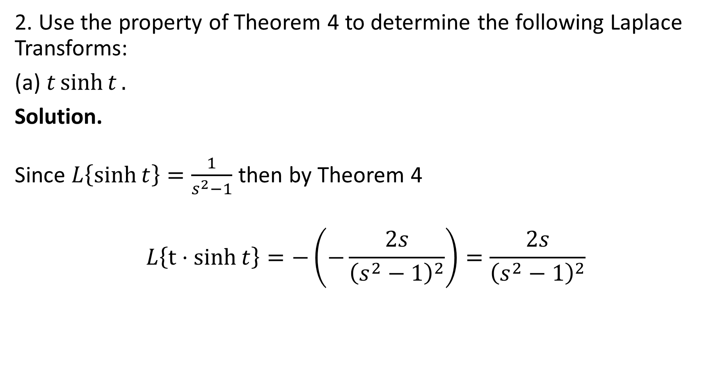
Solutions to the home exercises
2. Use the property of Theorem 4 to determine the following Laplace Transforms:
(a) $t\sinh{t}.$
Solution.
Since $L\left\{\sinh{t}\right\}=\frac{1}{s^{2}−1}$ then by Theorem 4
$$L\left\{t⋅sinh{t}\right\}=−\left(−\frac{2s}{{\left(s^{2}−1\right)}^{2}}\right)=\frac{2s}{{\left(s^{2}−1\right)}^{2}}$$

Slide 11

Solutions to the home exercises
2. Use the property of Theorem 4 to determine the following Laplace Transforms:
(b) $t^{2}\cos{t}.$
Solution.
Since $L\left\{\cos{t}\right\}=\frac{s}{s^{2}+1}$ then by Theorem 4
$$L\left\{t^{2}cos{t}\right\}={\left(−1\right)}^{2}{\left(\frac{s}{s^{2}+1}\right)}^{′′}={\left(\frac{\left(s^{2}+1\right)−2s^{2}}{{\left(s^{2}+1\right)}^{2}}\right)}^{′}$$
$$=\frac{−2s{\left(s^{2}+1\right)}^{2}−\left(1−s^{2}\right)2\left(s^{2}+1\right)⋅2s}{{\left(s^{2}+1\right)}^{4}}$$
$$=\frac{−2s{\left(s^{2}+1\right)}^{}−4\left(1−s^{2}\right)s}{{\left(s^{2}+1\right)}^{3}}$$
$$=\frac{−2s(3−s^{2})}{{\left(s^{2}+1\right)}^{3}}$$

Slide 12
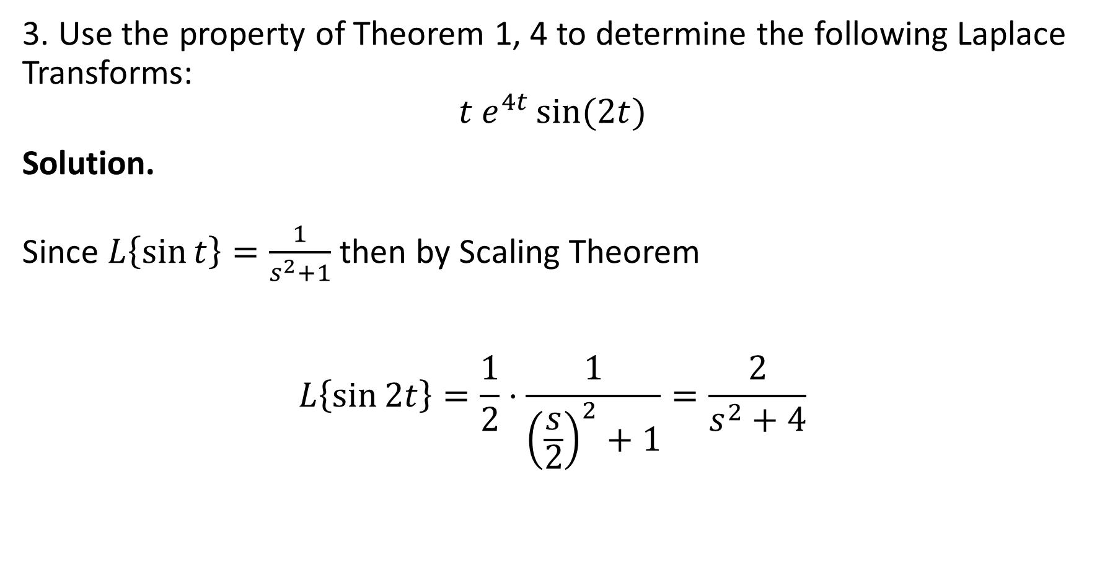
Solutions to the home exercises
3. Use the property of Theorem 1, 4 to determine the following Laplace Transforms:
$$t e^{4t}\sin{(2t)}$$
Solution.
Since $L\left\{\sin{t}\right\}=\frac{1}{s^{2}+1}$ then by Scaling Theorem
$$L\left\{\sin{2t}\right\}=\frac{1}{2}⋅\frac{1}{{\left(\frac{s}{2}\right)}^{2}+1}=\frac{2}{s^{2}+4}$$

Slide 13
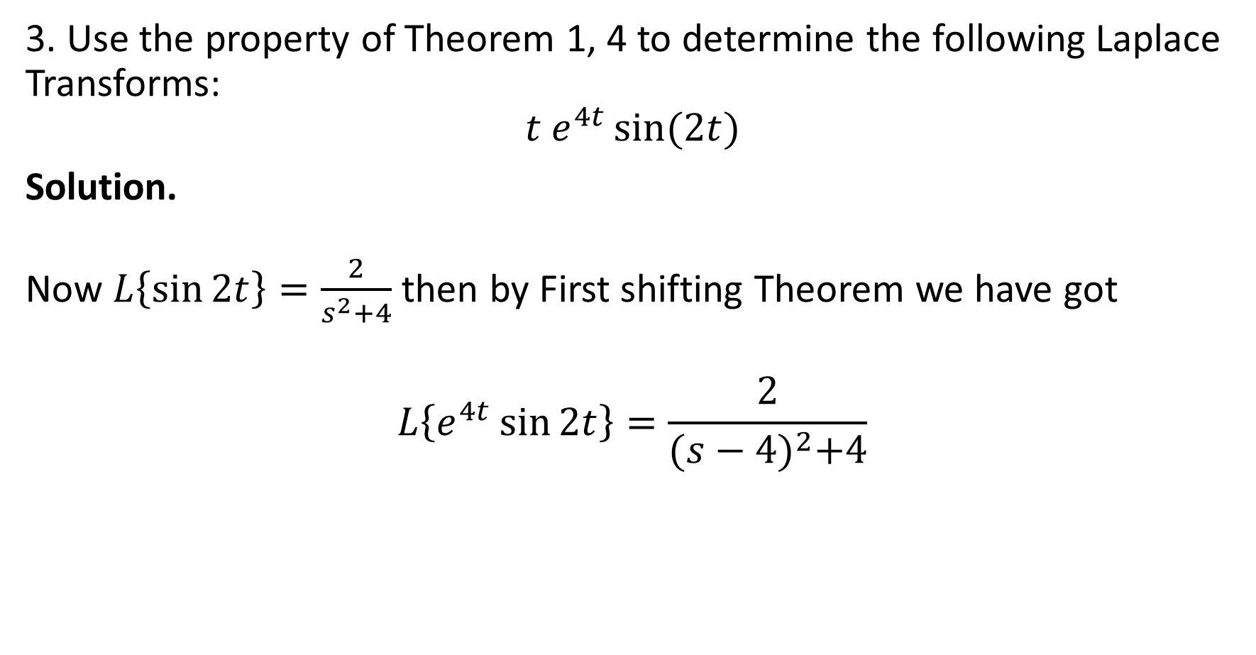
Solutions to the home exercises
3. Use the property of Theorem 1, 4 to determine the following Laplace Transforms:
$$t e^{4t}\sin{(2t)}$$
Solution.
Now $L\left\{\sin{2t}\right\}=\frac{2}{s^{2}+4}$ then by First shifting Theorem we have got
$$L\left\{e^{4t}\sin{2t}\right\}=\frac{2}{{(s−4)}^{2}+4}$$

Slide 14

Solutions to the home exercises
3. Use the property of Theorem 1, 4 to determine the following Laplace Transforms:
$$t e^{4t}\sin{(2t)}$$
Solution.
Further if $L\left\{e^{4t}\sin{2t}\right\}=\frac{2}{{(s−4)}^{2}+4}$ then by Theorem 4 (about differentiation of LT) we have got
$$L\left\{t e^{4t}\sin{2t}\right\}=−{\left(\frac{2}{{\left(s−4\right)}^{2}+4}\right)}^{′}$$
$$=−2⋅\frac{2(s−4)}{{\left({\left(s−4\right)}^{2}+4\right)}^{2} }$$
$$=\frac{4(s−4)}{{\left(s^{2}−8s+20\right)}^{2} }$$

Slide 15
Derivative property of the Laplace Transform

Slide 16
The Plan of the lecture
The Laplace Transform of derivative
Integration of the Laplace Transform
The Laplace Transform of the integral
Table of the Laplace Transforms
Homework

Slide 17

Laplace Transform of derivative
Theorem 1. If $L\left\{f\left(t\right)\right\}=F(s)$ then $L\left\{f′\left(t\right)\right\}=sF\left(s\right)−f(0)$.
Moreover
$$L\{f^{\left(n\right)}\left(t\right)\}=s^{n}F\left(s\right)−s^{n−1}f\left(0\right)−s^{n−2}f^{′}\left(0\right)−…−f^{\left(n−1\right)}(0)$$

Slide 18

Laplace Transform of derivative
Proof.
$$L\left\{f′\left(t\right)\right\}=\int_{0}^{+∞}{f′\left(t\right)} e^{−st}dt=\int_{0}^{+∞}{e^{−st}d f(t)}$$
$$={\left[e^{−st} f\left(t\right)\right]}_{t=0}^{t=+∞}−\int_{0}^{+∞}{f\left(t\right)de^{−st}}$$
$$=−f\left(0\right)+s\int_{0}^{+∞}{f\left(t\right)e^{−st}dt}$$
$$=sF\left(s\right)−f(0).$$

Slide 19

Laplace Transform of derivative
Proof.
Taking most left-hand side of equations and most right-hand side of equations we get
$$L\left\{f′\left(t\right)\right\}=sF\left(s\right)−f(0)$$
or
$$L\left\{f′\left(t\right)\right\}=sL\{f(t)\} −f(0)$$

Slide 20
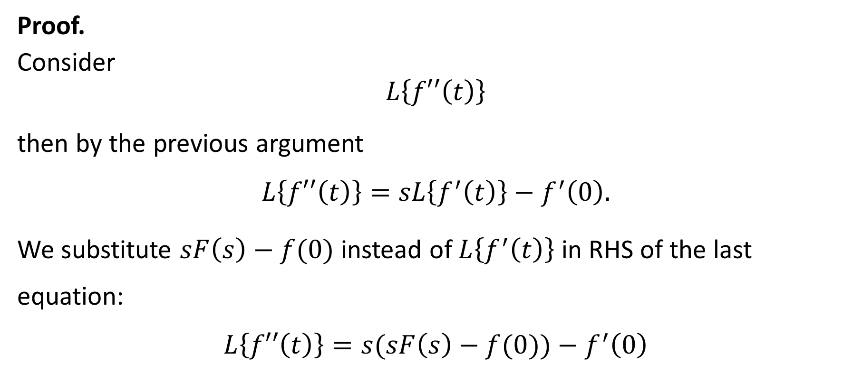
Laplace Transform of derivative
Proof.
Consider
$$L\left\{f′′\left(t\right)\right\}$$
then by the previous argument
$$L\left\{f′′\left(t\right)\right\}=sL\left\{f^{′}\left(t\right)\right\}−f^{′}\left(0\right).$$
We substitute $sF\left(s\right)−f(0)$ instead of $L\left\{f^{′}\left(t\right)\right\}$ in RHS of the last equation:
$$L\left\{f′′\left(t\right)\right\}=s(sF\left(s\right)−f(0))−f^{′}\left(0\right)$$

Slide 21
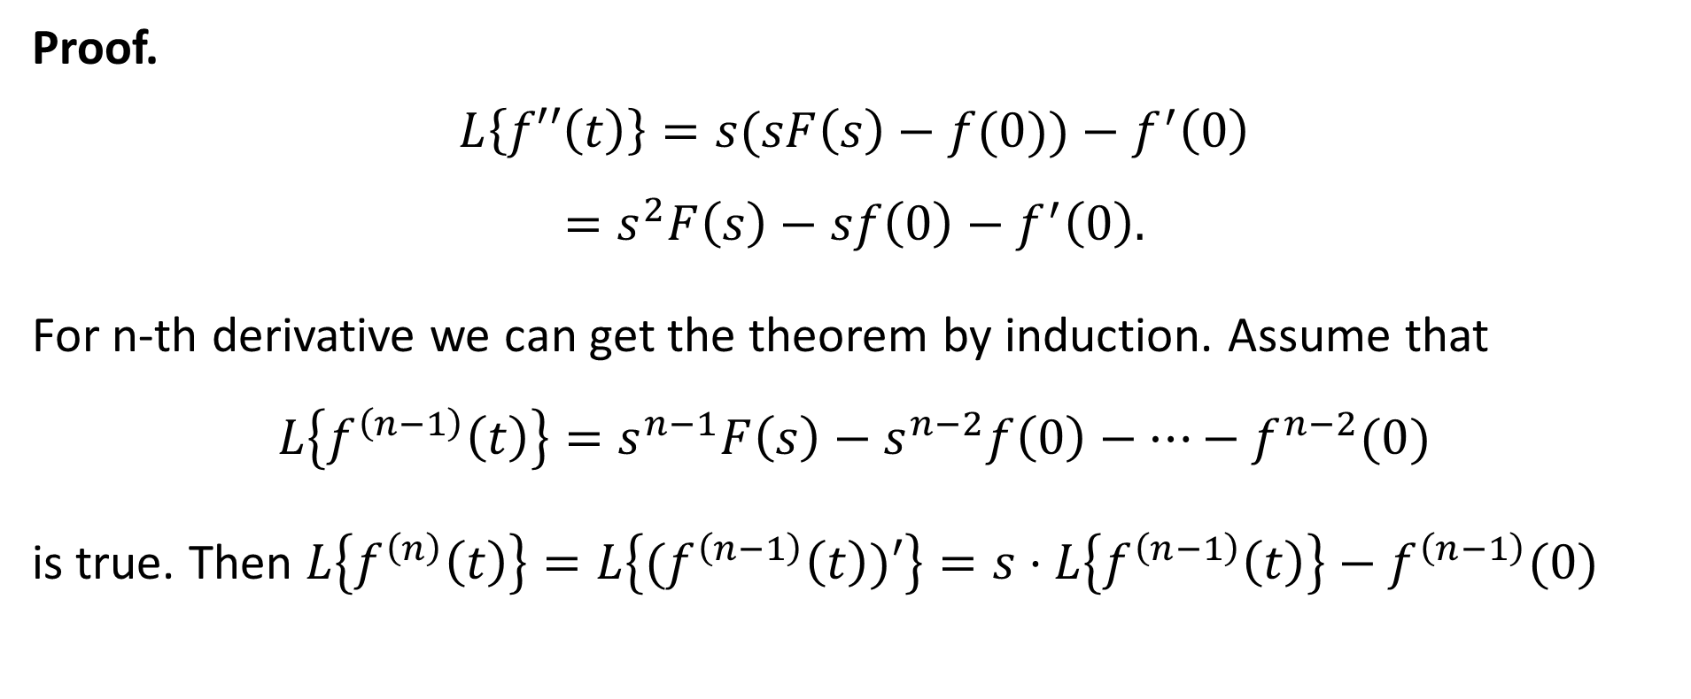
Laplace Transform of derivative
Proof.
$$L\left\{f′′\left(t\right)\right\}=s(sF\left(s\right)−f(0))−f^{′}\left(0\right)$$
$$=s^{2}F\left(s\right)−sf\left(0\right)−f^{′}\left(0\right).$$
For n-th derivative we can get the theorem by induction. Assume that
$$L\left\{f^{\left(n−1\right)}\left(t\right)\right\}=s^{n−1}F\left(s\right)−s^{n−2}f\left(0\right)−…−f^{n−2}(0)$$
is true. Then $L\left\{f^{\left(n\right)}\left(t\right)\right\}=L\left\{{(f}^{\left(n−1\right)}\left(t\right))′\right\}=s⋅L\left\{f^{\left(n−1\right)}\left(t\right)\right\}−f^{\left(n−1\right)}(0)$

Slide 22
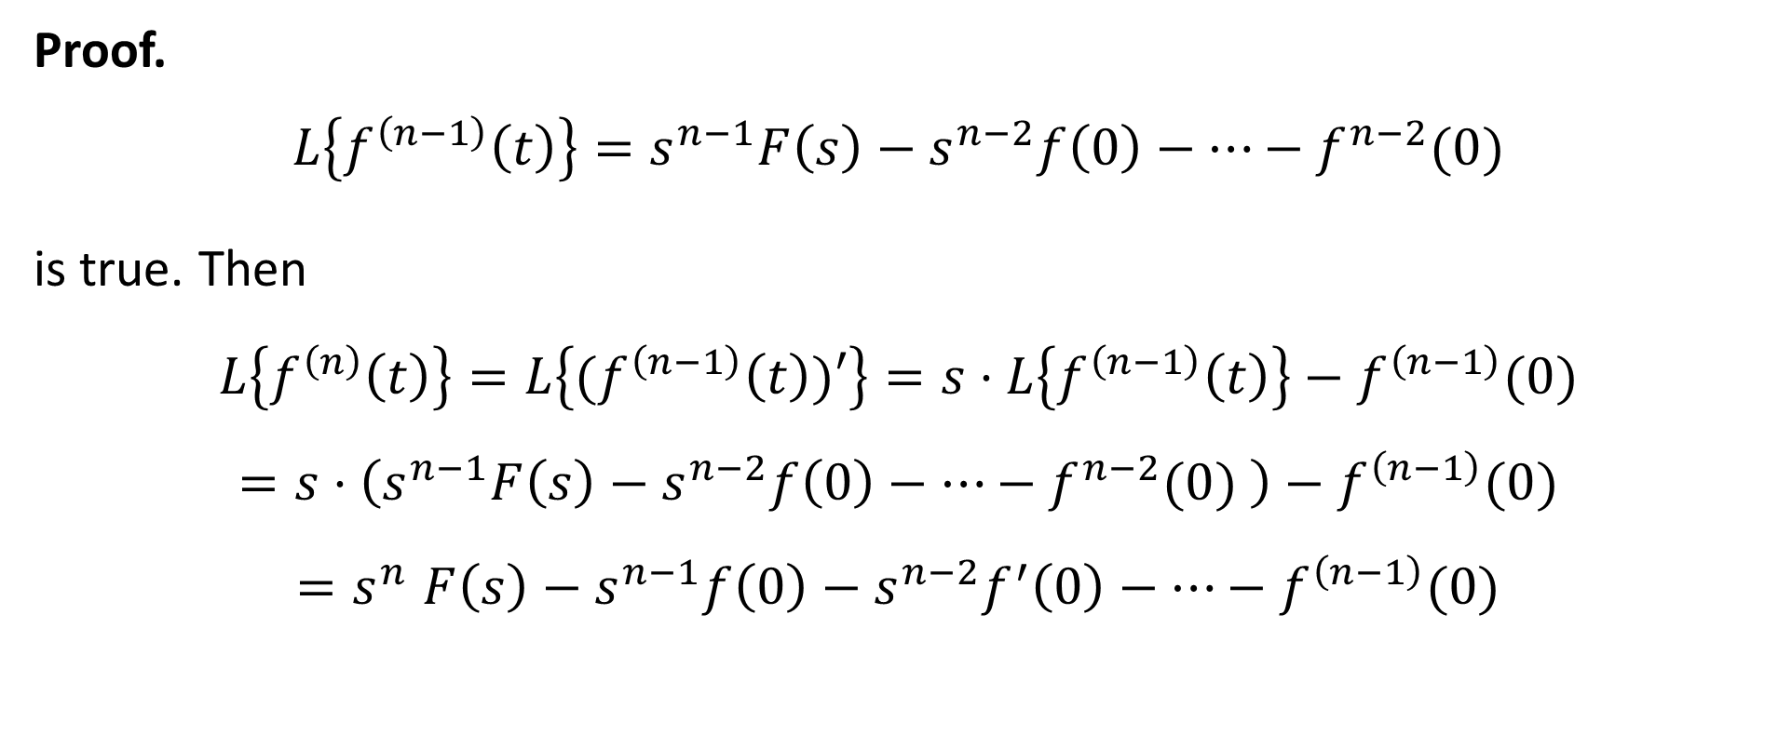
Laplace Transform of derivative
Proof.
$$L\left\{f^{\left(n−1\right)}\left(t\right)\right\}=s^{n−1}F\left(s\right)−s^{n−2}f\left(0\right)−…−f^{n−2}(0)$$
is true. Then
$$L\left\{f^{\left(n\right)}\left(t\right)\right\}=L\left\{{(f}^{\left(n−1\right)}\left(t\right))′\right\}=s⋅L\left\{f^{\left(n−1\right)}\left(t\right)\right\}−f^{\left(n−1\right)}(0)$$
$$=s⋅\left(s^{n−1}F\left(s\right)−s^{n−2}f\left(0\right)−…−f^{n−2}(0) \right)−f^{\left(n−1\right)}(0)$$
$${=s}^{n}F\left(s\right)−s^{n−1}f\left(0\right)−s^{n−2}f^{′}\left(0\right)−…−f^{\left(n−1\right)}(0)$$

Slide 23

An example for theorem 1
Exercise 1. Find the Laplace transform of $\cos{4t}$ if we know that
$L\left\{\sin{4t}\right\}=\frac{4}{s^{2}+16}$.

Slide 24
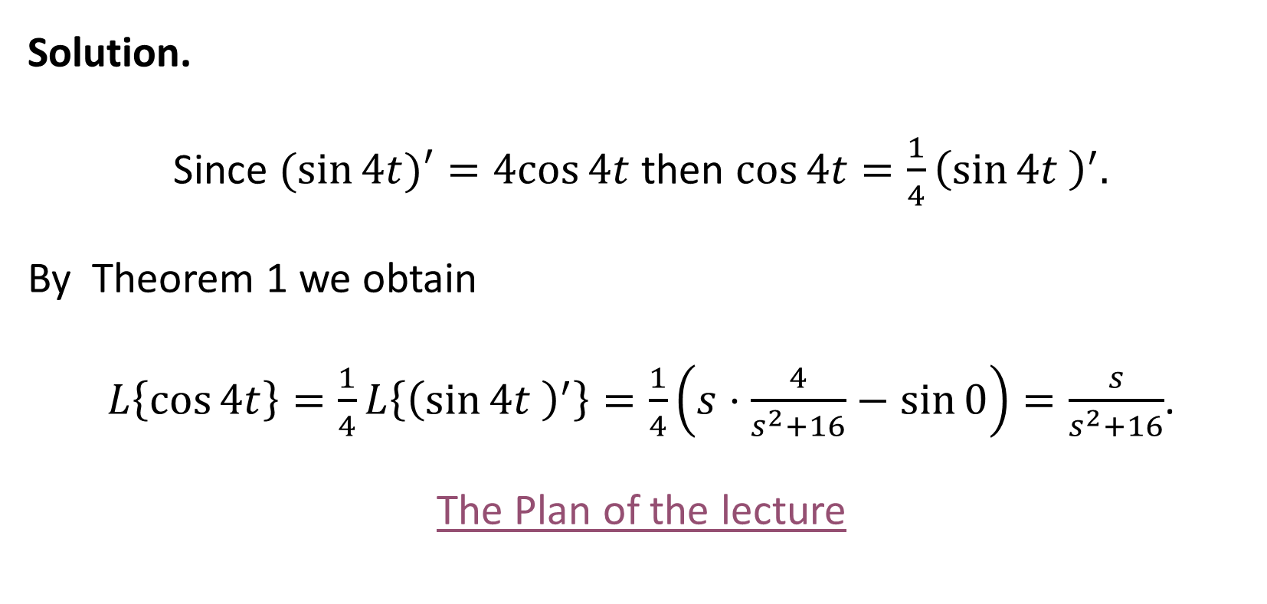
An example for theorem 1
Solution.
Since $(sin{4t)′=4cos⁡4t}$ then $\cos{4t}=\frac{1}{4}{\left(\sin{4t }\right)}^{′}.$
By Theorem 1 we obtain
$L\left\{\cos{4t}\right\}=\frac{1}{4}L\left\{{\left(\sin{4t }\right)}^{′}\right\}=\frac{1}{4}\left(s⋅\frac{4}{s^{2}+16}−\sin{0}\right)=\frac{s}{s^{2}+16}$.
The Plan of the lecture

Slide 25

Integration of the Laplace transform
Theorem 2. If $L\left\{f\left(t\right)\right\}=F(s)$,
$∃M>0, ∃ a≥0 , ∀ t≥0:\left|\frac{f\left(t\right)}{t}\right|≤M e^{at}$ then
$$L\left\{\frac{f\left(t\right)}{t}\right\}=\int_{s}^{+∞}{F\left(q\right)}dq.$$

Slide 26

Integration of the Laplace transform
Proof. We remark that
$$\frac{e^{−st}}{t}=\int_{s}^{+∞}{e^{−qt}dq}.$$
Then substitute RHS to
$$L\left\{\frac{f\left(t\right)}{t}\right\}=\int_{0}^{+∞}{\frac{f\left(t\right)e^{−st}}{t}}dt$$
instead of $\frac{e^{−st}}{t}$

Slide 27

Integration of the Laplace transform
$$L\left\{\frac{f\left(t\right)}{t}\right\}=\int_{0}^{+∞}{\frac{f\left(t\right)e^{−st}}{t}}dt=\int_{0}^{+∞}{f\left(t\right)}\int_{s}^{+∞}{e^{−qt}dq}dt$$
$$=\int_{s}^{+∞}{\left(\int_{0}^{+∞}{{f\left(t\right)e}^{−qt}dt}\right)dq=\int_{s}^{+∞}{F(q)dq}.}$$
The Plan of the lecture

Slide 28

Laplace transform of the integral
Theorem 3. If $L\left\{f\left(t\right)\right\}=F(s)$ then
$$L\left\{\int_{0}^{t}{f\left(u\right)du}\right\}=\frac{F\left(s\right)}{s}.$$

Slide 29
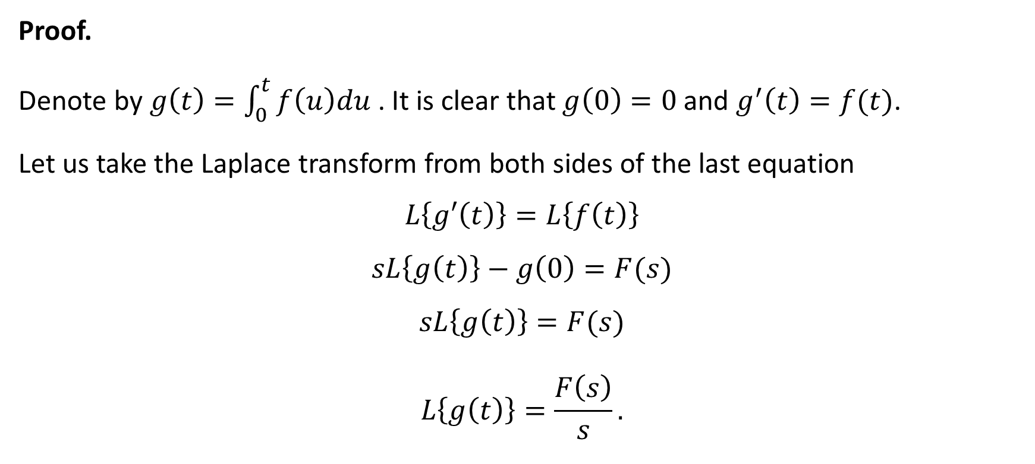
Laplace transform of the integral
Proof.
Denote by $g\left(t\right)=\int_{0}^{t}{f\left(u\right)du}$. It is clear that $g\left(0\right)=0$ and $g^{′}\left(t\right)=f(t)$.
Let us take the Laplace transform from both sides of the last equation
$$L\left\{g′\left(t\right)\right\}=L\left\{f\left(t\right)\right\}$$
$$sL\left\{g\left(t\right)\right\}−g\left(0\right)=F(s)$$
$$sL\left\{g\left(t\right)\right\}=F(s)$$
$$L\left\{g\left(t\right)\right\}=\frac{F\left(s\right)}{s}.$$

Slide 30
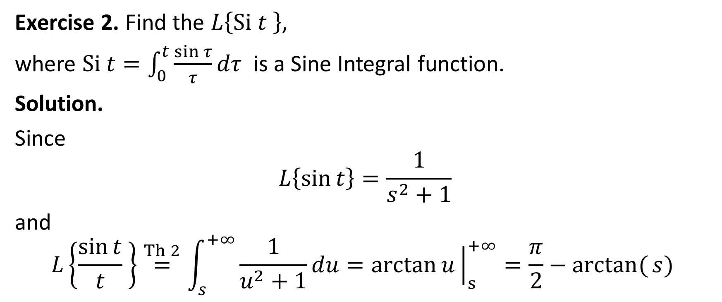
An example for theorem 3
Exercise 2. Find the $L\left\{Si t \right\}$,
where $Si t=\int_{0}^{t}{\frac{sin τ}{τ}{dτ}}$ is a Sine Integral function.
Solution.
Since
$$L\left\{\sin{t}\right\}=\frac{1}{s^{2}+1}$$
and
$$L\left\{\frac{\sin{t}}{t} \right\}\overset{Th 2}{=}\int_{s}^{+∞}{\frac{1}{u^{2}+1}du=\arctan{u}{\left.​\right|}_{s}^{+∞}=\frac{π}{2}−arctan({s)} }$$

Slide 31
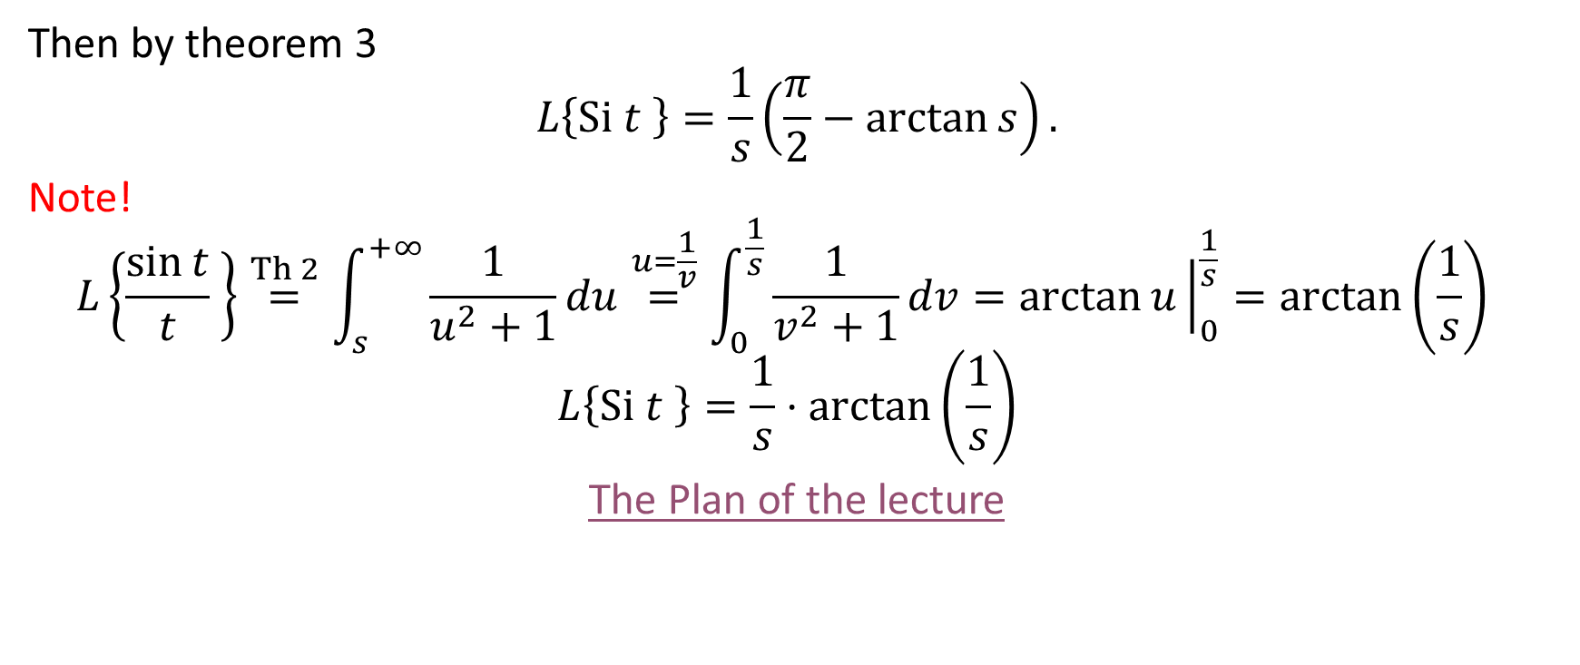
An example for theorem 3
Then by theorem 3
$$L\left\{Si t \right\}=\frac{1}{s}\left(\frac{π}{2}−\arctan{s}\right).$$
Note!
$$L\left\{\frac{\sin{t}}{t} \right\}\overset{Th 2}{=}\int_{s}^{+∞}{\frac{1}{u^{2}+1}du\overset{u=\frac{1}{v}}{=}\int_{0}^{\frac{1}{s}}{\frac{1}{v^{2}+1}dv}=\arctan{u}{\left.​\right|}_{0}^{\frac{1}{s}}=\arctan\left(\frac{1}{s}\right) }$$
$$L\left\{Si t \right\}=\frac{1}{s}⋅\arctan\left(\frac{1}{s}\right)$$
The Plan of the lecture

Slide 32
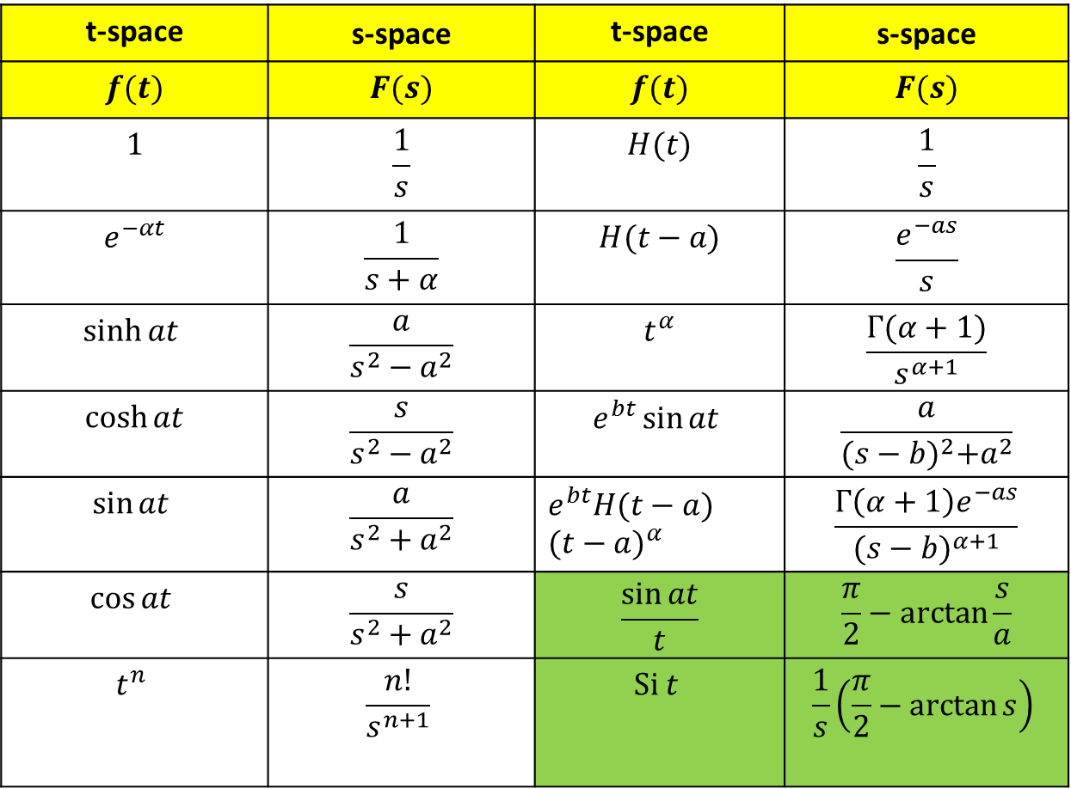
Table of the Laplace transforms
t-space | s-space | t-space | s-space
$$f(t)$$ | $$F(s)$$ | $$f(t)$$ | $$F(s)$$
$$1$$ | $$\frac{1}{s}$$ | $$H(t)$$ | $$\frac{1}{s}$$
$$e^{−αt}$$ | $$\frac{1}{s+α}$$ | $$H(t−a)$$ | $$\frac{e^{−as}}{s}$$
$$\sinh{at}$$ | $$\frac{a}{s^{2}−a^{2}}$$ | $$t^{α}$$ | $$\frac{Γ(α+1)}{s^{α+1}}$$
$$\cosh{at}$$ | $$\frac{s}{s^{2}−a^{2}}$$ | $$e^{bt}\sin{at}$$ | $$\frac{a}{{(s−b)}^{2}+a^{2}}$$
$$\sin{at}$$ | $$\frac{a}{s^{2}+a^{2}}$$ | $${e^{bt}H(t−a) (t−a)}^{α}$$ | $$\frac{Γ\left(α+1\right)e^{−as}}{{(s−b)}^{α+1}}$$
$$\cos{at}$$ | $$\frac{s}{s^{2}+a^{2}}$$ | $$\frac{\sin{at}}{t}$$ | $$\frac{π}{2}−\arctan{\frac{s}{a}}$$
$$t^{n}$$ | $$\frac{n!}{s^{n+1}}$$ | $$Si t$$ | $$\frac{1}{s}\left(\frac{π}{2}−\arctan{s}\right)$$

Slide 33

Homework
Prove that
$$L\left\{\int_{0}^{t}{\int_{0}^{v}{f\left(u\right)du}}dv\right\}=\frac{F\left(s\right)}{s^{2}}.$$
2. Find
$$L\left\{\int_{0}^{t}{\frac{\cos{au−\cos{bu}}}{u}du}\right\}.$$
3. Determine
$$L\left\{\frac{2\sin\left(t\right)⋅sinh⁡({t)} }{t}\right\}$$

