Slide 1
Mathematical Methods of Solid Mechanics
Aliaksandr Radyna Assoc. Prof.
DUT-BSU Joint Institute

Slide 2
The Inverse Laplace Transform

Slide 3
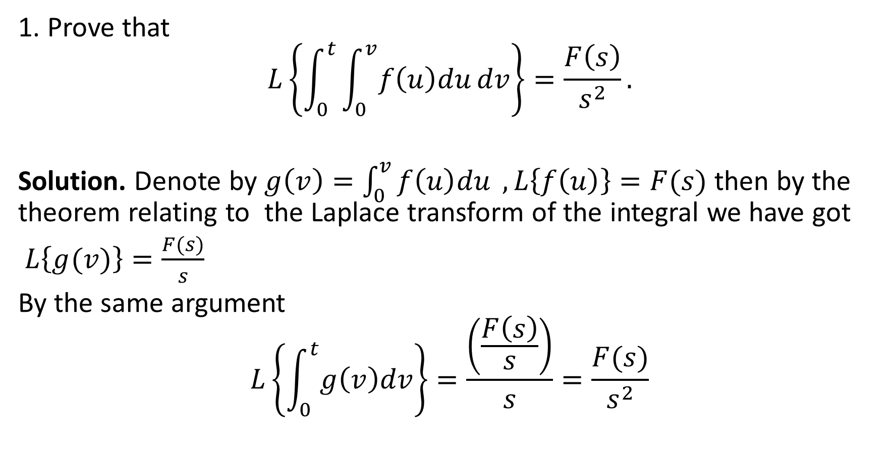
Solutions to the home exercises
1. Prove that
$$L\left\{\int_{0}^{t}{\int_{0}^{v}{f\left(u\right)du}}dv\right\}=\frac{F\left(s\right)}{s^{2}}.$$
Solution. Denote by $g\left(v\right)=\int_{0}^{v}{f\left(u\right)du} , L\left\{f\left(u\right)\right\}=F(s)$ then by the theorem relating to the Laplace transform of the integral we have got
$L\left\{g(v)\right\}=\frac{F(s)}{s}$
By the same argument
$$L\left\{\int_{0}^{t}{g\left(v\right)dv}\right\}=\frac{\left(\frac{F\left(s\right)}{s}\right)}{s}=\frac{F(s)}{s^{2}}$$

Slide 4
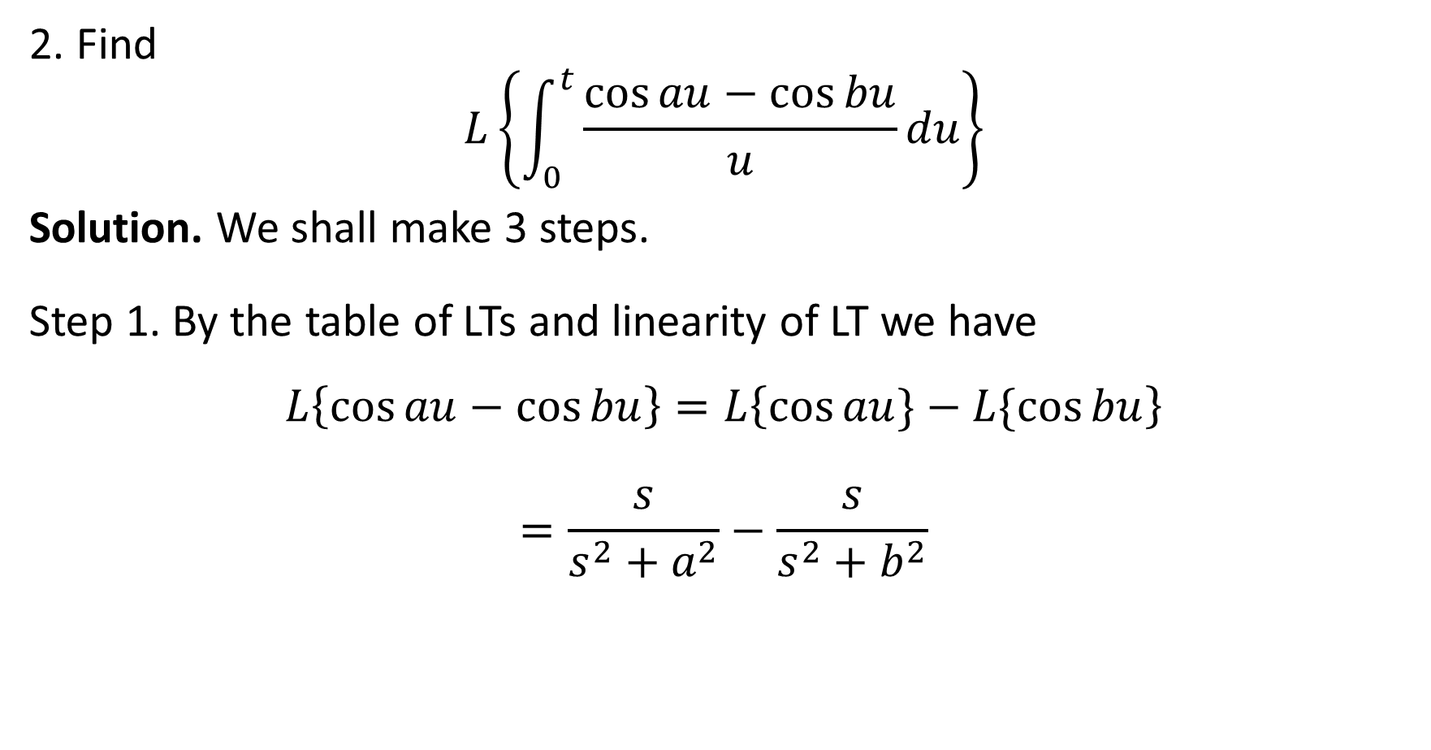
Solutions to the home exercises
2. Find
$$L\left\{\int_{0}^{t}{\frac{\cos{au−\cos{bu}}}{u}du}\right\}$$
Solution. We shall make 3 steps.
Step 1. By the table of LTs and linearity of LT we have
$$L\left\{\cos{au−\cos{bu}}\right\}=L\left\{\cos{au}\}−L\{\cos{bu}\right\}$$
$$=\frac{s}{s^{2}+a^{2}}−\frac{s}{s^{2}+b^{2}}$$

Slide 5

Solutions to the home exercises
2. Find
$$L\left\{\int_{0}^{t}{\frac{\cos{au−\cos{bu}}}{u}du}\right\}$$
Solution.
Step 2. By theorem 2 we have
$$L\left\{\frac{\cos{au−\cos{bu}}}{u}\right\}=\int_{q}^{+∞}{\frac{s}{s^{2}+a^{2}}−\frac{s}{s^{2}+b^{2}}ds}$$
$$={\left[\frac{1}{2}\ln{\frac{s^{2}+a^{2}}{s^{2}+b^{2}}}\right]}_{q}^{∞}=\frac{1}{2}\ln{\frac{q^{2}+b^{2}}{q^{2}+a^{2}}}$$

Slide 6

Solutions to the home exercises
2. Find
$$L\left\{\int_{0}^{t}{\frac{\cos{au−\cos{bu}}}{u}du}\right\}$$
Solution.
Step 3. By theorem 3 we have
$$L\left\{\int_{0}^{t}{\frac{\cos{au−\cos{bu}}}{u}}\right\}=\frac{1}{2s}\ln{\frac{s^{2}+b^{2}}{s^{2}+a^{2}}}.$$

Slide 7
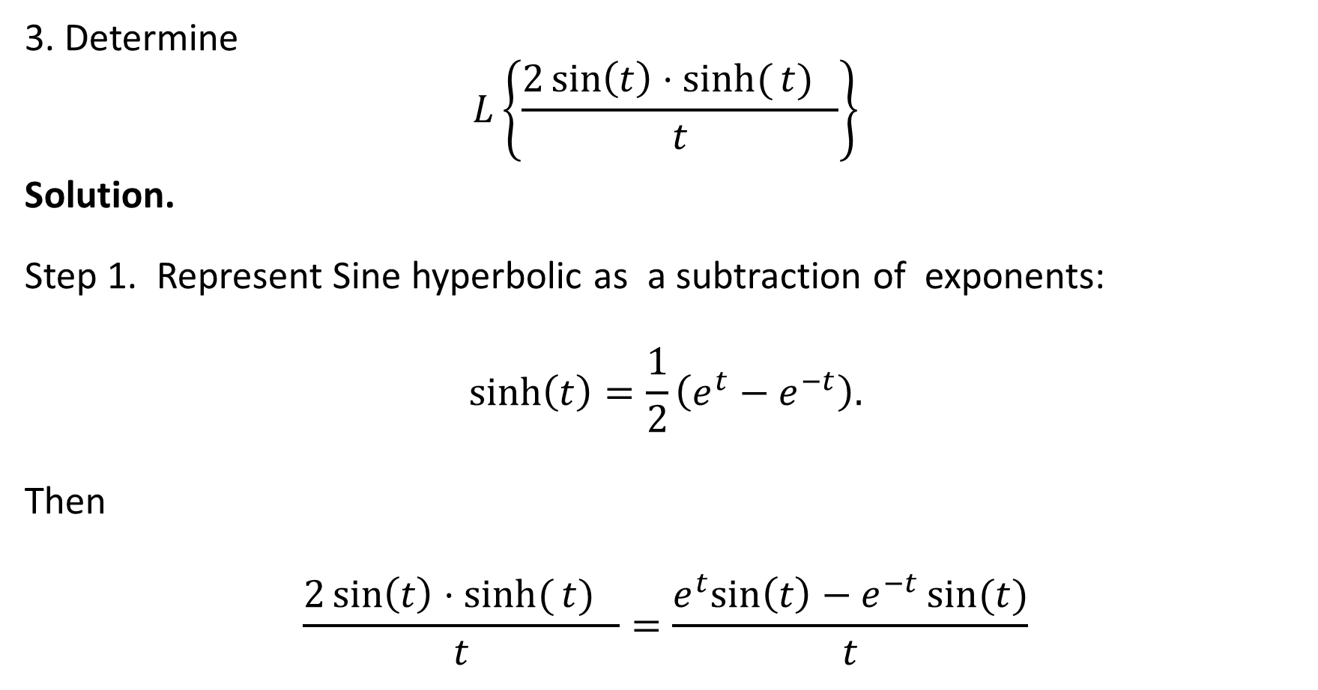
Solutions to the home exercises
3. Determine
$$L\left\{\frac{2\sin\left(t\right)⋅sinh⁡({t)} }{t}\right\}$$
Solution.
Step 1. Represent Sine hyperbolic as a subtraction of exponents:
$$\sinh\left(t\right)=\frac{1}{2}\left(e^{t}−e^{−t}\right).$$
Then
$$\frac{2\sin\left(t\right)⋅sinh⁡({t)} }{t}=\frac{e^{t}sin\left(t\right)−e^{−t}\sin{(t)}}{t}$$

Slide 8
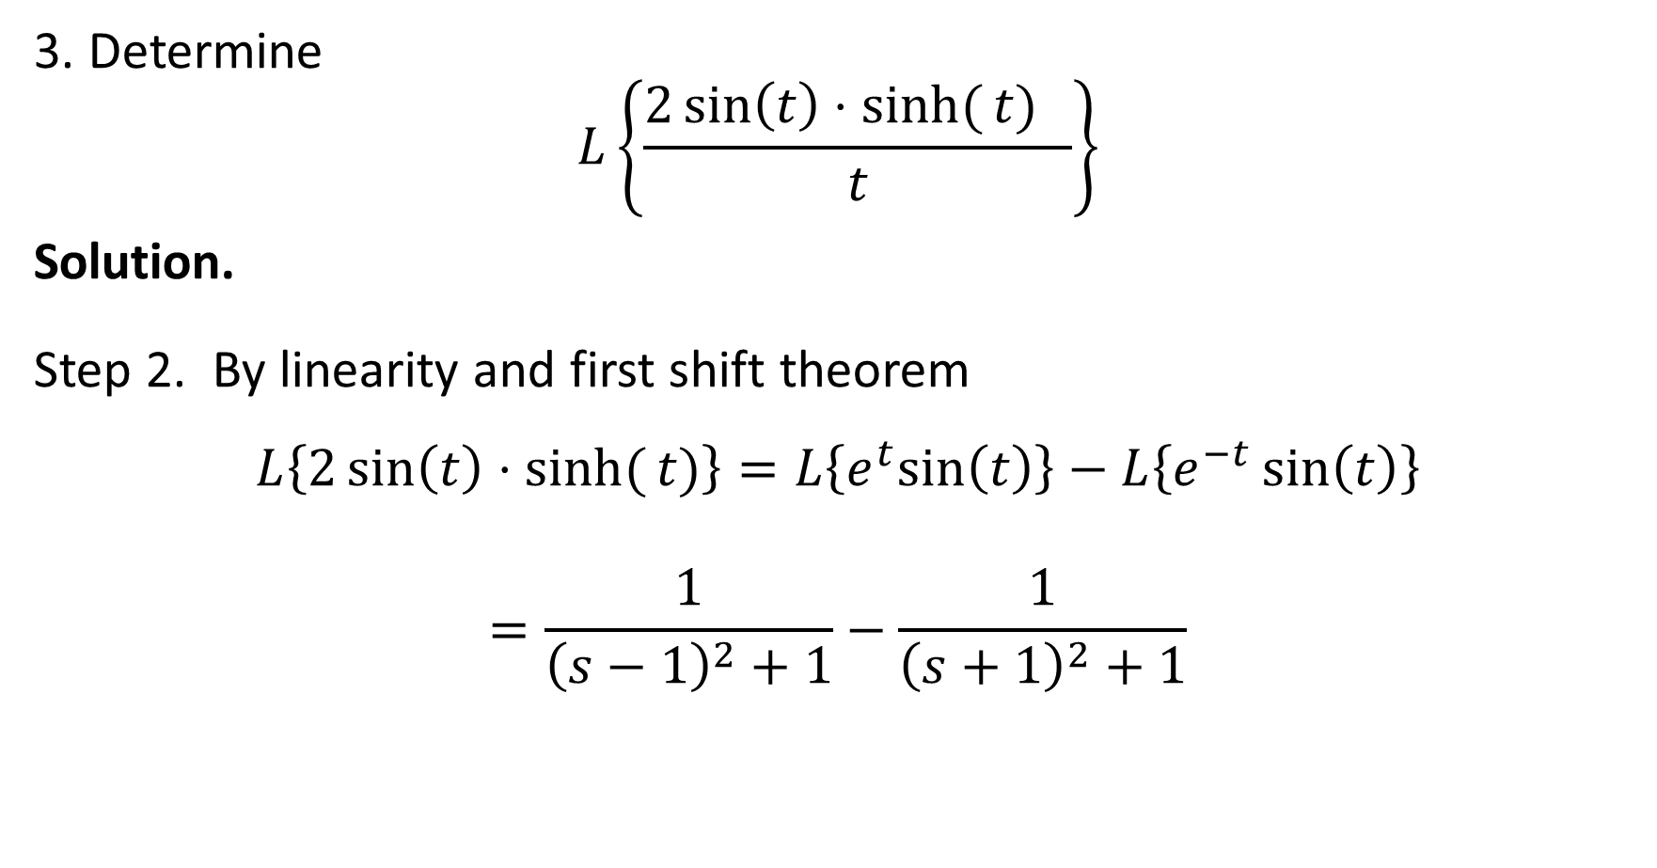
Solutions to the home exercises
3. Determine
$$L\left\{\frac{2\sin\left(t\right)⋅sinh⁡({t)} }{t}\right\}$$
Solution.
Step 2. By linearity and first shift theorem
$$L\left\{2\sin\left(t\right)⋅sinh⁡({t)}\right\}=L\left\{e^{t}sin\left(t\right)\right\}−L\left\{e^{−t}\sin\left(t\right)\right\}$$
$$=\frac{1}{{\left(s−1\right)}^{2}+1}−\frac{1}{{\left(s+1\right)}^{2}+1}$$

Slide 9
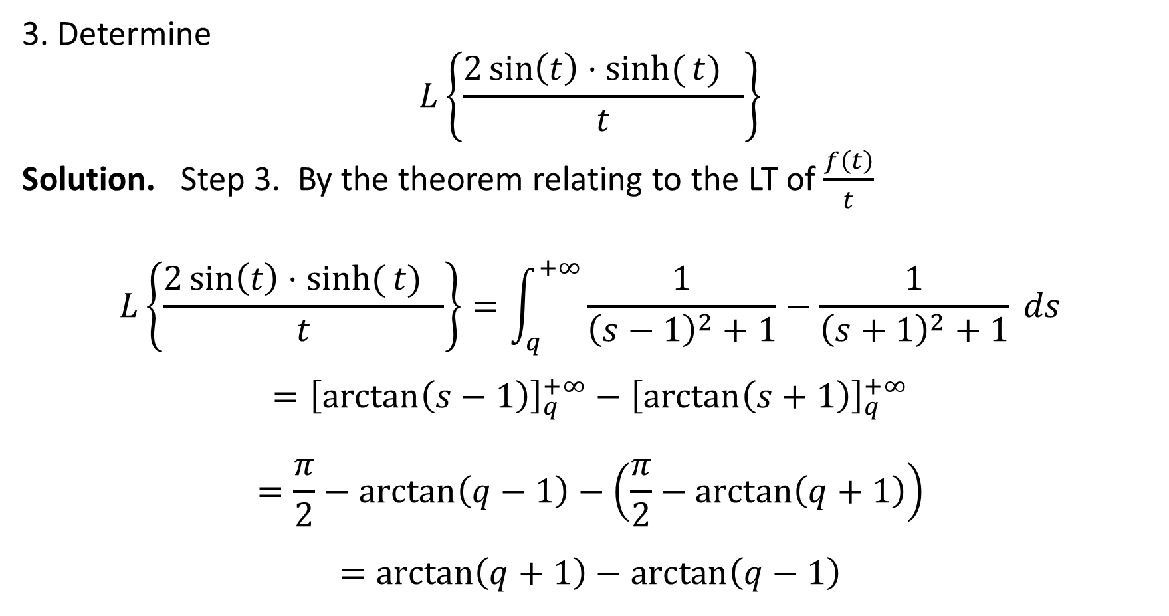
Solutions to the home exercises
3. Determine
$$L\left\{\frac{2\sin\left(t\right)⋅sinh⁡({t)} }{t}\right\}$$
Solution. Step 3. By the theorem relating to the LT of $\frac{f\left(t\right)}{t}$
$$L\left\{\frac{2\sin\left(t\right)⋅sinh⁡({t)} }{t}\right\}=\int_{q}^{+∞}{\frac{1}{{\left(s−1\right)}^{2}+1}−\frac{1}{{\left(s+1\right)}^{2}+1} }ds$$
$$={\left[\arctan\left(s−1\right)\right]}_{q}^{+∞}−{\left[\arctan\left(s+1\right)\right]}_{q}^{+∞}$$
$$=\frac{π}{2}−arctan\left(q−1\right)−\left(\frac{π}{2}−\arctan\left(q+1\right)\right)$$
$$=\arctan\left(q+1\right)−\arctan\left(q−1\right)$$

Slide 10
The Inverse Laplace Transform

Slide 11

Definition of Inverse Laplace transform
Definition 1. If $L\left\{f\left(t\right)\right\}=F(s)$ then the inverse Laplace transform is defined by
$L^{−1}\left\{F(s)\right\}=f(t)$.

Slide 12
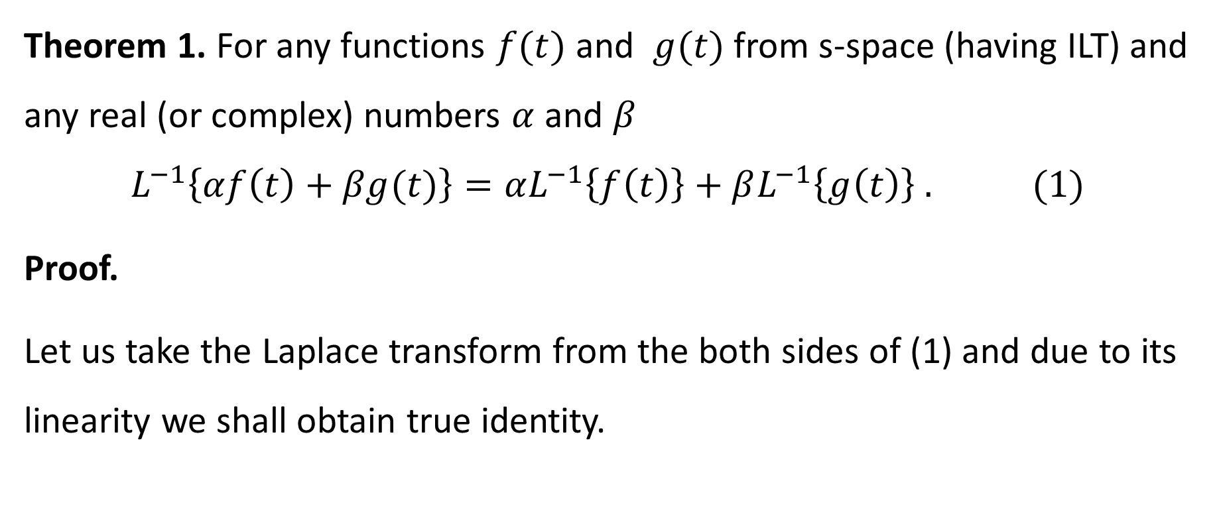
Linearity of the Inverse Laplace Transform
Theorem 1. For any functions $f(t)$ and $g(t)$ from s-space (having ILT) and any real (or complex) numbers $α$ and $β$
$$L^{−1}\left\{αf\left(t\right)+βg(t)\right\}=αL^{−1}\left\{f\left(t\right)\right\}+βL^{−1}\left\{g\left(t\right)\right\} . (1)$$
Proof.
Let us take the Laplace transform from the both sides of (1) and due to its linearity we shall obtain true identity.

Slide 13
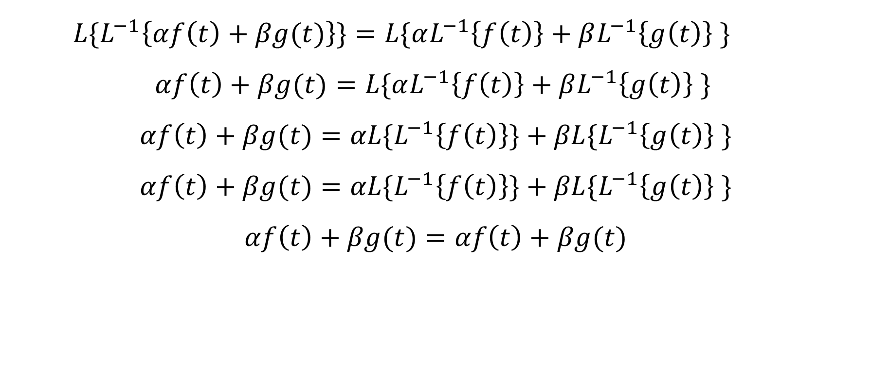
Linearity of the Inverse Laplace Transform
$${L\{L}^{−1}\left\{αf\left(t\right)+βg(t)\right\}\}=L\{αL^{−1}\left\{f\left(t\right)\right\}+βL^{−1}\left\{g\left(t\right)\right\} \}$$
$$αf\left(t\right)+βg(t)=L\{αL^{−1}\left\{f\left(t\right)\right\}+βL^{−1}\left\{g\left(t\right)\right\} \}$$
$$αf\left(t\right)+βg(t)=αL\{L^{−1}\left\{f\left(t\right)\right\}\}+βL\{L^{−1}\left\{g\left(t\right)\right\} \}$$
$$αf\left(t\right)+βg(t)=αL\{L^{−1}\left\{f\left(t\right)\right\}\}+βL\{L^{−1}\left\{g\left(t\right)\right\} \}$$
$$αf\left(t\right)+βg(t)=αf\left(t\right)+βg(t)$$

Slide 14
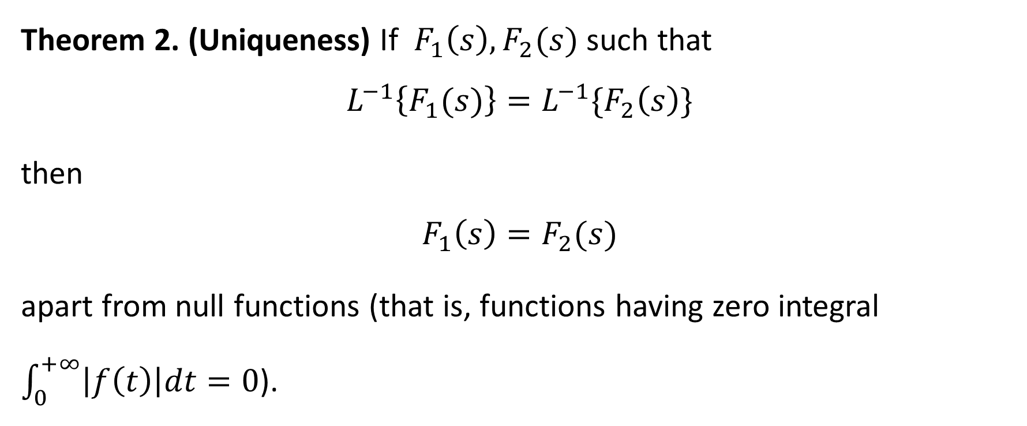
Uniqueness of the Inverse Laplace Transform
Theorem 2. (Uniqueness) If $F_{1}\left(s\right), F_{2}(s)$ such that
$$L^{−1}\left\{F_{1}(s)\right\}=L^{−1}\{F_{2}\left(s\right)\}$$
then
$$F_{1}\left(s\right)=F_{2}(s)$$
apart from null functions (that is, functions having zero integral $\int_{0}^{+∞}{\left|f\left(t\right)\right|dt=0}$).

Slide 15
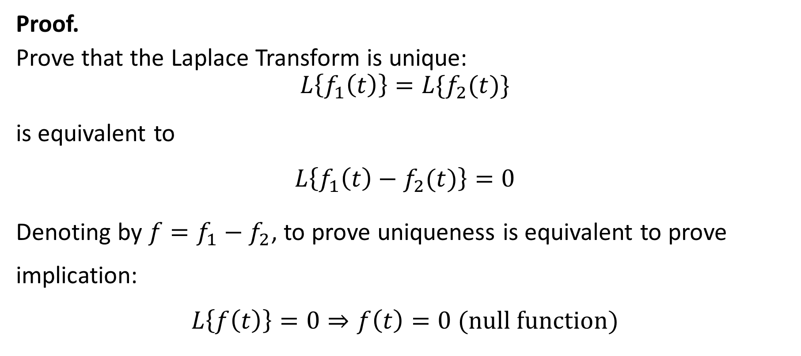
Uniqueness of the Inverse Laplace Transform
Proof.
Prove that the Laplace Transform is unique:
$$L\left\{f_{1}\left(t\right)\right\}=L\{f_{2}(t)\}$$
is equivalent to
$$L\left\{f_{1}\left(t\right)−f_{2}(t)\right\}=0$$
Denoting by $f=f_{1}−f_{2}$, to prove uniqueness is equivalent to prove implication:
$$L\left\{f\left(t\right)\right\}=0⇒f\left(t\right)=0 (null function)$$

Slide 16
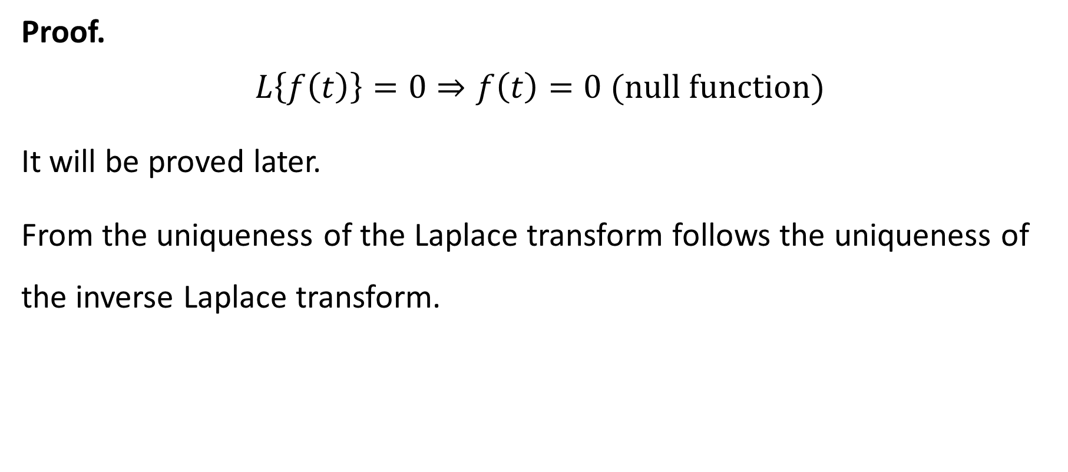
Uniqueness of the Inverse Laplace Transform
Proof.
$$L\left\{f\left(t\right)\right\}=0⇒f\left(t\right)=0 (null function)$$
It will be proved later.
From the uniqueness of the Laplace transform follows the uniqueness of the inverse Laplace transform.

Slide 17
Examples of the Inverse Laplace Transform

Slide 18
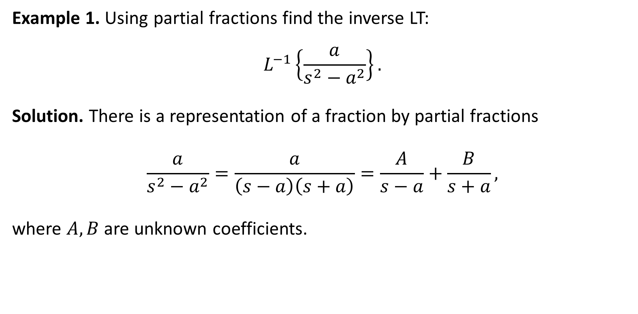
Example 1. Using partial fractions find the inverse LT:
$$L^{−1}\left\{\frac{a}{s^{2}−a^{2}}\right\}.$$
Solution. There is a representation of a fraction by partial fractions
$$\frac{a}{s^{2}−a^{2}}=\frac{a}{\left(s−a\right)\left(s+a\right)}=\frac{A}{s−a}+\frac{B}{s+a},$$
where $A, B$ are unknown coefficients.

Slide 19
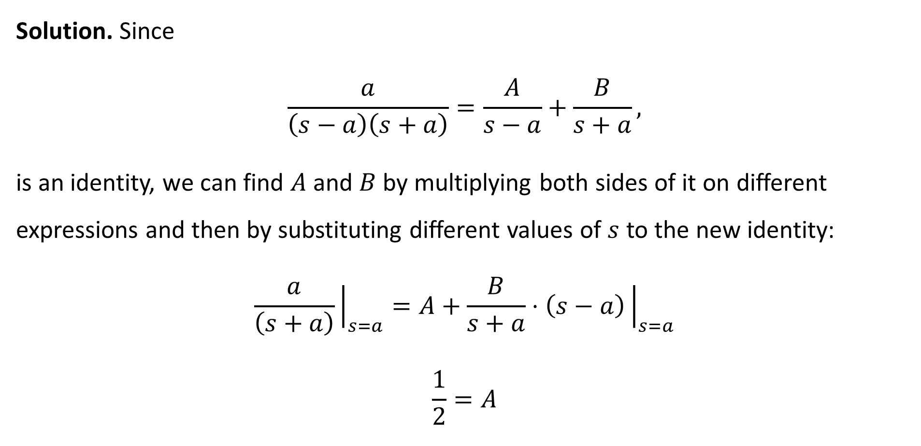
Solution. Since
$$\frac{a}{\left(s−a\right)\left(s+a\right)}=\frac{A}{s−a}+\frac{B}{s+a},$$
is an identity, we can find $A$ and $B$ by multiplying both sides of it on different expressions and then by substituting different values of $s$ to the new identity:
$$\frac{a}{\left(s+a\right)}{\left.​\right|}_{s=a}=A+\frac{B}{s+a}⋅\left(s−a\right){\left.​\right|}_{s=a}$$
$$\frac{1}{2}=A$$

Slide 20

Solution. The same procedure can be applied for parameter $B$:
$$\frac{a}{\left(s−a\right)\left(s+a\right)}=\frac{\frac{1}{2}}{s−a}+\frac{B}{s+a} |×(s+a),$$
$$\frac{a}{\left(s−a\right)}{\left.​\right|}_{s=−a}=\frac{1}{2}⋅\frac{\left(s+a\right)}{s−a}+B{\left.​\right|}_{s=−a}$$
$$−\frac{1}{2}=B$$

Slide 21

Solution. Therefore,
$$\frac{a}{\left(s−a\right)\left(s+a\right)}=\frac{\frac{1}{2}}{s−a}−\frac{\frac{1}{2}}{s+a}$$
$$L^{−1}\left\{\frac{a}{s^{2}−a^{2}}\right\}=L^{−1}\left\{\frac{a}{\left(s−a\right)\left(s+a\right)}\right\}=\frac{1}{2}L^{−1}\left\{\frac{1}{s−a}\right\}−\frac{1}{2}L^{−1}\left\{\frac{1}{s+a}\right\}$$
$$=\frac{1}{2}e^{at}−\frac{1}{2}e^{−at}=\sinh{(at)}$$

Slide 22
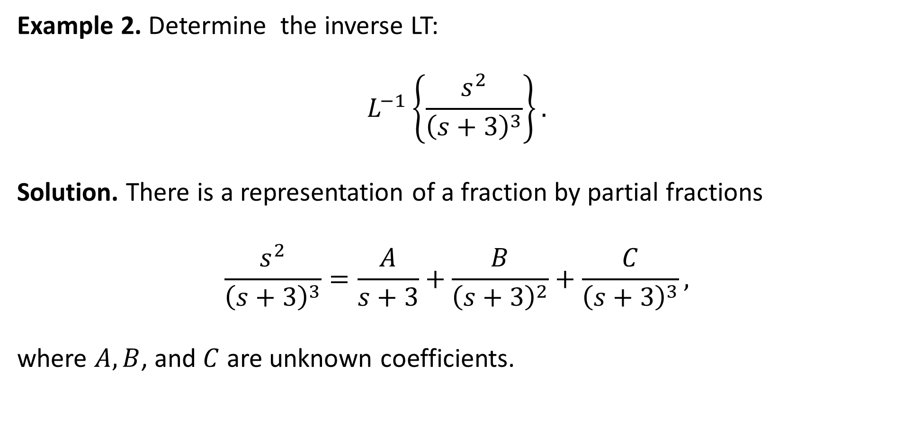
Example 2. Determine the inverse LT:
$$L^{−1}\left\{\frac{s^{2}}{{\left(s+3\right)}^{3}}\right\}.$$
Solution. There is a representation of a fraction by partial fractions
$$\frac{s^{2}}{{\left(s+3\right)}^{3}}=\frac{A}{s+3}+\frac{B}{{\left(s+3\right)}^{2}}+\frac{C}{{\left(s+3\right)}^{3}},$$
where $A, B$, and $C$ are unknown coefficients.

Slide 23
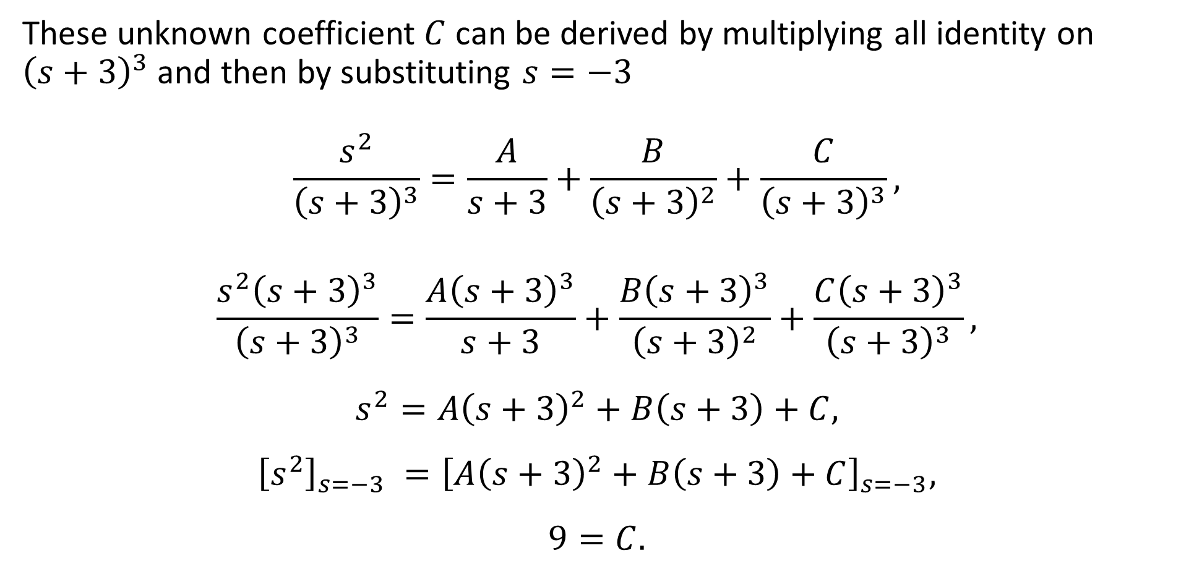
These unknown coefficient $C$ can be derived by multiplying all identity on ${\left(s+3\right)}^{3}$ and then by substituting $s=−3$
$$\frac{s^{2}}{{\left(s+3\right)}^{3}}=\frac{A}{s+3}+\frac{B}{{\left(s+3\right)}^{2}}+\frac{C}{{\left(s+3\right)}^{3}},$$
$$\frac{s^{2}{\left(s+3\right)}^{3}}{{\left(s+3\right)}^{3}}=\frac{A{\left(s+3\right)}^{3}}{s+3}+\frac{B{\left(s+3\right)}^{3}}{{\left(s+3\right)}^{2}}+\frac{C{\left(s+3\right)}^{3}}{{\left(s+3\right)}^{3}},$$
$$s^{2}=A{\left(s+3\right)}^{2}+B\left(s+3\right)+C,$$
$${\left[s^{2}\right]}_{s=−3} ={\left[A{\left(s+3\right)}^{2}+B\left(s+3\right)+C\right]}_{s=−3},$$
$$9=C.$$

Slide 24
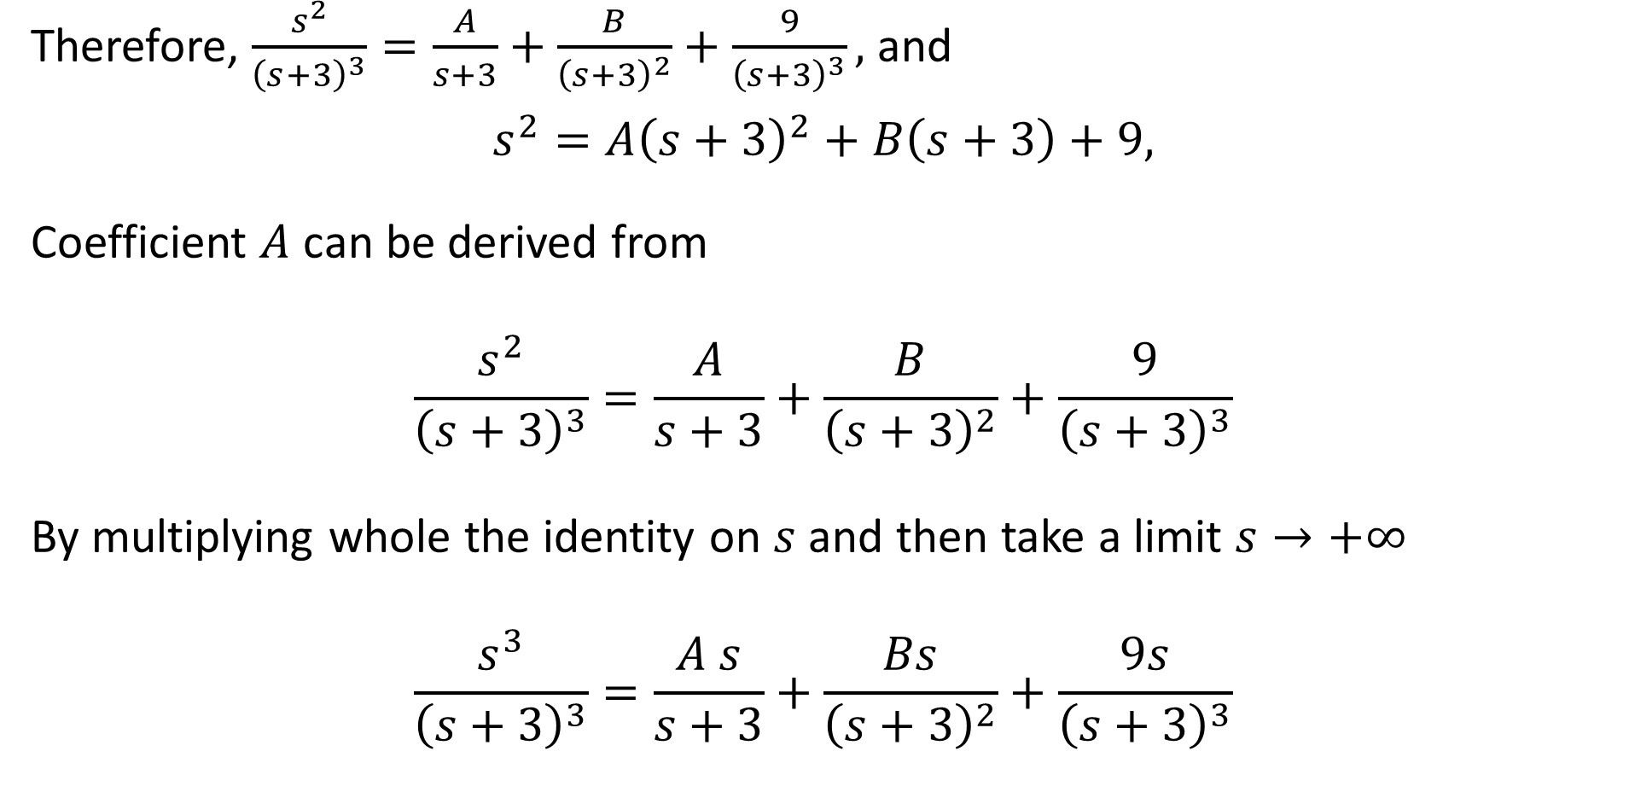
Therefore, $\frac{s^{2}}{{\left(s+3\right)}^{3}}=\frac{A}{s+3}+\frac{B}{{\left(s+3\right)}^{2}}+\frac{9}{{\left(s+3\right)}^{3}},$ and
$$s^{2}=A{\left(s+3\right)}^{2}+B\left(s+3\right)+9,$$
Coefficient $A$ can be derived from
$$\frac{s^{2}}{{\left(s+3\right)}^{3}}=\frac{A}{s+3}+\frac{B}{{\left(s+3\right)}^{2}}+\frac{9}{{\left(s+3\right)}^{3}}$$
By multiplying whole the identity on $s$ and then take a limit $s→+∞$
$$\frac{s^{3}}{{\left(s+3\right)}^{3}}=\frac{A s}{s+3}+\frac{Bs}{{\left(s+3\right)}^{2}}+\frac{9s}{{\left(s+3\right)}^{3}}$$

Slide 25

$$\lim_{s→+∞}{\frac{s^{3}}{{\left(s+3\right)}^{3}}}=\lim_{s→+∞}\frac{A s}{s+3}+\lim_{s→+∞}\frac{Bs}{{\left(s+3\right)}^{2}}+\lim_{s→+∞}\frac{9s}{{\left(s+3\right)}^{3}}$$
$$1=A+0+0$$
So, $A=1$.

Slide 26

The coefficient $B$ can be obtained from the equality
$s^{2}=A{\left(s+3\right)}^{2}+B\left(s+3\right)+9$
$s^{2}={\left(s+3\right)}^{2}+B\left(s+3\right)+9$
by substituting into it $s=0$:
$0^{2}={\left(0+3\right)}^{2}+B\left(0+3\right)+9$
$$0=3B+18$$
$B=−6$

Slide 27

Resuming, $A=1, B=−6, C=9$ we have
$$\frac{s^{2}}{{\left(s+3\right)}^{3}}=\frac{1}{s+3}−\frac{6}{{\left(s+3\right)}^{2}}+\frac{9}{{\left(s+3\right)}^{3}}$$
and
$$L^{−1}\left\{\frac{s^{2}}{{\left(s+3\right)}^{3}}\right\}=L^{−1}\left\{\frac{1}{s+3}\right\}−6L^{−1}\left\{\frac{1}{{\left(s+3\right)}^{2}}\right\}+{9L}^{−1}\left\{\frac{1}{{\left(s+3\right)}^{3}}\right\}$$

Slide 28
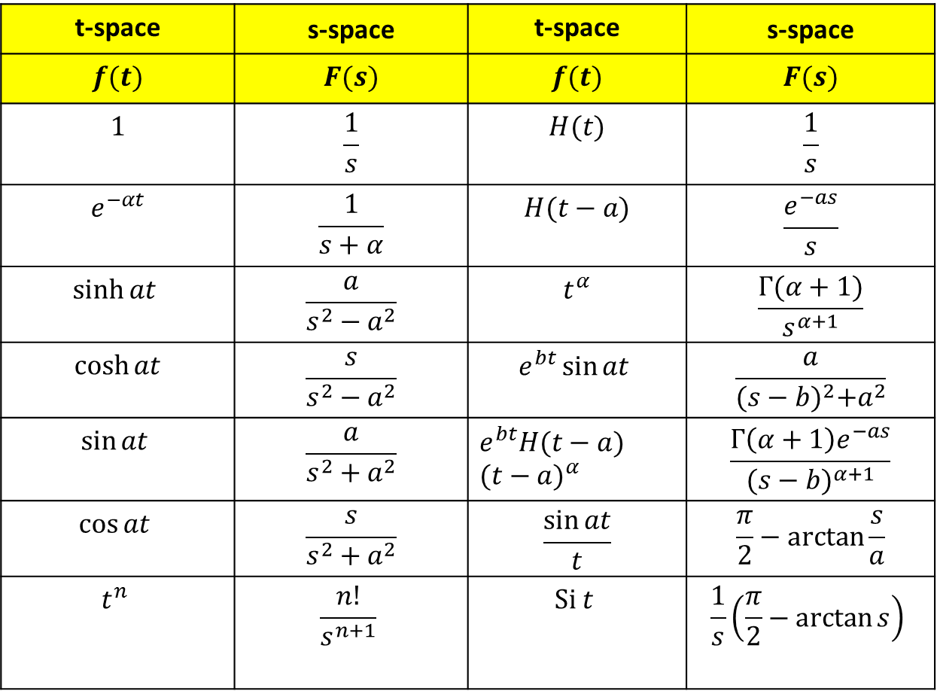
Laplace transform table
t-space | s-space | t-space | s-space
$$f(t)$$ | $$F(s)$$ | $$f(t)$$ | $$F(s)$$
$$1$$ | $$\frac{1}{s}$$ | $$H(t)$$ | $$\frac{1}{s}$$
$$e^{−αt}$$ | $$\frac{1}{s+α}$$ | $$H(t−a)$$ | $$\frac{e^{−as}}{s}$$
$$\sinh{at}$$ | $$\frac{a}{s^{2}−a^{2}}$$ | $$t^{α}$$ | $$\frac{Γ(α+1)}{s^{α+1}}$$
$$\cosh{at}$$ | $$\frac{s}{s^{2}−a^{2}}$$ | $$e^{bt}\sin{at}$$ | $$\frac{a}{{(s−b)}^{2}+a^{2}}$$
$$\sin{at}$$ | $$\frac{a}{s^{2}+a^{2}}$$ | $${e^{bt}H(t−a) (t−a)}^{α}$$ | $$\frac{Γ\left(α+1\right)e^{−as}}{{(s−b)}^{α+1}}$$
$$\cos{at}$$ | $$\frac{s}{s^{2}+a^{2}}$$ | $$\frac{\sin{at}}{t}$$ | $$\frac{π}{2}−\arctan{\frac{s}{a}}$$
$$t^{n}$$ | $$\frac{n!}{s^{n+1}}$$ | $$Si t$$ | $$\frac{1}{s}\left(\frac{π}{2}−\arctan{s}\right)$$

Slide 29

$$L^{−1}\left\{\frac{s^{2}}{{\left(s+3\right)}^{3}}\right\}=L^{−1}\left\{\frac{1}{s+3}\right\}−6L^{−1}\left\{\frac{1}{{\left(s+3\right)}^{2}}\right\}+{9L}^{−1}\left\{\frac{1}{{\left(s+3\right)}^{3}}\right\}$$
Due to Laplace transform table
$$L^{−1}\left\{\frac{s^{2}}{{\left(s+3\right)}^{3}}\right\}=L^{−1}\left\{\frac{1}{s+3}\right\}−6L^{−1}\left\{\frac{1}{{\left(s+3\right)}^{2}}\right\}+{9L}^{−1}\left\{\frac{1}{{\left(s+3\right)}^{3}}\right\}$$
$$L^{−1}\left\{\frac{s^{2}}{{\left(s+3\right)}^{3}}\right\}=e^{−3t}−6⋅e^{−3t}⋅t+9⋅\frac{1}{2!}e^{−3t}⋅t^{2}$$
$$L^{−1}\left\{\frac{s^{2}}{{\left(s+3\right)}^{3}}\right\}=e^{−3t}\left(1−6t+\frac{9}{2}t^{2}\right)$$

Slide 30
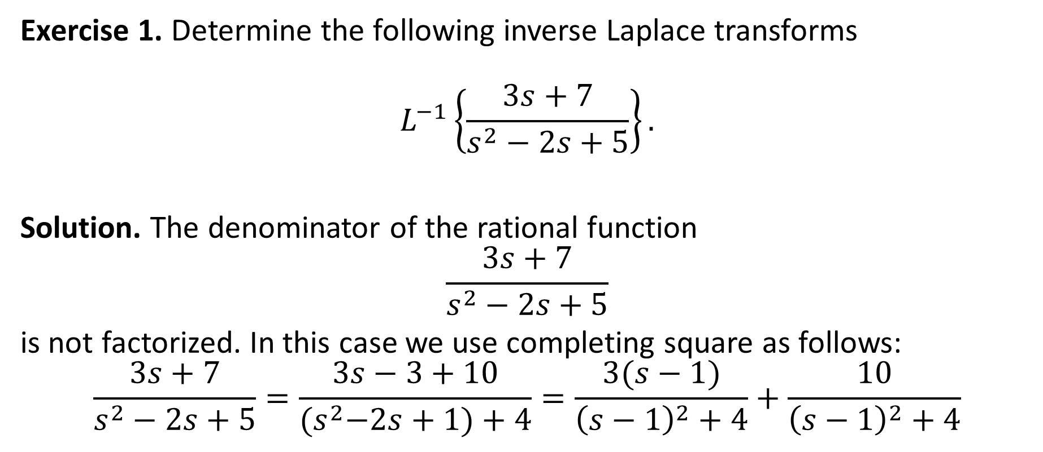
Exercise 1. Determine the following inverse Laplace transforms
$$L^{−1}\left\{\frac{3s+7}{s^{2}−2s+5}\right\}.$$
Solution. The denominator of the rational function
$$\frac{3s+7}{s^{2}−2s+5}$$
is not factorized. In this case we use completing square as follows:
$$\frac{3s+7}{s^{2}−2s+5}=\frac{3s−3+10}{{(s}^{2}−2s+1)+4}=\frac{3(s−1)}{{\left(s−1\right)}^{2}+4}+\frac{10}{{\left(s−1\right)}^{2}+4}$$

Slide 31
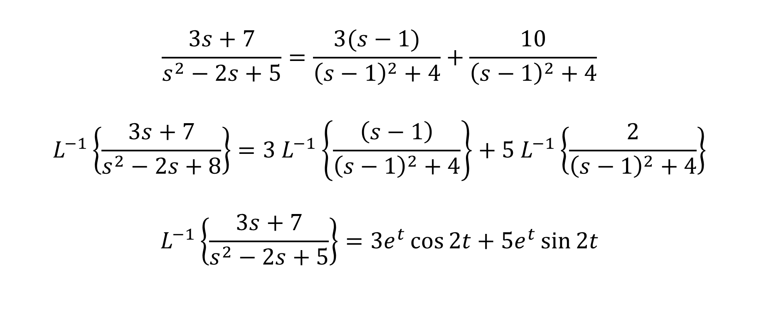
$$\frac{3s+7}{s^{2}−2s+5}=\frac{3(s−1)}{{\left(s−1\right)}^{2}+4}+\frac{10}{{\left(s−1\right)}^{2}+4}$$
$$L^{−1}\left\{\frac{3s+7}{s^{2}−2s+8}\right\}={3 L}^{−1}\left\{\frac{\left(s−1\right)}{{\left(s−1\right)}^{2}+4}\right\}+{5 L}^{−1}\left\{\frac{2}{{\left(s−1\right)}^{2}+4}\right\}$$
$$L^{−1}\left\{\frac{3s+7}{s^{2}−2s+5}\right\}=3e^{t}\cos{2t}+5e^{t}\sin{2t}$$

Slide 32
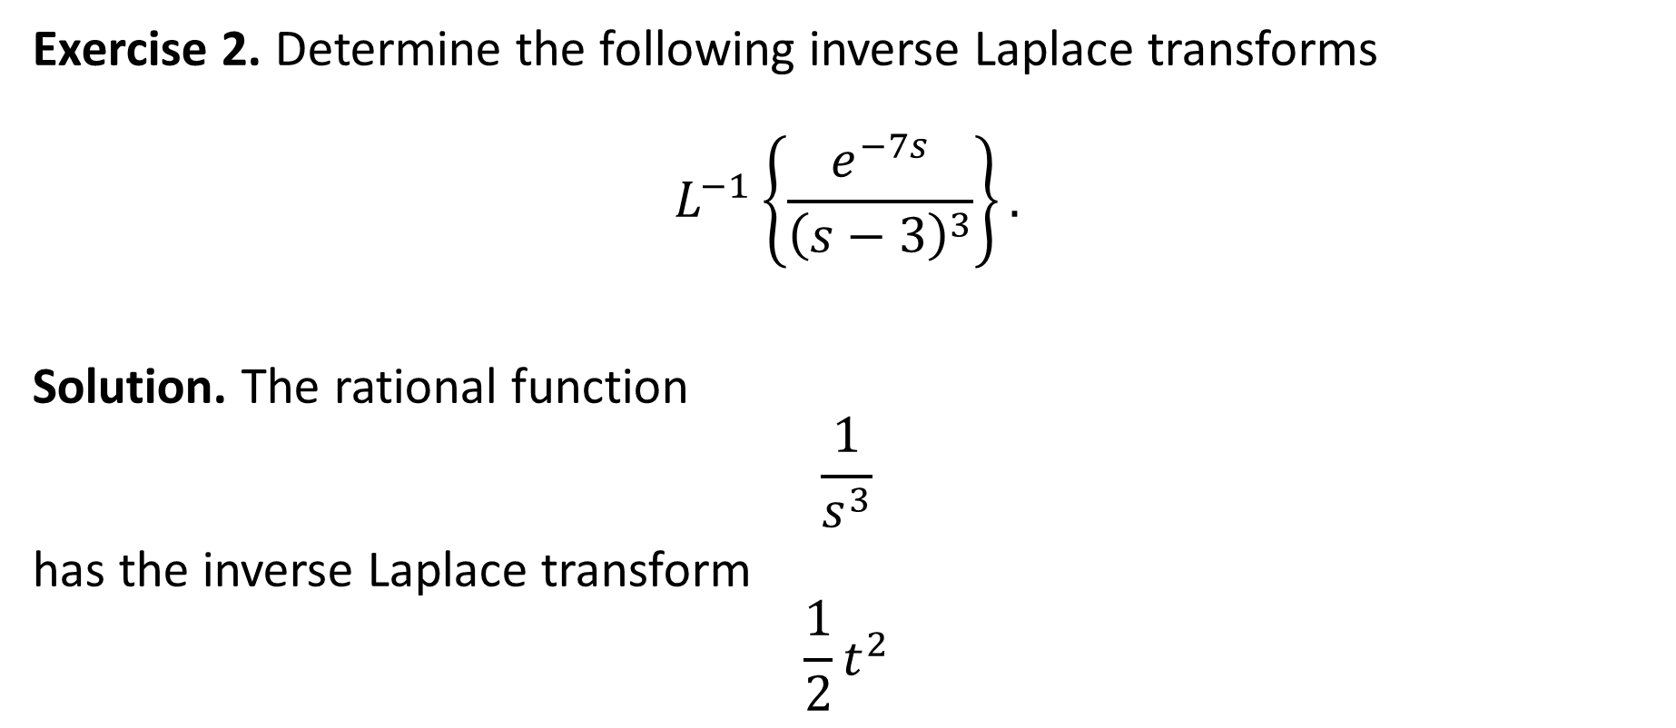
Exercise 2. Determine the following inverse Laplace transforms
$$L^{−1}\left\{\frac{e^{−7s}}{{\left(s−3\right)}^{3}}\right\}.$$
Solution. The rational function
$$\frac{1}{s^{3}}$$
has the inverse Laplace transform
$$\frac{1}{2}t^{2}$$

Slide 33
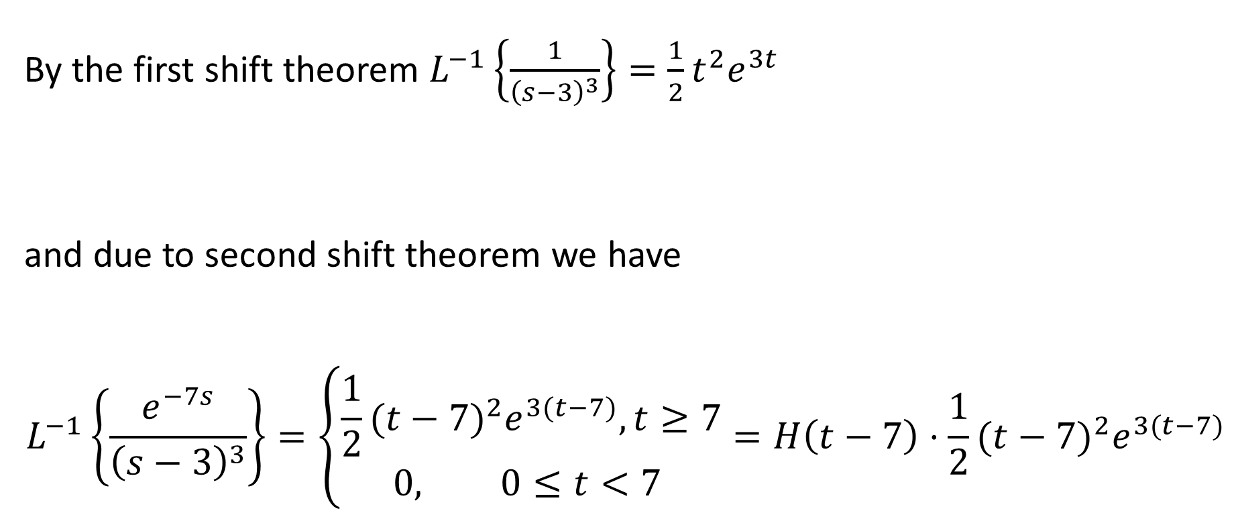
By the first shift theorem $L^{−1}\left\{\frac{1}{{\left(s−3\right)}^{3}}\right\}=\frac{1}{2}t^{2}e^{3t}$
and due to second shift theorem we have
$$L^{−1}\left\{\frac{e^{−7s}}{{\left(s−3\right)}^{3}}\right\}=\left\{\begin{aligned}\frac{1}{2}{(t−7)}^{2}e^{3(t−7)}, t≥7 \\ 0, 0≤t<7 \end{aligned}\right.=H\left(t−7\right)⋅\frac{1}{2}{(t−7)}^{2}e^{3(t−7)}$$

Slide 34

Homework
Determine the following inverse Laplace transforms
$$L^{−1}\left\{\frac{s+3}{s(s−1)(s+2)}\right\}.$$
2.
$$L^{−1}\left\{\frac{s−1}{s^{2}+2s−8}\right\}.$$
3.
$$L^{−1}\left\{\frac{s+2k^{2}}{{s(s}^{2}+4k^{2})}\right\}.$$
4.
$$L^{−1}\left\{\frac{1}{{s\left(s+3\right)}^{2}}\right\}.$$

