Slide 1
Mathematical Methods of Solid Mechanics
Aliaksandr Radyna Assoc. Prof.
DUT-BSU Joint Institute

Slide 2
Limiting theorems

Slide 3
Homework solutions
Limiting theorems
Initial value problem
Final value problem
Exercises
Homework

Slide 4
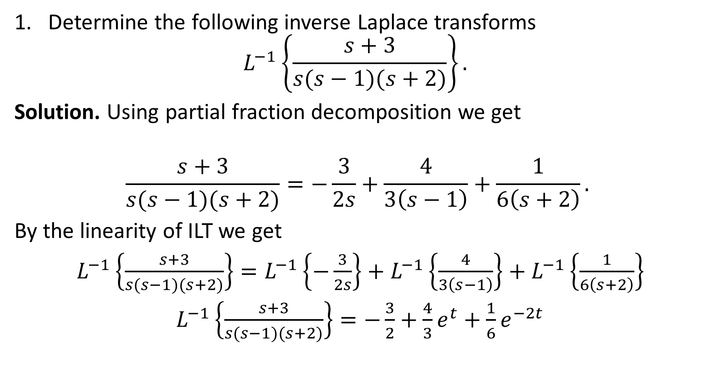
Solutions to the home exercises
Determine the following inverse Laplace transforms
$$L^{−1}\left\{\frac{s+3}{s(s−1)(s+2)}\right\}.$$
Solution. Using partial fraction decomposition we get
$$\frac{s+3}{s(s−1)(s+2)}=−\frac{3}{2s}+\frac{4}{3\left(s−1\right)}+\frac{1}{6\left(s+2\right)}.$$
By the linearity of ILT we get
$L^{−1}\left\{\frac{s+3}{s(s−1)(s+2)}\right\}=L^{−1}\left\{−\frac{3}{2s}\right\}+L^{−1}\left\{\frac{4}{3\left(s−1\right)}\right\}+L^{−1}\left\{\frac{1}{6\left(s+2\right)}\right\}$
$L^{−1}\left\{\frac{s+3}{s(s−1)(s+2)}\right\}=−\frac{3}{2}+\frac{4}{3}e^{t}+\frac{1}{6}e^{−2t}$

Slide 5
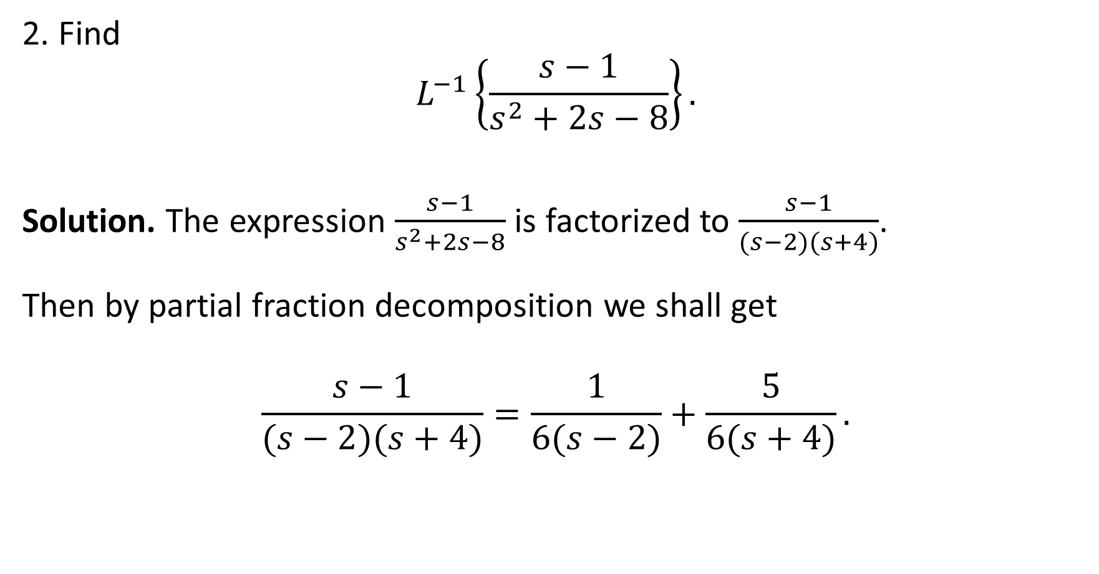
Solutions to the home exercises
2. Find
$$L^{−1}\left\{\frac{s−1}{s^{2}+2s−8}\right\}.$$
Solution. The expression $\frac{s−1}{s^{2}+2s−8}$ is factorized to $\frac{s−1}{(s−2)(s+4)}$.
Then by partial fraction decomposition we shall get
$$\frac{s−1}{(s−2)(s+4)}=\frac{1}{6(s−2)}+\frac{5}{6(s+4)}.$$

Slide 6

Solutions to the home exercises
$$L^{−1}\left\{\frac{s−1}{\left(s−2\right)\left(s+4\right)}\right\}=\frac{1}{6}L^{−1}\left\{\frac{1}{ \left(s−2\right)}\right\}+\frac{5}{6}L^{−1}\left\{\frac{1}{ \left(s+4\right)}\right\}$$
$$L^{−1}\left\{\frac{s−1}{\left(s−2\right)\left(s+4\right)}\right\}=\frac{1}{6}e^{2t}+\frac{5}{6}e^{−4t}$$

Slide 7
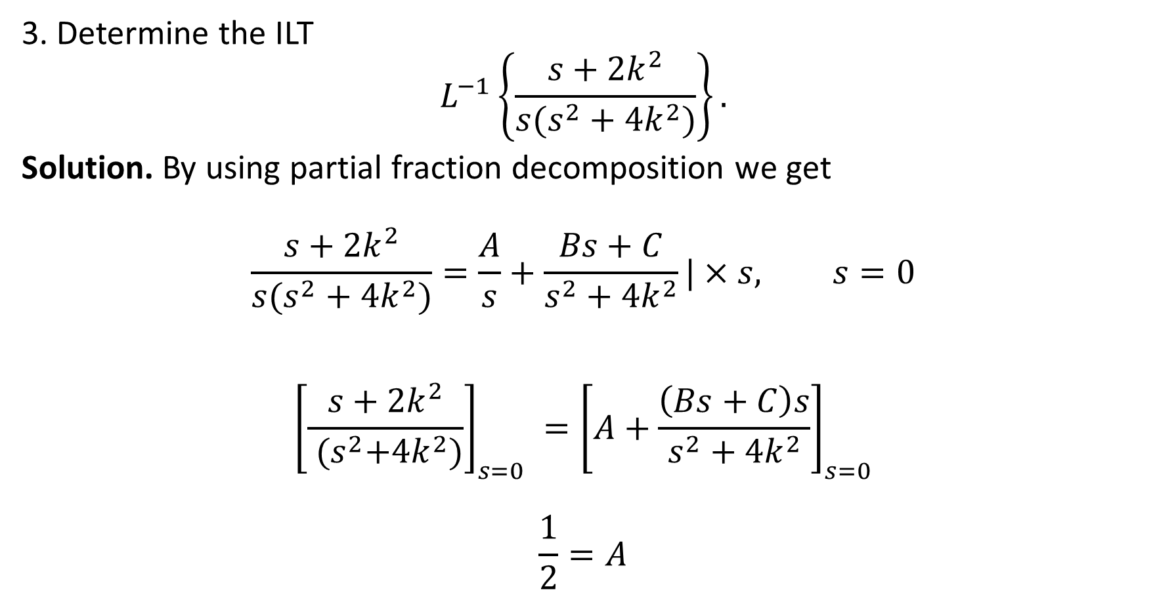
Solutions to the home exercises
3. Determine the ILT
$$L^{−1}\left\{\frac{s+2k^{2}}{{s(s}^{2}+4k^{2})}\right\}.$$
Solution. By using partial fraction decomposition we get
$$\frac{s+2k^{2}}{{s(s}^{2}+4k^{2})}=\frac{A}{s}+\frac{Bs+C}{s^{2}+4k^{2}}|×s, s=0$$
$${\left[\frac{s+2k^{2}}{{ (s}^{2}+4k^{2})}\right]}_{s=0} ={\left[A+\frac{\left(Bs+C\right)s}{s^{2}+4k^{2}}\right]}_{s=0}$$
$$\frac{1}{2}=A$$

Slide 8

Solutions to the home exercises
$$\frac{s+2k^{2}}{{s(s}^{2}+4k^{2})}=\frac{\frac{1}{2}}{s}+\frac{Bs+C}{s^{2}+4k^{2}}|×s, s→+∞$$
$${\left[\frac{s+2k^{2}}{{ (s}^{2}+4k^{2})}\right]}_{s→+∞} ={\left[\frac{1}{2}+\frac{\left(Bs+C\right)s}{s^{2}+4k^{2}}\right]}_{s→+∞}$$
$$0=\frac{1}{2}+B$$
$$B=−\frac{1}{2}$$

Slide 9

Solutions to the home exercises
$$\frac{s+2k^{2}}{{s(s}^{2}+4k^{2})}=\frac{\frac{1}{2}}{s}+\frac{−\frac{1}{2}s+C}{s^{2}+4k^{2}}| s=1$$
$$\frac{1+2k^{2}}{1+4k^{2}}=\frac{1}{2}+\frac{−\frac{1}{2}+C}{1+4k^{2}}$$
$$\frac{1+2k^{2}}{1+4k^{2}}=\frac{1+4k^{2}−1+2C}{2(1+4k^{2})}$$
$2+4k^{2}=$ $4k^{2}+2C$
$$C=1$$

Slide 10
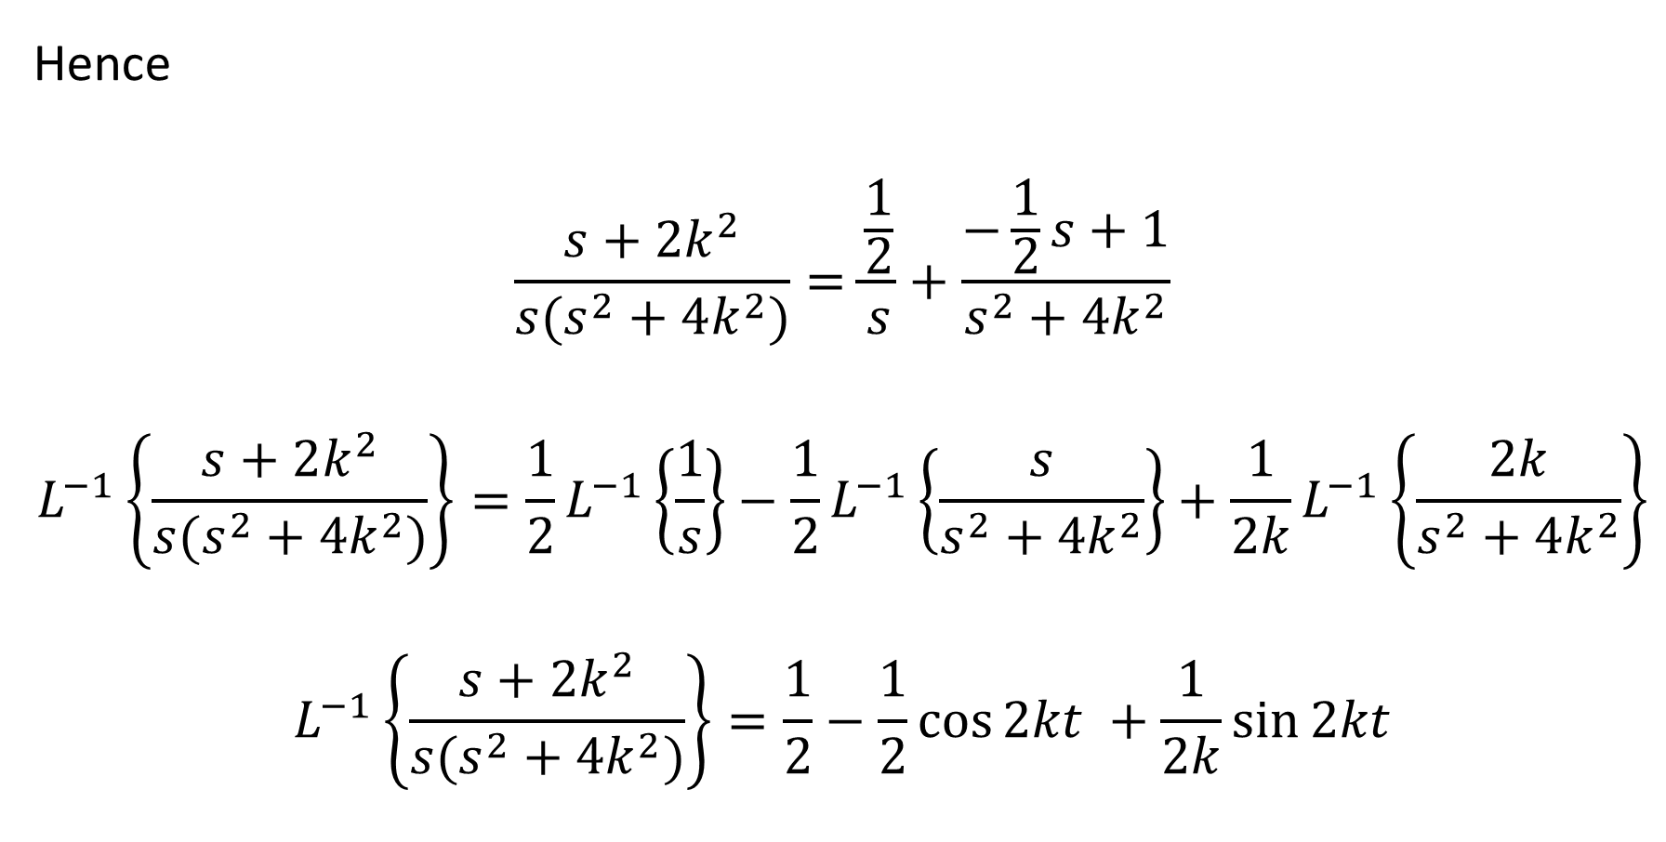
Solutions to the home exercises
Hence
$$\frac{s+2k^{2}}{{s(s}^{2}+4k^{2})}=\frac{\frac{1}{2}}{s}+\frac{−\frac{1}{2}s+1}{s^{2}+4k^{2}}$$
$$L^{−1}\left\{\frac{s+2k^{2}}{{s(s}^{2}+4k^{2})}\right\}=\frac{1}{2}L^{−1}\left\{\frac{1}{s}\right\}−\frac{1}{2}L^{−1}\left\{\frac{s}{s^{2}+4k^{2}}\right\}+\frac{1}{2k}L^{−1}\left\{\frac{2k}{s^{2}+4k^{2}}\right\}$$
$$L^{−1}\left\{\frac{s+2k^{2}}{{s(s}^{2}+4k^{2})}\right\}=\frac{1}{2}−\frac{1}{2}\cos{2kt }+\frac{1}{2k}\sin{2kt}$$

Slide 11
Limiting theorems

Slide 12
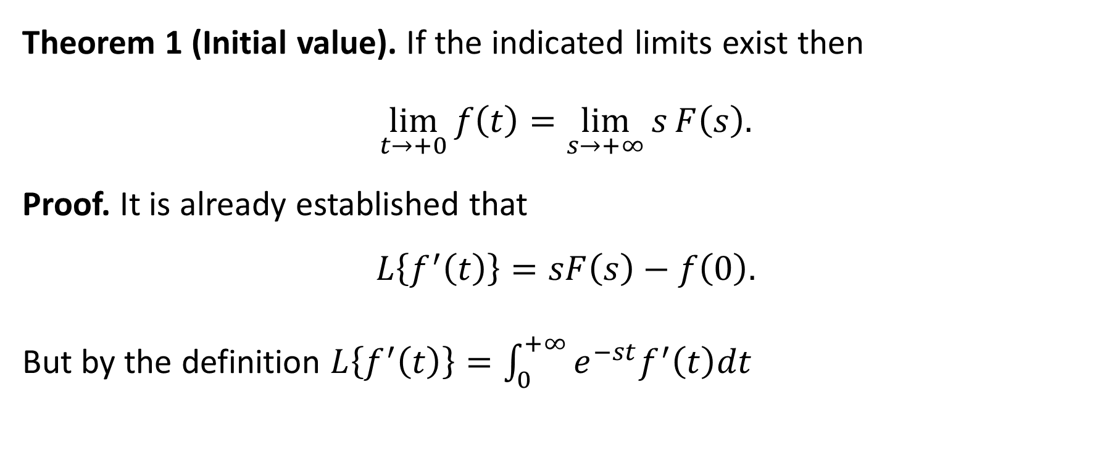
Theorem of Initial value
Theorem 1 (Initial value). If the indicated limits exist then
$$\lim_{t→+0}{f\left(t\right)}=\lim_{s→+∞}{s}F\left(s\right).$$
Proof. It is already established that
$$L\left\{f^{′}\left(t\right)\right\}=sF\left(s\right)−f\left(0\right).$$
But by the definition $L\left\{f^{′}\left(t\right)\right\}=\int_{0}^{+∞}{e^{−st}f^{′}\left(t\right)dt}$

Slide 13
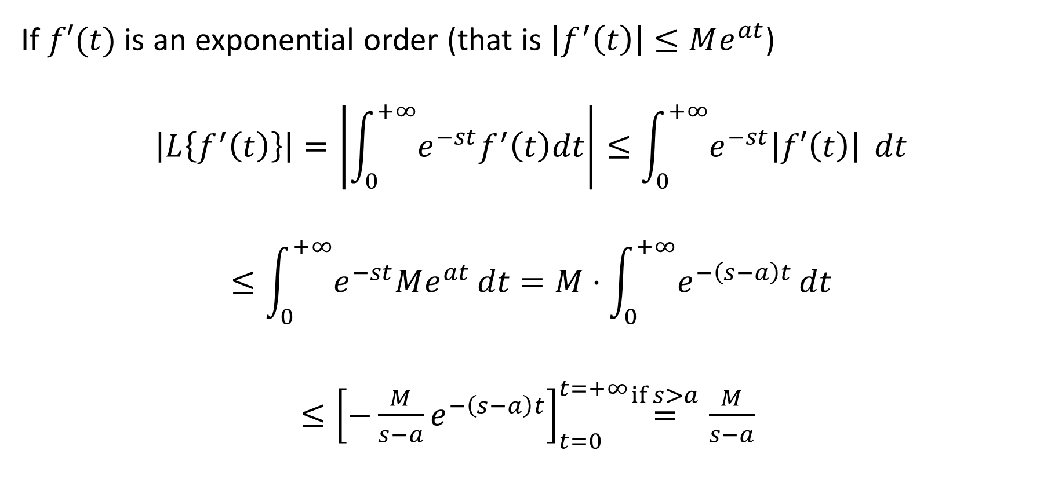
Theorem of Initial value
If $f′(t)$ is an exponential order (that is $\left|f^{′}\left(t\right)\right|≤Me^{at}$)
$$\left|L\left\{f^{′}\left(t\right)\right\}\right|=\left|\int_{0}^{+∞}{e^{−st}f^{′}\left(t\right)dt}\right|≤\int_{0}^{+∞}{e^{−st}\left|f′\left(t\right)\right| }dt$$
$$≤\int_{0}^{+∞}{e^{−st}Me^{at}}dt=M⋅\int_{0}^{+∞}{e^{−\left(s−a\right)t}}dt$$
${≤\left[−\frac{M}{s−a}e^{−\left(s−a\right)t}\right]}_{t=0}^{t=+∞}\overset{if s>a}{=}\frac{M}{s−a}$

Slide 14

Theorem of Initial value
$$\left|L\left\{f^{′}\left(t\right)\right\}\right|≤\frac{M}{s−a} .$$
Hence, $\lim_{s→+∞}{L\left\{f^{′}\left(t\right)\right\}=0}$. Therefore,
$$\lim_{s→+∞}L\left\{f^{′}\left(t\right)\right\}=\lim_{s→+∞}sF\left(s\right)−f\left(0\right)$$
$$0=\lim_{s→+∞}sF\left(s\right)−f\left(0\right)$$
$$f\left(0\right)=\lim_{s→+∞}sF\left(s\right)$$
$$\lim_{t→+0}{f(t)}=\lim_{s→+∞}sF\left(s\right)$$

Slide 15
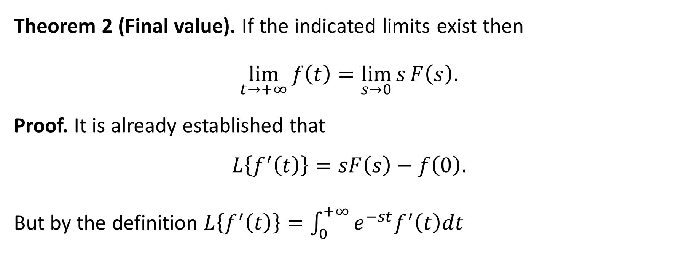
Theorem of Final value
Theorem 2 (Final value). If the indicated limits exist then
$$\lim_{t→+∞}{f\left(t\right)}=\lim_{s→0}{s}F\left(s\right).$$
Proof. It is already established that
$$L\left\{f^{′}\left(t\right)\right\}=sF\left(s\right)−f\left(0\right).$$
But by the definition $L\left\{f^{′}\left(t\right)\right\}=\int_{0}^{+∞}{e^{−st}f^{′}\left(t\right)dt}$

Slide 16

Theorem of Initial value
Consider the limit
$$\lim_{s→0}{\int_{0}^{+∞}{e^{−st}f^{′}\left(t\right)dt}}=\int_{0}^{+∞}{\lim_{s→0} e^{−st}f^{′}\left(t\right)dt}=\int_{0}^{+∞}{f^{′}\left(t\right)dt}$$
$$=f\left(+∞\right)−f\left(0\right).$$
$$\int_{0}^{+∞}{e^{−st}f^{′}\left(t\right)dt}=sF\left(s\right)−f(0)$$

Slide 17

Theorem of Initial value
$$\lim_{s→0}{\int_{0}^{+∞}{e^{−st}f^{′}\left(t\right)dt}}=f\left(+∞\right)−f\left(0\right) (1)$$
$$\int_{0}^{+∞}{e^{−st}f^{′}\left(t\right)dt}=sF\left(s\right)−f(0)$$
$\lim_{s→0}\int_{0}^{+∞}{e^{−st}f^{′}\left(t\right)dt}=\lim_{s→0} sF\left(s\right)−f\left(0\right) (2)$
$$f\left(+∞\right)−f\left(0\right)\overset{\left(1\right),(2)}{=}\lim_{s→0} sF\left(s\right)−f\left(0\right)$$
$$\lim_{t→+∞}{f\left(t\right)}=\lim_{s→0} sF\left(s\right)$$

Slide 18

Verification of the term by term method
Example 1. Let $f\left(t\right)=e^{−t}$ then $F\left(s\right)=\frac{1}{s+1}$
It is clear that $\lim_{t→+0}{f\left(t\right)=1}$ and $\lim_{s→+∞} sF\left(s\right)=1$,
hence theorem 1 is confirmed.

Slide 19

Verification of the term by term method
$\lim_{t→+∞}{f\left(t\right)=\lim_{t→+∞}{e^{−t}=0}}$
$\lim_{s→0} sF\left(s\right)=\lim_{s→0}\frac{s}{s+1}=$0,
hence theorem 2 is confirmed as well.

Slide 20
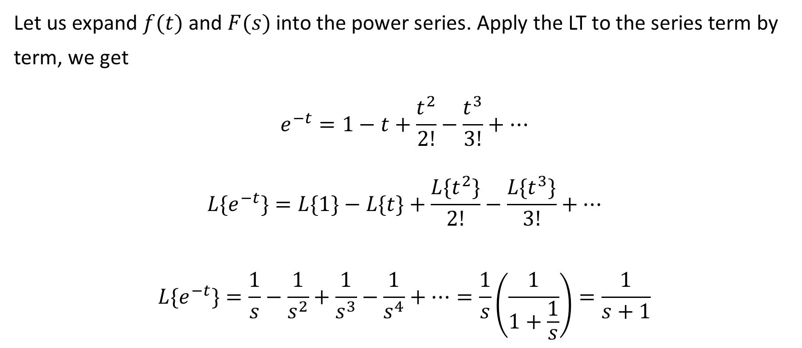
Verification of the term by term method
Let us expand $f(t)$ and $F(s)$ into the power series. Apply the LT to the series term by term, we get
$$e^{−t}=1−t+\frac{t^{2}}{2!}−\frac{t^{3}}{3!}+…$$
$${L\{e}^{−t}\}=L\{1\}−L\{t\}+\frac{L\{t^{2}\}}{2!}−\frac{L\{t^{3}\}}{3!}+…$$
$${L\{e}^{−t}\}=\frac{1}{s}−\frac{1}{s^{2}}+\frac{1}{s^{3}}−\frac{1}{s^{4}}+…=\frac{1}{s}\left(\frac{1}{1+\frac{1}{s}}\right)=\frac{1}{s+1}$$

Slide 21

Verification of the term by term method
$${L\{e}^{−t}\}=\frac{1}{s}−\frac{1}{s^{2}}+\frac{1}{s^{3}}−\frac{1}{s^{4}}+…=\frac{1}{s}\left(\frac{1}{1+\frac{1}{s}}\right)=\frac{1}{s+1}.$$
So, term by term evaluation gives the right answer.

Slide 22

Exercises
Exercise 1. Verify the initial value problem for the function
$$f\left(t\right)=2+\cos{t.}$$
Solution.
$$\lim_{t→+0}{f\left(t\right)}=\lim_{s→+∞}{s}F\left(s\right). (∗)$$
Left-hand side of $(∗)$ is
$$\lim_{t→+0}(2+\cos{t)}=3.$$

Slide 23

Exercises
$$F\left(s\right)=\frac{2}{s}+\frac{s}{s^{2}+1}.$$
Right-hand side of $(∗)$ is
$$\lim_{s→∞}{sF\left(s\right)}=\lim_{s→∞}{2+\frac{s^{2}}{s^{2}+1}=3}.$$

Slide 24

Exercises
Exercise 2. Verify the initial value problem for the function
$$f\left(t\right)=\frac{\sin{t}}{t}.$$
Solution.
$$\lim_{t→+0}{f\left(t\right)}=\lim_{s→+∞}{s}F\left(s\right). (∗)$$
Left-hand side of $(∗)$ is
$$\lim_{t→+0}\frac{\sin{t}}{t}=1.$$

Slide 25
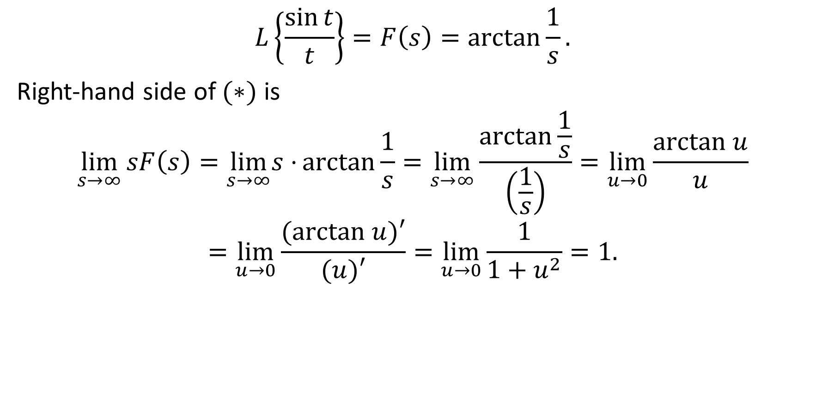
Exercises
$$L\left\{\frac{\sin{t}}{t}\right\}=F\left(s\right)=\arctan{\frac{1}{s}}.$$
Right-hand side of $(∗)$ is
$$\lim_{s→∞}{sF\left(s\right)}=\lim_{s→∞}s⋅{\arctan{\frac{1}{s}}=\lim_{s→∞}{\frac{\arctan{\frac{1}{s}}}{\left(\frac{1}{s}\right)}=\lim_{u→0}{\frac{arctan u}{u}}}}$$
$$=\lim_{u→0}{\frac{(arctan u)′}{(u)′}=\lim_{u→0}{\frac{1}{1+u^{2}}=1.}}$$

Slide 26

Exercises
Exercise 3. Verify the final value problem for the function
$$f\left(t\right)=3+e^{−t}$$
Solution.
$$\lim_{t→+∞}{f\left(t\right)}=\lim_{s→0}{s}F\left(s\right). (∗)$$
Left-hand side of $(∗)$ is
$$\lim_{t→+∞}\left(3+e^{−t}\right)=3.$$

Slide 27

Exercises
The Laplace transform of $3+e^{−t}$ is
$$F\left(s\right)=L\left\{3+e^{−t}\right\}=\frac{3}{s}+\frac{1}{s+1}.$$
Right-hand side of $(∗)$ is
$$\lim_{s→∞}{sF\left(s\right)}=\lim_{s→∞}{3+\frac{s}{s+1}=3}.$$
The final value problem is verified.

Slide 28

Homework
Exercise 1. Verify the initial value problem for the function
$$f\left(t\right)={\left(4+t\right)}^{2}.$$
Exercise 2. Verify the final value problem for the function
$$f\left(t\right)=t^{3}e^{−t}.$$

Slide 29
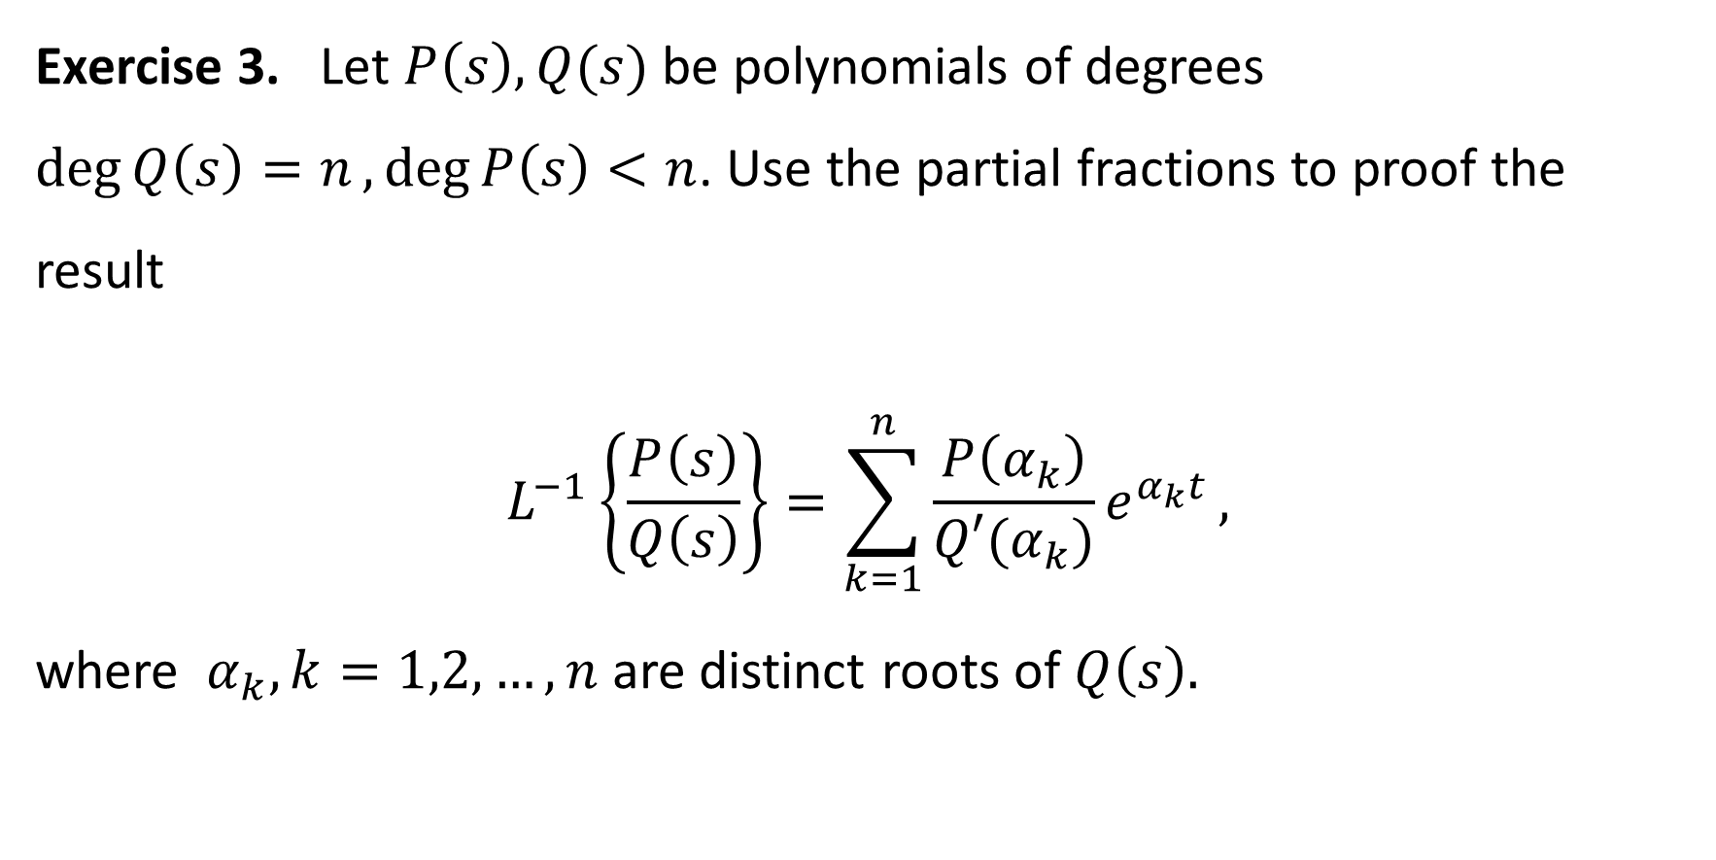
Homework
Exercise 3. Let $P\left(s\right), Q(s)$ be polynomials of degrees $\deg{Q\left(s\right)=n},\deg{P\left(s\right)<n}$. Use the partial fractions to proof the result
$$L^{−1}\left\{\frac{P\left(s\right)}{Q\left(s\right)}\right\}=\sum_{k=1}^{n}{\frac{P\left(α_{k}\right)}{Q′(α_{k})}e^{α_{k}t}},$$
where $α_{k}, k=1,2,…, n$ are distinct roots of $Q\left(s\right).$

