Slide 1
Mathematical Methods of Solid Mechanics
Aliaksandr Radyna Assoc. Prof.
DUT-BSU Joint Institute

Slide 2
The Impulse Function

Slide 3

The solutions to the home exercises
Right-hand side of $(∗)$ is
$$\lim_{s→∞}{sF\left(s\right)}=\lim_{s→∞}{16+\frac{8}{s}+\frac{2}{s^{2}}=16}.$$
Formula $(∗)$ is verified

Slide 4

The solutions to the home exercises
Exercise 2. Verify the final value problem for the function
$$f\left(t\right)=t^{3}e^{−t}.$$
Solution.
$$\lim_{t→+∞}{f\left(t\right)}=\lim_{s→0}{s}F\left(s\right). (∗)$$
Left-hand side of $(∗)$ is
$$\lim_{t→+∞}t^{3}e^{−t}=0.$$
$$F\left(s\right)=L\left\{t^{3}e^{−t}\right\}=\frac{6}{{\left(s+1\right)}^{4}}$$

Slide 5

The solutions to the home exercises
Right-hand side of $(∗)$ is
$$\lim_{s→0}{sF\left(s\right)}=\lim_{s→∞}{\frac{6s}{{\left(s+1\right)}^{4}}=0}.$$
Formula $(∗)$ is verified.

Slide 6
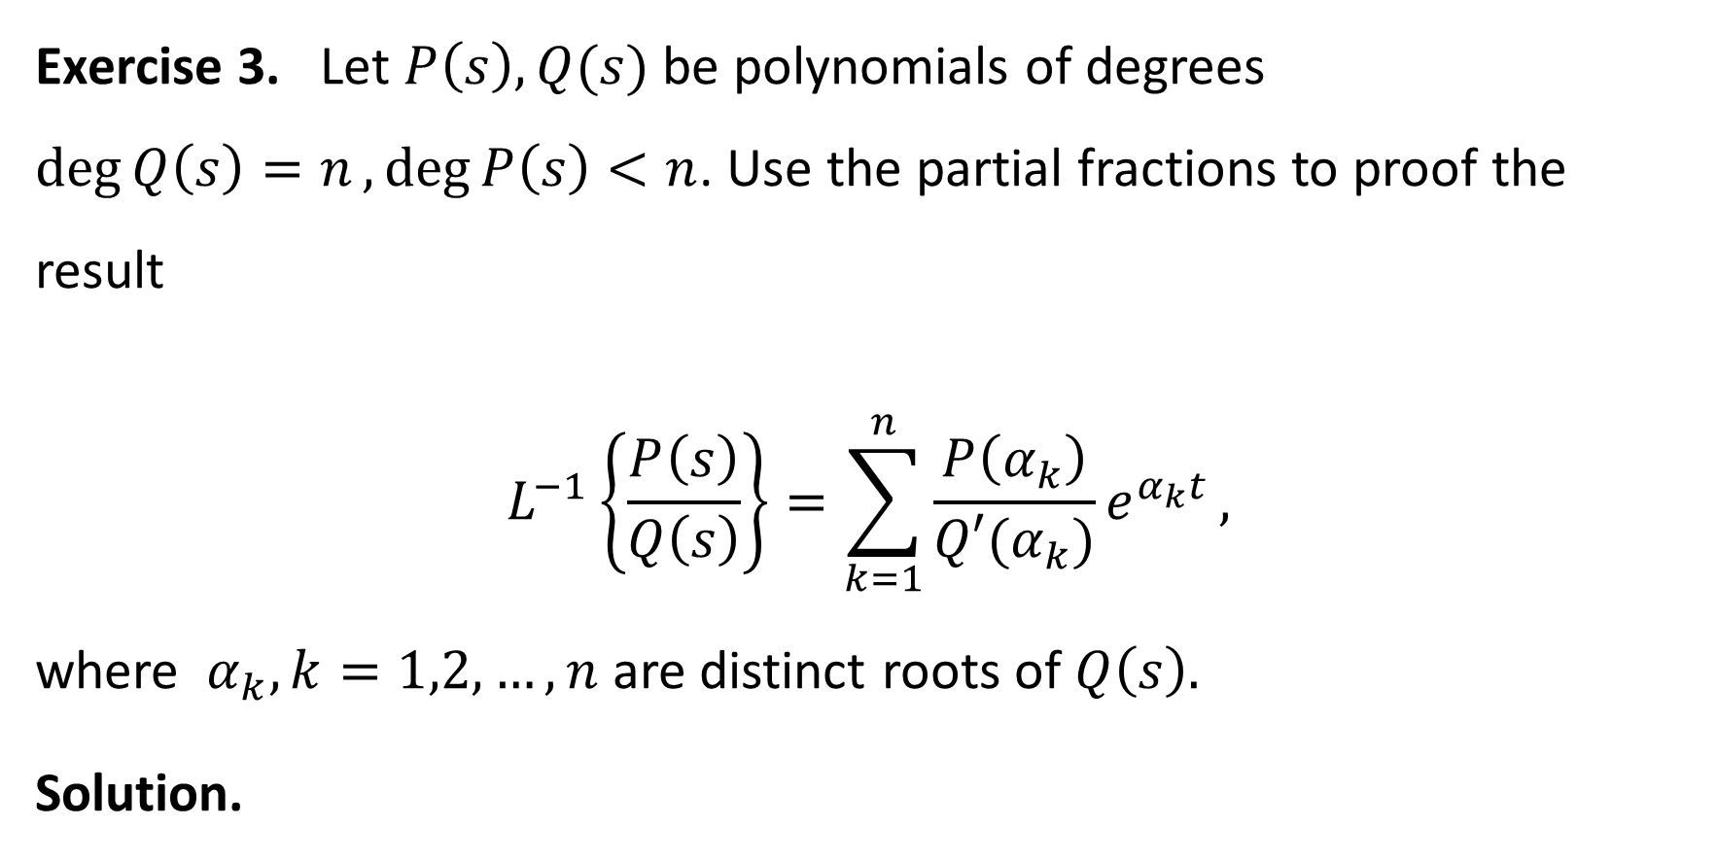
The solutions to the home exercises
Exercise 3. Let $P\left(s\right), Q(s)$ be polynomials of degrees $\deg{Q\left(s\right)=n},\deg{P\left(s\right)<n}$. Use the partial fractions to proof the result
$$L^{−1}\left\{\frac{P\left(s\right)}{Q\left(s\right)}\right\}=\sum_{k=1}^{n}{\frac{P\left(α_{k}\right)}{Q′(α_{k})}e^{α_{k}t}},$$
where $α_{k}, k=1,2,…, n$ are distinct roots of $Q\left(s\right).$
Solution.

Slide 7
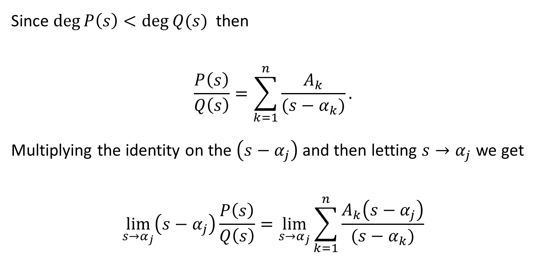
The solutions to the home exercises
Since $\deg{P\left(s\right)<\deg{Q(s)} }$ then
$$\frac{P\left(s\right)}{Q\left(s\right)}=\sum_{k=1}^{n}{\frac{A_{k}}{(s−α_{k})}}.$$
Multiplying the identity on the $\left(s−α_{j}\right)$ and then letting $s→α_{j}$ we get
$$\lim_{s→α_{j}}\left(s−α_{j}\right)\frac{P\left(s\right)}{Q\left(s\right)}=\lim_{s→α_{j}}{\sum_{k=1}^{n}{\frac{A_{k}\left(s−α_{j}\right)}{(s−α_{k})}}}$$

Slide 8

The solutions to the home exercises
$$\lim_{s→α_{j}}\left(s−α_{j}\right)\frac{P\left(s\right)}{Q\left(s\right)}=\lim_{s→α_{j}}{\sum_{k=1}^{n}{\frac{A_{k}\left(s−α_{j}\right)}{(s−α_{k})}}}$$
$$\lim_{s→α_{j}}\left(s−α_{j}\right)⋅\frac{P\left(s\right)}{Q\left(s\right)}=A_{j}$$

Slide 9
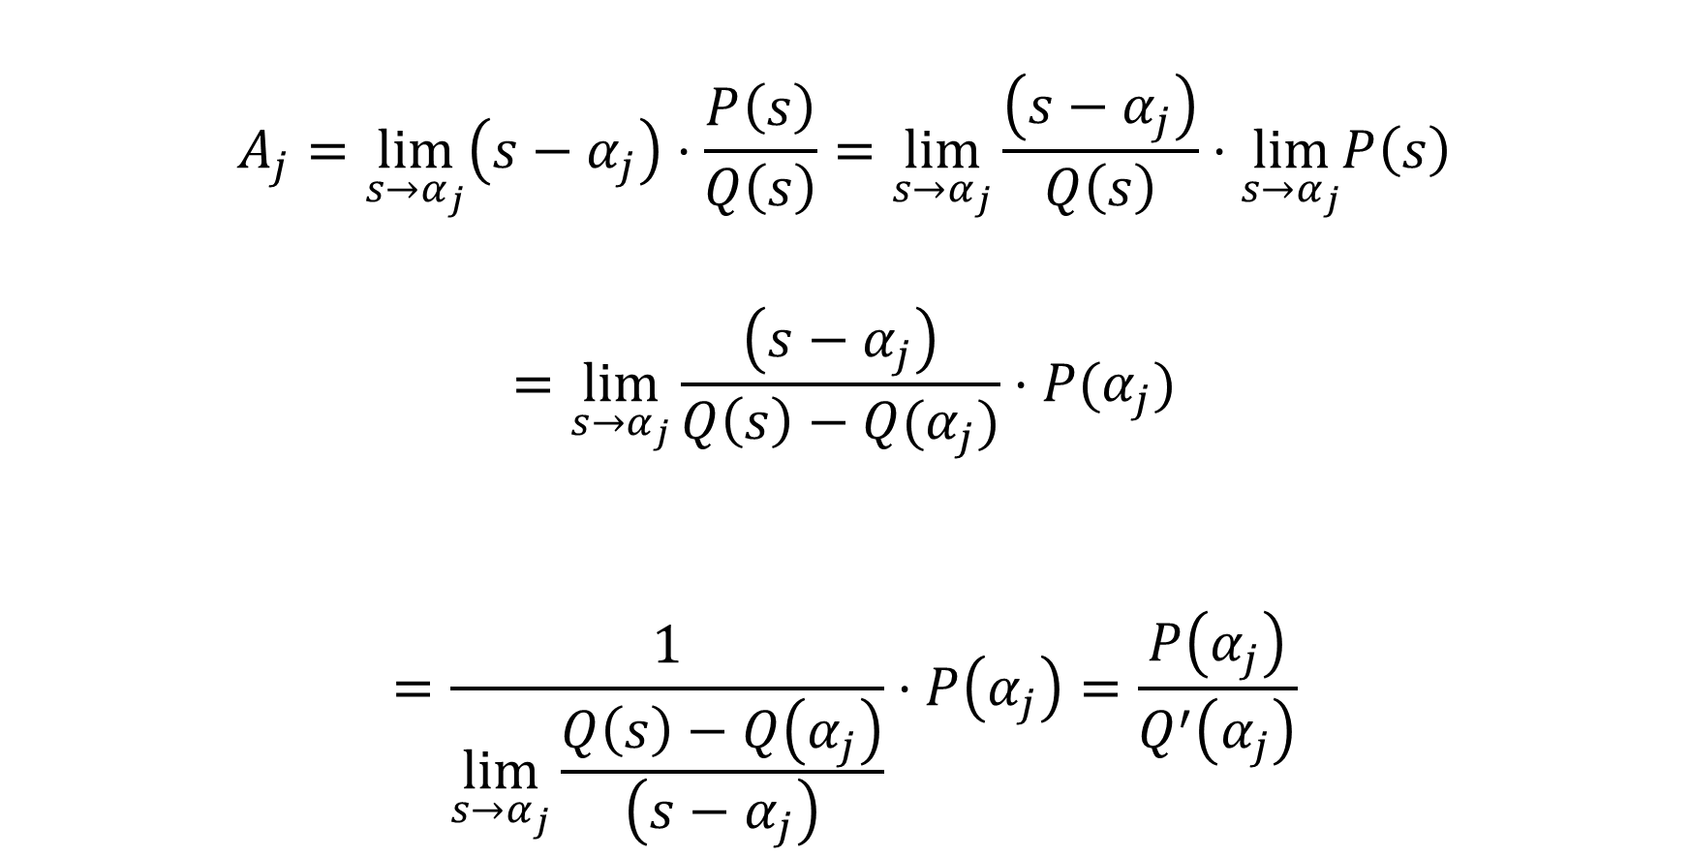
The solutions to the home exercises
$$A_{j}=\lim_{s→α_{j}}\left(s−α_{j}\right)⋅\frac{P\left(s\right)}{Q\left(s\right)}=\lim_{s→α_{j}}\frac{\left(s−α_{j}\right)}{Q\left(s\right)}⋅\lim_{s→α_{j}}P\left(s\right)$$
$$=\lim_{s→α_{j}}\frac{\left(s−α_{j}\right)}{Q\left(s\right)−Q(α_{j})}⋅P(α_{j})$$
$$=\frac{1}{\lim_{s→α_{j}}\frac{Q\left(s\right)−Q\left(α_{j}\right)}{\left(s−α_{j}\right)}}⋅P\left(α_{j}\right)=\frac{P\left(α_{j}\right)}{Q^{′}\left(α_{j}\right)}$$

Slide 10

The solutions to the home exercises
Therefore, for any $j=1,2,…,n$
$$A_{j}=\frac{P\left(α_{j}\right)}{Q^{′}\left(α_{j}\right)}$$
and
$$\frac{P\left(s\right)}{Q\left(s\right)}=\sum_{k=1}^{n}{\frac{A_{k}}{(s−α_{k})}}=\sum_{k=1}^{n}{\frac{\frac{P\left(α_{k}\right)}{Q^{′}\left(α_{k}\right)}}{(s−α_{k})}}$$

Slide 11

The solutions to the home exercises
Consequently,
$$L^{−1}\left\{\frac{P\left(s\right)}{Q\left(s\right)}\right\} =\sum_{k=1}^{n}{\frac{P\left(α_{k}\right)}{Q^{′}\left(α_{k}\right)}L^{−1}\left\{\frac{1}{\left(s−α_{k}\right)}\right\}}$$
$$=\sum_{k=1}^{n}{\frac{P\left(α_{k}\right)}{Q^{′}\left(α_{k}\right)}e^{α_{k}t}}$$

Slide 12
The Impulse Function
The Dirac delta function

Slide 13
The Plan of the Lecture
Evolution from functions to distributions
Definition of the Dirac delta function= the Impulse function
Definition of the Laplace transform for the Impulse function
Examples

Slide 14
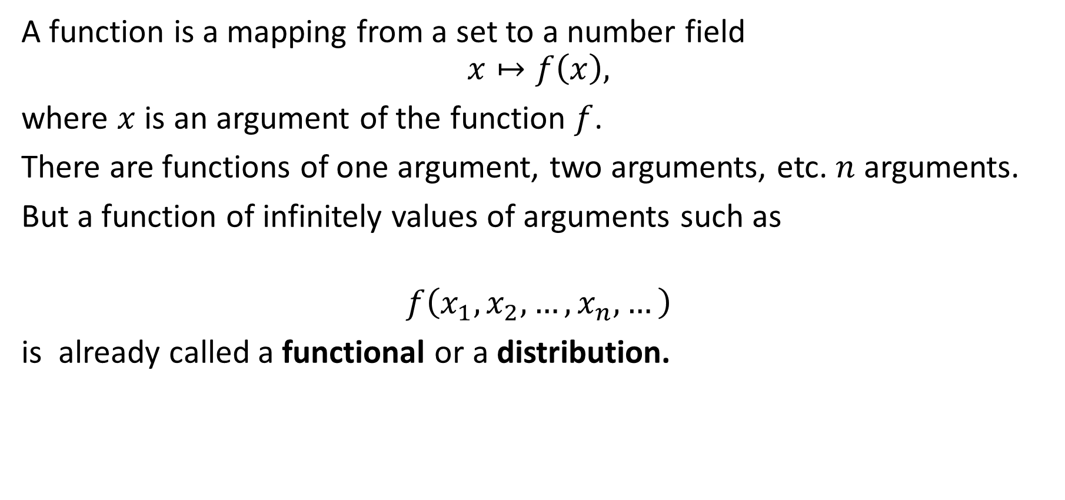
Evolution from functions to distributions
A function is a mapping from a set to a number field
$$x↦f\left(x\right),$$
where $x$ is an argument of the function $f$.
There are functions of one argument, two arguments, etc. $n$ arguments.
But a function of infinitely values of arguments such as
$$f\left(x_{1},x_{2},…,x_{n},…\right)$$
is already called a functional or a distribution.

Slide 15
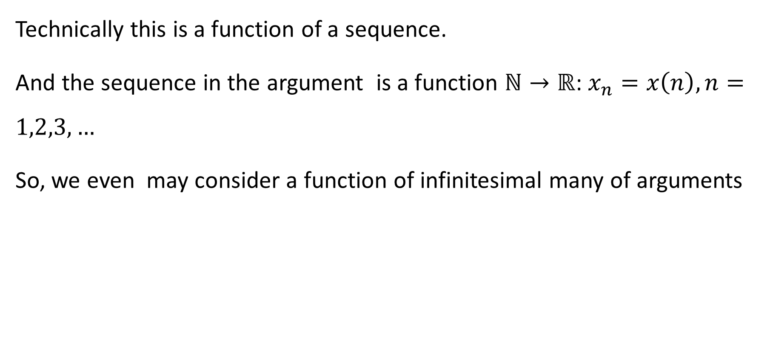
Evolution from functions to distributions
Technically this is a function of a sequence.
And the sequence in the argument is a function $ℕ→ℝ$: $x_{n}=x\left(n\right), n=1,2,3,…$
So, we even may consider a function of infinitesimal many of arguments

Slide 16

Evolution from functions to distributions
Example 1. Let $(f_{1},f_{2},…, f_{n},…)$ be a fixed number sequence. Then
$$f\left(x_{1},x_{2},…,x_{n},…\right)≔\sum_{k=1}^{+∞}{f_{k}⋅x_{k}}$$
Example 2. ${ e}^{\left(k\right)}\left(x_{1},…,x_{n},…\right)≔x_{k}$

Slide 17
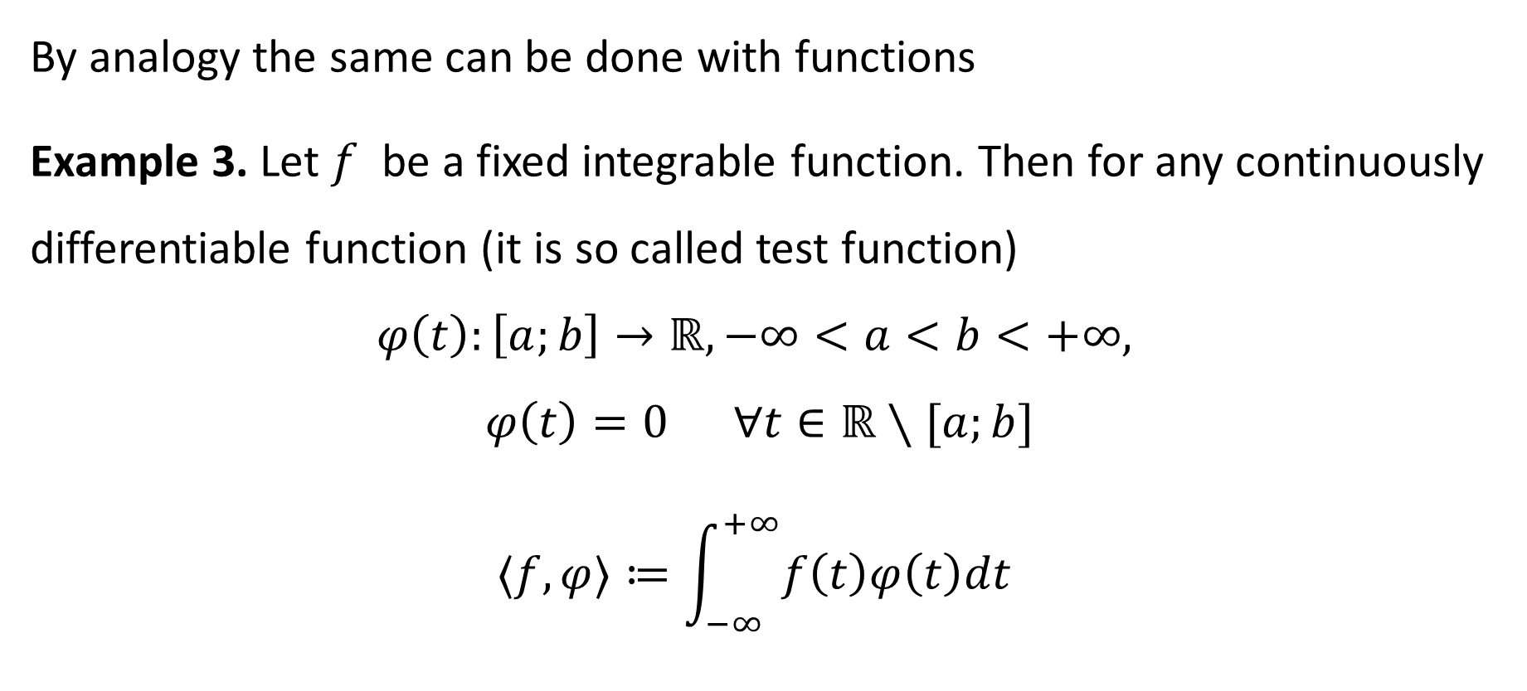
Evolution from functions to distributions
By analogy the same can be done with functions
Example 3. Let $f$ be a fixed integrable function. Then for any continuously differentiable function (it is so called test function)
$$φ\left(t\right):\left[a;b\right]→ℝ, −∞<a<b<+∞,$$
$$φ\left(t\right)=0 ∀t∈ℝ∖[a;b]$$
$$〈f,φ〉≔\int_{−∞}^{+∞}{f\left(t\right)φ\left(t\right)dt}$$

Slide 18
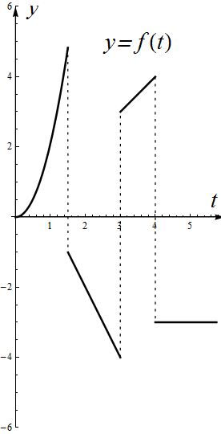
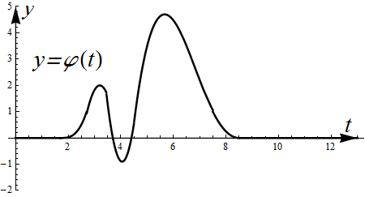

Slide 19
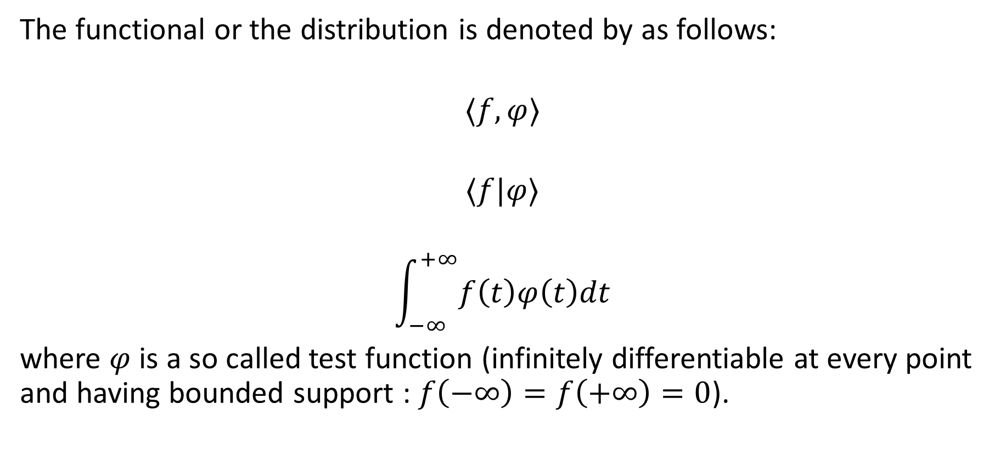
Evolution from functions to distributions
The functional or the distribution is denoted by as follows:
$$〈f,φ〉$$
$$〈f|φ〉$$
$$\int_{−∞}^{+∞}{f\left(t\right)φ\left(t\right)dt}$$
where $φ$ is a so called test function (infinitely differentiable at every point and having bounded support : $f\left(−∞\right)=f\left(+∞\right)=0$).

Slide 20
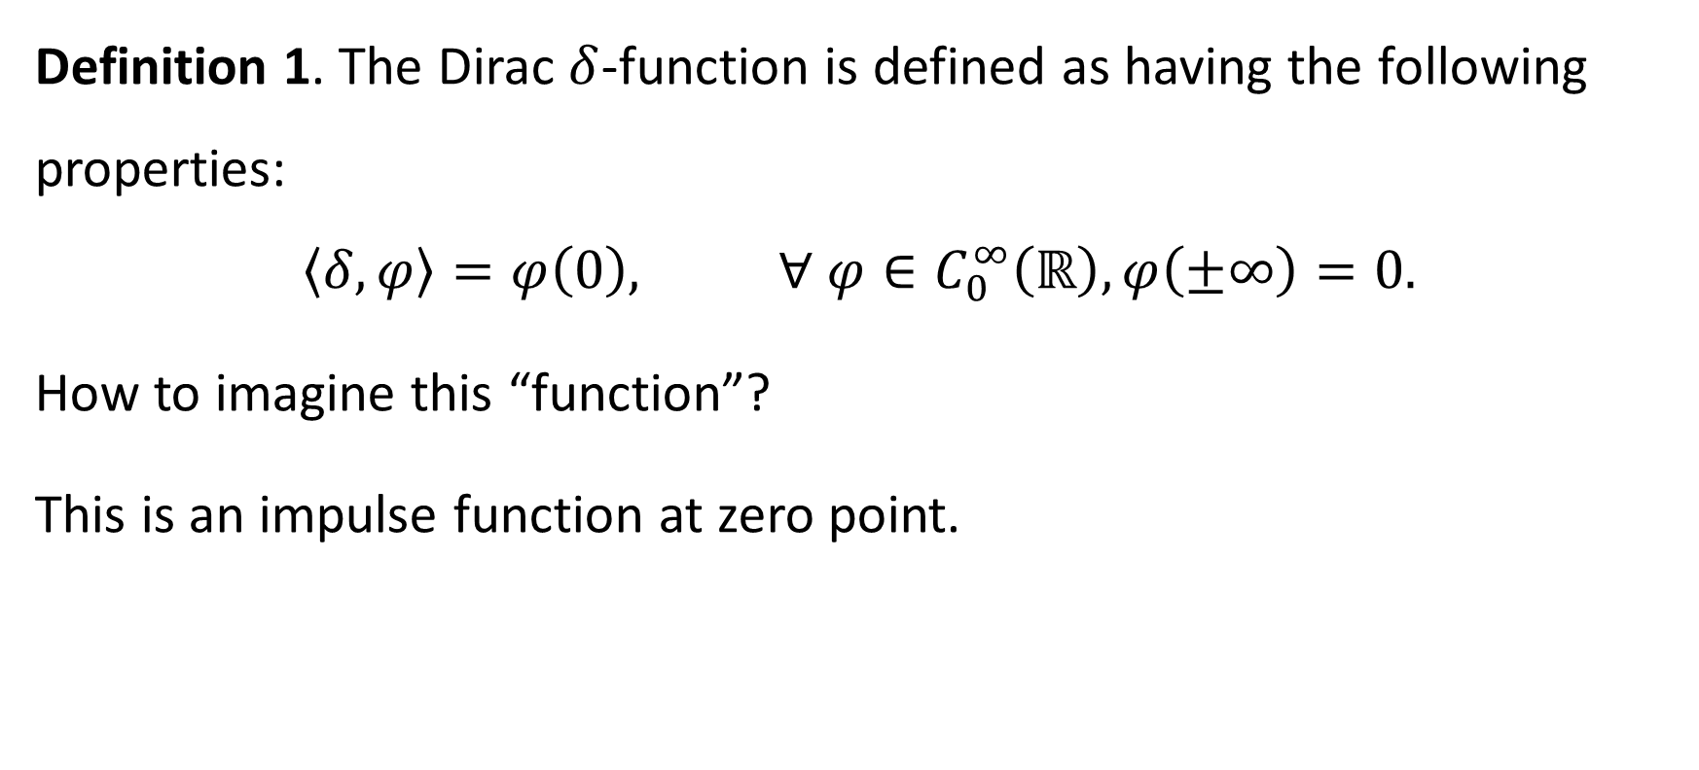
The Dirac delta function
Definition 1. The Dirac $δ$-function is defined as having the following properties:
$$〈δ, φ〉=φ\left(0\right), ∀ φ∈C_{0}^{∞}\left(ℝ\right), φ\left(±∞\right)=0.$$
How to imagine this “function”?
This is an impulse function at zero point.

Slide 21
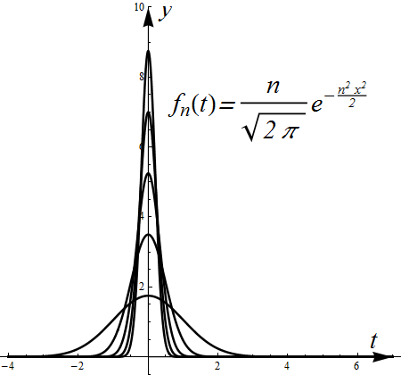
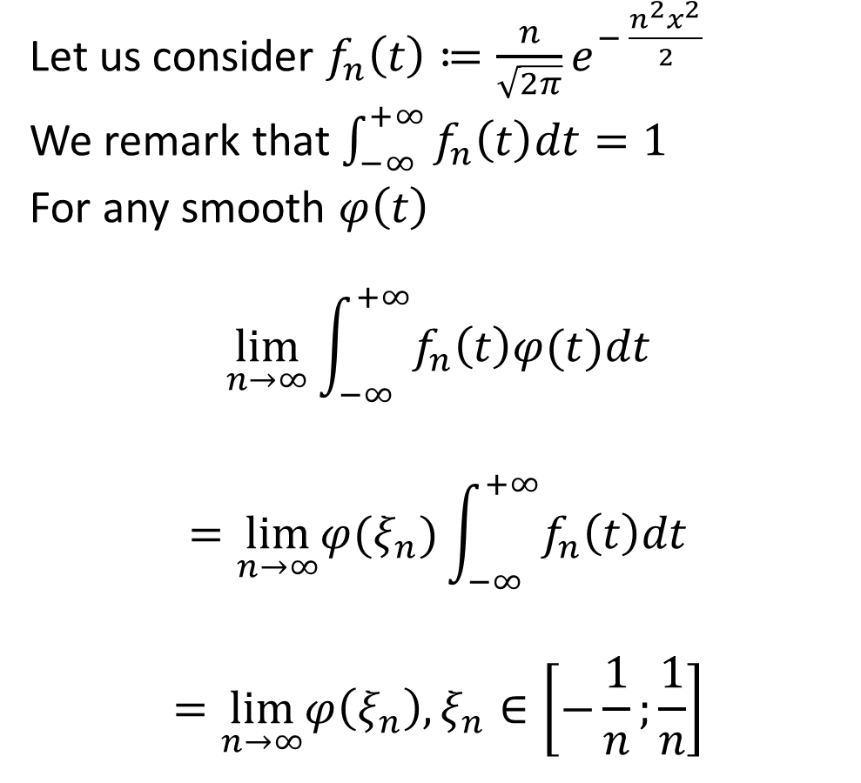
Let us consider $f_{n}\left(t\right)≔\frac{n}{\sqrt{2π}}e^{− \frac{n^{2}x^{2}}{2}}$
We remark that $\int_{−∞}^{+∞}{f_{n}\left(t\right)dt=1}$
For any smooth $φ\left(t\right)$
$$\lim_{n→∞}{\int_{−∞}^{+∞}{f_{n}\left(t\right)φ(t)dt}}$$
$$=\lim_{n→∞}φ(ξ_{n}){\int_{−∞}^{+∞}{f_{n}\left(t\right)dt}}$$
$$=\lim_{n→∞}φ\left(ξ_{n}\right), ξ_{n}∈\left[−\frac{1}{n};\frac{1}{n}\right]$$

Slide 22
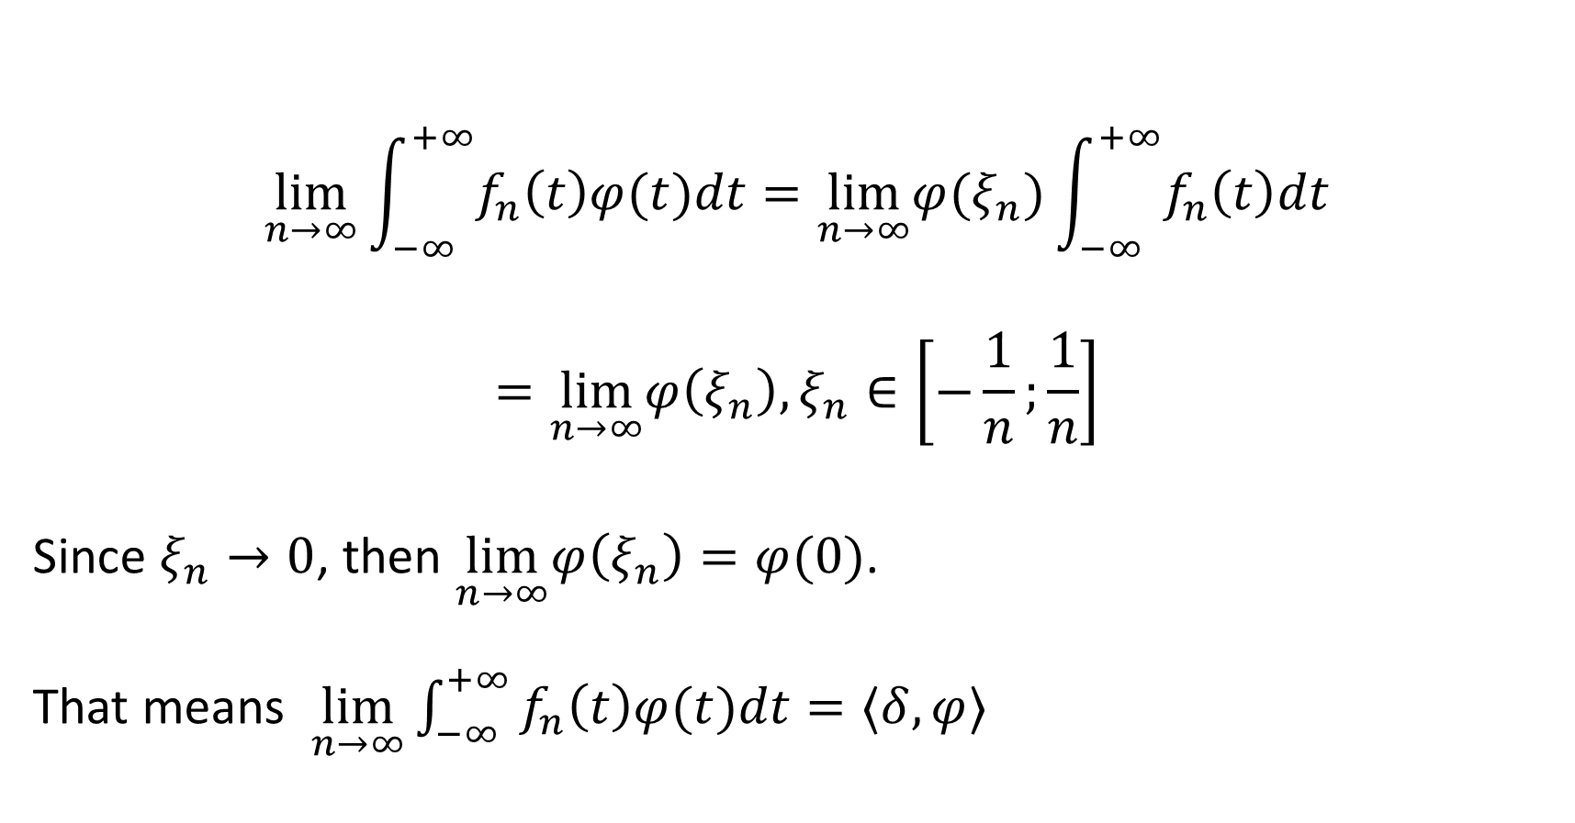
$$\lim_{n→∞}{\int_{−∞}^{+∞}{f_{n}\left(t\right)φ(t)dt}}=\lim_{n→∞}φ(ξ_{n}){\int_{−∞}^{+∞}{f_{n}\left(t\right)dt}}$$
$$=\lim_{n→∞}φ\left(ξ_{n}\right), ξ_{n}∈\left[−\frac{1}{n};\frac{1}{n}\right]$$
Since $ξ_{n}→0$, then $\lim_{n→∞}φ\left(ξ_{n}\right)=φ(0)$.
That means $\lim_{n→∞}{\int_{−∞}^{+∞}{f_{n}\left(t\right)φ(t)dt}}=〈δ, φ〉$

Slide 23
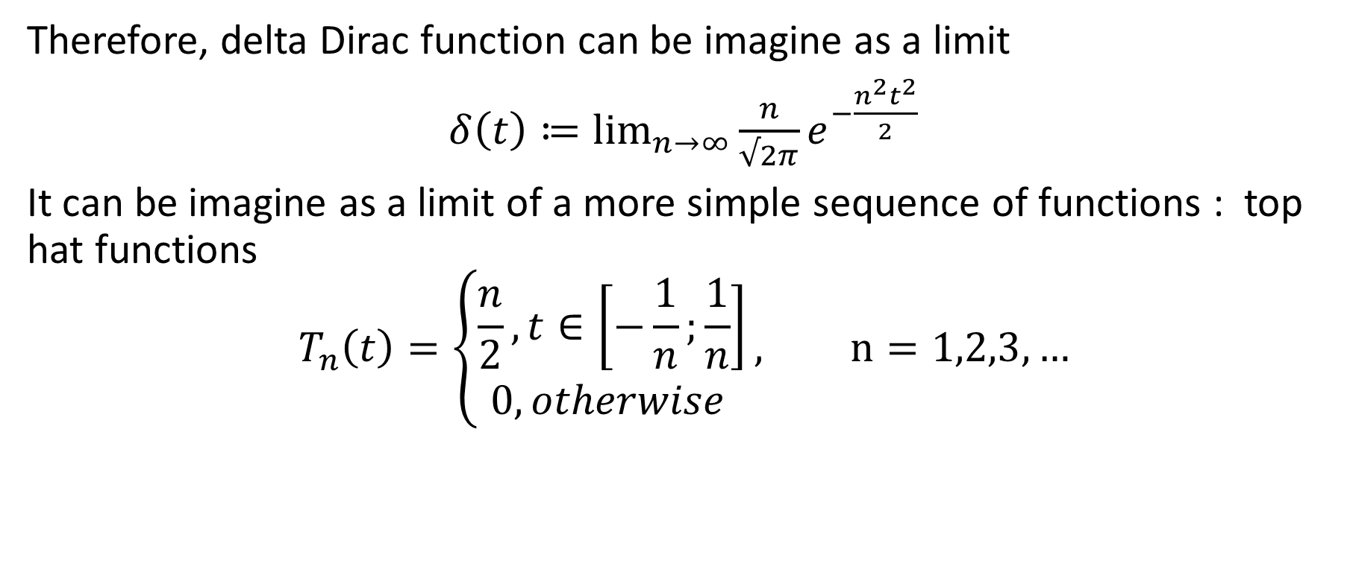
Interpretation of the Delta Dirac function
Therefore, delta Dirac function can be imagine as a limit
$δ\left(t\right)≔\lim_{n→∞}{\frac{n}{√2π}e^{−\frac{n^{2}t^{2}}{2}}}$
It can be imagine as a limit of a more simple sequence of functions : top hat functions
$$T_{n}\left(t\right)=\left\{\begin{aligned}\frac{n}{2}, t∈\left[−\frac{1}{n};\frac{1}{n}\right] \\ 0,otherwise \end{aligned}\right., n=1,2,3,…$$

Slide 24
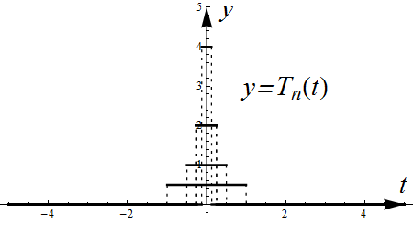
Another Delta-like sequence of the Top hat functions

Slide 25
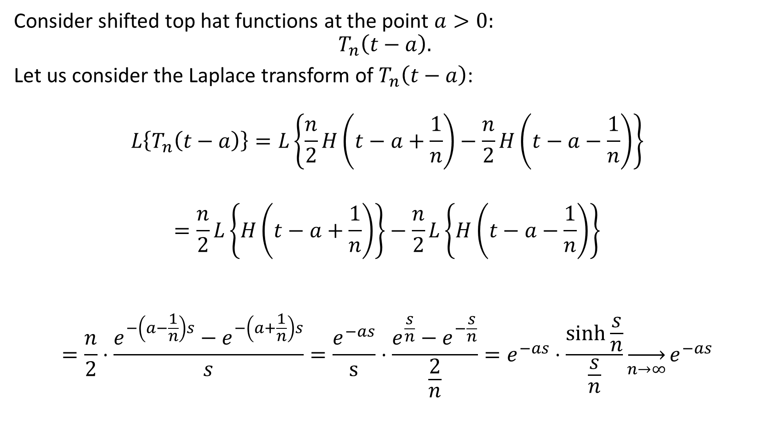
Consider shifted top hat functions at the point $a>0:$
$$T_{n}\left(t−a\right).$$
Let us consider the Laplace transform of $T_{n}\left(t−a\right)$:
$$L\left\{T_{n}\left(t−a\right)\right\}=L\left\{\frac{n}{2}H\left(t−a+\frac{1}{n}\right)−\frac{n}{2}H\left(t−a−\frac{1}{n}\right)\right\}$$
$$=\frac{n}{2}L\left\{H\left(t−a+\frac{1}{n}\right)\right\}−\frac{n}{2}L\left\{H\left(t−a−\frac{1}{n}\right)\right\}$$
$$=\frac{n}{2}⋅\frac{e^{−\left(a−\frac{1}{n}\right)s}−e^{−\left(a+\frac{1}{n}\right)s}}{s}=\frac{e^{−as}}{s}⋅\frac{e^{\frac{s}{n}}−e^{−\frac{s}{n}}}{\frac{2}{n}}=e^{−as}⋅\frac{\sinh{\frac{s}{n}}}{\frac{s}{n}}\overset{→}{n→∞}e^{−as}$$

Slide 26

The relation
$$\left\{T_{n}\left(t−a\right)\right\}\overset{→}{n→∞}e^{−as}$$
is equivalent to
$$L\left\{δ\left(t−a\right)\right\}=e^{−as}.$$
Letting $a→0$ we get
$$L\left\{δ\left(t\right)\right\}=1$$

Slide 27

The equation
$$L\left\{δ\left(t−a\right)\right\}=e^{−as}$$
can be generalized as
$$L\left\{δ\left(t−a\right)f(t)\right\}=e^{−as}f\left(a\right).$$
Hence we can append two functions to our Laplace Transform table.

Slide 28

Definition 2. The Laplace Transform of the impulse function equals $1$.
$$L\left\{δ\left(t−a\right)\right\}=e^{−as},$$
$$L\left\{δ\left(t−a\right)f(t)\right\}=e^{−as}f\left(a\right).$$

Slide 29
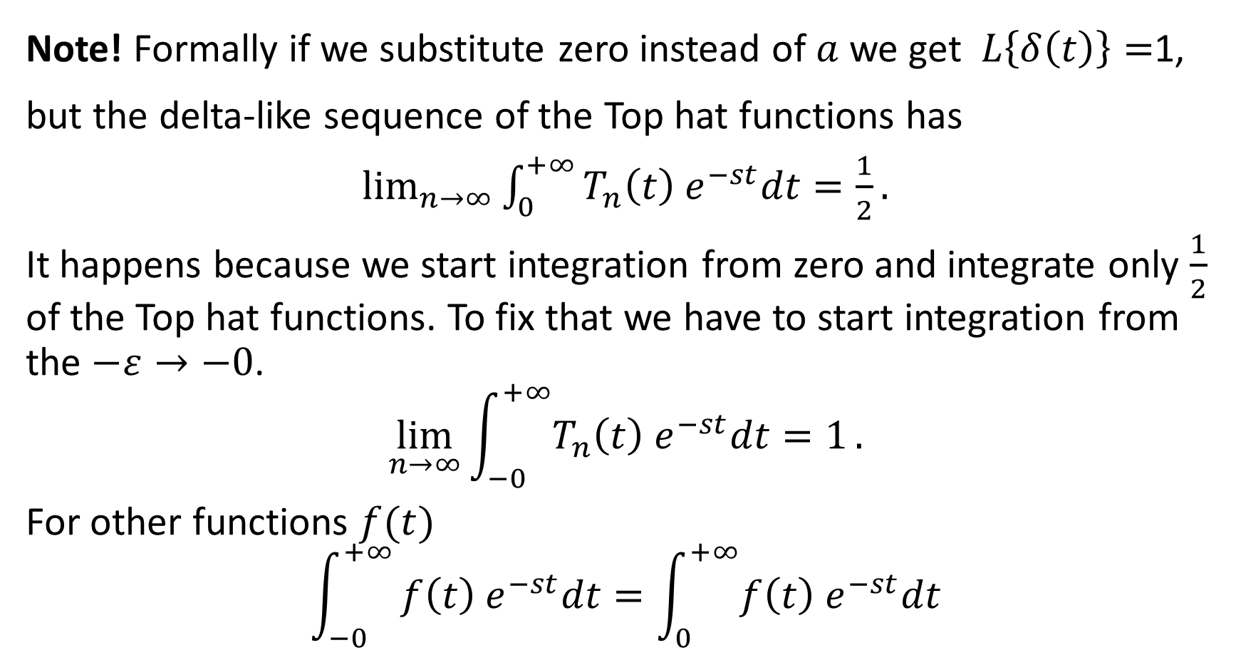
Note! Formally if we substitute zero instead of $a$ we get $L\left\{δ\left(t\right)\right\}=$1,
but the delta-like sequence of the Top hat functions has
$\lim_{n→∞}{\int_{0}^{+∞}{T_{n}\left(t\right) e^{−st}dt=\frac{1}{2}}}.$
It happens because we start integration from zero and integrate only $\frac{1}{2}$ of the Top hat functions. To fix that we have to start integration from the $−ε→−0$.
$$\lim_{n→∞}\int_{−0}^{+∞}{T_{n}\left(t\right) e^{−st}dt=1}.$$
For other functions $f(t)$
$$\int_{−0}^{+∞}{f\left(t\right) e^{−st}dt=\int_{0}^{+∞}{f\left(t\right) e^{−st}dt}}$$

Slide 30
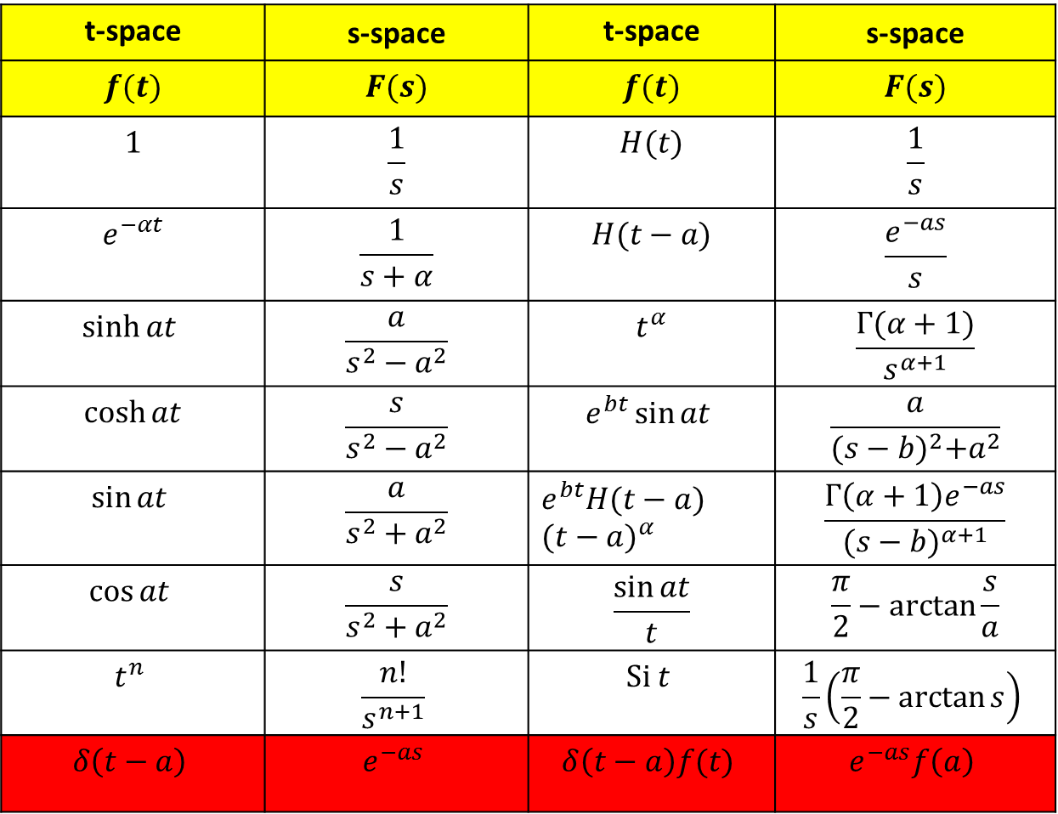
Laplace transform table
t-space | s-space | t-space | s-space
$$f(t)$$ | $$F(s)$$ | $$f(t)$$ | $$F(s)$$
$$1$$ | $$\frac{1}{s}$$ | $$H(t)$$ | $$\frac{1}{s}$$
$$e^{−αt}$$ | $$\frac{1}{s+α}$$ | $$H(t−a)$$ | $$\frac{e^{−as}}{s}$$
$$\sinh{at}$$ | $$\frac{a}{s^{2}−a^{2}}$$ | $$t^{α}$$ | $$\frac{Γ(α+1)}{s^{α+1}}$$
$$\cosh{at}$$ | $$\frac{s}{s^{2}−a^{2}}$$ | $$e^{bt}\sin{at}$$ | $$\frac{a}{{(s−b)}^{2}+a^{2}}$$
$$\sin{at}$$ | $$\frac{a}{s^{2}+a^{2}}$$ | $${e^{bt}H(t−a) (t−a)}^{α}$$ | $$\frac{Γ\left(α+1\right)e^{−as}}{{(s−b)}^{α+1}}$$
$$\cos{at}$$ | $$\frac{s}{s^{2}+a^{2}}$$ | $$\frac{\sin{at}}{t}$$ | $$\frac{π}{2}−\arctan{\frac{s}{a}}$$
$$t^{n}$$ | $$\frac{n!}{s^{n+1}}$$ | $$Si t$$ | $$\frac{1}{s}\left(\frac{π}{2}−\arctan{s}\right)$$
$$δ\left(t−a\right)$$ | $$e^{−as}$$ | $$δ\left(t−a\right)f(t)$$ | $$e^{−as}f\left(a\right)$$

Slide 31
Examples for the Impulse Dirac function and its Laplace Transform

Slide 32
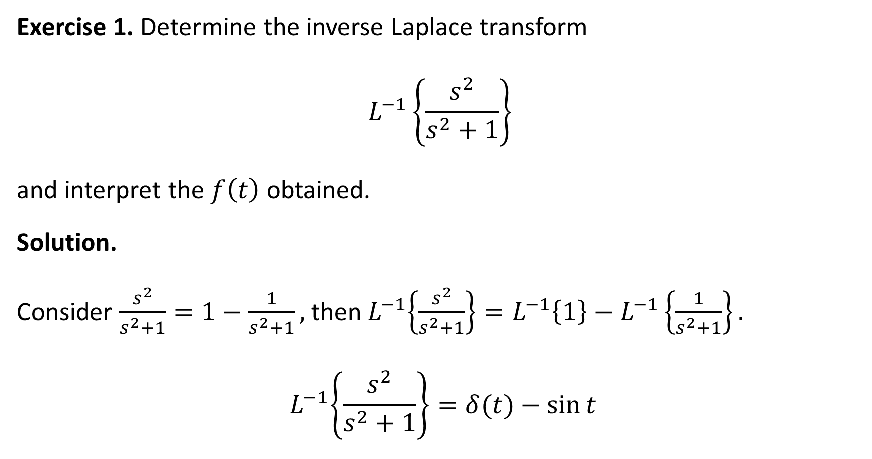
Exercise 1. Determine the inverse Laplace transform
$$L^{−1}\left\{\frac{s^{2}}{s^{2}+1}\right\}$$
and interpret the $f\left(t\right)$ obtained.
Solution.
Consider $\frac{s^{2}}{s^{2}+1}=1−\frac{1}{s^{2}+1},$ then${ L}^{−1}\left\{\frac{s^{2}}{s^{2}+1}\right\}=L^{−1}\left\{1\right\}−L^{−1}\left\{\frac{1}{s^{2}+1}\right\}.$
$${ L}^{−1}\left\{\frac{s^{2}}{s^{2}+1}\right\}=δ(t)−\sin{t}$$

Slide 33
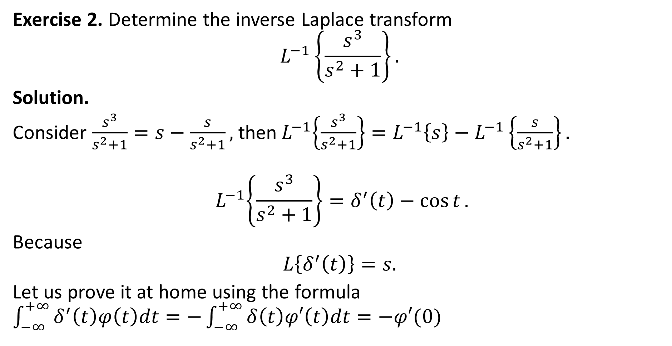
Exercise 2. Determine the inverse Laplace transform
$$L^{−1}\left\{\frac{s^{3}}{s^{2}+1}\right\}.$$
Solution.
Consider $\frac{s^{3}}{s^{2}+1}=s−\frac{s}{s^{2}+1},$ then${ L}^{−1}\left\{\frac{s^{3}}{s^{2}+1}\right\}=L^{−1}\left\{s\right\}−L^{−1}\left\{\frac{s}{s^{2}+1}\right\}.$
$${ L}^{−1}\left\{\frac{s^{3}}{s^{2}+1}\right\}=δ^{′}\left(t\right)−\cos{t}.$$
Because
$$L\left\{δ^{′}\left(t\right)\right\}=s.$$
Let us prove it at home using the formula $\int_{−∞}^{+∞}{δ^{′}\left(t\right)φ\left(t\right)dt=−\int_{−∞}^{+∞}{δ\left(t\right)φ′\left(t\right)dt}}=−φ′(0)$

Slide 34
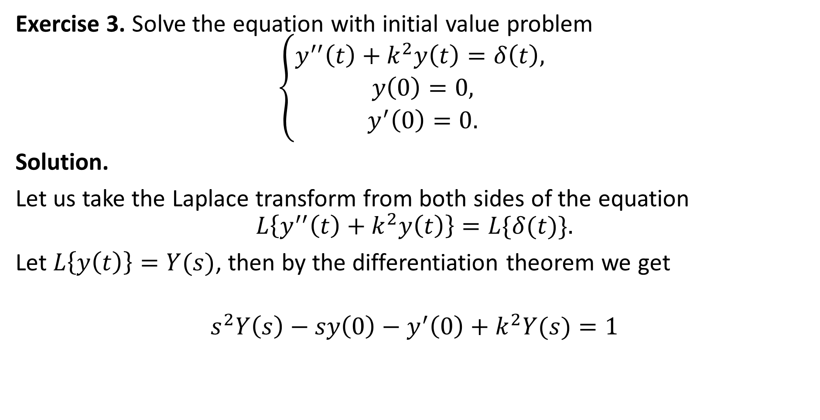
Exercise 3. Solve the equation with initial value problem
$$\left\{\begin{aligned}y^{′′}\left(t\right)+k^{2}y\left(t\right)=δ\left(t\right), \\ y\left(0\right)=0, \\ y^{′}\left(0\right)=0.\end{aligned}\right.$$
Solution.
Let us take the Laplace transform from both sides of the equation
$$L\left\{y^{′′}\left(t\right)+k^{2}y\left(t\right)\right\}=L\{δ(t)\}.$$
Let $L\left\{y\left(t\right)\right\}=Y(s)$, then by the differentiation theorem we get
$$s^{2}Y\left(s\right)−sy\left(0\right)−y^{′}\left(0\right)+k^{2}Y(s)=1$$

Slide 35

$$s^{2}Y\left(s\right)−sy\left(0\right)−y^{′}\left(0\right)+k^{2}Y(s)=1$$
$$s^{2}Y\left(s\right)+k^{2}Y(s)=1$$
$$Y(s)=\frac{1}{s^{2}+k^{2}}$$
Taking ILT from both sides of the last equation we obtain
$$L^{−1}\{Y\left(s\right)\}=L^{−1}\left\{\frac{1}{s^{2}+k^{2}}\right\}$$
$$y\left(t\right)=\frac{1}{k}sin{kt}.$$

Slide 36
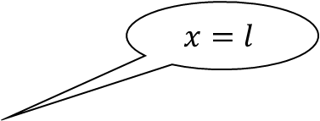

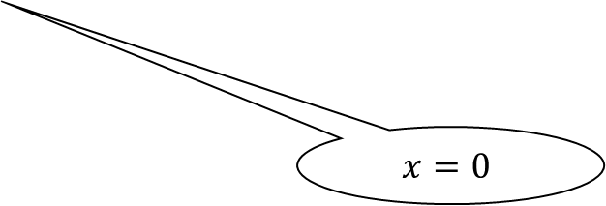

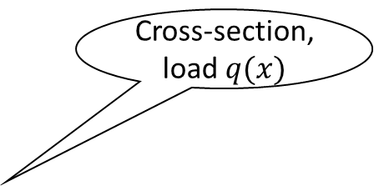


Exercise 4. From the elasticity theory of beams is known that
$${E⋅I⋅y}^{(4)}\left(x\right)=q\left(x\right),$$
where $y(x)$ is an elastic curve of the beam, $E$ is the Young’s modulus of elasticity, $I$ is a second moment of the cross-section area with respect to the z-axis (the centroidal axis), $q(x)$ is a load of the beam.
Cross-section, load $q(x)$
$$z$$
$$x=l$$
$$x$$
$$x=0$$
$$y$$

Slide 37
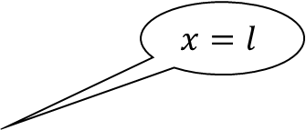

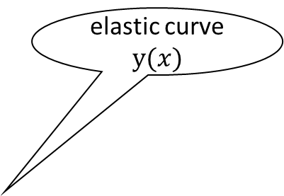



Exercise 4. From the elasticity theory of beams is known that
$${E⋅I⋅y}^{(4)}\left(x\right)=q\left(x\right),$$
where $y(x)$ is an elastic curve of the beam, $E$ is the Young’s modulus of elasticity, $I$ is a second moment of the cross-section area with respect to the z-axis (the centroidal axis), $q(x)$ is a load of the beam.
Cross-section, load $q(x)$
elastic curve $y(x)$
$$z$$
$$x=l$$
$$z$$
$$x$$
$$x$$
$$x=0$$
$$y$$
$$y$$

Slide 38
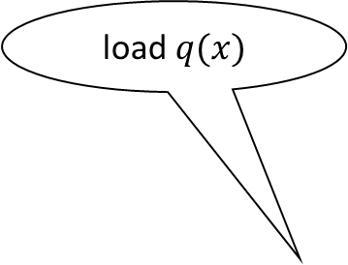
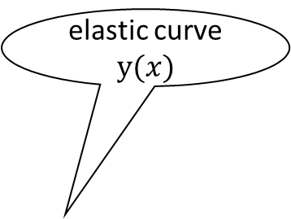
Exercise 4. From the elasticity theory of beams is known that
$${E⋅I⋅y}^{(4)}\left(x\right)=q\left(x\right),$$
where $y(x)$ is an elastic curve of the beam, $E$ is the Young’s modulus of elasticity, $I$ is a second moment of the cross-section area with respect to the z-axis (the centroidal axis), $q(x)$ is a load of the beam.
Cross-section, load $q(x)$
load $q(x)$
elastic curve $y(x)$
$$z$$
$$x=l$$
$$z$$
$$x$$
$$x$$
$$x=0$$
$$y$$
$$y$$

Slide 39
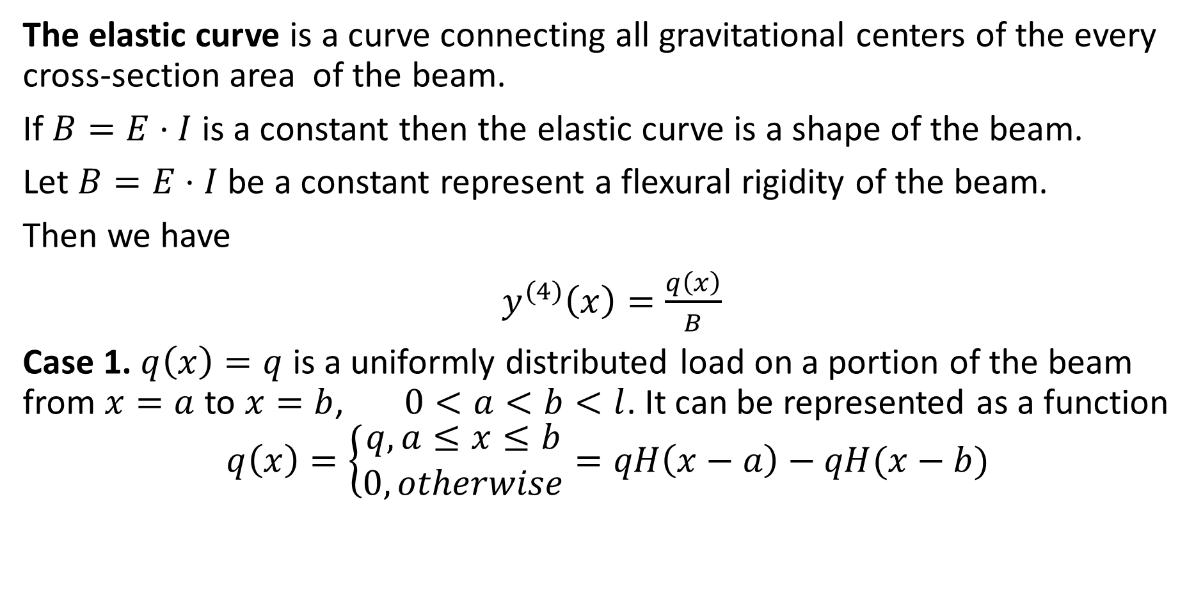
The elastic curve is a curve connecting all gravitational centers of the every cross-section area of the beam.
If $B=E⋅I$ is a constant then the elastic curve is a shape of the beam.
Let $B=E⋅I$ be a constant represent a flexural rigidity of the beam.
Then we have
$y^{(4)}\left(x\right)=\frac{q\left(x\right)}{B}$
Case 1. $q\left(x\right)=q$ is a uniformly distributed load on a portion of the beam from $x=a$ to $x=b$, $0<a<b<l$. It can be represented as a function
$$q\left(x\right)=\left\{\begin{aligned}q, a≤x≤b \\ 0, otherwise\end{aligned}=qH\left(x−a\right)−qH(x−b)\right.$$

Slide 40
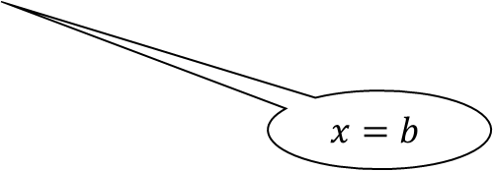
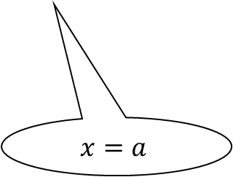
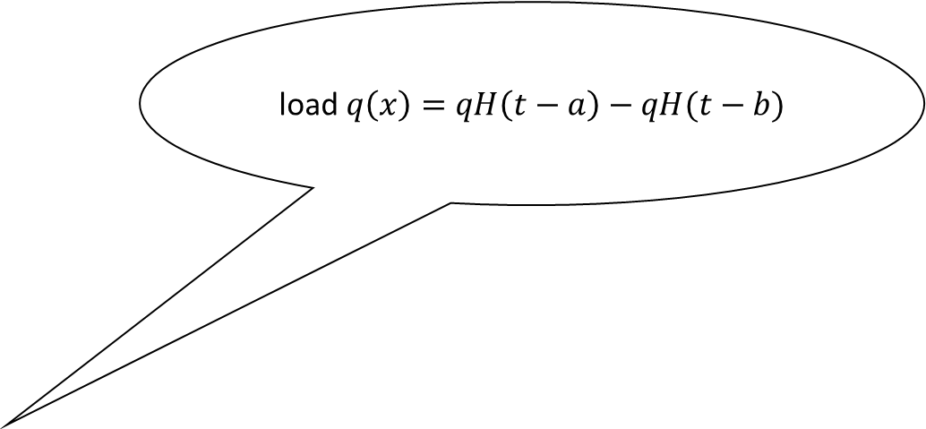
load $q\left(x\right)=qH\left(t−a\right)−qH(t−b)$
$$z$$
$$x$$
$$x=b$$
$$x=a$$
$$y$$

Slide 41
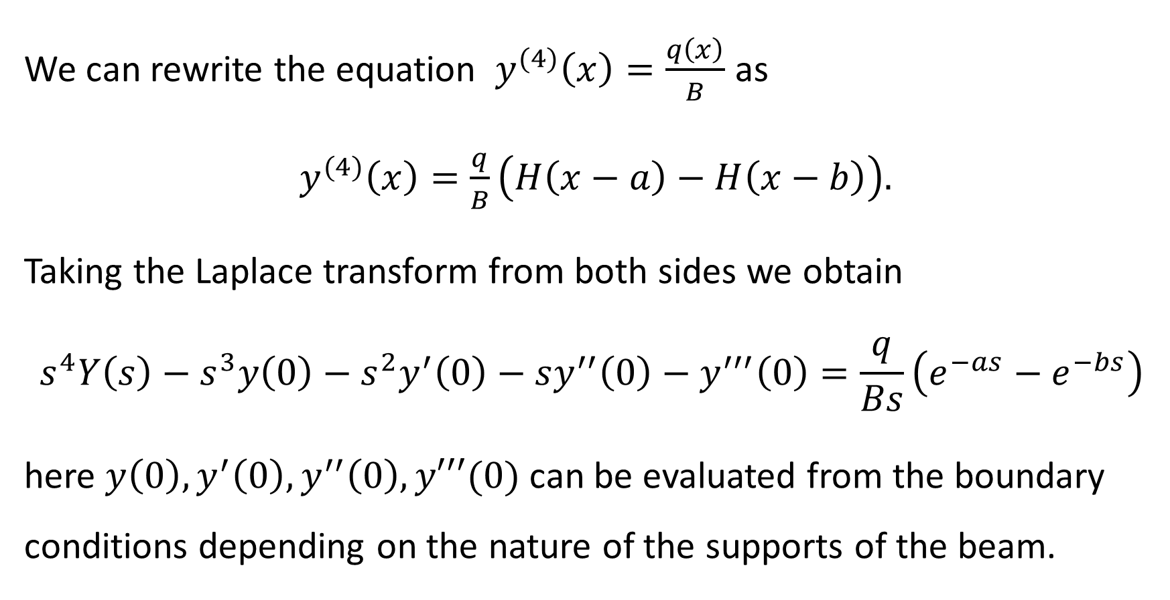
We can rewrite the equation $y^{(4)}\left(x\right)=\frac{q\left(x\right)}{B}$ as
$y^{(4)}\left(x\right)=\frac{q}{B}\left(H\left(x−a\right)−H\left(x−b\right)\right).$
Taking the Laplace transform from both sides we obtain
$$s^{4}Y\left(s\right)−s^{3}y\left(0\right)−s^{2}y^{′}\left(0\right)−sy^{′′}\left(0\right)−y^{′′′}\left(0\right)=\frac{q}{Bs}\left(e^{−as}−e^{−bs}\right)$$
here $y\left(0\right), y^{′}\left(0\right), y^{′′}\left(0\right), y′′′(0)$ can be evaluated from the boundary conditions depending on the nature of the supports of the beam.

Slide 42
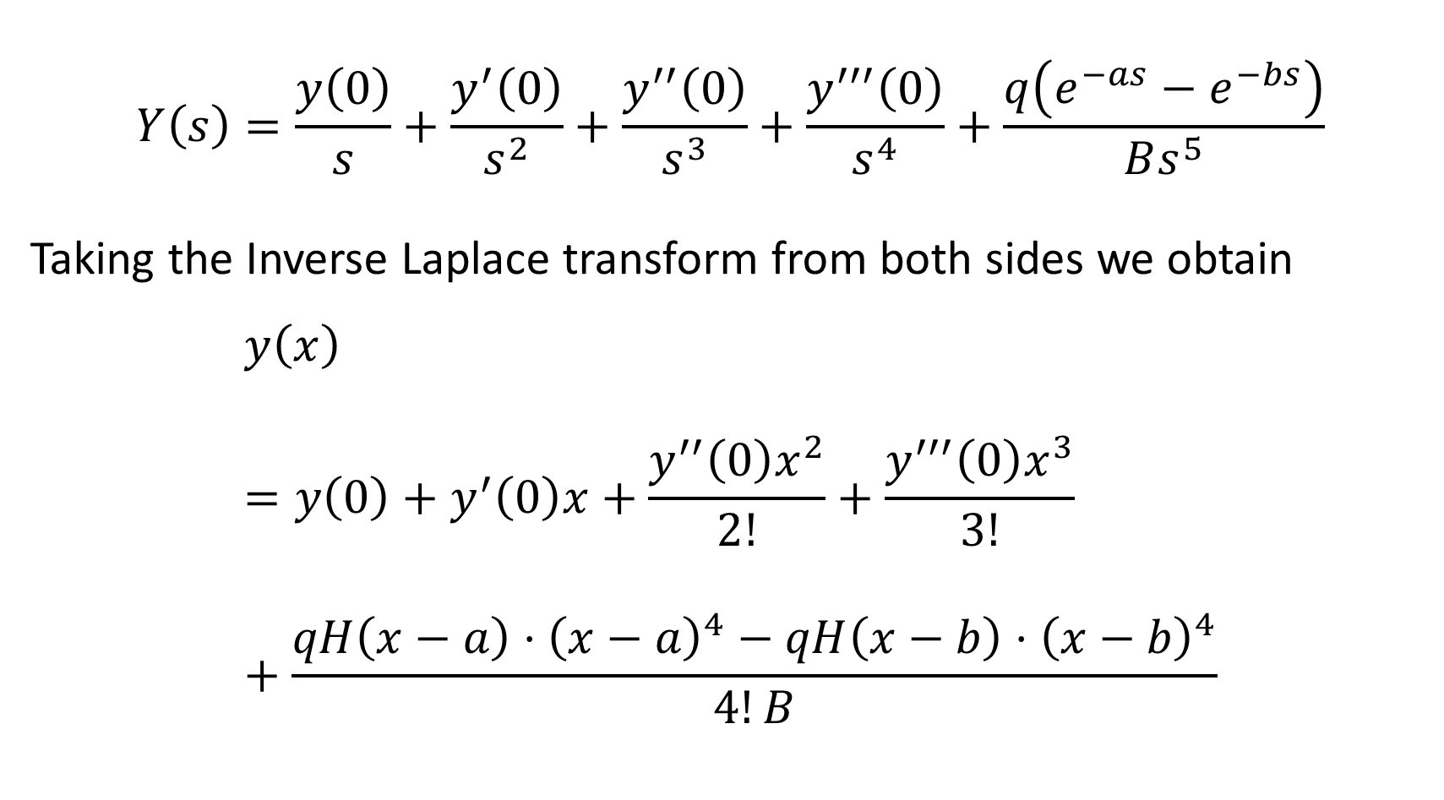
$$Y\left(s\right)=\frac{y\left(0\right)}{s}+\frac{y^{′}\left(0\right)}{s^{2}}+\frac{y^{′′}\left(0\right)}{s^{3}}+\frac{y^{′′′}\left(0\right)}{s^{4}}+\frac{q\left(e^{−as}−e^{−bs}\right)}{Bs^{5}}$$
Taking the Inverse Laplace transform from both sides we obtain
$$y\left(x\right)=y\left(0\right)+y^{′}\left(0\right)x+\frac{y^{′′}\left(0\right)x^{2}}{2!}+\frac{y^{′′′}\left(0\right)x^{3}}{3!}+\frac{qH\left(x−a\right)⋅{\left(x−a\right)}^{4}−qH\left(x−b\right)⋅{\left(x−b\right)}^{4}}{4!B}$$

Slide 43

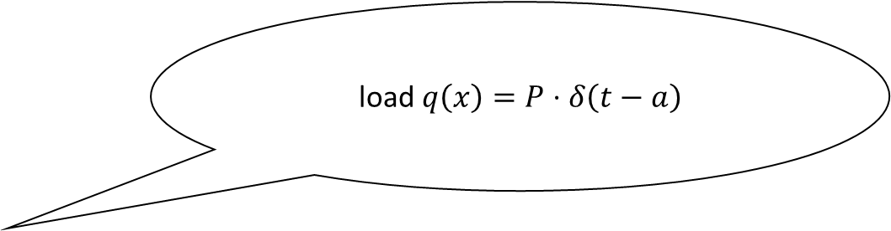
Case 2. Concentrated load $q\left(x\right)=P⋅δ(t−a)$ at the point $x=a$
$0<a<l$. Here $P=const.$
load $q\left(x\right)=P⋅δ\left(t−a\right)$
$$z$$
$$x$$
$$x=a$$

Slide 44
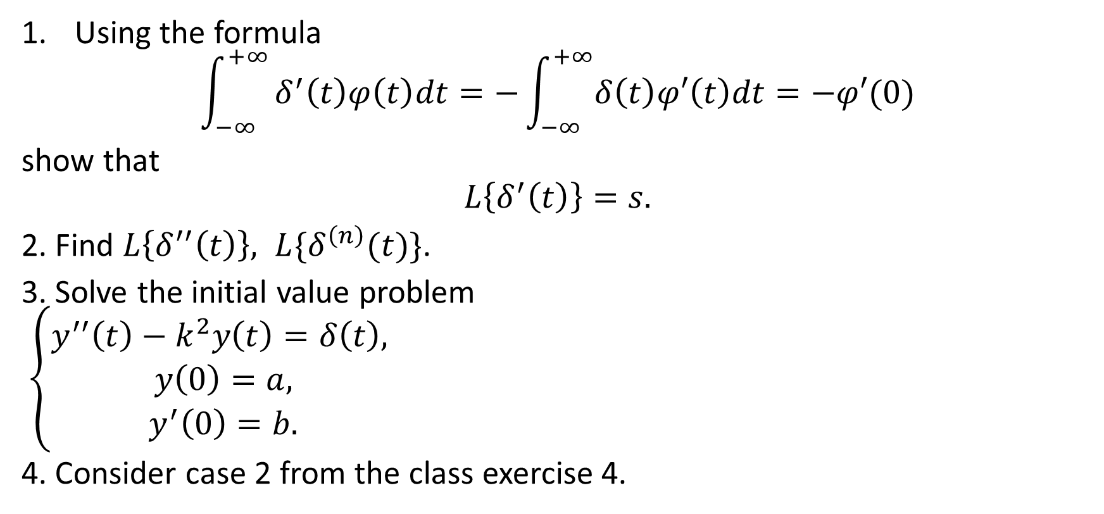
Homework
Using the formula
$$\int_{−∞}^{+∞}{δ^{′}\left(t\right)φ\left(t\right)dt=−\int_{−∞}^{+∞}{δ\left(t\right)φ′\left(t\right)dt}}=−φ′(0)$$
show that
$$L\left\{δ^{′}\left(t\right)\right\}=s.$$
2. Find $L\left\{δ^{′′}\left(t\right)\right\}, L\{δ^{\left(n\right)}(t)\}$.
3. Solve the initial value problem
$\left\{\begin{aligned}y^{′′}\left(t\right)−k^{2}y\left(t\right)=δ\left(t\right), \\ y\left(0\right)=a, \\ y^{′}\left(0\right)=b.\end{aligned}\right.$
4. Consider case 2 from the class exercise 4.

