Slide 1
Mathematical Methods of Solid Mechanics
Aliaksandr Radyna Assoc. Prof.
DUT-BSU Joint Institute

Slide 2
Periodic Functions

Slide 3

The solutions to the home exercises
Exercise 1. Using the formula
$$\int_{−∞}^{+∞}{δ^{′}\left(t\right)φ\left(t\right)dt=−\int_{−∞}^{+∞}{δ\left(t\right)φ′\left(t\right)dt}}=−φ′(0)$$
show that
$$L\left\{δ^{′}\left(t\right)\right\}=s.$$

Slide 4

The solutions to the home exercises
Solution.
The Laplace transform
$$L\left\{δ^{′}\left(t\right)\right\}=\int_{−0}^{+∞}{δ^{′}\left(t\right)e^{−st}dt=}−{\left[{\left(e^{−st}\right)}_{t}^{′}\right]}_{t=0}=−{\left[−se^{−st}\right]}_{t=0}=s$$

Slide 5
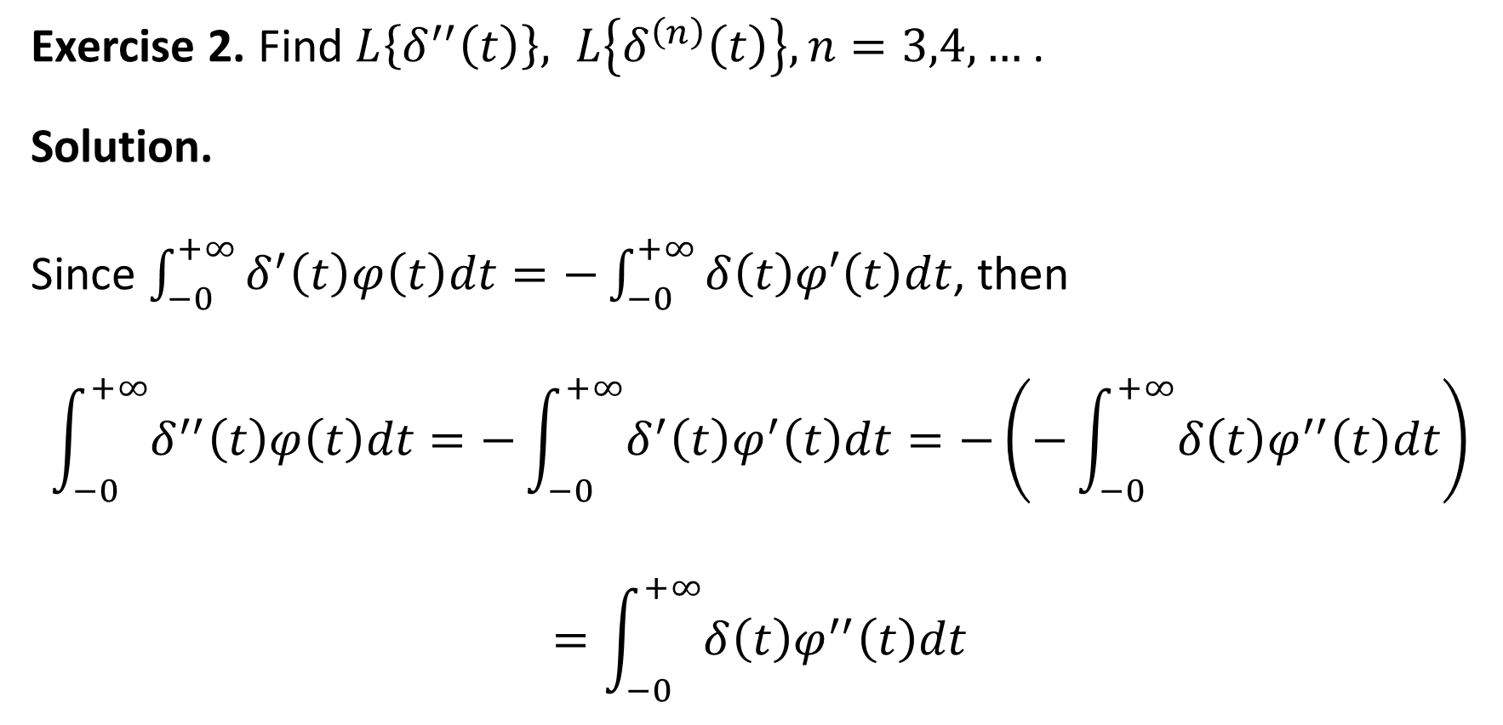
The solutions to the home exercises
Exercise 2. Find $L\left\{δ^{′′}\left(t\right)\right\}, L\left\{δ^{\left(n\right)}\left(t\right)\right\}, n=3,4,…$.
Solution.
Since $\int_{−0}^{+∞}{δ^{′}\left(t\right)φ\left(t\right)dt=−}\int_{−0}^{+∞}{δ\left(t\right)φ′\left(t\right)dt}$, then
$$\int_{−0}^{+∞}{δ^{′′}\left(t\right)φ\left(t\right)dt=−}\int_{−0}^{+∞}{δ^{′}\left(t\right)φ^{′}\left(t\right)dt}=−\left(−\int_{−0}^{+∞}{δ\left(t\right)φ^{′′}\left(t\right)dt}\right)$$
$$=\int_{−0}^{+∞}{δ\left(t\right)φ^{′′}\left(t\right)dt}$$

Slide 6
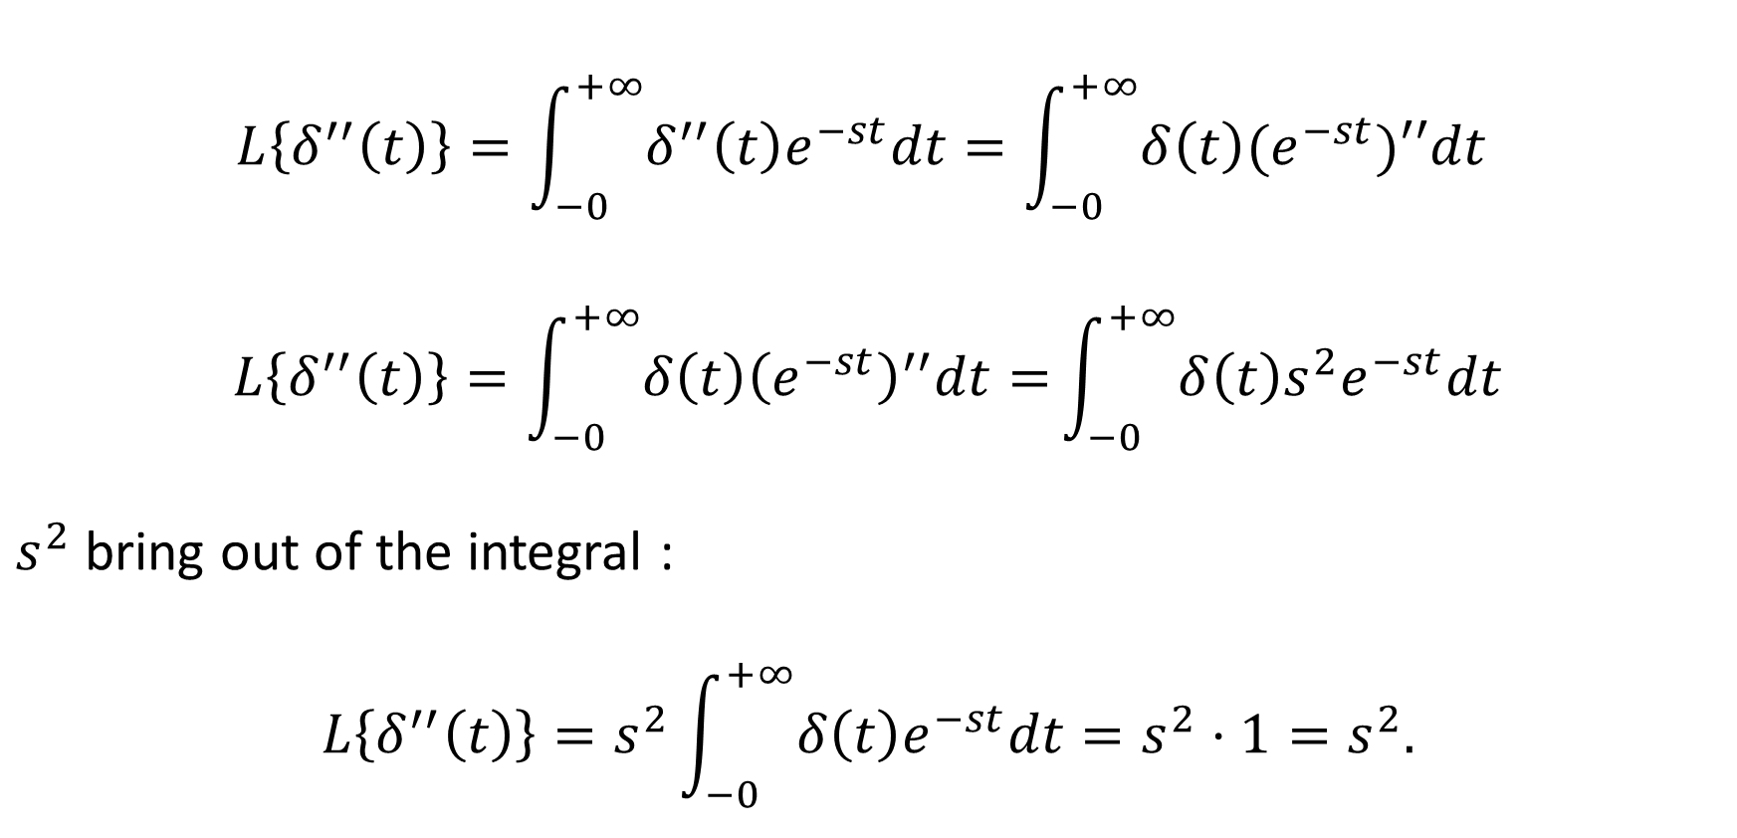
The solutions to the home exercises
$$L\left\{δ^{′′}\left(t\right)\right\}=\int_{−0}^{+∞}{δ^{′′}\left(t\right)e^{−st}dt}=\int_{−0}^{+∞}{δ\left(t\right)(e^{−st})′′dt}$$
$$L\left\{δ^{′′}\left(t\right)\right\}=\int_{−0}^{+∞}{δ\left(t\right){\left(e^{−st}\right)}^{′′}dt=}\int_{−0}^{+∞}{δ\left(t\right)s^{2}e^{−st}dt}$$
$s^{2}$ bring out of the integral :
$$L\left\{δ^{′′}\left(t\right)\right\}=s^{2}\int_{−0}^{+∞}{δ\left(t\right)e^{−st}dt=s^{2}⋅1=s^{2}.}$$

Slide 7
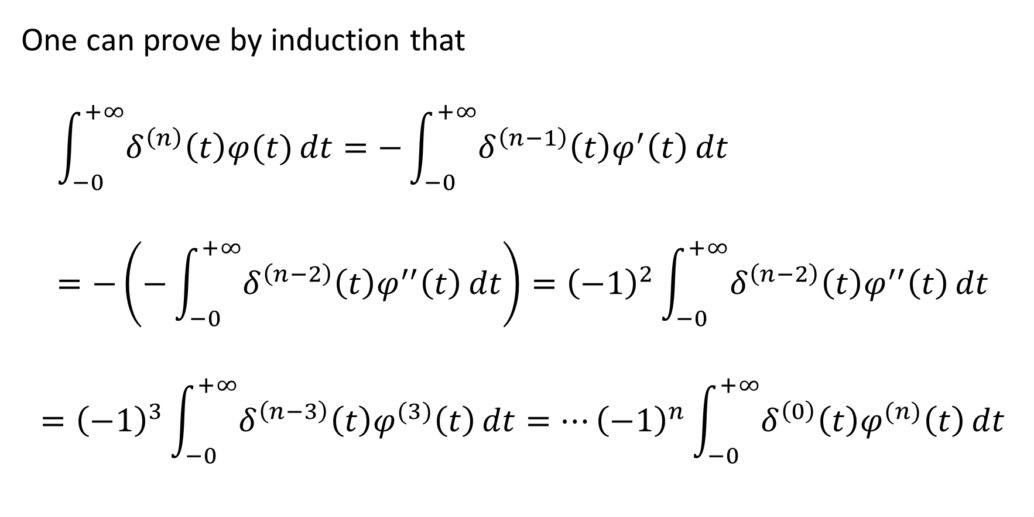
The solutions to the home exercises
One can prove by induction that
$$\int_{−0}^{+∞}{δ^{\left(n\right)}\left(t\right)φ(t)}dt=−\int_{−0}^{+∞}{δ^{\left(n−1\right)}\left(t\right)φ^{′}\left(t\right)}dt=−\left(−\int_{−0}^{+∞}{δ^{\left(n−2\right)}\left(t\right)φ^{′′}\left(t\right)}dt\right)={\left(−1\right)}^{2}\int_{−0}^{+∞}{δ^{\left(n−2\right)}\left(t\right)φ^{′′}\left(t\right)}dt$$
$$={\left(−1\right)}^{3}\int_{−0}^{+∞}{δ^{\left(n−3\right)}\left(t\right)φ^{(3)}\left(t\right)}dt=…{\left(−1\right)}^{n}\int_{−0}^{+∞}{δ^{\left(0\right)}\left(t\right)φ^{(n)}\left(t\right)}dt$$

Slide 8
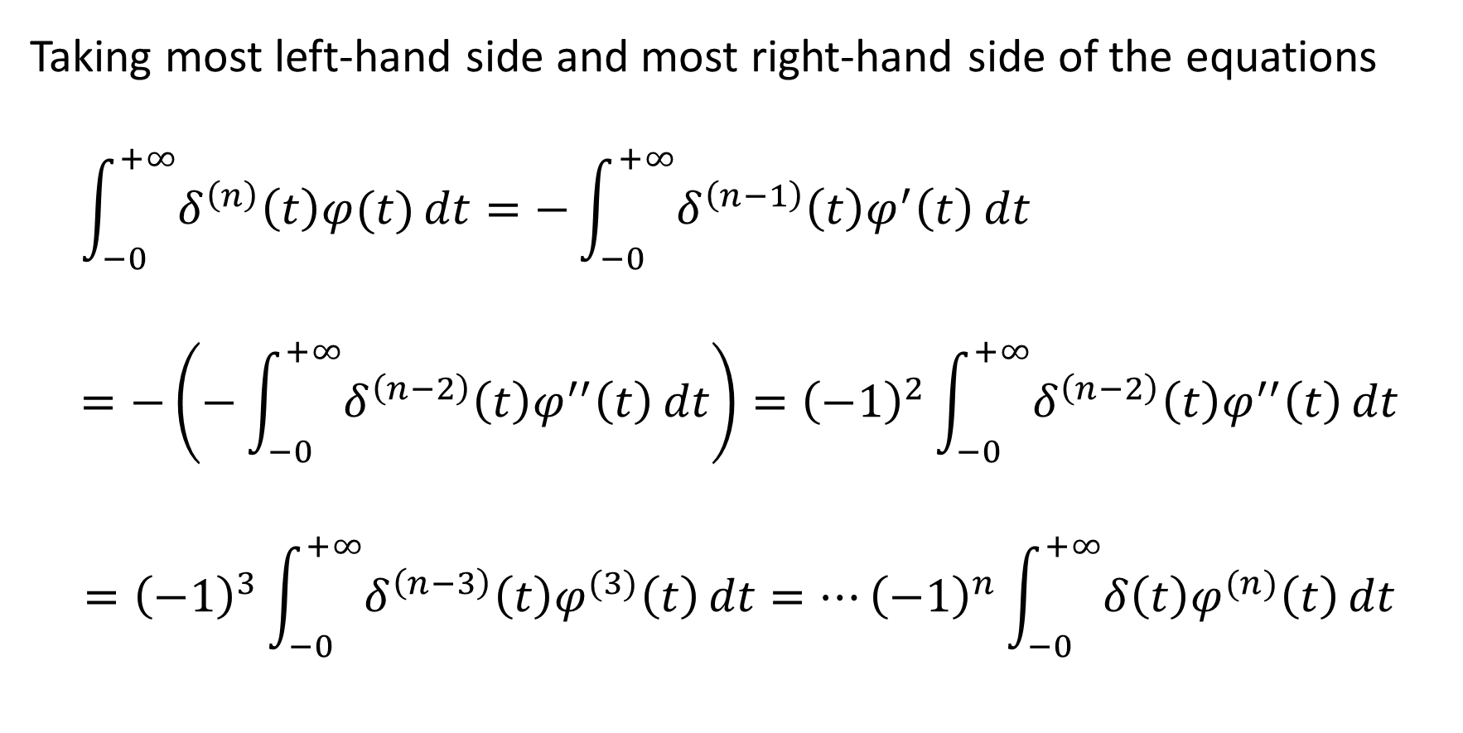
The solutions to the home exercises
Taking most left-hand side and most right-hand side of the equations
$$\int_{−0}^{+∞}{δ^{\left(n\right)}\left(t\right)φ(t)}dt=−\int_{−0}^{+∞}{δ^{\left(n−1\right)}\left(t\right)φ^{′}\left(t\right)}dt=−\left(−\int_{−0}^{+∞}{δ^{\left(n−2\right)}\left(t\right)φ^{′′}\left(t\right)}dt\right)={\left(−1\right)}^{2}\int_{−0}^{+∞}{δ^{\left(n−2\right)}\left(t\right)φ^{′′}\left(t\right)}dt$$
$$={\left(−1\right)}^{3}\int_{−0}^{+∞}{δ^{\left(n−3\right)}\left(t\right)φ^{(3)}\left(t\right)}dt=…{\left(−1\right)}^{n}\int_{−0}^{+∞}{δ\left(t\right)φ^{(n)}\left(t\right)}dt$$

Slide 9

The solutions to the home exercises
We obtain
$$\int_{−0}^{+∞}{δ^{\left(n\right)}\left(t\right)φ(t)}dt={\left(−1\right)}^{n}\int_{−0}^{+∞}{δ\left(t\right)φ^{(n)}\left(t\right)}dt$$
and
$$L\left\{δ^{\left(n\right)}\left(t\right)\right\}=\int_{−0}^{+∞}{δ^{\left(n\right)}\left(t\right)e^{−st}}dt=\int_{−0}^{+∞}{δ\left(t\right){\left(e^{−st}\right)}^{\left(n\right)}}dt$$
$$={\left(−1\right)}^{n}{\left[{\left(−1\right)}^{n}s^{n}e^{−st}\right]}_{t=0}=s^{n}.$$

Slide 10
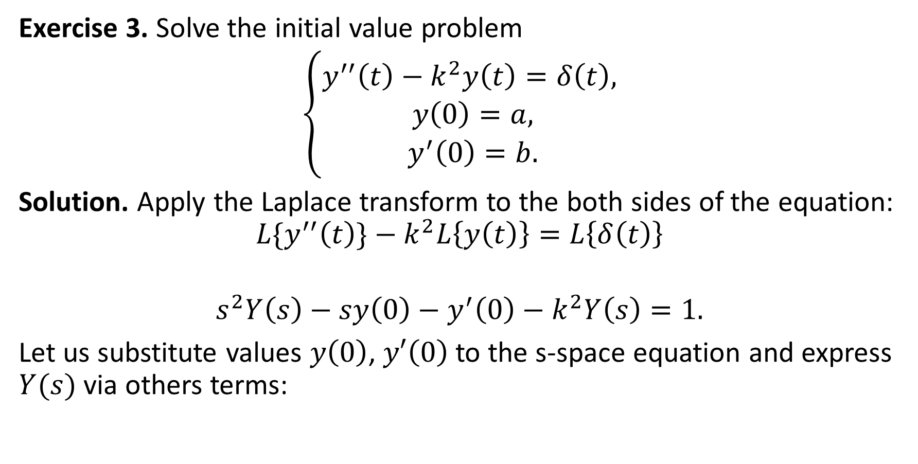
The solutions to the home exercises
Exercise 3. Solve the initial value problem
$\left\{\begin{aligned}y^{′′}\left(t\right)−k^{2}y\left(t\right)=δ\left(t\right), \\ y\left(0\right)=a, \\ y^{′}\left(0\right)=b.\end{aligned}\right.$
Solution. Apply the Laplace transform to the both sides of the equation:
$${L\{y}^{′′}\left(t\right)\}−k^{2}L\left\{y\left(t\right)\right\}=L\left\{δ\left(t\right)\right\}$$
$$s^{2}Y\left(s\right)−sy\left(0\right)−y^{′}\left(0\right)−k^{2}Y\left(s\right)=1.$$
Let us substitute values $y\left(0\right)$, $y′\left(0\right)$ to the s-space equation and express $Y(s)$ via others terms:

Slide 11

The solutions to the home exercises
$$s^{2}Y\left(s\right)−sa−b−k^{2}Y\left(s\right)=1$$
$${(s}^{2}−k^{2})Y\left(s\right)=1+b+as$$
$$Y\left(s\right)=\frac{1+b+as}{{(s}^{2}−k^{2})}$$
$$Y\left(s\right)=\frac{1+b}{{(s}^{2}−k^{2})}+\frac{as}{{(s}^{2}−k^{2})}$$
Perform the inverse Laplace transform from the both sides of the last eq.

Slide 12

The solutions to the home exercises
$$Y\left(s\right)=\frac{1+b}{{(s}^{2}−k^{2})}+\frac{as}{{(s}^{2}−k^{2})}$$
$$y\left(t\right)=\frac{1+b}{k}⋅\sinh{kt}+a⋅\cosh{kt}$$

Slide 13


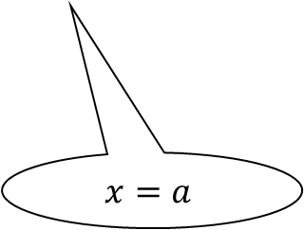
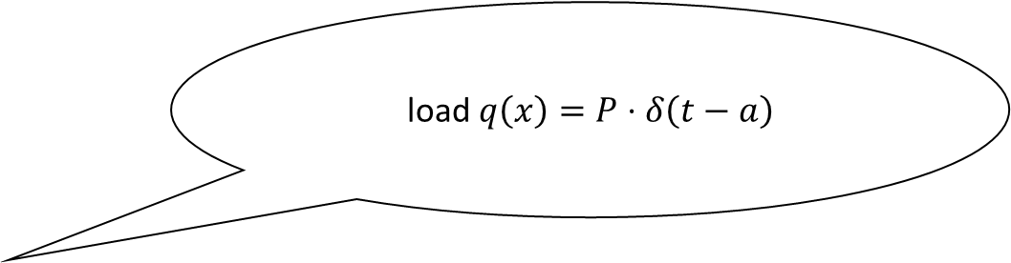

Exercise 4. Find the elastic curve of the beam under the concentrated load $q\left(x\right)=P⋅δ(t−a)$ at the point $x=a$, where $0<a<l$, $P=const.$
load $q\left(x\right)=P⋅δ\left(t−a\right)$
$$z$$
$$x$$
$$x=a$$

Slide 14
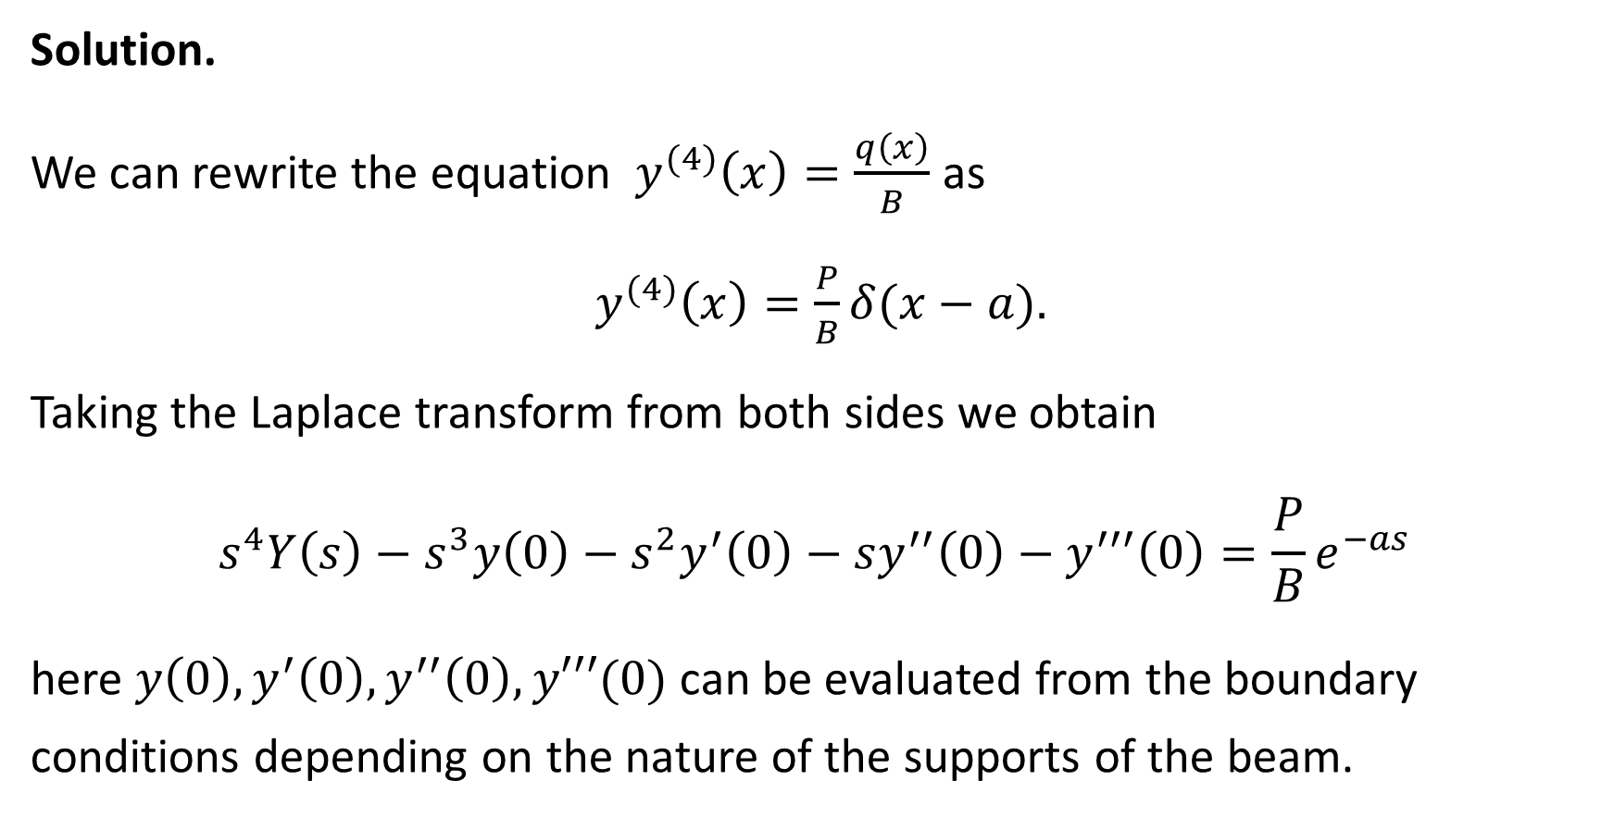
Solution.
We can rewrite the equation $y^{(4)}\left(x\right)=\frac{q\left(x\right)}{B}$ as
$y^{(4)}\left(x\right)=\frac{P}{B}δ(x−a).$
Taking the Laplace transform from both sides we obtain
$$s^{4}Y\left(s\right)−s^{3}y\left(0\right)−s^{2}y^{′}\left(0\right)−sy^{′′}\left(0\right)−y^{′′′}\left(0\right)=\frac{P}{B}e^{−as}$$
here $y\left(0\right), y^{′}\left(0\right), y^{′′}\left(0\right), y′′′(0)$ can be evaluated from the boundary conditions depending on the nature of the supports of the beam.

Slide 15
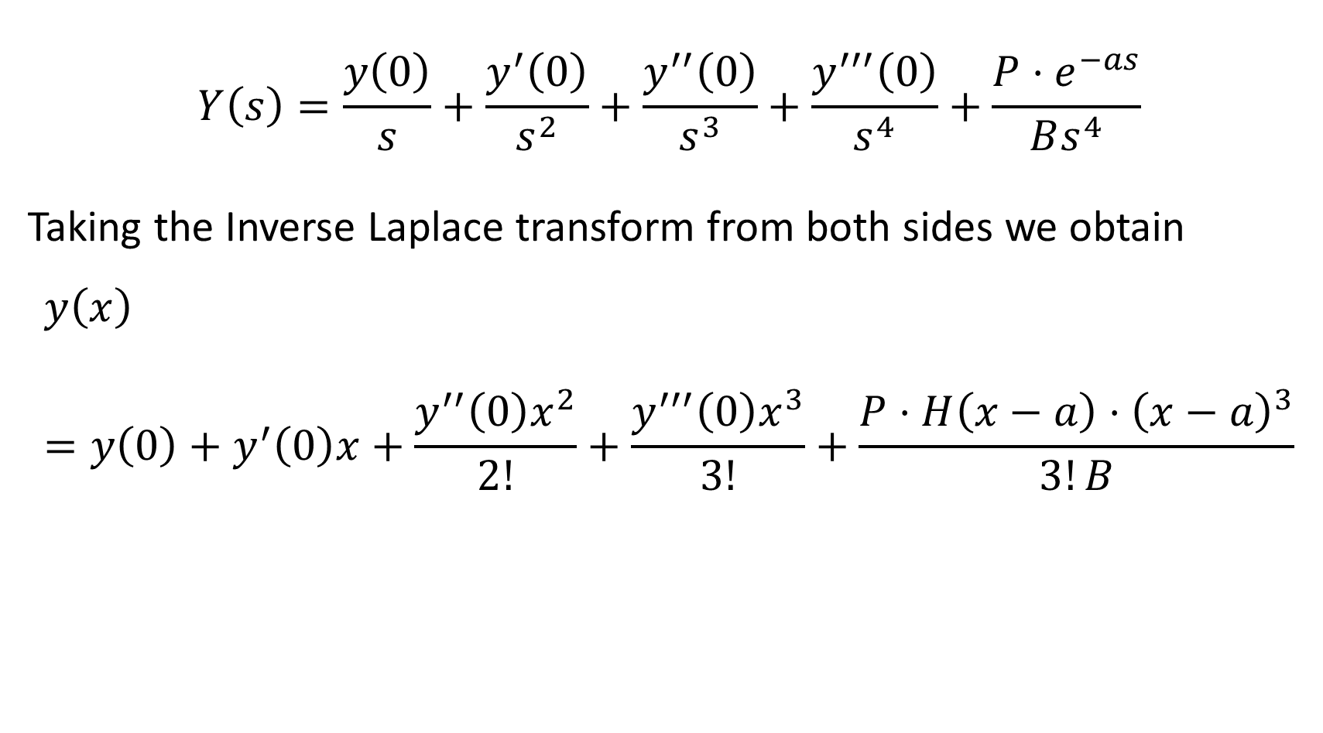
$$Y\left(s\right)=\frac{y\left(0\right)}{s}+\frac{y^{′}\left(0\right)}{s^{2}}+\frac{y^{′′}\left(0\right)}{s^{3}}+\frac{y^{′′′}\left(0\right)}{s^{4}}+\frac{P⋅e^{−as}}{Bs^{4}}$$
Taking the Inverse Laplace transform from both sides we obtain
$$y\left(x\right)=y\left(0\right)+y^{′}\left(0\right)x+\frac{y^{′′}\left(0\right)x^{2}}{2!}+\frac{y^{′′′}\left(0\right)x^{3}}{3!}+\frac{P⋅H\left(x−a\right)⋅{\left(x−a\right)}^{3}}{3!B}$$

Slide 16
Periodic Functions

Slide 17
The Plan of the Lecture
Definition of a periodic function
The Laplace transform of a periodic function
Examples
Exercises

Slide 18
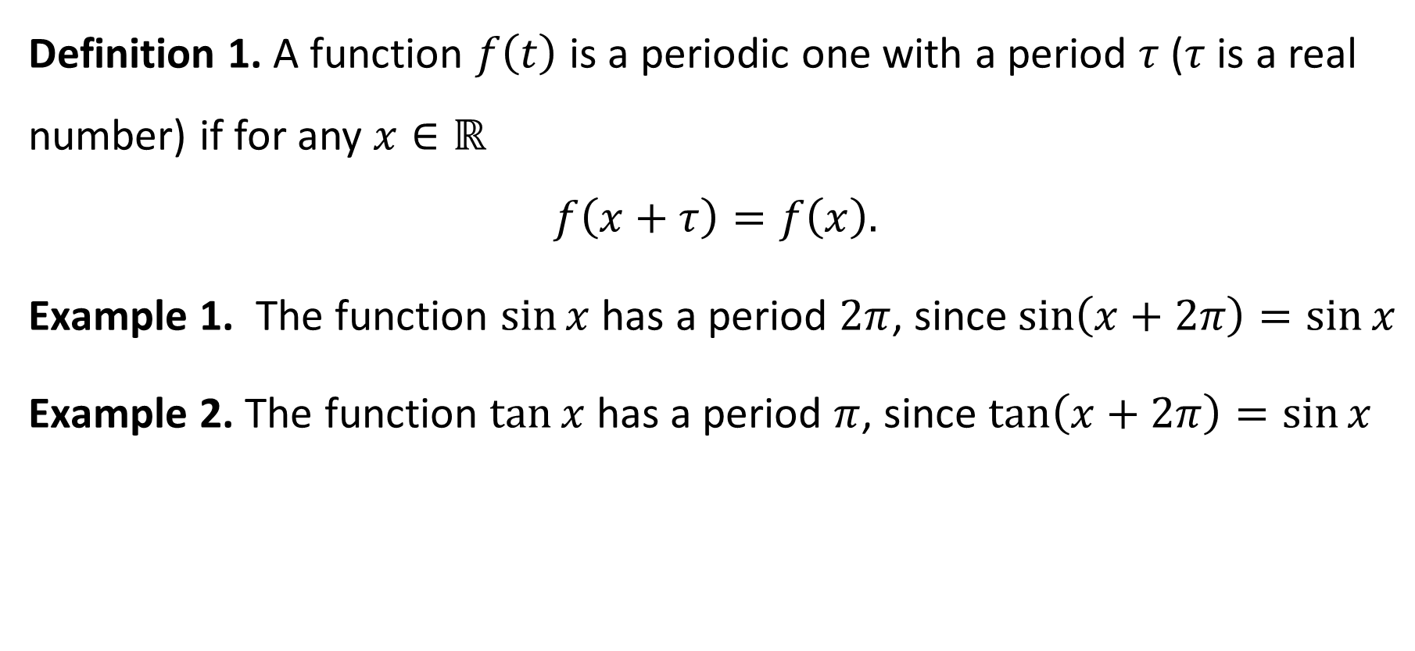
Definition of a periodic function
Definition 1. A function $f\left(t\right)$ is a periodic one with a period $τ$ ($τ$ is a real number) if for any $x∈ℝ$
$$f\left(x+τ\right)=f\left(x\right).$$
Example 1. The function $\sin{x}$ has a period $2π$, since $\sin\left(x+2π\right)=\sin{x}$
Example 2. The function $\tan{x}$ has a period $π$, since $\tan\left(x+2π\right)=\sin{x}$

Slide 19
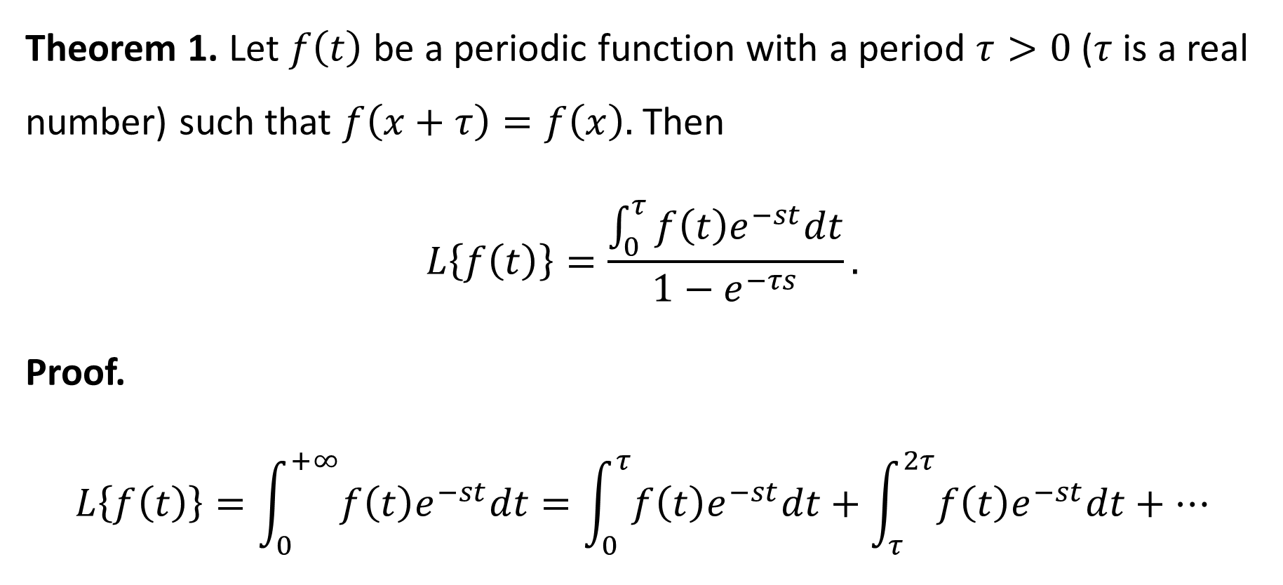
The Laplace transform of a periodic function
Theorem 1. Let $f\left(t\right)$ be a periodic function with a period $τ>0$ ($τ$ is a real number) such that $f\left(x+τ\right)=f\left(x\right).$ Then
$$L\left\{f\left(t\right)\right\}=\frac{\int_{0}^{τ}{f\left(t\right)e^{−st}dt}}{1−e^{−τs}}.$$
Proof.
$$L\left\{f\left(t\right)\right\}=\int_{0}^{+∞}{f\left(t\right)e^{−st}dt}=\int_{0}^{τ}{f\left(t\right)e^{−st}dt}+\int_{τ}^{2τ}{f\left(t\right)e^{−st}dt}+…$$

Slide 20

$$L\left\{f\left(t\right)\right\}=\int_{0}^{+∞}{f\left(t\right)e^{−st}dt}=\int_{0}^{τ}{f\left(t\right)e^{−st}dt}+\int_{τ}^{2τ}{f\left(t\right)e^{−st}dt}+…$$
$$=\sum_{n=0}^{+∞}{\int_{nτ}^{\left(n+1\right)τ}{f\left(t\right)e^{−st}dt}}\overset{u=t−nτ}{=}\sum_{n=0}^{+∞}{\int_{0}^{τ}{f\left(u+nτ\right)e^{−su−snτ}du}}$$
$$=\sum_{n=0}^{+∞}{e^{−nsτ}\int_{0}^{τ}{f\left(u\right)e^{−su}du}}=\int_{0}^{τ}{f\left(u\right)e^{−su}du}\sum_{n=0}^{+∞}{e^{−nsτ}}$$
$$=\frac{\int_{0}^{τ}{f\left(u\right)e^{−su}du}}{1−e^{−sτ} }$$

Slide 21

Taking most left-hand side and most right-hand side of the equations we get the assertion
$$L\left\{f(t)\right\}=\frac{\int_{0}^{τ}{f\left(u\right)e^{−su}du}}{1−e^{−sτ} }.$$

Slide 22

Definition 2. The Laplace Transform of the impulse function equals $1$.
$$L\left\{δ\left(t−a\right)\right\}=e^{−as},$$
$$L\left\{δ\left(t−a\right)f(t)\right\}=e^{−as}f\left(a\right).$$

Slide 23
Examples for the Laplace Transform of periodic functions

Slide 24
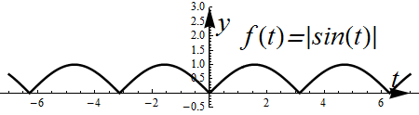

Exercise 1. Determine the Laplace transform of rectified sine function
$$L\left\{|\sin{t}|\right\}.$$
Solution. Function $|\sin{t}|$ has a graph

Slide 25
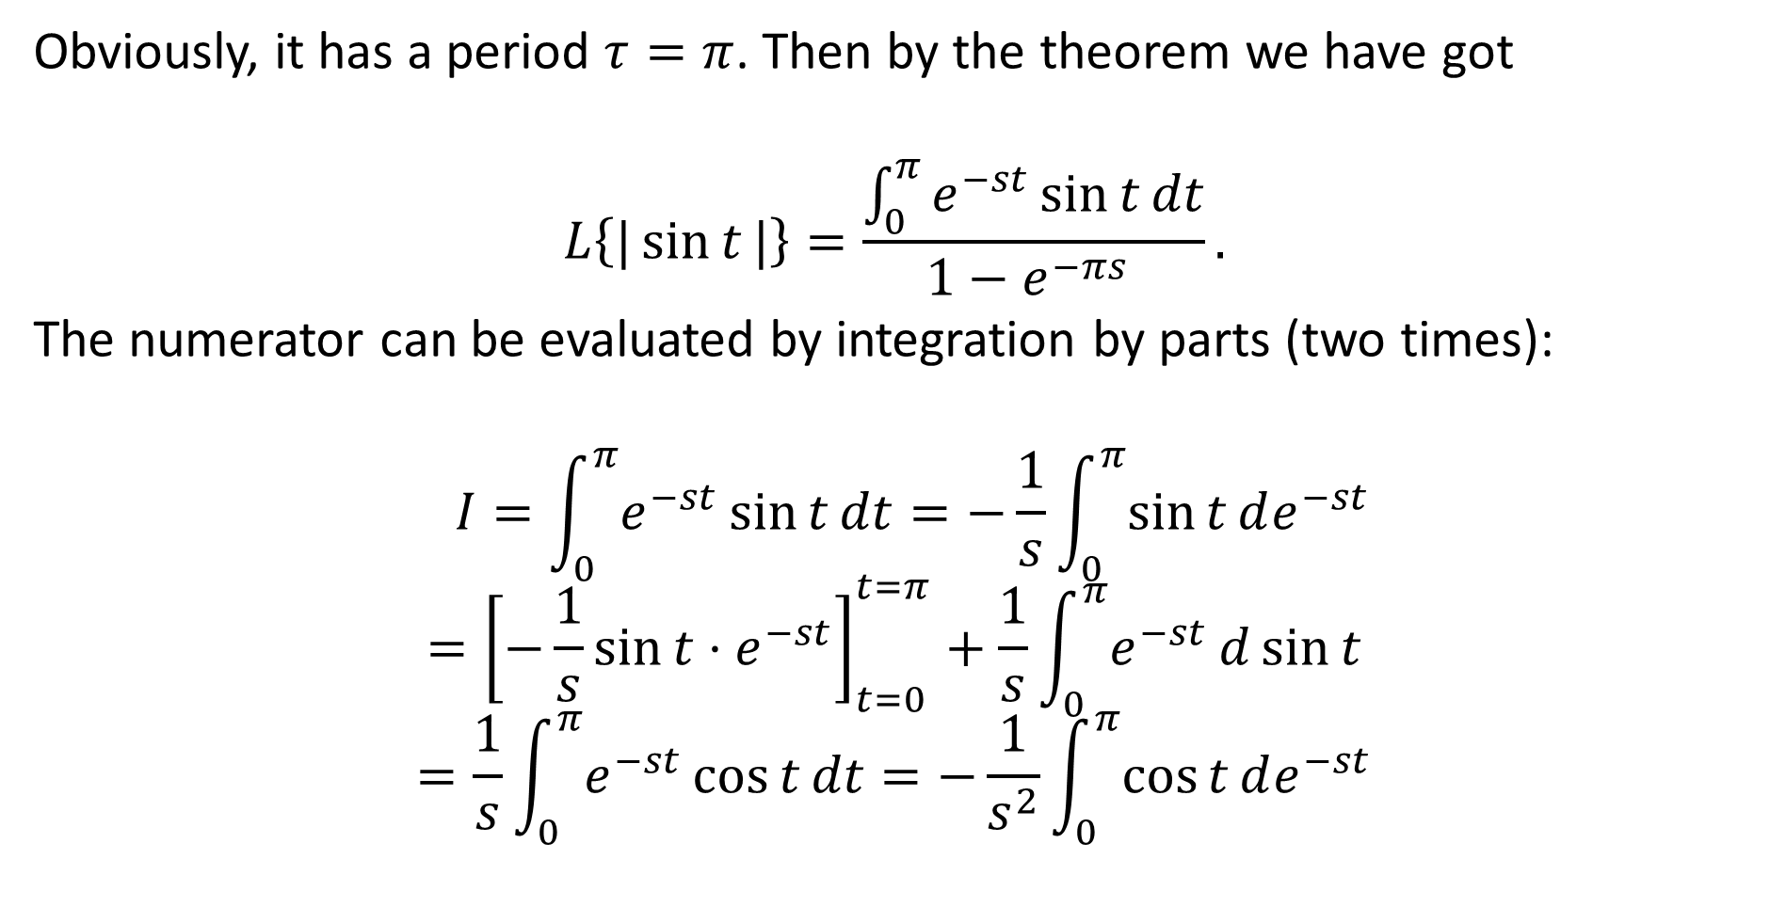
Obviously, it has a period $τ=π$. Then by the theorem we have got
$$L\left\{|\sin{t}|\right\}=\frac{\int_{0}^{π}{e^{−st}\sin{t}}dt}{1−e^{−πs} }.$$
The numerator can be evaluated by integration by parts (two times):
$$I=\int_{0}^{π}{e^{−st}\sin{t}}dt=−\frac{1}{s}\int_{0}^{π}{\sin{t}}de^{−st}$$
$$={\left[−\frac{1}{s}\sin{t}⋅e^{−st}\right]}_{t=0}^{t=π}+\frac{1}{s}\int_{0}^{π}{e^{−st}}d\sin{t}$$
$$=\frac{1}{s}\int_{0}^{π}{e^{−st}}\cos{t}dt=−\frac{1}{s^{2}}\int_{0}^{π}{\cos{t}}de^{−st}$$

Slide 26

$$I=−\frac{1}{s^{2}}\int_{0}^{π}{\cos{t}}de^{−st}={\left[−\frac{1}{s^{2}}e^{−st}cos{t}\right]}_{t=0}^{t=π}+\frac{1}{s^{2}}\int_{0}^{π}{e^{−st}{d}}cost$$
$$=\frac{1}{s^{2}}e^{−sπ}{+\frac{1}{s^{2}}}−\frac{1}{s^{2}}\int_{0}^{π}{e^{−st}{\sin{t}}}dt.$$
$$I=\frac{1}{s^{2}}e^{−sπ}{+\frac{1}{s^{2}}}−\frac{I}{s^{2}}.$$

Slide 27

Therefore, deriving $I$ from the last equation we get
$$\int_{0}^{π}{e^{−st}\sin{t}}dt=I=\frac{e^{−sπ}{+1}}{1+s^{2}}$$
and hence
$$L\left\{|\sin{t}|\right\}=\frac{\int_{0}^{π}{e^{−st}\sin{t}}dt}{1−e^{−πs} }=\frac{e^{−sπ}{+1}}{(1+s^{2})(1−e^{−πs})}$$

Slide 28
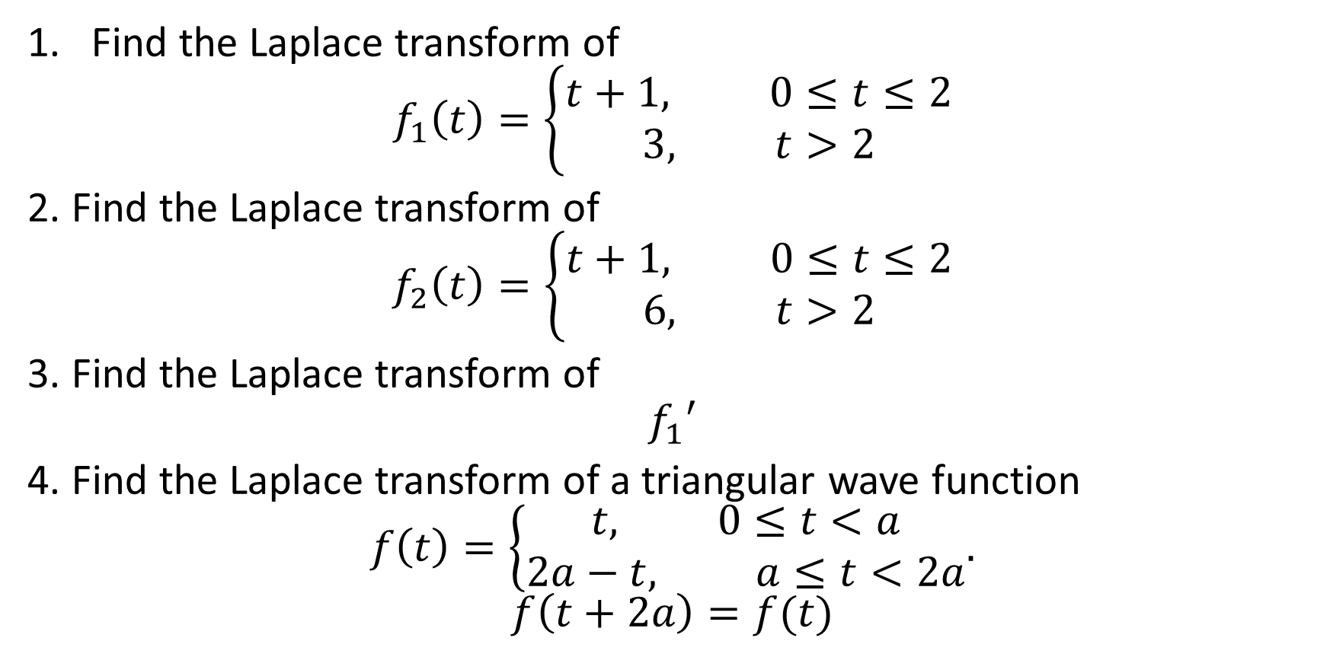
Homework
Find the Laplace transform of
$$f_{1}\left(t\right)=\left\{\begin{aligned}t+1, 0≤t≤2 \\ 3, t>2\end{aligned}\right.$$
2. Find the Laplace transform of
$$f_{2}\left(t\right)=\left\{\begin{aligned}t+1, 0≤t≤2 \\ 6, t>2\end{aligned}\right.$$
3. Find the Laplace transform of
$$f_{1}′$$
4. Find the Laplace transform of a triangular wave function
$$f\left(t\right)=\left\{\begin{aligned}t, 0≤t<a \\ 2a−t, a≤t<2a\end{aligned}.\right.$$
$$f\left(t+2a\right)=f(t)$$

