Slide 1

-Autoclicker for Windows
-External cheats for any game
-Tested for Minecraft used as hit spammer and autoplacer
-Customizable
-Not detectable with anticheat controls by server admins
-Portable
-Easy GUI

Slide 2
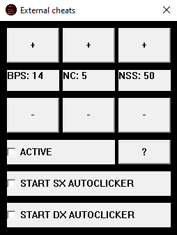
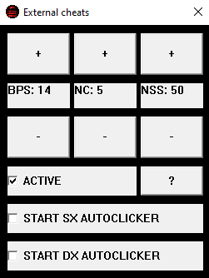
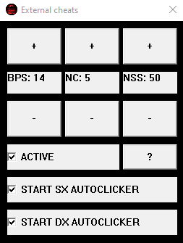
Cheats are on. It is not recommended to keep them both active.
Right clicks per second
Interval between one left click and another
Number of left clicks that the application will send when the user will click the left mouse button
It activates the cheats, but they don't start (are ready to go)

Slide 3
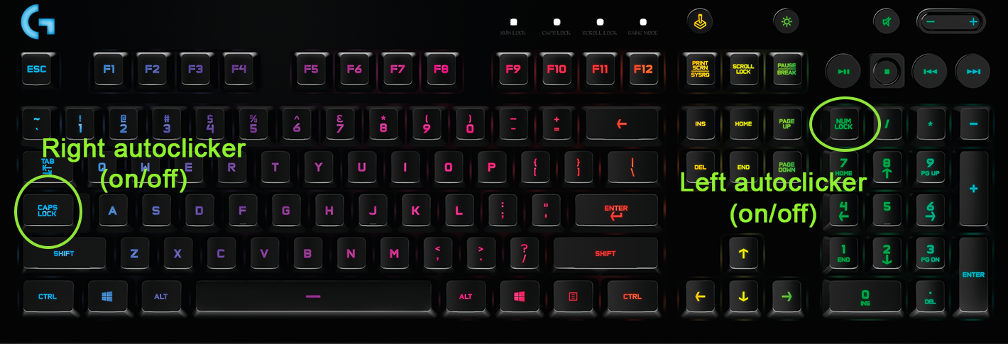
There are some shortcuts to activate/deactivate each autoclicker. This is essential to be able to start/stop clicking while playing a game.

