Slide 1
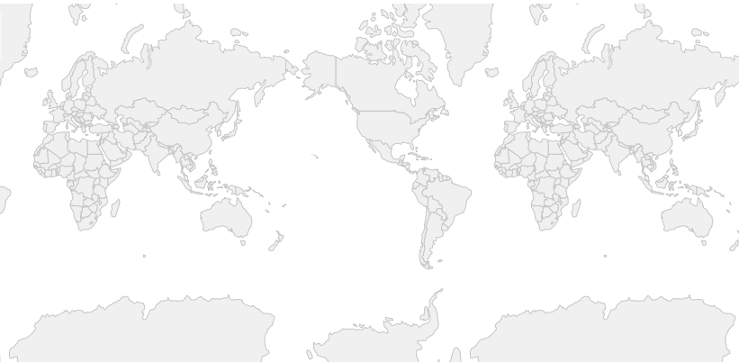

OpenLayers
基础实例详解

Slide 2
实例50：绘制点、线、面

Slide 3
实例50：绘制点、线、面
ol.Map
layer:
<div id="map" > </div>
view:ol.view
ol.view
ol.layer.Vector
ol.layer.Tile
options
options
ol.source.Vector
ol.source.OSM
ol.interaction.Draw
ol.source.Vector

Slide 4
实例51：绘制形状

Slide 5
实例51：绘制形状
ol.Map
layer:
<div id="map" > </div>
view:ol.view
ol.view
ol.layer.Vector
ol.layer.Tile
options
options
ol.source.Vector
ol.source.OSM
ol.interaction.Draw
ol.source.Vector

Slide 6
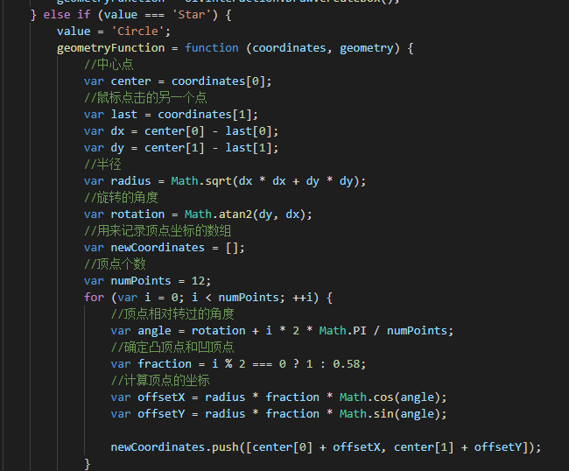
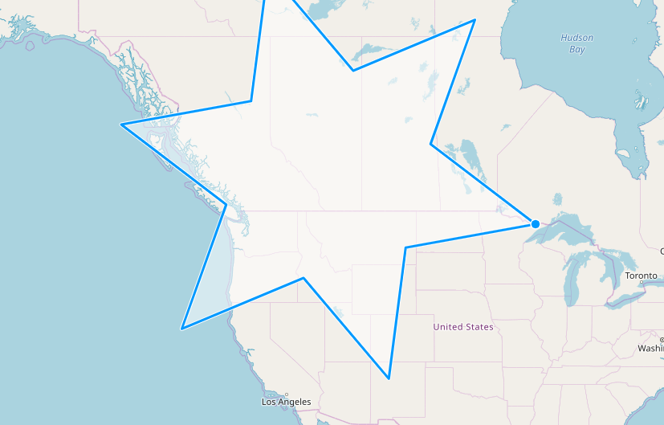
实例51：绘制形状
关键是addInteraction函数的实现
ol.interaction.Draw.createRegularPolygon
ol.interaction.Draw.createBox
dy
dx

Slide 7
实例52：自由绘制

Slide 8
实例52：自由绘制
ol.Map
layer:
<div id="map" > </div>
view:ol.view
ol.view
ol.layer.Vector
ol.layer.Tile
options
options
ol.source.Vector
ol.source.OSM
ol.interaction.Draw
ol.source.Vector
freehand:true

Slide 9
实例53：带箭头的多段直线

Slide 10
实例53：带箭头的多段直线
ol.Map
layer:
<div id="map" > </div>
view:ol.view
ol.view
ol.layer.Vector
ol.layer.Tile
options
options
ol.source.Vector
ol.source.OSM
ol.interaction.Draw
ol.source.Vector

Slide 11
实例53：带箭头的多段直线
StyleFunction
ol.geom.LineString.forEachSegment
API说明没有用法，怎样查？

Slide 12
实例54：绘制要素并修改

Slide 13
实例54：绘制要素并修改
ol.Map
layer:
<div id="map" > </div>
ol.view
ol.layer.Vector
ol.layer.Tile
options
ol.source.Vector
ol.source.OSM
ol.interaction.Draw
ol.interaction.Modify
ol.interaction.Snap
ol.source.Vector
ol.source.Vector
ol.source.Vector

Slide 14
实例55：鼠标拖拽以旋转和缩放地图

Slide 15
实例55：鼠标拖拽以旋转和缩放地图
ol.Map
layer:
<div id="map" > </div>
ol.view
ol.layer.Tile
options
ol.source.OSM
ol.interaction.DragRotateAndZoom

Slide 16
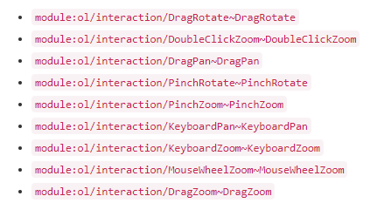
实例55：鼠标拖拽以旋转和缩放地图
ol.interaction.defaults()返回的是一个ol.Collection类型的对象。包含的元素是：
调用extend将会向该集合对象里面加入新的元素。

Slide 17
实例56：划框多选要素

Slide 18
实例56：划框多选要素
ol.Map
layer:
<div id="map" > </div>
ol.view
ol.layer.Vector
ol.layer.Tile
options
ol.source.Vector
ol.source.OSM
ol.interaction.Select
ol.interaction.DragBox
ol.source.Vector
ol.source.Vector

Slide 19
实例56：划框多选要素
ol.source.forEachFeatureIntersectingExtent
遍历所有在划定的extent内的要素

Slide 20
实例57：要素的多种选择方式

Slide 21
实例57：要素的多种选择方式
ol.Map
layer:
<div id="map" > </div>
ol.view
ol.layer.Vector
ol.layer.Tile
options
ol.source.Vector
ol.source.OSM
ol.interaction.Select

Slide 22
实例57：要素的多种选择方式
condition: ol.events.condition.click
condition: ol.events.condition.pointerMove
condition: function(mapBrowserEvent) {……})

Slide 23
实例58：要素的移动

Slide 24
实例58：要素的移动
ol.Map
layer:
<div id="map" > </div>
ol.view
ol.layer.Vector
ol.layer.Tile
options
ol.source.Vector
ol.source.OSM
ol.interaction.Select
ol.interaction.Translate
select.getFeatures()

Slide 25
实例59：要素的修改

Slide 26
实例59：要素的修改
ol.Map
layer:
ol.interaction.Select
<div id="map" > </div>
ol.layer.Vector
ol.view
ol.source.Vector
options
ol.interaction.Modify

